Slide 1

FINANCE & FINANCIAL TECHNOLOGY (FINTECH)
Prediction Markets & Information Finance
A Comparative Analysis of Kalshi & Polymarket: Architecture, Regulation, and Oracles
An exhaustive examination of decentralized and centralized event contract exchanges: Hayekian information aggregation, binary option mathematics, order book microstructure, the legal battle in Kalshi v. CFTC, Polymarket's Web3 USDC liquidity, UMA optimistic oracles, manipulation resilience, and the macroeconomic frontier of decision markets.
J. Christopher Westland
Fulbright-García Robles U.S. Scholar (Science and Technology)
hosted by Universidad Anáhuac Mayab | Mérida, México
Professor, Information & Decision Sciences | University of Illinois Chicago
Editor-in-Chief: Electronic Commerce Research (Springer)
Faculty Profile: business.uic.edu/profiles/westland-james-christopher
MASTERCLASS LECTURE
Focus & Thematic Scope:
Information Economics, Microstructure & Algorithmic Governance
Comparative Institutional Analysis: Kalshi (CFTC-Regulated) vs. Polymarket (Web3 / UMA Oracles)
© J. Christopher Westland. All rights reserved.

Slide 2
LECTURE OVERVIEW
Course Agenda & Thematic Roadmap
1. Theory & Mechanics
• Hayekian Information: Price systems as dispersed knowledge aggregators.
• Binary Event Contracts: Payoff structure ($1 or $0) and risk-neutral odds.
• Order Book Microstructure: Complementary pricing ($Bid_{Yes} + Ask_{No} = $1.00).
• Market Maker Arbitrage: Minting and burning binary pairs for cash.
• The Resolution Dilemma: Deterministic contracts vs. subjective reality.
2. Kalshi vs. Polymarket
• Kalshi Architecture: CFTC Designated Contract Market (DCM) & USD rails.
• Kalshi v. CFTC Lawsuit: The legal landmark legalizing US election trading.
• Polymarket Architecture: Polygon PoS L2, USDC stablecoin, & Web3 non-custody.
• Geopolitics & Geoblocking: Offshore liquidity vs. CFTC regulatory sanctions.
• 2024 Election Supercycle: Parabolic volume surge beyond $4.9B+.
3. Accuracy & Frontier
• Centralized vs UMA Oracles: Government data vs optimistic game-theoretic voting.
• Empirical Calibration: Prediction markets vs. opinion polls and pundits.
• Manipulation Resilience: Hanson's 'manipulation-as-subsidy' theorem & whales.
• Macroeconomic Hedging: Hedging Fed rates, inflation (CPI), and geopolitics.
• The Future (Futarchy): AI automated agents and governance by prediction.
© J. Christopher Westland. All rights reserved. | hosted by Universidad Anáhuac Mayab | Prediction Markets: Kalshi & Polymarket | Slide 02/22

Slide 3
INFORMATION ECONOMICS
Theoretical Foundations: Hayek, Information Aggregation & The Crowd
Hayek & The Price System as an Aggregator
• Friedrich Hayek (1945): 'The Use of Knowledge in Society'. Central planners cannot access dispersed, tacit, and localized knowledge. Market prices function as a telecommunications system aggregating decentralized signals.
• Surowiecki's 'Wisdom of Crowds': Aggregating diverse, independent, and incentivized probability assessments consistently outperforms individual experts, pollsters, and bureaucratic committees.
• 'Skin in the Game' (Taleb): Unlike non-binding public opinion surveys or pundit TV talk, market participants face direct financial consequences for cognitive bias and inaccurate forecasts.
• Real-Time Bayesian Updating: Contract prices continuously incorporate breaking news, leaks, and macro indicators instantaneously via marginal trader capital.
From 'Idea Futures' to Decision Markets
1. Robin Hanson (1990s): Formalized 'Idea Futures' and decision markets: creating financial derivatives on empirical propositions to settle intellectual and scientific debates.
2. Iowa Electronic Markets (IEM): Pioneered in 1988 by the University of Iowa under academic CFTC no-action relief, demonstrating superior accuracy over national presidential polls.
3. Information Finance: Transforming events (macro policy, weather, wars, regulatory approvals) into tradable financial assets with clear market-clearing prices.
4. Futarchy Governance: 'Vote on values, bet on beliefs.' Using prediction markets to guide corporate and national policy decisions.
© J. Christopher Westland. All rights reserved. | hosted by Universidad Anáhuac Mayab | Prediction Markets: Kalshi & Polymarket | Slide 03/22

Slide 4
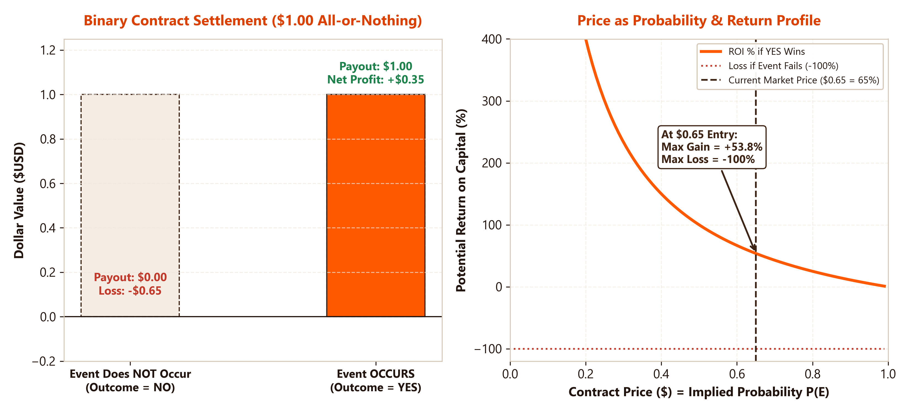
FINANCIAL ENGINEERING
Binary Event Contracts: Pricing, Probability, and Payoff Mechanics
The Mathematics of Binary Payoffs
• Discrete Binary Structure: Event contracts pay $1.00 if a strictly defined condition occurs before expiry, and $0.00 if it does not occur.
• Price as Implied Probability: Under risk-neutral pricing, a contract trading at $0.65 implies an estimated market probability of 65% for the event:
Price = P(Outcome = 1) × $1.00
• Asymmetric ROI Profile: Buying YES at $0.65 yields a profit of $0.35 (+53.8% return) if true, with a maximum downside of -$0.65 (-100%). Buying NO at $0.35 yields +185.7% if the event fails.
• Expected Return Equation: An investor anticipating true probability p_{true} executes when:
E[R] = (p_{true} - p_{market}) / p_{market} > 0
• Arrow-Debreu Securities: Event contracts represent the purest empirical implementation of state-contingent claims in financial economics.
© J. Christopher Westland. All rights reserved. | hosted by Universidad Anáhuac Mayab | Prediction Markets: Kalshi & Polymarket | Slide 04/22

Slide 5
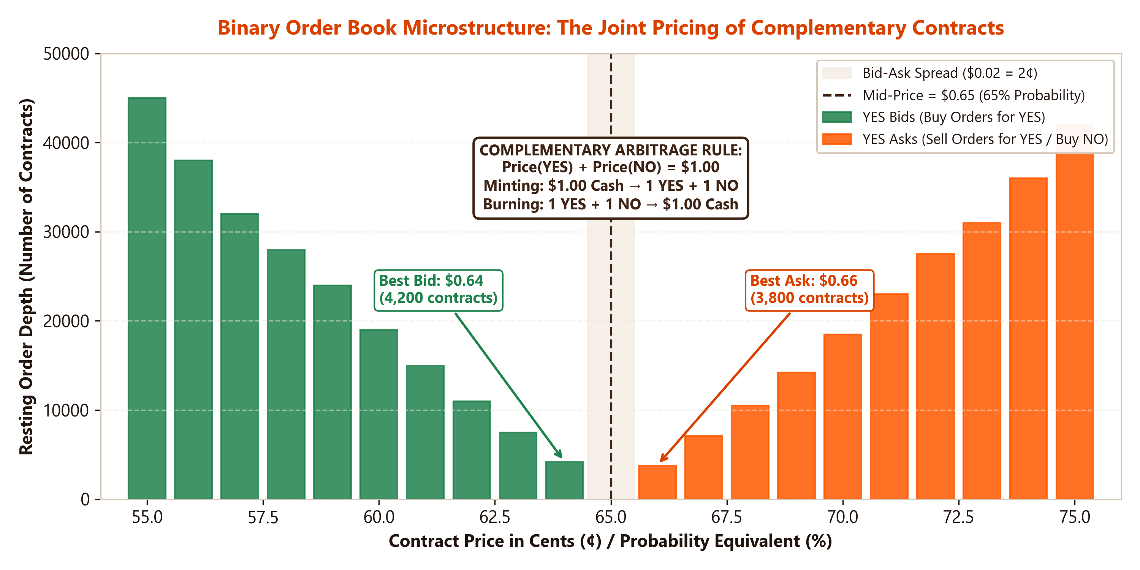
MARKET MICROSTRUCTURE
Binary Order Books: The Complementary Yes/No Architecture
The Complementary Arbitrage Rule
• Invariant Pricing Constraint: Because exactly one outcome must occur, the prices of the complementary shares must sum to $1.00:
Price(YES) + Price(NO) = $1.00
• Synthetic Equivalences: Buying a YES contract at $0.65 is mathematically identical to selling short (or writing) a NO contract at $0.35:
Bid_{Yes} = 1.00 - Ask_{No}
Ask_{Yes} = 1.00 - Bid_{No}
• Minting & Burning Mechanism: Traders can deposit $1.00 of collateral (USD on Kalshi, USDC on Polymarket) to 'mint' 1 YES + 1 NO share. Conversely, holding 1 YES + 1 NO can be 'burned' at any time to redeem $1.00 risk-free.
• Cross-Market Arbitrage: Any momentary pricing discrepancy where Price(YES) + Price(NO) < $1.00 triggers instant algorithmic risk-free mint/burn arbitrage.
© J. Christopher Westland. All rights reserved. | hosted by Universidad Anáhuac Mayab | Prediction Markets: Kalshi & Polymarket | Slide 05/22

Slide 6
REGULATED CENTRALIZED MARKETS
Kalshi: CFTC Designated Contract Market (DCM) & USD Clearing
1. Institutional Oversight
• CFTC Licensed (DCM): Granted Designated Contract Market status in November 2020 by the Commodity Futures Trading Commission.
• Derivatives Clearing Organization: Trades clear through regulated DCOs (LedgerX/Kalshi Clearing) with segregated customer funds.
• Full Legal Compliance: Subject to the Commodity Exchange Act (CEA), Bank Secrecy Act (BSA), and federal AML/KYC checks.
2. Fiat Rails & Microstructure
• Direct US Dollar Settlement: Funding via ACH, domestic wire transfers, and debit cards directly into US FDIC-insured depository accounts.
• Central Limit Order Book (CLOB): High-frequency in-memory matching engine located in US colocation data centers; zero blockchain gas.
• Fee Schedule: Modest taker fees per contract ($0.01 - $0.02) with maker rebates for registered liquidity providers.
3. Target Markets & Compliance
• Macroeconomic Contracts: CPI inflation prints, Federal Reserve FOMC rate decisions, GDP releases, and US nonfarm payrolls.
• Position Limits: Regulatory caps on contract sizes per account (ranging from $25,000 to millions for institutional hedging members).
• US Retail Exclusivity: Primarily serves verified US citizens and domestic institutional trading firms.
© J. Christopher Westland. All rights reserved. | hosted by Universidad Anáhuac Mayab | Prediction Markets: Kalshi & Polymarket | Slide 06/22

Slide 7
JUDICIAL & REGULATORY LANDMARK
Kalshi v. CFTC: The Legal Battle Over Congressional & Election Markets
The Regulatory Confrontation (2022-2024)
• The CFTC's Prohibition Order (2023): The CFTC prohibited Kalshi from listing political event contracts (e.g., 'Will Democrats control the Senate?'), claiming they constituted unlawful 'gaming' under CEA § 5c(c)(5)(C) and were contrary to the public interest.
• Kalshi's Lawsuit (Nov 2023): Kalshi filed suit in the US District Court for the District of Columbia, arguing that political control is NOT 'gaming' (which legally refers to games of chance/sports) and that election outcomes carry profound economic consequences.
• The Landmark Ruling (Sept 2024): Judge Jia M. Cobb ruled in Kalshi's favor, vacating the CFTC's order: 'This case is not about whether the Court thinks election trading is a good idea... The CFTC exceeded its statutory authority.'
• DC Circuit Emergency Stay Denied: The appellate court refused the CFTC's emergency motion to freeze trading, legally greenlighting US regulated election markets weeks before the 2024 election.
Legal & Economic Implications
1. A New Financial Asset Class: Officially codified political risk as a legitimate economic derivative eligible for CFTC-regulated exchange trading in the United States.
2. Commercial Hedging Legitimacy: Businesses can now legally hedge against government regulatory policy shifts, tax law changes, and legislative turnover.
3. Wall Street Integration: Major brokerage platforms (Robinhood, Interactive Brokers) immediately initiated integration of election contracts for retail investors.
4. Congressional Backlash: Prominent lawmakers (Sen. Elizabeth Warren) voiced concerns over election integrity, calling for legislative bans on political betting.
© J. Christopher Westland. All rights reserved. | hosted by Universidad Anáhuac Mayab | Prediction Markets: Kalshi & Polymarket | Slide 07/22

Slide 8
DECENTRALIZED WEB3 MARKETS
Polymarket: Polygon PoS L2, USDC Collateral & Web3 Architecture
1. Technical Infrastructure
• Built on Polygon PoS: Leverages an Ethereum Layer-2 sidechain to achieve sub-second finality and near-zero gas fees.
• Non-Custodial Architecture: Users retain full sovereign control over assets via self-custody smart contract wallets (MetaMask, Safe, Magic Link).
• USDC Collateralization: All markets denominated strictly in Circle's USD Coin (USDC) bridged onto Polygon.
2. Hybrid CLOB Engine
• Off-Chain Order Matching: Replaced early AMM designs with an off-chain Central Limit Order Book with on-chain atomic settlement.
• 0% Trading Fees: Free trading on order books subsidized by network infrastructure and algorithmic maker incentive pools.
• Global Crypto Liquidity: Attracted global capital from crypto hedge funds, venture funds, and decentralized finance (DeFi) traders.
3. Market Scope & Virality
• Permissionless Listing Speed: Rapidly lists niche cultural, geopolitical, crypto, pop-culture, and global political questions.
• Social Media Embedding: Live dynamic odds embedded natively on X (Twitter), Substack, and global financial news media.
• Multi-Billion Scale: Processed over $3.8B in volume in 2024 alone, cementing itself as the world's largest event market.
© J. Christopher Westland. All rights reserved. | hosted by Universidad Anáhuac Mayab | Prediction Markets: Kalshi & Polymarket | Slide 08/22

Slide 9
REGULATORY CONFLICT & SOVEREIGNTY
Polymarket's Regulatory Dilemma: 2022 CFTC Settlement & Geoblocking
The 2022 CFTC Enforcement Action
• January 2022 Consent Order: The CFTC charged Polymarket (Blockratize Inc.) with operating an unregistered binary options facility and failing to obtain DCM or SEF status under the CEA.
• $1.4 Million Civil Penalty: Polymarket paid a $1.4M fine without admitting or denying guilt, agreeing to wind down non-compliant markets and block US residents.
• Strict Geofencing Policy: Polymarket implemented IP-based geoblocking and front-end terms of service barring US persons from trading.
• The Decentralized Disconnect: While the centralized web portal blocks US IPs, the underlying Polygon smart contracts remain immutable, permissionless, and transparent on-chain.
The Offshore / VPN Liquidity Paradox
1. Global Ex-US Market Traction: Massive organic participation from Europe, Asia, and Latin America looking for high-liquidity prediction venues.
2. The VPN Open Secret: Widespread allegations that substantial US liquidity circumvents front-end geofencing through Virtual Private Networks (VPNs).
3. FBI & DOJ Investigation (Nov 2024): Following the election, federal authorities seized Polymarket CEO Shayne Coplan's electronic devices in an investigation over whether US users accessed the exchange.
4. Regulatory Divergence: Highlights the sharp contrast between regulated US compliance (Kalshi) and borderless Web3 protocols (Polymarket).
© J. Christopher Westland. All rights reserved. | hosted by Universidad Anáhuac Mayab | Prediction Markets: Kalshi & Polymarket | Slide 09/22

Slide 10
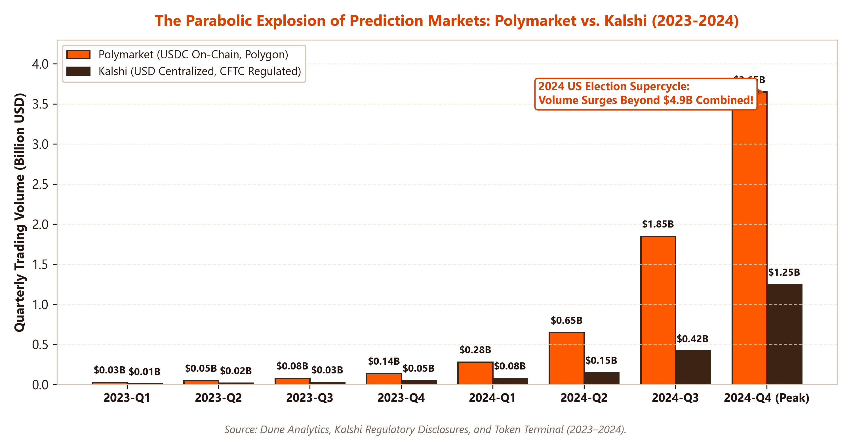
MARKET EVOLUTION & SCALE
The 2024 Election Supercycle: The Parabolic Inflection Point
From Fringe Experiment to Bloomberg Terminal
• The 2024 Watershed Moment: Prediction markets evolved from niche academic experiments into the definitive global gauge of political and macroeconomic probability.
• Mainstream Financial Integration: Polymarket and Kalshi odds were integrated live into Bloomberg Terminals, CNBC, Wall Street Journal, and CNN broadcast graphics.
• The Presidential Showdown: The single market 'Presidential Election Winner 2024' attracted over $3.6B in trading volume, surpassing the volume of many NYSE equities.
• Institutional Trading Influx: Quantitative proprietary trading shops and market makers (Susquehanna, Wintermute) entered to harvest spreads and funding yields.
© J. Christopher Westland. All rights reserved. | hosted by Universidad Anáhuac Mayab | Prediction Markets: Kalshi & Polymarket | Slide 10/22

Slide 11
CONTRACT SETTLEMENT ARCHITECTURE
The Resolution Problem: How Prediction Markets Determine Truth
The Fundamental Challenge of Event Settlement
• The Oracle Problem Defined: Blockchains and electronic clearing engines are closed deterministic loops; they have no native awareness of real-world physical events. An external data feed ('oracle') must declare the state.
• Semantic Ambiguity in Wording: Real-world events are messy. Poorly drafted contract rules lead to disputed edge-cases (e.g., 'Will Israel strike Iran by Friday?'—does an airspace drone interception count?).
• Malicious Proposer Attacks: An adversary can purchase a large position and bribe or trick the oracle mechanism into an erroneous settlement.
• The Dual Philosophical Paths: Kalshi solves this via centralized legal arbitration, while Polymarket relies on game-theoretic decentralized voting (UMA).
Failure Modes & Edge-Case Case Studies
• The 'SEC ETF Approval' Dispute (Jan 2024): When the SEC's X account was hacked announcing Bitcoin ETF approval hours before the official filing, prediction markets faced mass disputes over settlement timestamps.
• Candidate Name Withdrawals: Debates over whether Joe Biden dropping out in July 2024 resolved 'nomination' contracts immediately or required official DNC roll-call votes.
• Rulebook Specificity as Defense: Exchanges learned that legal precision in market contracts is as critical as financial solvency.
© J. Christopher Westland. All rights reserved. | hosted by Universidad Anáhuac Mayab | Prediction Markets: Kalshi & Polymarket | Slide 11/22

Slide 12
CENTRALIZED SETTLEMENT
Kalshi's Resolution Mechanism: Rulebooks & Official Data Sources
1. Contractual Rulebooks
• CFTC Regulatory Filings: Every contract lists an exhaustive Rulebook publicly filed with the CFTC detailing exact definitions and edge-case procedures.
• Deterministic Resolution Criteria: Strictly avoids subjective human interpretations. Clear binary conditions established prior to market launch.
• Expiration Timestamp: Exact second-level cutoff timestamps for all event occurrences.
2. Sovereign Source Feeds
• Macroeconomic Data: Resolves exclusively from primary releases: Bureau of Labor Statistics (CPI/NFP), Federal Reserve, and BEA.
• Weather & Climate: National Oceanic and Atmospheric Administration (NOAA) and National Weather Service.
• Elections & Politics: Associated Press (AP), Edison Research, and official State Secretaries of State election certifications.
3. Centralized Arbitration
• Kalshi Settlement Committee: In-house legal and compliance committee reviews source data and executes settlements.
• Zero Blockchain Latency: Settlement occurs within minutes of official government data publication.
• Legal Recourse: Users possess legal standing under US contract law and CFTC ombudsman arbitration if terms are breached.
© J. Christopher Westland. All rights reserved. | hosted by Universidad Anáhuac Mayab | Prediction Markets: Kalshi & Polymarket | Slide 12/22

Slide 13
DECENTRALIZED SETTLEMENT
Polymarket's Engine: The UMA Optimistic Oracle & Dispute Resolution
How the UMA Optimistic Oracle Works
• Step 1: Market Expiration & Assertion: When an event concludes, anyone can assert the outcome (YES/NO) by posting a mandatory financial bond in UMA/USDC tokens.
• Step 2: The Challenge Window (Liveness Period): A 2-hour window opens. If no one disputes the assertion within 2 hours, the outcome is assumed 'optimistically' correct, settlement finalizes, and the proposer recovers their bond + reward.
• Step 3: Dispute & Counter-Bond: If a trader believes the proposed settlement is false, they must post an equal dispute bond to challenge it.
• Step 4: Token-Holder Voting (DVM): Disputed contracts escalate to UMA's Data Verification Mechanism (DVM), where UMA token holders vote on the true outcome via Schelling point consensus.
Game Theory, Bond-Slashing & Vulnerabilities
1. Slashing Economics: Whichever party loses the dispute loses 100% of their bond, which is awarded to the correct party. Economic self-interest aligns truth-telling.
2. Schelling Point Consensus: Voters are rewarded for voting with the majority; truth becomes the focal coordination point (Schelling, 1960).
3. Settlement Delay: Disputes can stall payouts for 48 to 72 hours, locking up trader capital during contentious elections.
4. Governance Voter Apathy: Low turnout among UMA token holders can leave edge-case disputes vulnerable to coordinated whale voter manipulation.
© J. Christopher Westland. All rights reserved. | hosted by Universidad Anáhuac Mayab | Prediction Markets: Kalshi & Polymarket | Slide 13/22

Slide 14
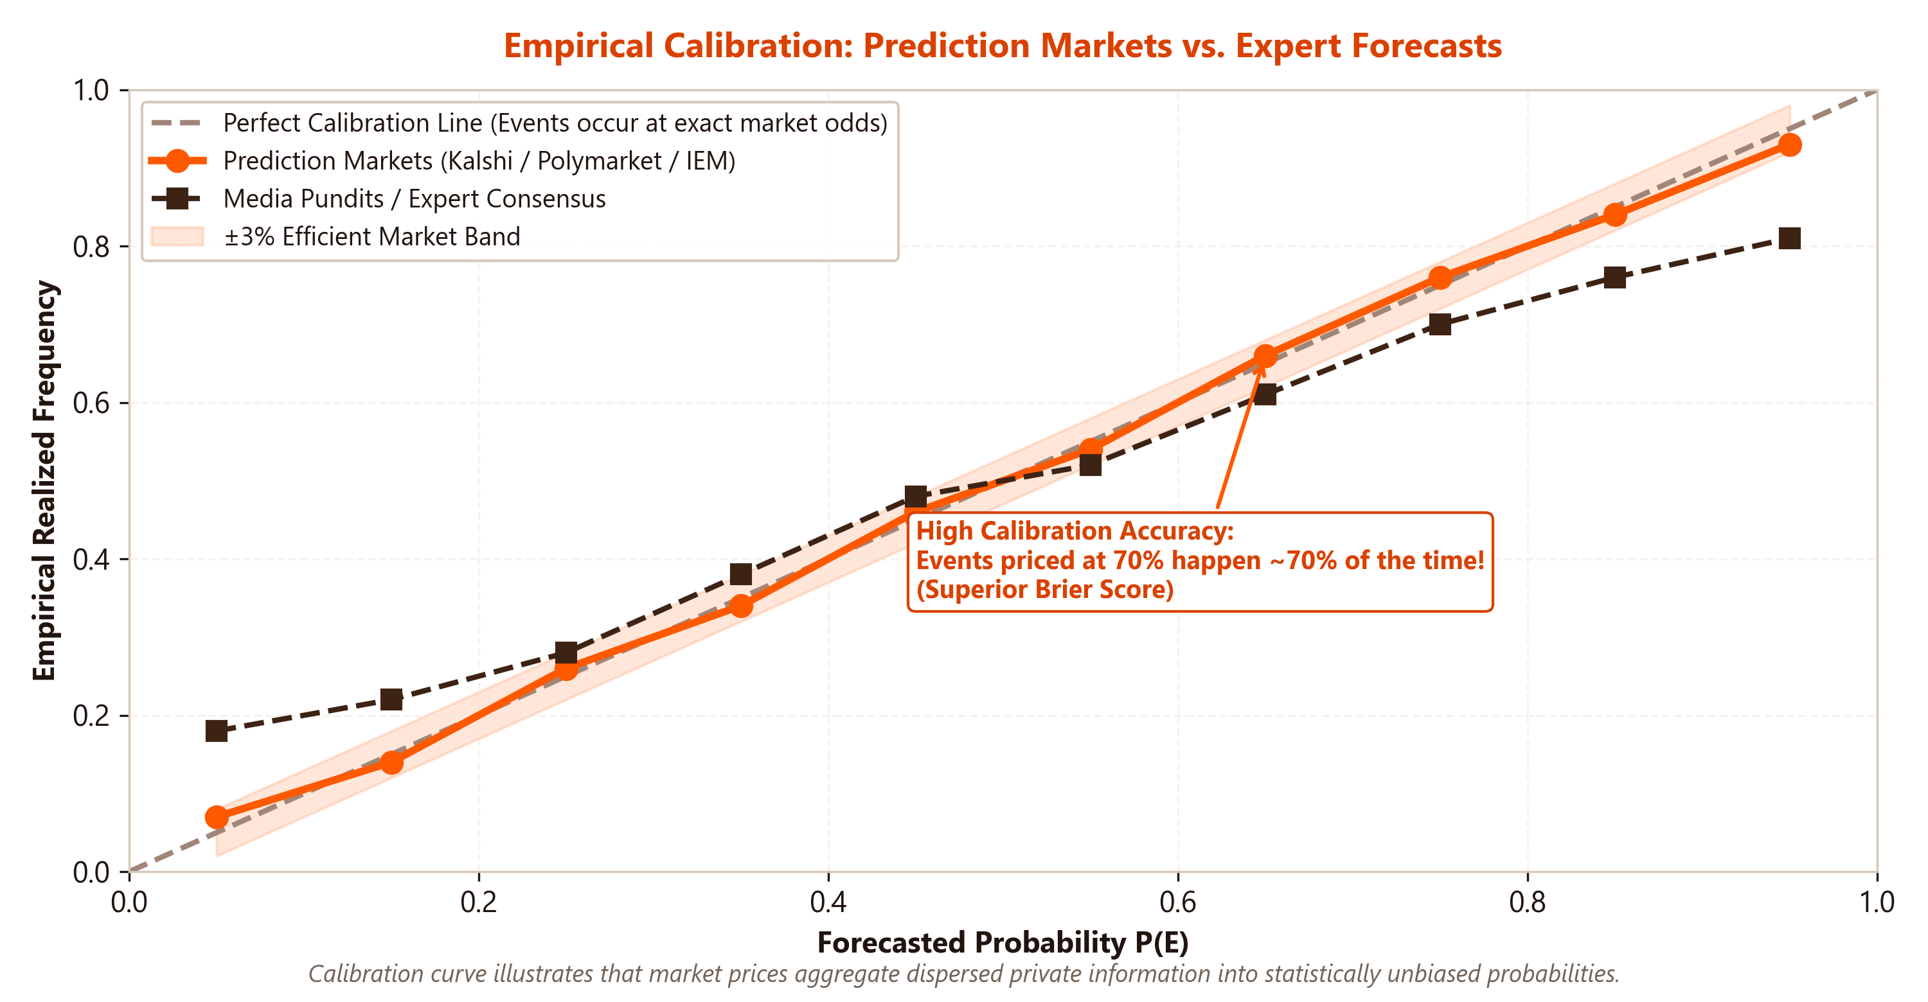
STATISTICAL VALIDATION
Empirical Forecasting Accuracy: Prediction Markets vs. Polls & Pundits
Why Financial Markets Outperform Surveys
• Superior Brier Score Performance: Academic literature (Berg, Nelson & Rietz, 2008; Rothschild, 2009) proves prediction markets consistently achieve lower Brier error scores than national opinion polls.
• Polls are Historical, Markets are Forward-Looking: Polls reflect what a sampled demographic thought 4 days ago. Markets reflect what traders expect will happen on election day.
• Self-Correcting for Non-Response Bias: Traditional polling suffers from plummeting telephone response rates (<1%). Prediction markets incorporate non-response bias corrections automatically via informed capital.
• The 2024 Proof of Concept: In the 2024 presidential election, Polymarket and Kalshi signaled Donald Trump's decisive electoral sweep weeks ahead of deadlocked 50/50 polling aggregates.
© J. Christopher Westland. All rights reserved. | hosted by Universidad Anáhuac Mayab | Prediction Markets: Kalshi & Polymarket | Slide 14/22

Slide 15
BEHAVIORAL ECONOMICS
Behavioral Biases & Imperfections: Longshot Biases and Whales
Well-Documented Market Anomaly Patterns
• Favorite-Longshot Bias: Traders systematically overvalue extreme low-probability outcomes (e.g., pricing 1% events at 5%-8%) due to lottery-like payoff psychology.
• Ideological & Partisan Skew: In political markets, participants often 'bet with their hearts' rather than their heads, temporarily bidding up favored candidates.
• Liquidity Droughts in the Tail: While headline election markets trade billions, long-tail markets (local mayoral races, specialized scientific discoveries) suffer wide bid-ask spreads.
• Opportunity Cost & Capital Lockup: Holding long-horizon contracts (e.g., 2028 election) ties up capital that could earn 5% risk-free yield in US Treasuries, depressing far-dated probabilities.
The 'Fredi9999' French Whale Case Study
• $30M+ Concentrated Bet: In October 2024, a single French national operating four accounts ('Fredi9999', 'Theo4') amassed over $30M in Trump victory contracts.
• Manipulation or Informed Alpha?: Critics cried market manipulation to alter polling perceptions. However, the trader deployed sophisticated 'neighbor polling' statistical models identifying unmeasured enthusiasm.
• The $47 Million Windfall: When Trump won, the position paid out ~$78M (a net profit exceeding $47M), demonstrating how high-conviction informed capital moves markets toward ultimate truth.
© J. Christopher Westland. All rights reserved. | hosted by Universidad Anáhuac Mayab | Prediction Markets: Kalshi & Polymarket | Slide 15/22

Slide 16
MARKET MICROSTRUCTURE THEORY
Can Prediction Markets Be Rigged? Manipulation-as-Subsidy
The Mechanics of Attempted Market Manipulation
• Why Manipulate?: An actor might attempt to temporarily inflate a candidate's odds to create media momentum, improve donor fundraising, or influence voter turnout expectations.
• The High Cost of Capital: Because contracts settle to definitive empirical reality ($1.00 or $0.00), artificially holding an untrue contract above fair value requires continuously buying all resting sell orders.
• Infinite Counterparty Liquidity: Unlike equities where share float is limited, prediction markets can mint infinite new YES/NO pairs as long as arbitrageurs post $1.00 cash.
• Empirical Evidence: Rhodes & Strumpf (2004) tested intentional manipulation on TradeSports; prices reverted to true odds almost immediately.
Hanson's 'Manipulation-as-Subsidy' Theorem
• Robin Hanson's Classic Finding: Manipulators who enter prediction markets with ideological rather than profit-seeking motives effectively **subsidize** information collection.
• The Honey-Pot Effect: By artificially pushing prices away from fundamental probabilities, manipulators create free expected value (EV) for smart money arbitrageurs.
• Attracting Sharps: Institutional algorithmic market makers aggressively step in to absorb the manipulator's mispriced capital, driving the price right back to true probability.
• Conclusion: In liquid markets, manipulation attempts result in massive financial losses for the manipulator and increased accuracy for the public.
© J. Christopher Westland. All rights reserved. | hosted by Universidad Anáhuac Mayab | Prediction Markets: Kalshi & Polymarket | Slide 16/22

Slide 17
REAL-WORLD USE CASES
Corporate & Macroeconomic Hedging: Real-World Applications
1. Macro & Central Bank Risk
• Federal Reserve Rate Cuts: Mortgage lenders hedge borrowing cost spikes by trading Kalshi's FOMC rate contracts.
• CPI Inflation Protection: Supply-chain managers protect inventory purchase budgets against surprise inflation prints.
• Treasury Yield Benchmarking: Fixed-income asset managers hedge duration risk directly on specific 10-year yield thresholds.
2. Regulatory & Tax Policy
• Corporate Tax Increases: Corporations hedge capital expenditure exposure against proposed changes in the federal corporate tax rate.
• Tariff & Trade Barriers: Importers hedge tariff risk on specific foreign goods under prospective executive orders.
• Drug & FDA Approvals: Biotech firms hedge regulatory clinical trial approvals and FDA drug clearance timelines.
3. Climate & Disruption
• Parametric Weather Insurance: Airlines and agricultural firms hedge rainfall, snowfall, or hurricane landfall without traditional insurer delays.
• Geopolitical Conflict: Shipping conglomerates hedge canal closures (Suez, Panama) or regional military escalations.
• Event Risk Unbundling: Isolating specific operational risks without buying expensive multi-asset cross-hedges.
© J. Christopher Westland. All rights reserved. | hosted by Universidad Anáhuac Mayab | Prediction Markets: Kalshi & Polymarket | Slide 17/22

Slide 18
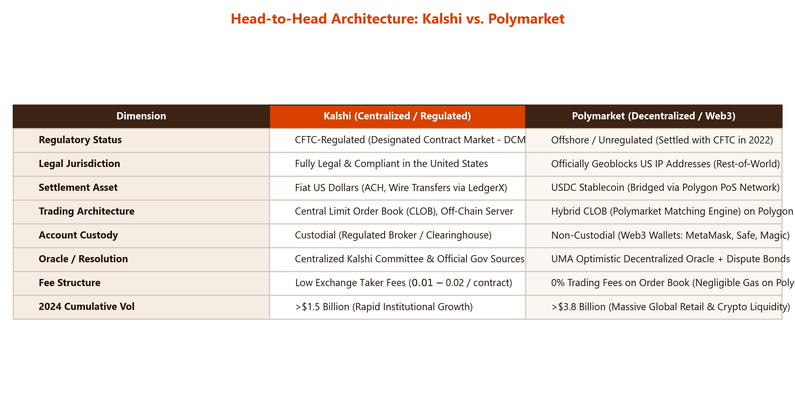
COMPARATIVE MATRIX
Head-to-Head Architectural Comparison: Kalshi vs. Polymarket
© J. Christopher Westland. All rights reserved. | hosted by Universidad Anáhuac Mayab | Prediction Markets: Kalshi & Polymarket | Slide 18/22

Slide 19
MARKET MICROSTRUCTURE
Liquidity Provision: Algorithmic Market Makers & Spread Dynamics
The Role of Quantitative Market Makers
• Who Provides the Liquidity?: Leading Wall Street proprietary trading desks (Susquehanna International Group, Jane Street) and institutional crypto market makers (Wintermute, Keyrock).
• Automated Inventory Balancing: Algorithms quote simultaneous bids and asks on both YES and NO contracts, locking in bid-ask spreads while remaining delta-neutral.
• Liquidity Mining Incentives: Polymarket distributes daily rewards from fee pools to traders who maintain resting limit orders within 1¢ to 3¢ of the mid-price.
• Spreads Collapse Under Scale: In high-volume contracts, bid-ask spreads narrowed to $0.01 (the minimum 1-cent tick size), creating frictionless retail execution.
Risks Faced by Event Market Makers
1. Adverse Selection from 'Insiders': Event contracts carry asymmetric risk: someone in government or media may possess outcome knowledge before public release. Market makers risk getting picked off ('sniped').
2. Jump-Risk Discontinuity: Unlike equities which move continuously, event contracts can jump from $0.50 directly to $1.00 in a millisecond upon news breaking.
3. Oracle Ambiguity Risk: Holding large inventory across a market that settles into contentious dispute locks up capital in arbitration.
© J. Christopher Westland. All rights reserved. | hosted by Universidad Anáhuac Mayab | Prediction Markets: Kalshi & Polymarket | Slide 19/22

Slide 20
THE FUTURE OF INFORMATION FINANCE
The Frontier: Robin Hanson's Futarchy & Autonomous AI Agents
Futarchy: Governance by Speculation
• 'Vote on Values, Bet on Beliefs': Robin Hanson's radical governance model. Democracy votes on a national success metric (e.g., GDP + life expectancy). Prediction markets then evaluate which proposed policies would maximize that metric.
• Conditional Event Markets: Two parallel markets are opened: 'GDP growth if Policy X passes' vs. 'GDP growth if Policy X is rejected'. Whichever policy market trades higher is automatically enacted into law.
• Eliminating Political Populism: Replaces partisan rhetoric and empty campaign promises with objective, crowd-vetted financial forecasts.
• DAO Experimentation: Web3 Decentralized Autonomous Organizations (DAOs) are currently piloting futarchy to manage multi-million dollar treasury allocations.
Autonomous AI Agent Speculators
1. High-Speed Web Scrapers & LLMs: Autonomous AI trading bots connected directly to Polymarket and Kalshi APIs digest breaking news, transcripts, and satellite imagery in sub-second intervals.
2. Continuous Probability Calibration: Multi-modal AI models compute real-time probability estimates and execute trades whenever market odds deviate from algorithmic consensus.
3. Synthetic Consensus Engines: Future search engines may synthesize prediction market odds rather than blue links to answer forward-looking factual queries.
© J. Christopher Westland. All rights reserved. | hosted by Universidad Anáhuac Mayab | Prediction Markets: Kalshi & Polymarket | Slide 20/22

Slide 21
POLICY & LEGAL FRONTIER
Regulatory Challenges & Future Outlook: CFTC, Gambling & Insider Trading
Key Legal and Structural Headwinds
• Gambling vs. Hedging Classification: State gaming commissions argue event contracts are unconstitutional state-lottery or sports-betting circumventions; the CFTC asserts federal preemption over derivatives.
• The Insider Trading Question: Traditional insider trading laws (SEC Rule 10b-5) apply to corporate securities. Does an election campaign staffer or government aide who trades on internal private polling commit insider trading? Current commodity law contains statutory ambiguities.
• Moral Hazard & Assassination Contracts: Regulatory bodies explicitly forbid markets on war casualties, terrorism, or political violence to prevent perverse financial incentives.
• International Licensing Friction: UK/EU gambling vs financial regulator conflicts.
Strategic Policy Recommendations
1. Modernized CFTC Rulemaking: Congress and the CFTC should craft a dedicated 'Event Contract' regulatory sandbox balancing hedging legitimacy with consumer protection.
2. Institutional Transparency Standards: Mandate disclosure of large wallet clusters on decentralized platforms to eliminate synthetic volume wash trading.
3. Formalized Primary Source Oracles: Standardize cryptographic API oracle signing directly by government agencies (BLS, NOAA) to prevent resolution disputes.
© J. Christopher Westland. All rights reserved. | hosted by Universidad Anáhuac Mayab | Prediction Markets: Kalshi & Polymarket | Slide 21/22

Slide 22
COURSE CONCLUSION
Key Takeaways & Classroom Discussion Questions
Conceptual Synthesis of the Course
• Information as an Asset Class: Prediction markets convert diffuse private beliefs into calibrated risk-neutral probabilities, proving superior to static opinion polling.
• The Binary Microstructure: Event contracts represent pure Arrow-Debreu claims governed by the complementary rule $Price(YES) + Price(NO) = $1.00$.
• Kalshi vs. Polymarket Divergence: Kalshi represents the regulated, fiat-cleared, centralized US institutional pathway; Polymarket embodies borderless, Web3, USDC-denominated global liquidity.
• The Oracle Imperative: A prediction market is only as robust as its resolution mechanism; centralized contracts depend on legal precision, while decentralized markets rely on game-theoretic UMA voting.
Questions for Classroom Debate
1. Democracy vs. Financial Speculation: Do election prediction markets strengthen democratic accountability by providing unbiased probability data, or do they debase civic participation into commercial gambling?
2. The Insider Trading Boundary: If a White House or corporate staffer trades on non-public regulatory information in a prediction market, does that harm market integrity, or does it accelerate societal price discovery?
3. Centralized vs. Decentralized Supremacy: Which model will dominate global information finance over the next decade: the compliant, fiat-backed, CFTC-regulated architecture of Kalshi, or the borderless, non-custodial, Web3 liquidity of Polymarket?
© J. Christopher Westland. All rights reserved. | hosted by Universidad Anáhuac Mayab | Prediction Markets: Kalshi & Polymarket | Slide 22/22

