Slide 1
{ async }
New asyhcronous library in
.Net Framework 4.5
Heavily used in WinRT and available within Visual Studio 11

Slide 2
A bit of history …
.Net 1.0 – Threads
.Net 1.1 – APM, Asychronous
Programming Model
.Net 4.0 – Parallel Task Library
and Plinq
.Net 4.0 – Reactive Extensions

Slide 3
Key goals for async #1
Identify long running process and handle them asychronously
‘Long-running’ in the Windows Runtime it is specifically anything that could take longer than 50ms to execute

Slide 4
Key goals for async #2
An asynchronous programming model familiar to the way that you might write synchronous code
- lower barrier to entry

Slide 5
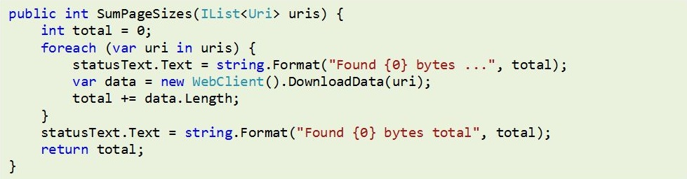
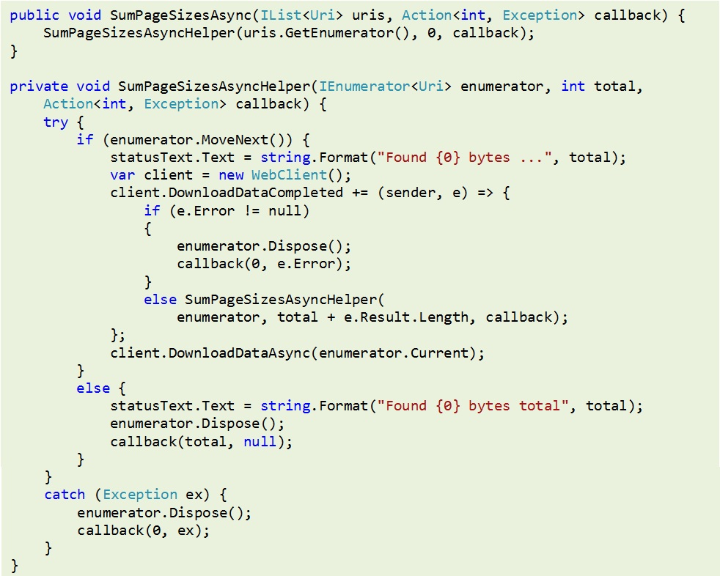
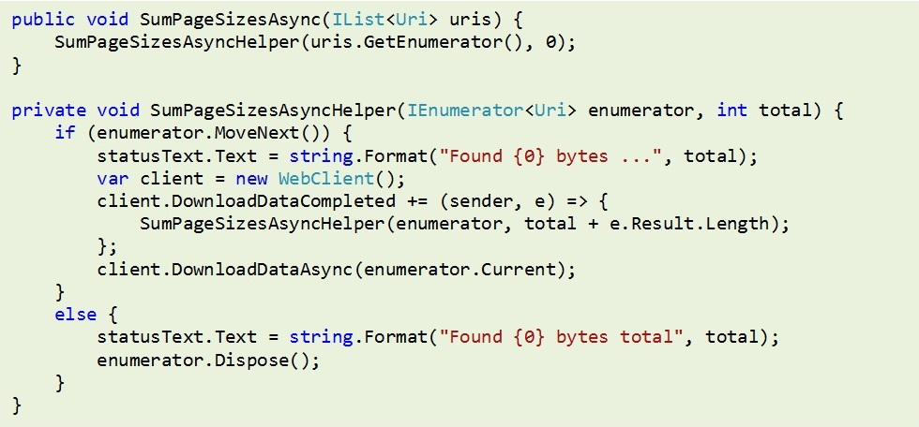
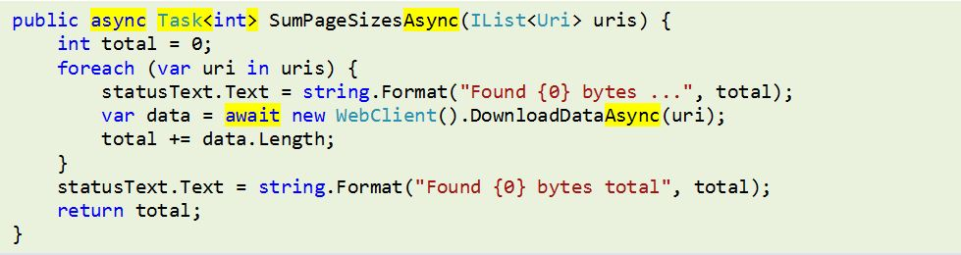

Slide 6
‘Aync is about managing complexity, not hiding it’
Jon Skeet

Slide 7
async
Indicates that a method is likely to contain a control flow that involves awaiting asynchronous operations

Slide 8
await
await signs up the rest of the method as a continuation of the task and returns to the caller
Possible to include more than one await within a single aync method

Slide 9
A short diversion

Slide 10
Task Task<T>
You cannot return out or ref parameters from async methods
Return values of async methods use Task from the Parallel task library

Slide 11
Task Task<T>
Where you would have had a void return value, use Task.
Where you would have had a return value,or parameter output values, use Task<T>.

Slide 12
Task<T>
Using Task<T> means we not only receive a return value, we can obtain additional information about the task performed by the async method, including cancellation support

Slide 13
WhenAll
Useful for batch processing
all are important.
Sending a set of e-mails.
Batch lookups returning many values.
‘boiling a single kettle’

Slide 14
WhenAny
Useful for competing services
first wins
Multiple lookups where all will
return the same value
- stock prices, geo lookup

Slide 15
CancellationToken
Methods that support cancellation
can use the CancellationToken
from the Parallel Task Library.
var hc = new System.Net.Http.HttpClient();
var cts = new CancellationTokenSource();
var ct = cts.Token;
ct.Register(() => cancellationNotification());
var res = await hc.GetAsync("http://www.bbc.co.uk", ct);

Slide 16
Iprogress<T>
To enable monitoring of progress you
should implement IProgress<T>
Clients pass an instance of this to an async method as a parameter.

Slide 17
AggregateException
Especially when using Task.WhenAll there may be multiple exceptions held in the Task as an AggregateException

Slide 18
Liam Westley @westleyl http://geekswithblogs.net/twickers

