Slide 1
What Is The Point Of … Microsoft ?
Liam Westley – Application Architect

Slide 2
What Is The Point Of … Microsoft ?
Stolen from a BBC Radio 4 series – examined various large organizations and wondered whether their creation and wondered if they have a future
Formula One racing
Michelin Stars
The London Black Cab
If Microsoft hasn’t got an inherent right to exist,
Where is it strongest?
Where are it’s weak points?
… and why should you care as a developer?

Slide 3



Who is Liam Westley ?
< cycling
cheese >
< work

Slide 4
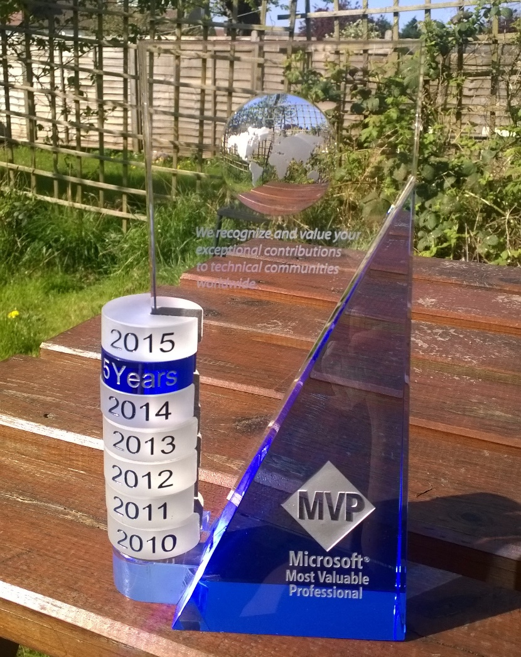
Disclaimer
Notes:
Liam Westley was a Microsoft MVP from 2010 to 2017.

Slide 5
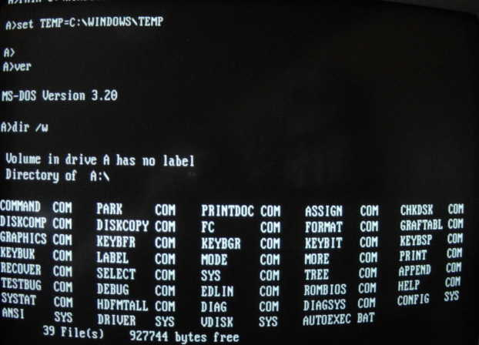
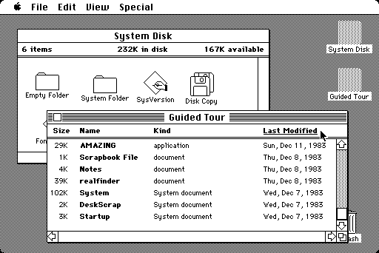
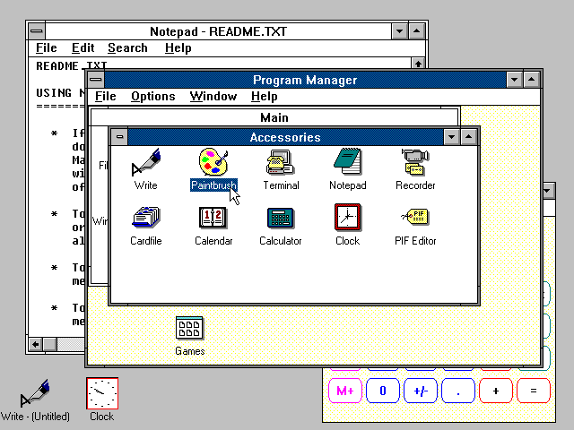
History …
operating systems
1981 : PC-DOS
1984 : Macintosh
1990 : Windows 3.0
Notes:
Beginning in 80’s, launch of the IBM PC, going into the 90’s for the birth of the operating systems we use today.
1981 : IBM PC launched and Microsoft was contracted, by IBM, to created the first PC-DOS operating system. Capable of being run from a single floppy disk (it took another two years before hard drives were supported).
1984 : Despite basic graphics being available in DOS, the windowed operating system controlled by a mouse really appeared with mac OS on the Apple Macintosh, an operating system owned by the hardware manufacturer.
1985 : More hardware integration with the first Laser Printer designed to work with an Apple Mac.
1989 : NeXTStep/OpenStep O/S, Steve Jobs having left Apple creating a Unix based O/S on NeXT hardware.
1990 : Windows 3.0 arrived, the first ‘usable’ Windows, with DOS running underneath, but with colour windowing since 1987.
1991 : Mac OS System 7 brought colour to the Apple hardware.
1991 : A guy called Linus Torvalds released v0.01 of a Unix-like kernel called ‘Linux’, as source code only
1992 : Windows 3.1 included TrueType fonts, and much improved networking.
1993 : The first Debian Linux distribution was released.
1995 : Windows 95 brought the start button, the explorer shell and the end of the Program Manager.
2001 : End of DOS as Windows XP becomes the single 32-bit Windows operating system.
Copyright details
1984 : Mac OS (original), http://oldcomputers.net/macintosh.html
1986 : DOS 3.2, http://www.winhistory.de/more/msdos.htm
1990 : Windows 3.0, http://www.guidebookgallery.org/screenshots/win30

Slide 6
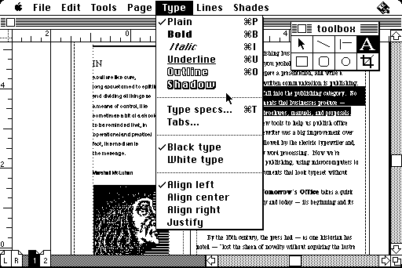
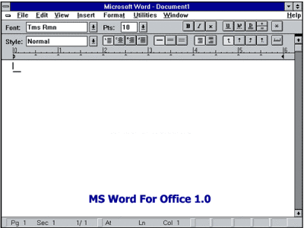
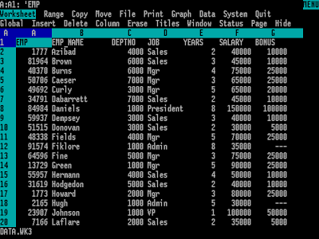
History …
applications
Aldus PageMaker
Word for Windows 1.0
VisiCalc for DOS
Notes:
The first real business software that sold microcomputers; VisiCalc leading the way on the Apple II, and Lotus 1-2-3 dominating the market for the IBM PC. Software was selling computer systems. WordStar and WordPerfect were the word processing pioneers.
Aldus PageMaker, with Postscript suitable for the LaserWriter saw the Macintosh become THE standard system for desktop publishing and creative industries. The hardware was great but the software made it work.
Microsoft realised to sell Windows it needed applications and it worked hard to get Word (released in 1983 on DOS) ported to Windows by 1989. Excel was released to Macintosh first in 1985, but was ported to Windows by 1987 (with Windows 2.0 runtime bundled with Excel). Powerpoint also hit the Macintosh first in 1987 (by a previous owner) before appearing in 1990 the same day as Windows 3.0. And in the same year the first version of Office, bundling Word, Excel and PowerPoint became available.
With competitors, Lotus and WordPerfect, working on OS/2 version of their applications they missed Windows becoming successful and Microsoft had a two year lead on their rivals with a proprietary operating system that they owned and could change as required.
By the
Reference:
VisiCalc importance, https://en.wikipedia.org/wiki/VisiCalc#Reception
Copyright details
1983 onwards : Lotus 1-2-3, http://wjmc.blogspot.co.uk/2010/04/from-ledgers-to-electronic-spreadsheets.html
1985 : Aldus Pagemaker 1.0, http://arkivum.com/blog/bttf15/
1989 : Word for Windows 1.0, http://www.thewindowsclub.com/history-evolution-microsoft-office-software

Slide 7
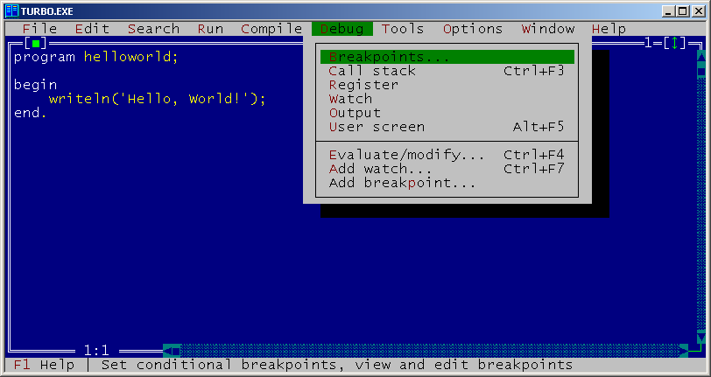
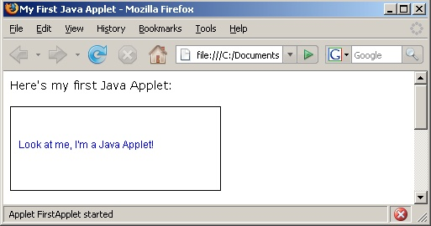

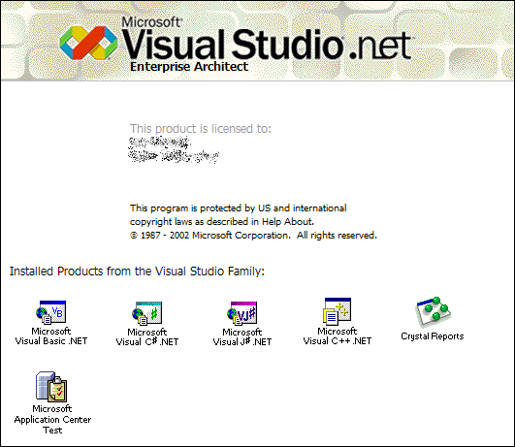
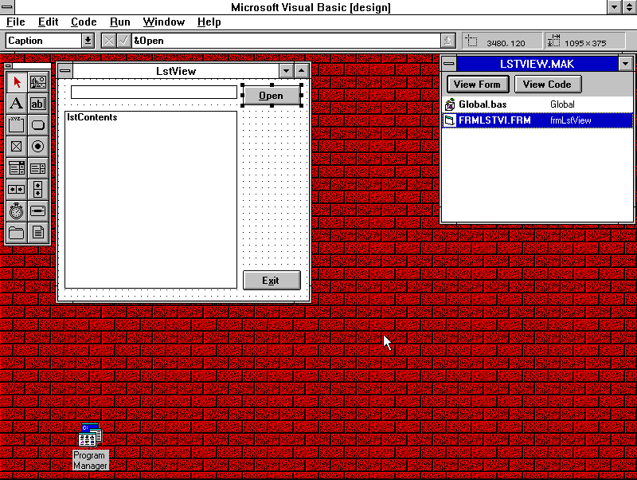

History …
programming languages
1983 : Turbo Pascal
1995 : Java
1991
Visual Basic
2002
.NET and C#
Notes:
1983 : Turbo Pascal, with an IDE. Anders Hejlsberg created a Pascal compiler for Nascom computers in 1981. Made Bill Gates mad at how fast it was. (A version of Pascal was used to create the original Macintosh OS, until System7 when it was rewritten in C++)
1988 : Steve Jobs at NeXT licensed Objective-C
1991 : Microsoft releases Visual Basic 1.0 with a forms engine bought from Cooper Software – democratising Windows development
1995 : First public release of Java by Sun (started in 1991 as a language for interactive television)
2002 : .NET Framework with a new language C# building on work Anders Hejlsberg with J++ to capture C++/COM developers leaving Windows and going to Java. Visual Basic .NET designed to replace Visual Basic 6.0 (released in 1998)
2003 : C# becomes a full ISO standard
2007 : Core of Java completely released as GPL open source including JVM; Java EE remained as a licensed option
2007 : After Android Inc bought by Google in 2005, two years later it became publicly available – Linux O/S written in C++ but with Java as a high level language for creating applications
2014 : Apple launches Swift as a replacement to Objective-C
2014 : .NET Core announced as a multi platform implementation of a subset of the .NET framework
Reference:
Shooting yourself in the foot, https://www-users.cs.york.ac.uk/susan/joke/foot.htm
Copyright details
1983 : Turbo Pascal 7.0, http://www.top4download.com/turbo-pascal/screenshot-vlzdyhfu.html
Early Anders: https://tiny.antville.org/stories/189643/
1991 : Visual Basic 1.0, http://bc-programming.com/blogs/2013/05/history-of-development-visual-basic-1-0/
2002 : Visual Studio .NET, http://www.guidebookgallery.org/splashes/visualstudio
Later Anders: https://channel9.msdn.com/Blogs/TheChannel9Team/Anders-Hejlsberg-What-influenced-the-development-of-C

Slide 8


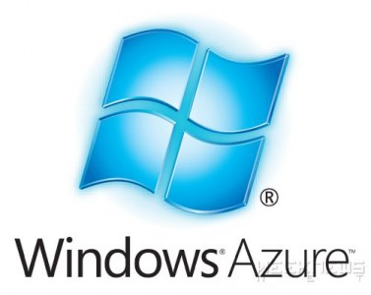
History …
cloud
2008
2006
2010 (2008)
Notes:
2006 : After two years of exposing some of their web services (for searching the store), Amazon make public elements of their server infrastructure with EC2 and S3 launching in 2006.
2008 : Google has been toying with similar ideas of utilising their infrastructure and making part of it public, they start with Google App Engine, followed by Cloud Storage in 2010.
2008 : Microsoft announces ‘Windows Azure’, based on their Hyper-V technology, however actual release occurs two years later in 2010 and by 2012 they were supporting Linux and Python
Copyright details
2006 : amazon web services, http://melagency.it/partner/
2008 : Windows Azure, http://www.cloudwedge.com/2014-microsoft-introduces-azure-ad-application-proxy-preview/
2011 : Google App Engine, http://codehacksblog.blogspot.co.uk/2011/05/run-php-on-google-app-engine.html

Slide 9
Browsers …
gateway to the web
Chrome 55.68%
Safari 14.22%
USC Browser 7.30%
Firefox 5.96%
IE 3.56%
Edge 2.17%
(desktop)
63.98%
5.46%
-
13.6%
8.21%
4.3%
BREAKING NEWS
Total Internet Usage
(March 2017)
Android 37.93%
Windows 37.91%
Notes:
March 2017 statistics; 15 billion page views over 2.5 million sites, as measured by StatCounter (https://gs.statcounter.com/)
Reference:
Android beats Windows as most popular OS for interwebz – by 0.02%, https://www.theregister.co.uk/2017/04/03/android_beats_windows_on_internet/
September it had budged a little: Android 39.81%, Windows 36.34%
http://gs.statcounter.com/os-market-share

Slide 10
The Players
Apple ($805 BN)
sells hardware* (with good software thrown in)
Google ($679 BN)
sells you to advertisers (well all their data about you)
Microsoft ($587 BN)
sells software licenses (and occasionally hardware)
Facebook ($498 BN)
like Google, sells you and your data to advertisers
Amazon ($474 BN)
sells you actual, real stuff; and runs cloud services
* actually they sell iPhones, 70% of their revenue, iPad is next at 10%
Notes:
Interestingly, since this talk was first given in 2015 – Apple had a value of $750BN and has only got above that in the second half of 2017.
All the other companies have increased in value since 2015, by 100’s of billion $, and Amazon has overtaken Oracle which is pretty much static at $202BN.
3Only Berkshire Hathaway at $464BN comes close to the top five companies (by market value) which are now all IT companies.
Apple is around 90% hardware – they have commoditised software.
Microsoft is over 70% software licenses – they have commoditised hardware (except in Xbox area)
Google is virtually 100% ad revenue (now that Motorola Mobility has been sold to Lenovo) – they have commoditised software and hardware.
Note:
Good comparison of Apple vs Google vs Microsoft revenue areas can be found at http://www.zdnet.com/article/google-microsoft-apple-where-does-the-money-come-from/

Slide 11
But what do devs care about?
Frameworks and platforms
languages and underlying architecture
open source, multi platform
The .NET Framework and Windows
Cloud services
Containerisation, management and services
Mobile platform and web
Progressive web applications
Windows Mobile
Notes:
Oh yeah … and getting paid. Which can be quite tricky if you develop your own mobile applications.

Slide 12
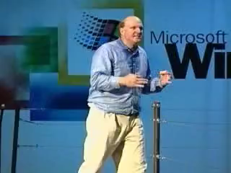
Developers, Developers, Developers !!!!
Notes:
1992 : This was the point it was Microsoft that really cared about developers, launching MSDN, a resource for developers working on Windows, with SDKs, test operating systems and development tools. Apple and Oracle in comparison were more expensive, and came with less extensive support.
Today, every company has premier developer support including Apple, Google, Amazon and Facebook all with huge amounts of resources as well as open source frameworks.
Copyright video:
Steve Balmer from https://vimeo.com/6668315 (actually from 2000)

Slide 13
Enterprise development
In 2003 I was asked to provide a comparison of Java versus .NET.
Java – one language, deploy anywhere
not quite true even in 2003; various flavours of Java including EE, SE and ME
.NET framework – multiple languages, deploy on any Microsoft platform
Windows desktop, server and Windows CE (mobile)

Slide 14
Enterprise development
Java or more specifically the JVM (which includes JRuby, Clojure, Groovy and Scala) and .NET framework have been the dominant enterprise languages for creating server side software.
However, do not underestimate the ability of dynamic languages such as JavaScript (via Node), Python and Go to permeate the enterprise architecture at all levels.
Notes:
Java was challenged by Rails at one point, but everyone who started with Ruby on Rails realised that although it is a good prototyping framework, it doesn’t scale particularly well and they end up using a different solution to solve their problems.

Slide 15
.NET languages
C#
Taking it’s cues from java, C# is a heavyweight language with advanced features such as generics that are missing in other languages
Visual Basic.NET
Still heavily in use within in-house enterprise development
F#
Created by Microsoft Research in Cambridge in the UK, this has made .NET relevant in the world of functional languages
Notes:
See the Wikipedia comparison of programming languages http://en.wikipedia.org/wiki/Comparison_of_programming_languages
C# is there as one of the most fully featured languages. Thanks to Unity it is also THE language for programming games, whether for console or mobile.
Although not widely adopted, the concepts from F# have fed back into the .NET CLR and C#.
IMHO – The desire for VisualBasic.NET to be at feature parity with C# has resulted in a more complex language than was ideal, and means there is no ‘starter’ language that could have made life easier for new developers.

Slide 16
.NET Framework – not just languages
CLI – Common Language Infrastructure
Abstraction of high level languages from hardware (strictly, the .NET Framework is an implementation of the CLI)
ISO and ECMA standards
CIL – Common Intermediate Language
This is IL – the hardware independent language suitable for running in the CLR
CLR – Common Language Runtime
Virtual machine that runs the IL, handling compilation to specific hardware, memory management etc.
‘Roslyn’ – the new .NET compiler for C# and VB
Completely open source on GitHub
Notes:
CLI - http://en.wikipedia.org/wiki/Common_Language_Infrastructure (see Overview for good diagram of high-level language to IL to machine code.
CIL - http://en.wikipedia.org/wiki/Common_Intermediate_Language.
CLR - http://en.wikipedia.org/wiki/Common_Language_Runtime (another diagram shows flow from high-level language to native code)
Roslyn - https://github.com/dotnet/Roslyn

Slide 17
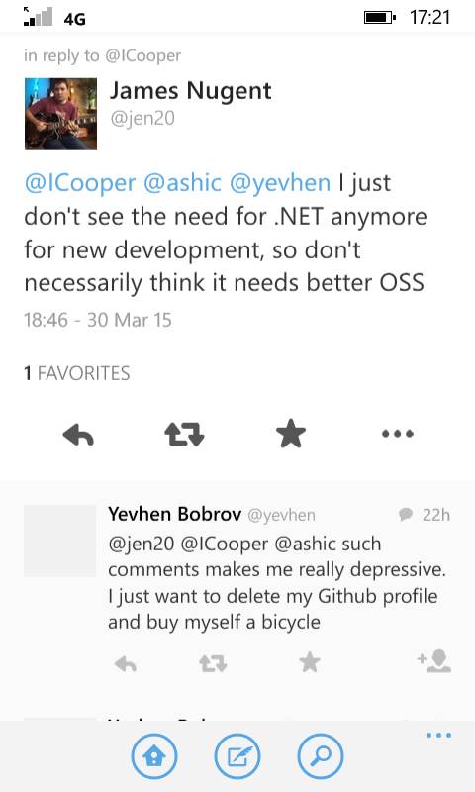
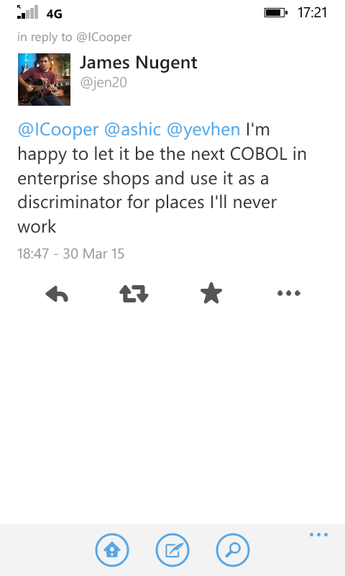
Does .NET have a future?

Slide 18


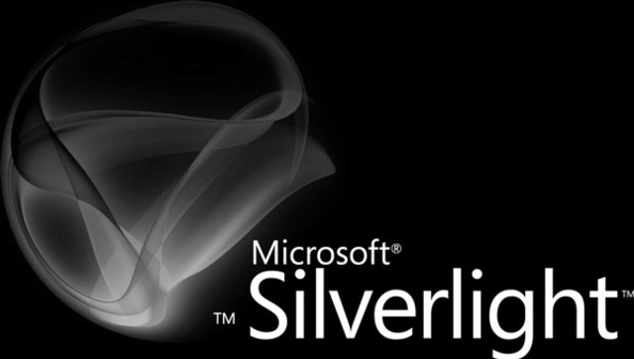
.NET Core
.NET that runs on more than Windows, didn’t Microsoft already do this?
Notes:
Steven Sinofsky – than man who brought you Windows RT, believed Silverlight had to die because it ran on stuff other than Windows.

Slide 19
.NET Core and ASP.NET Core
.NET Core is a rewrite of .NET
true multi-platform; Windows, Linux and OS/X
designed to run on (minimal) servers, not just desktop or mobile – serverless such as AWS Lambda or Azure Functions
update mechanism is NuGet
ASP.NET Core
new model
runs on .NET Core
run your ASP.NET applications on Linux
Notes:
Specifically .NET Core does not include WinForms or WPF, and ASP.NET Core does not include WebForms. UWP apps are tied to versions of Windows.
While getting rid of WebForms might make quite a few people happy, the lack of the ability to build a UI on .NET Core may worry some developers.
However, many modern desktop applications have already migrated to effectively being a browser UI; a web application hosted as a desktop application; think Slack, WhatsApp and Spotify.
If the web application is delivered from a locally hosted .NET Core server such as kestrel then we effectively have a .NET Core desktop application with a UI.

Slide 20
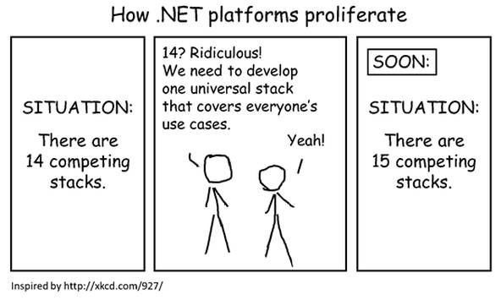
… let’s hope it all goes well.
http://blogs.msdn.com/b/dotnet/archive/2014/12/04/introducing-net-core.aspx
Notes:
Introducing .NET Core, blog post by Immo Landswerth, http://blogs.msdn.com/b/dotnet/archive/2014/12/04/introducing-net-core.aspx

Slide 21
Open Source - then
Steve Ballmer, 2001
‘Linux is a cancer that attaches itself in an intellectual property sense to everything it touches’
Bill Gates, 2008
Open source, he said, creates a license ‘so that nobody can ever improve the software’
Notes:
Steve Ballmer, The Register, http://www.theregister.co.uk/2001/06/02/ballmer_linux_is_a_cancer/
Bill Gates, http://www.wired.com/2008/04/bill-gates-what/

Slide 22
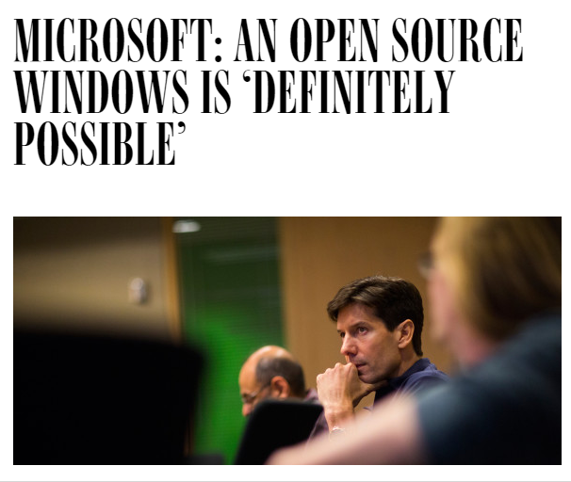
Open Source – now
http://www.wired.com/2015/04/microsoft-open-source-windows-definitely-possible
Notes:
http://www.wired.com/2015/04/microsoft-open-source-windows-definitely-possible
But one day, the company could “open source” the code that underpins the OS—giving it away for free. So says Mark Russinovich, one of the company’s top engineers.
“It’s definitely possible,” Russinovich says. “It’s a new Microsoft.”
MS Open Technologies, a separate subsidiary is to be brought into main Microsoft fold,
http://www.theregister.co.uk/2015/04/20/microsoft_absorbs_opensource_spinoff/

Slide 23
.NET Foundation
dotnetfoundation.org
.NET Core (libraries, runtime and CLI tools)
.NET Compiler Platform (“Roslyn”)
C# language
ASP.NET Core
Xamarin.Forms
SignalR
Entity Framework

Slide 24
Welcome to the ‘Dev’ Store
Package managers matter, they are the App Store for developers.
Node.js popularity has in part helped by node package manager (NPM) - 475,000 packages
NuGet now exposes programmers to the world outside Microsoft
93,738 unique packages
‘dark matter’ developers are being freed from their MSDN shackles

Slide 25
Because We Want To!
Microsoft now supporting multiple development environments
Visual Studio, available only on Windows
Visual Studio Code, a cross platform, lightweight editor based on electron (basically a web based desktop application)
Xamarin Studio for OS/X Visual Studio for Mac
Other environments are available too
JetBrains Rider combining the power of Resharper with an IDE (R-IDE-r)
Windows 10 now includes a Subsystem for Linux for developers
Bash shell, on Ubuntu, on Windows
Notes:
Some may have heard about JetBrains having legal issues with Microsoft regarding .NET debugging within Rider. This was related to a usage licence, for software that should probably have never been placed in a NuGet package, and which JetBrains were not even using. This has been resolved (by February 23rd, 2017) and Rider happily debugs .NET Core apps once more using a JetBrains debugger.
‘Because We Want To!’ is a song performed by British pop singer Billie Piper who went on to become a Doctor Who assistant. It won the NME award for ‘Worst Single of 1998’
(watch https://www.youtube.com/watch?v=D_XI_290cfw, if you dare!)

Slide 26
Public cloud services
Amazon AWS
$12.2 billion, over 75% of public cloud market
Microsoft Azure
$2.7 billion (estimated)
Google
$1 billion (estimated)
For comparison;
Apple iTunes/Services stood at $24 billion, Facebook at $27.6 billion and Netflix at $8.8 billion

Slide 27
IaaS revenue (2016)
Amazon AWS
$9.775 billion
Microsoft Azure
$1.579 billion
Alibaba
$675 million
Google
$500 million (estimated)
For comparison;
Also, the only two companies with serious pretentions to hybrid cloud
Notes:
https://www.theregister.co.uk/2017/09/27/iaas_market_share/

Slide 28
Microsoft Azure
Azure predicted to exceed AWS by revenue by 2018
partly driven by some companies disliking providing a competitor (Amazon) with revenue
Catching up on AWS
Serverless, BigData and ML, Service Fabric
Docker providing containerisation, not just Hyper-V VM’s
Nearly 1/3 of all Azure virtual machines are running Linux (as of Q4 2016)
Only Microsoft and Oracle have true hybrid cloud offerings
Notes:
Azure overtaking AWS by end of 2017 with combined SaaS, PaaS and Iaas?
http://www.computerweekly.com/news/450421064/Analyst-tips-Microsoft-Azure-to-overtake-AWS-as-cloud-revenue-market-leader-in-2017
https://www.theregister.co.uk/2017/10/11/oracle_cloud_at_customer_and_azure_stack_are_the_perfect_hybrid_clouds/

Slide 29
Windows operating system
Windows desktop
Windows versus OS/X? or Linux? or Chrome O/S?
… or Windows versus Android (36.3% vs 39.8%)
Windows 10 adoption way ahead of 8.x but Windows 7 still higher (39% vs 40%, trending to pass Q4 2017)
Windows server
Server is transitioning to SaaS in the cloud
SQL Server is now available on Linux
you may not even need Windows Server soon
Notes:
Windows version market share
http://gs.statcounter.com/os-version-market-share/windows/desktop/worldwide

Slide 30
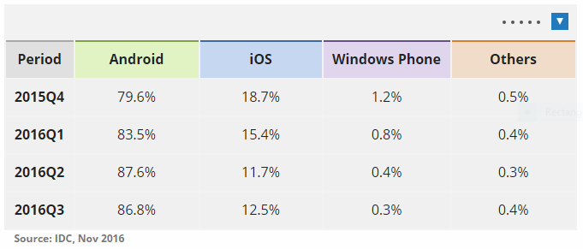
Mobile – Windows Phone 10 Mobile
Windows 10 Mobile
< 0.3% market share, was actually around 10% in Europe
Support ends mid 2019 – OFFICAL!
Future, maybe …
Windows 10 on ARM is coming, with an x86 emulator but on low power, long battery SoC
ARM SoC will make it cheap to integrate 3G in Windows
Notes:
Transforming laptops with detachable touch screens are eating into the premium priced iPad market and Windows 10 on ARM could be the final nail in the coffin. Not just the high priced Microsoft Surface devices, but lower cost netbook style devices.
Windows 10 on ARM is due 2017 but this will be crunch time for the future of Windows 10 Mobile – it has to work better than Windows RT / Surface RT which was a huge financial disappointment.
Source:
Mobile platforms – unit shipments market share from IDC – http://www.idc.com/prodserv/smartphone-os-market-share.jsp

Slide 31
Mobile – iOS and Android
Office applications on all platforms
OneNote now joined by Word, Excel and PowerPoint
iOS, Android and Windows 10 Mobile UWP
Full fidelity and full editing capability
Outlook for iOS
Previously known as Accompli
Brings serious handling of e-mail, especially Exchange based e-mail – and it works in iOS 11
OneDrive, Skype, Cortana, ToDo, Arrow Launcher for Android
Notes:
With virtually no market share Microsoft no longer cares about devoting itself solely to Windows, which actually makes it one of the more open vendors

Slide 32
Other stuff
Office co-editing now working on Office 365
Co-editing goal is to be available from mobile, desktop and web clients
Google Docs USP of co-editing is being eroded
Office 365 subscriptions are providing a more reliable income stream than one off purchases every few years
AR
HoloLens is market leader, if ludicrously expensive
Xbox
30% of the console market
Notes:
Google Docs was good when it appeared, but has had no major development effort. Google appeared to have succumbed to a similar problem exhibited by Microsoft with Internet Explorer; they though they had the market sewn up and sat back and didn’t improve the product.
I normally summarise the fumbling by Google with Google Docs as follows; ‘Office has won – get over it’.

Slide 33
So the big question is?
Will you be developing with the .NET Framework in the future?
… and will it be on Windows?
(I know, that’s two questions ☺)

Slide 34
And my answer?
Probably, but with NodeJS and Python in the mix.
… who cares about the OS, containers are more important – and it will be cloud based.

