Slide 2
What Is The Point Of … Microsoft?
Liam Westley
Application Architect
liam.westley@huddle.com
@westleyl

Slide 3

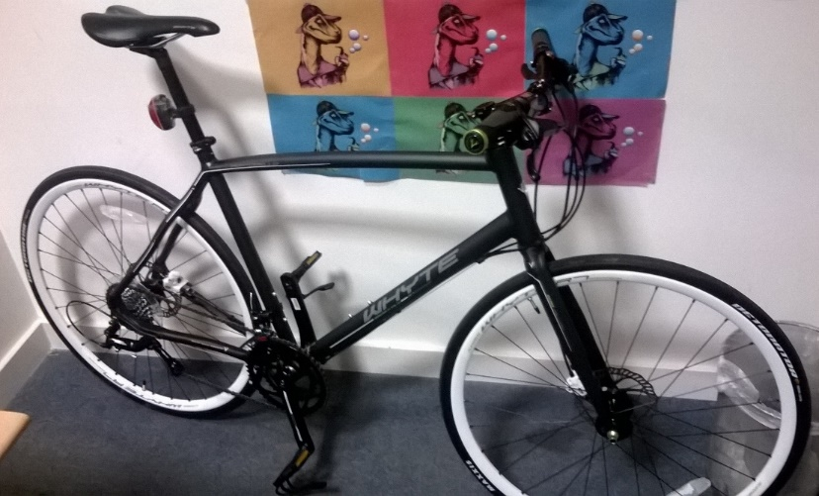

Who is Liam Westley?
< commute
play >
< work

Slide 4
What is the point of …
this talk?
‘What is the point of …?’ is a BBC Radio 4 documentary series about institutions and their purpose in the modern world.
In the past they have tackled such institutions as; Formula 1, The Methodists, The Lord Mayor Of London, Michelin Stars, The Football Association.
So I thought why not look at … Microsoft.

Slide 5
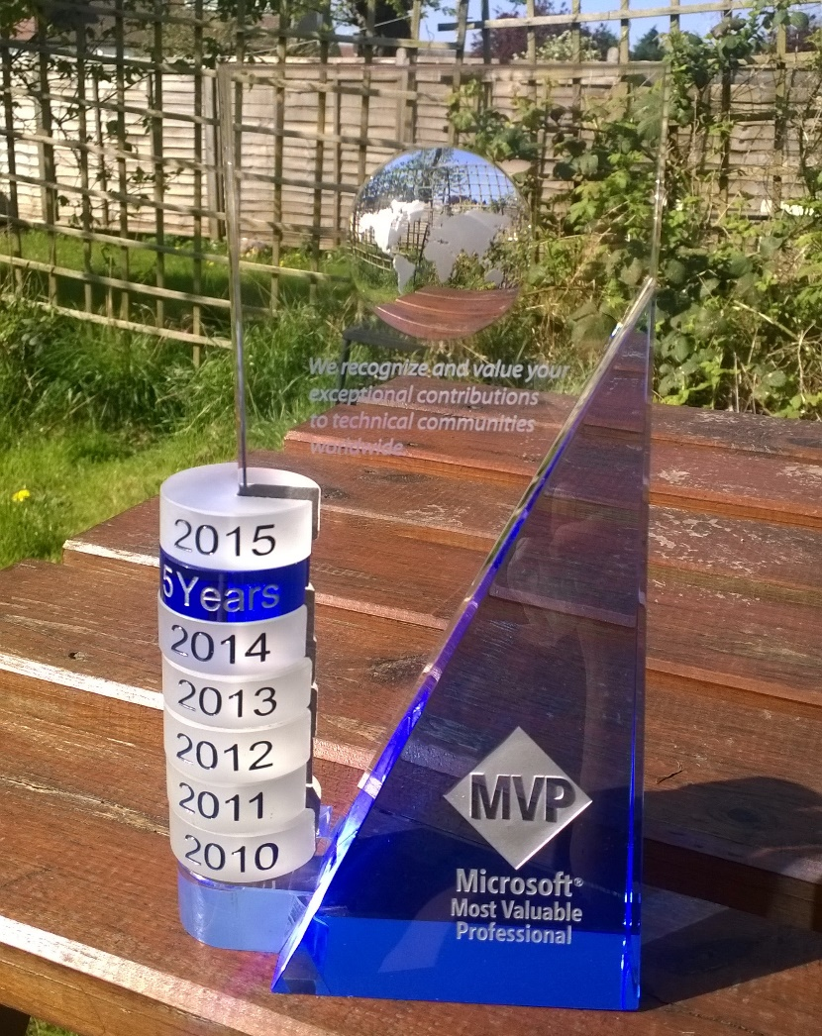
Disclaimer 1

Slide 6

Disclaimer 2
By the end of next week this
may all have changed …

Slide 7
Introducing ‘The Players’
Apple ($750 BN)
sells hardware (with good software thrown in)
Google ($370 BN)
sells you to advertisers (well all their data about you)
Microsoft ($355 BN)
sells software licenses (and occasionally hardware)
Facebook ($230 BN)
like Google, sells you and your data to advertisers
Oracle ($190 BN)
sells database software and services
Amazon ($180 BN)
sells you actual, real stuff; and runs cloud services
Notes:
Apple is around 90% hardware – they have commoditised software.
Microsoft is over 70% software licenses – they have commoditised hardware (except in Xbox area)
Google is virtually 100% ad revenue (now that Motorola Mobility has been sold to Lenovo) – they have commoditised software and hardware.
Market Capitalization (Google, 22nd April 2015)
Apple 750 billion, Google 370 billion, Microsoft 355 billion, Oracle 190 billion, Amazon 180 billion
Note:
Good comparison of Apple vs Google vs Microsoft revenue areas can be found at http://bgr.com/2014/02/06/apple-google-microsoft-revenue-sources/

Slide 8
But what do devs care about?
Windows and the .NET Framework
languages and underlying architecture
open source
multi platform
Cloud services
Azure, containerisation, and management
Mobile platform
Windows Mobile
Other mobile platforms

Slide 9
Enterprise development
In 2003 I was asked to provide a comparison of Java versus .NET.
Java – one language, deploy anywhere
not quite true even in 2003; various flavours of Java including EE, SE and ME
.NET framework – multiple languages, deploy on any Microsoft platform
Windows desktop, server and Windows CE (mobile)

Slide 10
Enterprise development
Java or more specifically the JVM (which includes JRuby, Clojure, Groovy and Scala) and .NET framework are the dominant enterprise languages for creating server side software.
However, do not underestimate the ability of dynamic languages such as JavaScript, Python and Go to permeate the enterprise architecture at all levels.
Typescript is the Microsoft response in the world of scripting on the server.

Slide 11
.NET languages
C#
Taking it’s cues from java, C# is a heavyweight language with advanced features such as generics that are missing in other languages
Visual Basic.NET
Still heavily in use within enterprise development
F#
Started by Microsoft Research in Cambridge, this has made .NET relevant in the world of functional languages
Concepts have fed back into the .NET CLR and C#
Notes:
See the Wikipedia comparison of programming languages http://en.wikipedia.org/wiki/Comparison_of_programming_languages
C# is there as one of the most fully featured languages.
IMHO – The desire for VisualBasic.NET to be at feature parity with C# has resulted in a more complex language than was ideal, and means there is no ‘starter’ language that could have made life easier for new developers.

Slide 12
.NET – more than languages
CLI – Common Language Infrastructure
Abstraction of high level languages from hardware
ISO and ECMA standards
.NET Framework is an implementation of the CLI
CIL – Common Intermediate Language
This is IL – the hardware independent language suitable for running in the CLR
CLR – Common Language Runtime
Virtual machine that runs the IL, handling compilation to specific hardware, memory management etc.
‘Roslyn’ – the new .NET compiler for C# and VB
Completely open source on GitHub
Notes:
CLI - http://en.wikipedia.org/wiki/Common_Language_Infrastructure (see Overview for good diagram of high-level language to IL to machine code.
CIL - http://en.wikipedia.org/wiki/Common_Intermediate_Language.
CLR - http://en.wikipedia.org/wiki/Common_Language_Runtime (another diagram shows flow from high-level language to native code)
Roslyn - https://github.com/dotnet/Roslyn

Slide 13
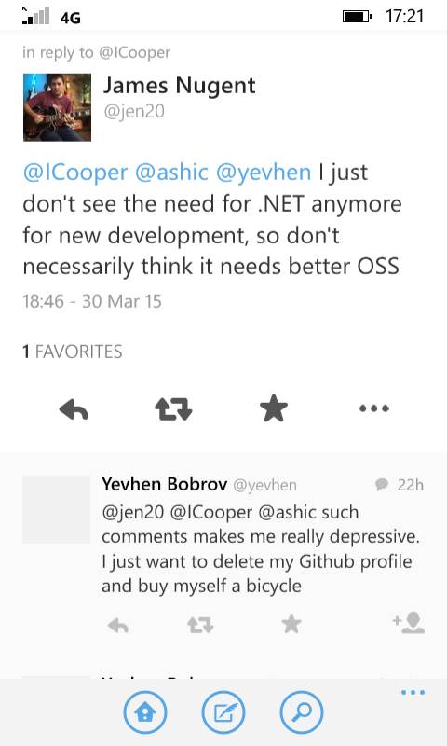
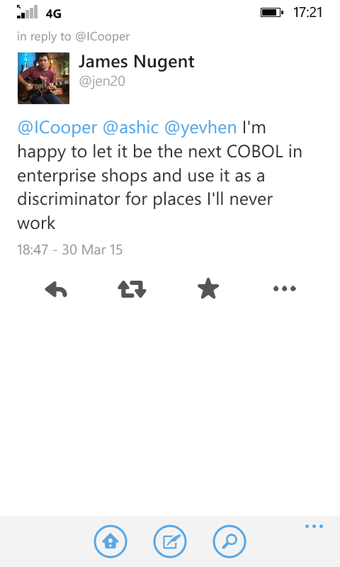
Does .NET have a future?

Slide 14
Open Source - Microsoft
Steve Ballmer, 2001
‘Linux is a cancer that attaches itself in an intellectual property sense to everything it touches’
Bill Gates, 2008
Open source, he said, creates a license ‘so that nobody can ever improve the software’
Notes:
Steve Ballmer, The Register, http://www.theregister.co.uk/2001/06/02/ballmer_linux_is_a_cancer/
Bill Gates, http://www.wired.com/2008/04/bill-gates-what/

Slide 15
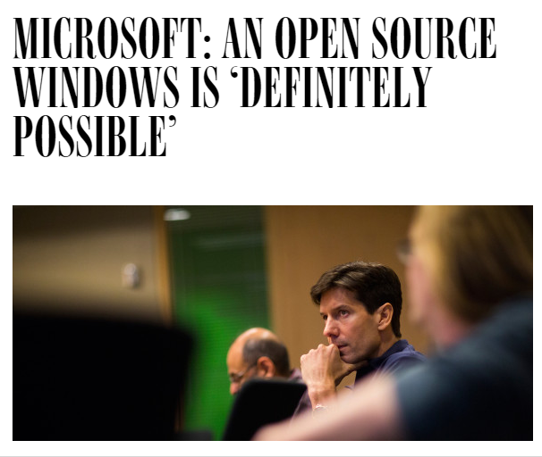
Open Source
http://www.wired.com/2015/04/microsoft-open-source-windows-definitely-possible
Notes:
http://www.wired.com/2015/04/microsoft-open-source-windows-definitely-possible
But one day, the company could “open source” the code that underpins the OS—giving it away for free. So says Mark Russinovich, one of the company’s top engineers.
“It’s definitely possible,” Russinovich says. “It’s a new Microsoft.”
MS Open Technologies, a separate subsidiary is to be brought into main Microsoft fold,
http://www.theregister.co.uk/2015/04/20/microsoft_absorbs_opensource_spinoff/

Slide 16
.NET Foundation
dotnetfoundation.org
.NET Core 5
.NET Compiler Platform (“Roslyn”)
MSBuild
ASP.NET 5
ASP.NET SignalR
MEF
Entity Framework 6
Xamarin.Mobile
Windows Phone Toolkit
Couchbase Lite for .NET

Slide 17


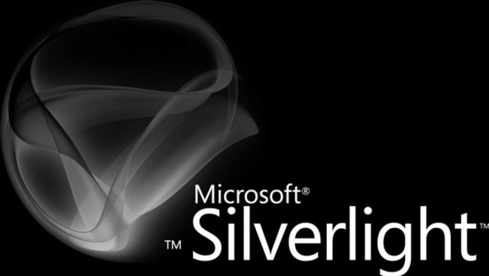
.NET Core 5
.NET that runs on more than Windows, didn’t Microsoft already do this?

Slide 18
.NET Core 5 and ASP.NET 5
.NET Core is a rewrite of .NET
true multi-platform; Windows, Linux and OS/X
designed to run on servers, not just desktop or mobile
update mechanism will be NuGet
1st version for FreeBSD compiled on 23rd April
ASP.NET 5
new model
runs on .NET Core 5
run your ASP.NET applications on Linux

Slide 19
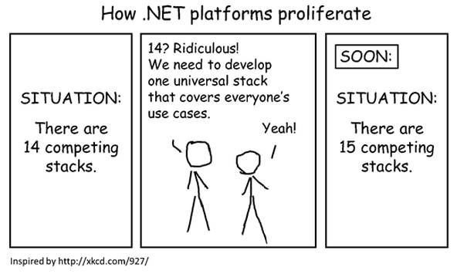
… let’s hope it all goes well.
http://blogs.msdn.com/b/dotnet/archive/2014/12/04/introducing-net-core.aspx
Notes:
Introducing .NET Core, blog post by Immo Landswerth, http://blogs.msdn.com/b/dotnet/archive/2014/12/04/introducing-net-core.aspx

Slide 20
Welcome to the ‘Dev’Store
Package managers matter, they are the AppStore for developers.
Node.js popularity has in part helped by node package manager (NPM)
142,330 packages
NuGet exposes programmers to the world outside Microsoft
35,371 packages
‘dark matter’ developers are being freed from their MSDN shackles
subscription

Slide 21
Public cloud services
Amazon AWS
$5.2 billion, 50% of public cloud market
Rackspace public cloud
est. $1.8 billion, 8% of public cloud market
Microsoft Azure
6% of public cloud market
$6.3 billion, but includes Office 365, CRM online
For comparison;
Apple iTunes/Services stood at $18.5 billion, Facebook at $12.5 billion and Netflix at $5.5 billion
Notes:
AWS results 23 April 2015 – http://qz.com/390191/amazon-web-services-is-a-5-billion-business-and-its-growing-50-a-year/
Microsoft results 23 April 2015 – http://www.zdnet.com/article/how-much-is-microsoft-making-from-azure/
AWS 21 April 2015 - http://qz.com/388105/amazon-is-about-to-reveal-one-of-its-biggest-secrets-the-size-of-its-cloud-business/ - AWS about to be reported separately, $4.5 billion estimate 2014, (compare to Apple iTunes/Services $18.5 billion), Rackspace $1.8 billion

Slide 22
Cloud – Azure
Docker
Containerisation of applications
Already supporting Docker in Linux images
Docker coming soon to Windows via Hyper-V, and will likely come to Azure first
Azure Service Fabric
cloud management
SQL Server, TFS, CRM, hosted SharePoint
SaaS will also be a big driver
Notes:
http://azure.microsoft.com/blog/2015/04/20/announcing-azure-service-fabric-reducing-complexity-in-a-hyper-scale-world/

Slide 23
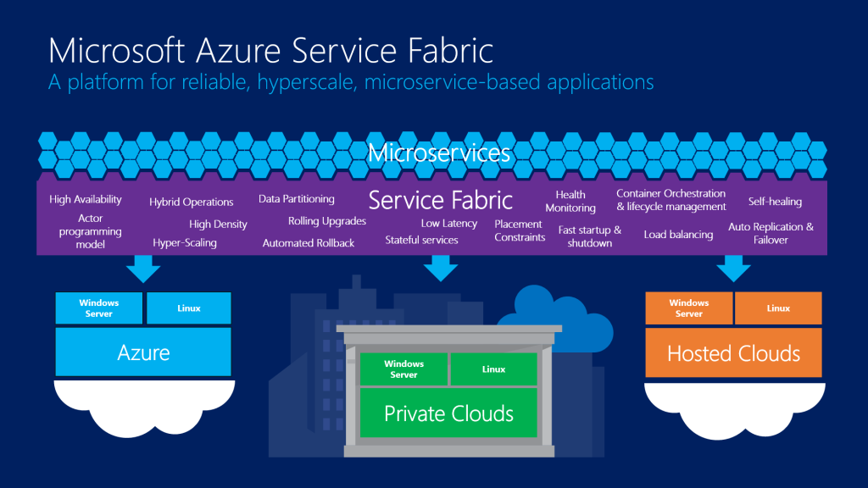

Slide 24
Windows – Desktop, Server
Linux/Chrome O/S versus Windows
… or is it versus Windows or OS/X?
Windows 10 – make or break
touch still ahead of competition (IMHO)
however … UX can be grizzly at times, and high resolution displays are an issue
Windows Server
Still great at hosting SQL Server, Exchange, SharePoint, App Servers, and containerisation may help
But isn’t this only becoming SaaS?
Notes:
Chrome O/S not as much a concern in Europe as in U.S.
http://www.channelregister.co.uk/2015/02/11/windows_with_bing_death_knell_licences/
In fact, Windows with Bing is being ramped down as the challenge is not being made by Chrome notebooks.

Slide 25
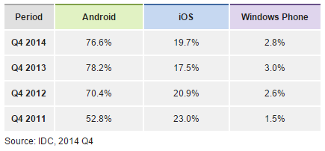
Mobile – Windows Phone
Windows Phone
< 3% market share
10% in Europe
Low in US and Japan
Windows 10 (for Phone)
Universal application model
Microsoft maps (so maps for Japan!)
As good as Office as iOS and Android
Notes:
Mobile platforms – unit shipments market share from IDC – http://www.idc.com/prodserv/smartphone-os-market-share.jsp

Slide 26
Mobile – iOS and Android
Office applications now launched
OneNote now joined by Word, Excel and PowerPoint
On iOS and Android tablets
Full fidelity and full editing capability
Outlook for iOS
Previously known as Accompli
Brings serious handling of e-mail, especially Exchange based e-mail
OneDrive, Skype

Slide 28
What Is The Point Of … Microsoft?
Liam Westley
Application Architect
liam.westley@huddle.com
@westleyl

