Slide 1
Give it a REST
Tips for designing and consuming public API’s

Slide 2



< cycling
Porto >
< work

Slide 3


Is that really REST?
What is REST?
Roy Fielding original proposal from 2000
HATEOAS – Hypermedia API
Richardson Maturity Model
Roy Fielding
‘Hypermedia as the engine of application state” is a REST constraint. Not an option. Not an ideal. Hypermedia is a constraint. As in, you either do it or you aren’t doing REST.’
Mike Amundsen tweet highlights that REST ≠ CRUD
‘Remember, when designing your WebAPI, your data model is not your object model is not your resource model is not your message model.’
https://sebastianbooksblog.wordpress.com/2015/07/05/3390
Roy Fielding, Hoang Xuan Pham and Daniel A. Anderson / University Communications
Notes:
Mike Amundsen tweet - https://twitter.com/mamund/status/767212233759657984 (via https://nordicapis.com/rest-state-machine-revisited/)
Richardson Maturity Model - https://www.martinfowler.com/articles/richardsonMaturityModel.html
Jamaican man – https://sebastianbooksblog.wordpress.com/2015/07/05/3390/
Roy Fielding – http://www.zotzine.uci.edu/v02/2009_10/fielding.php
Hoang Xuan Pham and Daniel A. Anderson / University Communications

Slide 4
Anatomy of a REST request
A REST request is a HTTP* operation on a resource, which may include a message
HTTP Verb: GET
Resource: https://api.huddle.net/files/users/123/recentitems
Headers: Authorization, If-Modified-Since
Message (optional): body of request, may be JSON, XML or even just plain text
GET https://api.huddle.net/files/users/123/recentitem
Authorization: OAuth2 Imh0dHBzOi8vbG9naW4uaHVkZGxlLm5ldCIsImF1ZCI6IiouaHVkZG
Accept: application/json
User-Agent: HuddleDesktopPC/4.4.0.0
If-Modified-Since: Wed, 25 Apr 2018 08:44:40 GMT
Host: api.huddle.net
* for pedants it doesn’t have to be HTTP

Slide 5
Anatomy of a REST response
Content-Length: 36209
Content-Type: application/json
Last-Modified: Wed, 25 Apr 2018 08:45:53 GMT
{
"maxItems": 50,
"items": [
{
"type": "Document",
"links": [
{
"rel": "delete",
"href": "https://api.huddle.net/files/users/123/recentitems/456"
},
{
"rel": "self",
"href": "https://api.huddle.net/files/documents/456"
},
{
"rel": "alternate",
"href": "https://my.huddle.net/workspaces/789/files/456"
}
],
"title": "Notes – Huddle API Design",
"contentType" : "application/vnd.openxmlformats-officedocument.wordprocessingml.document",
"extension" : "docx",
: : : :
HTTP Status: 200 OK
Headers: Content-Type, Last-Modified
Message (optional): body of request, may be JSON, XML or even just plain text
Hypermedia API links: collection of links to resources with rel attribute to allow identification of the appropriate link

Slide 6

But what about gRPC?
gRPC
Remote Procedure Call system created by Google
Always connected, HTTP/2
Binary protocol (protobuff),
Procedure based rather than resource based
A bit like Java RMI, or CORBA or DCOM or SOAP
We’ve been here before, however much we tried to forget …
Notes:
Image : Born On The 4th July

Slide 7

API design – where do you start?
Human and automated users
Readable by a human
SOAP and XML were not inherently readable
While you have a model on the server it may not fit all your clients
Should you design for the server or for the client?
Design for the business
Balance of Security, Reliability and Speed
At Huddle we have an API design Slack channel
Remember – there is NO right answer for everyone!
Prohibited icon made by https://www.flaticon.com/authors/roundicons
Green letters by http://gimpchat.com/viewtopic.php?f=11&t=5232
Notes:
Green letters by http://gimpchat.com/viewtopic.php?f=11&t=5232
Prohibited icon made by https://www.flaticon.com/authors/roundicons from https://www.flaticon.com/ and is licensed by Creative Commons BY 3.0 (http://creativecommons.org/licenses/by/3.0/)

Slide 8
An API is a contract
An API is a contract between the publisher and the consumer, which creates a set of mutual obligations
For the person publishing the API
Document the API – responses, headers, acceptable media types, sample code
Make it clear what is optional, and what might be extended
Consider how different clients might use the API and what local caching might exist
For the person consuming the API
Read the documentation and expect to handle all the possible responses
Use only what you need from the response to minimise your coupling
Documentation is key whatever form it is in; wiki, Swagger, Apiary.io. Include as much information as possible, including expected HTTP responses, media types, headers as well as URI and resource formats

Slide 9
Versioning an API
On the Nordic API web site, there is a blog which references Zdenek Nemec talking about API Change Management,
What versions exist?
Client version
Message Format version
API implementation (server) version,
API documentation version
Resources, relationships between resources and the API itself does not have a version
In an ideal world versioning is not simply adding v2, v3 to the URI. At best use extension strategies, and if you have radically new formats they better modelled as new resources with new URIs
Notes:
https://nordicapis.com/api-change-strategy/

Slide 10
Extending an API
What are the extension rules?
You must not take anything away
You must not change processing rules
You must not make optional things required
Anything you add must be optional (you may use default values, either within the form in the case of hypermedia, or on the API implementation on the server)
Monitor feature usage
see who keeps using deprecated fields/methods
Formalise how you communicate API changes and timescales
Notes:
https://nordicapis.com/api-change-strategy/

Slide 11
How do we introduce breaking changes?
Zdenek Nemec has an answer for this question as well, again for brevity; if a change to either of the following violate the extension rules listed earlier, you simply need to create a new resource:
Resource Identifier (the URI) including any query parameters and their semantics
Resource metadata (such as the HTTP headers)
Resource data (such as the HTTP body) fields and their semantics
Actions the resource affords (e.g., available HTTP Methods)
Relations with other resources (e.g., Links)
If an existing client does not produce the same results with the same resources as previously you have broken the API. A client can not be expected to intelligently handle new data items, or use different or additional HTTP methods to perform the same operations
Notes:
https://nordicapis.com/api-change-strategy/

Slide 12
Patterns and strategies

Slide 13


Deprecation

Slide 14
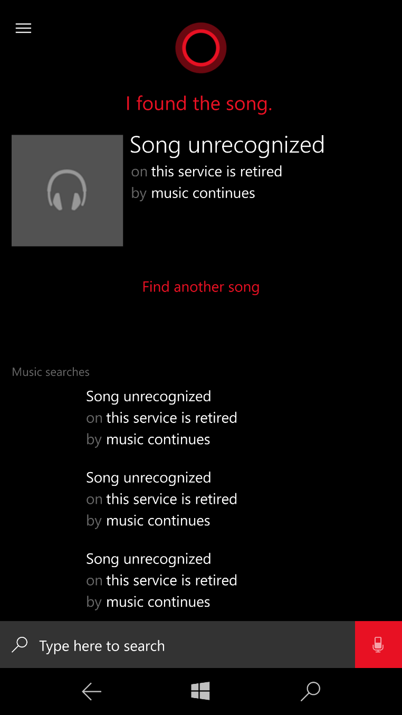
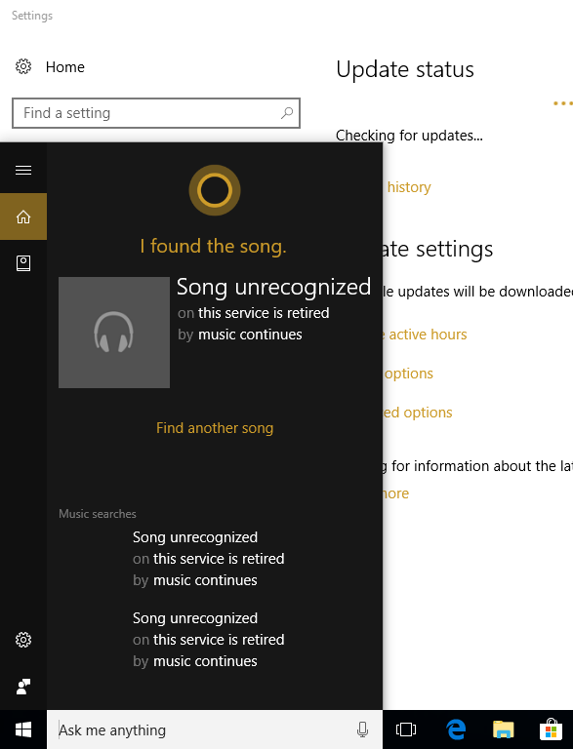
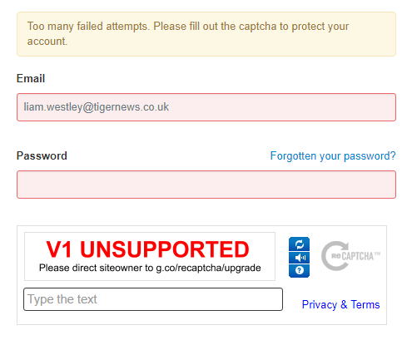
Elegant deprecation
Notes:
In the last few months of v1 of Recaptcha a random 1% of users were provided with the UNSUPPORTED image telling them to contact the owner of the web site.
In January 2018 Groove Music was retired, together with the Shazamm style music matching service – but instead of showing an error, data was returned on both Windows 10 Mobile and Windows 10 Cortana indicating the service had been retired.

Slide 15
BFF – for compatibility and tailoring
BFF – Backend For Frontend (Thoughtworks Tech Radar 2016)
Compatibility
If you are re-engineering your data within the backend, you may generate a new API with different semantics
You can create a BFF to replicate the old API semantics, making use of the new API
Tailoring results to specific clients
Some clients may want data in a different form to the original API
Mobile clients have network performance issues so it can be useful aggregate calls
A BFF may be only used by internal clients, making changes to the BFF much easier
Notes:
https://www.thoughtworks.com/radar/techniques/bff-backend-for-frontends

Slide 16
Using links to construct a user interface
With a Hypermedia API when you deliver a resource, you include various links within the response to provide information to the consumer of what operations are available
The presence and absence of links in the response can provide the consumer with a means of constructing a valid user interface for a resource, and can work well with user permissions
You can supply edit, update, delete, download rel links
Based on presence, or absence of links the UI can include the appropriate buttons and links
Links reflect the permission you might have on a document; i.e. the difference between a viewer and an editor of content

Slide 17
Hypermedia UI (consumer/publisher)
We use this model in Huddle, but there are limitations if those links are affected by not just permissions, but the state of a resource
When a document is locked for editing we do not provide an edit link, so there is no Edit button (acting as if a user had a read only permission)
When we added web push notifications (via WebSockets) our Single Page Application receives a notification saying the document is not unlocked …
… but there is no Edit button to enable, as it was never created in the HTML DOM, as it did not receive a link to support editing the document, as when it first loaded the document resource it was locked

Slide 18
Caching – 304 Not Modified
Last-Modified, If-Modified-Since headers
Last-Modified header included when a resource is provided
The consumer than uses that value in an If-Modified-Since header when requesting a resource
The API returns 304 Not Modified if nothing has changed and the consumer knows that the resource it already has is up to date
ETag (Entity Tag)
Strong and weak Etags
"123456789“ – a strong ETag validator, based on a hash of the resource
W/"123456789" – a weak ETag validator, often hashed on a version of the resource
Response header – ETag: "686897696a7c876b7e"
Request header – If-None-Match: "686897696a7c876b7e"

Slide 19
Last-Modified header (producer)
Real world example – BFF to ‘replicate’ existing API
Original API included a Last-Modified header
The BFF did not include this header (an oversight, not be design)
Clients (iOS in this case) were now making multiple requests rather than a single request when data is unchanged
Mitigation
The header was part of the original API contract
Replicate that behaviour in the new BFF, achieved by passing the header from the new API straight through to the BFF
We could have also modified the client app to use the new API, or handle the new BFF response better … but updating every iOS app might take SIX months

Slide 20
Rate limiting – 429 Too Many Requests
API’s can utilise rate limiting, especially for particularly chatty clients
Provide a Retry-After header to indicate to consumers how long to wait before retrying an operation
Can rate limited based on specific clients
Can be used with leaky bucket strategy to monitor API usage
Consumers
There is a responsibility on consumers to honour 429 responses
Consumers should honour the back off time
If consumers treat rate limiting as just a standard error and immediately retry an operation, the benefit can be lost
Even if consumers ignore the 429 response it can still protect servers, as the response is much more efficient to produce.

Slide 21
Async and REST
Progress endpoint pattern
POST operation
Returns 202 Accepted and a link for progress / exception reporting
Client polls the link for completion of operation
On completion the response either returns the final response or provides a link to the resource for the completed operation
Once had a developer ask for how to make an API call asynchronous (using async in C#), in that it could return control immediately after issuing a request, but if anything went wrong they would like it to somehow provide a HttpStatusCode straight away
The progress endpoint pattern provides a better model – no need to make the request async in the client, if initial validation and/or authentication are successful the server returns 202 Accepted with a progress endpoint for obtaining the final result
Notes:
https://gooroo.io/GoorooTHINK/Article/16673/Http-Patterns-Progress/25734#.WtnTvXrwZhE

Slide 22
Mini PUT/POST …../status example
Often you want to update a subset of information in a resource, often only a single property of a resource, such as status.
PATCH operation could be used but requires a specially format patch data format such as JSON-patch, and PATCH is not guaranteed to be idempotent
Can use PUT (or POST) on a ‘child’ resource
PUT https://api.huddle.net/files/document/123 updates whole resource
PUT https://api.huddle.net/files/document/123/readonly updates just the read only status of the document
Can return a full representation of the resource after the PUT is successful
If you do provide a Content-Location header to indicate that the response is at a different location to the resource on which the PUT was made
Notes:
https://www.thoughtworks.com/radar/techniques/rest-without-put
https://gooroo.io/GoorooTHINK/Article/16412/HTTP-Patterns-Miniput
REST interfaces commonly use PUT to update resource state, however it's often better to POST to record a new event resource which captures intent, i.e. capture the business process rather than mere state.

Slide 23
Real world examples

Slide 24
Updating FileRequest status
Huddle has a concept of a task that is a request for a file, which includes a status property. The front end team realised that the standard REST model was really heavy and asked the back end for a solution to updating the status … a mini PUT.
If you update the status in the web UI these calls have to be made
GET https://api.huddle.net/tasks/123 to get latest task resource
PUT https://api.huddle.net/tasks/123 to save with updated status
GET https://api.huddle.net/tasks/123 to get latest task resource
Currently under development this will change to
PUT https://api.huddle.net/tasks/123/status to save the new status and return the latest state of the resource
This reduces server calls, and clearly indicates the business process being invoked.
Notes:
Could describe that document lock/unlock works in the purist REST world where the lock is an individual resource, separate to the document – a document is locked with a POST to the lock resource link, to create the lock, and then unlocked with a DELETE to that lock resource.

Slide 25
Over consuming (consumer)
Just because a response includes data does not mean it all has to be deserialized into a local version of a resource
Responses are messages, there is no requirement to process all the data returned, especially on GET calls
Real world example – Huddle Desktop
When a QA tested putting an invalid URI into the personal website of their user profile they not only proved it is not validated on our server, but Huddle Desktop also had problems; despite being a string in the JSON response, Huddle Desktop deserialized the personal website to a System.URI which failed
At no point was the personal web site used by Huddle Desktop, the inclusion in the deserialization was for ‘completeness’ and possible ‘future use’

Slide 26
Enumerated values (consumer)
Real world example – Android ToDo list processing, when a new type was added, FileRequest, the code threw an exception and the list failed to load
Mitigation
List could only show tasks that it knows how to display
The app could provide information to user that there are items it cannot display
switch (type) {
case "task":
taskType = ActionType.TASK;
break;
case "approval":
taskType = ActionType.APPROVAL;
break;
default:
throw new JSONException(“Unknown item type in todo list.");
}

Slide 27
Relying on link order (consumer)
Real world example – BFF to ‘replicate’ existing API
Android app was grabbing first link to perform a PUT on updating last-seen item
Mitigation
Had to order the links in the response in exact order of original API event though that is not relevant in a Hypermedia API, clients should use the rel attribute not ordering
{
"unseenCount": 0,
"links": [ {
"rel": "self",
"href": "https://api.huddle.net/notifications/user/20906501/received/last-seen"
}, {
"rel": "alternate",
"href": "https://api.huddle.net/notifications/user/20906501/received",
"title": "Received Notifications"
} ],
"lastNotificationSeen": {
"id": "urn:uuid:1eb8b39a-72d3-4666-9451-3cfcd337cf79",
"createdDate": "Tue, 24 Apr 2018 14:38:36 GMT"
}
}

Slide 28
Resources
https://www.ics.uci.edu/~fielding/pubs/dissertation/rest_arch_style.htm
Roy Fielding’s original doctorate dissertation from 2000
https://nordicapis.com/blog/
Great active discussion of everything related to APIs
http://slack.httpapis.com
Slack channel, created by Sebastien Lambla (serialseb) where you can
http://www.bizcoder.com/http-pattern-index
HTTP REST patterns, such as progress endpoint pattern
http://restcookbook.com/
Full of guidance on how to create RESTful API and basic fundamentals of REST

Slide 29
Huddle is hiring - https://www.huddle.com/about/careers-huddle/

