Slide 1
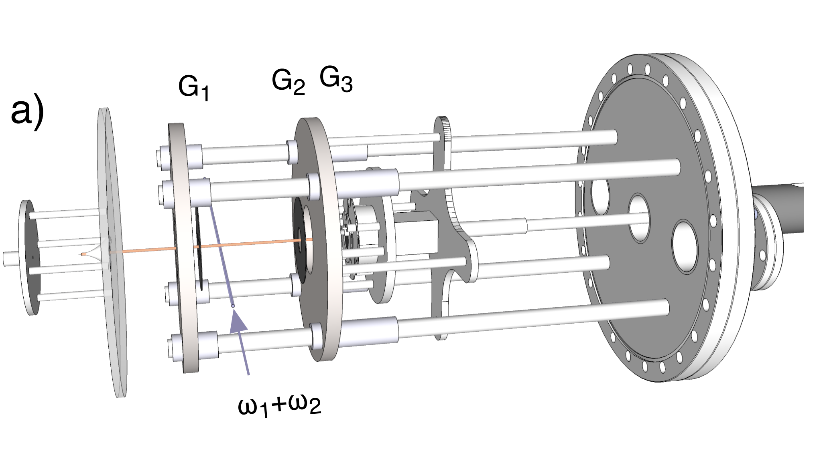
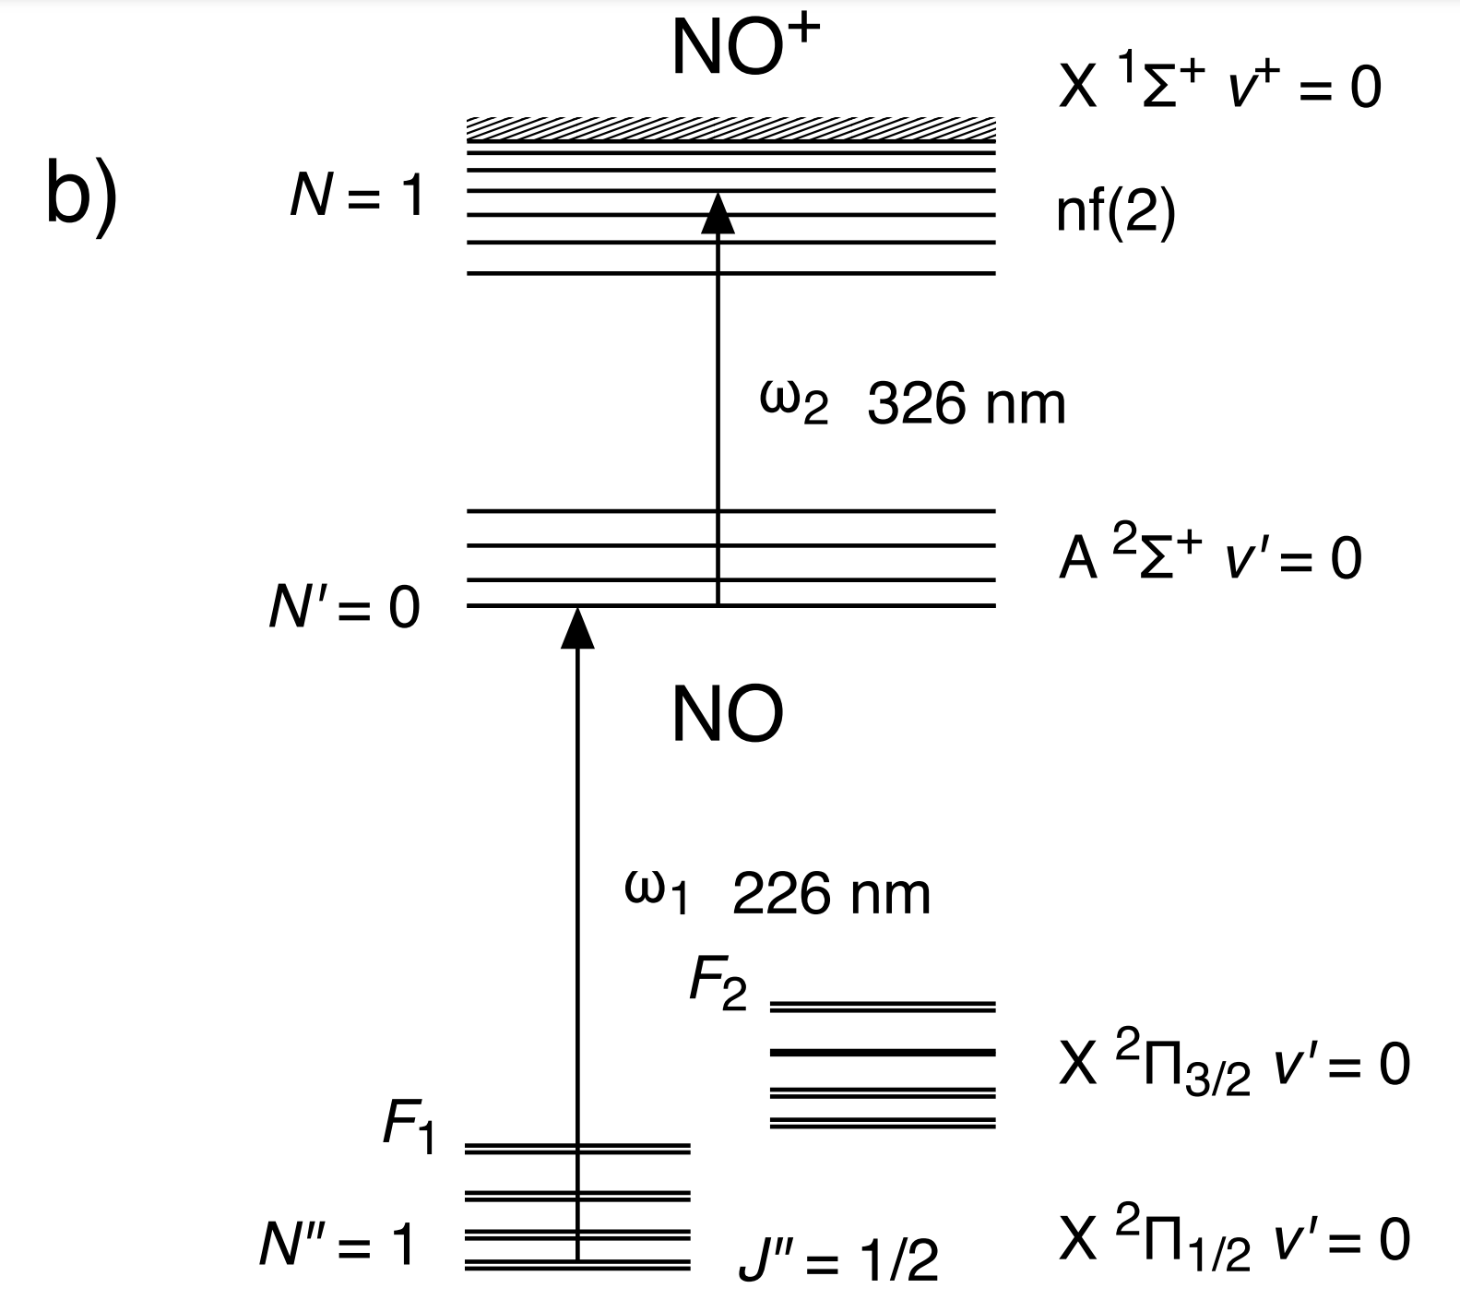
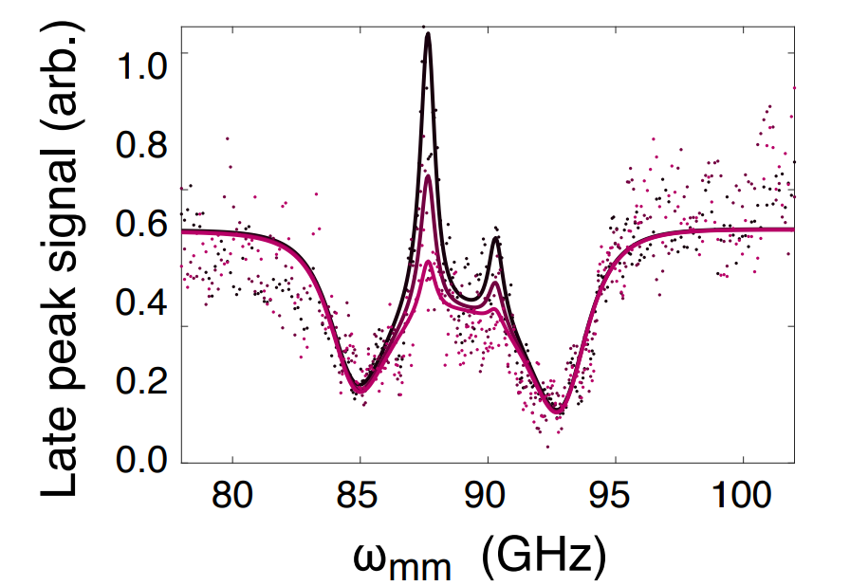
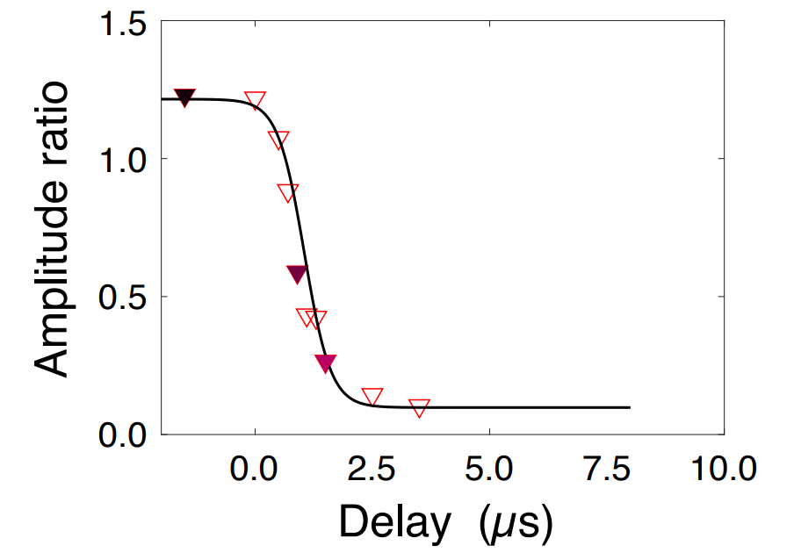

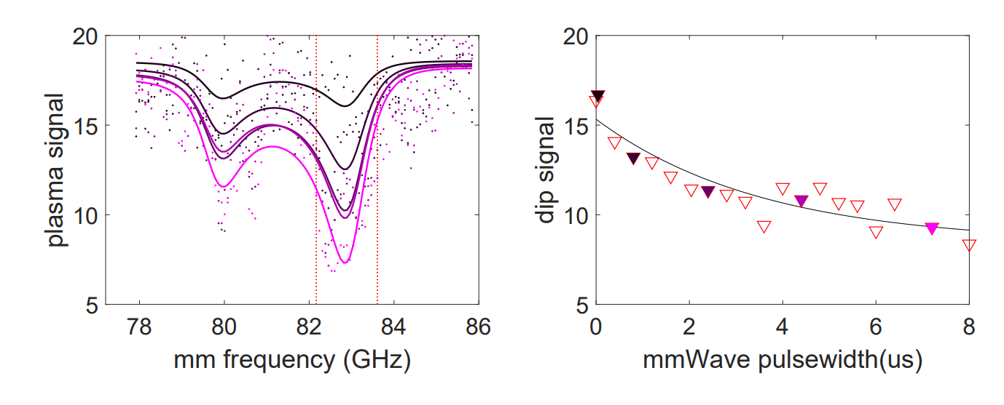
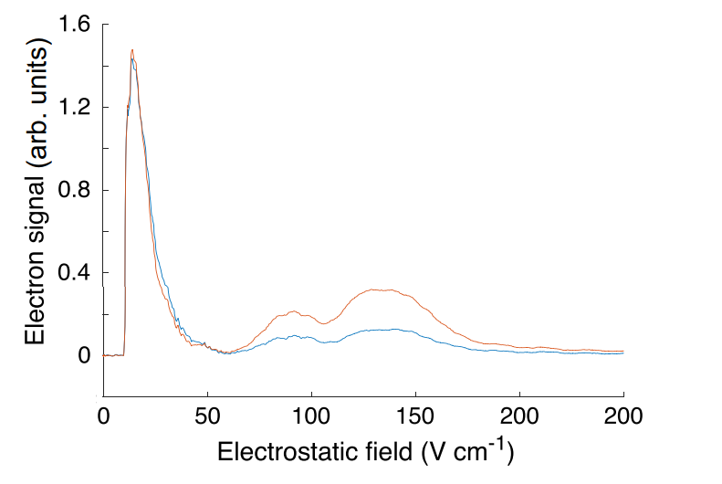
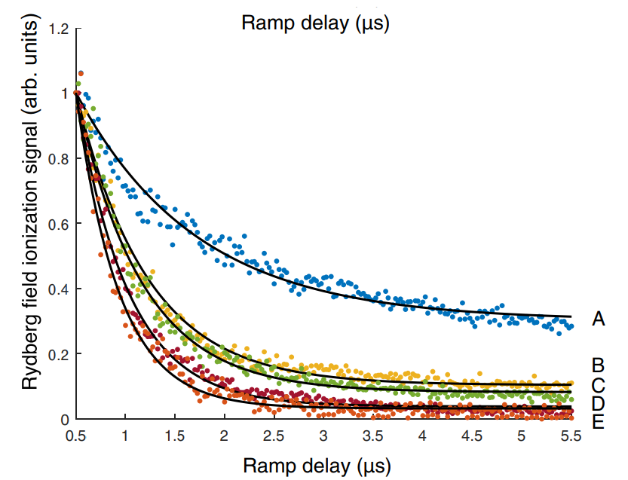
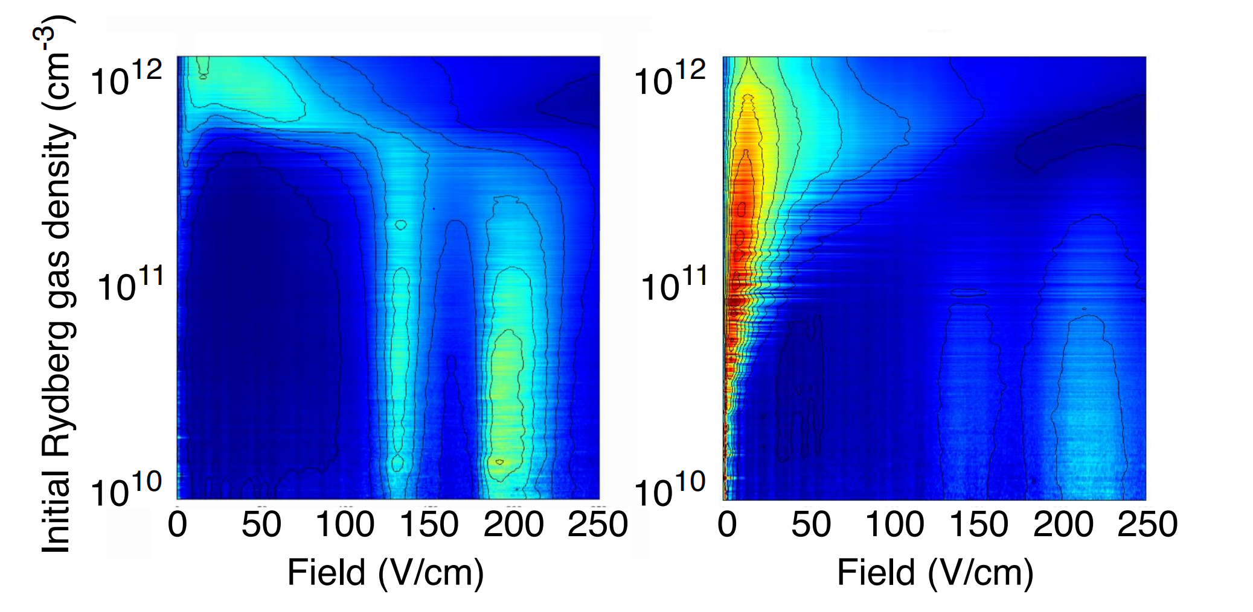
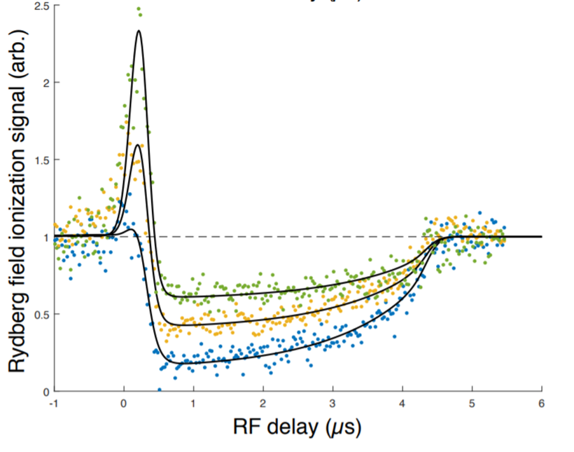
The University of British Columbia
Control of molecular ultracold plasma relaxation dynamics in mm-wave and radio-frequency fields Ruoxi Wang, Kevin Marroquin, Mahyad Aghigh, Fernanda Banic Viana Martins, James Keller, and Edward Grant
Heading
This research poster template can be edited to suit your presentation needs. Please note that it is built to the most common poster size, 48x36”. Please check with presentation organizers to ensure that this size will be accepted.
This is a Long Heading
That Goes Over Two Lines
To ensure that your poster is legible, we recommend using a light coloured background and darker coloured fonts and graphics. Avoid using patterns, gradients or images as backgrounds, as these can make the poster more difficult to read.
Heading
If you are using images, ensure that you have proper rights to reproduce the image. Make sure that the size of the image is large enough that it will not appear distorted when printed.
The best file types for images are .jpegs and .pngs.
To make a picture larger or smaller without distorting the proportions, take one of the corners of the image, and hold down the the “shift” key while pulling the corner in (for smaller images) or out (for larger images).
This is a Long Heading
That Goes Over Two Lines
Lists are a useful way to present your information in a condensed, easy-to-read format:
Item one
Item two
Item three
Item four
Item five
Heading
We hope that this poster template will assist you with your presentation. If you have any questions about the template, or any suggestions about improvements to the template, please visit http://brand.ubc.ca/support/ and send a support ticket to UBC Communications and Marketing.
Reference / Bibliography
Add your references in this section. Ensure that you are using the correct reference format.
Add your references in this section. Ensure that you are using the correct reference format.
Add your references in this section. Ensure that you are using the correct reference format.
Add your references in this section. Ensure that you are using the correct reference format.
Acknowledgement
Give acknowledgement to any partners that assisted with your research.
Graph or Image Title
Captions for a graph or image can be smaller than the rest of the text on your poster. If you are using another person’s image or graph, ensure that you have rights to reproduce it. If needed, give acknowledgement to the original source of the material.
Graph or Image Title
Captions for a graph or image can be smaller than the rest of the text on your poster. If you are using someone else’s image or graph, ensure that you have rights to reproduce it. If needed, give acknowledgement to the original source of the material.
Graph or Image Title
Captions for a graph or image can be smaller than the rest of the text on your poster. If you are using another person’s image or graph, ensure that you have rights to reproduce it. If needed, give acknowledgement to the original source of the material.
Heading
Lists are a useful way to present your information in a condensed, easy-to-read format:
Item one
Item two
Item three
Item four
Item five
Item six
Graph or Image Title
Captions for a graph or image can be smaller than the rest of the text on your poster. If you are using someone else’s image or graph, ensure that you have rights to reproduce it. If needed, give acknowledgement to the original source of the material.
Photo credit: Don Erhardt
Partners
Delete shape and insert partner logo (if applicable)
Delete shape and Insert partner logo (if applicable)
Delete shape and Insert partner logo (if applicable)

