Slide 1

Mapper for Android
IE 5541: Project Presentation
Twin Cities Edition
April 23, 2012
Andrey Bruslavtsev
Ian De Silva
Jared Swanson
Jonathan Lee
Kristin Mead
Sriram Rajendran
Usha Kumar
Weston Platter
Notes:
Kristin

Slide 2

Overview
The Minneapolis Skyway System and U of M “Gopher Way” can be difficult to navigate.
There are apps for iOS to
help navigate the Skyway.
What about Android?
Notes:
Kristin

Slide 3
Project Objective
Video
Notes:
Kristin

Slide 4
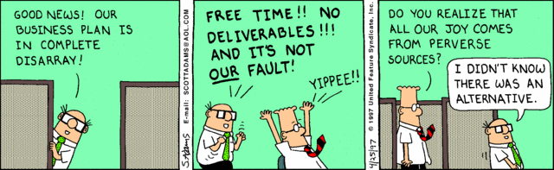
Deliverables
Notes:
Jon

Slide 5
Product Deliverables
Installable Android Application
Marketing & Distribution Materials
Notes:
Jon

Slide 6
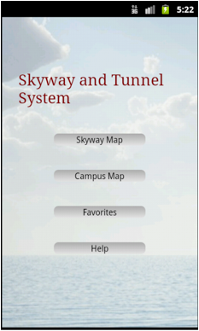
Major Functionalities
Map of Minneapolis Skyway
Map of U of M tunnel system
Search
Search History
Routing
Save Favorites
Help
Notes:
Jon

Slide 7
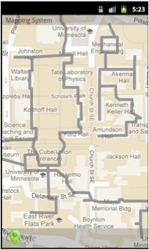
Map of Skyway/Tunnel System
Our app draws the skyway/tunnel system as a map overlay.
How?
  Open source libraries and Android API
  Google Maps: Provided map images
  Google Earth: Tool to extract coordinate data
Notes:
Jon

Slide 8
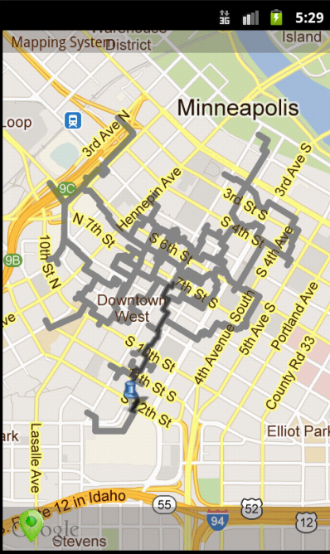

Search & Route
Our app allows users to search for nearby businesses
Yelp API - used to provide business data
Routing
  Draw shortest path to destination based on current location
  Location is updated via device’s native positioning system
Notes:
Jon

Slide 9
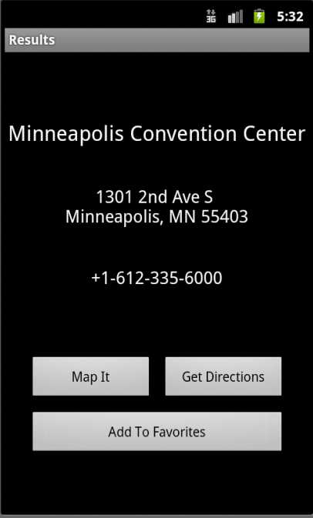
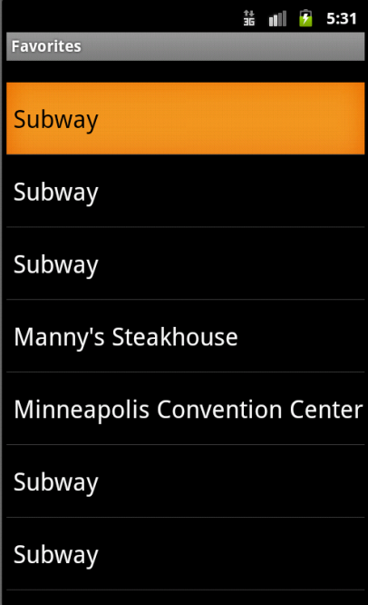
Favorites
Our app allows users to save a business as for quick access
Notes:
Jon

Slide 10
Marketing
Minnesota Daily
  Contacted publishers
  Interested – want to see additional functionality
Flyers created for campus and downtown Minneapolis
Facebook page
Android Marketplace
  Appeal to general public
Notes:
Andrey

Slide 11

Notes:
Andrey

Slide 12

Notes:
Andrey

Slide 13

Project Approach
X
Notes:
Jared

Slide 14
Project Approach
Plan
Process
Risk Analysis
Notes:
Jared

Slide 15
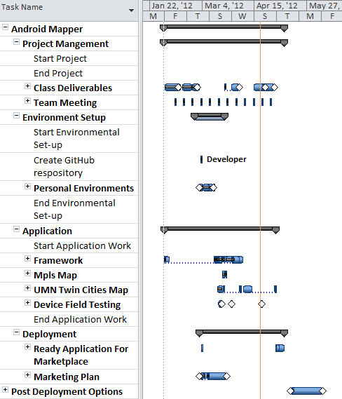
Plan: Baseline
Project Mgt.
Team Prep Work
Software
Development
Deployment & Future Work
Notes:
Jared

Slide 16
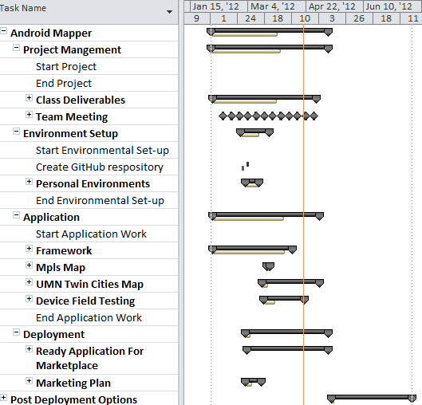
Plan: Current
Project Mgt.
Team Prep Work
Software
Development
Deployment & Future Work
Notes:
Jared

Slide 17
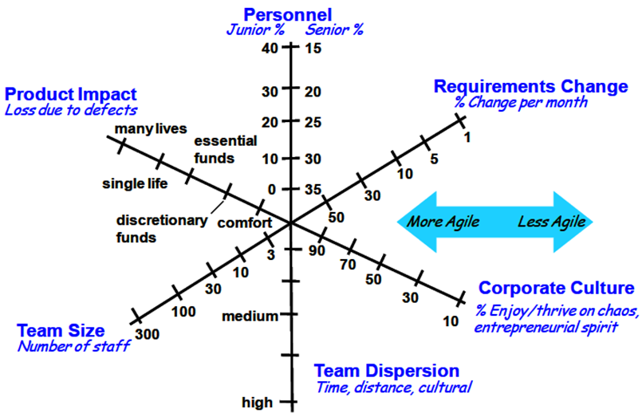
Approach: Processes
Diagram from S. McConnell, “Right-Sizing Agile Development,” 01-Oct-2008.
Notes:
Weston – What do you think our profile is?

Slide 18
Process: SCRUM
Contains Tasks
Scrum Meeting
2 week Sprint
(Iteration)
Sprint Planning Meeting (Kick-off)
Sprint Backlog
Sprint
Wrap-up
Meeting
Shippable
Product
(Prototype)
Req. 3
Req. 1
Contains Stories
Req. 2
Product Backlog
Notes:
Ian
- Product Backlog created from WBS in git.
Iteration planning meeting held to determine scope for iteration (Sprint)
Scrum meeting held weekly with an e-mail “scrum” on Wednesdays (lasted ¾ of the semester)
Sprint Wrap-up: Reflected on last iteration and tried to correct. We merged with planning.

Slide 19
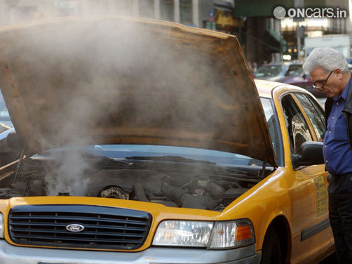
Problems: Process Breakdown
Varying acceptance of process
Time constraints toward end of semester
Resistance to testing in favor of increased functionality
Ineffective
communication
Image from:
http://atozautocar.com/car-how-to/3540/solve-overheating-car.jsp
Notes:
Ian
Talk to: We had lots of communication, it was just ineffective.
1) Agreed understanding of the situation, claim responsibility for follow-up.
11) Understood tasks, but did not understand integration.
What was lacking:
Integration tie-in points

Slide 20
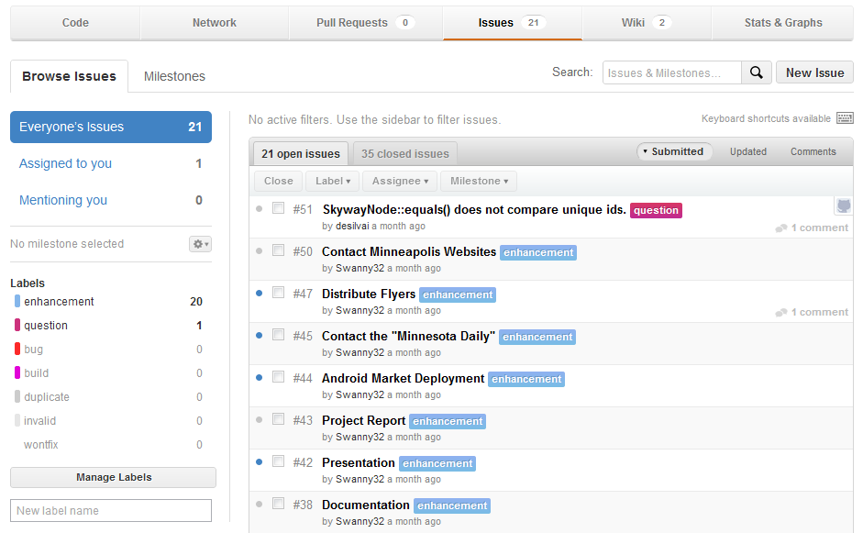
Problems: Process Breakdown
Notes:
Ian
Talk to: We had lots of communication, it was just ineffective.
1) Agreed understanding of the situation, claim responsibility for follow-up.
11) Understood tasks, but did not understand integration.
What was lacking:
Integration tie-in points

Slide 21
Problems: Ineffective Communication
<Picture>
Lack of time
Size of team
Notes:
Weston:
Lack of time
Size of team

Slide 22
Failed Communication
Marketing
Failed to integrate
Team
Technical Work
Software Development
Notes:
Weston

Slide 23
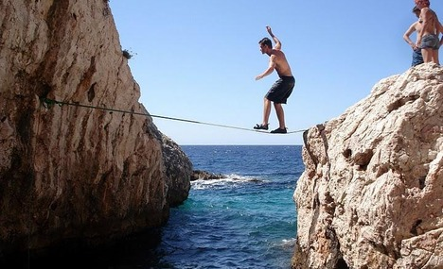
Risk Analysis
Risk – mitigation strategy
Code quality of application – testing
Complexity of project scope – reduce scope
Licensing issues with
employers – release
Image from:
http://cache.virtualtourist.com/15/4933424-Supja_Stina_tightrope_walking_Sveta_Nedjelja.jpg
Notes:
Weston

Slide 24
Lessons Learned
Notes:
Usha

Slide 25
Lessons Learned
What Worked
Execution
  Well-defined processes , helped us to be dynamic
  Clear task identification
  Good development & co-ordination tools
  Timely identification of risk
Team Dynamics
  Weekly Team meetings
  Motivated & responsible team
Technical
  Learned about Android programming
  Learned about team dynamics
Notes:
Usha

Slide 26
Lessons Learned
What Didn’t
Execution
  Communication plan
  Virtual SCRUM
  Meeting documentation
  Quality was compromised for functionality
  No at-a-glance way of tracking
Technical
  Coordination tools
  Learning curve
Notes:
Usha -- Are you going to talk on what we’d do differently next time?

Slide 27
Lessons Learned
What could have been done
Execution
  Close monitoring of task progress
  Active use of task tracker, for better utilization of resources.
Team Dynamics
  Daily tele scrum
  Forum to discuss issues and sharing ideas.
Technical
  Knowledge sharing sessions
  visual configuration management tool
Notes:
Usha

Slide 28
Future?
Aesthetics
Skyway closures
Indicate floor changes
<More?>
Notes:
Sri

Slide 29

Questions?
Notes:
Sri

