Slide 1
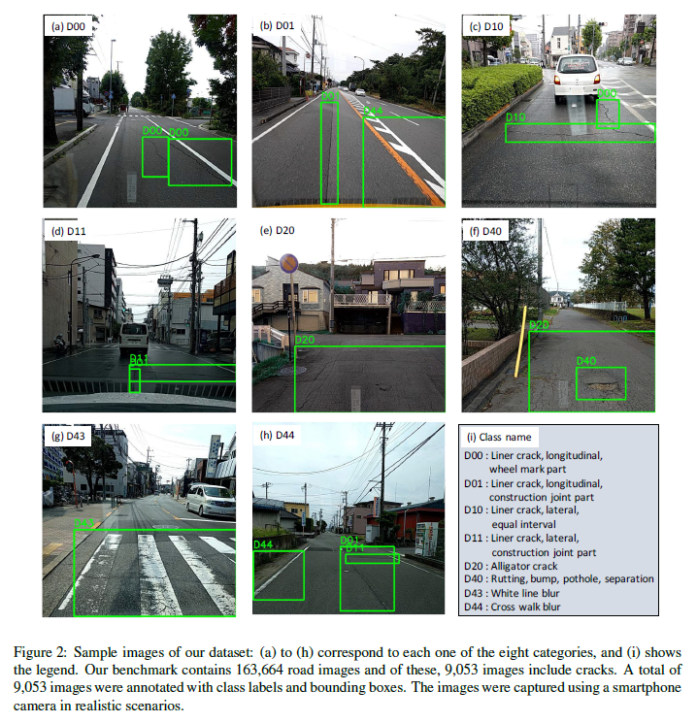
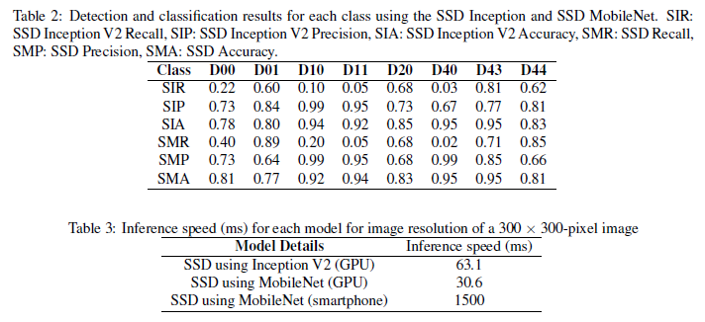
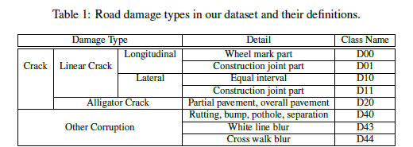
Road Damage Detection Using Deep Neural Networks with Images Captured Through a Smartphone
Hiroya Maeda et al. University of Tokyo, arXiv:1801.09454 (2018)

