Slide 1
CICFlowMeter CSV is the standard input for IDS classification
Prior experiments: XGB · TabPFN · SOTA · proposed models → CICFlowMeter CSV vectors
Most IDS tabular-classification studies also train and evaluate on the supplied flow-statistics CSV
Input to prior classifiers
CIC-IDS2017: How PCAP becomes CSV
One CSV row
Testbed
PCAP
CICFlowMeter
CSV
[duration, packets, length, IAT, flags, …]
→ numeric vector + label
benign +
attack
raw packets
in time order
flows + fixed
statistics
vector
+ label
Examples of fixed flow statistics in the CSV
Each row treated as an independent sample
Flow duration
Fwd. packets
Packet interval
first to last packet
packets sent
interval statistics
A summary of predefined flow statistics, not the packet sequence itself
Prior models use the supplied flow-statistics CSV
01 Existing CSV
1
Notes:
Speaker notes
I will begin with the input that has been used throughout our IDS experiments. CIC datasets first record network traffic as PCAP files. CICFlowMeter then groups packets into flows and writes one CSV row per flow using fixed statistics such as duration, packet counts, packet lengths, inter-arrival times, and TCP flags. Our previous XGB, TabPFN, SOTA, and proposed-model experiments all used these CSV vectors, as do many IDS studies that frame the task as tabular classification. The important point is that a row is a predefined statistical summary. It does not retain the full order of packets that generated the flow. The following observations therefore concern both the classifiers and this shared input representation.
Sources
CIC-IDS2017 official dataset
UNB CIC, 2017
PCAP, labeled CICFlowMeter CSV, capture setup and attack timetable
https://www.unb.ca/cic/datasets/ids-2017.html

Slide 2
Two issues in CSV-based IDS classification
Issue 1 Early saturation in some attacks
Issue 2 Identical features, different labels
Head attacks such as DDoS and Bot
reach F1 in the 90% range with n = 2 to 20
→ a high data ceiling before adding labels
Rows with dozens of identical flow statistics
can still have different recorded labels
→ one deterministic classifier cannot fit both
Early saturation and feature–label contradictions require separate diagnosis
01 Existing CSV
2
Notes:
Speaker notes
When we inspected the CSV-based experiments, two patterns required separate attention. First, some head attack classes reached very high F1 with only a small label budget. Second, the raw CSV contained rows whose flow statistics were identical even though their recorded classes differed. These patterns affect how classification scores should be interpreted. The next slide quantifies the first pattern across label budgets, and the slide after that shows literal source-CSV rows for the second pattern.

Slide 3
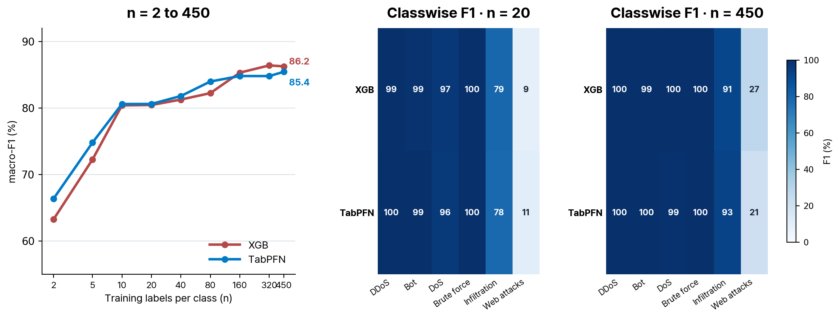
Some head attacks already have high F1 with few labels
Macro F1 still changes beyond n = 20, but DDoS and Bot approach high F1 with few labels
EXP87 · attack-only training and evaluation · benign excluded · 5 seeds · fixed conflict-free test · n = 450 is the balanced-label-budget ceiling
Macro F1 changes with n, while classwise saturation is uneven
02 Data ceiling
3
Notes:
Speaker notes
This figure is a diagnostic learning curve for attack-only classification. At n equals 20 labels per class, XGB reached F1 of 99.3 for DDoS, 98.6 for Bot, 96.7 for DoS, and 99.9 for BF. TabPFN reached 99.7 for DDoS, 99.4 for Bot, 96.1 for DoS, and 100.0 for BF under the same condition. Infiltration remained around 78 to 79, and web attacks remained around 9 to 11. The curve shows that adding labels still changes macro F1, but four classes are already close to saturation at n equals 20 while difficult classes remain difficult. This classwise imbalance motivates checking the data representation before drawing conclusions from an aggregate score.

Slide 4
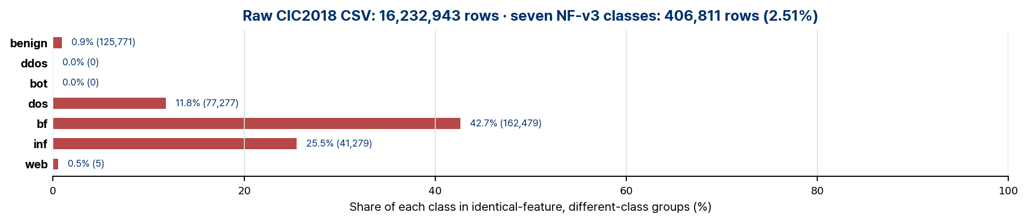
Identical features, different classes in CIC2018 CSV
Exact agreement on 78 common CICFlowMeter statistics, excluding timestamp, Flow ID, source IP/port, destination IP, and label
Dst Port
Protocol
Flow Duration
Tot Fwd
Pkts
Tot Bwd
Pkts
… 69 fields …
TotLen Bwd
Pkts
Flow Byts/s
Flow Pkts/s
Idle Min
NF-v3
class
21
6
2
1
1
… 69 fields …
0
0
1000000
0
dos
21
6
2
1
1
… 69 fields …
0
0
1000000
0
bf
The two rows above: bf · dos · all other 69 fields are also identical
Audit of all 16,232,943 raw CSV rows · aggregated to seven NF-v3 classes · bar endpoint: different-class rows
Literal rows share all 78 common flow statistics but belong to different NF-v3 classes
03 Label conflicts
4
Notes:
Speaker notes
Next, we inspected the original CIC2018 CSV files directly. We grouped rows whose 78 common CICFlowMeter statistics were exactly identical after excluding Timestamp, Flow ID, source IP and port, destination IP, and Label. The two rows at the top are a literal example: every displayed value and the omitted 69 fields agree, but their NF-v3 classes are dos and bf. Across all 16.23 million rows, 406,811 rows, or 2.51 percent, belong to identical-feature groups that span multiple NF-v3 classes. The incidence is particularly large for bf at 42.7 percent, followed by inf at 25.5 percent and dos at 11.8 percent. A classifier receives the same input for these cases, so the representation and the evidence used to assign labels must be examined together.
Sources
CSE-CIC-IDS2018 official dataset
UNB CIC, 2018
PCAP/system logs, feature list and attack setup
https://www.unb.ca/cic/datasets/ids-2018.html
Error Prevalence in NIDS datasets: A Case Study on CIC-IDS-2017 and CSE-CIC-IDS-2018
IEEE CNS, 2022
Author tools and dataset documentation, corrected labels updated 2023; 2018 FTP closed-port example
https://intrusion-detection.distrinet-research.be/CNS2022/index.html

Slide 5
A PCAP-based CIC2018 representation pipeline
Generate representations from packet sequences, then recheck both issues under the same protocol
PCAP + labels
Flow linkage
Encoder
Projection
New vectors
packet, time,
label evidence
traceable traffic
and labels
packet-sequence
embedding
fit PCA on the
training split only
XGB + TabPFN
same evaluation
Representation audit
Classification evaluation
identical embeddings with different labels
and the PCAP evidence for each label
baselines, few-shot curves, and classwise F1
to test whether early head saturation remains
Candidate encoders netFound (arXiv, 2026) · ET-BERT (WWW, 2022) · NetMamba (ICNP, 2024)
CICFlowMeter uses specified statistics; encoders learn from packet order, timing, and headers
Keep encoders interchangeable and repeat representation audits with matched classification evaluation
04 PCAP reconstruction
5
Notes:
Speaker notes
The next step is to build a new CIC2018 feature representation from the raw PCAP files. We preserve the link among each flow, its packets, its label evidence, and its train or test split. A network encoder then reads packet direction, size, timing, protocol, and header patterns and produces one vector per flow. NetFound is the first encoder in this pipeline. It is a pretrained network-data encoder; in this study it serves only to generate a 512-dimensional flow representation, which is projected to 64 dimensions using PCA fit on the training split. NetFound does not produce the attack label here. XGB and TabPFN receive its output vectors and perform the classification. The same corpus and split can later be reused with ET-BERT or NetMamba, so encoder choice can be evaluated under matched conditions.
Sources
netFound: Principled Design for Network Foundation Models
arXiv v5 / implementation v2, 2026
Frozen header/metadata encoder, excludes IP and payload; repo b3ab5a3, HF e27221d
https://arxiv.org/abs/2310.17025v5
ET-BERT: A Contextualized Datagram Representation with Pre-training Transformers for Encrypted Traffic Classification
The Web Conference (WWW), 2022
Datagram byte representations with Transformer; https://github.com/linwhitehat/ET-BERT
https://arxiv.org/abs/2202.06335
NetMamba: Efficient Network Traffic Classification via Pre-training Unidirectional Mamba
IEEE ICNP, 2024
Byte-sequence representation with state-space model; ICNP 2024 implementation, distinct from NetMamba+ 2026
https://github.com/wangtz19/NetMamba

Slide 6
Summary
1 Existing CSV input
2 Observed data issues
3 Next validation
XGB · TabPFN · SOTA
CICFlowMeter flow statistics
row-level inputs
early head saturation
identical features, different classes
average score alone
does not establish difficulty
new vectors from PCAP
repeat audits and baselines
under the same protocol
Goal Test whether new representations reduce the data ceiling and feature–label conflicts
If reduced, repeat TabPFN and XGB comparisons on the new vectors; if retained, examine PCAP label linkage further
Recheck both CSV observations in a new PCAP-based representation
05 Summary
6
Notes:
Speaker notes
This presentation establishes the reason for rebuilding the input representation. The CSV experiments revealed early saturation for several head classes and exact feature conflicts across recorded classes in the original data. The PCAP pipeline creates a reusable corpus and encoder-specific vector views while keeping labels and splits traceable. The next evaluation will first repeat the representation audit, then rerun XGB and TabPFN baselines and few-shot curves on the new vectors. These checks will show whether the new representation changes the feature conflicts and classwise learning behavior observed in the current CSV experiments.

