Slide 1
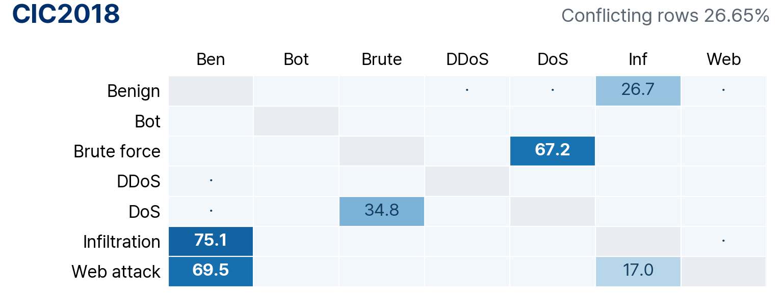

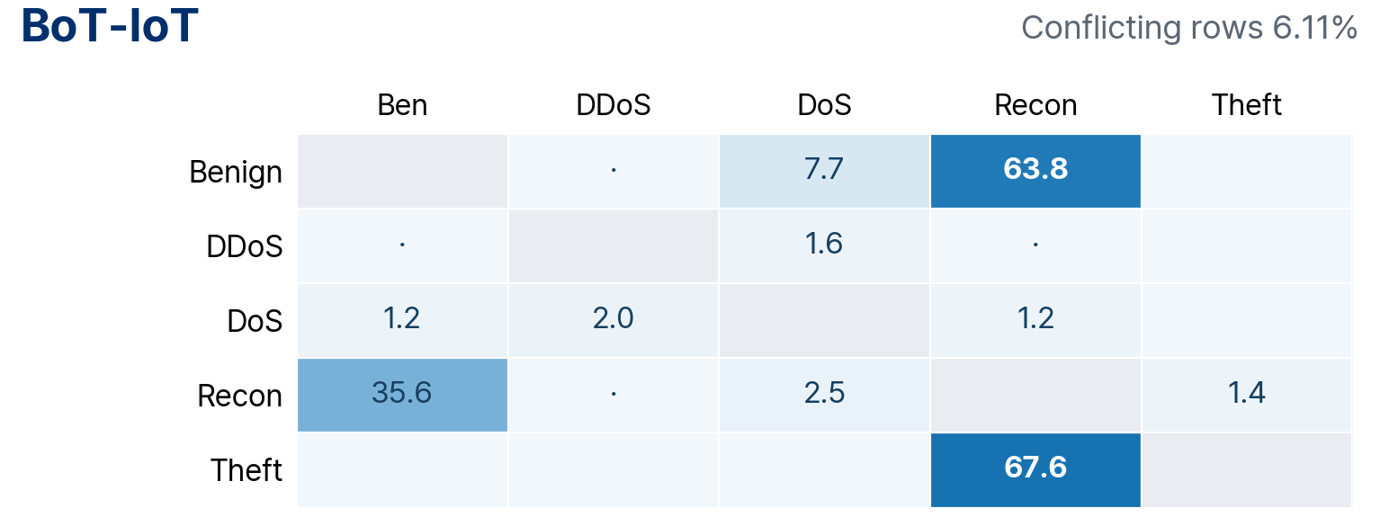

Classes sharing identical feature vectors
Row: original label Column: other label on the same feature vector Cell: share of all rows in the row class (%)
Blank: 0% ·: below 1% Grey: same class A row can count in several cells, so cells do not add up
%
0
25
50
75
100
Web attack: 1,764 + 432 − 429 overlap = 1,767 rows removed · 771 remain
Data review
1
Notes:
Share of rows whose exact feature vector also appears under another label; not a model confusion matrix
Denominator: all rows of the row class, over the full uncleaned data
Even when A and B share vectors with each other, the cell shares are asymmetric because class sizes differ
A row shared with several other labels counts in several cells, so row sums are not removal rates
Web attack: 1,335 rows shared with Benign only, 3 with Infiltration only, 429 with both, 771 unshared
Data and figure sources: docs/slides/kor/1002_intro_assets/ (English figures: docs/slides/eng/1002_intro_assets/)
Column abbreviations follow the full class names in row order

Slide 2
Class distribution after cleaning
All data (train + validation + test) · row counts and within-dataset class share (%)
CIC2018
ToN-IoT
Class | Before | After | Share before → after
Benign | 17,514,626 | 12,798,328 | 87.07 → 86.74
Bot | 207,703 | 207,703 | 1.03 → 1.41
Brute force | 575,194 | 188,414 | 2.86 → 1.28
DDoS | 1,324,350 | 1,316,025 | 6.58 → 8.92
DoS | 302,966 | 197,415 | 1.51 → 1.34
Infiltration | 188,152 | 46,761 | 0.94 → 0.32
Web attack | 2,538 | 771 | 0.013 → 0.005
Total | 20,115,529 | 14,755,417 | 100 → 100
Class | Before | After | Share before → after
Backdoor | 203,384 | 200,688 | 0.74 → 1.86
Benign | 16,792,214 | 6,446,120 | 61.02 → 59.65
DDoS | 4,141,256 | 925,247 | 15.05 → 8.56
DoS | 203,456 | 113,655 | 0.74 → 1.05
Injection | 381,777 | 341,263 | 1.39 → 3.16
MitM | 6,013 | 5,446 | 0.022 → 0.050
Password | 1,594,777 | 1,061,699 | 5.79 → 9.82
Ransomware | 3,971 | 3,604 | 0.014 → 0.033
Scanning | 1,358,977 | 39,069 | 4.94 → 0.36
XSS | 2,834,435 | 1,670,497 | 10.30 → 15.46
Total | 27,520,260 | 10,807,288 | 100 → 100
Infiltration down 75.1%
Web attack down 69.6% · 771 rows after cleaning
Imbalance remains after cleaning · CIC2018 Web attack 771 rows, ToN Scanning 39,069 rows
Data review
2
Notes:
Per-class rows before/after cleaning are the train/val/test totals of the current fixed split class_counts.csv
CIC2018 total 20,115,529 → 14,755,417; ToN total 27,520,260 → 10,807,288
Share denominators are the total rows before and after cleaning, respectively
CIC2018 Infiltration 188,152 → 46,761; Web attack 2,538 → 771
Removal criteria omitted at the user's request

Slide 3
Global model and residual expert structure
Separate roles of the training data · Global construction / expert construction / S·V training
Global pool · shared context
Expert pool · residuals and experts
Route pool · S/V training
Offline · model construction
Build Global
Compute residuals
Cluster residuals
Build experts
Train S/V
Base classifier from
the shared context
Embedding · probabilities
gap to truth · error size
Split into K clusters
by failure pattern
Shared anchor +
cluster-specific block
Learn from Global/expert
corrections and damage
Online · per-input prediction
Global prediction
Scorer
Expert inference
Verifier
Final prediction
Base class prediction
Selects an expert,
decides whether to call
Classify with the selected context
Decides whether to
accept the expert
Expert prediction if accepted
Call or acceptance condition not met → keep the Global prediction
Backbone frozen · experts built from contexts · S/V decide whether to replace the prediction
Model
3
Notes:
Offline/online two-stage flow from the user-edited 0904 deck, restructured to match the current implementation
Residuals are computed on the expert pool; contexts are not restricted to Global misclassifications
Residuals use the input embedding, Global probabilities, the gap between truth and probabilities, and the error size
A shared anchor supplies class examples; each expert adds a cluster-specific block
The scorer selects an expert and decides whether to call it; the verifier decides whether to accept its prediction
The current context comparisons do not yet apply the S/V of the new bank
This slide introduces the overall design and claims neither active S/V nor a performance gain

Slide 4
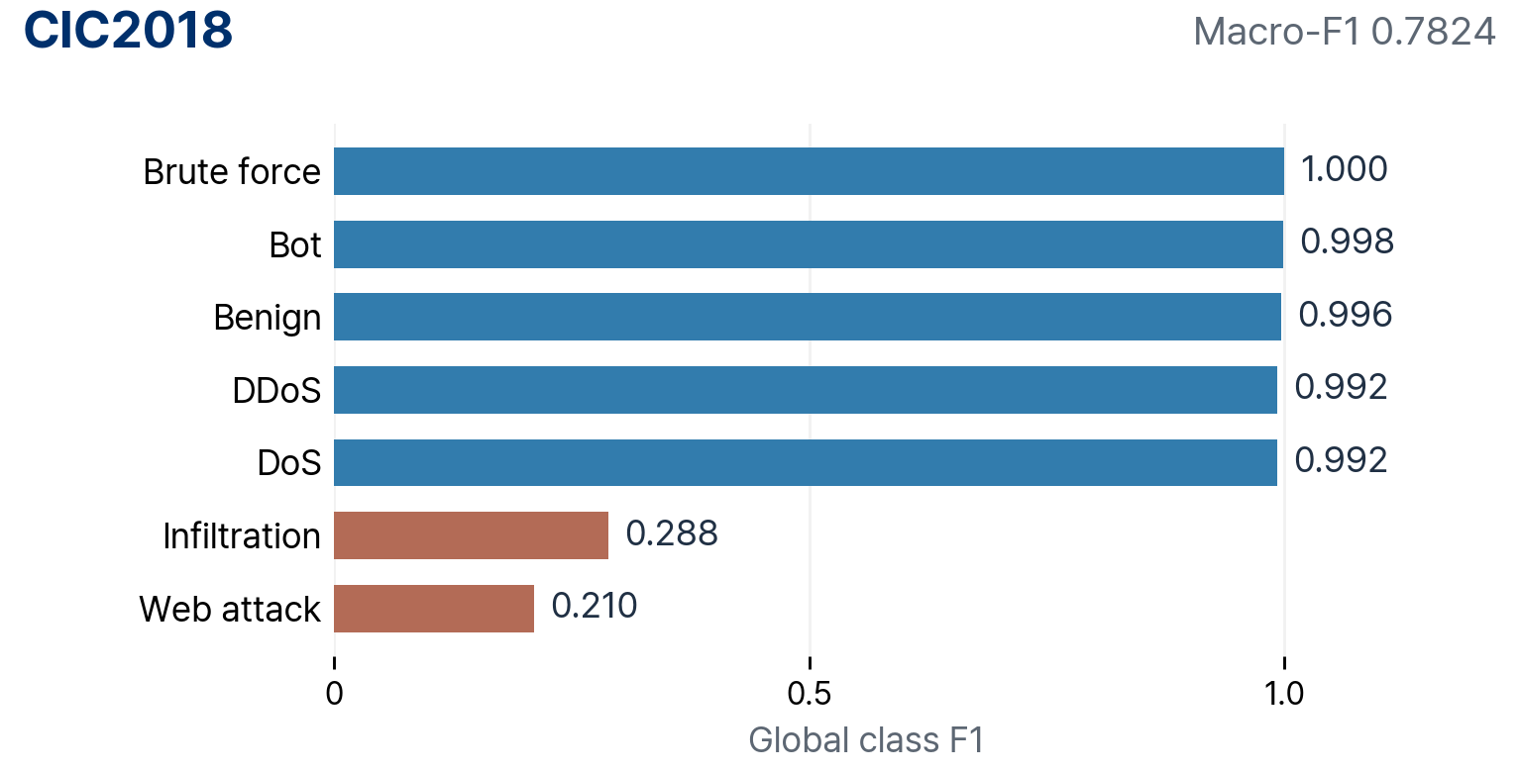
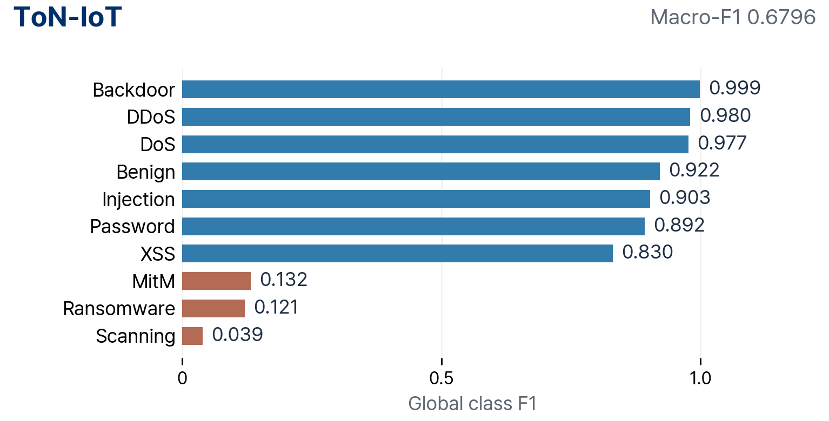
Global per-class performance and the expert bottleneck
Cleaned data · seed 43 · diagnosis of the existing residual contexts · before S/V
Existing e3 · Infiltration
Existing e3 · Injection
Own residual region F1 0.440 → 0.967
Own residual region F1 0.159 → 0.939
Input-nearest group precision 12.4% · FP 7,935 → 21,535
Input-nearest group precision 8.7% · FP 581 → 14,222
Own region: assigned by true residual · Input-nearest group: assigned by input embedding and Global probabilities · Arrow: Global → Expert
Improve both: correcting own-region errors and separating similar rows of other classes
Model
4
Notes:
Global per-class F1 is the full-test result of the seed 43 Global confirmed in EXP59 and EXP61
The existing e3 example uses the EXP59 residual context
Own residual region: label-assisted diagnosis; input-nearest group: fixed assignment from input embedding and Global probabilities
The two scopes contain different rows, so F1 is not compared across scopes
CIC2018 e3 Infiltration: precision 12.4% in the input-nearest group despite high recall; ToN e3 Injection: precision 8.7%
Direction: context composition that keeps the correction targets while reducing FP on other classes

Slide 5
SOTA classification on cleaned data
Seed 43 · same C0 100,000 rows · CIC2018 test 3.04M rows / ToN test 2.27M rows
Method | CIC2018 Macro-F1 | ToN Macro-F1 | Training pool rows · CIC / ToN
Global TabPFN v3 | 0.7824 | 0.6796 | 100,000
XGBoost | 0.7821 | 0.6983 | 100,000
BoostPFN | 0.7148 | 0.5866 | 100,000
LoCalPFN · FT | 0.7024 | 0.6462 | 100,000
DistPFN · v3 | 0.7839 | 0.6682 | 100,000
XGBoost · full train | 0.7795 | 0.7162 | 8.67M / 4.67M
Full-train XGB: reference with extra training data · Global: base classifier before experts and S/V
CIC2018 · per-class differences · shared 100k
ToN · per-class differences · shared 100k
Best Infiltration F1 0.3055 · DistPFN
Best Web attack F1 0.3321 · XGB
Best MitM F1 0.2363 · XGB
Best Scanning F1 0.3281 · BoostPFN
Best Macro-F1 on the same 100k rows · CIC2018 DistPFN 0.7839 · ToN XGB 0.6983
SOTA comparison
5
Notes:
EXP61 completed results, updated 2026-09-30
Conflict-free fixed split and exactly the same 100,000 training IDs as the Global C0
Test: CIC2018 3,042,473 rows, ToN 2,271,723 rows, full-test evaluation
Full-train XGB: CIC2018 8,666,430 rows, ToN 4,669,119 rows, a separate training budget
Global/DistPFN backbone v3, BoostPFN/LoCalPFN backbone v1
LoCalPFN selects the fine-tuned checkpoint by validation AUC; validation CIC 30,194 / ToN 41,744 rows
BoostPFN T=50, context 500; LoCalPFN context 1000, FT 21 epochs × 30 steps
Same training IDs; backbones and validation usage are not identical
Per-class best values are among the shared-100k methods, excluding full-train XGB
The full proposed expert/S/V system is not included in this table
Single seed; the current test is the already observed development holdout
docs/research/20260930/exp61_report_data.json

Slide 6
SOTA training and inference cost
RTX 4090 24GB · up to 2 jobs in parallel · elapsed time including resource contention
Method | CIC fit (s) | CIC predict (s) | ToN fit (s) | ToN predict (s) | GPU GiB CIC / ToN
Global TabPFN v3 | 36.4 | 1,099.3 | 36.7 | 821.7 | 2.92 / 2.94
XGBoost | 2.3 | 1.0 | 55.4 | 1.0 | 0.55 / 0.53
BoostPFN | 98.5 | 2,308.5 | 97.8 | 1,737.6 | 0.89 / 0.89
LoCalPFN · FT | 3,196.3 | 17,300.8 | 5,783.1 | 11,144.8 | 7.54 / 7.54
DistPFN · v3 | 36.4 | 1,099.4 | 36.7 | 821.9 | 2.92 / 2.94
XGBoost · full train | 107.8 | 1.0 | 143.2 | 1.1 | 2.20 / 1.59
LoCalPFN fit includes validation · full-test inference includes kNN search
DistPFN shares the Global fit and inference · prior correction adds about 0.19 s
GPU: per-process peak sampled every 1 s · not a standalone speed comparison
LoCalPFN full-test inference · CIC2018 4.81 h · ToN 3.10 h
SOTA comparison
6
Notes:
Fit, full-test prediction and per-process GPU usage measured in the same EXP61 run
Two workers share the GPU, so the numbers are not standalone speed ratios between models
LoCalPFN validation is included in fit: CIC 3,129.97 s / ToN 5,694.41 s
DistPFN fit/predict share the Global computation and are not counted twice
Global uses the separately saved backbone predictions; DistPFN adds only about 0.19 s of prior post-processing
Inference throughput, per-stage RAM and the input-loading peak are in the HTML detail tables and cost.json
Model RAM covers preprocessing, model loading, fit, validation and predict, excluding raw PKL loading
Actual single-GPU wall time is about 6.65 h, distinct from the sum of parallel job times
docs/research/20260930/exp61_report_data.json

Slide 7
Expert ability: own region vs input-nearest group
Draft · TBD
View A · own residual region
View B · input-nearest group
Representative expert · class: TBD
Representative expert · class: TBD
Metric | Global | Expert
Precision | TBD | TBD
Recall | TBD | TBD
F1 | TBD | TBD
Metric | Global | Expert
Precision | TBD | TBD
Recall | TBD | TBD
F1 | TBD | TBD
Corrections: TBD
Damage: TBD
Corrections: TBD
Damage: TBD
Takeaway
TBD
Expert evaluation
7
Notes:
Body, numbers, figures and takeaway TBD
Classification ability in own region and input-nearest group

Slide 8
Contribution of scorer and verifier
Draft · TBD
Configuration | CIC2018 | ToN-IoT | Calls · accepted | Corrections · damage
Global | TBD | TBD | TBD | TBD
No S·V | TBD | TBD | TBD | TBD
S only | TBD | TBD | TBD | TBD
V only | TBD | TBD | TBD | TBD
S+V | TBD | TBD | TBD | TBD
Context · gate settings
TBD
Takeaway
TBD
Component ablation
8
Notes:
Body, numbers, figures and takeaway TBD
Contribution of scorer and verifier

Slide 9
Final performance and cost of the proposed model
Final comparison of the validated expert and S/V configuration
Configuration | CIC2018 | ToN | Training info | Call cost
Expert · no S/V | TBD | TBD | TBD | TBD
Expert · S only | TBD | TBD | TBD | TBD
Expert · V only | TBD | TBD | TBD | TBD
Expert · S+V | TBD | TBD | TBD | TBD
Baselines: SOTA performance (slide 5) · measured cost (slide 6)
Includes the extra training rows for experts and routing, and the conditional inference cost
Final comparison
9
Notes:
New S/V ablation and final proposed-model results on the current seed 43, K=4 bank: TBD
EXP61 baseline performance is on slide 5 and cost on slide 6
Extra training labels for experts and routing are reported separately from the Global C0 100k budget

Slide 10
Confirmed effects and next improvements
Draft · TBD
Context composition
Expert discrimination
Final model performance
TBD
TBD
TBD
Next improvements
TBD
Conclusion
TBD
Conclusion
10
Notes:
Body, numbers, figures and takeaway TBD
Confirmed effects and next improvements

