Slide 1
고정된 환경의 분류 정확도를 넘어
변화하는 네트워크에서의 적응성 평가
사전학습 TabPFN을 활용한
소량 라벨·저비용 탐지 모델 갱신
1
Notes:
No title. Rephrase the user intent into concise presentation language instead of copying their draft. Adaptation to changing networks motivates the research; current class-arrival tests do not establish network-drift robustness.

Slide 2
TabPFN · 표 데이터 예측 규칙을 사전학습한 모델 (v3: arXiv, 2026)
사전학습
합성 표 데이터의 8조 개 이상 토큰으로 학습
일부 행의 정답을 맞히며 표 데이터의 예측 규칙 습득
In-context learning
라벨된 사례(context)를 참고해 새 flow(query)의 라벨 예측
추론 중 모델 가중치는 그대로 유지
Fine-tuning
초기 IDS를 context와 query로 나눠 query의 정답 예측
예측 오류를 역전파해 모델 가중치를 IDS에 맞게 조정
갱신: 사전학습 가중치 유지 → 기존 클래스 사례 보존 + 신규 사례 누적
기대: 반복 재학습과 비슷한 탐지 품질을 더 적은 데이터·갱신 비용으로 달성
2
Notes:
Source: https://arxiv.org/pdf/2605.13986 §2.5, PDF page 10: more than 8 trillion tokens, not datasets. Official TabPFN 8.2.0: https://github.com/PriorLabs/TabPFN/blob/main/src/tabpfn/finetuning/finetuned_base.py. The archived initial-FT ablation in EXP77 uses AdamW, learning rate 1e-5, 10 fixed epochs, context/query cross-entropy; current displayed PFN results use no IDS FT. The v3 decoder weights context one-hot labels, so old-class examples remain necessary in the inference context. Validation is inside the 1000 revealed-label budget; no test tuning.

Slide 3

v3 구조
① 입력 변환 · Cell embedding
패킷 길이·지속시간 등의 값을 숫자 벡터로 변환
값이 비어 있는 위치도 함께 표시
② 특징별 분포 파악 · Feature embedding
여러 flow를 살펴 각 특징의 값 분포를 요약
Context의 정상·공격 라벨도 함께 반영
③ Flow별 정보 통합 · Feature aggregation
한 flow의 여러 특징을 하나의 표현으로 통합
이 표현을 이용해 flow 사이의 관계 비교
3
Notes:
Original Figure 5, https://arxiv.org/pdf/2605.13986#page=6. Native PPTX crop excludes the original caption. Labels and source remain in speaker notes. First three stages: feature grouping/cell embedding; target-aware column distribution embedding; row-level feature aggregation. Plain language deliberately omits implementation dimensions.

Slide 4
v3 구조
④ 사례 참조 · In-context learning
새 flow(query)가 라벨된 기존 사례(context)를 참조
어떤 사례가 예측에 도움이 되는지 attention으로 계산
⑤ 확률 출력 · Many-class decoder
관련성이 큰 사례의 라벨에 더 큰 가중치 부여
참고한 라벨을 모아 정상·공격별 확률 계산
기존 클래스도 분류하려면
해당 라벨의 context 유지 필요
4
Notes:
Same Figure 5, https://arxiv.org/pdf/2605.13986#page=6; no visible caption by user request. ICL attends to training/context keys; many-class decoder uses attention-weighted one-hot context labels. This is learned contextual relevance, not merely raw-feature nearest-neighbour distance. Context determines available class labels.

Slide 5
평가시나리오
초기 1,000개 · 신규 공격당 100개 누적 · 단계순, 단계 내 표본 수 내림차순
CIC2018
ToN
단계 | 신규 공개 클래스 | 클래스별 수 | 누적 수
1 | Benign Brute force DoS | 750 125 125 | 1,000
2 | DDoS | 100 | 1,100
3 | Web attacks | 100 | 1,200
4 | Infiltration | 100 | 1,300
5 | Bot | 100 | 1,400
단계 | 신규 공개 클래스 | 클래스별 수 | 누적 수
1 | Benign DoS Scanning | 750 125 125 | 1,000
2 | DDoS Injection | 100 100 | 1,200
3 | Password | 100 | 1,300
4 | XSS | 100 | 1,400
5 | Backdoor Ransomware | 100 100 | 1,600
6 | MitM | 100 | 1,700
전체 test: CIC2018 3,042,473개 / ToN 2,271,723개 · 최종 모델 · seed 43 혼합 순서
5
Notes:
Displayed XGB and no-FT PFN use the same released IDs as EXP76/77. XGB cumulatively retrains; PFN retains original pretrained weights and cumulative context. Initial and repeated IDS FT ablations remain in the experiment archive and are not shown. Proposed model uses five feature-disjoint roles within the SAME total label budget, original pretrained backbone to keep calibration labels outside weight training. Stage order chronological, within-stage sample counts descending. Main score is the FINAL state on ALL held-out rows, not pooled stage predictions. Final evaluation convention: EXP81 seed43 permutation of test row indices independent of labels, query batch8192. PFN probabilities and DistPFN correction recomputed on all mixed batches. Row-wise XGB/proposed/Boost predictions retained only after exact mixed-query audit; any mismatching model is fully reevaluated. Budget10/20/50/200/400 PFN predictions checked with the same audit. Original-order results preserved in EXP77/78/79/80. No model tuning on test. Source: tabpfn/results/v7/exp81/20261016_025421_mixed_query_final_s43_b6ba1d34/results.json

Slide 6
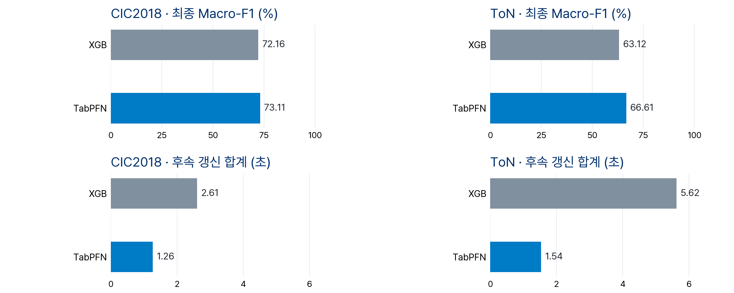
결과
최종 상태 전체 test 평가 · XGB: 누적 재학습 · TabPFN: FT 없이 누적 context 갱신
비용: 2단계 이후 갱신 합계 · 초기 준비·추론 제외 · 두 데이터셋 동일 비용 눈금
6
Notes:
EXP77 final-model full-test results: tabpfn/results/v7/exp77/20261015_230535_initialft10_finalfull_s43_2eb2237d/results.json. Two displayed methods: XGB cumulative retraining from scratch at every stage and original pretrained TabPFN with cumulative context, no IDS fine-tuning. Initial-FT results are retained in EXP77/EXP78, removed from slides 6 and 7 at user request. Slide 6 alone reports later-stage update cost: GPU-synchronized context selection + model construction + fit summed AFTER the initial stage; initial preparation and all inference excluded. Single seed 43. A separate EXP78 label-budget artifact covers 100/50/20/10 new examples per class, with initial 1000 fixed. Final evaluation convention: EXP81 seed43 permutation of test row indices independent of labels, query batch8192. PFN probabilities and DistPFN correction recomputed on all mixed batches. Row-wise XGB/proposed/Boost predictions retained only after exact mixed-query audit; any mismatching model is fully reevaluated. Budget10/20/50/200/400 PFN predictions checked with the same audit. Original-order results preserved in EXP77/78/79/80. No model tuning on test. Source: tabpfn/results/v7/exp81/20261016_025421_mixed_query_final_s43_b6ba1d34/results.json

Slide 7
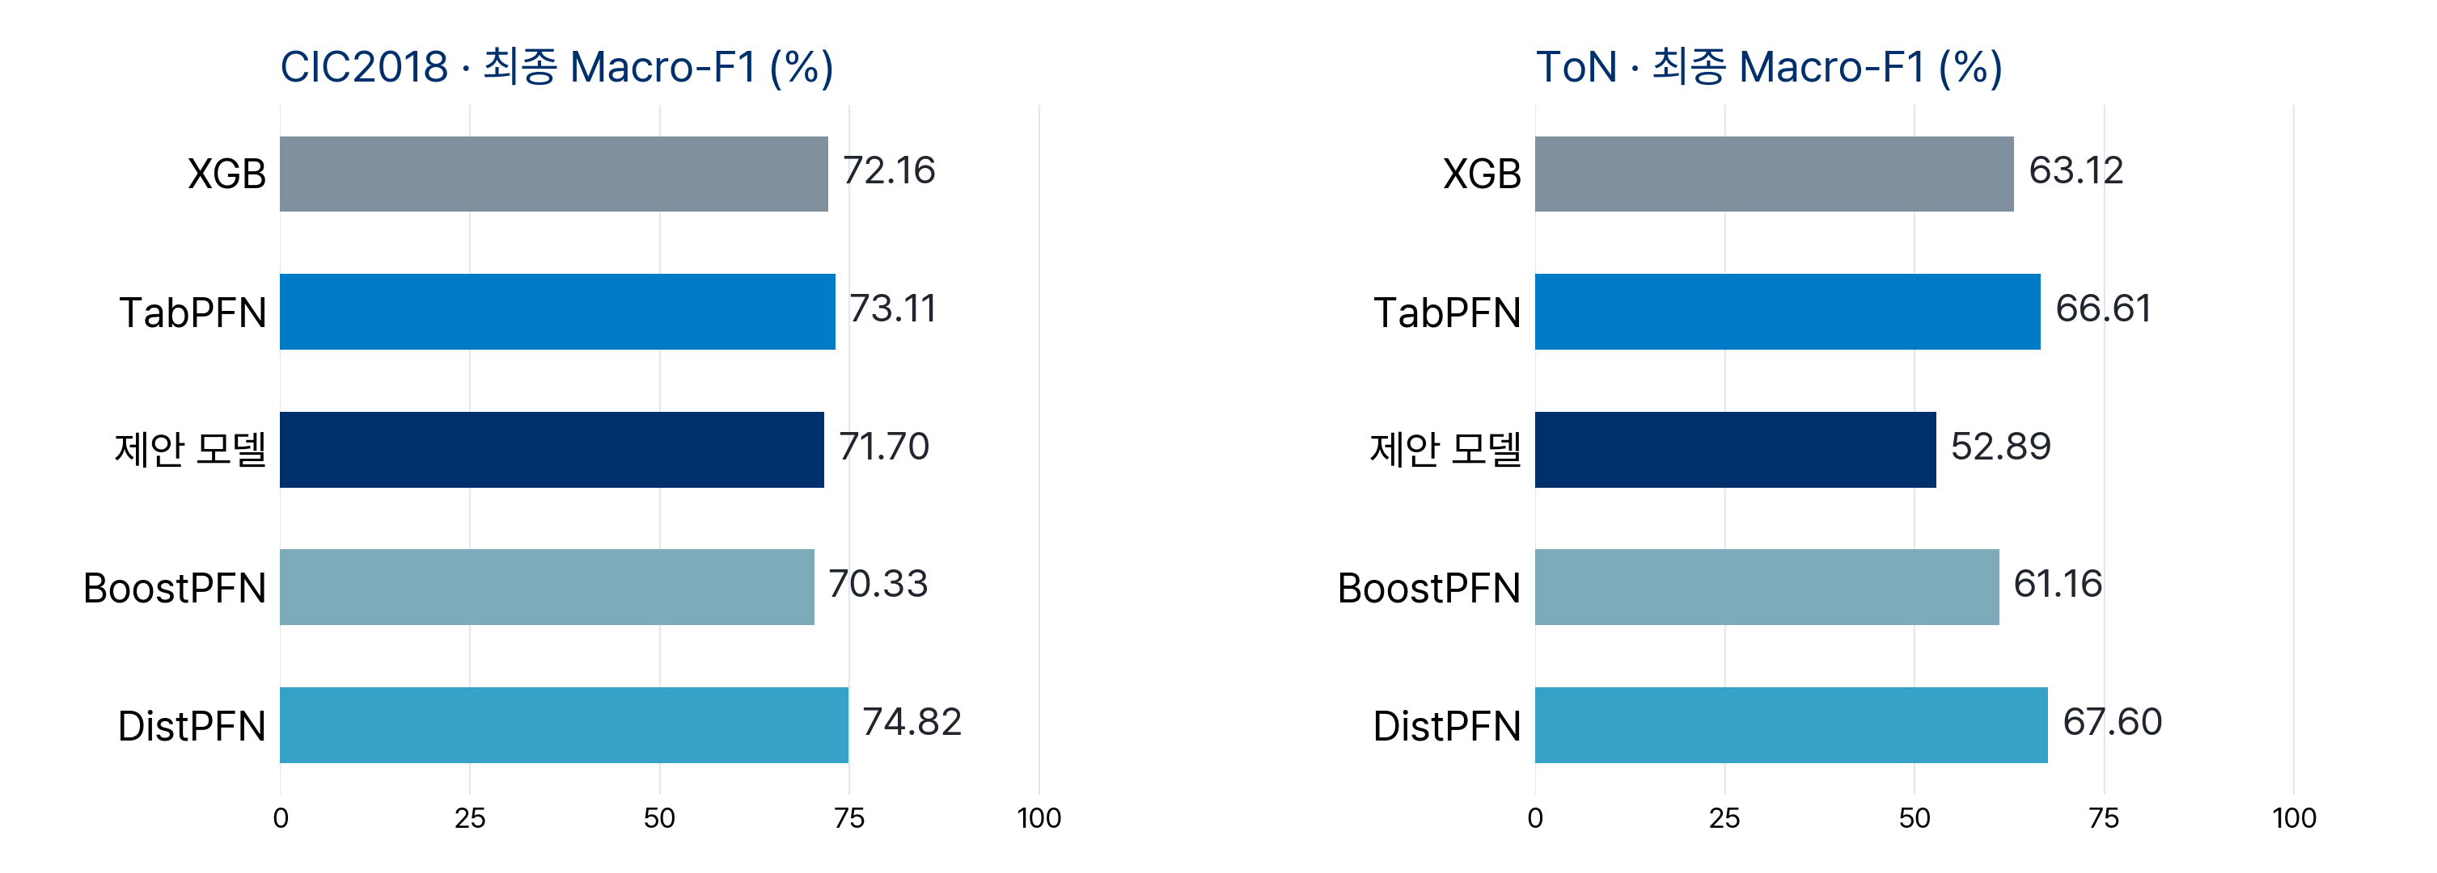
제안 모델·SOTA 성능 비교
동일 라벨 예산: CIC2018 1,400개 / ToN 1,700개 · 최종 상태 전체 test 평가
TabPFN·DistPFN: FT 없음 · test를 8,192개씩 혼합 평가 · 제안 모델 expert 호출 0건
7
Notes:
Same EXP77 released-label budget: CIC2018 1400 / ToN 1700, including all internal validation and calibration. Only final full-test Macro-F1 is displayed; all cost panels and initial-FT baseline removed per user request. Existing K=4 anchor/residual + S1V0 proposed model uses original pretrained weights and global/expert/route/tune/cal roles within that total budget. Both datasets have zero expert calls in the final evaluation, so this is a diagnosed current configuration, not demonstrated ensemble improvement. Candidate expert corrections changed correctness on at most 0/4 calibration rows (CIC2018/ToN), below the existing 30-case requirement. Next diagnostic controls are a single PFN with identical Global context and adjustment of shared anchors/expert-specific allocation; do not retune thresholds on test. BoostPFN is the existing 50-learner port. DistPFN uses original pretrained v3 without IDS FT and current-query-batch posterior adjustment; no query labels. The appendix separately evaluates the saved large-data final model on the same complete test; its training and validation budgets differ from this small-data comparison. Source: tabpfn/results/v7/exp78/20261016_005435_noft_dist_new100_50_20_10_s43_52588487/dist_results.json Final evaluation convention: EXP81 seed43 permutation of test row indices independent of labels, query batch8192. PFN probabilities and DistPFN correction recomputed on all mixed batches. Row-wise XGB/proposed/Boost predictions retained only after exact mixed-query audit; any mismatching model is fully reevaluated. Budget10/20/50/200/400 PFN predictions checked with the same audit. Original-order results preserved in EXP77/78/79/80. No model tuning on test. Source: tabpfn/results/v7/exp81/20261016_025421_mixed_query_final_s43_b6ba1d34/results.json

Slide 8
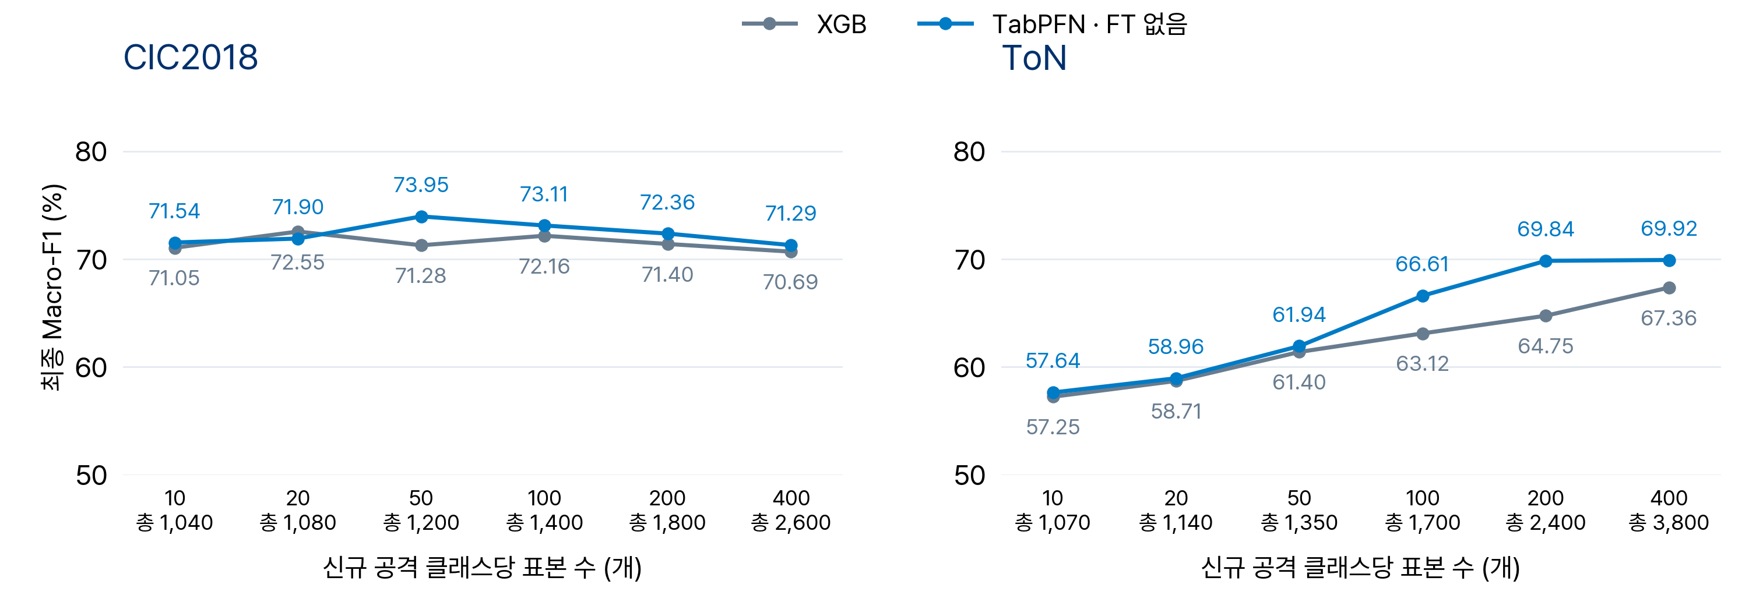
신규 공격 표본 수에 따른 성능
초기 1,000개 고정 · 신규 공격당 10·20·50·100·200·400개 · 최종 상태 전체 test · seed 43
신규 공격 400개 · XGB 대비 TabPFN 차이: CIC2018 +0.60%p · ToN +2.56%p
8
Notes:
EXP78 and EXP80. Initial 1000 fixed (Benign750 + two attacks125 each), seed43 once, no IDS FT. EXP80 preserves the original 100 incoming IDs and appends nested 200/400 samples; Web attacks availability 450 limits the shared budget. Final models predict the complete held-out test. EXP81 aligns query composition and audits row-wise prediction reuse. Varying new-class counts also changes class priors. Sources: tabpfn/results/v7/exp78/20261016_005435_noft_dist_new100_50_20_10_s43_52588487 and tabpfn/results/v7/exp80/20261016_022614_new200_400_noft_s43_c6f6ea24 Final evaluation convention: EXP81 seed43 permutation of test row indices independent of labels, query batch8192. PFN probabilities and DistPFN correction recomputed on all mixed batches. Row-wise XGB/proposed/Boost predictions retained only after exact mixed-query audit; any mismatching model is fully reevaluated. Budget10/20/50/200/400 PFN predictions checked with the same audit. Original-order results preserved in EXP77/78/79/80. No model tuning on test. Source: tabpfn/results/v7/exp81/20261016_025421_mixed_query_final_s43_b6ba1d34/results.json

Slide 9
부록 · 학습 10만 개 시나리오 · CIC2018
동일 공격 순서 · 소규모: 신규 공격당 100개 · 대규모: Benign 매 단계 15,000개 추가
이번 단계 추가 수 (개)
누적 수 (개)
단계 | 추가 클래스 | 소규모 | 10만 자연 | 10만 균등 | 소규모 | 10만 자연 | 10만 균등
1 | Benign DoS Brute force | 750 125 125 | 15,000 2,518 2,403 | 15,000 4,910 4,910 | 1,000 | 19,921 | 24,820
2 | DDoS Benign | 100 0 | 16,780 15,000 | 4,910 15,000 | 1,100 | 51,701 | 44,730
3 | Benign Web attacks | 0 100 | 15,000 9 | 15,000 450 | 1,200 | 66,710 | 60,180
4 | Benign Infiltration | 0 100 | 15,000 641 | 15,000 4,910 | 1,300 | 82,351 | 80,090
5 | Benign Bot | 0 100 | 15,000 2,649 | 15,000 4,910 | 1,400 | 100,000 | 100,000
 | 별도 검증 |  |  |  | 0 | 8,211 | 8,047
별도 검증: 제안 모델의 잔차 확률 보정·expert 채택 기준 선택 · 소규모는 전체 예산 내 분할
자연: 학습 공격 비율 · 균등: 공격별 균등, 표본 상한 반영 · 단계순, 단계 내 자연 추가 수 내림차순
9
Notes:
Original EXP72/73 stage-wise data. Same attack introduction order as current small-data experiment, but Benign is also added each stage: 15000 CIC2018 /12500 ToN, reaching75000. Small-data Benign750 is initial-only. Natural and uniform each reach25000 attack rows; uniform respects class availability caps. Rows are chronological; classes within each stage sorted by NATURAL incoming count descending. Each numeric cell lists class-specific newly supplied samples in matching order; cumulative totals are separate columns. Separate validation is outside100k; tune40% selects residual temperature, cal60% selects expert gate thresholds. Original LoCalPFN uses validation checkpoint selection; XGB/TabPFN/BoostPFN/DistPFN do not use those labels. Small proposed validation is inside total1400/1700. Sources: tabpfn/results/v7/exp73/20261014_154250_replay_current_sota_100k_s43_b0f8a9dc and tabpfn/results/v7/exp72/20261014_134735_replay_100k_xgb_tabpfn_s43_de8b4a78

Slide 10
부록 · 학습 10만 개 시나리오 · ToN
동일 공격 순서 · 소규모: 신규 공격당 100개 · 대규모: Benign 매 단계 12,500개 추가
이번 단계 추가 수 (개)
누적 수 (개)
단계 | 추가 클래스 | 소규모 | 10만 자연 | 10만 균등 | 소규모 | 10만 자연 | 10만 균등
1 | Benign DoS Scanning | 750 125 125 | 12,500 644 168 | 12,500 2,856 2,856 | 1,000 | 13,312 | 18,212
2 | Benign DDoS Injection | 0 100 100 | 12,500 5,785 1,899 | 12,500 2,856 2,856 | 1,200 | 33,496 | 36,424
3 | Benign Password | 0 100 | 12,500 6,009 | 12,500 2,856 | 1,300 | 52,005 | 51,780
4 | Benign XSS | 0 100 | 12,500 9,308 | 12,500 2,856 | 1,400 | 73,813 | 67,136
5 | Benign Backdoor Ransomware | 0 100 100 | 12,500 1,136 20 | 12,500 2,857 2,151 | 1,600 | 87,469 | 84,644
6 | Benign MitM | 0 100 | 12,500 31 | 12,500 2,856 | 1,700 | 100,000 | 100,000
 | 별도 검증 |  |  |  | 0 | 8,668 | 8,605
별도 검증: 제안 모델의 잔차 확률 보정·expert 채택 기준 선택 · 소규모는 전체 예산 내 분할
자연: 학습 공격 비율 · 균등: 공격별 균등, 표본 상한 반영 · 단계순, 단계 내 자연 추가 수 내림차순
10
Notes:
Original EXP72/73 stage-wise data. Same attack introduction order as current small-data experiment, but Benign is also added each stage: 15000 CIC2018 /12500 ToN, reaching75000. Small-data Benign750 is initial-only. Natural and uniform each reach25000 attack rows; uniform respects class availability caps. Rows are chronological; classes within each stage sorted by NATURAL incoming count descending. Each numeric cell lists class-specific newly supplied samples in matching order; cumulative totals are separate columns. Separate validation is outside100k; tune40% selects residual temperature, cal60% selects expert gate thresholds. Original LoCalPFN uses validation checkpoint selection; XGB/TabPFN/BoostPFN/DistPFN do not use those labels. Small proposed validation is inside total1400/1700. Sources: tabpfn/results/v7/exp73/20261014_154250_replay_current_sota_100k_s43_b0f8a9dc and tabpfn/results/v7/exp72/20261014_134735_replay_100k_xgb_tabpfn_s43_de8b4a78

Slide 11
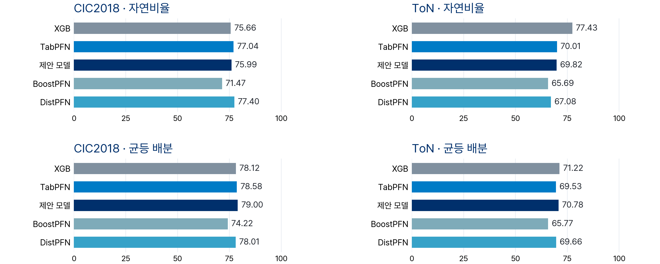
부록 · 학습 10만 개의 최종 성능
최종 모델로 전체 test 평가 · Macro-F1 (%) · 학습 10만 개 + 별도 검증
본문과 동일 test·혼합 순서·최종 상태 평가 · 학습·검증 예산 상이 · BoostPFN v1, 나머지 PFN v3
11
Notes:
EXP79/81 inference-only reevaluation: immutable saved EXP72/73 FINAL stage model states, no retraining or threshold retuning. Complete test, mixed query batch8192, identical final-state evaluation convention to main slides. DistPFN adjusts current completed query-batch posterior only, without query labels. No synthetic arrival rate, queue or update delay in these scores. Five methods; LoCalPFN omitted under prior user scope because of slow inference. Separate validation remains available to proposed model, so total label budgets differ from small-data setup beyond training size. BoostPFN v1; other PFN models v3. tabpfn/results/v7/exp81/20261016_025421_mixed_query_final_s43_b6ba1d34/results.json Final evaluation convention: EXP81 seed43 permutation of test row indices independent of labels, query batch8192. PFN probabilities and DistPFN correction recomputed on all mixed batches. Row-wise XGB/proposed/Boost predictions retained only after exact mixed-query audit; any mismatching model is fully reevaluated. Budget10/20/50/200/400 PFN predictions checked with the same audit. Original-order results preserved in EXP77/78/79/80. No model tuning on test. Source: tabpfn/results/v7/exp81/20261016_025421_mixed_query_final_s43_b6ba1d34/results.json

