Slide 1
고정된 환경의 분류 정확도를 넘어
변화하는 네트워크에서의 적응성 평가
사전학습 TabPFN을 활용한
소량 라벨·저비용 탐지 모델 갱신
1
Notes:
No title. Rephrase the user intent into concise presentation language instead of copying their draft. Adaptation to changing networks motivates the research; current class-arrival tests do not establish network-drift robustness.

Slide 2
TabPFN · 표 데이터 예측 규칙을 사전학습한 모델 (v3: arXiv, 2026)
사전학습
합성 표 데이터의 8조 개 이상 토큰으로 학습
일부 행의 정답을 맞히며 표 데이터의 예측 규칙 습득
In-context learning
라벨된 사례(context)를 참고해 새 flow(query)의 라벨 예측
추론 중 모델 가중치는 그대로 유지
Fine-tuning
초기 IDS를 context와 query로 나눠 query의 정답 예측
예측 오류를 역전파해 모델 가중치를 IDS에 맞게 조정
갱신: 사전학습 가중치 유지 → 기존 클래스 사례 보존 + 신규 사례 누적
기대: 반복 재학습과 비슷한 탐지 품질을 더 적은 데이터·갱신 비용으로 달성
2
Notes:
Source: https://arxiv.org/pdf/2605.13986 §2.5, PDF page 10: more than 8 trillion tokens, not datasets. Official TabPFN 8.2.0: https://github.com/PriorLabs/TabPFN/blob/main/src/tabpfn/finetuning/finetuned_base.py. EXP77 actually fine-tunes the initial IDS data using AdamW, learning rate 1e-5, 10 fixed epochs, context/query cross-entropy; then freezes weights. The v3 decoder weights context one-hot labels, so old-class examples remain necessary in the inference context. Validation is inside the 1000 revealed-label budget; no test tuning.

Slide 3

v3 구조
① 입력 변환 · Cell embedding
패킷 길이·지속시간 등의 값을 숫자 벡터로 변환
값이 비어 있는 위치도 함께 표시
② 특징별 분포 파악 · Feature embedding
여러 flow를 살펴 각 특징의 값 분포를 요약
Context의 정상·공격 라벨도 함께 반영
③ Flow별 정보 통합 · Feature aggregation
한 flow의 여러 특징을 하나의 표현으로 통합
이 표현을 이용해 flow 사이의 관계 비교
3
Notes:
Original Figure 5, https://arxiv.org/pdf/2605.13986#page=6. Native PPTX crop excludes the original caption. Labels and source remain in speaker notes. First three stages: feature grouping/cell embedding; target-aware column distribution embedding; row-level feature aggregation. Plain language deliberately omits implementation dimensions.

Slide 4
v3 구조
④ 사례 참조 · In-context learning
새 flow(query)가 라벨된 기존 사례(context)를 참조
어떤 사례가 예측에 도움이 되는지 attention으로 계산
⑤ 확률 출력 · Many-class decoder
관련성이 큰 사례의 라벨에 더 큰 가중치 부여
참고한 라벨을 모아 정상·공격별 확률 계산
기존 클래스도 분류하려면
해당 라벨의 context 유지 필요
4
Notes:
Same Figure 5, https://arxiv.org/pdf/2605.13986#page=6; no visible caption by user request. ICL attends to training/context keys; many-class decoder uses attention-weighted one-hot context labels. This is learned contextual relevance, not merely raw-feature nearest-neighbour distance. Context determines available class labels.

Slide 5
평가시나리오
초기 1,000개 · 신규 공격당 100개 누적 · 단계순, 단계 내 표본 수 내림차순
CIC2018
ToN
단계 | 신규 공개 클래스 | 클래스별 수 | 누적 수
1 | Benign Brute force DoS | 750 125 125 | 1,000
2 | DDoS | 100 | 1,100
3 | Web attacks | 100 | 1,200
4 | Infiltration | 100 | 1,300
5 | Bot | 100 | 1,400
단계 | 신규 공개 클래스 | 클래스별 수 | 누적 수
1 | Benign DoS Scanning | 750 125 125 | 1,000
2 | DDoS Injection | 100 100 | 1,200
3 | Password | 100 | 1,300
4 | XSS | 100 | 1,400
5 | Backdoor Ransomware | 100 100 | 1,600
6 | MitM | 100 | 1,700
최종 상태로 전체 test 평가 · CIC2018 3,042,473개 / ToN 2,271,723개 · seed 43 단일 실행
5
Notes:
EXP77 uses the same released IDs as EXP76. Initial IDS weight fine-tuning: fixed 10 epochs, AdamW, lr 1e-5; initial internal feature-group validation only. Subsequent context policies freeze the initial checkpoint; repeated FT is a separate control. XGB cumulatively retrains. Proposed model uses five feature-disjoint roles within the SAME total label budget, original pretrained backbone to keep calibration labels outside weight training. Stage order chronological, within-stage sample counts descending. Main score is the FINAL state on ALL held-out rows, not pooled stage predictions.

Slide 6
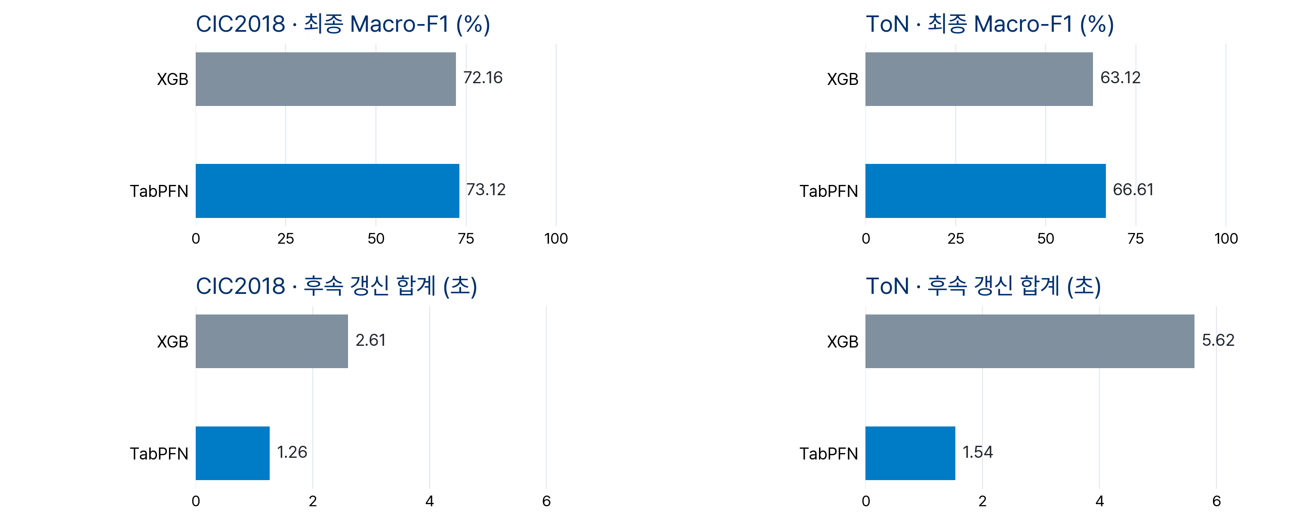
결과
최종 상태 전체 test 평가 · XGB: 누적 재학습 · TabPFN: FT 없이 누적 context 갱신
비용: 2단계 이후 갱신 합계 · 초기 준비·추론 제외 · 두 데이터셋 동일 비용 눈금
6
Notes:
EXP77 final-model full-test results: tabpfn/results/v7/exp77/20261015_230535_initialft10_finalfull_s43_2eb2237d/results.json. Two displayed methods: XGB cumulative retraining from scratch at every stage and original pretrained TabPFN with cumulative context, no IDS fine-tuning. Initial-FT results are retained in EXP77/EXP78, removed from slides 6 and 7 at user request. Slide 6 alone reports later-stage update cost: GPU-synchronized context selection + model construction + fit summed AFTER the initial stage; initial preparation and all inference excluded. Single seed 43. A separate EXP78 label-budget artifact covers 100/50/20/10 new examples per class, with initial 1000 fixed.

Slide 7
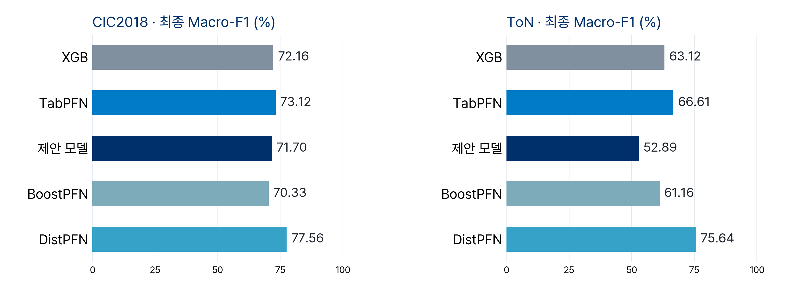
제안 모델·SOTA 성능 비교
동일 라벨 예산: CIC2018 1,400개 / ToN 1,700개 · 최종 상태 전체 test 평가
TabPFN·DistPFN: FT 없음 · 제안 모델: 두 데이터셋 모두 expert 호출 0건, Global만 사용
7
Notes:
Same EXP77 released-label budget: CIC2018 1400 / ToN 1700, including all internal validation and calibration. Only final full-test Macro-F1 is displayed; all cost panels and initial-FT baseline removed per user request. Existing K=4 anchor/residual + S1V0 proposed model uses original pretrained weights and global/expert/route/tune/cal roles within that total budget. Both datasets have zero expert calls in the final evaluation, so this is a diagnosed current configuration, not demonstrated ensemble improvement. Candidate expert corrections changed correctness on at most 0/4 calibration rows (CIC2018/ToN), below the existing 30-case requirement. Next diagnostic controls are a single PFN with identical Global context and adjustment of shared anchors/expert-specific allocation; do not retune thresholds on test. BoostPFN is the existing 50-learner port. DistPFN uses original pretrained v3 without IDS FT and current-query-batch posterior adjustment; no query labels. Historical 1014 results have a different 100k budget and pooled replay evaluation and are not inserted into the current final-state comparison. Source: tabpfn/results/v7/exp78/20261016_005435_noft_dist_new100_50_20_10_s43_52588487/dist_results.json

Slide 8
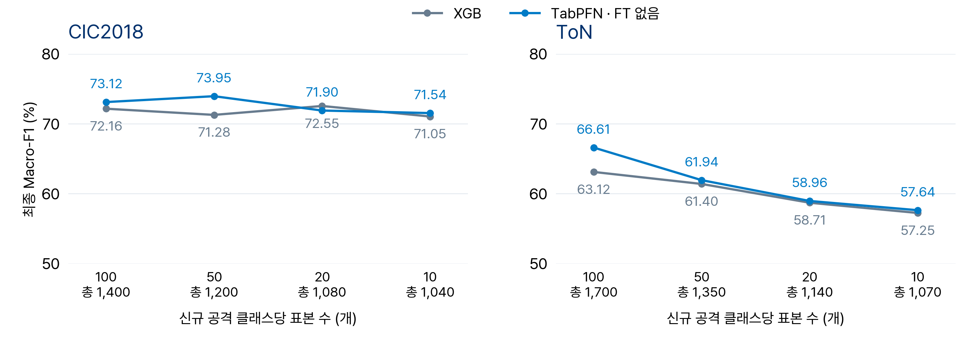
신규 공격 표본 수에 따른 성능
초기 1,000개 고정 · 신규 공격당 100·50·20·10개 · 최종 상태 전체 test · seed 43
CIC2018의 전체 점수 변화는 소폭 · ToN은 두 모델 모두 하락 · 클래스별 변화 분석 필요
8
Notes:
EXP78: tabpfn/results/v7/exp78/20261016_005435_noft_dist_new100_50_20_10_s43_52588487/results.json. Initial 1000 fixed (Benign 750 plus two initial attacks 125 each), new attack class budgets 100/50/20/10. Nested subsets within each class, same full held-out test, final-model evaluation, seed 43 once without repetitions. Only XGB and pretrained TabPFN cumulative-context variants displayed; initial-FT ablation remains in source records. Initial class data stay fixed but class proportions change as new-class counts change, so this is not an isolated sample-size effect at fixed priors. CIC2018 four new classes; ToN seven new classes. Per-point labels use two decimal places; common vertical scale between datasets.

Slide 9
부록 · 1014와 현재의 클래스별 학습 표본 수
최종 누적 표본 수 · 1014 자연비율 표본 수 내림차순 · 현재: 신규 공격당 100개
CIC2018
ToN
클래스 | 1014 자연 | 1014 균등 | 현재
Benign | 75,000 | 75,000 | 750
DDoS | 16,780 | 4,910 | 100
Bot | 2,649 | 4,910 | 100
DoS | 2,518 | 4,910 | 125
Brute force | 2,403 | 4,910 | 125
Infiltration | 641 | 4,910 | 100
Web attacks | 9 | 450 | 100
학습 합계 | 100,000 | 100,000 | 1,400
별도 검증 | 8,211 | 8,047 | 0
클래스 | 1014 자연 | 1014 균등 | 현재
Benign | 75,000 | 75,000 | 750
XSS | 9,308 | 2,856 | 100
Password | 6,009 | 2,856 | 100
DDoS | 5,785 | 2,856 | 100
Injection | 1,899 | 2,856 | 100
Backdoor | 1,136 | 2,857 | 100
DoS | 644 | 2,856 | 125
Scanning | 168 | 2,856 | 125
MitM | 31 | 2,856 | 100
Ransomware | 20 | 2,151 | 100
학습 합계 | 100,000 | 100,000 | 1,700
별도 검증 | 8,668 | 8,605 | 0
1014: 학습 10만 개 + 별도 검증 · 현재: 전체 라벨 예산 안에 검증 포함
1014 균등 배분도 확보 가능한 표본 수 상한 반영 · Web attacks 450개, Ransomware 2,151개
9
Notes:
1014 EXP72/73 final cumulative TRAIN counts, sorted by 1014 natural training support descending in each dataset. Natural allocates 25000 attack rows proportionally; uniform redistributes under availability caps (CIC Web attacks 450, ToN Ransomware 2151). Benign reaches 75000 through stage-wise additions, not fixed 750 as now. Current column is main slides 5–7, new attack class budget 100. Separate validation counts are available to proposed/LoCalPFN, not consumed by fixed-setting XGB/TabPFN; they are excluded from 100000 training rows. Current proposed validation/calibration is inside the 1400/1700 total, hence zero EXTRA labels. 1014 global/expert/route ~50/25/25% plus separate validation; current global/expert/route/tune/cal ~40/20/20/8/12%. Global final context: historical CIC natural/uniform 49914/50125 and ToN 49621/49860; current CIC583 and ToN695. Counts independently checked from saved train IDs and labels. Sources: tabpfn/results/v7/exp72/20261014_134735_replay_100k_xgb_tabpfn_s43_de8b4a78 and tabpfn/results/v7/exp73/20261014_154250_replay_current_sota_100k_s43_b0f8a9dc

Slide 10
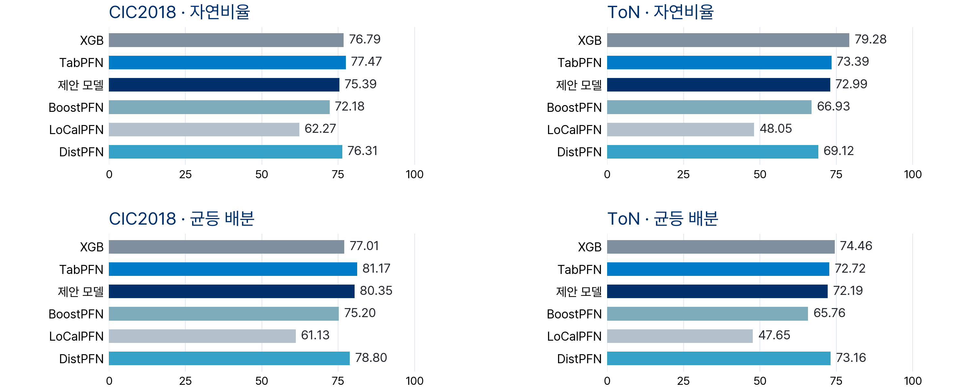
부록 · 1014 성능 비교
1,000행/초 · 단계별 버전의 예측을 합산한 Macro-F1 (%) · 갱신 지연 반영
BoostPFN·LoCalPFN: v1 · 나머지 PFN 모델: v3 · 현재 최종 상태 평가와 집계 방식 상이
10
Notes:
Historical EXP72/73, seed43, rate_1000 replay policy. These are NOT final-model whole-test scores: every test row is evaluated once during the stage where it is scheduled; the serving model version depends on cumulative training and measured update delay. The overall confusion matrix pools these predictions, not averages stage F1. Current slides 6–8 evaluate final models on the complete original-order test. Historical query batch 1024 versus current 8192; natural/uniform train priors and train/validation budgets also differ. DistPFN uses unlabelled current query-batch posterior/prior adjustment without IDS FT. These simultaneous changes prevent single-factor causal claims about ranking differences. Proposed natural branches have zero calls; uniform branches have active expert corrections in selected stages. 1014 LoCalPFN is reused from completed historical execution; no rerun. BoostPFN/LoCalPFN use their original v1 ports, other PFN models v3. Source: docs/research/20261015/exp73_report_data.json

