Slide 1
Evaluating adaptation to changing networks
beyond accuracy in a fixed environment
Updating IDS models with few labeled examples
at low cost using pretrained TabPFN
1
Notes:
No title. Rephrase the user intent into concise presentation language instead of copying their draft. Adaptation to changing networks motivates the research; current class-arrival tests do not establish network-drift robustness.

Slide 2
TabPFN · Pretrained prediction rules for tabular data (v3: arXiv, 2026)
Pretraining
Pretrained on over 8 trillion tokens of synthetic tables
Learns prediction rules by predicting hidden targets
In-context learning
Predicts a new flow using labeled examples as context
Model weights remain fixed during inference
Fine-tuning
Splits initial IDS data into context and query examples
Backpropagates query loss to adapt the model weights
Update: fixed pretrained weights → retain old classes and add new examples
Hypothesis: comparable detection quality with fewer labels and lower update cost
2
Notes:
Source: https://arxiv.org/pdf/2605.13986 §2.5, PDF page 10: more than 8 trillion tokens, not datasets. Official TabPFN 8.2.0: https://github.com/PriorLabs/TabPFN/blob/main/src/tabpfn/finetuning/finetuned_base.py. The archived initial-FT ablation in EXP77 uses AdamW, learning rate 1e-5, 10 fixed epochs, context/query cross-entropy; current displayed PFN results use no IDS FT. The v3 decoder weights context one-hot labels, so old-class examples remain necessary in the inference context. Validation is inside the 1000 revealed-label budget; no test tuning.

Slide 3

v3 architecture
① Encode inputs · Cell embedding
Converts values such as packet length into vectors
Also indicates which entries are missing
② Summarize columns · Feature embedding
Summarizes each feature across multiple flows
Uses the benign and attack labels in the context
③ Combine features · Feature aggregation
Combines each flow’s features into one representation
Uses it to compare relationships between flows
3
Notes:
Original Figure 5, https://arxiv.org/pdf/2605.13986#page=6. Native PPTX crop excludes the original caption. Labels and source remain in speaker notes. First three stages: feature grouping/cell embedding; target-aware column distribution embedding; row-level feature aggregation. Plain language deliberately omits implementation dimensions.

Slide 4
v3 architecture
④ Consult examples · In-context learning
A new flow queries the labeled context examples
Attention identifies relevant examples for prediction
⑤ Predict probabilities · Many-class decoder
Assigns greater weight to labels of relevant examples
Combines them into benign and attack probabilities
Keep context examples of existing classes
to continue predicting those classes
4
Notes:
Same Figure 5, https://arxiv.org/pdf/2605.13986#page=6; no visible caption by user request. ICL attends to training/context keys; many-class decoder uses attention-weighted one-hot context labels. This is learned contextual relevance, not merely raw-feature nearest-neighbour distance. Context determines available class labels.

Slide 5
Evaluation scenario
Initial 1,000 · Add 100 per new attack class · Stage order, then descending sample count
CIC2018
ToN
Stage | New classes | Per class | Cumulative
1 | Benign Brute force DoS | 750 125 125 | 1,000
2 | DDoS | 100 | 1,100
3 | Web attacks | 100 | 1,200
4 | Infiltration | 100 | 1,300
5 | Bot | 100 | 1,400
Stage | New classes | Per class | Cumulative
1 | Benign DoS Scanning | 750 125 125 | 1,000
2 | DDoS Injection | 100 100 | 1,200
3 | Password | 100 | 1,300
4 | XSS | 100 | 1,400
5 | Backdoor Ransomware | 100 100 | 1,600
6 | MitM | 100 | 1,700
Full test: CIC2018 3,042,473 / ToN 2,271,723 · Final model · Mixed order, seed 43
5
Notes:
Displayed XGB and no-FT PFN use the same released IDs as EXP76/77. XGB cumulatively retrains; PFN retains original pretrained weights and cumulative context. Initial and repeated IDS FT ablations remain in the experiment archive and are not shown. This small-label scenario supports slides6 and8; slide7 instead uses100000 training rows and separate proposed-model validation, detailed on pages9 and10. Stage order chronological, within-stage sample counts descending. Main score is the FINAL state on ALL held-out rows, not pooled stage predictions. Final evaluation convention: EXP81 seed43 permutation of test row indices independent of labels, query batch8192. PFN probabilities and DistPFN correction recomputed on all mixed batches. Row-wise XGB/proposed/Boost predictions retained only after exact mixed-query audit; any mismatching model is fully reevaluated. Budget10/20/50/200/400 PFN predictions checked with the same audit. Original-order results preserved in EXP77/78/79/80. No model tuning on test. Source: tabpfn/results/v7/exp81/20261016_025421_mixed_query_final_s43_b6ba1d34/results.json

Slide 6
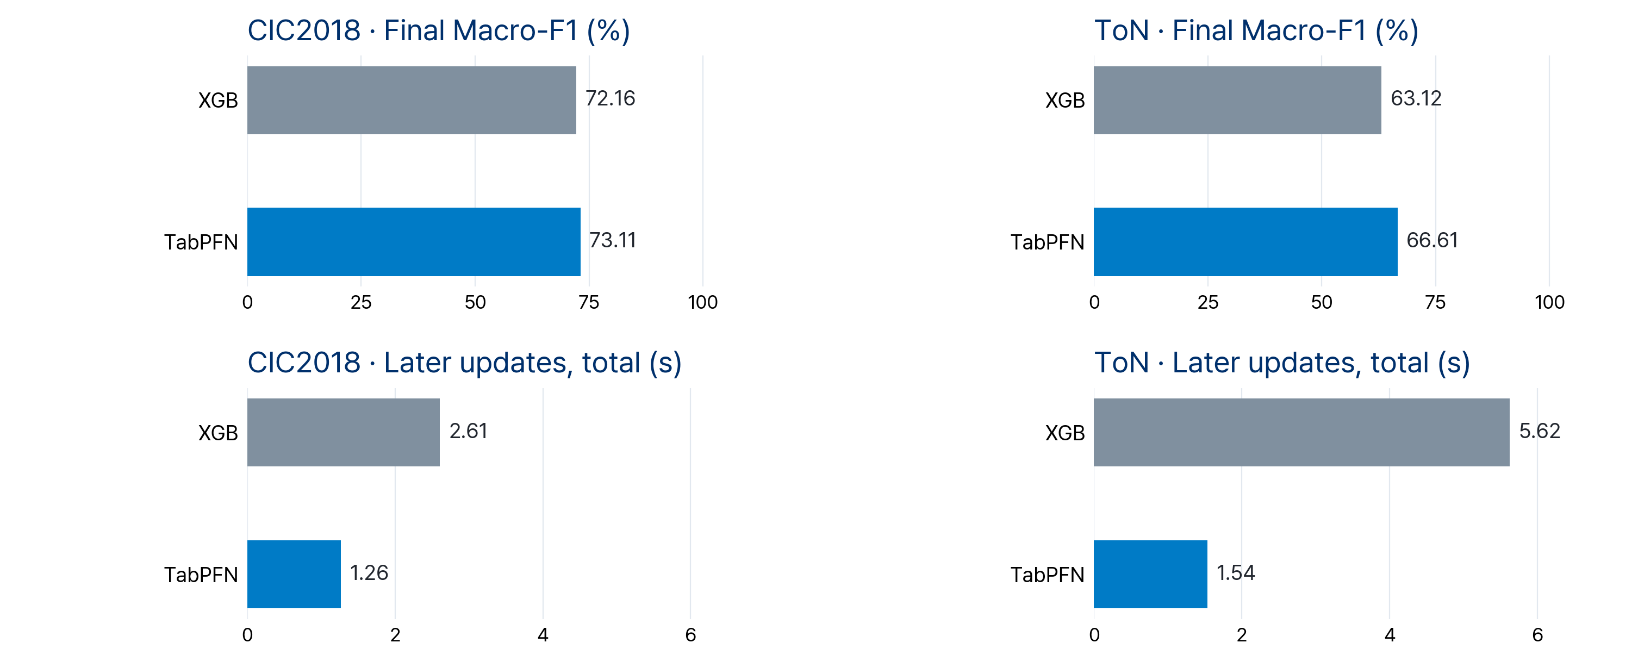
Results
Final model, full test · XGB: cumulative retraining · TabPFN: cumulative context, no FT
Cost: updates from stage 2 onward · Initial setup and inference excluded · Shared time scale
6
Notes:
EXP77 final-model full-test results: tabpfn/results/v7/exp77/20261015_230535_initialft10_finalfull_s43_2eb2237d/results.json. Two displayed methods: XGB cumulative retraining from scratch at every stage and original pretrained TabPFN with cumulative context, no IDS fine-tuning. Initial-FT results are retained in EXP77/EXP78, removed from slides 6 and 7 at user request. Slide 6 alone reports later-stage update cost: GPU-synchronized context selection + model construction + fit summed AFTER the initial stage; initial preparation and all inference excluded. Single seed 43. A separate EXP78 label-budget artifact covers 100/50/20/10 new examples per class, with initial 1000 fixed. Final evaluation convention: EXP81 seed43 permutation of test row indices independent of labels, query batch8192. PFN probabilities and DistPFN correction recomputed on all mixed batches. Row-wise XGB/proposed/Boost predictions retained only after exact mixed-query audit; any mismatching model is fully reevaluated. Budget10/20/50/200/400 PFN predictions checked with the same audit. Original-order results preserved in EXP77/78/79/80. No model tuning on test. Source: tabpfn/results/v7/exp81/20261016_025421_mixed_query_final_s43_b6ba1d34/results.json

Slide 7
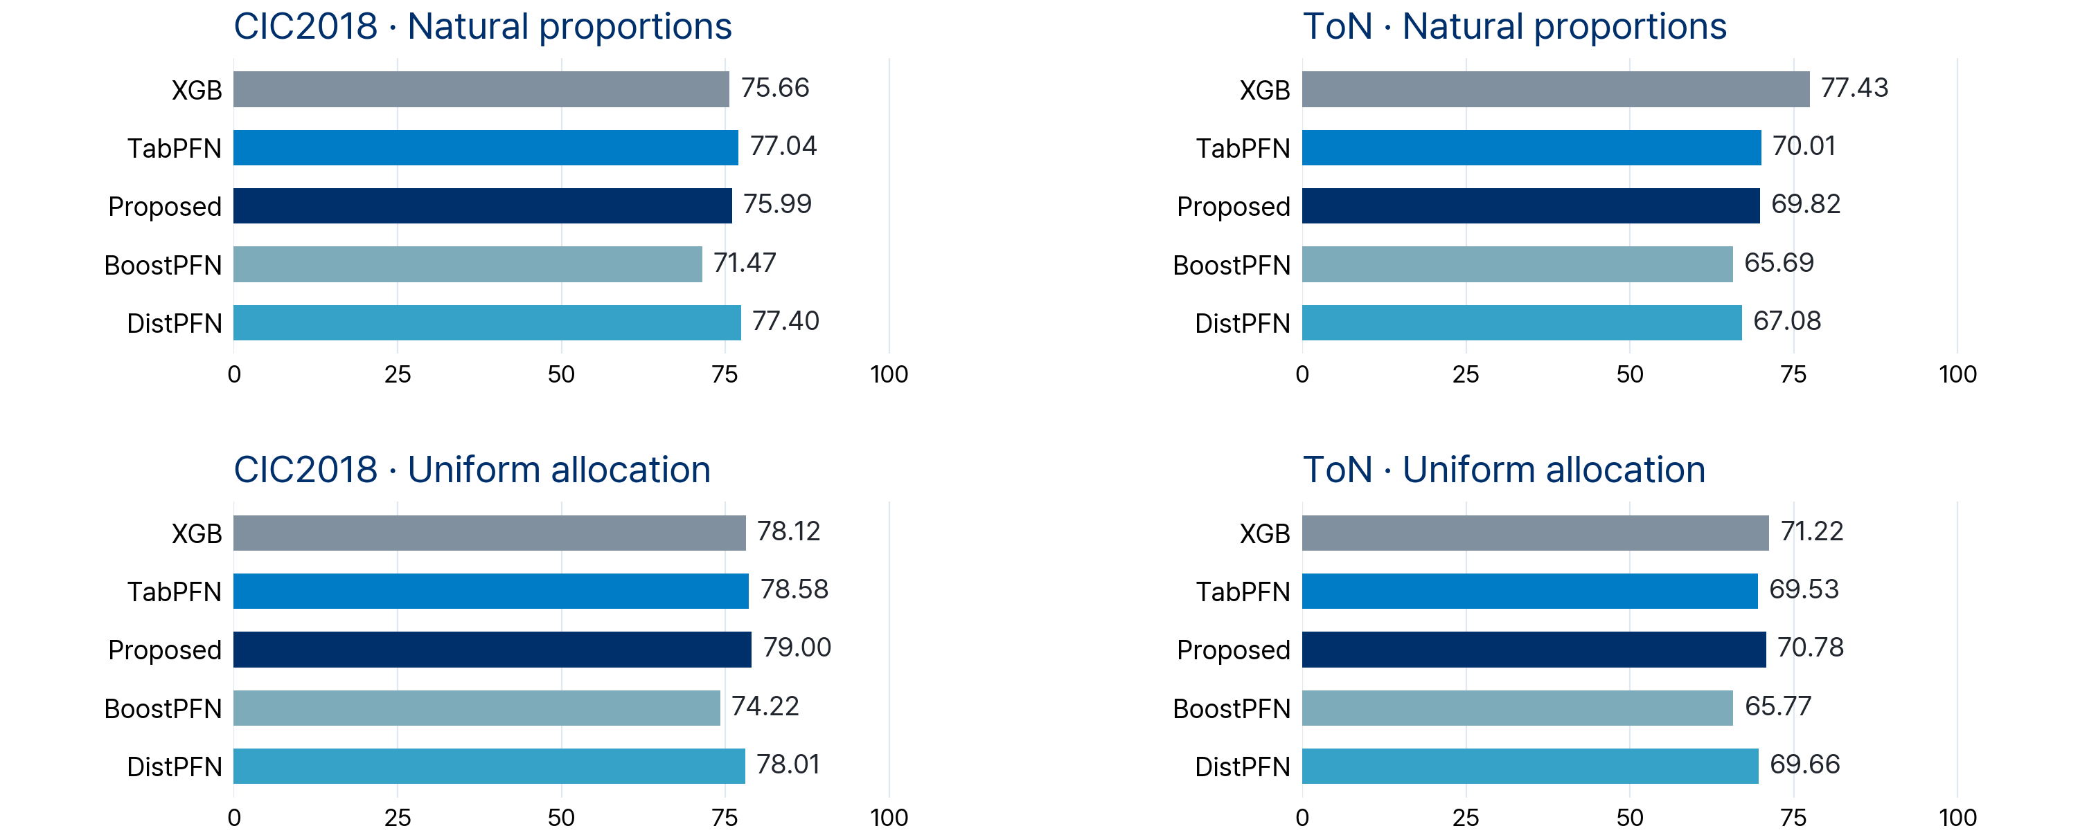
100k training samples · Proposed model and SOTA
75,000 benign + 25,000 attack samples · Final model, full test · Macro-F1 (%)
Proposed: Global ≈50k + separate validation · Counts: pp. 9, 10 · BoostPFN v1, other PFNs v3
Proposed: 79.00% on CIC2018 uniform · XGB leads both ToN allocations
7
Notes:
User-requested replacement of the small-label SOTA comparison after EXP82 diagnosis. EXP79/81 final-stage models, same complete test as the small-data evaluation, mixed query convention, no retraining or threshold tuning for reevaluation. Every method uses a 100000-row training pool (75000 Benign +25000 attacks), with natural and availability-capped uniform attack allocations. Proposed Global context is approximately50000 rows; its separate validation is additional to the training pool. Exact stage and validation counts are on appendix pages9 and10. BoostPFN uses v1; other PFN methods use v3, no IDS weight FT. Results do not establish consistent superiority: proposed is highest at CIC2018 uniform79.00%, while XGB leads both ToN allocations. Improve expert construction and routing using held-out training/validation evidence. Small-label comparison was removed from presentation at user request, not invalidated: EXP82 reproduced52.89% and identical probabilities with the695-row Global-only control. tabpfn/results/v7/exp81/20261016_025421_mixed_query_final_s43_b6ba1d34/results.json Final evaluation convention: EXP81 seed43 permutation of test row indices independent of labels, query batch8192. PFN probabilities and DistPFN correction recomputed on all mixed batches. Row-wise XGB/proposed/Boost predictions retained only after exact mixed-query audit; any mismatching model is fully reevaluated. Budget10/20/50/200/400 PFN predictions checked with the same audit. Original-order results preserved in EXP77/78/79/80. No model tuning on test. Source: tabpfn/results/v7/exp81/20261016_025421_mixed_query_final_s43_b6ba1d34/results.json

Slide 8
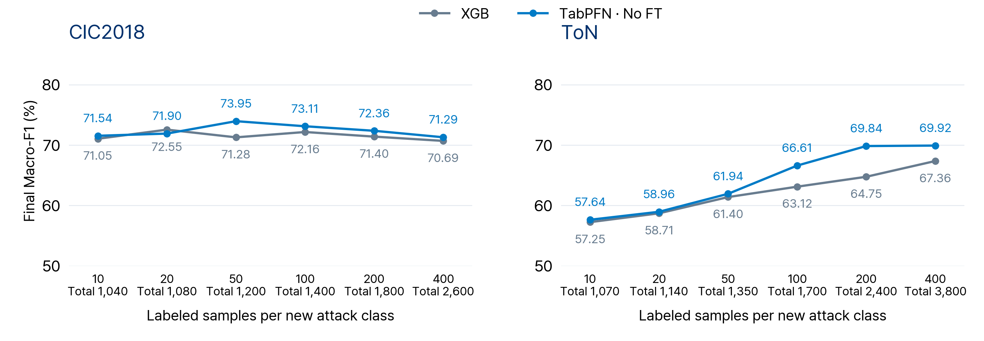
Performance by new attack sample budget
Initial 1,000 fixed · 10/20/50/100/200/400 per new attack class · Final model, full test · Seed 43
400 per new attack · TabPFN minus XGB: CIC2018 +0.60 pp · ToN +2.56 pp
8
Notes:
EXP78 and EXP80. Initial 1000 fixed (Benign750 + two attacks125 each), seed43 once, no IDS FT. EXP80 preserves the original 100 incoming IDs and appends nested 200/400 samples; Web attacks availability 450 limits the shared budget. Final models predict the complete held-out test. EXP81 aligns query composition and audits row-wise prediction reuse. Varying new-class counts also changes class priors. Sources: tabpfn/results/v7/exp78/20261016_005435_noft_dist_new100_50_20_10_s43_52588487 and tabpfn/results/v7/exp80/20261016_022614_new200_400_noft_s43_c6f6ea24 Final evaluation convention: EXP81 seed43 permutation of test row indices independent of labels, query batch8192. PFN probabilities and DistPFN correction recomputed on all mixed batches. Row-wise XGB/proposed/Boost predictions retained only after exact mixed-query audit; any mismatching model is fully reevaluated. Budget10/20/50/200/400 PFN predictions checked with the same audit. Original-order results preserved in EXP77/78/79/80. No model tuning on test. Source: tabpfn/results/v7/exp81/20261016_025421_mixed_query_final_s43_b6ba1d34/results.json

Slide 9
Appendix · 100k training sample scenario · CIC2018
Same attack order · Small: 100 per new attack · Large: 15,000 new benign samples per stage
New samples at this stage
Cumulative samples
Stage | Added classes | Small budget | 100k natural | 100k uniform | Small budget | 100k natural | 100k uniform
1 | Benign DoS Brute force | 750 125 125 | 15,000 2,518 2,403 | 15,000 4,910 4,910 | 1,000 | 19,921 | 24,820
2 | DDoS Benign | 100 0 | 16,780 15,000 | 4,910 15,000 | 1,100 | 51,701 | 44,730
3 | Benign Web attacks | 0 100 | 15,000 9 | 15,000 450 | 1,200 | 66,710 | 60,180
4 | Benign Infiltration | 0 100 | 15,000 641 | 15,000 4,910 | 1,300 | 82,351 | 80,090
5 | Benign Bot | 0 100 | 15,000 2,649 | 15,000 4,910 | 1,400 | 100,000 | 100,000
 | Separate val. |  |  |  | 0 | 8,211 | 8,047
Separate validation: residual calibration and expert acceptance · Small setting: within total budget
Natural: training attack ratios · Uniform: equal attack quotas, availability caps · Sorted by stage, then natural additions
9
Notes:
Original EXP72/73 stage-wise data. Same attack introduction order as current small-data experiment, but Benign is also added each stage: 15000 CIC2018 /12500 ToN, reaching75000. Small-data Benign750 is initial-only. Natural and uniform each reach25000 attack rows; uniform respects class availability caps. Rows are chronological; classes within each stage sorted by NATURAL incoming count descending. Each numeric cell lists class-specific newly supplied samples in matching order; cumulative totals are separate columns. Separate validation is outside100k; tune40% selects residual temperature, cal60% selects expert gate thresholds. Original LoCalPFN uses validation checkpoint selection; XGB/TabPFN/BoostPFN/DistPFN do not use those labels. Small proposed validation is inside total1400/1700. Sources: tabpfn/results/v7/exp73/20261014_154250_replay_current_sota_100k_s43_b0f8a9dc and tabpfn/results/v7/exp72/20261014_134735_replay_100k_xgb_tabpfn_s43_de8b4a78

Slide 10
Appendix · 100k training sample scenario · ToN
Same attack order · Small: 100 per new attack · Large: 12,500 new benign samples per stage
New samples at this stage
Cumulative samples
Stage | Added classes | Small budget | 100k natural | 100k uniform | Small budget | 100k natural | 100k uniform
1 | Benign DoS Scanning | 750 125 125 | 12,500 644 168 | 12,500 2,856 2,856 | 1,000 | 13,312 | 18,212
2 | Benign DDoS Injection | 0 100 100 | 12,500 5,785 1,899 | 12,500 2,856 2,856 | 1,200 | 33,496 | 36,424
3 | Benign Password | 0 100 | 12,500 6,009 | 12,500 2,856 | 1,300 | 52,005 | 51,780
4 | Benign XSS | 0 100 | 12,500 9,308 | 12,500 2,856 | 1,400 | 73,813 | 67,136
5 | Benign Backdoor Ransomware | 0 100 100 | 12,500 1,136 20 | 12,500 2,857 2,151 | 1,600 | 87,469 | 84,644
6 | Benign MitM | 0 100 | 12,500 31 | 12,500 2,856 | 1,700 | 100,000 | 100,000
 | Separate val. |  |  |  | 0 | 8,668 | 8,605
Separate validation: residual calibration and expert acceptance · Small setting: within total budget
Natural: training attack ratios · Uniform: equal attack quotas, availability caps · Sorted by stage, then natural additions
10
Notes:
Original EXP72/73 stage-wise data. Same attack introduction order as current small-data experiment, but Benign is also added each stage: 15000 CIC2018 /12500 ToN, reaching75000. Small-data Benign750 is initial-only. Natural and uniform each reach25000 attack rows; uniform respects class availability caps. Rows are chronological; classes within each stage sorted by NATURAL incoming count descending. Each numeric cell lists class-specific newly supplied samples in matching order; cumulative totals are separate columns. Separate validation is outside100k; tune40% selects residual temperature, cal60% selects expert gate thresholds. Original LoCalPFN uses validation checkpoint selection; XGB/TabPFN/BoostPFN/DistPFN do not use those labels. Small proposed validation is inside total1400/1700. Sources: tabpfn/results/v7/exp73/20261014_154250_replay_current_sota_100k_s43_b0f8a9dc and tabpfn/results/v7/exp72/20261014_134735_replay_100k_xgb_tabpfn_s43_de8b4a78

