Slide 1
Adapting IDS to newly labelled attacks
IDS · Classifying network flows as benign or attack types
Initial deployment
Newly labelled attack
Detector update
Labelled benign traffic
and known attacks
A small labelled sample
of a newly observed attack
Recognize the new attack
and preserve earlier quality
XGBoost
Comparator: refit on all labelled examples available so far
TabPFN
Fixed pretrained weights; labelled examples supplied as context
Comparison · New-attack detection · Retained quality · Update cost
Notes:
Problem before dataset. A labelled flow is a tabular network record with an assigned class. Labels are assumed available after investigation; their acquisition is not evaluated here. XGBoost full refitting is the chosen comparator, not a claim that all tree updates require retraining. Class arrival is not a claim of zero-label novelty detection or cross-network robustness.

Slide 2
TabPFN · Weights, context and query
Prediction rules pretrained on synthetic tabular tasks · TabPFN-3, arXiv 2026
Context
Flow features + labels
TabPFN
Class probabilities
Query
Pretrained weights fixed
Benign · Attack A · Attack B …
Flow features to classify
In-context learning
Predict the query using its context, with no weight optimization
Fine-tuning
Split IDS examples into context/query; update weights
by backpropagating the labelled-query loss
Current comparison · Original pretrained weights, with no IDS fine-tuning
Notes:
https://arxiv.org/html/2605.13986v1 Sections 1, 2.2, 2.5. Synthetic tasks refer to model pretraining, not the IDS evaluation data. Context is a supplied labelled dataset, not information stored inside fixed pretrained weights. Fine-tuning is optional weight optimization and is not used in the supplied result pages. FT interface: https://github.com/PriorLabs/TabPFN/blob/main/src/tabpfn/finetuning/finetuned_base.py

Slide 3

v3 architecture · Representing network flows
1 Encode values · Cell embedding
Convert each value, such as packet length, into a vector
Include an indicator for missing values
2 Summarize columns · Feature embedding
Summarize each feature across multiple flows
Use the labels supplied with the context
3 Combine features · Feature aggregation
Combine a flow’s features into one representation
Prepare it for comparison with other flows
Notes:
https://arxiv.org/html/2605.13986v1 Figure 5, Section 2.1. Original figure on the left, without a visible caption per user instruction. Steps 1–3 follow cell embedding, column-wise feature embedding, and row-wise feature aggregation. The labelled context is external input; the diagram does not depict IDS weight fine-tuning.

Slide 4
v3 architecture · Context-based prediction
4 Consult examples · In-context learning
Compare the query with labelled context examples
Weight their relevance through attention
5 Predict probabilities · Many-class decoder
Combine context labels with attention weights
Keep examples of both existing and new classes
Context updates also require computation
Preprocessing · Representations · Cache preparation
Measure update time separately from weight training
Notes:
https://arxiv.org/html/2605.13986v1 Sections 2.2 and 2.4.2. The decoder averages one-hot context labels with learned attention weights. Cached prediction can reuse prepared context states; changing context may require recomputation. No claim that a context update is free, or universally faster than XGBoost refitting.

Slide 5
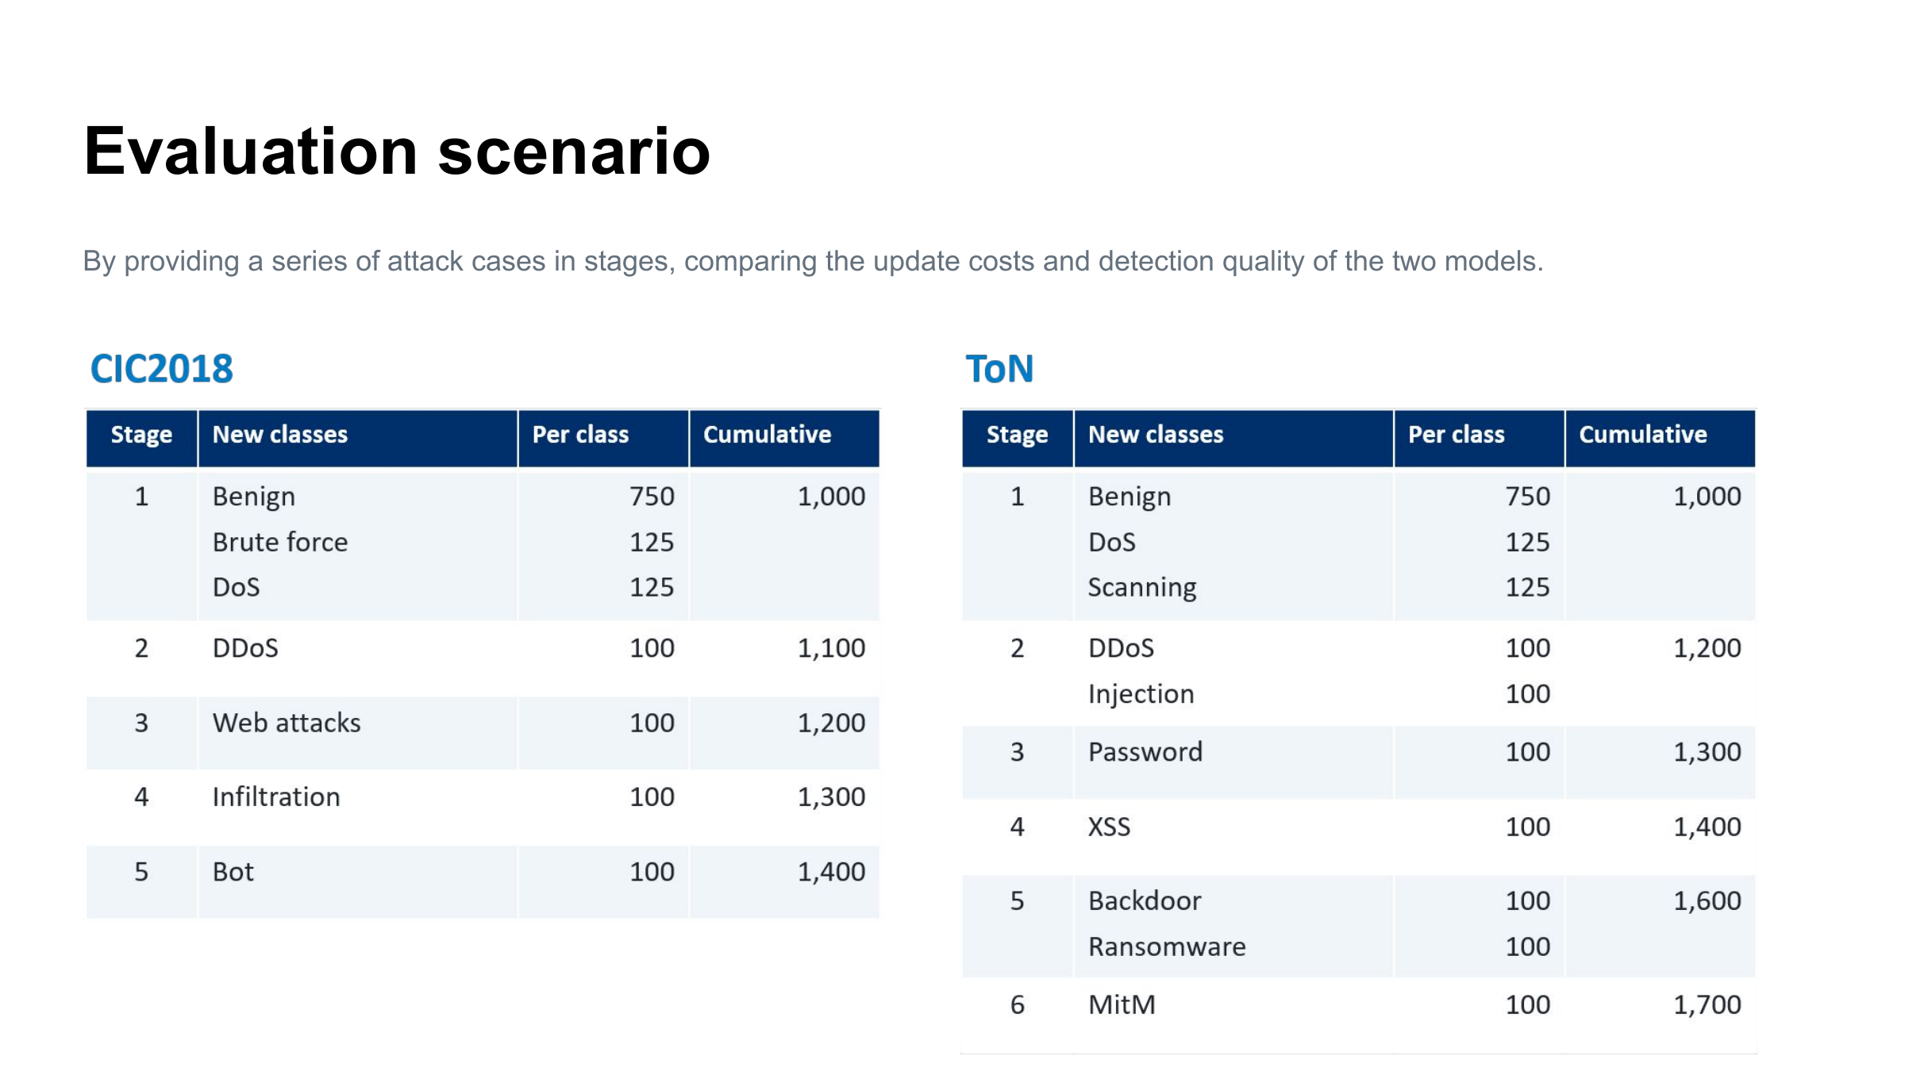
Notes:
Unchanged supplied 26S_Meeting.pdf page 4. PDF source only: original content is a page image in PPTX. The companion PDF preserves the original vector page. Experiment redesign is separately documented and has not been applied here.

Slide 6
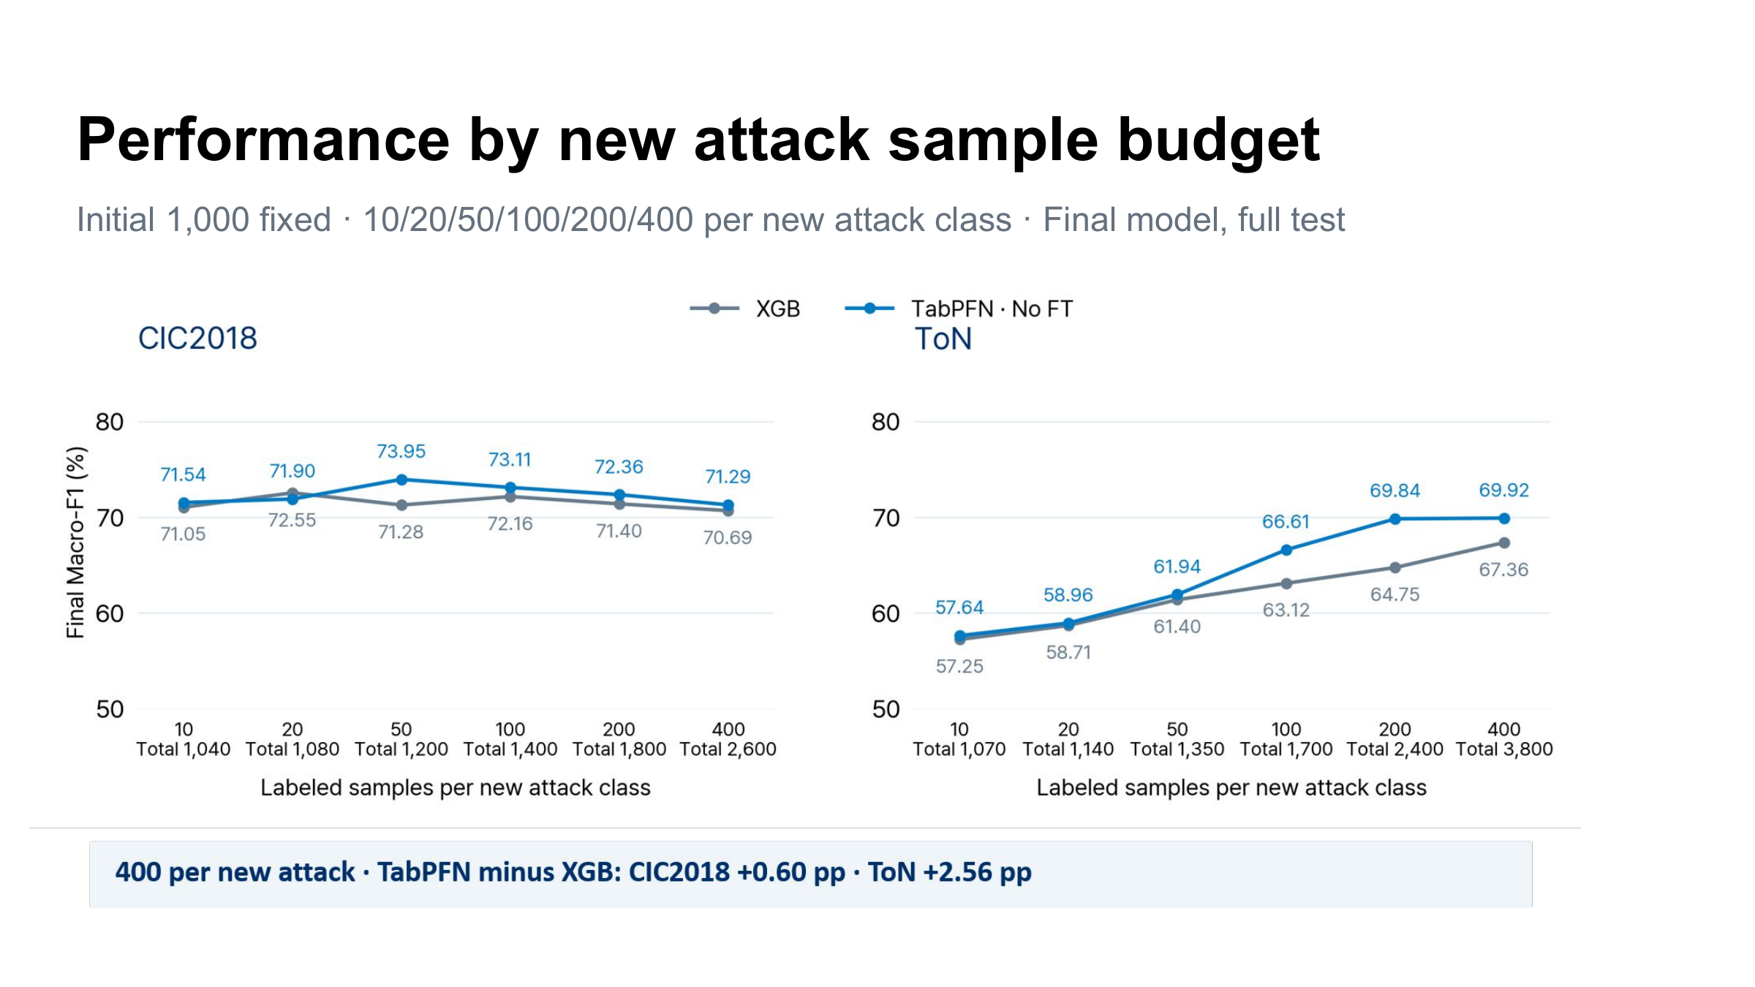
Notes:
Unchanged supplied 26S_Meeting.pdf page 5. PDF source only: original content is a page image in PPTX. The companion PDF preserves the original vector page. Experiment redesign is separately documented and has not been applied here.

Slide 7
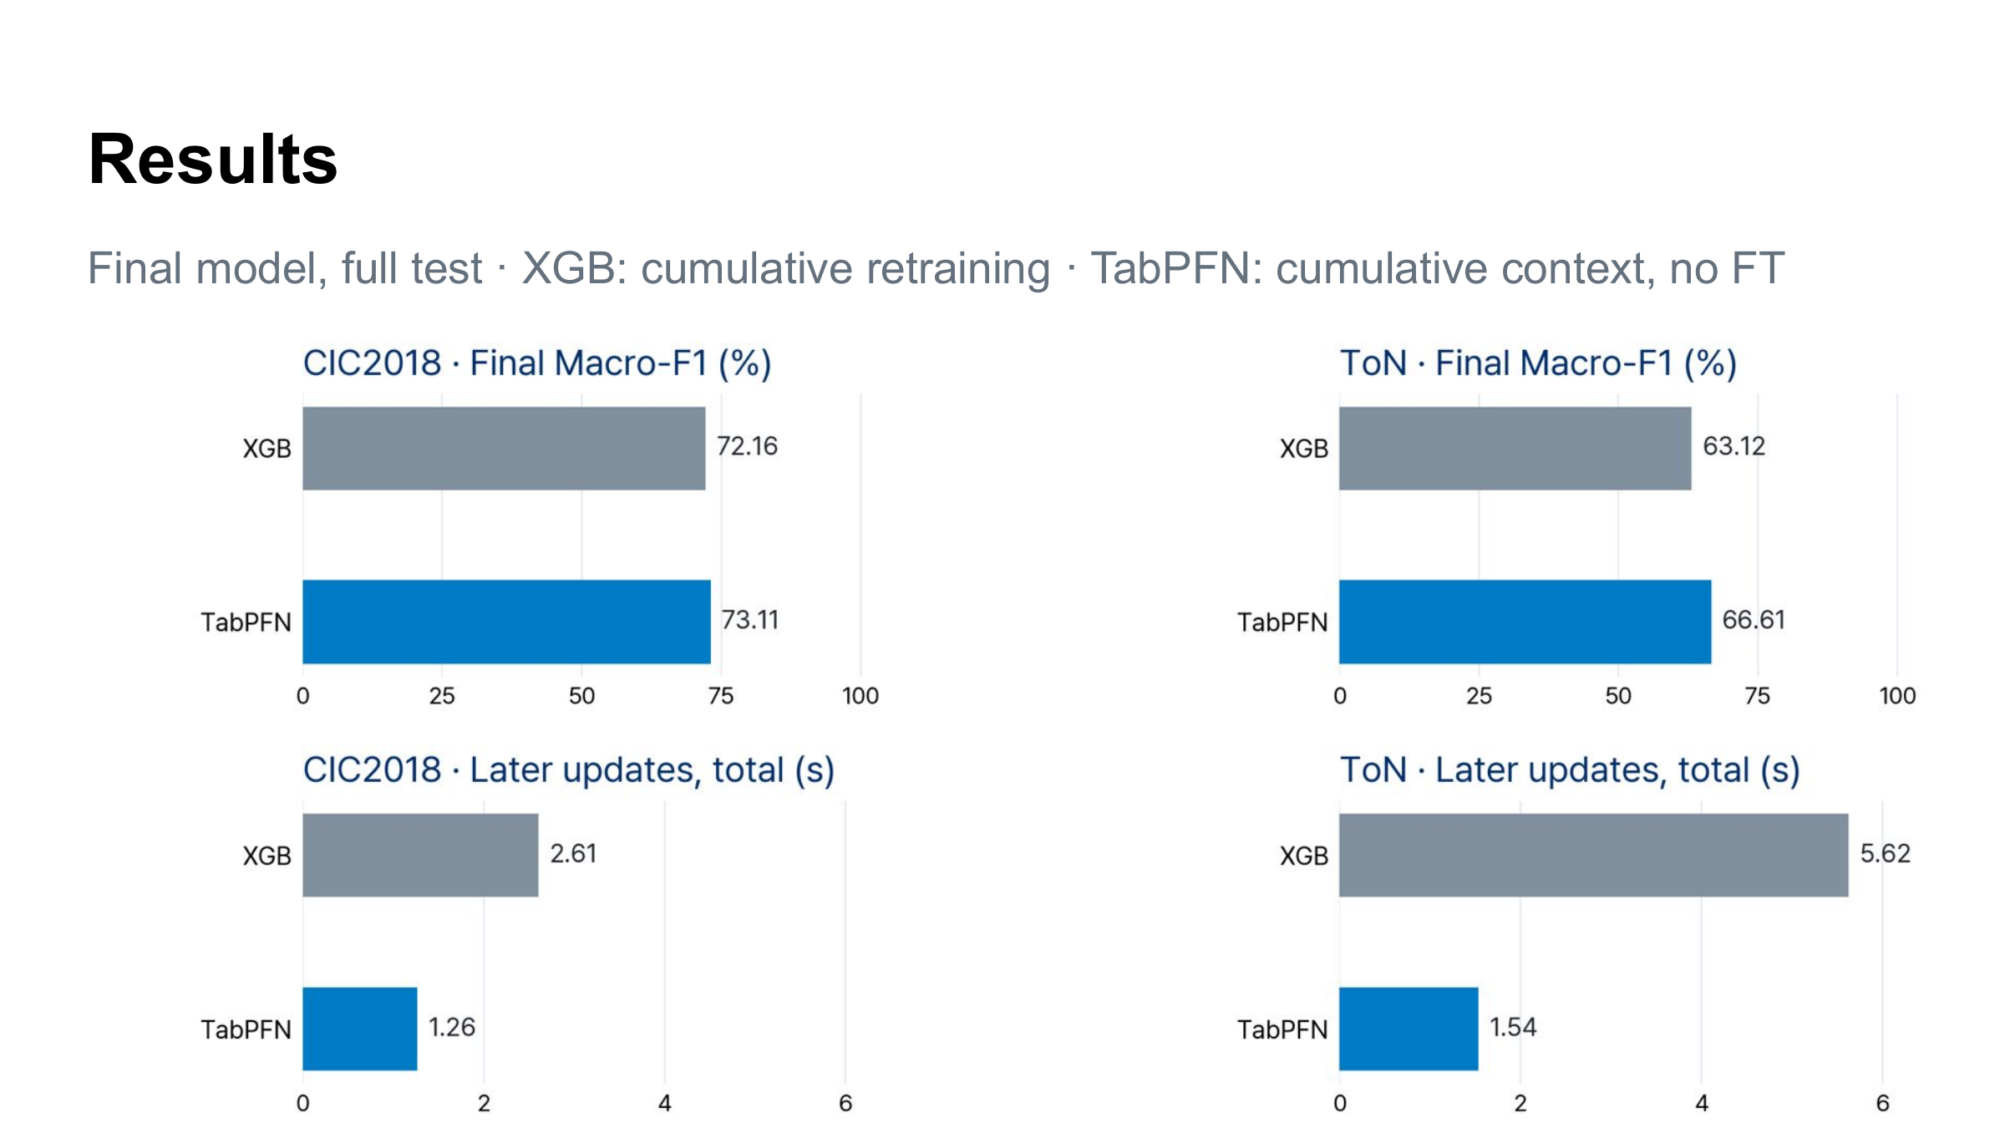
Notes:
Unchanged supplied 26S_Meeting.pdf page 6. PDF source only: original content is a page image in PPTX. The companion PDF preserves the original vector page. Experiment redesign is separately documented and has not been applied here.

