Slide 1
Dr. John Watson, ML
--- Wesley Swain ---

Slide 2
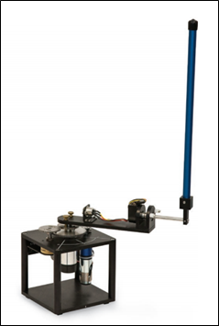
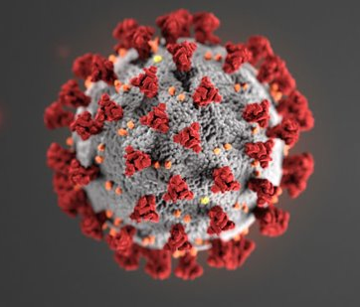


The Concept and How it Devolved
Coronavirus Chaos
Pendulum Panic
Preliminary Proposal
Watson Wonder (Jeopardy! Jealousy)
Dataset Difficulties (QA Questions)
Possible Data in the Public Domain (Doyle Docs)
Repo Research
Final Freeman Focus
GPT-2 Generation
Clever Cloning
Potential Puppetry

Slide 3
Text Generation
Corpus-Handling (Project Gutenberg)
GPT-2 (Simple Model) Fine-Tuning
Transformer Architecture Advantages
Incredible Samples:
“””
The Adventure of the Dying Detective
Mrs. Hudson, of Greenaulay, was a long-suffering
house-suburbs landlord. She died in her sleep in the early
morning of March, 1892. The cause of her death was suicide, for
she had kept a low, confidential party, but the matter might be
final. All I can do is to keep in touch with you, Mr. Roundhay, and,
useless as I are, I shall keep on keeping in touch with you. An
amateur observer you will be with to-morrow in such a fashion that
anyone outside notices?”
“The same people who keep a low party to keep out of a suicide.”
“And an amateur?”
“Ah, you don’t seem to have a doubt about it, my friend.
”””
“””
“Well, my dear Watson, I take it that you have no theory yourself which would match the description already mentioned?”
“The description?”
“Well, yes, there was a fellow named Garcia, and he seems to have rung a long
way lately. He spoke good English,” and we both know that he can make no
make of the noise of a curling axe in the shop. Then and only does he rung.”
“Do you mean to say that anyone of service can make a creaking
axe stop in the shop, and then come back again after?”
“It is a wonder that a man should cast so great a span through a
business.”
“Well, I suppose if he can do something even as an accomplice he must take
the spot of the victim.”
“Exactly! Now we will consider the question of the money.”
“””

Slide 4

Voice Cloning
Martin Freeman’s recorded voice (acquired legally)
Voice Embedding
Generated Sample
Very rushed, no heed to punctuation
Issue in training of base model?
Lacking long sequence support
Hitchhiker’s Guide voices
“Well, my dear Watson, I take it that you have no theory yourself which would match the description already mentioned?”
“The description?”

Slide 5
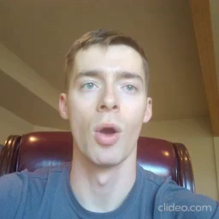


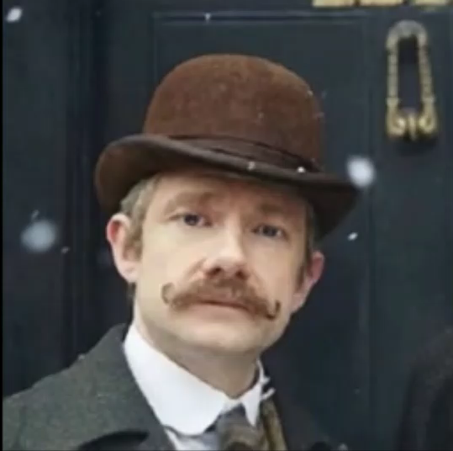

Quick + Dirty “Puppetry”
Neural puppetry
TwoMinutePapers mention
No open-sourced code
DeepFake Proof-Of-Concept
Driving Video
Source Image
Speed vs Accuracy/Believability
BlahBlahBlah vs Dubbed Videos
Manual Assembling
Final Product

Slide 6
Repos
westpoint-neural-networks, final-project-wjwswain:
https://github.com/westpoint-neural-networks/final-project-wjwswain
CorentinJ, Real-Time-Voice-Cloning:
https://github.com/CorentinJ/Real-Time-Voice-Cloning
AliaksandrSiarohin, first-order-model:
https://github.com/AliaksandrSiarohin/first-order-model
minimaxir, gpt-2-simple:
https://github.com/minimaxir/gpt-2-simple

