Slide 1
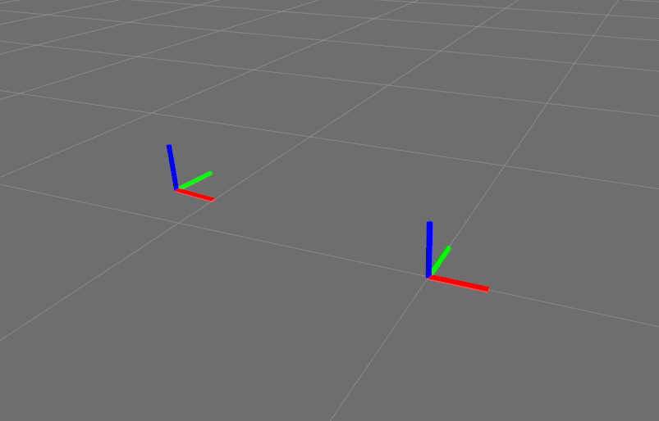
X axis is indicated in red
Y axis is indicated in green
Z axis is indicated in blue
up
left
up
BASE_LINK
forward
north
In relation to a body the standard is:
x forward
y left
z up
geographic locations (ENU) convention:
X east
Y north
Z up
MAP
east

