Slide 1
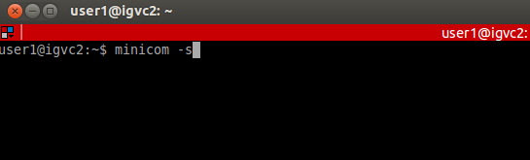
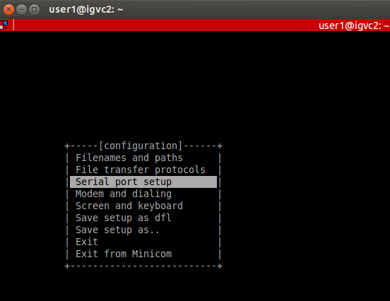
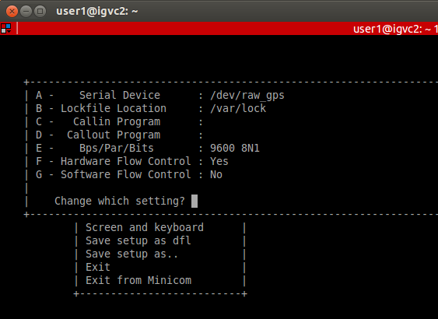
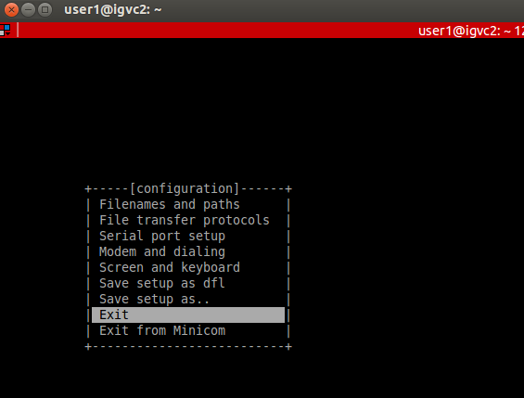
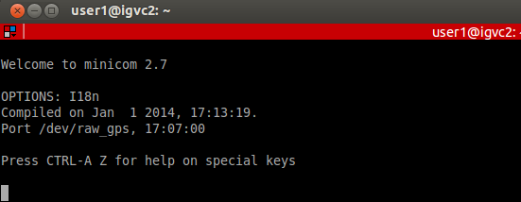

- Use minicom to communicate with the CNS5000 directly:
$ minicom -s
The configuration should look like this:
Then choose exit on configuration menu
- To verify the TerraStar subscription and status
LOG TERRASTARSTATUS
On the second line of the status the word DISABLED implies that the Terrastar service is disabled.
ASSIGNLBANDBEAM AUTO
LOG VERSIONB ONCE
LOG RXSTATUSB ONCHANGED
LOG RAWEPHEMB ONCHANGED
LOG ALMANACB ONCHANGED
LOG IONUTCB ONCHANGED
LOG RANGEB ONTIME 1
LOG BESTPOSB ONTIME 1
LOG PPPPOSB ONTIME 1
LOG PPPSATSB ONTIME 1
LOG LBANDTRACKSTAT ONCE
LOG TERRASTARINFOA ONCHANGED
LOG TERRASTARSTATUSB ONCHANGED
LOG LBANDBEAMTABLEB ONCHANGED

Slide 2
- To verify the TerraStar subscription and status
LOG TERRASTARSTATUS
On the second line of the status the word DISABLED implies that the Terrastar service is disabled.
- To verify you have reception with L-Band satellite:
ASSIGNLBANDBEAM AUTO
LOG LBANDBEAMTABLE
LOG LBANDTRACKSTAT
LOG TERRASTARSTATUS
LOG TERRASTARINFO

