Slide 1
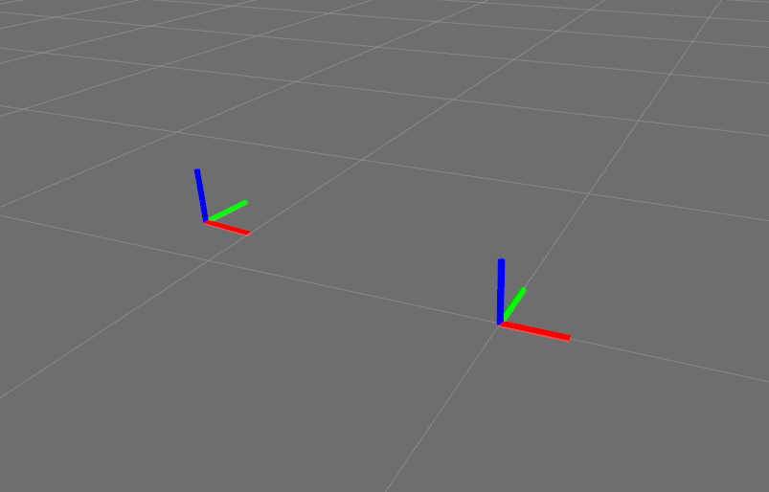
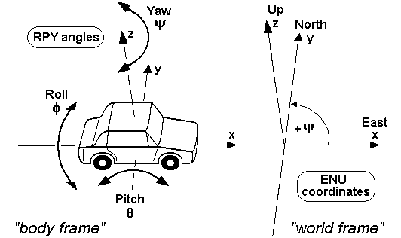
ROS Enhancement Proposals (REPs)
For more details see: REP 103 and REP 105
Reference:
REP 103 Axis Orientation
X axis is indicated in red
Y axis is indicated in green
Z axis is indicated in blue
Chirality
All systems are right handed. This means they comply with the right hand rule
For right-handed coordinates your right thumb points along the Z axis in a positive Z-direction and the curl of your fingers represents a motion from the first or X axis to the second or Y axis. When viewed from the top or Z axis the system is counter-clockwise.
By the right hand rule, the yaw component of orientation increases as the child frame rotates counter-clockwise, and for geographic poses, yaw is zero when pointing east.
This requires special mention only because it differs from a traditional compass bearing, which is zero when pointing north and increments clockwise. Hardware drivers should make the appropriate transformations before publishing standard ROS messages.
up
left
BASE_LINK
forward
up
In relation to a body the standard is:
x forward
y left
z up
geographic locations (ENU) convention:
X east
Y north
Z up
north
MAP
east

Slide 2
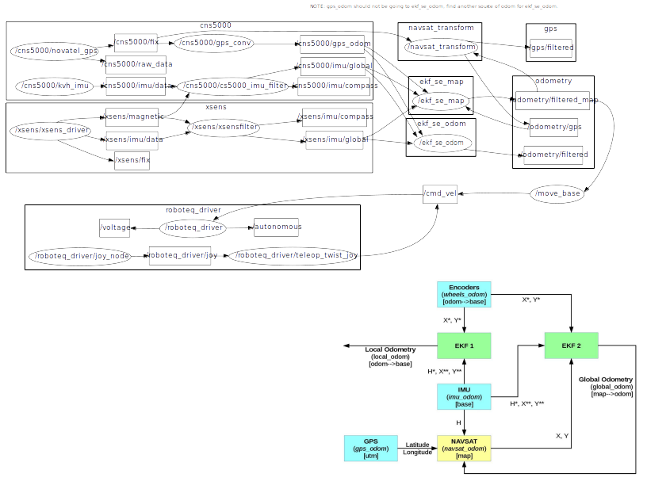
navsat_transform_node takes as input a nav_msgs/Odometry message, a sensor_msgs/Imu containing an accurate estimate of your robot’s heading, and a sensor_msgs/NavSatFix message containing GPS data. It produces an odometry message in coordinates that are consistent with your robot’s world frame. This value can be directly fused into your state estimate. Publishes world_frame->utm transform
utm_odometry_node (aka gps_conv) converts latitude-longitude readings into UTM odometry
ekf_localization_node is an implementation of an extended Kalman filter. It uses an omnidirectional motion model to project the state forward in time, and corrects that projected estimate using perceived sensor data.
a 0 heading corresponds to east. Check yaw_offset: 0.0 in navsat_transform. navsat_transform_node launched by
dual_ekfnavsat.

