Slide 1
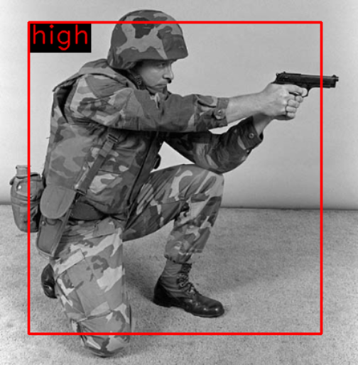
Original
YOLO
OpenPose

Slide 2
