Slide 1
Gaming Quiz

Slide 2
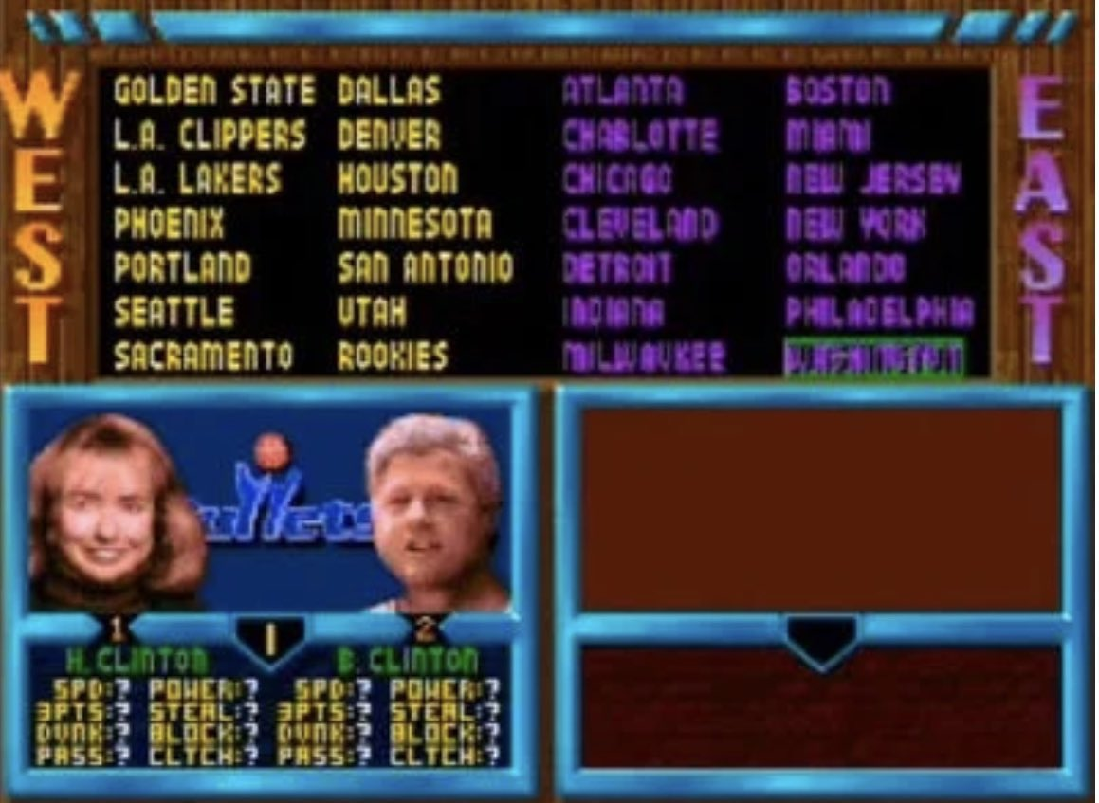
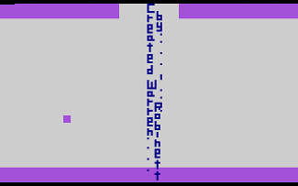
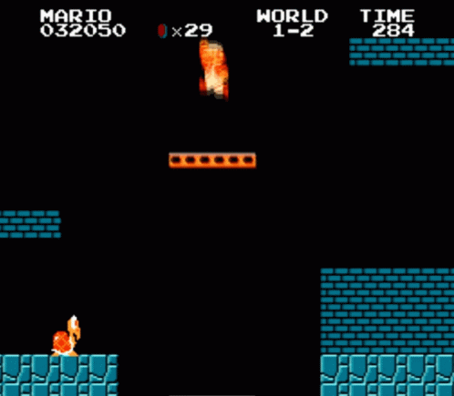
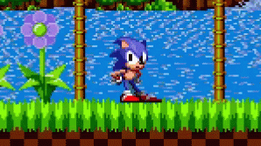
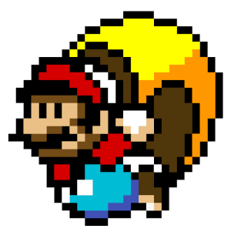
What was the first video game Easter Egg?
Moonlander (1973)
Adventure (1980, first called Easter Egg)

Slide 3
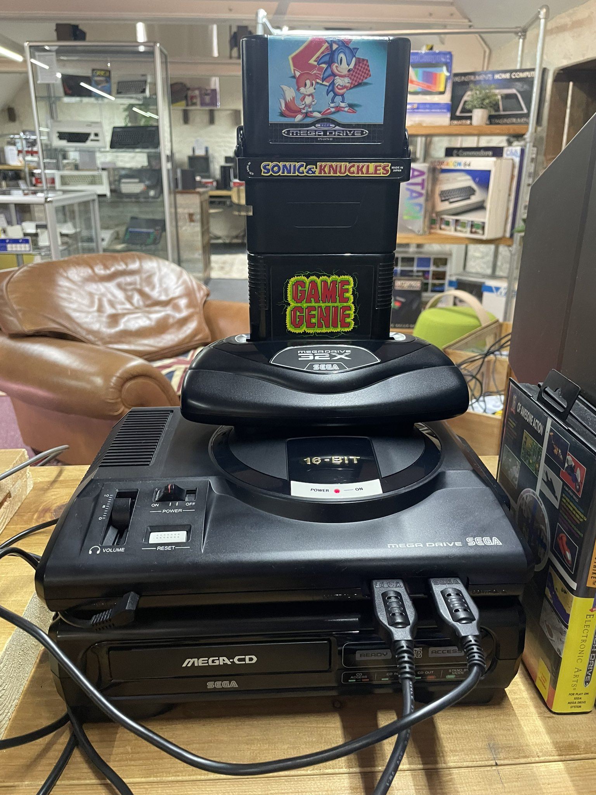
How many power outlets does the tower of power require?
1 for Genesis, 1 for Sega CD, 1 for 32X, 1 for TV

Slide 4
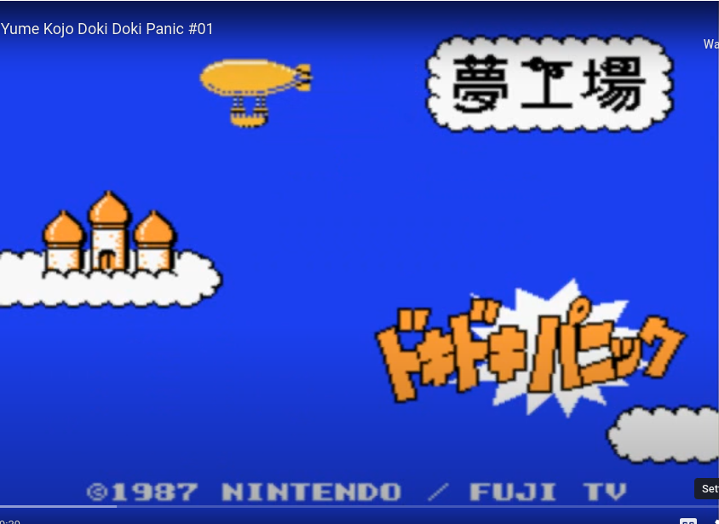
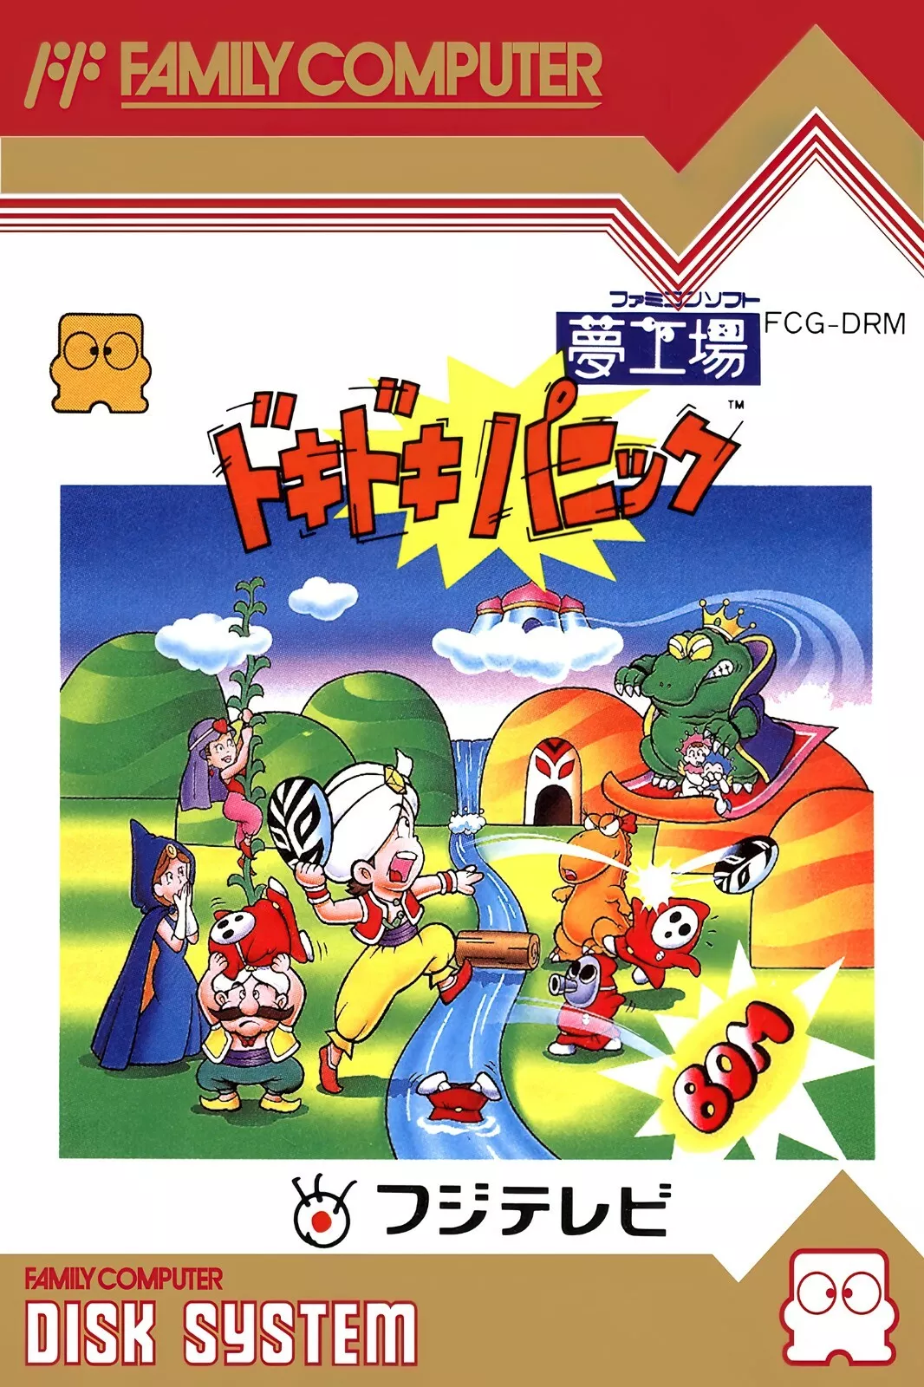
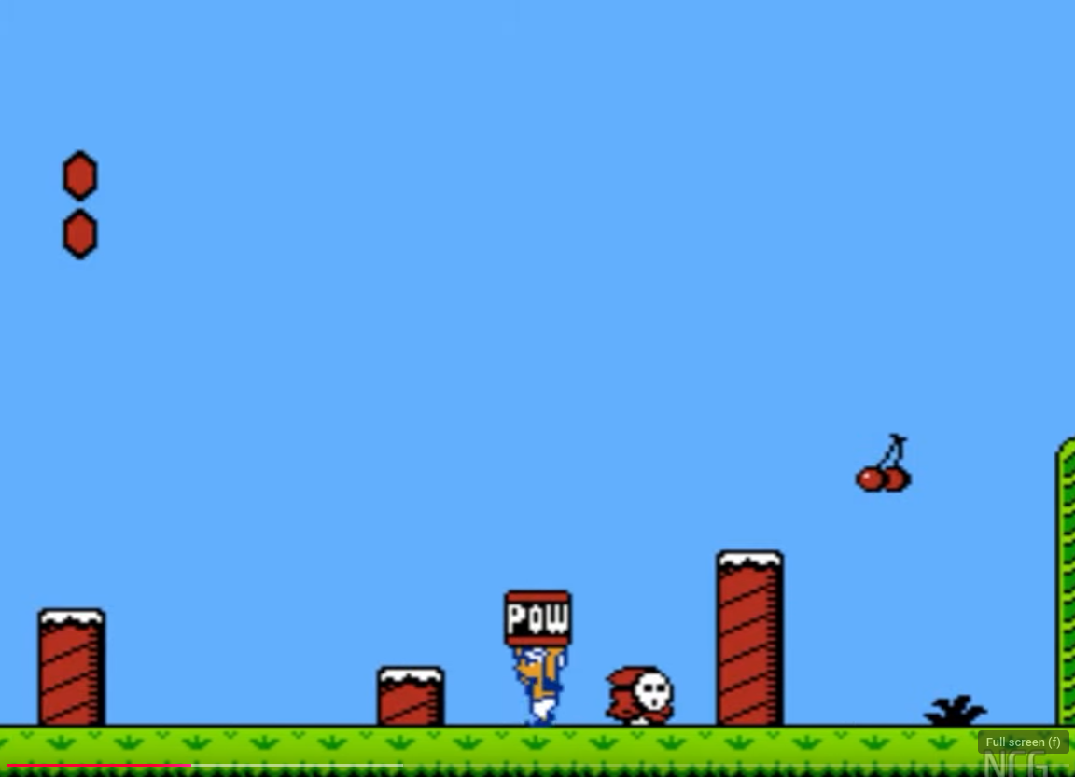
Doki Doki Panic for the Famicom Disk System is more commonly known to American’s as what title?
Super Mario Bros 2

Slide 5
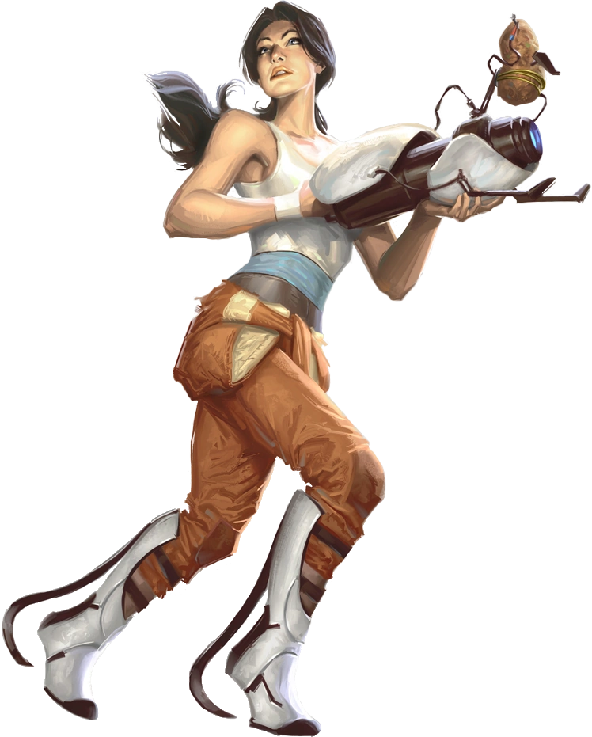
How did we first discover Chell’s (from Portal) name?
The credits and / or name of game assets in the game files

Slide 6
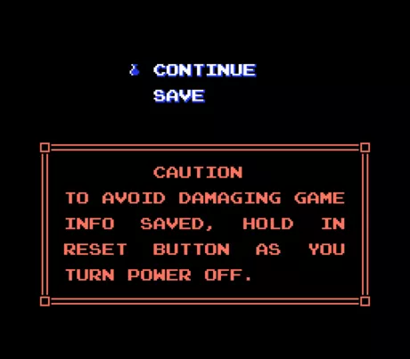
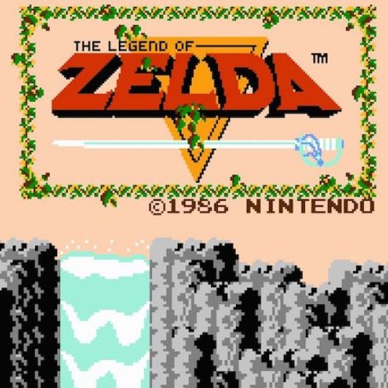
What was the first console game to have a built-in save feature?
Legend of Zelda (NES)

Slide 7
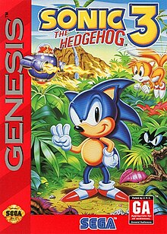
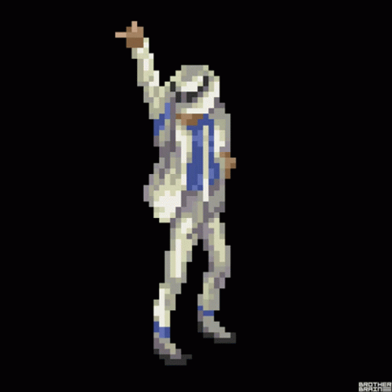
What well known pop artist helped on the Sonic the Hedgehog 3 soundtrack?
Michael Jackson

Slide 8
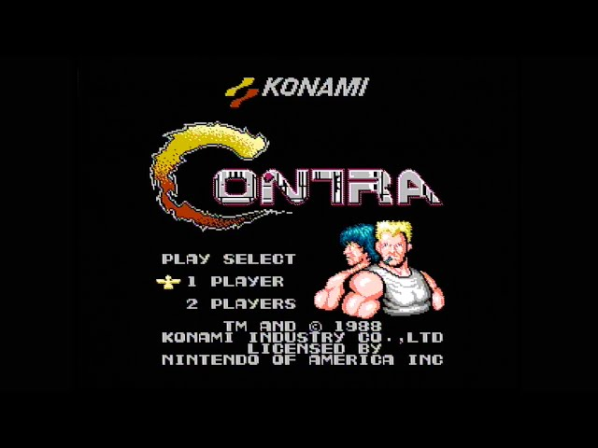
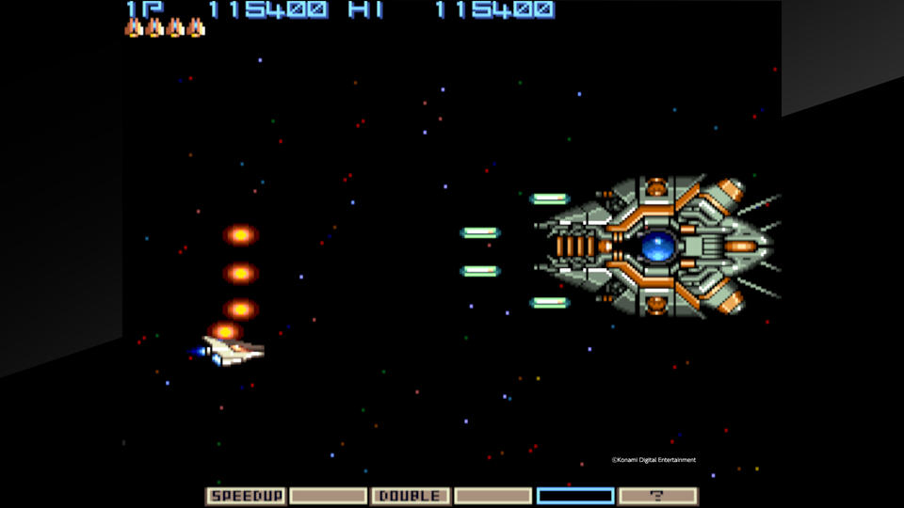
What is the Konami code? What game does it kill you in?
↑↑↓↓←→←→BA (start)
Gradius III (SNES). Power up code became:
↑↑↓↓LRLRBA (start)

Slide 9
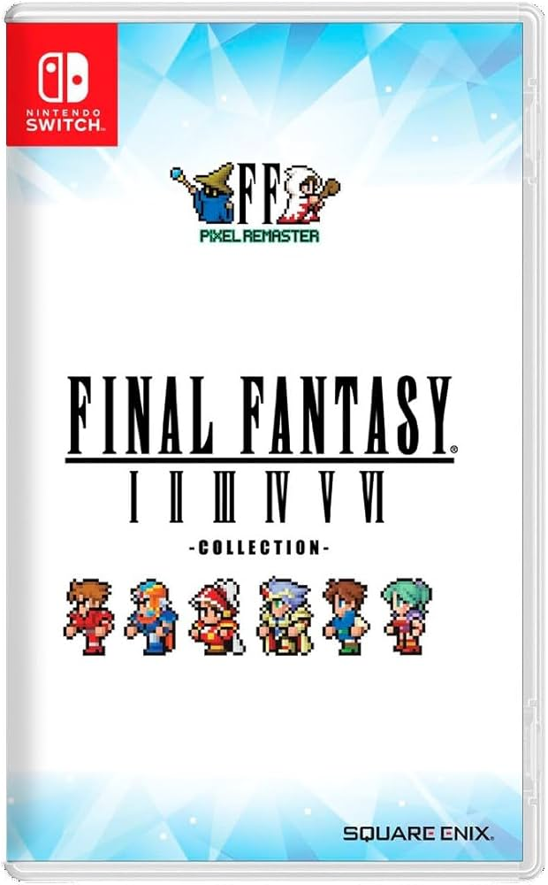
Which Final Fantasy games skipped US releases originally?
2, 3 and 5

Slide 10
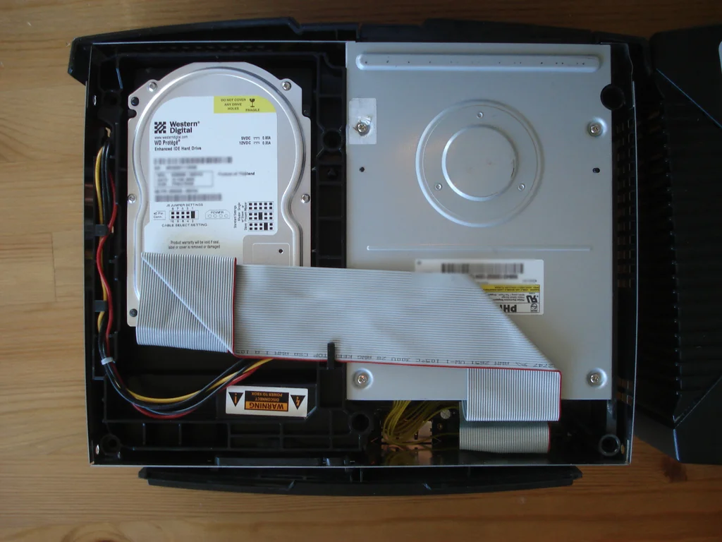
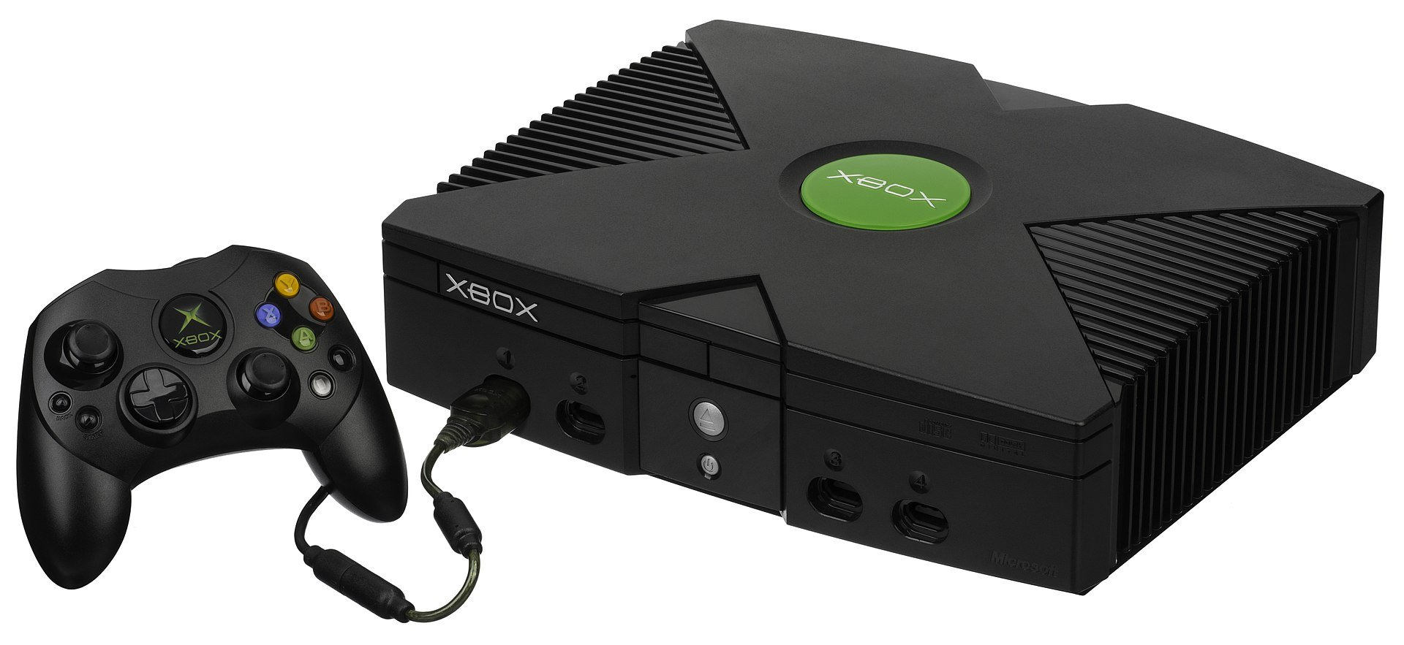
Which game console was the first to come with a hard drive?
XBox

Slide 11
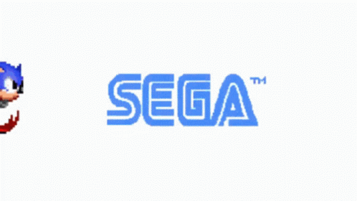
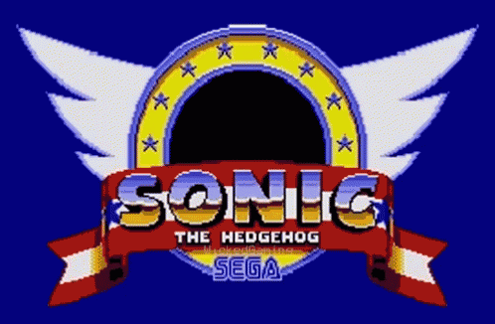
What fraction of Sonic the Hedgehog ROM is devoted to “SEGA” voice?
1/8 of space on cartridge

Slide 12
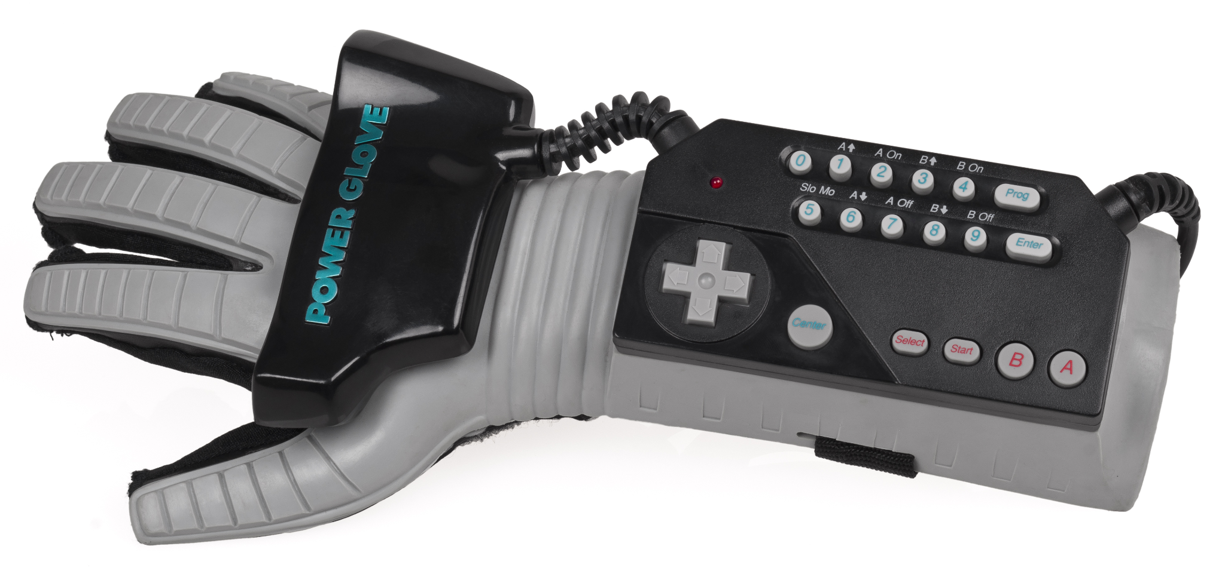
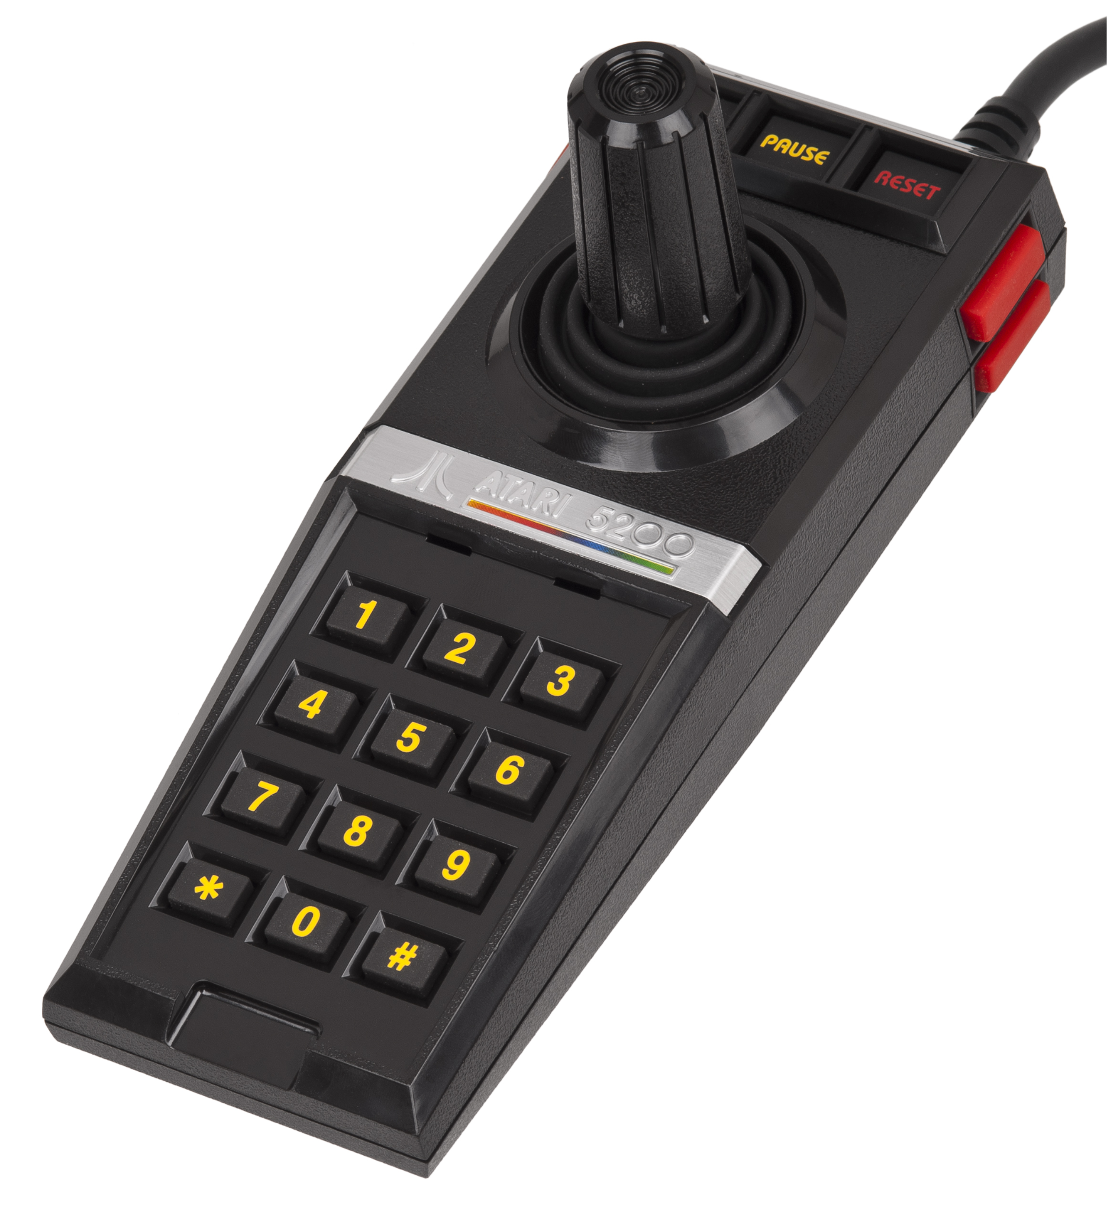
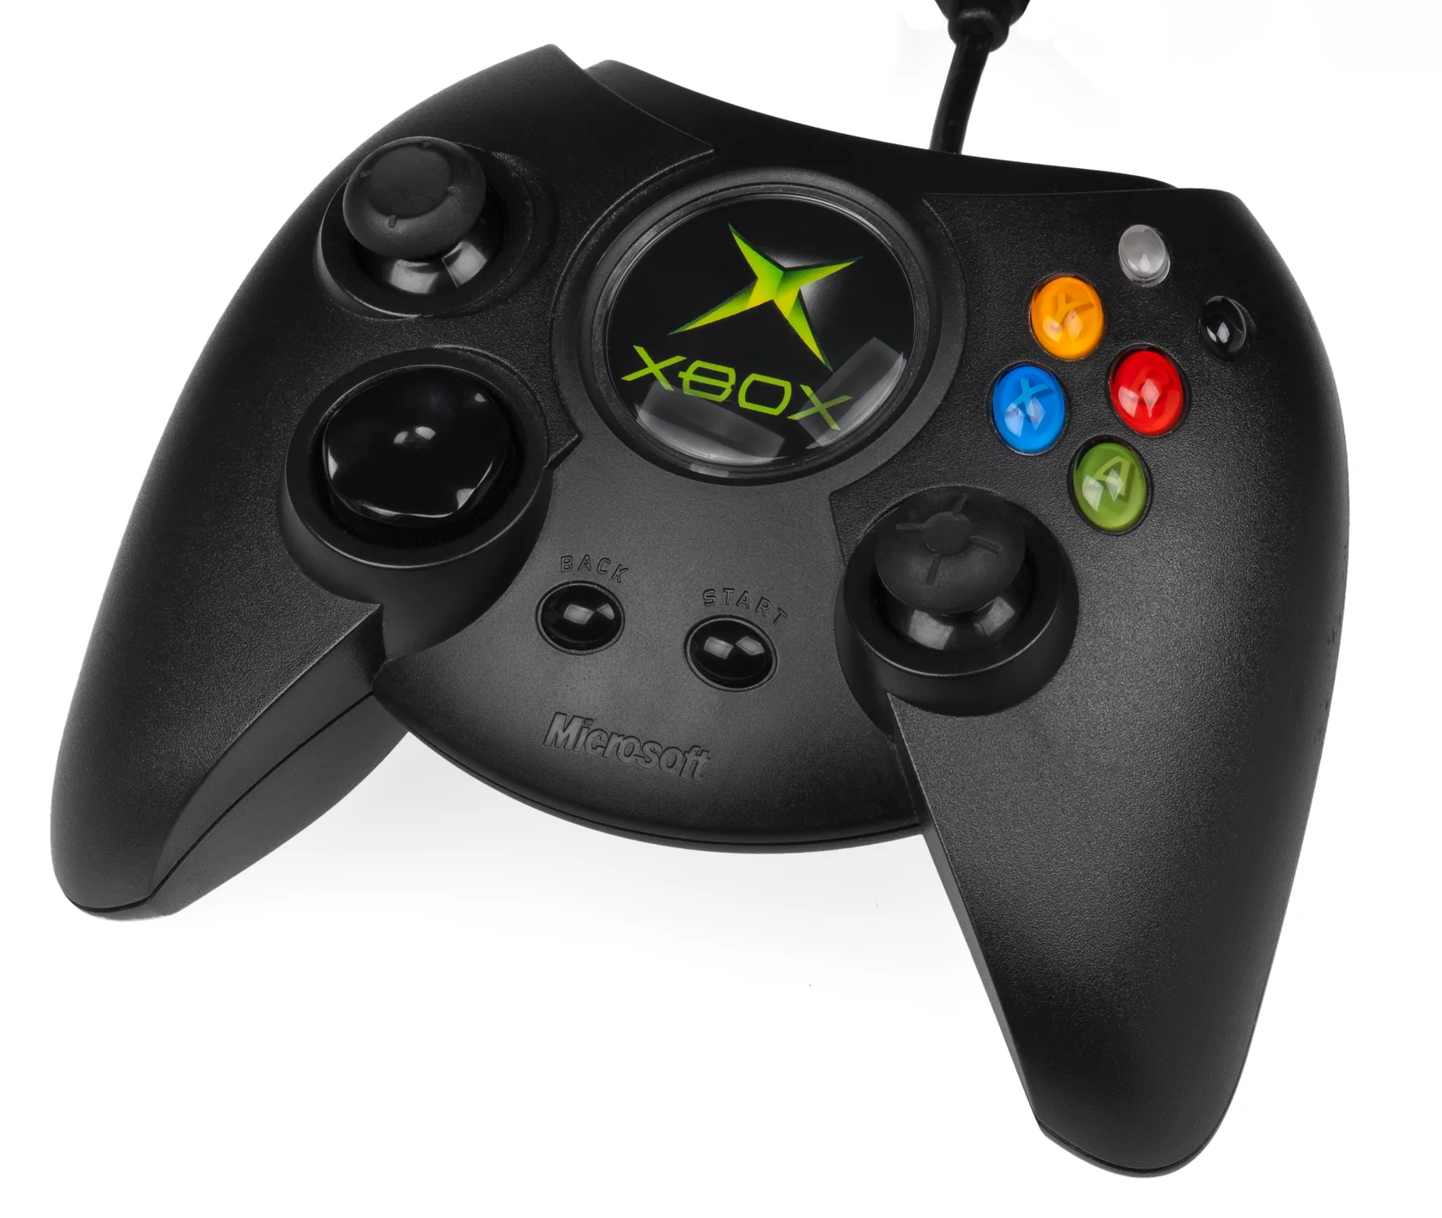
Which console had the worst video game controller ever?
Atari 5200

Slide 13
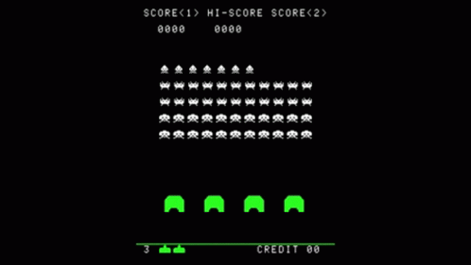
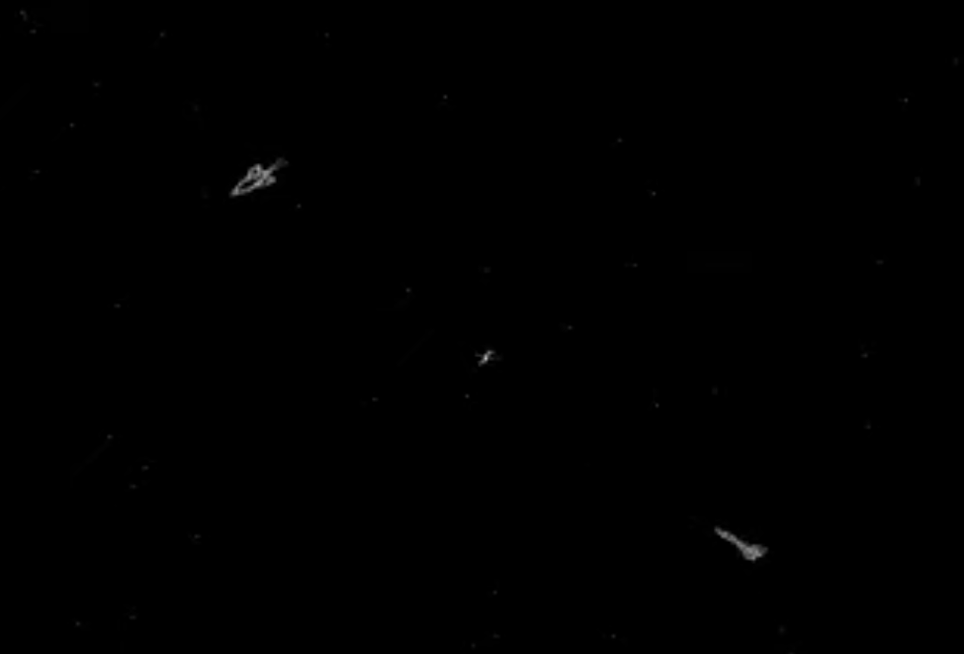
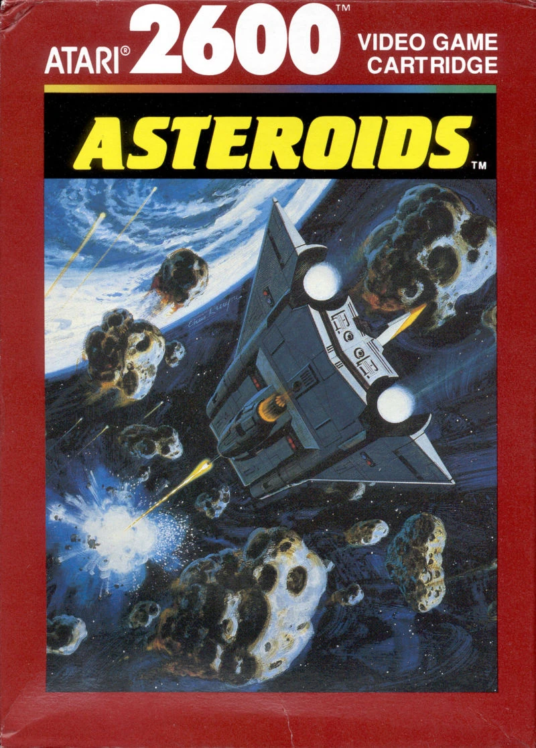
What was the first video game ever?
Space War (1962)
PDP-1

Slide 14
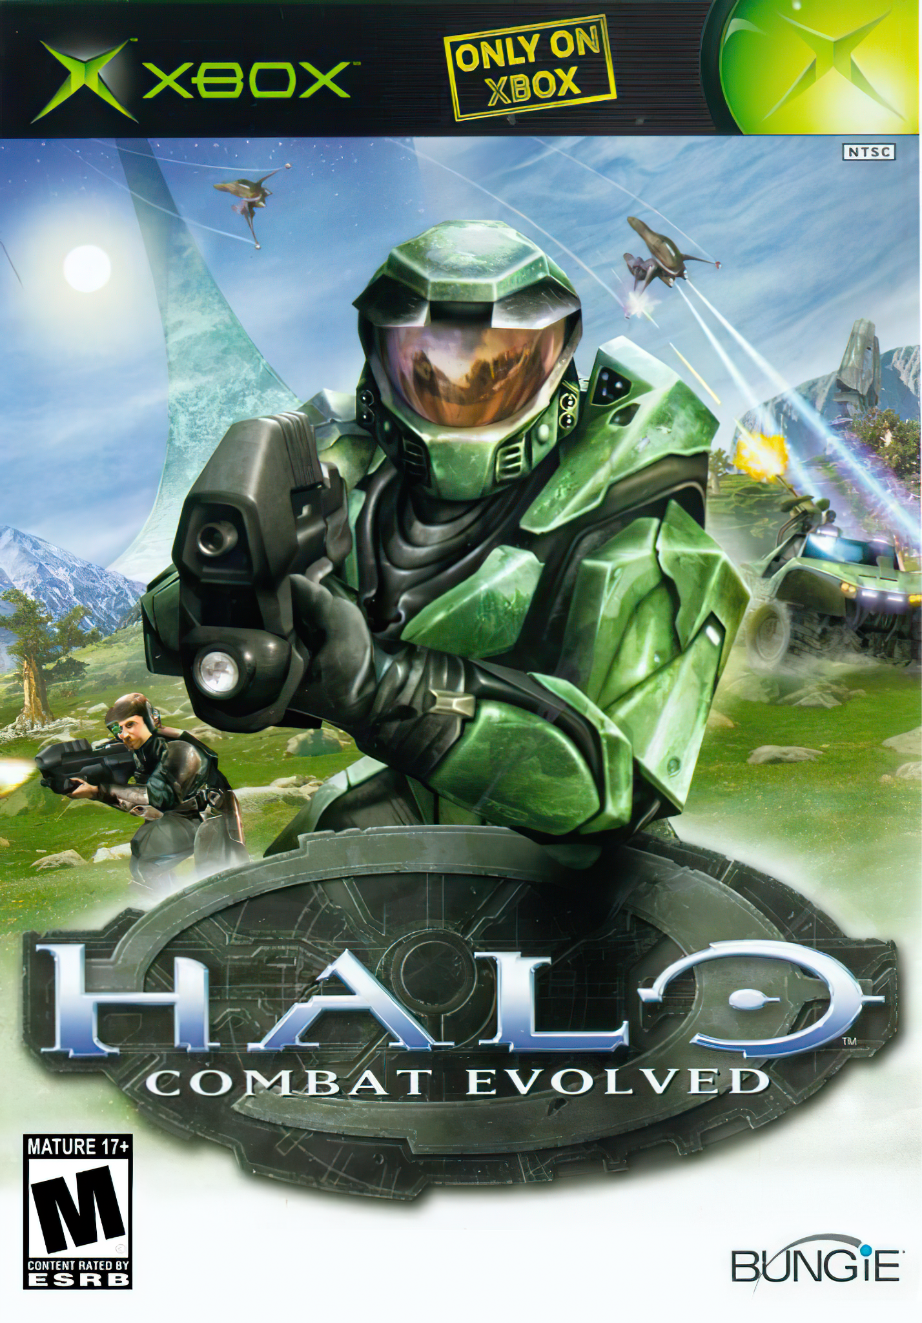
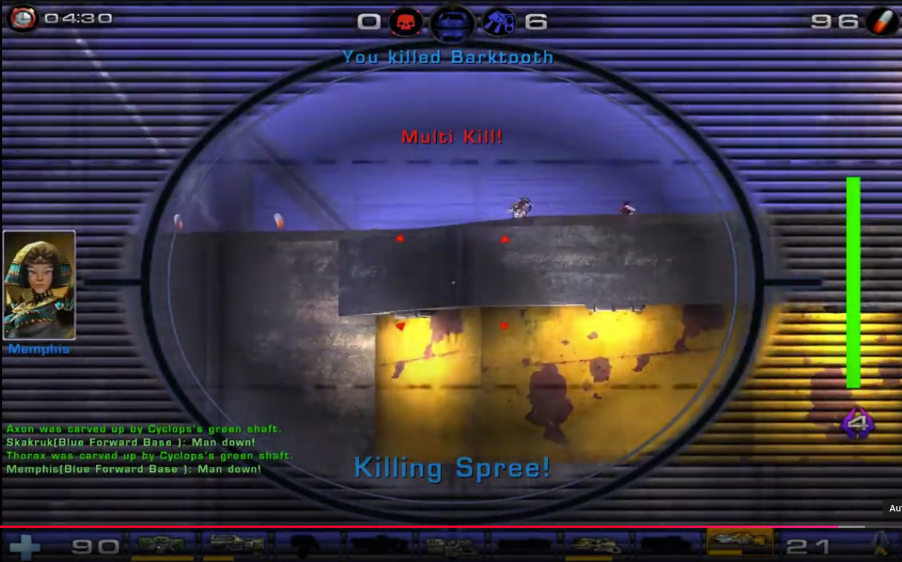
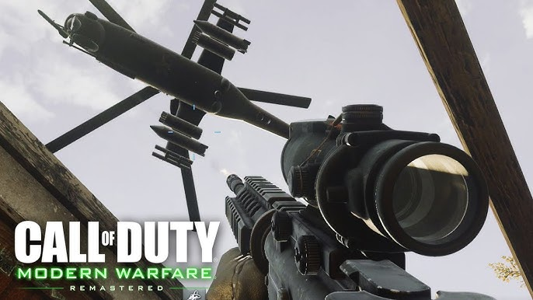
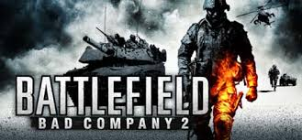
What FPS had killstreak announcements first? Killstreak rewards?
Unreal Tournament
Call of Duty 4: Modern Warfare

Slide 15
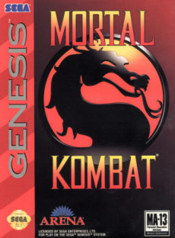
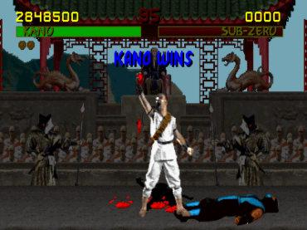
What was the Mortal Kombat blood code?
A, B, A, C, A, B, B

Slide 16
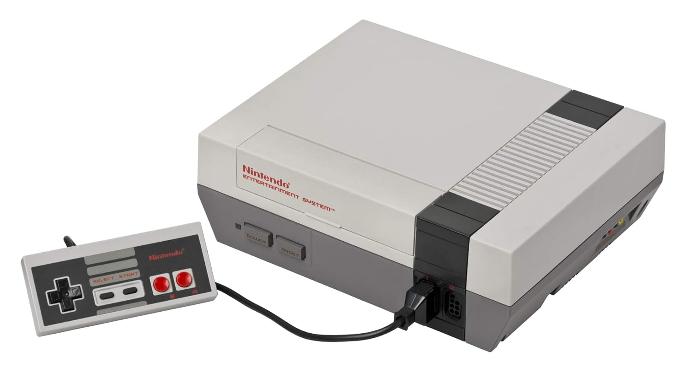
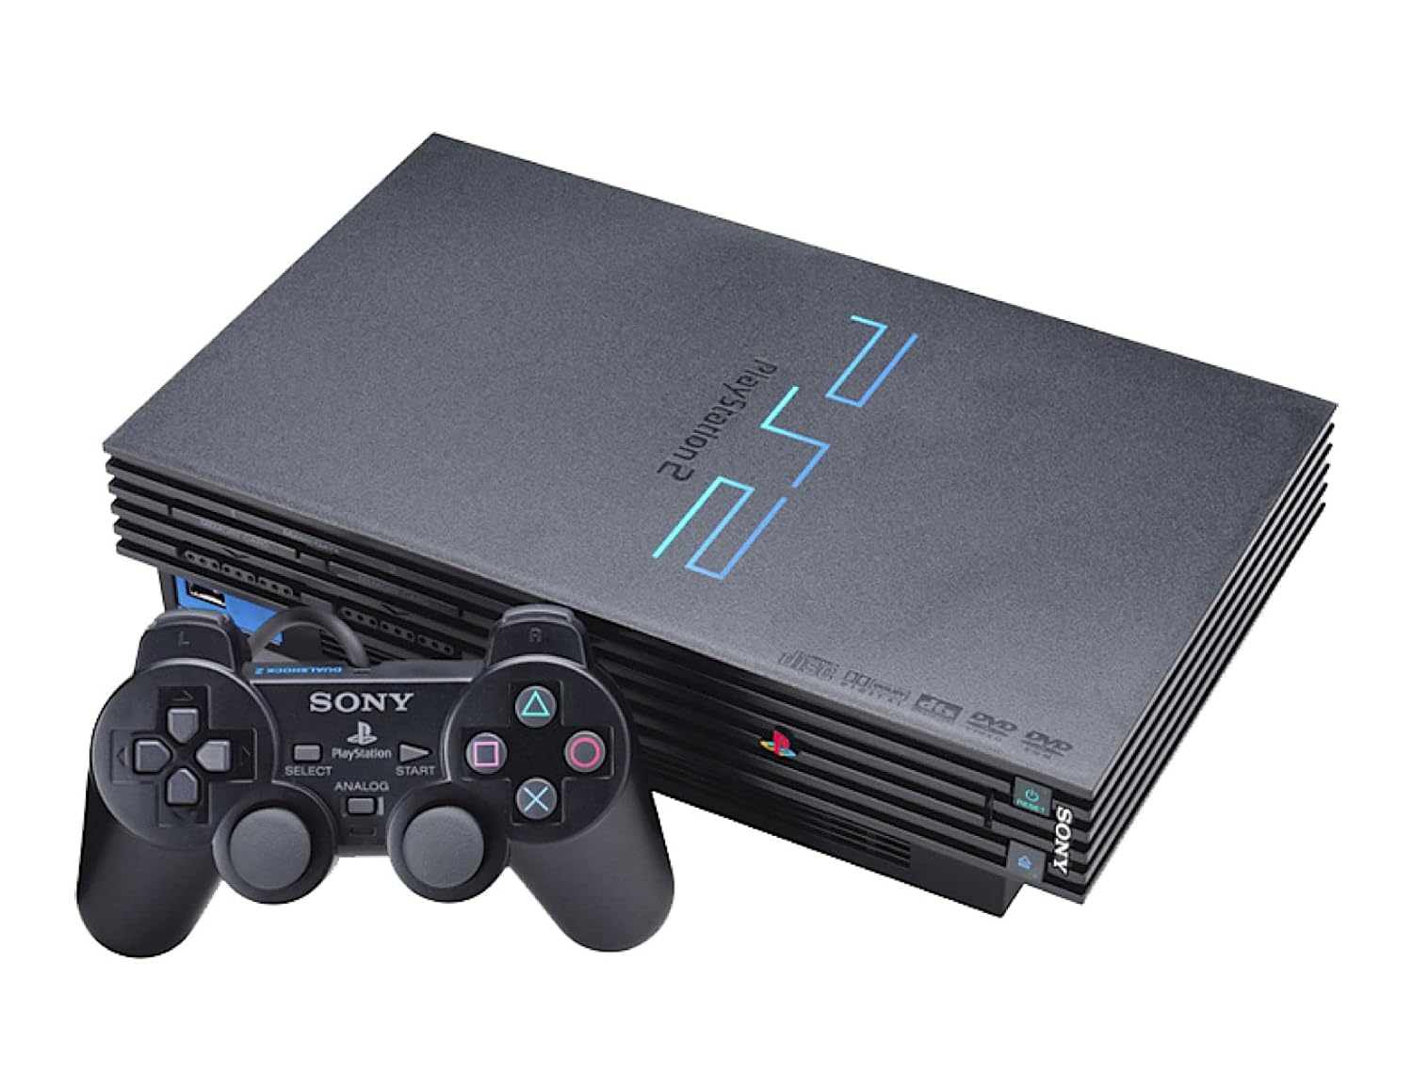
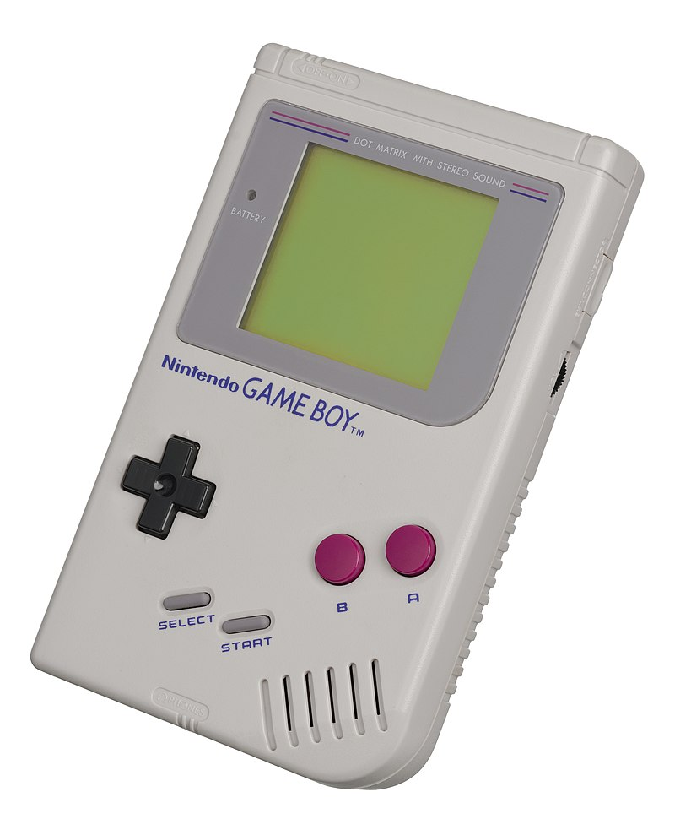
What is the best selling game console of all time
Playstation 2
158 million

Slide 17
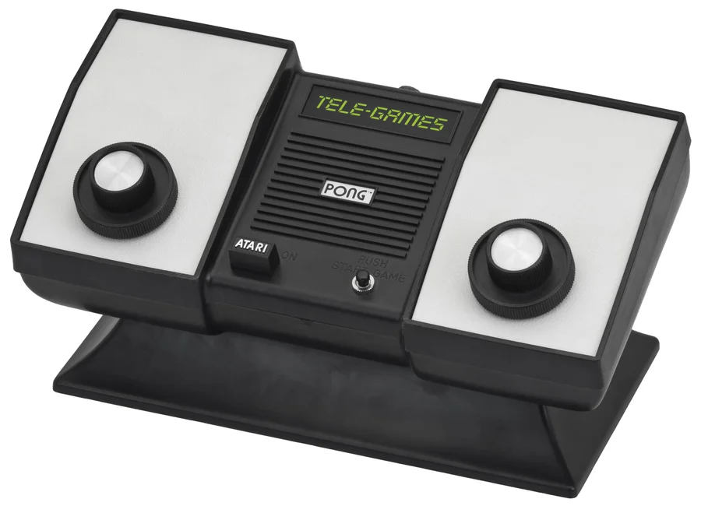
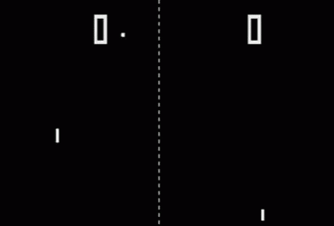
How many lines of code did Pong have?
0. It was all discrete and analog circuits

Slide 18
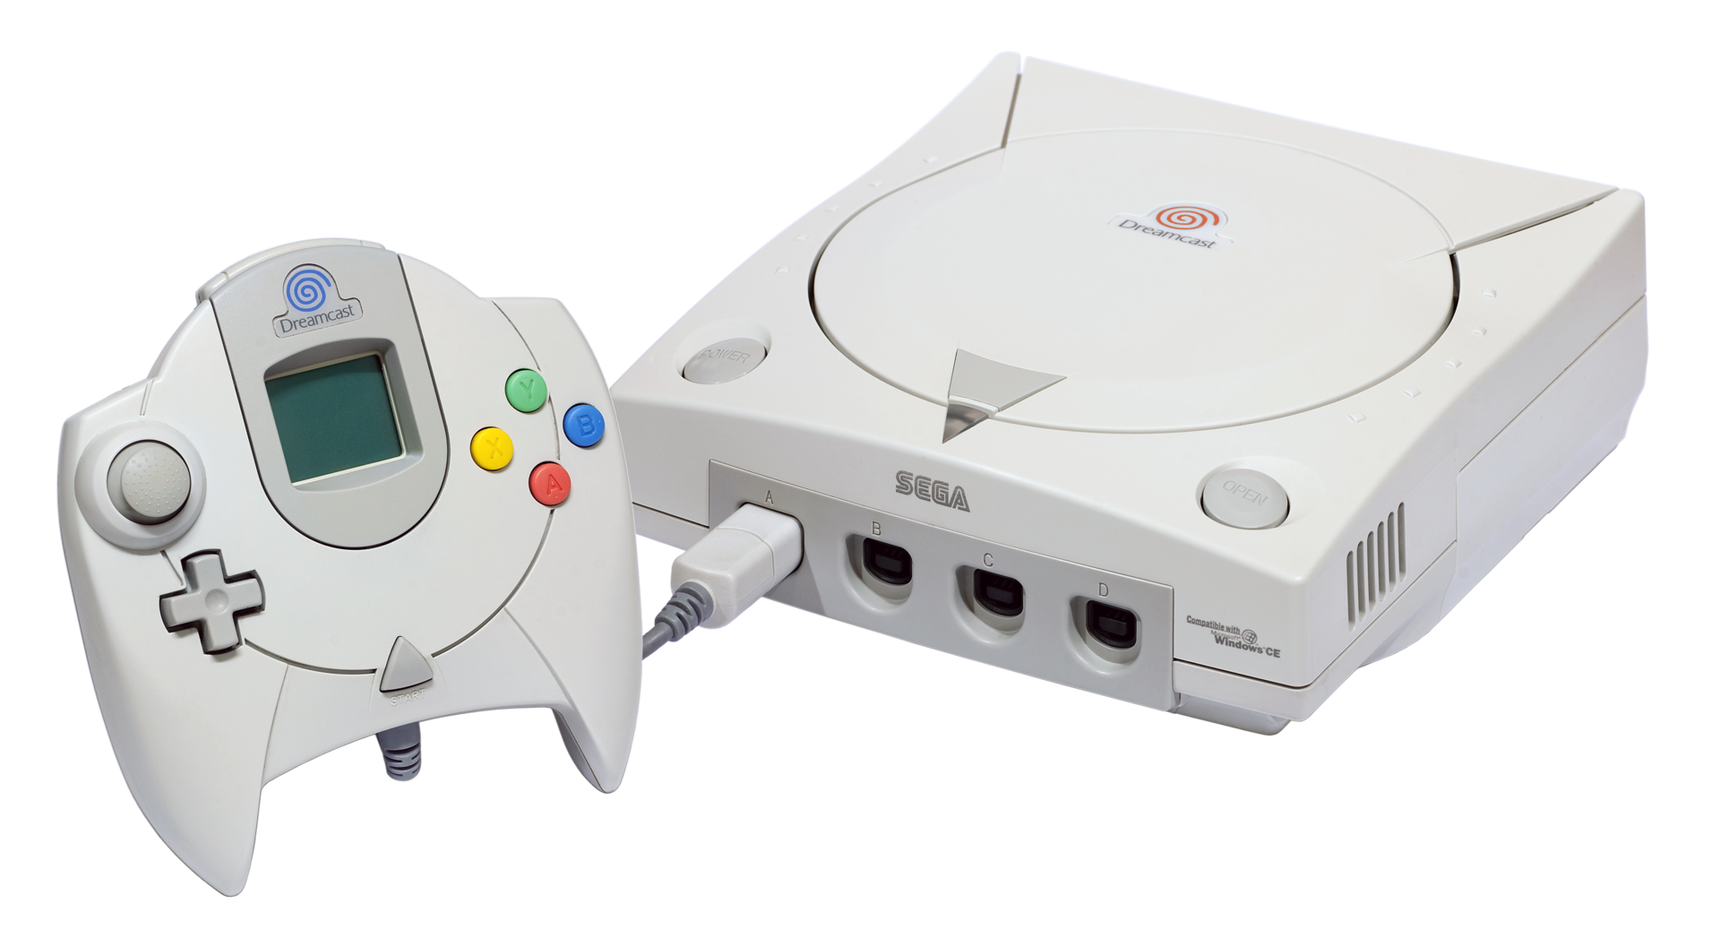
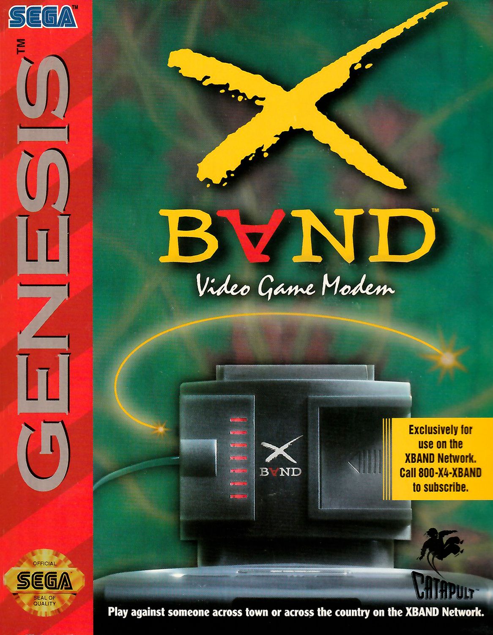
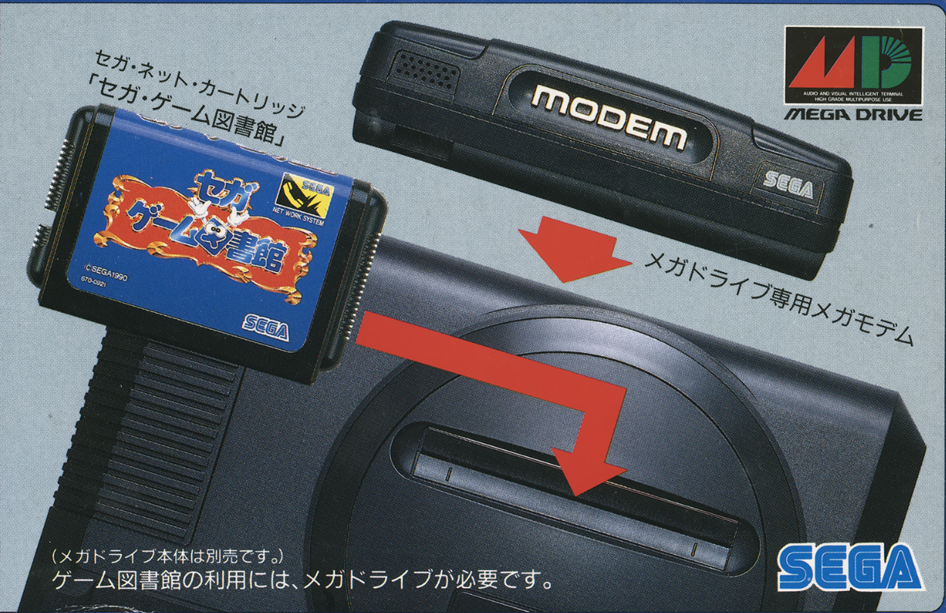
What was the first console to have online multiplayer?
Sega Genesis
MegaNet and X-Band

