Slide 1




PixelPets
PixelPets
Play first.
A tiny companion that leaves the house for you.
Chain when you choose. · Wes · Colosseum Demo Day
Notes:
Hi, I'm Wes. This is PixelPets — a tiny companion that leaves the house for you, and comes back with a postcard you can keep, gift, and prove on Solana.
Not another mint-and-flip pet. Play first. Chain when you choose.
[Script 0:00–0:20 hook — docs/submission/DEMODAY-SCRIPT.md]

Slide 2

PixelPets
the problem
Chain pets lead with hype, not heart
Most on-chain pets lead with speculation, confusing wallets and empty JPEGs.
Travel Frog proved the emotion
Prepare → wait → surprise → show. Solana adds the missing piece — ownership, provenance and gifts — without putting every feed on-chain.
4 beats
prepare · wait
surprise · show
Notes:
Most on-chain pets lead with speculation, confusing wallets, or empty JPEGs. Games like Travel Frog already proved the emotion: prepare, wait, surprise, show.
Solana is perfect for the missing piece — ownership, journey provenance, and gifts — without putting every feed on-chain. That's why we built this for Colosseum now.
[Script 0:20–0:45]

Slide 3


PixelPets
the player loop
Five steps, one cozy loop
01
02
03
04
05
Adopt
Care
Travel
Postcard + Album
Optional chain
Moss, Puddle or Wisp. Free, no wallet.
Soft timers. Pets never die from neglect.
Pack a bag, pick a place, wait for news.
A story postcard and keepsakes to collect.
Claim, journey receipt, gift — when you choose.
back home → care → the next trip
Emotion order: prepare → wait → surprise → show → share
Notes:
The loop is five steps:
1. Adopt Moss, Puddle, or Wisp — free, no wallet.
2. Care on soft timers; pets never die from neglect.
3. Travel — pack a bag, pick a place. Demo trips are labelled accelerated.
4. Return — a story postcard, maybe a keepsake in your Album.
5. Optional chain — claim a Metaplex Core companion, save a journey receipt, gift to a friend.
Emotion order: prepare → wait → surprise → show → share.
[Script 0:45–1:15]

Slide 4
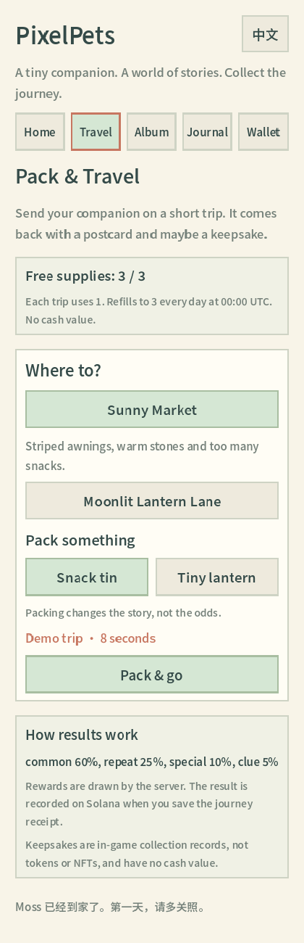
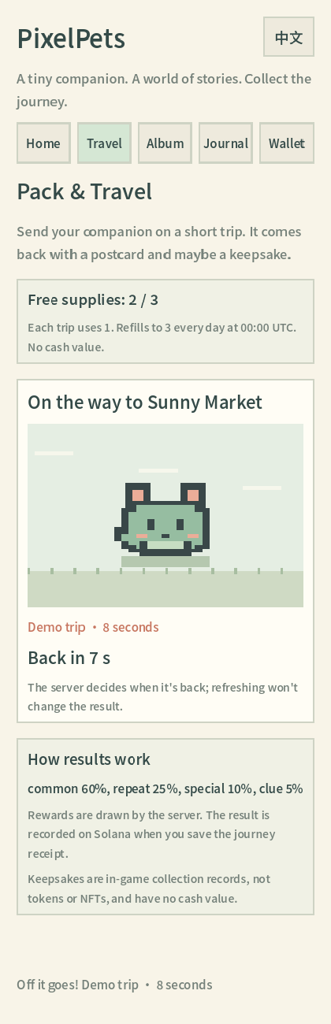
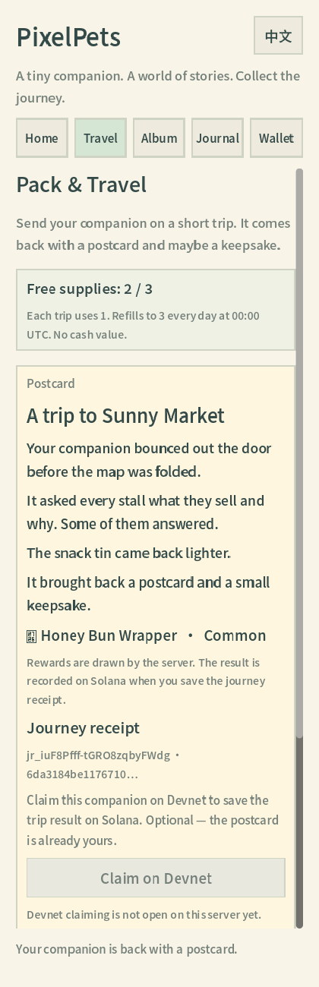
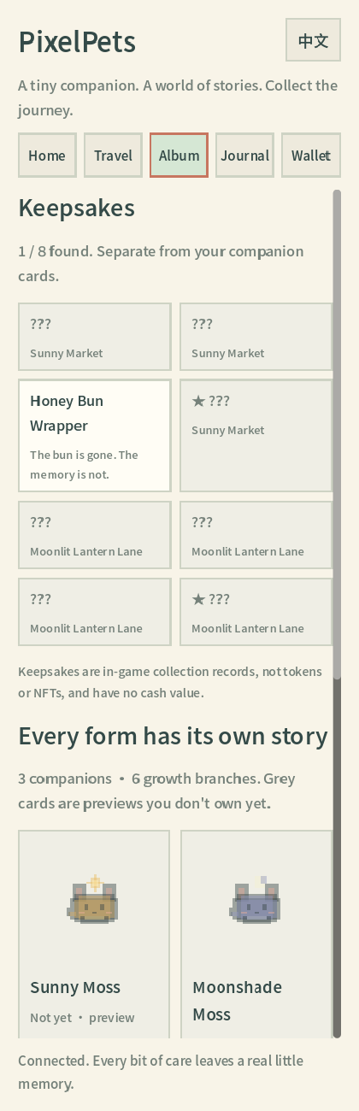
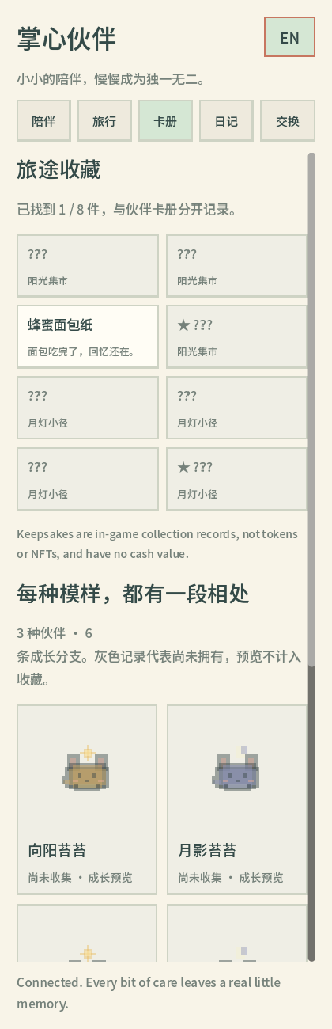
PixelPets
real product screens
Every beat is already playable
SCREENS
Travel
Away
Postcard
Album
Chinese UI
Notes:
Real screens from the live build (docs/evidence/ui-smoke): travel, away, postcard, album, Chinese UI.
3. Travel — pack a bag, pick a place. Demo trips are labelled accelerated.
4. Return — a story postcard, maybe a keepsake in your Album.
Emotion order: prepare → wait → surprise → show → share.
[Script 0:45–1:15, player loop]

Slide 5
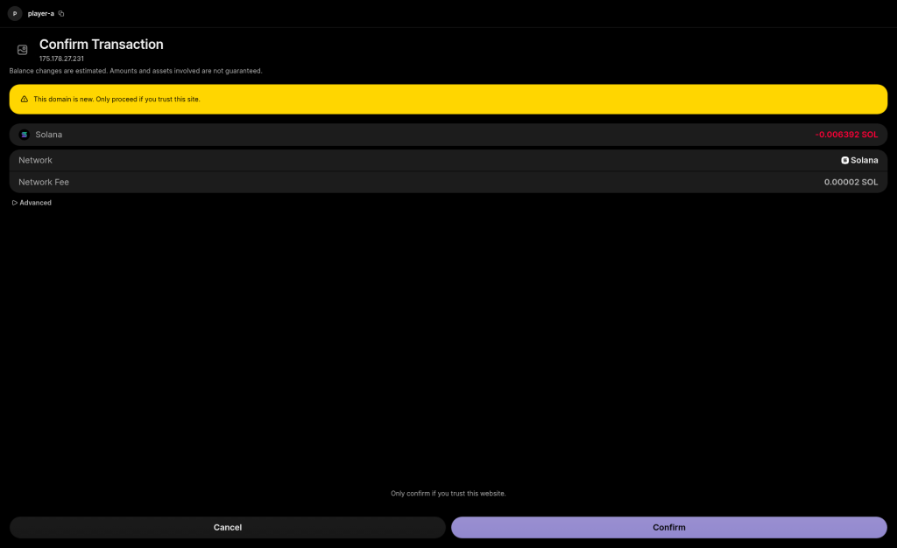
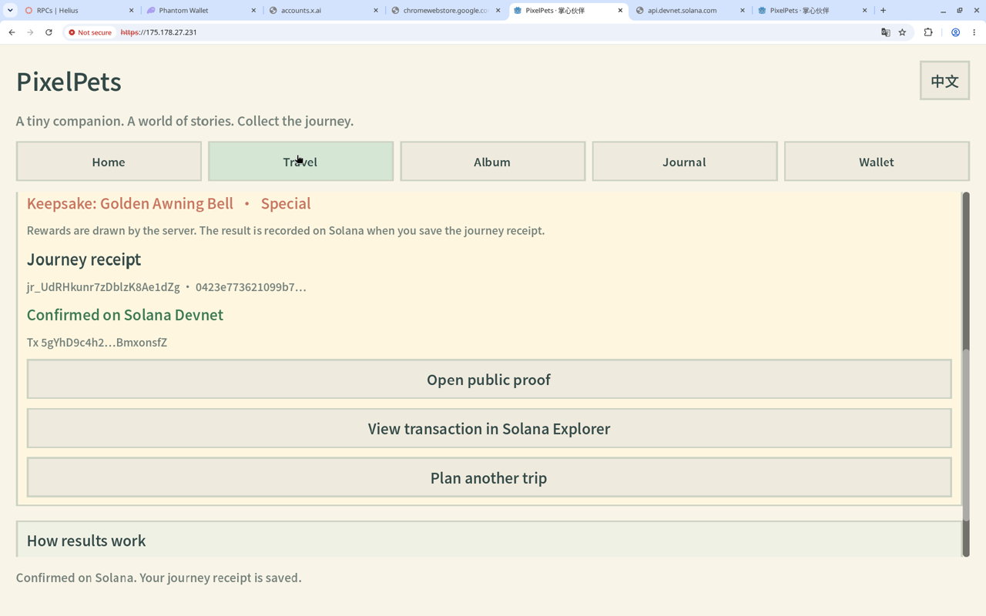
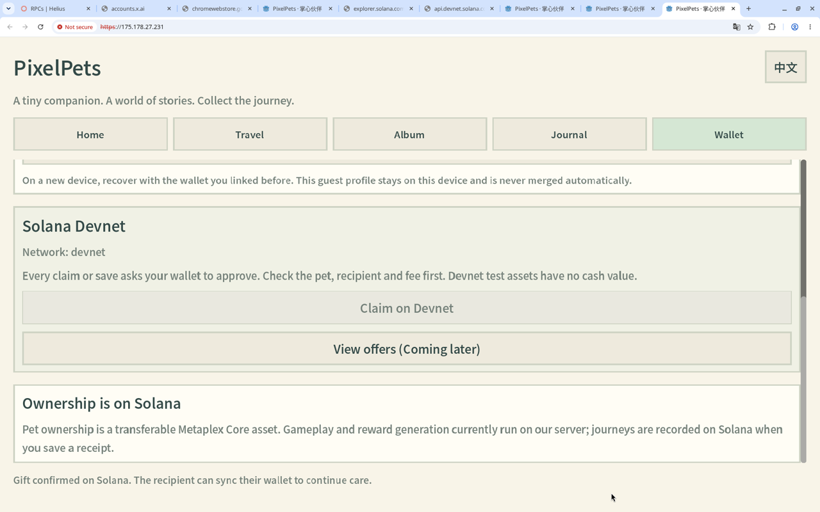
PixelPets
live demo
Real Phantom, real Devnet, live today
DEMO
1 Claim
2 Journey receipt
3 Gift
Co-signed Metaplex Core companion — you see network, asset, fee.
Checkpoint v2 receipt: the settled trip, hashed on-chain.
Owner-signed transfer; the friend syncs and keeps caring.
Live: https://175.178.27.231/ · real Phantom on Solana Devnet
Demo video: github.com/weswes233/PixelPets/releases/download/demo-videos-2026-10-10/PixelPets-product-demo-en-v5.mp4
Notes:
Option A — play the product demo video (recommended): https://github.com/weswes233/PixelPets/releases/download/demo-videos-2026-10-10/PixelPets-product-demo-en-v5.mp4
- "Here is a real Phantom on Devnet."
- Claim popup: "Co-signed claim — you see network, asset, fee."
- Receipt confirmed: "Checkpoint v2 journey receipt — settled trip hashed on-chain."
- Gift success: "Owner-signed transfer; the friend syncs and keeps caring."
Option B — live at https://175.178.27.231/ (accept the self-signed certificate): Adopt / open Moss → Care → Connect Phantom → Claim → Save journey receipt → open Explorer.
[Script 1:15–2:00] Images: docs/evidence/phantom-p0-2026-10-10/screens/

Slide 6
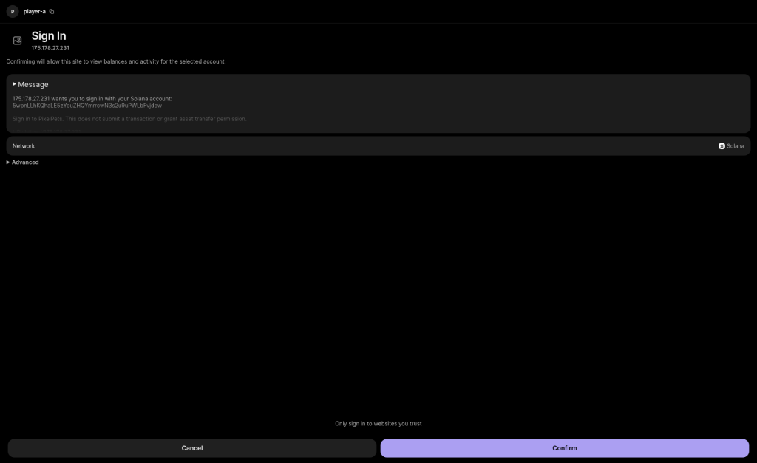
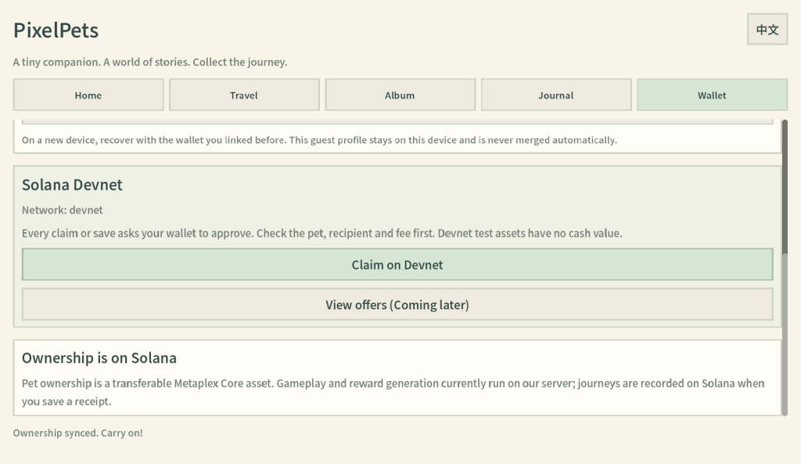
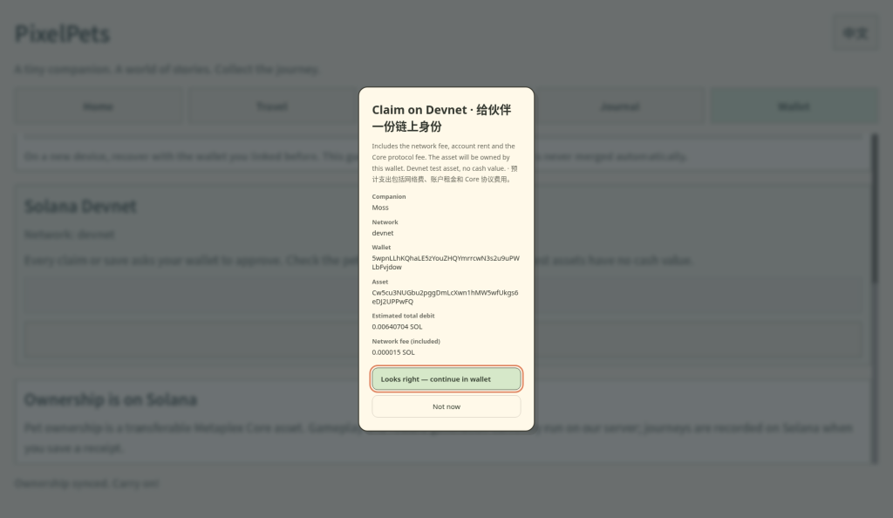

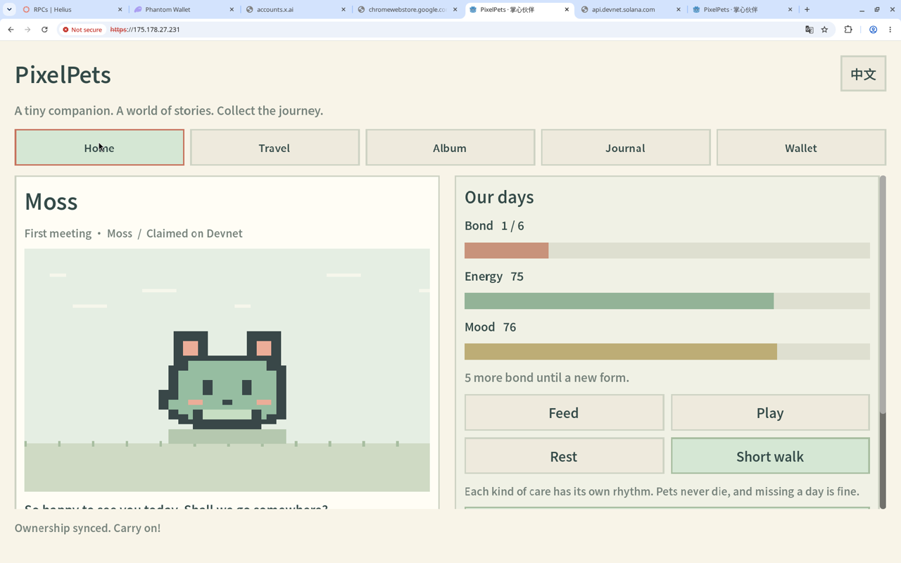
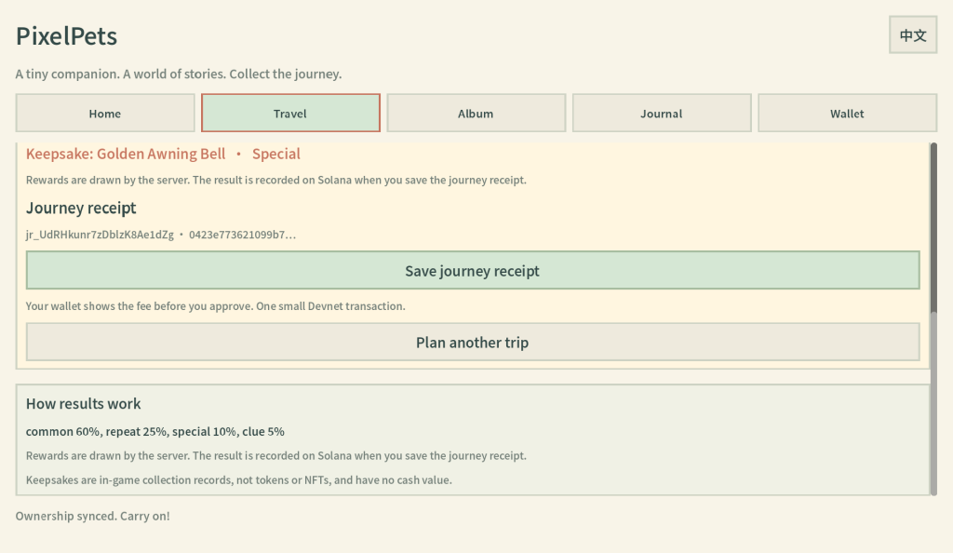
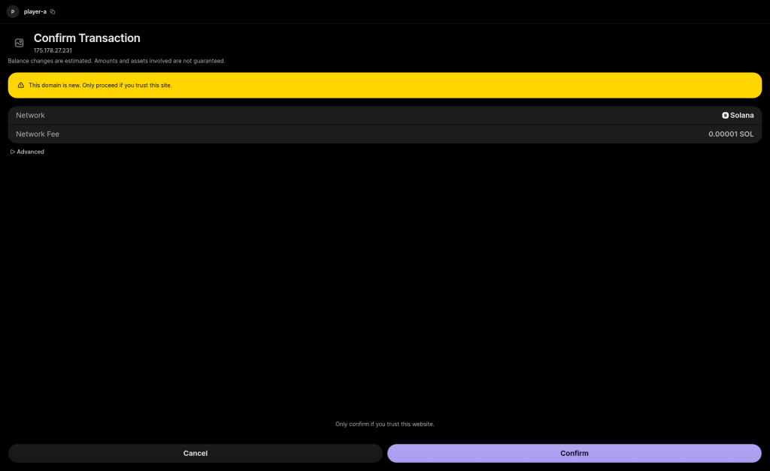
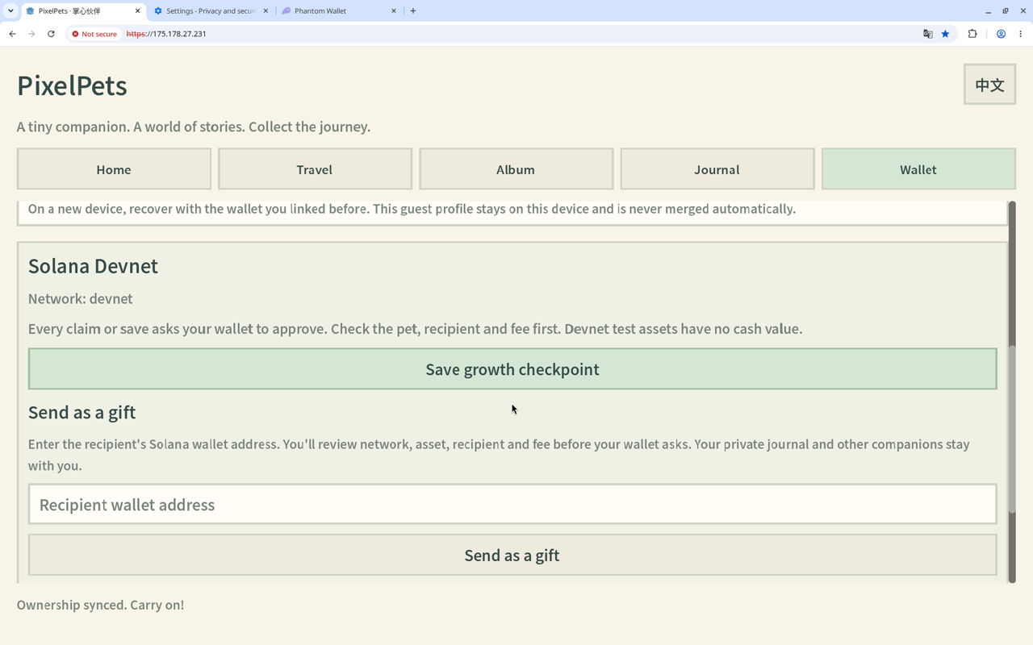
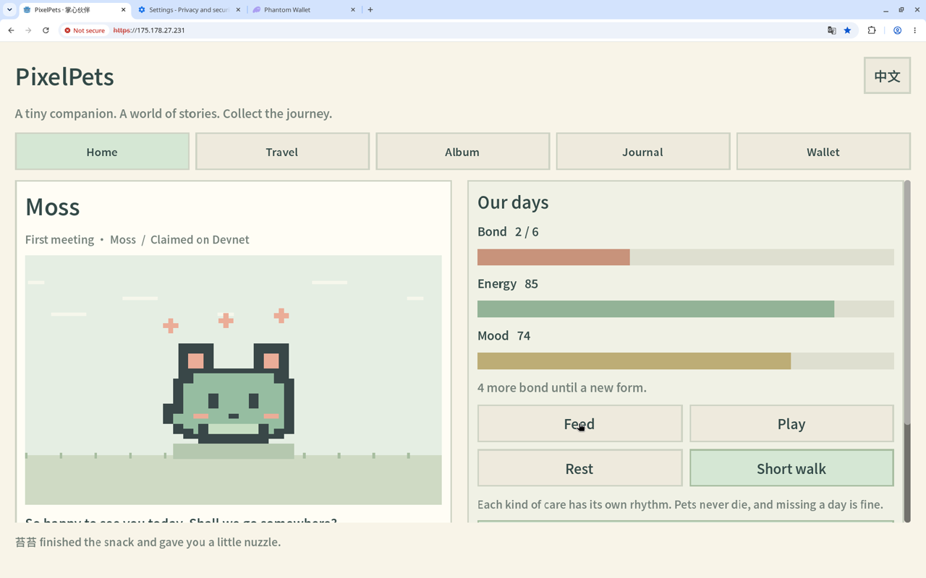
1 Sign in with Solana
2 Wallet connected
3 Review the claim
Real transactions on Devnet
4 Claimed on Devnet
5 Receipt ready
6 Sign the receipt
7 Friend's wallet syncs
8 Friend keeps caring
Every step is a real Phantom signature on Solana Devnet — QA run of Oct 10, 2026. Gift ran end to end with a second wallet.
Notes:
Key frames to call out:
- "Here is a real Phantom on Devnet."
- Claim: "Co-signed claim — you see network, asset, fee."
- Receipt: "Checkpoint v2 journey receipt — settled trip hashed on-chain."
- Gift: "Owner-signed transfer; the friend syncs and keeps caring."
(Bonus) We already ran gift sync + feed with a second wallet.
[Script 1:15–2:00] Screens: docs/evidence/phantom-p0-2026-10-10/screens/ (v3-01…v3-07, gift5-synced, gift5-feed)

Slide 7

PixelPets
on-chain, on purpose
What lives on Solana
03.
04.
Anchor program + Metaplex Core collection on Devnet. Daily care and travel RNG stay off-chain — the chain stores provenance, not every snack.
Journey receipt
Gift
Checkpoint v2: settled trip hashed, public proof verified.
Owner-signed Core transfer; recipient syncs & keeps caring.
01.
02.
Claim
PetRecord
Metaplex Core companion, co-signed.
Written on claim; stores checkpoint hashes.
Program 2SCKfWszFZuqsjcmRbtmctHwZTgQopYmGSofoEtQm2nT · Solana Devnet
Notes:
On Solana Devnet: Anchor program + Metaplex Core collection, three limited editions.
- Claim writes a PetRecord.
- Journey receipt stores a hash of the settled trip — public proof, independently checked.
- Gift is a Core transfer the owner signs.
Daily care and travel RNG stay off-chain for UX. The chain stores provenance, not every snack.
Program: 2SCKfWszFZuqsjcmRbtmctHwZTgQopYmGSofoEtQm2nT — live in the repo README and Explorer.
[Script 2:00–2:25]

Slide 8

PixelPets
architecture
Care off-chain, proof on-chain
Solana Devnet
Godot Web client
Node + SQLite server
Adopt, care, travel and album — right in the browser.
API
Care timers, travel RNG; settles each trip.
Anchor program
co-sign
trip hash
PetRecord + checkpoint v2 journey receipts.
connect
Metaplex Core
Companion asset; owner-signed transfers.
Phantom wallet
signs claim · receipt · gift
The player signs, only when they choose.
Off-chain for UX: daily care + travel RNG. On-chain for trust: identity, provenance, gifts.
Notes:
Daily care and travel RNG stay off-chain for UX. The chain stores provenance, not every snack.
Q&A — Is travel RNG fair? Server settles the trip; chain stores the hash + public proof id.
Q&A — Mobile? Godot Web today; mobile later if retention proves out.
[Script 2:00–2:25 and Q&A prep]

Slide 9
PixelPets
differentiation
What we take, what we leave
Travel Frog
Typical NFT pet
Axie-style
WE TAKE
Offline hope + souvenirs
WE LEAVE
Nothing to chain
WE TAKE
Ownership + gifts
WE LEAVE
Daily feeds on-chain & token emissions
WE TAKE
Bond + evolving forms
WE LEAVE
Speculative breeding on day one
Notes:
Not another mint-and-flip pet. Play first. Chain when you choose.
Games like Travel Frog already proved the emotion: prepare, wait, surprise, show. We keep that, add ownership and gifts, and leave out daily feeds on-chain, token emissions and speculative breeding.
Q&A — Why no token? Emotion retention first; cosmetics later if unpaid players stick.
[Script hook + 0:20–0:45; Q&A prep]

Slide 10

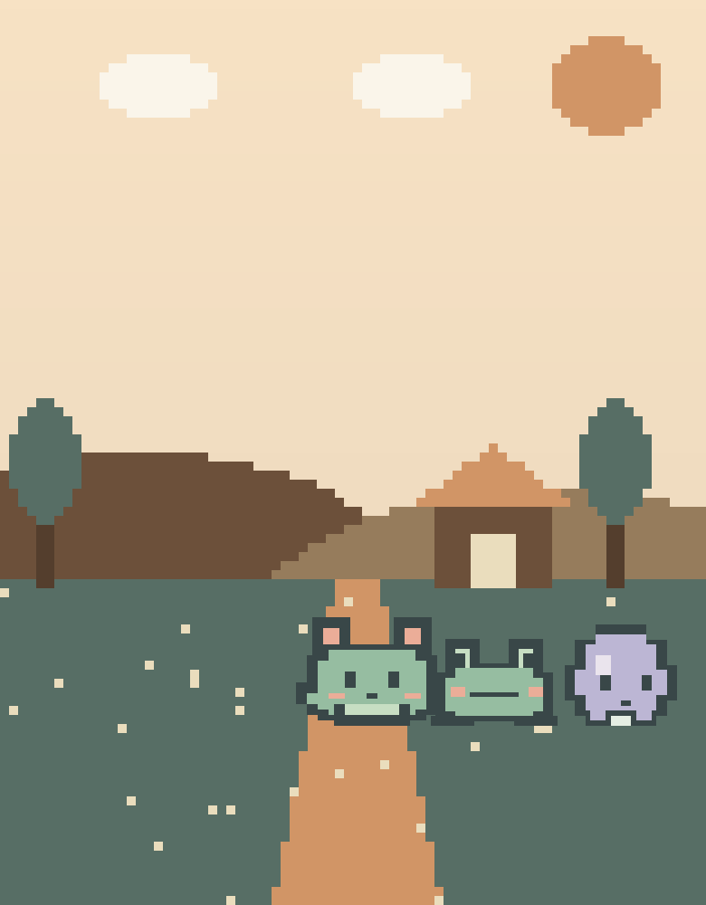
PixelPets
business model
0
project tokens
Free
care & supplies
Devnet today
No cash value yet — by design.
How it earns, later
Previewable cosmetics, room frames and theme route packs — not emissions, not a casino wrapped as a pet.
Kill criterion: if players only ask “wen token”, we fix the toy.
Notes:
Devnet only today — no cash value. No project token by design.
Later: fixed cosmetics and theme packs players can preview — not emissions, not a casino wrapped as a pet. If players only ask "wen token," we fix the toy, we don't print a chart.
[Script 2:25–2:45]

Slide 11


PixelPets
roadmap & ask
Loop shipped, stories next
01
02
03
04
Core loop
Real-wallet QA
More stories
Mainnet
Travel loop, album and the Devnet program.
Real Phantom claim, receipt & gift QA; public demo.
More routes & stories; a cosmetics test.
Mainnet only after review.
1
Done
2
Done
3
Next
4
Later
shipped
shipped
up next
after review
Ask: your feedback on the emotion loop + the Solana surface.
Notes:
We're asking judges for feedback on the emotion loop and the Solana surface area — not whether the tokenomics are aggressive enough.
Q&A — Why Devnet? Ship an honest play-first loop this weekend; mainnet after review.
[Script 2:45–3:00 ask; Q&A prep]

Slide 12
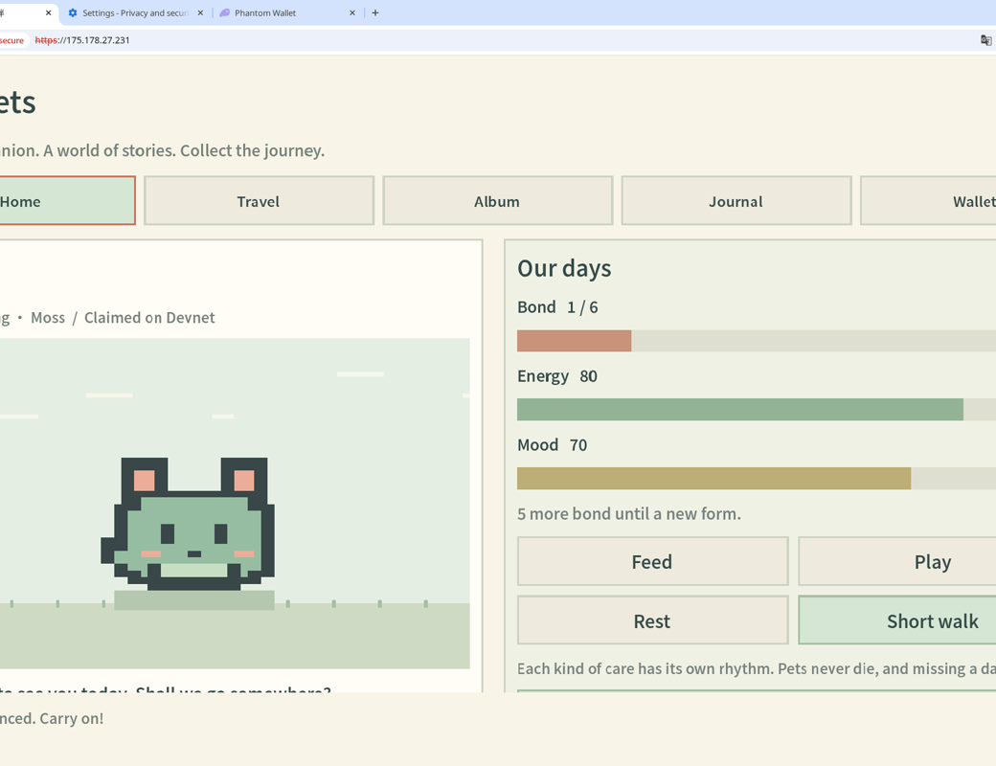
PixelPets
thank you
Try it live
Adopt a pet in your browser — no wallet needed. Connect Phantom on Devnet when you want to claim.
175.178.27.231
bye for now!
github.com/weswes233/PixelPets
X @wess1yan
Questions? Happy to walk you through a claim live.
Notes:
Live demo: https://175.178.27.231/
Repo: github.com/weswes233/PixelPets — default branch is the hackathon build.
X: @wess1yan
We're asking judges for feedback on the emotion loop and the Solana surface area — not whether the tokenomics are aggressive enough.
Thanks — happy to take questions, or walk you through a claim live.
[Script 2:45–3:00]

