Slide 1
3416-003 Web Development Using Angular 8 and TypeScript
Assignment 3 Requirements

Slide 2
Module 1: Section 1
What Is This Course About

Slide 3
Basic Requirements
Requirements:
<div class="container">
<div class="row">
<div class="col-xs-12 col-sm-10 col-md-8 col-sm-offset-1 col-md-offset-2">
<!-- Add a Form with the following Inputs (and Validators)
1 Mail address (should not be empty and should be an email address) (2 marks)
2 A Dropdown which allows the user to select from three different Subscriptions ("Basic", "Advanced", "Pro") (2 marks)
Set "Advanced" as Default (2 marks)
3 A Password field (should not be empty) (2 marks)
4 A Submit Button (2 marks)
Display a warning message if the Form is invalid AND was touched. Display a warning message below each input if it's invalid. (2 marks)
Upon submitting the form, you should simply print the Value of the Form to the Console.
(2 marks)
-->
</div>
</div>
</div>

Slide 4
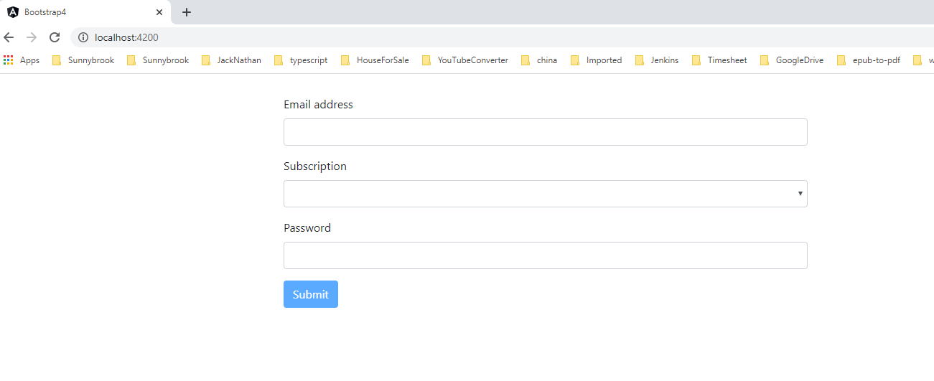
First Load Page

Slide 5
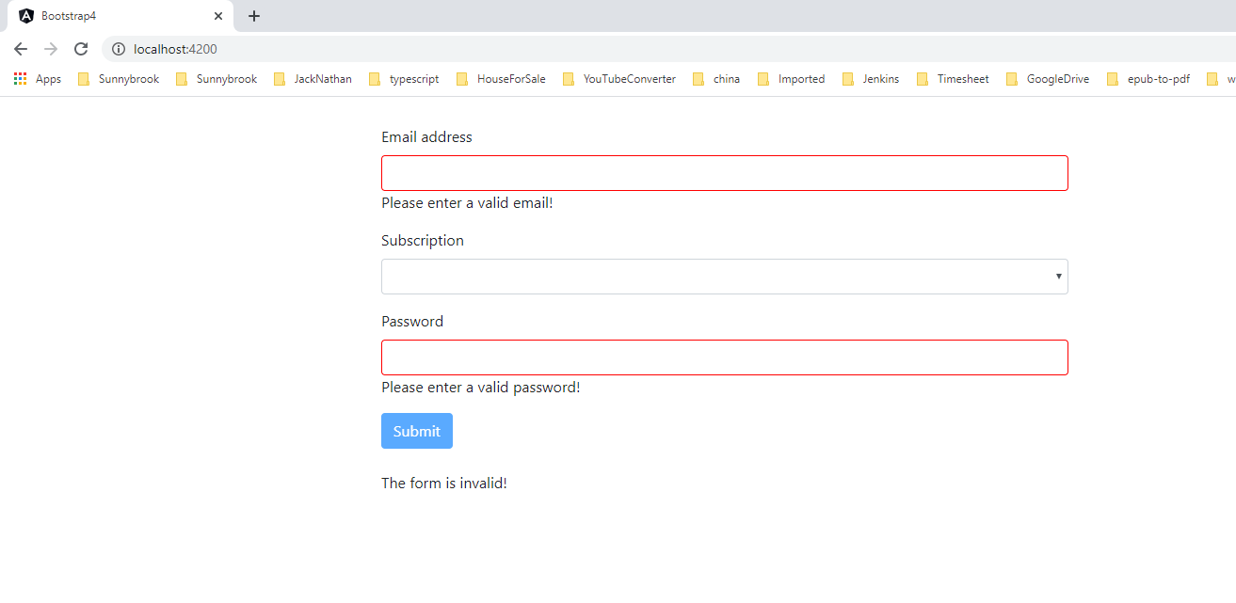
Touched input fields

Slide 6
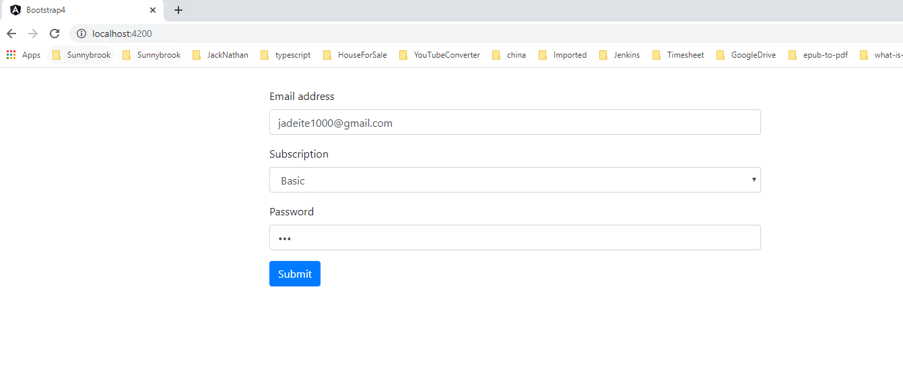
Entered valid values

Slide 7
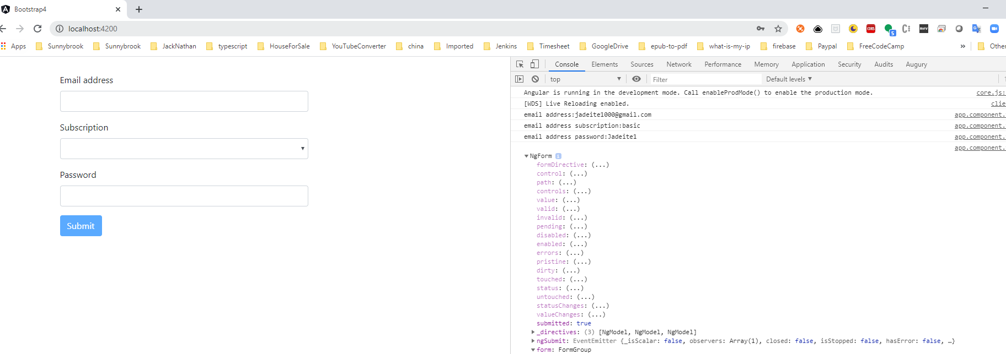
Click Submit button

Slide 8
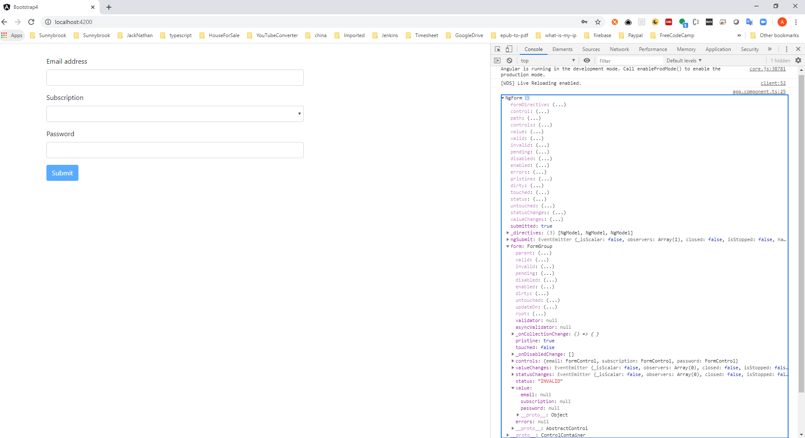
Click Submit button

