Slide 1
A DECLARATION OF INTERNET INDEPENDENCE
We the Users
An internet owned by the people who use it.
JULY 2, 2026
Notes:
Open here. The 250th anniversary of the vote for American independence, reclaimed for the internet. One breath, then move.

Slide 2
WE THE USERS
THE SHADOW YOU CAST
You cast a shadow
you cannot see.
Every click, message, route, and purchase is a trace of a real life. Yours. Gathered and kept, they become a detailed, searchable record of a single person: your digital shadow.
2
Notes:
Make it personal. The shadow is not an abstraction, it is them. Land 'your digital shadow' as the name for it.

Slide 3
WE THE USERS
THE BARGAIN WE NEVER AGREED TO
We the Users have become
we the used.
Your digital shadow is taken without leave, and the value built on it, above all the new artificial intelligence, flows to the few who hold it.
No
No
SAY
SHARE
3
Notes:
The indictment, in four words: We the Users have become we the used. Let the pun land, then the proof, your shadow taken and the value kept: no say, no share.

Slide 4
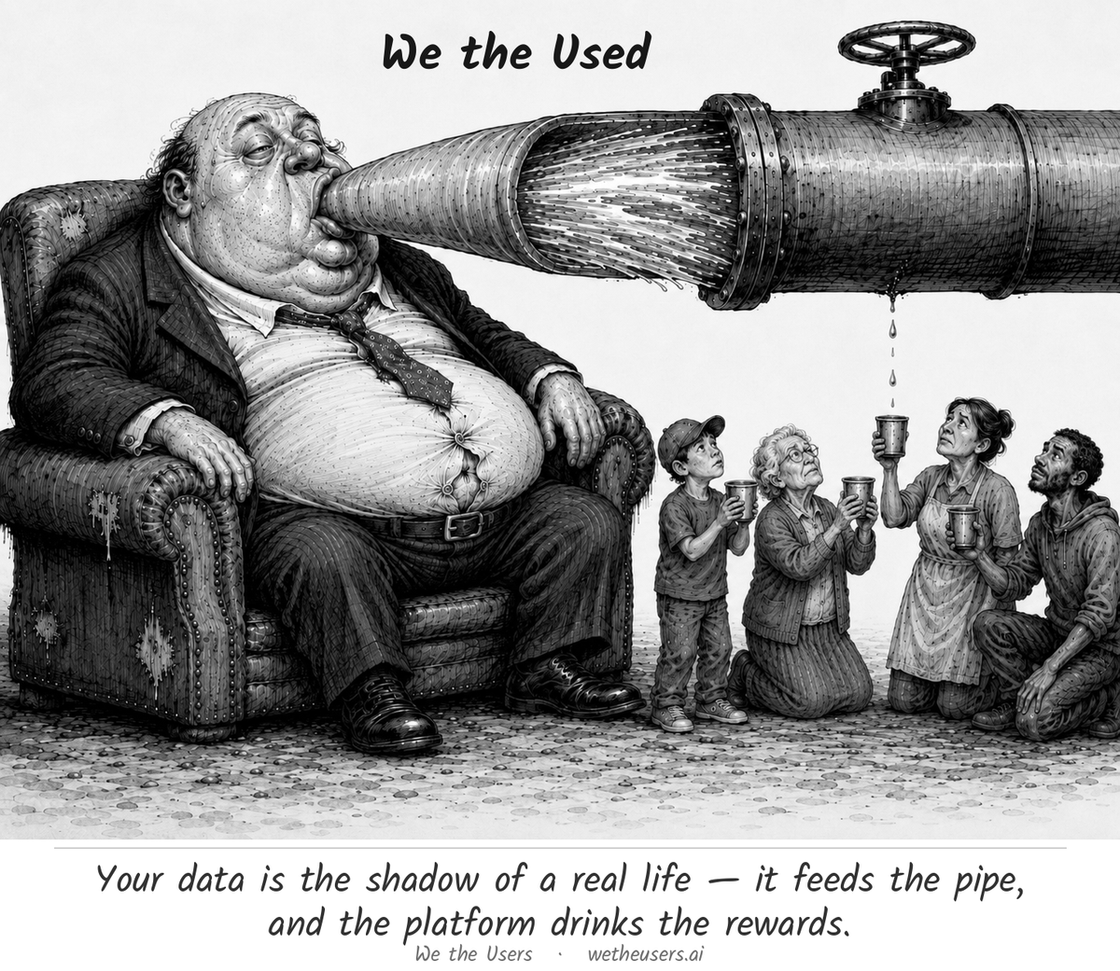
WE THE USERS
THE PROBLEM
4
Notes:
The indictment as one picture: your data fills the pipe, the platform drinks, and only a trickle reaches the person who made it. Let it land.

Slide 5
WE THE USERS
IT WAS A CHOICE
It is not the weather.
We have been taught to call all of this normal: the fixed and unalterable weather of the modern world.
It was built. And it can be built differently.
5
Notes:
The hinge of the whole pitch. The internet feels like nature; it is architecture. Slow down on the last line.

Slide 6
WE THE USERS
A 250-YEAR-OLD IDEA
We have done this before.
Settled by reflection and choice, not by accident and force.
1776
2026
The physical world declared independence from a power that ruled it without its consent.
The digital world declares its own, exactly 250 years on.
6
Notes:
Borrow the legitimacy of 1776. The physical world threw off rule without consent; the digital world now does the same. Hamilton's framing: government by reflection and choice.

Slide 7



WE THE USERS
THE VISION
An internet owned by the people who use it.
Your data is yours
Rewards flow back
No one above the rest
Held by you, shared on your terms, and yours to carry away.
The value the network creates returns to the people who make it.
Returns are capped. No founder, engineer, or investor reigns.
7
Notes:
The promise, in three. Ownership, fair return, and the anti-oligarchy rule that keeps it honest.

Slide 8
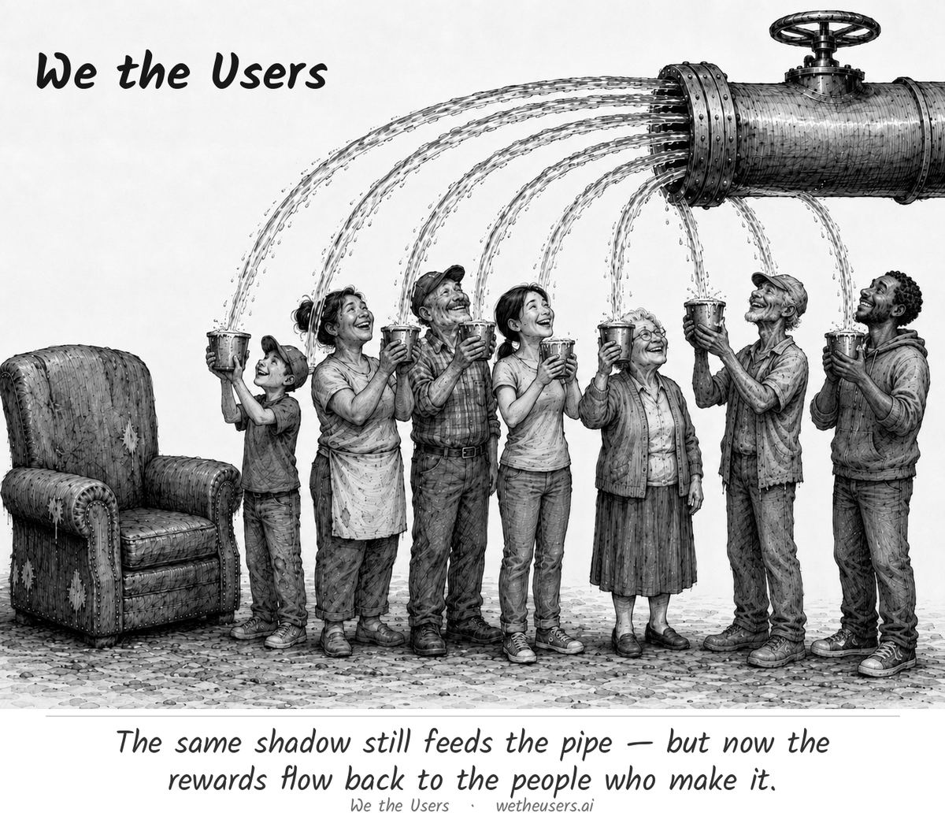
WE THE USERS
THE REMEDY
8
Notes:
The same shadow, the same pipe, but the rewards now branch out to everyone and the hoarder's chair sits empty. This is what 'owned by the people who use it' looks like.

Slide 9



WE THE USERS
HOW IT IS BUILT
Power, divided three ways.
Federalism, so that no part can rule the rest.
Individuals
Each person, holding their own shadow and identity.
Communities
Where people gather and set the rules of their own house.
The Commonwealth
A thin, shared floor, deliberately the least powerful tier.
9
Notes:
Keep this light for a public room. The point is not the org chart, it is that power is split on purpose, like a citizen, a state, and a federal government.

Slide 10



WE THE USERS
WHAT KEEPS IT HONEST
Three guardrails against
the old internet's return.
Capped returns
Written in the open
Forkable
No one draws permanent rent on a public square.
The Covenant and the Code, with nothing run in secret.
If the center betrays the people, they take it and leave.
10
Notes:
The constitution is two things: the Covenant people agree to, and the Code that runs it. And the deepest check: the whole thing can be forked.

Slide 11
WE THE USERS
THE HORIZON
1,000 years
Not built for the next quarter. Built for the next thousand years, because only an internet owned by the people who use it is built to last that long.
11
Notes:
The time signature of the project. This is not a startup quarter, it is a founding meant to endure.

Slide 12
WE THE USERS
THE CASE
We didn't just declare it.
We made the case.
01
It Is Not the Weather
why change is possible
02
The Shape of Your Digital Shadow
what your data is made of
03
Ambition Against Ambition
how power stays divided
04
The Longer Race
the economics
05
The Ledger and the Spoils
AI meets crypto
12
Notes:
Pivot to depth. The movement is not a slogan; the full argument lives in five short essays. Walk them quickly.

Slide 13
WE THE USERS
WHY CHANGE IS POSSIBLE
It Is Not the Weather
ESSAY
01
What was built can be built differently.
We treat the extractive internet as inevitable. It is not. It was designed this way by a few, for their benefit, and a design is a choice we can remake.
13

Slide 14
WE THE USERS
WHAT YOUR DATA IS MADE OF
The Shape of Your Digital Shadow
ESSAY
02
Your shadow has a shape, and the shape has rights.
Your shadow comes in regions: what you make, what you do, what you are, and what is inferred about you. Over each, a free person should hold the rights to see, correct, hold, and profit.
14

Slide 15
WE THE USERS
HOW POWER STAYS DIVIDED
Ambition Against Ambition
ESSAY
03
No part of the new internet should rule the rest.
The old internet fused control, money, and authority in a few hands. The new one splits those powers, holds them in check, and keeps the whole thing forkable, so no part can ever dominate.
15

Slide 16
WE THE USERS
THE ECONOMICS
The Longer Race
ESSAY
04
Working together can out-build racing apart.
A collaborative internet can create at least as much value as a cut-throat one, and share it far more evenly. Cooperation is not charity. Over a long enough race, it wins.
16

Slide 17
WE THE USERS
AI MEETS CRYPTO
The Ledger and the Spoils
ESSAY
05
The ledger was the easy part. The spoils are the prize.
Crypto decentralized the ledger but left the rewards concentrated in a few hands. Joining AI's value creation to crypto's verifiable ownership can finally decentralize the spoils themselves.
17

Slide 18



WE THE USERS
WHAT WE LAUNCH ON JULY 2
Words first. Then the building.
The Declaration
The case
Your name
The principles, the grievances, and the intent.
Five short essays making the argument in full.
A place to affirm it and join the founding cohort.
The constitution comes after: the Covenant and the Code, written in public.
18
Notes:
Manage expectations honestly: July 2 is the declaration moment, not the finished republic. In 1776 they declared; the constitution came later.

Slide 19
WE THE USERS
WHO IT IS FOR
This one is for everyone.
Belonging is a matter of affirmation and participation.
Not of birth, or border, or wealth.
19
Notes:
Open the doors. No geography, no gatekeeping by money or birth. You belong by showing up and affirming the idea.

Slide 20
WE THE USERS
JULY 2, 2026
Add your name.
Affirm the Declaration. Join the founding cohort. Help build the internet that should have been.
wetheusers.ai
20
Notes:
The ask. One action: add your name at wetheusers.ai.

Slide 21
We the Users
Not we the used.
JULY 2, 2026 · WETHEUSERS.AI
Notes:
Close on the banner and its shadow: We the Users, not we the used. The whole movement in five words.

