Slide 1

Ciaoeventi
Web-Based Event Management System
National Institute of Business Management (NIBM).

Slide 2

Introduction to Ciaoeventi
In modern society, many people, especially university students and working professionals, feel stressed or bored and seek social activities. Event organizers often struggle to promote events efficiently across various social media platforms, making it hard for users to find local events.
Ciaoeventi is an event management system designed to solve this problem by providing a single platform where users can easily find events and organizers can promote them effectively. It connects people looking for relaxation and connection with events happening near them.

Slide 3
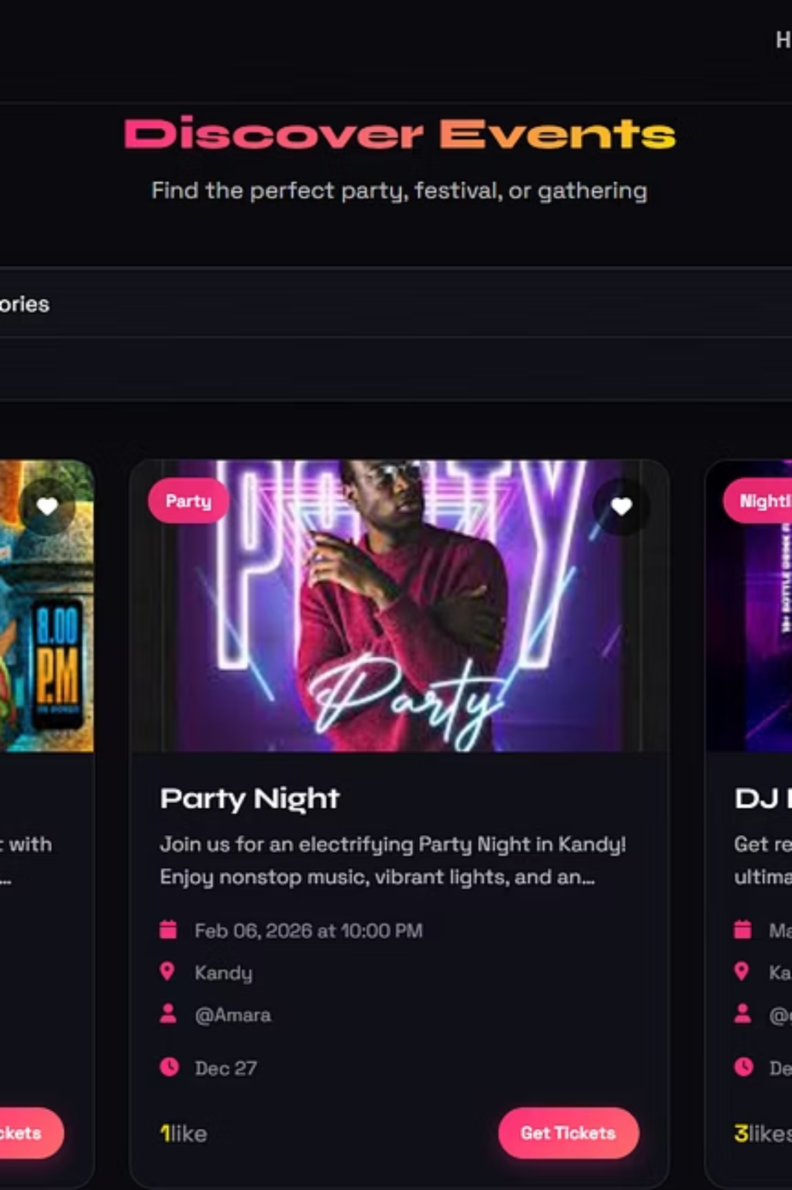
Why Ciaoeventi?
Ciaoeventi was created to simplify event discovery for users and event promotion for organizers. Many individuals desire to attend social events but lack a centralized platform to find local happenings.
This system bridges the gap by bringing events and users together in one convenient online space, addressing the real-world problem of fragmented event information and inefficient promotion.

Slide 4
Core Technologies Used
HTML & CSS
JavaScript
PHP & MySQL
Structures content and styles the website, ensuring responsiveness and visual appeal.
Adds interactivity, including form validation, search/filter functionality, and dynamic content.
Handles server-side logic for user management and CRUD operations for events, storing all essential data.
API
InfinityFree & Namecheap
Enables real-time updates, such as 'like' counts, without page reloads.
Provides online hosting for the website and manages the domain name, making Ciaoeventi accessible.

Slide 5


Website Features & Design
Navigation & Pages
Interactive Features
Home Page: Quick links to explore or create events.
Like Button: Users can express interest in events.
Events Page: Search, filter, like events, and access ticket links.
Search & Filter: JavaScript-powered event filtering by category or location.
Create Event Page: Registered users add new events with full details.
Form Validation: JavaScript ensures valid registration and login inputs.
Profile Page: Displays user info and created/liked events.
Responsive Design: Uses Flexbox and Grid for optimal viewing on all devices.
Logout Option: Securely ends user session.

Slide 6

Scope of the System
Ciaoeventi allows users to browse, search, and "like" events in their area. Registered users can create, edit, and delete their own events. The system does not include a separate admin panel or direct ticket sales; ticket purchases redirect to an external website (www.tickets.lk).
The website is fully responsive, ensuring a seamless experience across desktops, tablets, and mobile devices. This focused scope ensures efficient event discovery and promotion without overcomplicating the platform.

Slide 7
Functional Requirements
1
User Management
User registration and login, along with profile management.
2
Event Management
Registered users can create, edit, and delete their own events with ease.
3
Event Discovery
Event browsing with search and filter capabilities by category or location.
4
Interactive Features
"Like" events functionality and redirection to external ticket purchase pages.
5
Data Validation
Form validation for registration, login, and event creation forms to ensure data integrity.

Slide 8





Non-Functional Requirements
Responsiveness
Security
Usability
Works seamlessly on desktops, tablets, and mobile devices.
Passwords are hashed before storing in the database for protection.
Simple and clear navigation and layout for an intuitive experience.
Performance
Maintainability
Pages load quickly, even with multiple events, ensuring a smooth user experience.
Clean code structure with separate folders for CSS, JS, PHP, and includes.

Slide 9
Challenges and Solutions
Handling Likes without page reload
Used API to update dynamically.
No dedicated admin panel
Users manage their own events.
Responsive design for all screens
Implemented CSS Flexbox and Grid with media queries.
Form validation
Used JavaScript to check required fields before submission.

Slide 10

Conclusion & Future Enhancements
Ciaoeventi is a fully functional, interactive, and responsive website that effectively solves the real-world problem of finding local events and helping organizers reach their audience. It leverages HTML, CSS, JavaScript, PHP, and MySQL for robust frontend and backend operations.
Future Enhancements:
Adding a dedicated admin panel to manage all events and users.
Integrating payment processing for direct ticket sales on the site.
Enhancing the UI with animations and real-time notifications.
Website Link: https://ciaoeventi.com

Slide 11
THANK YOU!

