Slide 1

Brand Of
HOMEIFFIN DELIVERY SOLUTION PVT. LTD.

Slide 2


What is Rassoi Home Food is all About?
Our Rassoi Home Food is all about providing services to the Distributors and making collaboration with the distributors & complete meal solutions for those who are far from home, and for working personal (offices).
Leader

Slide 3
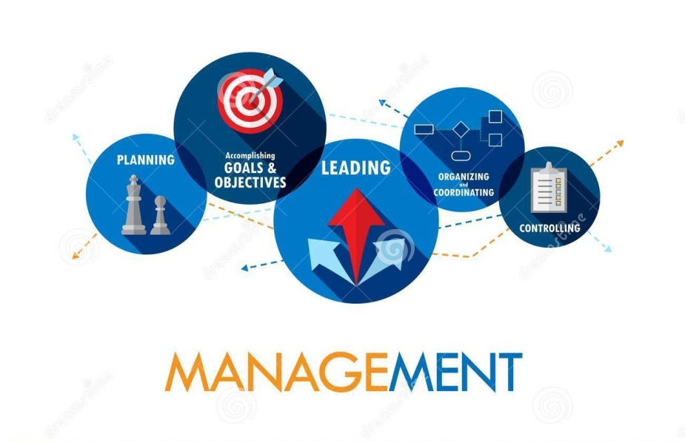
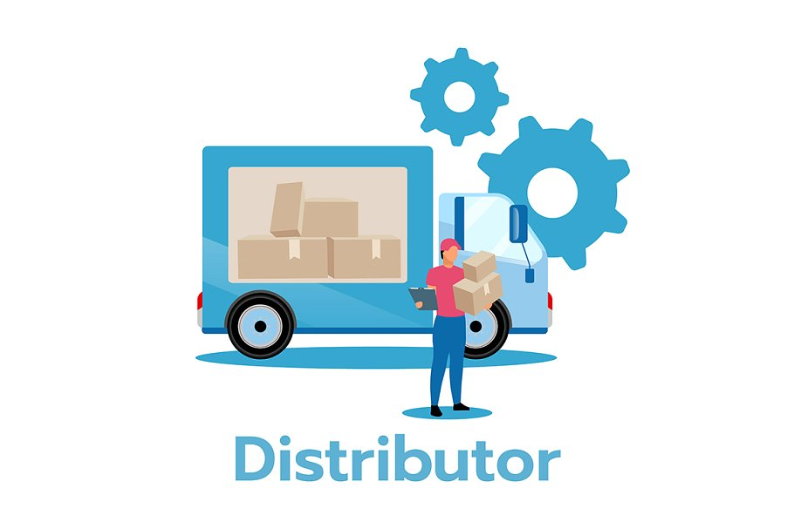

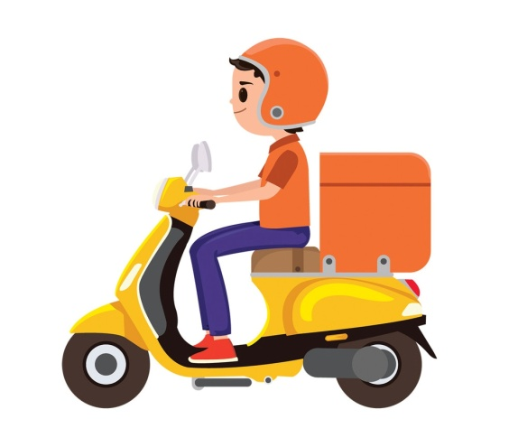
Services Of Our Company.
Services we’ll provide are as follow:-
Delivery Services.
Management Services.
Customer Services.
Distributor Services.

Slide 4

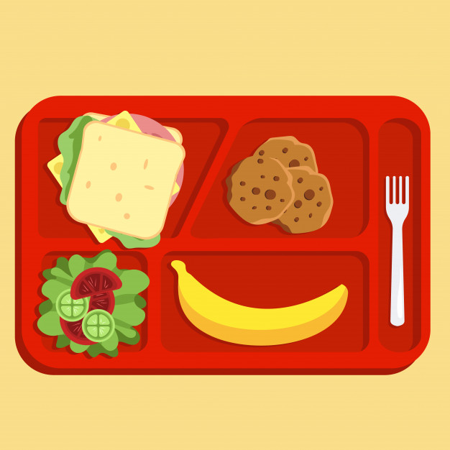

Tiffin Menu
Morning Breakfast.
Lunch.
Dinner.
Even some Desserts.

Slide 5
Condition For Our Company.
Whenever any work will start their will be minimum Thousand happy customers to start with.
50 % (percentage Fifty) of License Fee shall be refunded if Agreement terminated within one month to six months of the agreement.
30 % (percentage thirty) of License Fee shall be refunded if Agreement terminated within two months to 12 months of agreement.
10% (percentage ten) of License Fee shall be refunded if Agreement terminated after one year of Agreement.

Slide 6


How our Business/Company Works?
If any start-up happens in any other city, the city will be divide into 5 zones from where the customer data would be collected. Their would Minimum 1000 happy customers. After data had been collected the company would be working upon their marketing/sales, distributors etc. After every six months the customers would be increasing by 500-1000 customers more. When every customers increases after 1500 customers the 1% extra margin would be provided to that distributor.

Slide 7
Cities in which we are starting up:-
In Madhya Pradesh
Jabalpur
Indore
Bhopal
Satna
Reewa
Katni
Itarsi
Hoshangabad
In Chattishgarh
Raipur
Bilashpur
Bhilai
Durg
Raigarh

Slide 8
Sales Graph
Percentage

Slide 9
Thanks For Watching

