Slide 1

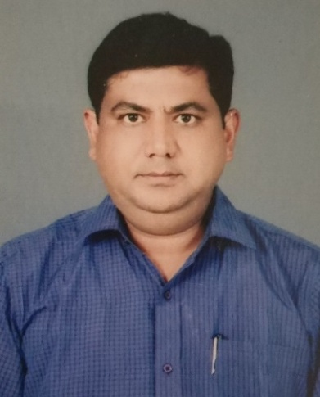
Farm Haat An Initiative by Yopun Solution Pvt. Ltd.
Founder- Puneet Tripathi
Qualification- B. Sc. (Agri.) & MBA (Agri Business)
Experience- 12 years prolific experience of Agochem

Slide 2
Problems
High Price & Low quality agri input.
No guidance for crop cultivation & marketing.
Low price of farm produce due to middle man.

Slide 3
Solutions
Complete crop wise consultancy.
Online platform for agri input as well as farm produce.
Marketing support for farm produce.

Slide 4


Agri Input Companies
Seed, Agrochem, Machinari
Farm Produce Market
Business Model of Farm Haat
Farm Haat Centre
Farm Haat Centre
Farm Haat Centre
Farm Haat Centre
Farm Haat Centre
Shajhanpur
Kanpur
Noida
Gorakhpur
Varanashi
Farm Mitra
Farmer

Slide 5
Farm Haat Centre Facility
Farmer centric customise crop solution.
Supply of farm inputs-Seed, Pesticide, farm machinery etc.
Soil testing & Balanced diet recommendation.
Marketing support for farm produce.
Knowledge based support for govt schemes
One stop solution for all farmer needs

Slide 6
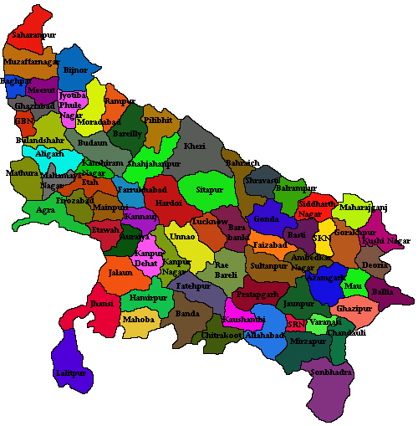
Shajhanpur
Noida
Kanpur
Gorakhpur
Varanasi
Farm Haat Centres in UP

Slide 7
Investment
S. No. | Particulars | Monthly Cost | Months | Yearly Budget
1 | Noida office cum godown | 15000 | 12 | 180000
2 | Office Boy cum dispacther | 10000 | 12 | 120000
3 | Telle Caller 2 | 20000 | 12 | 240000
4 | Accountant | 10000 | 12 | 120000
5 | CEO Salary | 100000 | 12 | 1200000
6 | Category Manager 2 | 50000 | 12 | 600000
7 | Farm Produce Sales Mager2 | 50000 | 12 | 600000
8 | Soil testing Lab | 100000 | 1 | 100000
9 | Lab Technician | 10000 | 12 | 120000
10 | Security with company | 500000 | 1 | 500000
11 | Software & Maintenance | 100000 | 1 | 100000
12 | Missc. | 200000 | 1 | 200000
Corporate office |  |  |  | 4080000
12 | Shajhanpur Center |  |  | 1580000
13 | Noida Centre |  |  | 0
14 | Kanpur Center |  |  | 1500000
15 | Varanashi Center |  |  | 1500000
16 | Gorakhpur Centre |  |  | 1500000
Centre Cost |  |  |  | 6080000
Grand Total |  |  |  | 10160000

Slide 8
Centre Cost
S. No. | Particulars | Monthly Cost | Months | Yearly Budget
1 | SPN office cum godown | 15000 | 12 | 180000
2 | Office Boy cum dispacther | 5000 | 12 | 60000
3 | Officer cum Telle Caller 1 | 10000 | 12 | 120000
4 | Agronomist 4 | 60000 | 12 | 720000
5 | Marketing Exp. | 400000 | 1 | 400000
6 | Missc. | 100000 | 1 | 100000
 |  |  |  | 1580000

Slide 9
Return on Investment
S. No. | Particulars | Rs. | No | Total Revenue
1 | Farmhaat Centre Security | 10000 | 100 | 1000000
2 | Expexted Sale per Centre | 300000 | 100 | 30000000
3 | Profit from Revenue per Centre @10% |  |  | 3000000
Total revenue |  | 3000000 | 5 | 15000000
Return on investment with in One Years Rs.150 Lacs

Slide 10
Thanks

