Slide 1
RePORT
Federated Learning
Initiative
Evan Johnson, PhD
Sue Siminski, MS, MBA

Slide 2
What Is
Federated Learning
A federated database connects multiple independent databases into a single virtual environment, without physically integrating them.
Data is retained where it is stored (local site systems keep ownership).
Users and applications interact with the system as if it were one cohesive data source.

Slide 3
Key
Features
Seamless and integrated access to distributed data.
Participating sites keep control of their data.
Common query layer reduces duplication of data transfers.
Standardized metadata supports consistent definitions across systems.
Scalable architecture that accommodates additional country sites.

Slide 4
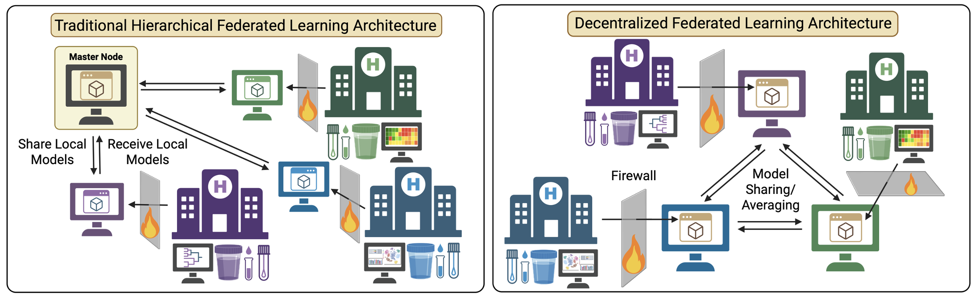
Architectures -- Hierarchical

Slide 5
Architectures -- Decentralized

Slide 6
Why Pilot a
Federated Database?
Reduces long-term burden on sites by avoiding repeated full dataset transfers.
Enables near-real-time access to updated data for reporting and analyses.
Improves data quality and simplifies harmonization process, as it is now done at the source.
Strengthens cross-project collaboration without centralizing data.
Supports compliance by keeping identifiable data local.

Slide 7
Pilot
Goals
Test feasibility across a small group of participating sites.
  Long TB is a good study candidate.
Evaluate performance, security, and governance requirements.
Develop shared data dictionaries and access rules.
Identify the resources, staffing, and infrastructure needed for scale-up.
Provide recommendations for a long-term federated architecture.
(More than a pilot?? See Aims below)

Slide 8
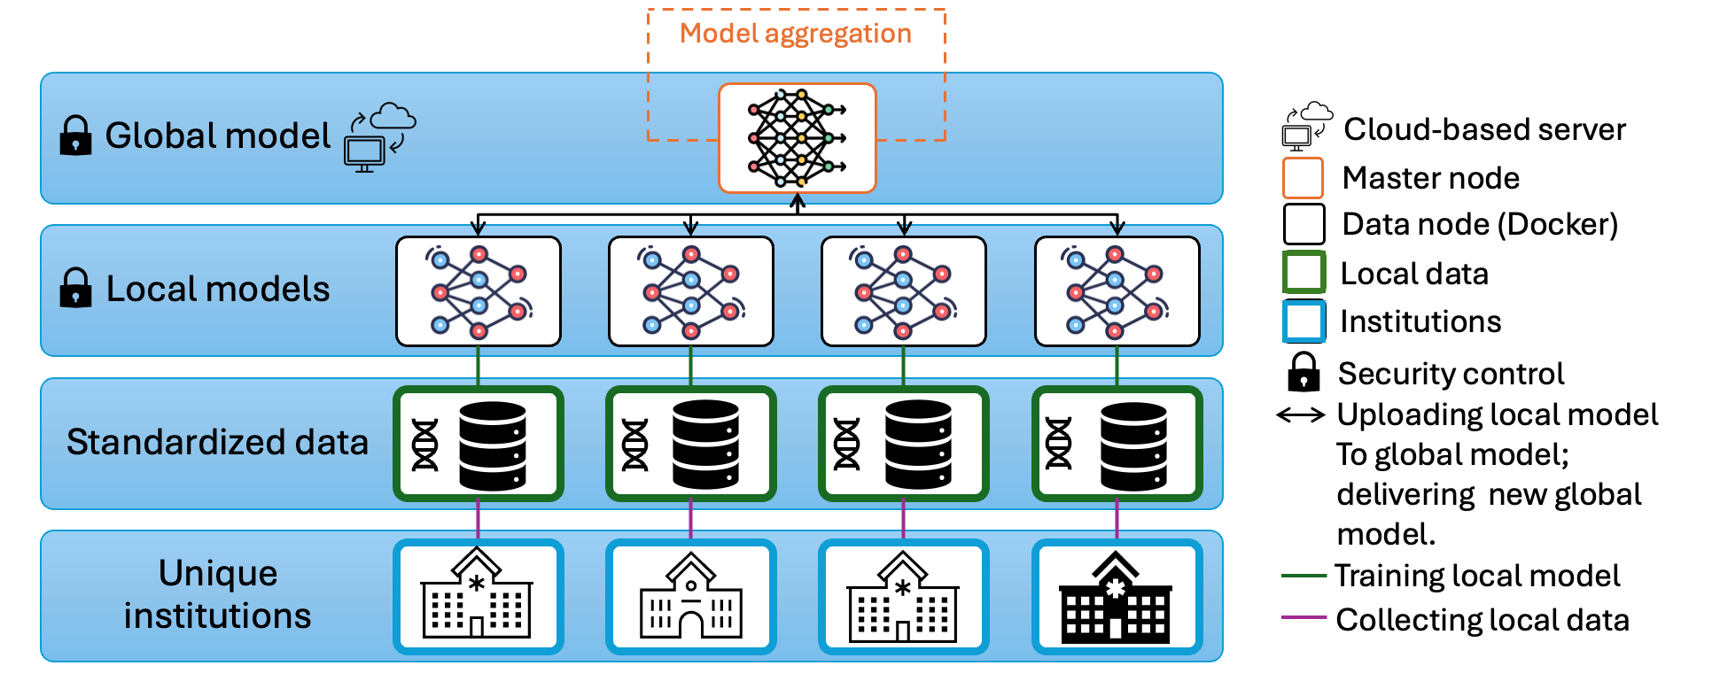
Aim 1 – Build Federated Learning System for RePORT
Containerized FL clients (Docker/Singularity)
Central orchestrator with authentication
Zero data movement out of sites

Slide 10
Rationale
Maintain data privacy and enable collaborations without centralizing sensitive information.
  FL allows multiple independent database to connect into a single environment without physical integration.
  Ensures data remains stored at the local sites, which maintain ownership.
  Architecture is scalable to accommodate additional sites.

Slide 11
Preliminary Data
Proof-of-concept testing using REDCap data from Frontier Science.
Pilot discussions show Long TB is an ideal candidate for early deployment.
Demonstrated feasibility of containerized execution at multiple sites (local inference without exporting raw data).

Slide 12
Experimental approach
Platform Development
  Build FL orchestration layer with site authentication and secure communication.
  Use open-source FL frameworks (TensorFlow Federated, Flower/FLwr, FedML, FATE).
Containerized Clients
  Deploy Singularity/Docker images for each site.
  Each image runs training locally and sends only gradients/weights to the central orchestrator.
Standardization Layer
  Use shared metadata and data dictionary to ensure consistent modeling.
System Validation
  Compare federated vs. centralized model performance, convergence behavior, reproducibility.

Slide 13
Expected outcome
A secure, production-ready federated learning system running across RePORT sites.
Evidence of model convergence and accuracy comparable to non-federated baselines.
Verified privacy guarantees (no raw data leaves sites).
A reproducible container workflow ready for scale-up.

Slide 14

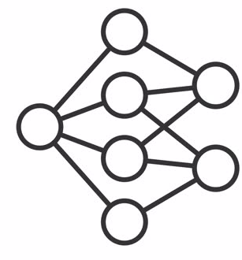





Aim 2 – Federated GLM & Foundation Models
Privacy
Federated Foundation Models (FM):
Domain Models (DM) enhance FMs with domain-specific knowledge via Federated Foundation Models
FMs improve DMs’ generalization across sites
Parameter-efficient fine-tuning with all data kept local
Pre-trained
Foundation Model
Enhancement
Guidance
Domain
Models
Efficiency
…
Utility
https://arxiv.org/pdf/2502.12176

Slide 15
Rationale
Sites have heterogeneous study designs, populations, and data types.
GLM: straight-forward to implement, highly interpretable, and computationally light resource efficiency, but do not generalize well
FM can capture shared structure and improve cross-site robustness
Parameter-efficient tuning enables each site to adapt models locally

Slide 16
Prelim Data
Initial experiments using public FM architectures show improved generalization with domain-specific fine-tuning
Synthetic data generated from RePORT data shows stable convergence for GLMs
Early literature demonstrates federated FMs outperform site-specific models in sparse or imbalanced settings.

Slide 17
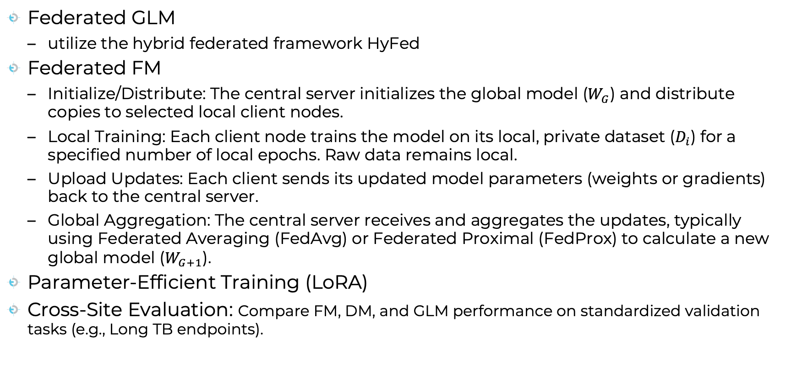
Experimental approach
Federated GLM
  utilize the hybrid federated framework HyFed
Federated FM
  Initialize/Distribute: The central server initializes the global model ($W_{G}$) and distribute copies to selected local client nodes.
  Local Training: Each client node trains the model on its local, private dataset ($D_{i}$) for a specified number of local epochs. Raw data remains local.
  Upload Updates: Each client sends its updated model parameters (weights or gradients) back to the central server.
  Global Aggregation: The central server receives and aggregates the updates, typically using Federated Averaging (FedAvg) or Federated Proximal (FedProx) to calculate a new global model ($W_{G+1}$).
Parameter-Efficient Training (LoRA)
Cross-Site Evaluation: Compare FM, DM, and GLM performance on standardized validation tasks (e.g., Long TB endpoints).

Slide 18
Expected outcome
Federated GLM toolkit deployable across all RePORT sites.
Federated foundation model for TB immunology and clinical metadata.
Robust cross-site predictions with improved fairness and generalization.

Slide 19
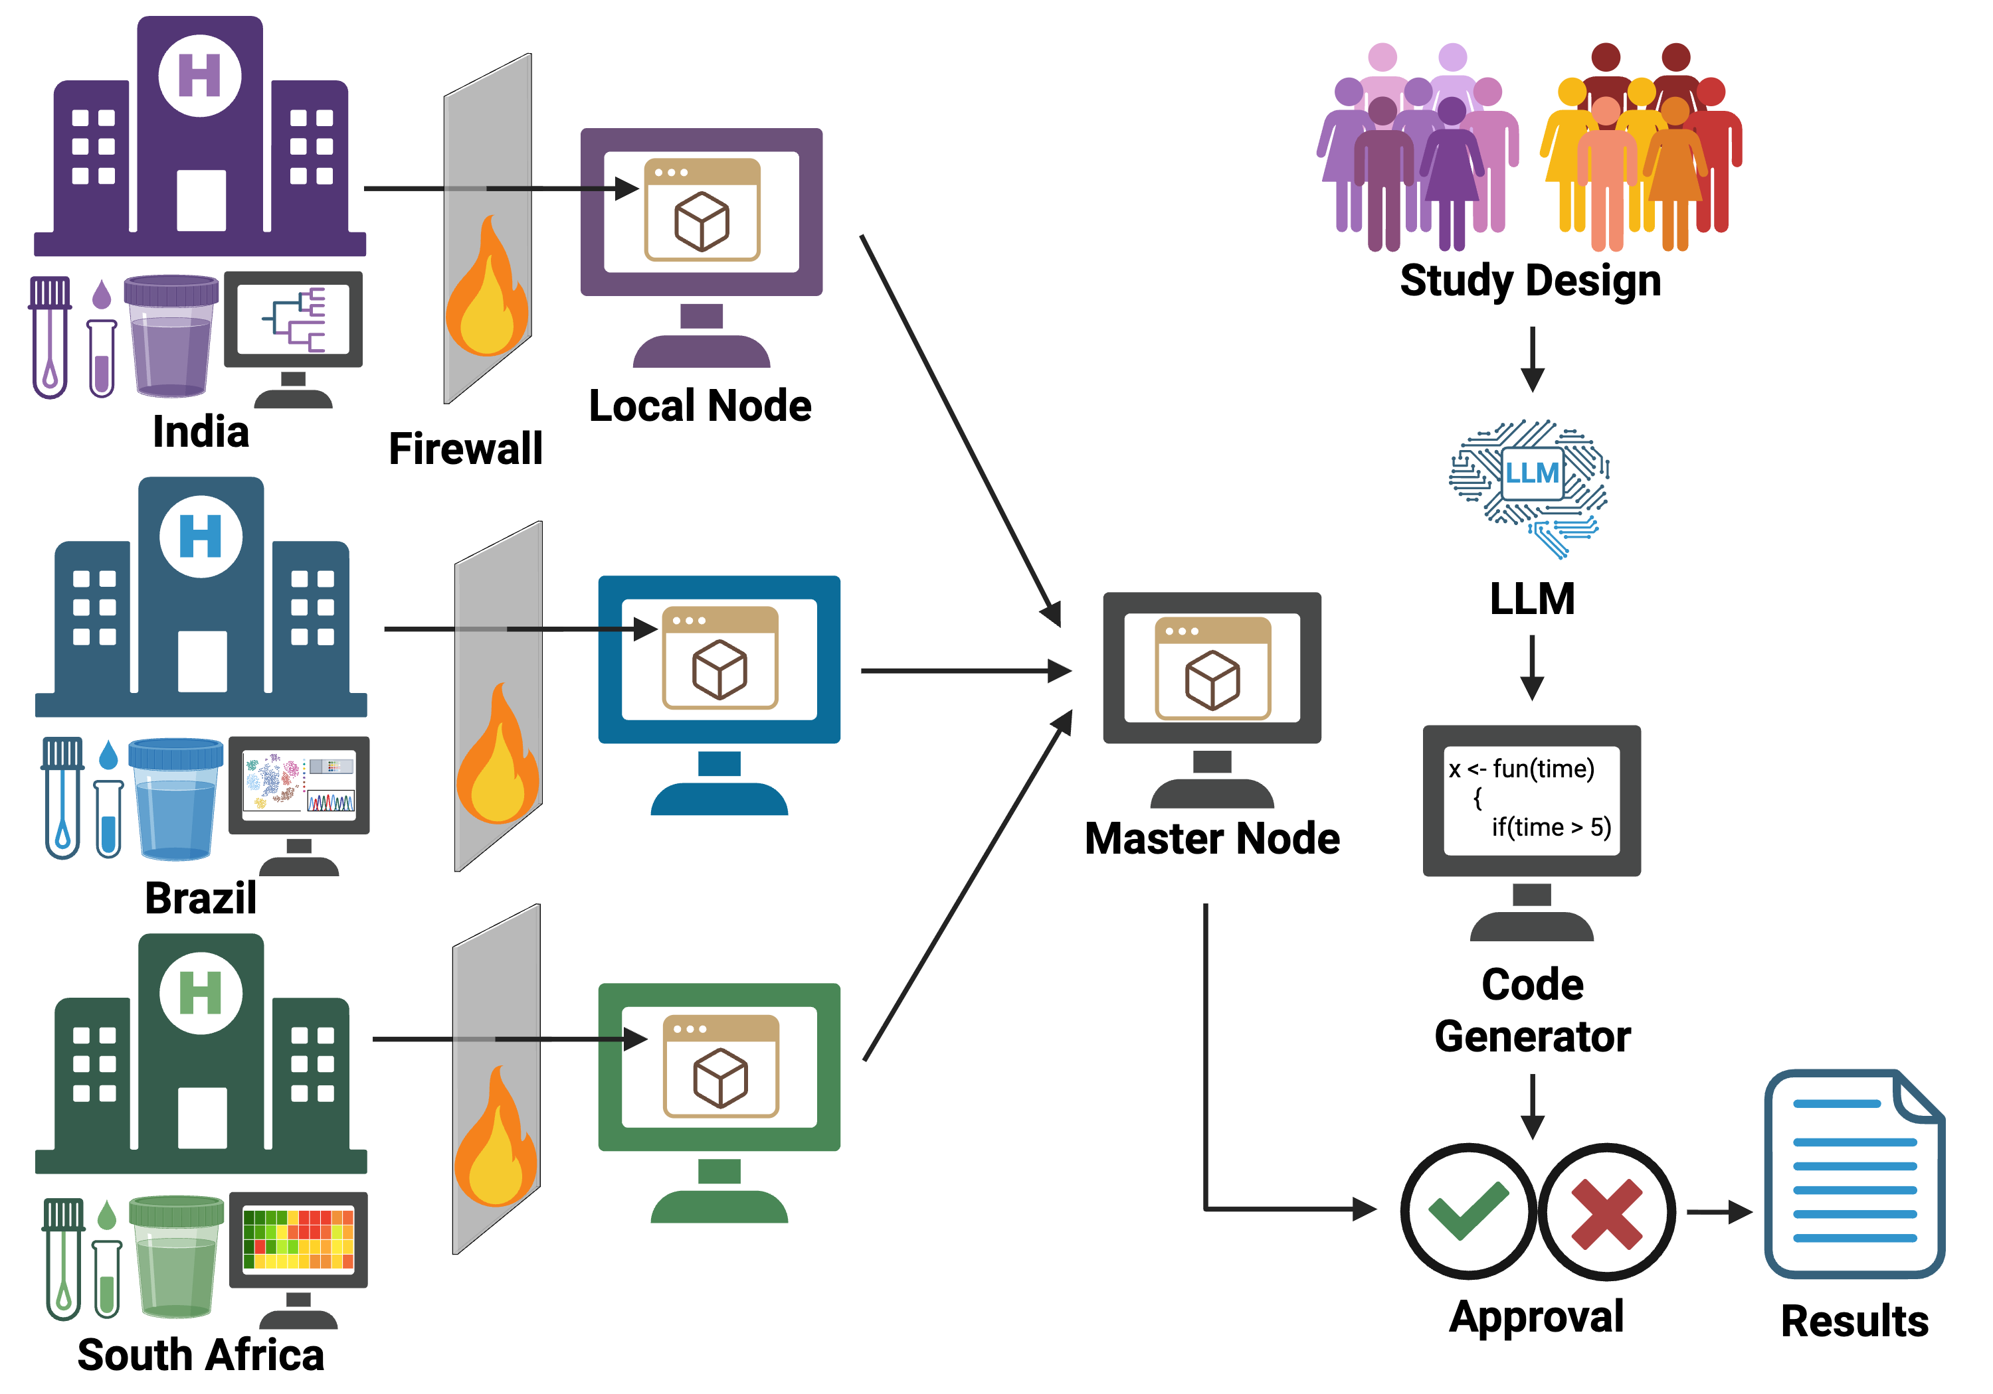
Aim 3 – LLM-Generated Code + Safe Execution Layer
Overview: Build an LLM-Driven Code Generator & Executor Embedded in the Federated System
Purpose:
Reduce analysis burden on sites (mirroring the Federated DB goal of reducing repeated requests).
Use LLMs to enable user-driven analysis requests
Automatically harmonize queries using standardized metadata.
Capabilities:
Interpret investigator requests (“run logistic regression on Long TB”).
Generate privacy-safe, site-local Python/R code.
Execute code inside containerized, sandboxed compute nodes.

Slide 20
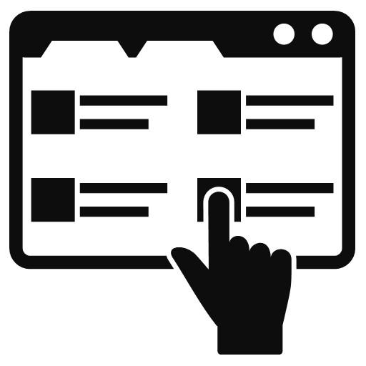
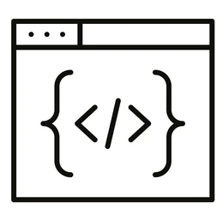


Aim 3 – LLM-Generated Code + Safe Execution Layer
Governance, Logging & Safety
User Interaction Layer
User provides analysis request
LLM interprets query
Code Generator
LLM refines analysis plan and
generates metadata-aware code
Master Node
Code Review & Privacy Check
Send approved execution tasks to
Local Node
End-to-end workflow for the LLM-based federated analysis system.

Slide 21
Rationale
Sites frequently receive repeated requests for the same analyses, causing bottlenecks.
Analysts need a flexible way to run new models while preserving privacy and consistency.
LLM-based code generation can automate statistical analyses directly at the site.
Governance/safety checks ensure only privacy-safe code is executed.

Slide 22
Prelim Data
Internal prototypes show LLMs can translate investigator requests into accurate analysis plans.
Early sandbox tests confirm safe execution inside containerized local environments.
Metadata-aware prompting enables automatic harmonization of variable names and coding standards.

Slide 23
Experimental approach
User interaction layer
  Build interface for natural-language analysis request.
Code generation layer
  LLM creates R/Python code aligned with the shared data dictionary
  Master node performs privacy, safety checks.
Secure execution layer
  Approved code is run inside local site containers (sandboxed compute).
  Results only are returned to the master node.
Governance & Logging
  Full audit trail for requests, generated code, execution metadata.

Slide 24
Expected outcome
A fully integrated “LLM-assisted federated analysis” system.
Significantly reduced analysis burden on sites.
Safely generated, reproducible code that follows shared metadata standards.
A novel, human-interpretable governance workflow for AI-generated analysis within a federated network.

Slide 25
Key Challenges
Do we want a federated system?
Its functionally possible – is it conceptually possible?
  Problems with adoption?
Will it really streamline projects/analyses?
Where to do we get funding?
  How much funding will determine scope

