Slide 1
Machine Learning and Artificial Intelligence
Machine learning (ML) is a computer’s way of learning from examples, and it is one of the most useful tools we have for the construction of artificially intelligent systems
Artificial intelligence (AI) is a term used when machines or computers can mimic functions that humans can do.

Slide 2
AI is not magic; it’s math.
-Peter Norvig

Slide 3
AI will not replace us,
it will amplify us."
-Pedro Domingos

Slide 4
With great power comes
great responsibility.
-Uncle Ben, Spiderman

Slide 5
Machine Learning and Artificial Intelligence
Machine learning (ML) is a computer’s way of learning from examples, and it is one of the most useful tools we have for the construction of artificially intelligent systems
Artificial intelligence (AI) is a term used when machines or computers can mimic functions that humans can do.

Slide 6
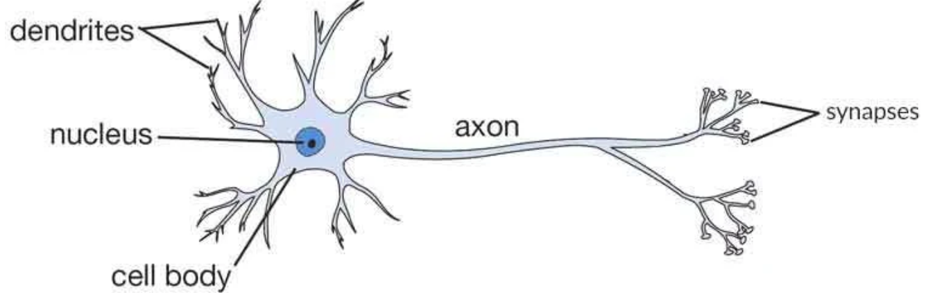
Biological Nerve Cells

Slide 7
Neural Networks
The human brain consists of billions of neural cells that process information.
Each neural cell is a simple processing system.
The interconnected web of neurons, a biological neural network, transmits information through electrical signals from neuron to neuron.

Slide 8
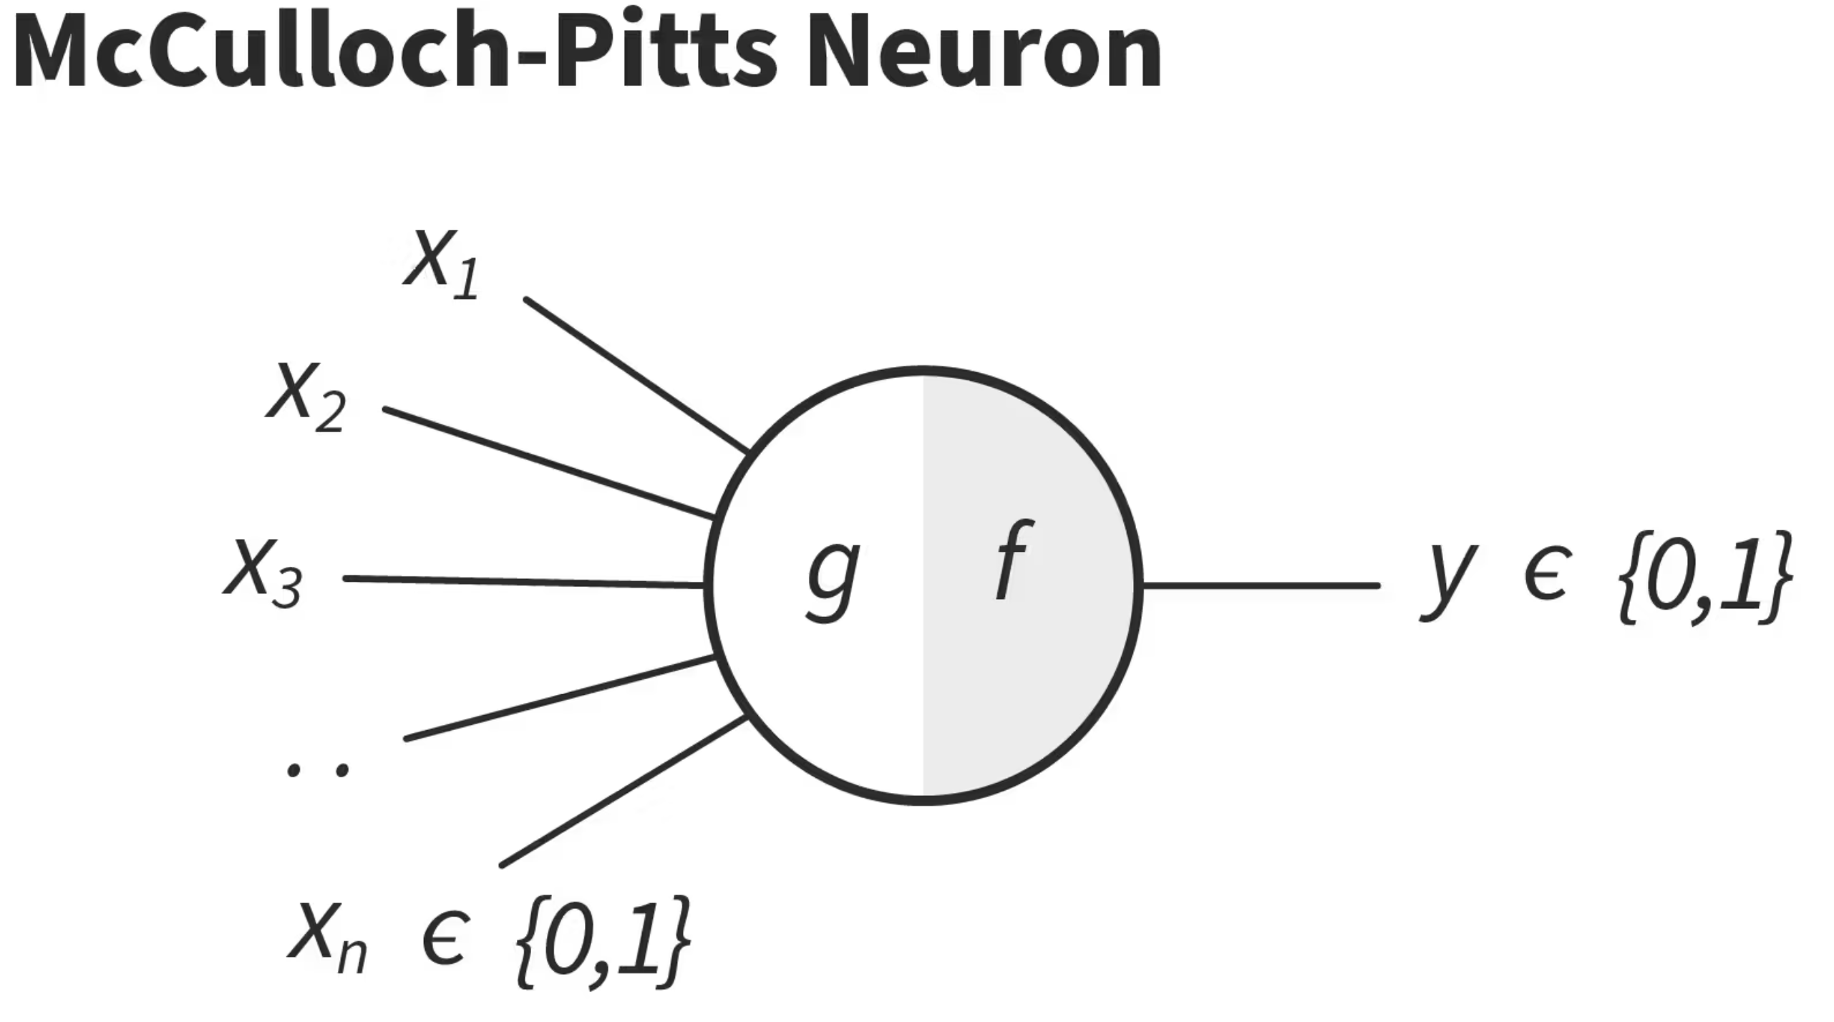
(1944)

Slide 9
McCullough-Pitts Neuron
What McCullough and Pitts showed was that a neural net could compute any function that a digital computer could.
The result was more neuroscience than computer science
The point was to suggest that the human brain could be thought of as a computing device.

Slide 10
Frank Rosenblatt (1957)
Proposed the first trainable neural network, the Perceptron
Design was much like that of the modern neural net, except that it had only one layer with adjustable weights and thresholds, sandwiched between input and output layers.
But Minsky and Papert (1959) published a book, which demonstrated that executing certain fairly common computations would be impractically time consuming.

Slide 11
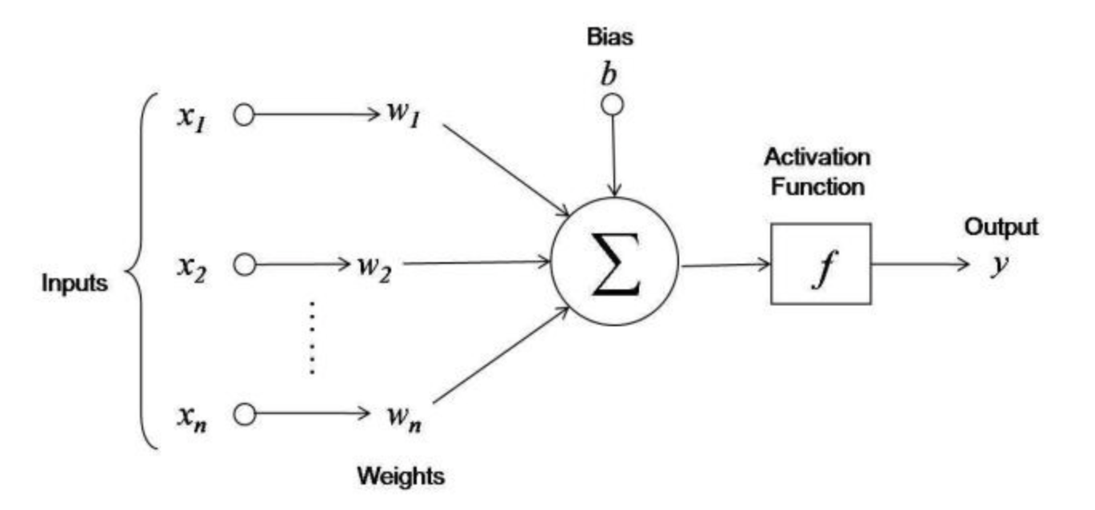
The Perceptron model looked like this:

Slide 12
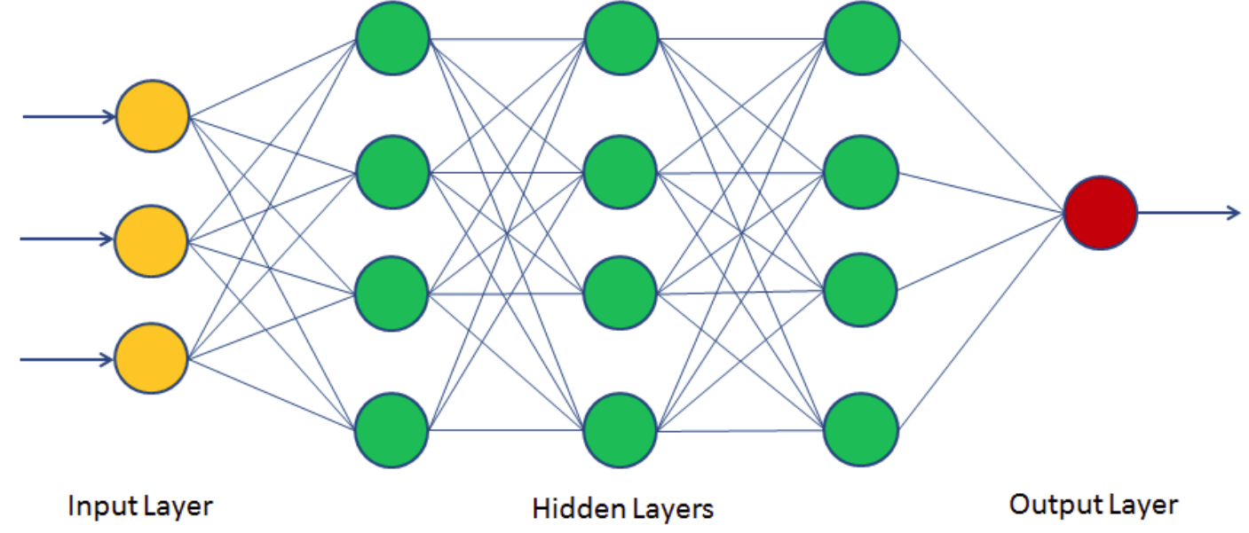
Modern Neural Networks: Multi-layer Perceptrons

Slide 13
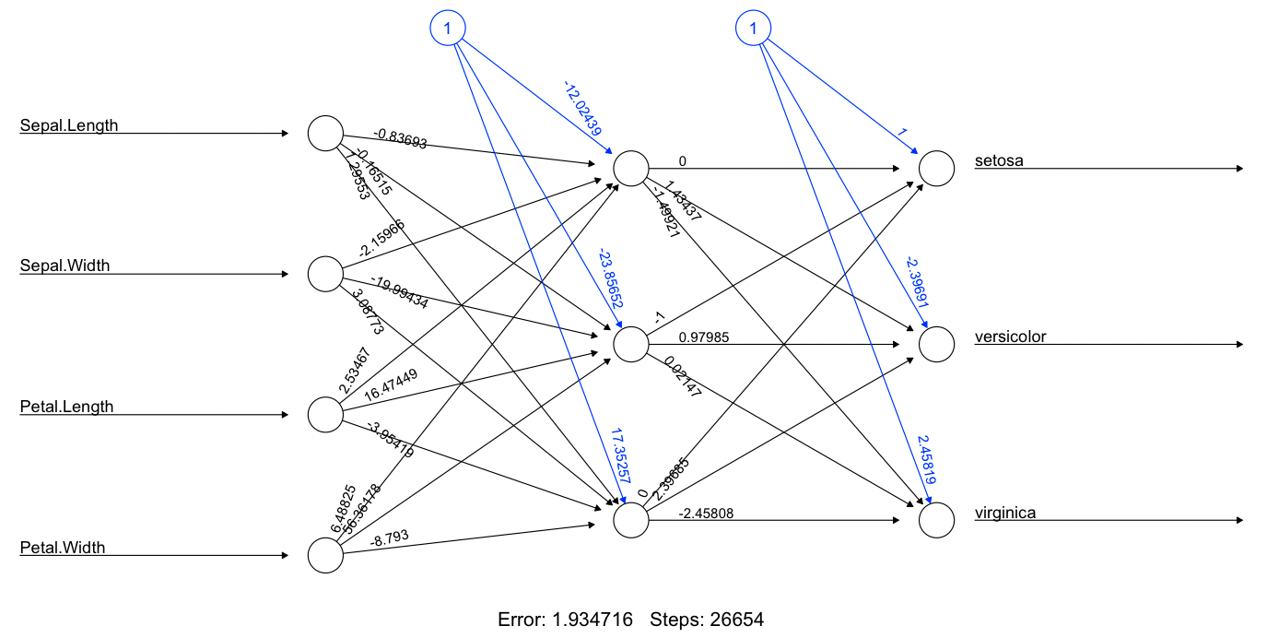
Modern Neural Networks: Multi-layer Perceptrons

Slide 14
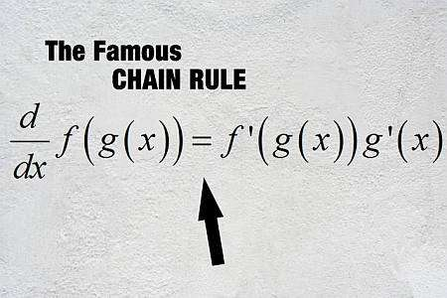
Chain Rule: When will I ever use this??

Slide 15
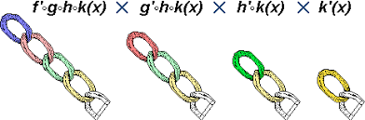
Chain Rule: When will I ever use this??

Slide 16
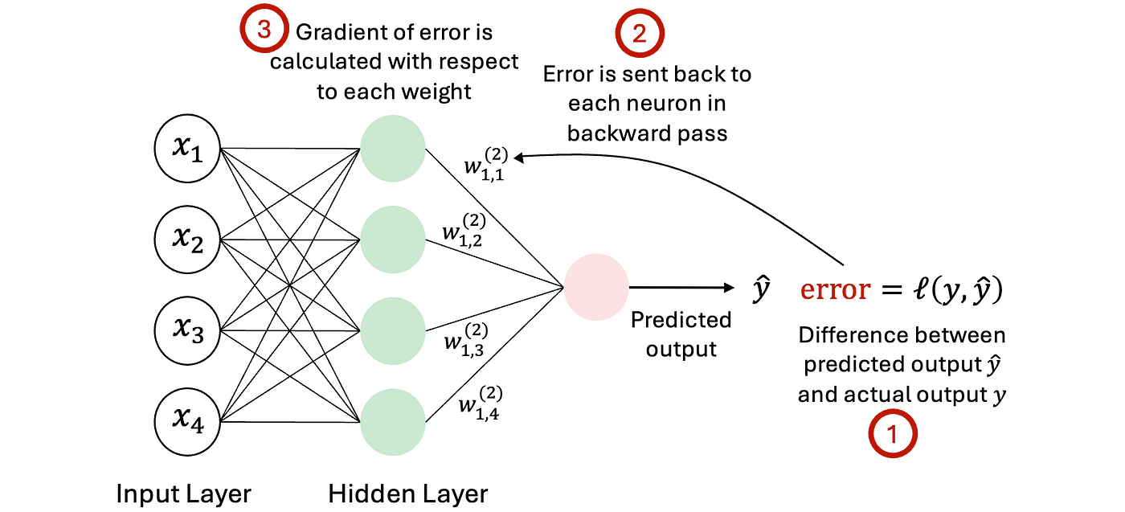
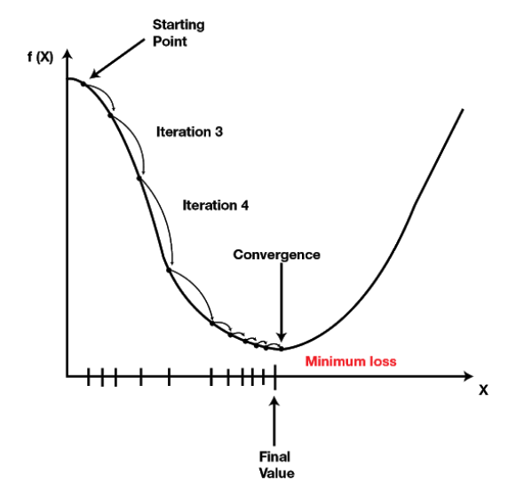
Chain Rule: Backward Propagation in Neural Nets

Slide 17
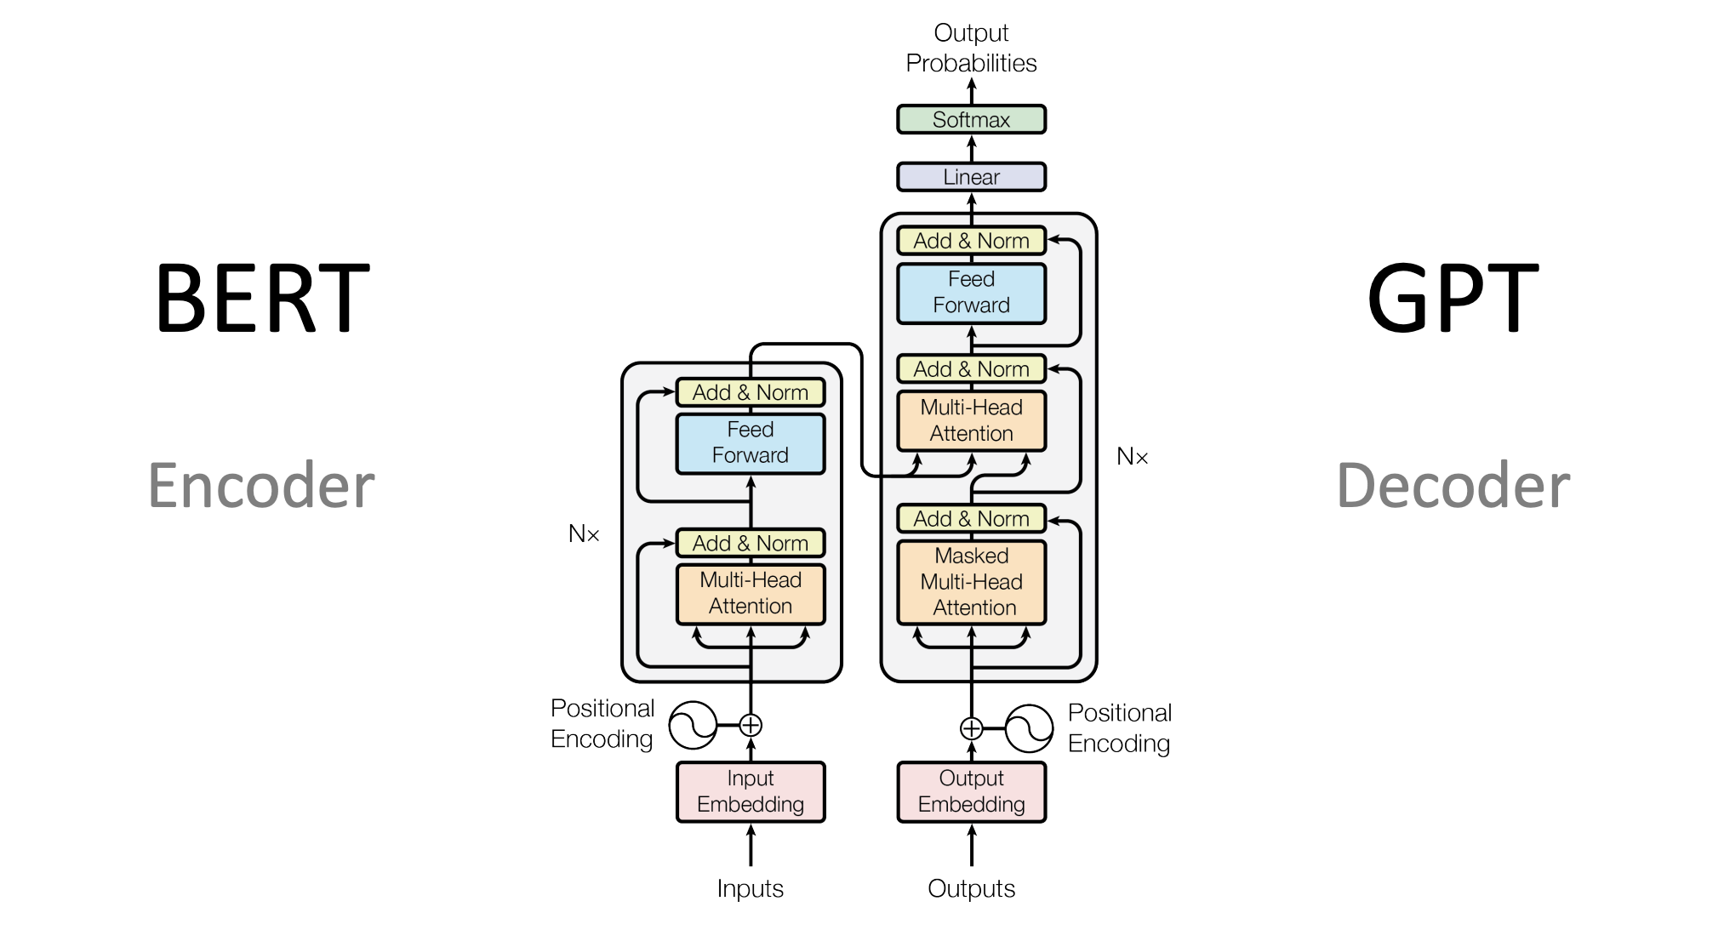
Chain Rule makes LLMs Possible

Slide 18
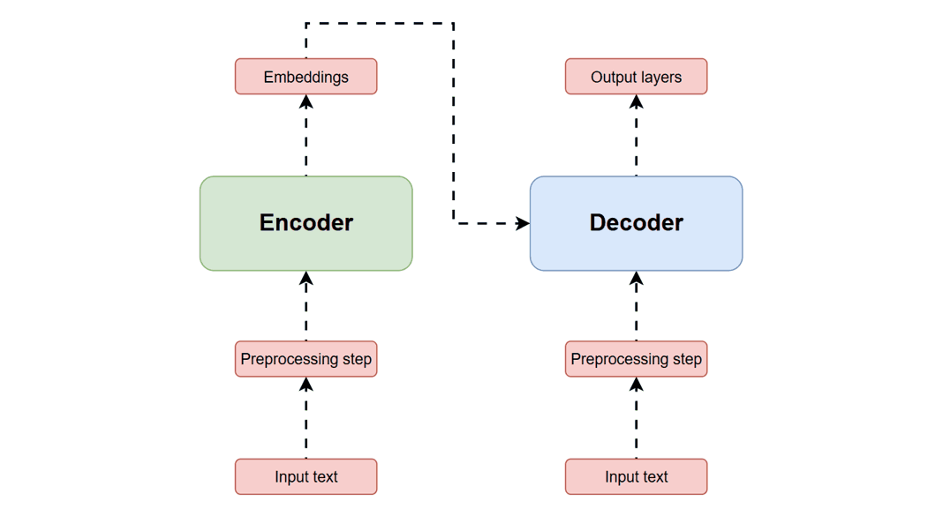
Transformer models: Language prediction
“GPT” = Generative Pretrained Transformer Model
You type a prompt
The model:
  Looks at all the words
  Assigns probabilities to possible next words
It picks the most likely next word
Then repeats—again and again
ChatGPT is a very advanced autocomplete.
Notes:
“The best day of my life was…”
Explain:
The model calculates probabilities like:
“the” (30%)
“when” (25%)
“because” (10%)
Key insight:
“ChatGPT is a very advanced autocomplete.”

Slide 19
AI is not magic; it’s math.
-Peter Norvig

Slide 20

Thank you!

