Slide 1
Overview of AI Agent and Prompt Engineering
Xutao Wang
Nov. 6th 2025

Slide 2



What is an AI Agent?
How we use AI today
Human: Give explicit instruction
AI: Execute one command → one action
AI Agent
Human: Give a goal
AI: Figures out how to achieve it
Explain RNA-seq
Perform DE analysis for the attached RNA-seq
Clarification… Choose package… Run code… Format output …
RNA sequencing is a high-throughput sequencing technique …
Code for filtering outlier cells in scRNA-seq
An autonomous system that plans, experiments, and analyzes to solve problems
(No execution & debug)

Slide 3
Build an AI Agent
Observation
More possibilities
Use external tools
Goal
vs.
LLM-Based Agent
AI co-scientist (Research)
AutoKaggle (Train Model)
RL-Based Agent
Alpha-Go (GO)
OpenAI Five (Game)
State
Action
How can we make our LLM-based agent smarter, more reliable, and better aligned with our goals?
RL: Reinforcement Learning
LLM: Large language model
Notes:
Here is how AI agent works in a diagram:
So the concept of an AI agent isn’t new, it’s actually been around for quite a while.
For instance, AlphaGo is a classic example of an AI agent built using reinforcement learning.
It interacts with its environment — in this case, the Go board — by taking actions, receiving rewards or penalties, and continuously improving its strategy through self-play.
Another famous example is OpenAI Five, which mastered the complex strategy game Dota 2.
These are what we call reinforcement learning-based agents — agents that learn by doing, optimizing their actions through experience and reward signals.
But more recently, with the rise of large language models, a new kind of agent has emerged — the LLM-based agent.
Instead of learning through explicit rewards, these agents rely on the pre-trained reasoning and knowledge embedded within large language models.
They can interpret natural language instructions, plan multi-step actions, and even use external tools — all driven by what the model already knows.
AI co-scientist, a multi-agent AI system built with Gemini 2.0 as a virtual scientific collaborator to help scientists generate novel hypotheses and research proposals.
A Multi-Agent Framework that can automatically build, train, and evaluate machine learning models on datasets
Now, the advantage of running agents with LLMs is flexibility.
Unlike traditional RL agents that operate within fixed rules — like the 19x19 Go board —
LLM-based agents have nearly unlimited possibilities.
They can integrate external data, connect to APIs, perform reasoning, and even control lab workflows or analysis pipelines — all through natural language instructions.
So the big question we want to ask is:
How can we enhance LLMs to become even better agents?
As of now, AI Co-Scientist is available only through Google’s Trusted Tester Program, targeting research organizations and principal investigators. Individual access isn’t widely open yet.
frameworks that allow LLMs to pursue goals through reasoning and tool use.
Finding connections in large amounts of data does seem like one of the better use cases for current AI?

Slide 4


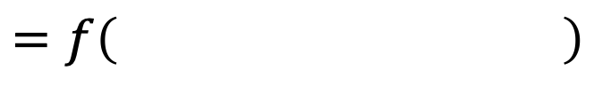
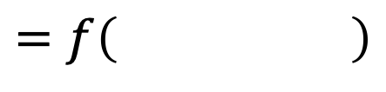
Approach 1: Prompt Engineering
Enhance LLM without retraining
$$=f\left( \right)$$
$$=f\left( \right)$$
Fixed LLM
Fixed LLM
Strengthen LLM Interaction through better prompting:
Provide clear instruction
Add context or extra information
Enable tool integration or usage
Adapted from Lee (2024), Slide 25 (Chinese):
https://speech.ee.ntu.edu.tw/~hylee/genai/2024-spring-course-data/0301/0301_universal.pdf
Notes:
There are really two main ways to enhance large language models, depending on your resources and the level of control you need.
Do not change model, change ourselves!

Slide 5
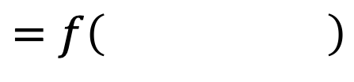
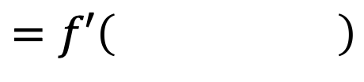
Approach 2: Train Your Own Model (Fine-tuning)
$$=f\left( \right)$$
$$=f′\left( \right)$$
LLM
(Open Source)
Edited LLM
More complex process
Requires additional resources
Adapted from Lee (2024), Slide 25 (Chinese):
https://speech.ee.ntu.edu.tw/~hylee/genai/2024-spring-course-data/0301/0301_universal.pdf

Slide 6




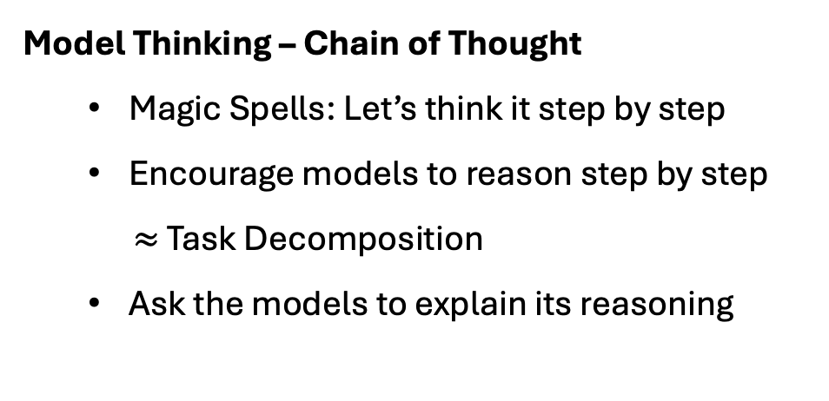
Enhance LLM Without Retraining
Model Thinking – Chain of Thought
  Magic Spells: Let’s think it step by step
  Encourage models to reason step by step
  $≈$ Task Decomposition
  Ask the models to explain its reasoning
Question
Output
Task 1
Question
Task 2
Output
Task $n$
Provide Additional Information
  Clarify context and background if model lacks prior knowledge
  Give model relevant data before asking the question
  Give example before asking
Extra Info.
Question
Output
Notes:
self-checking and reflection

Slide 7


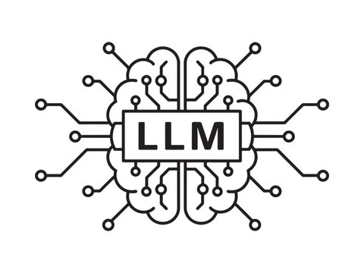


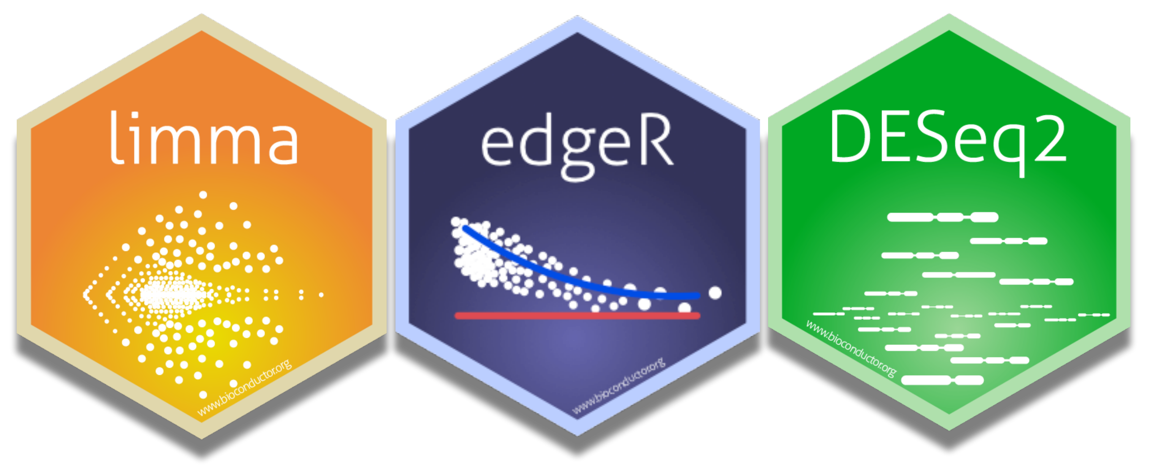

Enhance LLM Without Retraining – Function Calling
Search
Profession Query
External Info
Output
Retrieval-Augmented Generation
(RAG)
Search Engine
Programming
Other AI
Domain-specific packages
Notes:
Another core mechanism to enhance LLM is tool usage.
Tools can be viewed as functions; using a tool means calling that function.
The use of tools is also known as a “Function Call.”
By using tools, LLM don’t need to understand its internal workings, instead, it only needs to know how to use it
Common tools like RAG, a technique that improves LLM responses by having them first retrieve relevant information from an external knowledge base.
other AI: different capability, stronger but costly

Slide 8





Use Enhanced LLM to Build AI Agent
Docker
User
Retrieve
Tools
Question
Agent 1
(observational data)
Encryption Indexing
Human
Human
Task 1
Agent 2
(Sequencing)
LLM
Task 2
Communicator with LLM (Distributor)
Communicator with LLM (Summarizer)
Task 3
Agent 3
(Imaging)
….
Decryption
Task $n$
…
Output
Extra Datasets (optional)
Agent $m$
(EHR)
Concept courtesy of Solomon

Slide 9
Inside the Agent
Datasets (optional)
[python/R code]
Executor
Output
Tasks
ReACT
(Debug)
To Be Added
Incorporate Human Feedback
Memory Integration
RAG
More to come
Current Bottleneck
Requires scalable multi-node parallelism
Notes:
reduce hallucination
transforms it from a “stateless chatbot” into something that can reason across turns, tasks, or sessions.
LLM inference is resource-intensive and slow on a single node
Frequent GPU memory exhaustion during large-batch or long-context inference
Need scalable multi-node parallelism for reliable distributed inference
Key bottleneck: efficiently distributing inference workloads across nodes

