Slide 1
Generalized Least Squares

Slide 2
Overview
How does GLS differ from ordinary least-squares?
Identifying and describing autocorrelation
Regularly and irregularly spaced data

Slide 3
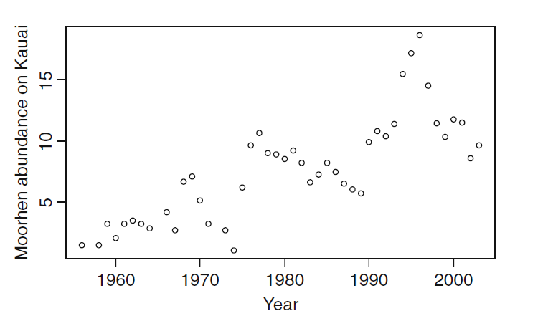
Relaxing Linear Model Assumptions:
Independence
Data can be auto-correlated
Often for temporally or spatially structured data, assumptions of independence are not valid
Ex: How does rainfall affect populations?

Slide 4

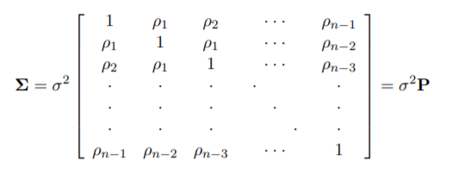
Two minutes of matrix algebra
Standard linear models can be expressed:
y is n x 1 response vector
X is n x k+1 matrix of data
β is k+1 x 1 vector of regression coefficients
ε is n x 1 vector of errors
ε is assumed to have a mean of zero, and variance σ²
No covariance allowed (OLS)
In GLS, we create an error covariance matrix that describes a correlation structure of errors

Slide 5
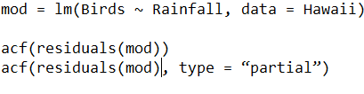
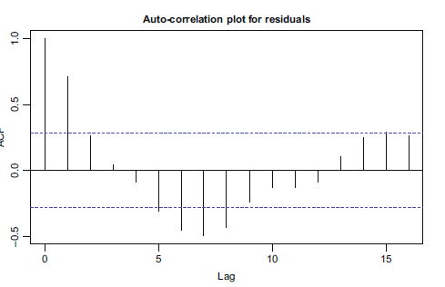
Recognizing autocorrelation – regularly spaced data
Auto-correlation plot
Show correlation between data points of different lag distances
Partial acf is similar, but corrects for correlation caused by lower lag steps

Slide 6

ARMA correlation structure
Autoregressive correlation structure:
Parameter p determines the lag of the autocorrelation
Moving average correlation structure:
Parameter q determines moving average lag
Can combine AR and MA to make ARMA, with parameters (p, q)
Zuur: “The ARMA(p, q) can be seen as a black box to fix residual correlation problems”

Slide 7

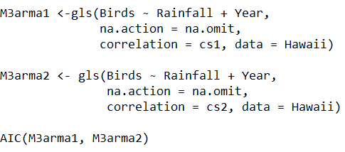
Implementation in R
Package nlme
corARMA
Starting value somewhat arbitrary
gls()
Works like lm(), but allows for definition of correlation structure
Determine best correlation structure by model comparison with AIC

Slide 8
Irregularly spaced data

