Slide 1
Generalized Least Squares

Slide 2
Overview
How does GLS differ from ordinary least-squares?
Identifying and describing autocorrelation
Regularly and irregularly spaced data

Slide 3
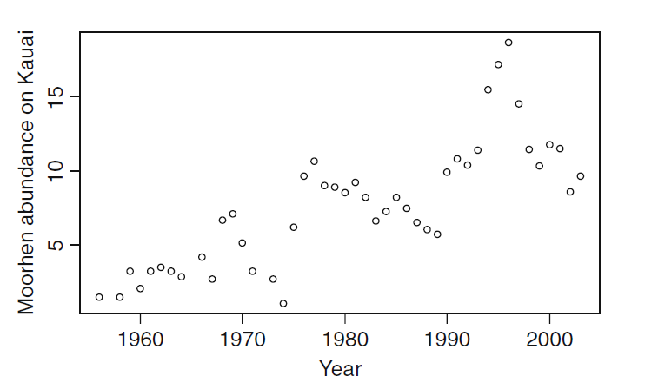
Relaxing Linear Model Assumptions:
Independence
Data can be auto-correlated
Often for temporally or spatially structured data, assumptions of independence are not valid
Ex: How does rainfall affect bird populations?

Slide 4


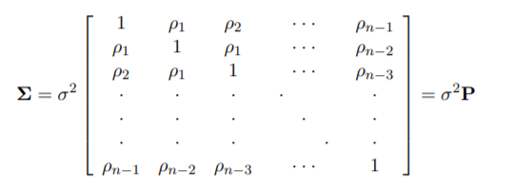
Two minutes of matrix algebra
Standard linear models can be expressed:
y is n x 1 response vector
X is n x k+1 matrix of data
β is k+1 x 1 vector of regression coefficients
ε is n x 1 vector of residuals
ε is assumed to have a mean of zero, and variance σ²
No covariance allowed (OLS)
In GLS, we create an variance-covariance matrix that describes a correlation structure of residuals
In OLS, this is just an identity matrix

Slide 5
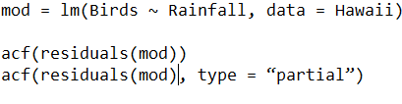
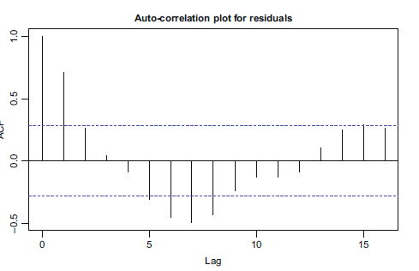
Recognizing autocorrelation – regularly spaced data
Auto-correlation plot
Show correlation between data points of different lag distances
Partial acf is similar, but corrects for correlation caused by lower lag steps

Slide 6

ARMA correlation structure
Autoregressive correlation structure:
Parameter p determines the lag of the autocorrelation
Moving average correlation structure:
Parameter q determines moving average lag
Can combine AR and MA to make ARMA, with parameters (p, q)
Zuur: “The ARMA(p, q) can be seen as a black box to fix residual correlation problems”

Slide 7

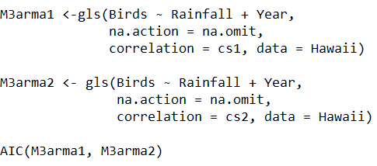
Implementation
Package nlme
corARMA
Starting value somewhat arbitrary
gls()
Works like lm(), but allows for definition of correlation structure
Determine best correlation structure by model comparison with AIC

Slide 8
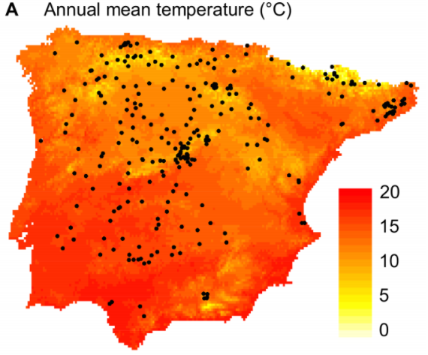
Irregularly spaced data
Approach is conceptually similar
Look for evidence of autocorrelation
Find an appropriate model to describe autocorrelation
Flowering time of Arabidopsis in Spain & Portugal

Slide 9
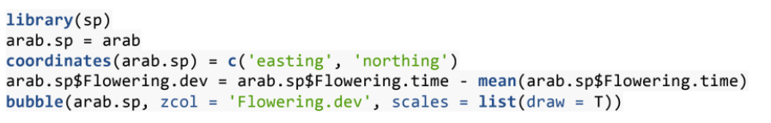
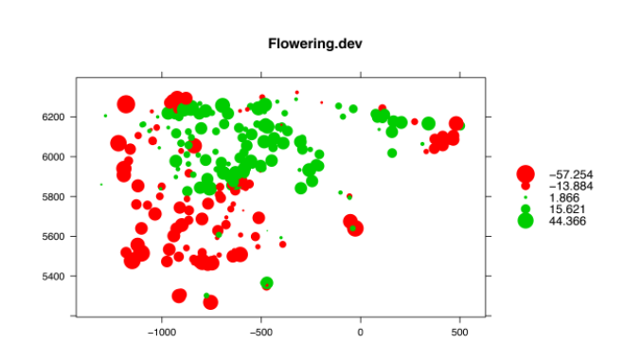
Identifying spatial autocorrelation
Start by plot deviation from mean in 2d space with bubble ()

Slide 10
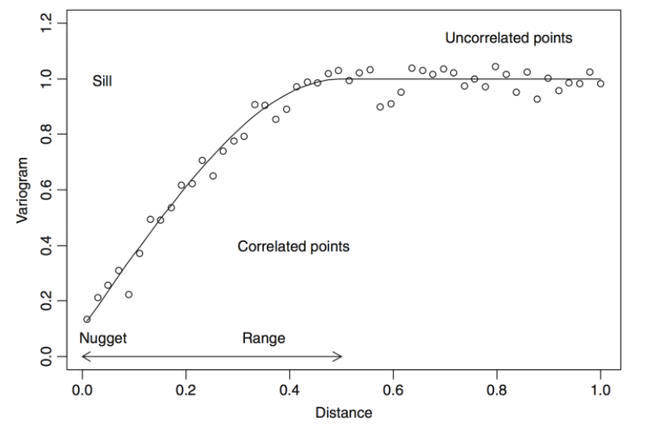
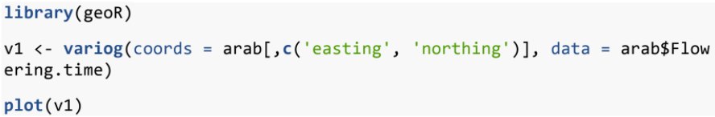
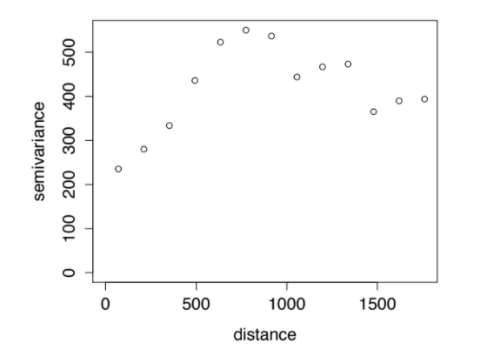
Using a variogram to identify autocorrelation
idealized
Plots variance as a function of distance between sample points
“nugget” is variance at zero distance
“sill” is the asymptote value
“range” is distance where variogram levels

Slide 11
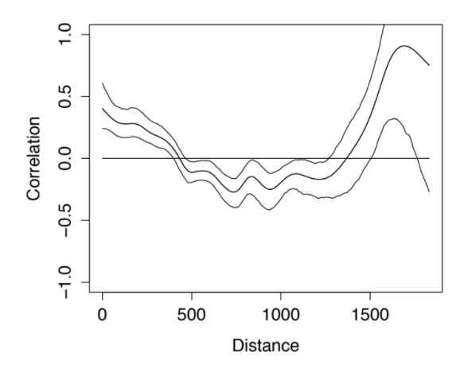
Using a spline correlogram
Plots correlation as a function of distance between sample points
Non-parametric estimator to get smooth function for correlation

Slide 12
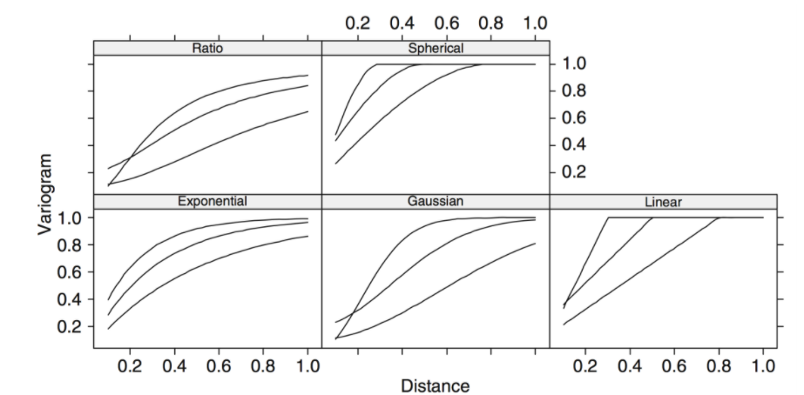
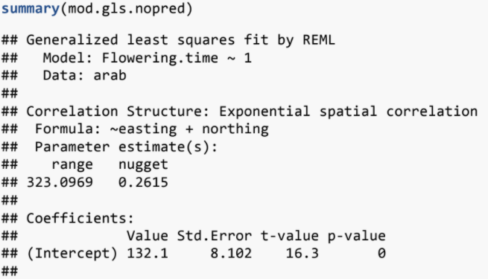
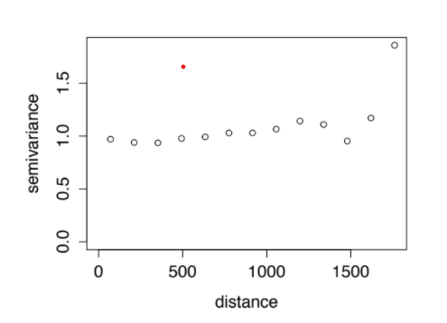
Functions to describe autocorrelation
Spherical, Linear, Ratio, Gaussian, Exponential
Continuous functions that define autocorrelation
Can compare AIC between different autocorrelation models

Slide 13

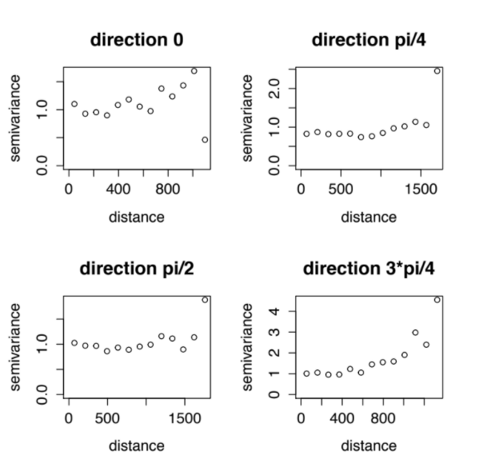
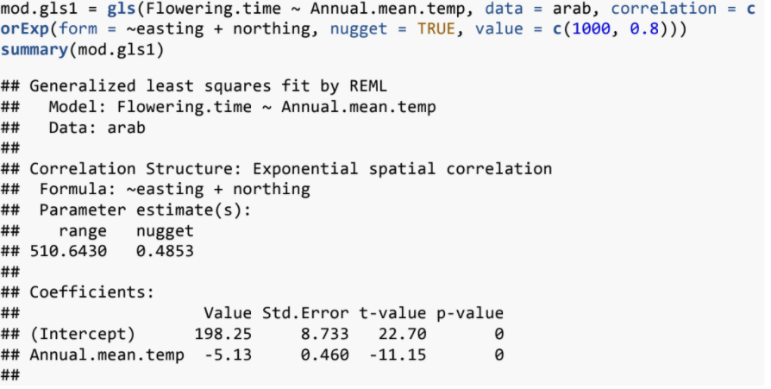
Other spatial considerations
Importance of direction

