Slide 1

Navigating Quantum Realities: A Comprehensive Analysis of Quantum Computers, Providers, and Qiskit Compatibility Challenges and Opportunities
Weverton de Souza Castanho TU Dublin Tallaght Email: X00193205@myTUDublin.ie 14.DEC.2023 MSc. Solution Software Architecture Program School of Enterprise Computing and Digital Transformation, TU Dublin, Ireland

Slide 2
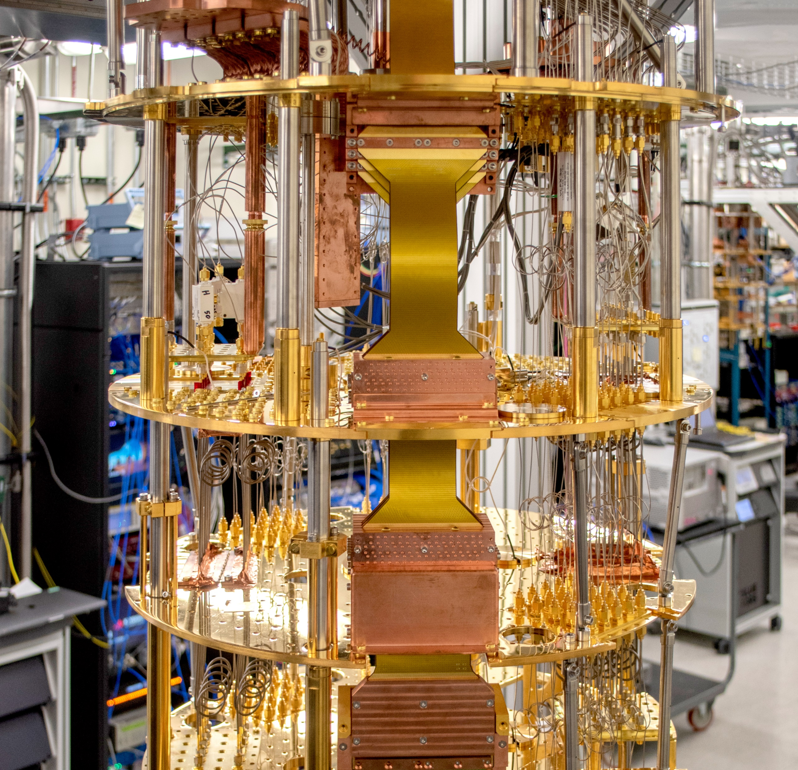
Objectives
Analysis of the degree of availability, capacity, and compatibility of quantum infrastructure service providers and types of quantum computers running a compatible application to assess the maturity level of available services and infrastructure.
Since quantum computers are a promise for the present and future, it is necessary to analyze their compatibility, identify the best development framework (Qiskit) that can run on all of them, preserving the investment applied in code...

Slide 3

Qiskit stands as the IBM's comprehensive suite of quantum software development tools.
Programming Language:
- Fully based on Python, providing accessibility for large developer communities to implement applications in Quantum Computing.
Modularity:
- Terra: Quantum circuit manipulation.
- Aer: High-performance quantum simulators.
- Ignis: Tools for error characterization and mitigation in quantum hardware.
- Aqua: Quantum algorithms for general applications.
Quantum Circuits:
- Provides the possibility to implement complex circuits based on diverse algorithms and gates.
Execution on Real Hardware:
- Qiskit provides support for QASM, a quantum simulator, and support for different providers' quantum processor architectures.
Community and Collaboration:
- Supported by a large, active, and collaborative community, Qiskit is open for participation and values contributions aimed at enhancing the framework.
Comprehensive Documentation:
- Qiskit's official documentation offers in-depth resources, including tutorials, guides, and references. IBM provides open infrastructure and hardware open for anyone to improve all fundamental concepts of the language.
Education:
- Qiskit and IBM provide many resources such as documentation, educational programs, and support learning open for anyone.
Open Development:
- Qiskit is an open-source project, offering transparency and flexibility to users. Access to the source code enables community adaptations and contributions to continually enhance the framework.
source: https://docs.quantum.ibm.com/

Slide 4
Providers and Architectures
Target name | Target ID | Provider | Number of qubits | Description
Rigetti QVM (simulator) | rigetti.sim.qvm | Microsoft Azure | 20 qubits | Rigetti's cloud-based, open-source "Quantum Virtual Machine" simulator. Free to use.
Aspen M-3 (hardware) | rigetti.qpu.aspen-m-3 | Microsoft Azure | 80 qubits | Rigetti's "Aspen-M-3" universal, physical QPU. Read more at Rigetti's website.
Quantum simulator | ionq.simulator | Microsoft Azure | 29 qubits | IonQ's cloud-based idealized simulator. Free of cost.
Aria 1 | ionq.qpu.aria-1 | Microsoft Azure | 23 qubits | IonQ's Aria 1 trapped-ion quantum computer. This is real quantum hardware, not a simulation.
Quantum computer | ionq.qpu | Microsoft Azure | 11 qubits | IonQ's trapped-ion quantum computer. This is real quantum hardware, not a simulation.
H1-1 Syntax Checker | quantinuum.sim.h1-1sc | Microsoft Azure | 20 qubits | Quantinuum's H1-1 Syntax Checker. This will return all zeros in place of actual or simulated results. Use this to validate quantum programs against the H1-1 compiler before submitting to hardware or emulators on Quantinuum's platform. Free of cost.
H1-2 Syntax Checker | quantinuum.sim.h1-2sc | Microsoft Azure | 20 qubits | Quantinuum's H1-2 Syntax Checker. This will return all zeros in place of actual or simulated results. Use this to validate quantum programs against the H1-2 compiler before submitting to hardware or emulators on Quantinuum's platform. Free of cost.
H2-1 Syntax Checker | quantinuum.sim.h2-1sc | Microsoft Azure | 32 qubits | Quantinuum's H2-1 Syntax Checker. This will return all zeros in place of actual or simulated results. Use this to validate quantum programs against the H2-1 compiler before submitting to hardware or emulators on Quantinuum's platform. Free of cost.
H1-1 Emulator | quantinuum.sim.h1-1e | Microsoft Azure | 20 qubits | Quantinuum's H1-1 Emulator. Uses a realistic physical model and noise model of H1-1.
H1-2 Emulator | quantinuum.sim.h1-2e | Microsoft Azure | 20 qubits | Quantinuum's H1-2 Emulator. Uses a realistic physical model and noise model of H1-2.
H2-1 Emulator | quantinuum.sim.h2-1e | Microsoft Azure | 32 qubits | Quantinuum's H2-1 Emulator. Uses a realistic physical model and noise model of H2-1.
H1-1 | quantinuum.qpu.h1-1 | Microsoft Azure | 20 qubits | Quantinuum's H1-1 trapped ion device.
H1-2 | quantinuum.qpu.h1-2 | Microsoft Azure | 20 qubits | Quantinuum's H1-2 trapped ion device.
H2-1 | quantinuum.qpu.h2-1 | Microsoft Azure | 32 qubits | Quantinuum's H2-1 trapped ion device.
IBM Brisbane | ibm_brisbane | IBM Quantum Platform | 127 qubits | IBM Quantum Platform with Eagle r3 processor
IBM Osaka | ibm_ osaka | IBM Quantum Platform | 127 qubits | IBM Quantum Platform with Eagle r3 processor

Slide 5
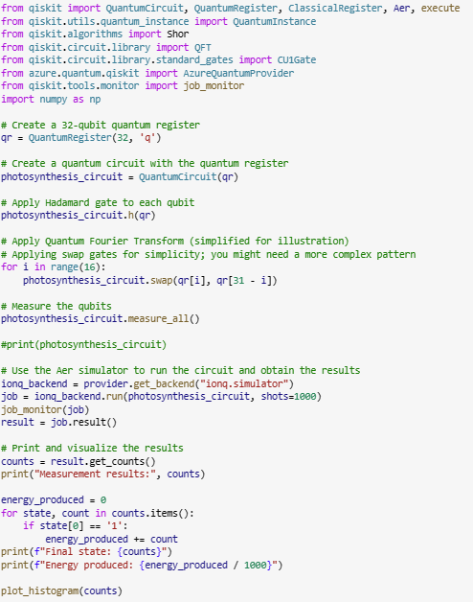
Simulation 1
Quantum Photosynthesis
Photosynthesis is a vital process for plants and life on the planet. However, its efficiency, approaching 100%, cannot be fully explained by classical physics. One explanation lies in the use of quantum processes within plant leaves. A simulation based on a quantum circuit was developed and tested on various computers to assess the maturity of Qiskit on these platforms.

Slide 6
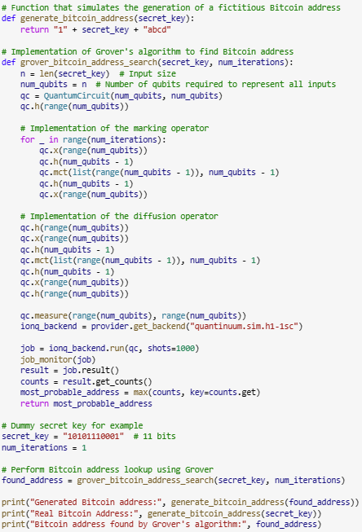
Simulation 2
Quantum Bitcoin Mining
The Bitcoin attracts significant investments from banks and companies as a substantial store of value. However, the energy consumption in processing the currency is equivalent to that of some countries. Quantum computers provide a more efficient solution, consuming less energy and processing cryptography rapidly through algorithms designed for this purpose. An address generator was tested using the Grover algorithm on various quantum computing platforms.

Slide 7
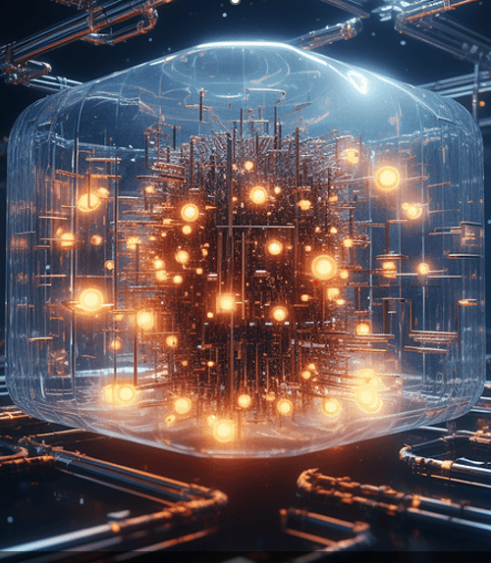
Conclusions
The Qiskit language, a promising tool for the future, opens up possibilities for compatibility among various quantum processor architectures. However, there is still no complete integration among the different available quantum computers. The shortage of machines for testing complicates the debugging and improvement process for Qiskit applications, especially when migrating to other quantum platforms. While the opportunities that quantum computing can offer to humanity are significant, the journey for those embarking on it is challenging, filled with efforts and incremental results.
image source: https://innovationorigins.com/en/quandela-takes-the-quantum-computer-from-lab-to-fab-for-first-time/

Slide 8

THANKS!
image source: Only God knows where it came from!

