Slide 1
TLS 1.2 / TLS 1.3 / QUIC 握手与会话恢复抓包分析

Slide 2
建立连接的命令
TLS 1.2:
建立连接：openssl s_client -connect tls-v1-2.badssl.com:1012 -servername tls-v1-2.badssl.com -tls1_2 -sess_out tls12_sess.pem –msg
会话恢复：openssl s_client -connect tls-v1-2.badssl.com:1012 -servername tls-v1-2.badssl.com -tls1_2 -sess_in tls12_sess.pem –msg
TLS 1.3:
建立连接：openssl s_client -connect www.cloudflare.com:443 -servername www.cloudflare.com -tls1_3 -sess_out tls13_sess.pem –msg
会话恢复：openssl s_client -connect www.cloudflare.com:443 -servername www.cloudflare.com -tls1_3 -sess_in tls13_sess.pem –msg
QUIC：（借助了aioquic库）
清除已有票据文件：Remove-Item .\quic.ticket -ErrorAction SilentlyContinue
建立连接：python .\examples\http3_client.py -v -l quic_new.keys -s quic.ticket https://cloudflare-quic.com/
会话恢复：python .\examples\http3_client.py -v -l quic_resume.keys -s quic.ticket https://cloudflare-quic.com/

Slide 3
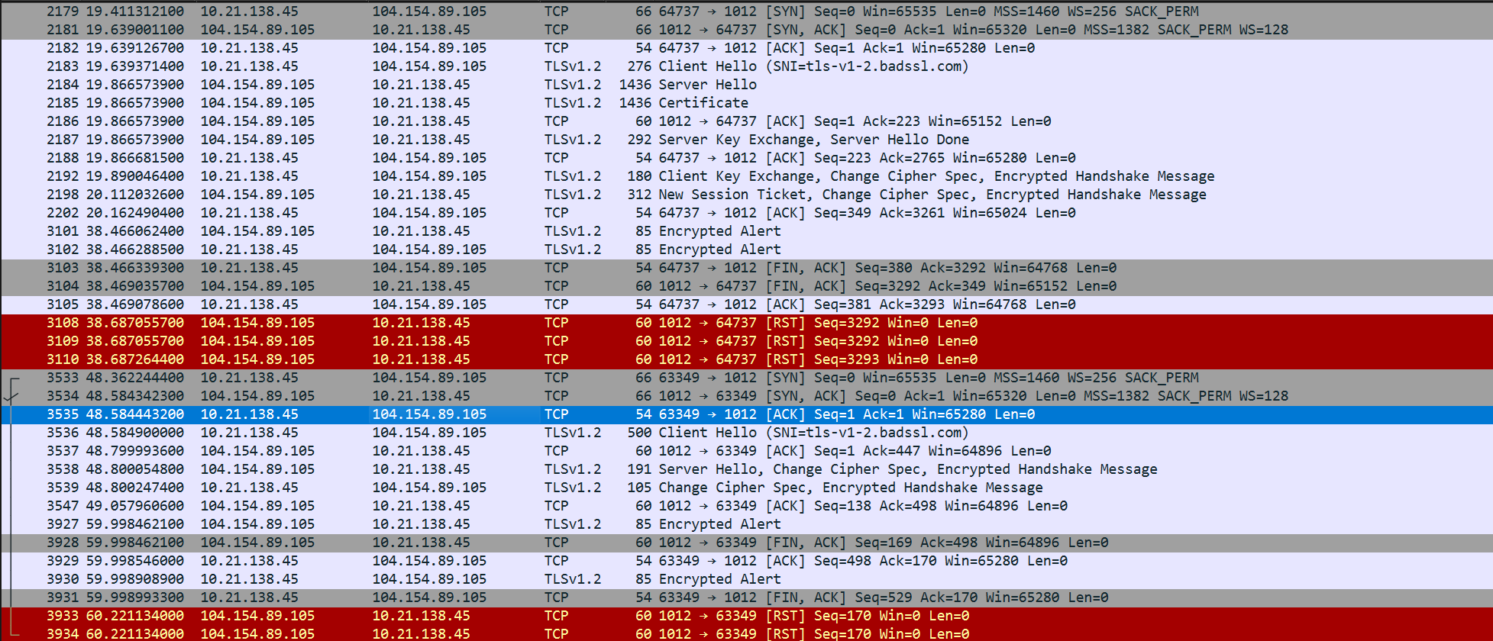
TLS 1.2

Slide 4
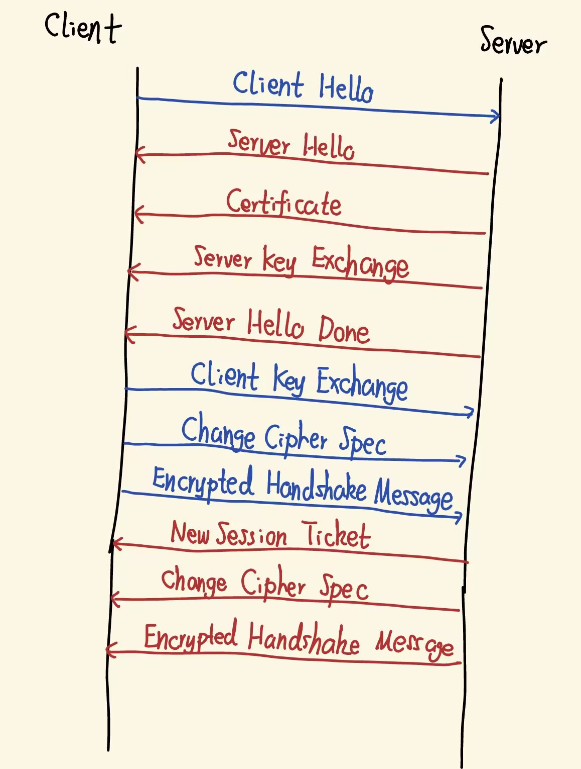
新会话建立

Slide 5
Client Hello:
Transport Layer Security
[Stream index: 56]
TLSv1.2 Record Layer: Handshake Protocol: Client Hello
Content Type: Handshake (22)
Version: TLS 1.0 (0x0301) 规避这些设备因不识新版本而直接丢弃数据包的兼容性问题
Length: 217
Handshake Protocol: Client Hello
Handshake Type: Client Hello (1)
Length: 213
Version: TLS 1.2 (0x0303) 客户端支持的最高 TLS 版本
Random: fb813030fe84acaaf64ca62259d99fd790d92e370a0c7051046065476791a9f2
Session ID Length: 0
Cipher Suites Length: 56
Cipher Suites (28 suites)
Compression Methods Length: 1
Compression Methods (1 method)
Extensions Length: 116
Extension: server_name (len=24) name=tls-v1-2.badssl.com
Extension: ec_point_formats (len=4)
Extension: supported_groups (len=12)
Extension: session_ticket (len=0)
Extension: encrypt_then_mac (len=0)
Extension: extended_master_secret (len=0)
Extension: signature_algorithms (len=48)
由时间戳和随机字节组成的随机数，
参与主密钥的生成，防重放攻击
不提供Session ID, 开启新对话
支持的密码套件
不压缩，防止CRIME攻击
告诉访问的域名，可能一个虚拟主机托管多个域名，
服务器要根据这个信息返回对应证书
支持的椭圆曲线公钥数据格式
支持的椭圆参数组
支持通过会话票证复用会话，客户端首次连接时会发一个空扩展告知服务器。
支持先加密再计算MAC（消息认证码），能防御针对 CBC 模式的部分 padding oracle 攻击
支持把整个握手过程的消息摘要也掺进去计算，增强主密钥的安全性，
防御握手过程中被三方攻击者干预的连接劫持。
支持的签名算法

Slide 6
Server Hello
Transport Layer Security
[Stream index: 56]
TLSv1.2 Record Layer: Handshake Protocol: Server Hello
Content Type: Handshake (22)
Version: TLS 1.2 (0x0303)
Length: 61
Handshake Protocol: Server Hello
Handshake Type: Server Hello (2)
Length: 57
Version: TLS 1.2 (0x0303)
Random: 486a974c8e660d73f1b7ad2823180dbfd77b11d5d58cd9a5384aaf77f97eb05c
Session ID Length: 0
Cipher Suite: TLS_ECDHE_RSA_WITH_AES_256_GCM_SHA384 (0xc030)
Compression Method: null (0)
Extensions Length: 17
Extension: renegotiation_info (len=1)
Extension: ec_point_formats (len=4)
Extension: session_ticket (len=0)
服务器发送的随机数
不发送Session ID，表明开始建立新会话
选定的密码套件
同意不压缩
renegotiation_info 表明服务器支持安全重协商，用于把后续重协商与当前连接绑定，防止前缀注入式重协商攻击。
支持的椭圆曲线点的格式
支持发送票证

Slide 7
Certificate
Transport Layer Security
[Stream index: 56]
TLSv1.2 Record Layer: Handshake Protocol: Certificate
Content Type: Handshake (22)
Version: TLS 1.2 (0x0303)
Length: 2584
Handshake Protocol: Certificate
Handshake Type: Certificate (11)
Length: 2580
Certificates Length: 2577
Certificates (2577 bytes)
Certificate Length: 1282
Certificate […]: …
Certificate Length: 1289
Certificate […]: …
服务器发送完整证书链，包括实体证书和中间证书

Slide 8
Server Key Exchange
Transport Layer Security
[Stream index: 56]
TLSv1.2 Record Layer: Handshake Protocol: Server Key Exchange
Content Type: Handshake (22)
Version: TLS 1.2 (0x0303)
Length: 333
Handshake Protocol: Server Key Exchange
Handshake Type: Server Key Exchange (12)
Length: 329
EC Diffie-Hellman Server Params
Curve Type: named_curve (0x03)
Named Curve: secp256r1 (0x0017)
Pubkey Length: 65
Pubkey: …
Signature Algorithm: rsa_pkcs1_sha512 (0x0601)
Signature Hash Algorithm Hash: SHA512 (6)
Signature Hash Algorithm Signature: RSA (1)
Signature Length: 256
Signature […]:…
ECDH生成密钥的服务器参数
决定用于密钥交换的椭圆曲线类型
服务器发送的公钥
服务器用证书私钥签名

Slide 9
Server Hello Done
Transport Layer Security
[Stream index: 56]
TLSv1.2 Record Layer: Handshake Protocol: Server Hello Done
Content Type: Handshake (22)
Version: TLS 1.2 (0x0303)
Length: 4
Handshake Protocol: Server Hello Done
Handshake Type: Server Hello Done (14)
Length: 0

Slide 10
Client Key Exchange, Change Cipher Spec, Encrypted Handshake Message
Transport Layer Security
[Stream index: 42]
TLSv1.2 Record Layer: Handshake Protocol: Client Key Exchange
Content Type: Handshake (22)
Version: TLS 1.2 (0x0303)
Length: 70
Handshake Protocol: Client Key Exchange
Handshake Type: Client Key Exchange (16)
Length: 66
EC Diffie-Hellman Client Params
Pubkey Length: 65
Pubkey: …
TLSv1.2 Record Layer: Change Cipher Spec Protocol: Change Cipher Spec
Content Type: Change Cipher Spec (20)
Version: TLS 1.2 (0x0303)
Length: 1
Change Cipher Spec Message
TLSv1.2 Record Layer: Handshake Protocol: Encrypted Handshake Message
Content Type: Handshake (22)
Version: TLS 1.2 (0x0303)
Length: 40
Handshake Protocol: Encrypted Handshake Message
据推测，这里是用于检验双方生成的密钥是否相同的Finished消息

Slide 11
New Session Ticket, Change Cipher Spec, Encrypted Handshake Message
Transport Layer Security
[Stream index: 56]
TLSv1.2 Record Layer: Handshake Protocol: New Session Ticket
// 新会话票据
Content Type: Handshake (22)
Version: TLS 1.2 (0x0303)
Length: 202
Handshake Protocol: New Session Ticket
Handshake Type: New Session Ticket (4)
Length: 198
TLS Session Ticket
Session Ticket Lifetime Hint: 300 seconds (5 minutes)
Session Ticket Length: 192
Session Ticket […]: …
TLSv1.2 Record Layer: Change Cipher Spec Protocol: Change Cipher Spec
Content Type: Change Cipher Spec (20)
Version: TLS 1.2 (0x0303)
Length: 1
Change Cipher Spec Message
TLSv1.2 Record Layer: Handshake Protocol: Encrypted Handshake Message
Content Type: Handshake (22)
Version: TLS 1.2 (0x0303)
Length: 40
Handshake Protocol: Encrypted Handshake Message
票据生存周期
发送票据，用于会话恢复

Slide 12
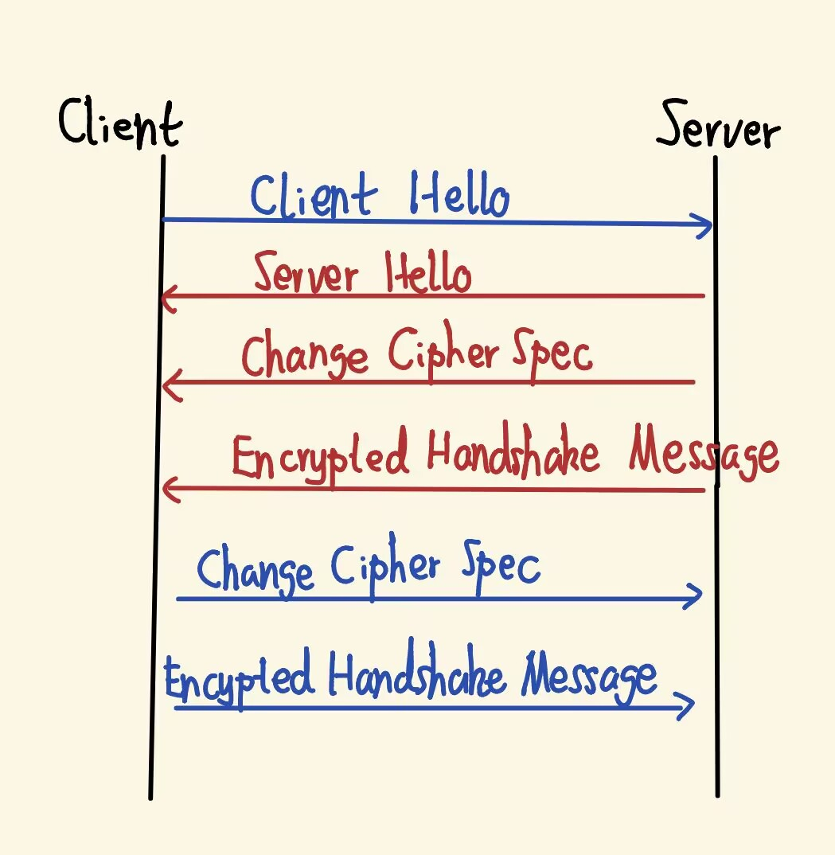
会话恢复

Slide 13
Client Hello
Transport Layer Security
[Stream index: 64]
TLSv1.2 Record Layer: Handshake Protocol: Client Hello
Content Type: Handshake (22)
Version: TLS 1.0 (0x0301)
Length: 441
Handshake Protocol: Client Hello
Handshake Type: Client Hello (1)
Length: 437
Version: TLS 1.2 (0x0303)
Random: c2651511a1523bcbb49c8610bd0c9d43cb62c299b591ab0dd799977453afe31d
Session ID Length: 32
Session ID: 85c332e37eae0728f4949d7e57e205ddb9d01590a8ec0ec9dfc4fb03011633e3
Cipher Suites Length: 56
Cipher Suites (28 suites)
Compression Methods Length: 1
Compression Methods (1 method)
Extensions Length: 308
Extension: server_name (len=24) name=tls-v1-2.badssl.com
Extension: ec_point_formats (len=4)
Extension: supported_groups (len=12)
Extension: session_ticket (len=192)
Extension: encrypt_then_mac (len=0)
Extension: extended_master_secret (len=0)
Extension: signature_algorithms (len=48)
Session ID 非空，Session Ticket 也非空，结合握手流程明显缩短，可以判断本次连接发生了会话恢复
Session Ticket非空，与建立会话时服务器给的Session Ticket相同

Slide 14
Server Hello, Change Cipher Spec, Encrypted Handshake Message
Transport Layer Security
[Stream index: 64]
TLSv1.2 Record Layer: Handshake Protocol: Server Hello
Content Type: Handshake (22)
Version: TLS 1.2 (0x0303)
Length: 81
Handshake Protocol: Server Hello
Handshake Type: Server Hello (2)
Length: 77
Version: TLS 1.2 (0x0303)
Random: f546dffa6d3a0cb1abcd616e294c4ef406a305d554d62a3164e9c15324b2a372
Session ID Length: 32
Session ID: 85c332e37eae0728f4949d7e57e205ddb9d01590a8ec0ec9dfc4fb03011633e3
Cipher Suite: TLS_ECDHE_RSA_WITH_AES_256_GCM_SHA384 (0xc030)
Compression Method: null (0)
Extensions Length: 5
Extension: renegotiation_info (len=1)
Type: renegotiation_info (65281)
Length: 1
Renegotiation Info extension
TLSv1.2 Record Layer: Change Cipher Spec Protocol: Change Cipher Spec
Content Type: Change Cipher Spec (20)
Version: TLS 1.2 (0x0303)
Length: 1
Change Cipher Spec Message
TLSv1.2 Record Layer: Handshake Protocol: Encrypted Handshake Message
Content Type: Handshake (22)
Version: TLS 1.2 (0x0303)
Length: 40
Handshake Protocol: Encrypted Handshake Message
标志重新连接

Slide 15
Change Cipher Spec, Encrypted Handshake Message
Transport Layer Security
[Stream index: 64]
TLSv1.2 Record Layer: Change Cipher Spec Protocol: Change Cipher Spec
Content Type: Change Cipher Spec (20)
Version: TLS 1.2 (0x0303)
Length: 1
Change Cipher Spec Message
TLSv1.2 Record Layer: Handshake Protocol: Encrypted Handshake Message
Content Type: Handshake (22)
Version: TLS 1.2 (0x0303)
Length: 40
Handshake Protocol: Encrypted Handshake Message

Slide 16
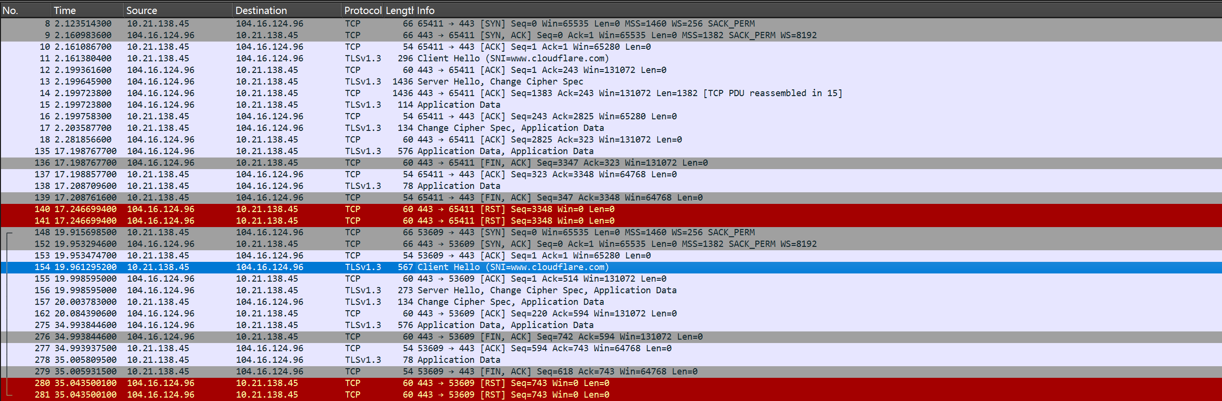
TLS 1.3

Slide 17
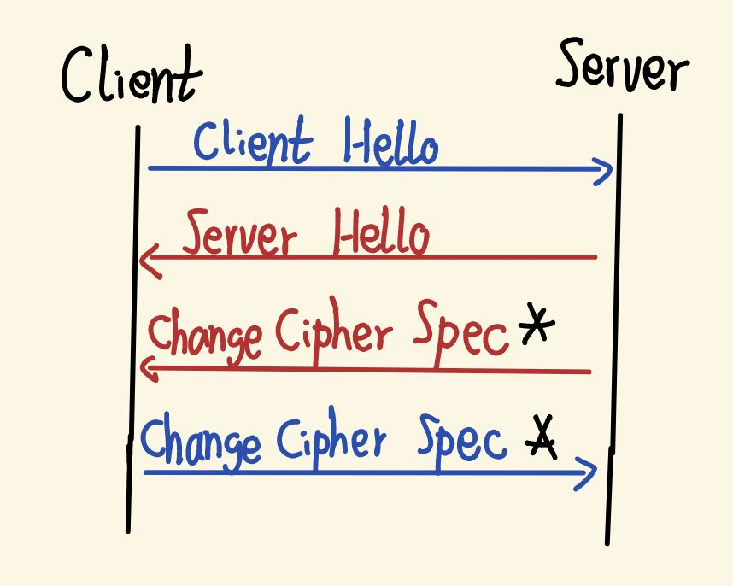
新会话建立

Slide 18
Client Hello
Transport Layer Security
TLSv1.3 Record Layer: Handshake Protocol: Client Hello
Content Type: Handshake (22)
Version: TLS 1.0 (0x0301)
Length: 237
Handshake Protocol: Client Hello
Handshake Type: Client Hello (1)
Length: 233
Version: TLS 1.2 (0x0303)
Random: 8abffa14b5fe81f23af9e966c01152b9c18b5192ce159c95ed144aa546d2f59a
Session ID Length: 32
Session ID: 4433da5474a449973b2e622fb11d86b20ce05f7ce393d22b212143422cb8460c
Cipher Suites Length: 8
Cipher Suites (4 suites)
Compression Methods Length: 1
Compression Methods (1 method)
Extensions Length: 152
Extension: server_name (len=23) name=www.cloudflare.com
Type: server_name (0)
Length: 23
Server Name Indication extension
Extension: ec_point_formats (len=4)
Type: ec_point_formats (11)
Length: 4
EC point formats Length: 3
Elliptic curves point formats (3)
Extension: supported_groups (len=12)
Type: supported_groups (10)
Length: 12
Supported Groups List Length: 10
Supported Groups (5 groups)
为了兼容TLS 1.2包版本格式的遗留产物，TLS 1.3写在后续的扩展里
兼容旧实现的产物，TLS 1.3不再需要Session ID进行会话恢复

Slide 19
Extension: session_ticket (len=0)
Type: session_ticket (35)
Length: 0
Session Ticket: <MISSING>
Extension: encrypt_then_mac (len=0)
Type: encrypt_then_mac (22)
Length: 0
Extension: extended_master_secret (len=0)
Type: extended_master_secret (23)
Length: 0
Extension: signature_algorithms (len=30)
Type: signature_algorithms (13)
Length: 30
Signature Hash Algorithms Length: 28
Signature Hash Algorithms (14 algorithms)
Extension: supported_versions (len=3) TLS 1.3
Type: supported_versions (43)
Length: 3
Supported Versions length: 2
Supported Version: TLS 1.3 (0x0304)
Extension: psk_key_exchange_modes (len=2)
Type: psk_key_exchange_modes (45)
Length: 2
PSK Key Exchange Modes Length: 1
PSK Key Exchange Mode: PSK with (EC)
DHE key establishment (psk_dhe_ke) (1)
Extension: key_share (len=38) x25519
Type: key_share (51)
Length: 38
Key Share extension
客户端列出自己真正支持的 TLS 版本
psk_dhe_ke 表示“PSK 恢复 + 再做一次 (EC)DHE”，从而恢复连接时仍获得新的密钥材料和前向安全性；psk_ke 也不是“直接拿老主密钥原样继续加密”，而是基于 PSK 重新派生本次连接的密钥，只是缺少新的 DHE 前向安全性。
直接把密钥交换的公钥发出而不是再等待第二个来回

Slide 20
Server Hello, Change Cipher Spec
Transport Layer Security
[Stream index: 19]
TLSv1.3 Record Layer: Handshake Protocol: Server Hello
Content Type: Handshake (22)
Version: TLS 1.2 (0x0303)
Length: 122
Handshake Protocol: Server Hello
Handshake Type: Server Hello (2)
Length: 118
Version: TLS 1.2 (0x0303)
Random: 8e906a8f0d0722e28ca781a98c894658c96619d508dd7e3d98dad034b7eb6dd8
Session ID Length: 32
Session ID: 4433da5474a449973b2e622fb11d86b20ce05f7ce393d22b212143422cb8460c
Cipher Suite: TLS_AES_256_GCM_SHA384 (0x1302)
Compression Method: null (0)
Extensions Length: 46
Extension: key_share (len=36) x25519
Type: key_share (51)
Length: 36
Key Share extension
Key Share Entry: Group: x25519, Key Exchange length: 32
Extension: supported_versions (len=2) TLS 1.3
Type: supported_versions (43)
Length: 2
Supported Version: TLS 1.3 (0x0304)
TLSv1.3 Record Layer: Change Cipher Spec Protocol: Change Cipher Spec
Content Type: Change Cipher Spec (20)
Version: TLS 1.2 (0x0303)
Length: 1
Change Cipher Spec Message
发送服务器端的密钥
支持连接的TLS版本
TLS 1.3 本身已不需要再发送Change Cipher Spec, 目的依然是欺骗中间老旧设备，告诉他们握手已完成，但实际上客户端收到后必须忽略，同理，客户端也会给服务器发一个Change Cipher Spec，这里不再重复展示

Slide 21
会话恢复

Slide 22
Client Hello：大体结构和新会话建立相同，新增了一个扩展：
Extension: pre_shared_key (len=267)
Type: pre_shared_key (41)
Length: 267
Pre-Shared Key extension
提供身份标识和用于验证的HMAC
有几个psk，就会带上几个psk，提供给服务器选择，其中会包含ticket_age等信息
同时psk_key_exchange_modes还会重申会话恢复模式，与之前相同，仍会采用DHE会话恢复模式，双方重新发送随机数，重新建立密钥（比如这次客户端还是会带上key_share）

Slide 23
Server Hello
Transport Layer Security
TLSv1.3 Record Layer: Handshake Protocol: Server Hello
Content Type: Handshake (22)
Version: TLS 1.2 (0x0303)
Length: 128
Handshake Protocol: Server Hello
Handshake Type: Server Hello (2)
Length: 124
Version: TLS 1.2 (0x0303)
Random: 768b942c0abf538d4b0ea652952bdd52f49a256a7d31de7f76c8f73673113ee2
Session ID Length: 32
Session ID: 1f1b4b32af63b43247bf932f04865e122a176c985c18580cdac9c718d412f314
Cipher Suite: TLS_AES_256_GCM_SHA384 (0x1302)
Compression Method: null (0)
Extensions Length: 52
Extension: pre_shared_key (len=2)
Type: pre_shared_key (41)
Length: 2
Pre-Shared Key extension
Selected Identity: 0
Extension: key_share (len=36) x25519
Type: key_share (51)
Length: 36
Key Share extension
Key Share Entry: Group: x25519, Key Exchange length: 32
Extension: supported_versions (len=2) TLS 1.3
Type: supported_versions (43)
Length: 2
Supported Version: TLS 1.3 (0x0304)
确认恢复会话，同时告诉客户端选择的是哪一个 PSK 身份（比如这次因为只有一个psk，选择的自然也是第一个，即0）
重新发送服务器的密钥

Slide 24
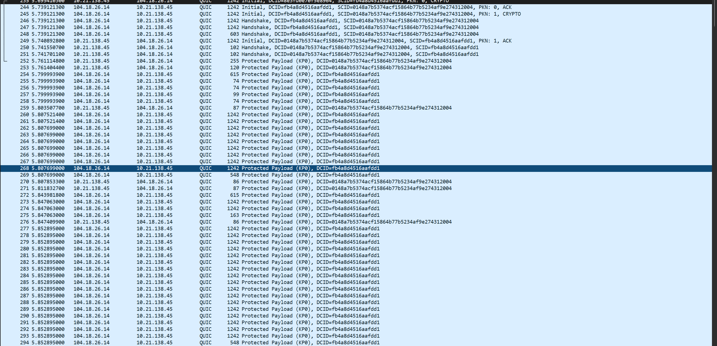
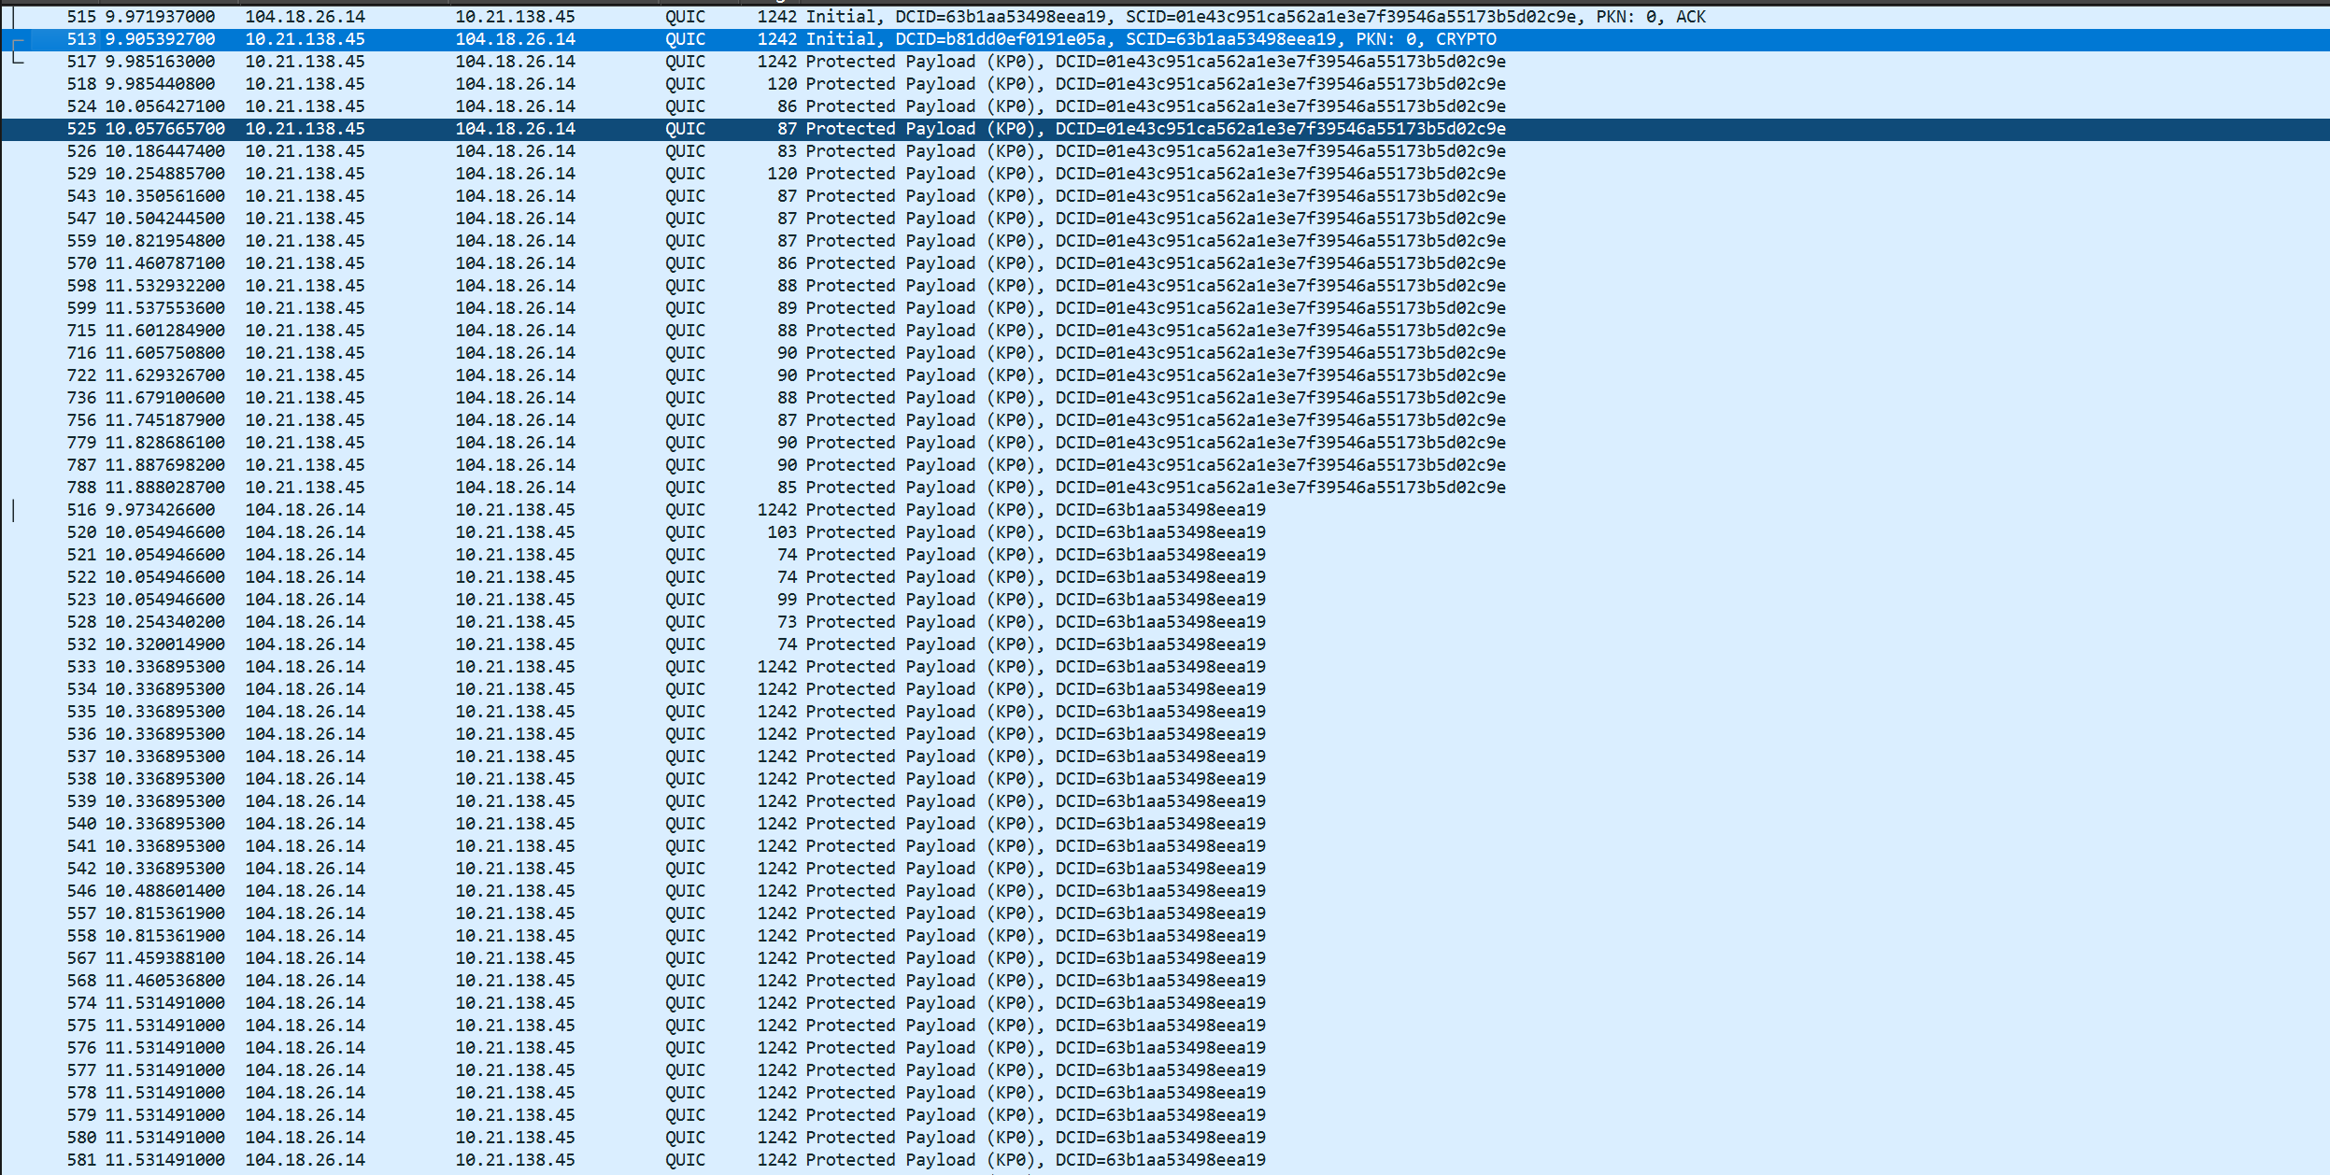
QUIC

Slide 25
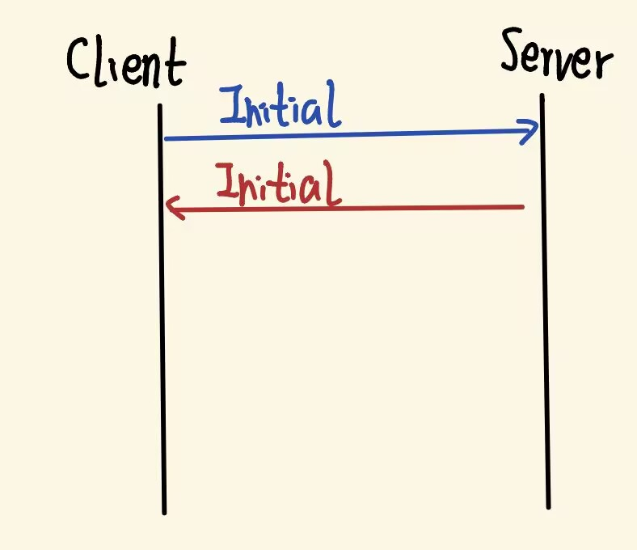
新会话建立
Client: Initial
Server: ACK -> Server Hello -> Handshake
Client: ACK -> Handshake
其中，Handshake 包空间中的报文已受握手密钥保护，其中可承载 TLS 1.3 的加密握手消息，例如 Certificate、CertificateVerify、Finished 等。

Slide 26
Client Initial
CRYPTO
Frame Type: CRYPTO (0x0000000000000006)
Offset: 0
Length: 486
Crypto Data
TLSv1.3 Record Layer: Handshake Protocol: Client Hello
Handshake Protocol: Client Hello
Handshake Type: Client Hello (1)
Length: 482
Version: TLS 1.2 (0x0303)
Random: 338a709b1bf66037405b1cac5f2dc7239bd3927792f3fa7837f74e91d8ed603e
Session ID Length: 0
Cipher Suites Length: 6
Cipher Suites (3 suites)
Cipher Suite: TLS_AES_256_GCM_SHA384 (0x1302)
Cipher Suite: TLS_AES_128_GCM_SHA256 (0x1301)
Cipher Suite: TLS_CHACHA20_POLY1305_SHA256 (0x1303)
Compression Methods Length: 1
Compression Methods (1 method)
Compression Method: null (0)
TLS格式要求，实际上已弃用

Slide 27
Extensions Length: 435
Extension: key_share (len=268) secp256r1, secp384r1, x25519, x448
Type: key_share (51)
Length: 268
Key Share extension
Client Key Share Length: 266
Key Share Entry: Group: secp256r1, Key Exchange length: 65
Key Share Entry: Group: secp384r1, Key Exchange length: 97
Key Share Entry: Group: x25519, Key Exchange length: 32
Key Share Entry: Group: x448, Key Exchange length: 56
Extension: supported_versions (len=3) TLS 1.3
Type: supported_versions (43)
Length: 3
Supported Versions length: 2
Supported Version: TLS 1.3 (0x0304)
Extension: signature_algorithms (len=20)
Type: signature_algorithms (13)
Length: 20
Signature Hash Algorithms Length: 18
Signature Hash Algorithms (9 algorithms)
Extension: supported_groups (len=10)
Type: supported_groups (10)
Length: 10
Supported Groups List Length: 8
Supported Groups (4 groups)

Slide 28
Extension: psk_key_exchange_modes (len=2)
Type: psk_key_exchange_modes (45)
Length: 2
PSK Key Exchange Modes Length: 1
PSK Key Exchange Mode: PSK with (EC)DHE key establishment (psk_dhe_ke) (1)
Extension: server_name (len=24) name=cloudflare-quic.com
Type: server_name (0)
Length: 24
Server Name Indication extension
Extension: application_layer_protocol_negotiation (len=5)
Type: application_layer_protocol_negotiation (16)
Length: 5
ALPN Extension Length: 3
ALPN Protocol
Extension: quic_transport_parameters (len=71)
Type: quic_transport_parameters (57)
Length: 71
Parameter: max_idle_timeout (len=4) 60000 ms
Parameter: initial_max_data (len=4) 1048576
Parameter: initial_max_stream_data_bidi_local (len=4) 1048576
Parameter: initial_max_stream_data_bidi_remote (len=4) 1048576
Parameter: initial_max_stream_data_uni (len=4) 1048576
Parameter: initial_max_streams_bidi (len=2) 128
Parameter: initial_max_streams_uni (len=2) 128
Parameter: ack_delay_exponent (len=1)
Parameter: max_ack_delay (len=1) 25
Parameter: active_connection_id_limit (len=1) 8
Parameter: initial_source_connection_id (len=8)
Parameter: version_information (len=12)
告诉服务器建立的是HTTP/3.0的连接
下面是QUIC的一些连接参数
空闲时间超过60000ms直接关闭连接
整个连接的总流控窗口，所有流加起来不能超过 1 MB
本地发起的双向流，单个流的流控窗口 1 MB
对方发起的双向流，单个流的流控窗口 1 MB
单向流，单个流的流控窗口 1 MB
最多同时打开 128 个双向流
最多同时打开 128 个单向流
定义 ACK 延迟的编码精度（传输的整数需要乘上多少倍，才能还原成真实的微秒延迟）
对方最多延迟 25 毫秒发 ACK
告诉通信对方，我方同时愿意接收/维护多少个活跃的连接 ID
客户端一开始选的连接 ID，用来防止被错误关联
客户端支持的 QUIC 版本列表，供服务器选择

Slide 29
Server Initial
CRYPTO
Frame Type: CRYPTO (0x0000000000000006)
Offset: 0
Length: 90
Crypto Data
TLSv1.3 Record Layer: Handshake Protocol: Server Hello
Handshake Protocol: Server Hello
Handshake Type: Server Hello (2)
Length: 86
Version: TLS 1.2 (0x0303)
Random: 4dc6c9dfaeee46a6a231d448c28b84affa4db3ca6d4ffb4e8937d08f38e1400d
Session ID Length: 0
Cipher Suite: TLS_AES_256_GCM_SHA384 (0x1302)
Compression Method: null (0)
Extensions Length: 46
Extension: key_share (len=36) x25519
Type: key_share (51)
Length: 36
Key Share extension
Key Share Entry: Group: x25519, Key Exchange length: 32
Extension: supported_versions (len=2) TLS 1.3
Type: supported_versions (43)
Length: 2
Supported Version: TLS 1.3 (0x0304)

Slide 30
会话恢复
Client: Initial
Server: ACK -> Server Hello

Slide 31
Client Initial
CRYPTO
Frame Type: CRYPTO (0x0000000000000006)
Offset: 0
Length: 777
Crypto Data
TLSv1.3 Record Layer: Handshake Protocol: Client Hello
Handshake Protocol: Client Hello
Handshake Type: Client Hello (1)
Length: 773
Version: TLS 1.2 (0x0303)
Random: dc75d8d6e0502072061cb2ce97a5284957ec25bce6cdbf032118d264f4b231ee
Session ID Length: 0
Cipher Suites Length: 6
Cipher Suites (3 suites)
Cipher Suite: TLS_AES_256_GCM_SHA384 (0x1302)
Cipher Suite: TLS_AES_128_GCM_SHA256 (0x1301)
Cipher Suite: TLS_CHACHA20_POLY1305_SHA256 (0x1303)
Compression Methods Length: 1
Compression Methods (1 method)
Compression Method: null (0)

Slide 32
Extensions Length: 726
Extension: key_share (len=268) secp256r1, secp384r1, x25519, x448
Type: key_share (51)
Length: 268
Key Share extension
Client Key Share Length: 266
Key Share Entry: Group: secp256r1, Key Exchange length: 65
Key Share Entry: Group: secp384r1, Key Exchange length: 97
Key Share Entry: Group: x25519, Key Exchange length: 32
Key Share Entry: Group: x448, Key Exchange length: 56
Extension: supported_versions (len=3) TLS 1.3
Type: supported_versions (43)
Length: 3
Supported Versions length: 2
Supported Version: TLS 1.3 (0x0304)
Extension: signature_algorithms (len=20)
Type: signature_algorithms (13)
Length: 20
Signature Hash Algorithms Length: 18
Signature Hash Algorithms (9 algorithms)
Extension: supported_groups (len=10)
Type: supported_groups (10)
Length: 10
Supported Groups List Length: 8
Supported Groups (4 groups)

Slide 33
Extension: psk_key_exchange_modes (len=2)
Type: psk_key_exchange_modes (45)
Length: 2
PSK Key Exchange Modes Length: 1
PSK Key Exchange Mode: PSK with (EC)DHE key establishment (psk_dhe_ke) (1)
Extension: server_name (len=24) name=cloudflare-quic.com
Type: server_name (0)
Length: 24
Server Name Indication extension
Extension: application_layer_protocol_negotiation (len=5)
Type: application_layer_protocol_negotiation (16)
Length: 5
ALPN Extension Length: 3
ALPN Protocol
ALPN string length: 2
ALPN Next Protocol: h3
Extension: quic_transport_parameters (len=71)
Type: quic_transport_parameters (57)
Length: 71
Parameter: max_idle_timeout (len=4) 60000 ms
Parameter: initial_max_data (len=4) 1048576
Parameter: initial_max_stream_data_bidi_local (len=4) 1048576
Parameter: initial_max_stream_data_bidi_remote (len=4) 1048576
Parameter: initial_max_stream_data_uni (len=4) 1048576
Parameter: initial_max_streams_bidi (len=2) 128
Parameter: initial_max_streams_uni (len=2) 128
Parameter: ack_delay_exponent (len=1)
Parameter: max_ack_delay (len=1) 25
Parameter: active_connection_id_limit (len=1) 8
Parameter: initial_source_connection_id (len=8)
Parameter: version_information (len=12)

Slide 34
Extension: early_data (len=0)
Type: early_data (42)
Length: 0
Extension: pre_shared_key (len=283)
Type: pre_shared_key (41)
Length: 283
Pre-Shared Key extension
Identities Length: 230
PSK Identity (length: 224)
Identity Length: 224
Identity […]: …
Obfuscated Ticket Age: 2239458613
PSK Binders length: 49
PSK Binders
PSK Binder (length: 48)
Binder Length: 48
Binder: …
出现 early_data 扩展，说明客户端声明了 0-RTT 早期数据能力

Slide 35
Server Initial
CRYPTO
Frame Type: CRYPTO (0x0000000000000006)
Offset: 0
Length: 96
Crypto Data
TLSv1.3 Record Layer: Handshake Protocol: Server Hello
Handshake Protocol: Server Hello
Handshake Type: Server Hello (2)
Length: 92
Version: TLS 1.2 (0x0303)
Random: fbe971f241990c584b5d33e28a5be694d39c62e3b7f6e9b5d0a50cc9a75e47b5
Session ID Length: 0
Cipher Suite: TLS_AES_256_GCM_SHA384 (0x1302)
Compression Method: null (0)
Extensions Length: 52
Extension: pre_shared_key (len=2)
Type: pre_shared_key (41)
Length: 2
Pre-Shared Key extension
Selected Identity: 0
Extension: key_share (len=36) x25519
Type: key_share (51)
Length: 36
Key Share extension
Key Share Entry: Group: x25519, Key Exchange length: 32
Extension: supported_versions (len=2) TLS 1.3
Type: supported_versions (43)
Length: 2
Supported Version: TLS 1.3 (0x0304)

Slide 36
恢复判据从 Session ID / Ticket 演进到 PSK，QUIC 还可携带 early_data
对比项 | TLS 1.2 | TLS 1.3 | QUIC
恢复判据 | Session ID + session_ticket | pre_shared_key | pre_shared_key（可伴随early_data）
关键协商字段 | Cipher Suite, ECDHE, Certificate | supported_versions, key_share | ALPN, key_share, quic_transport_parameters
报文可见性 | 完整握手大多明文可见 | Server Hello 后大量加密 | TLS 1.3 握手封装在 CRYPTO
效率特点 | 恢复能减少证书与密钥交换 | 1-RTT 更紧凑 | 低时延最明显，可支持 0-RTT
结论
TLS 1.2 看 Session ID / Session Ticket 和握手是否缩短，TLS 1.3 看 pre_shared_key，QUIC 在此基础上再关注 ALPN、Transport Parameters，以及是否出现 early_data。
第 5 部分：字段级总结

