Slide 1
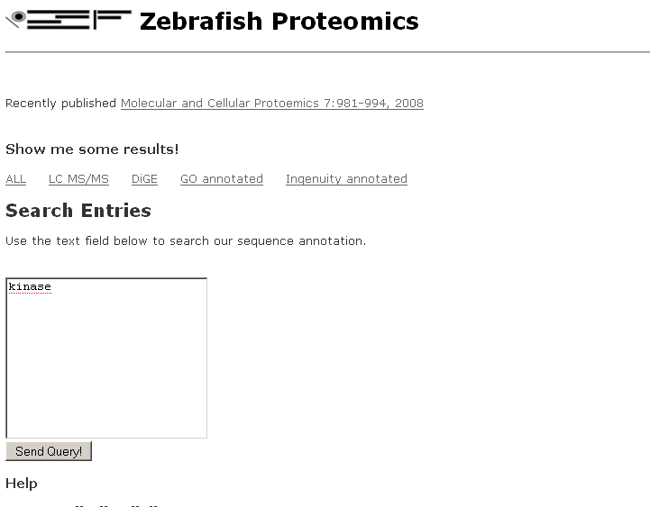
New Peptides (not in existing exons)
Add a new link to show interesting peptides

Slide 2

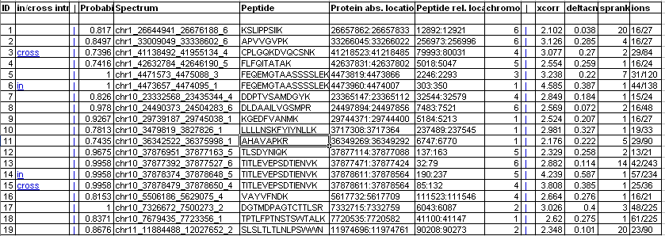
Only show spectra in or cross introns
Show all peptides first and give an option to show new peptides

Slide 3

Only show spectra in or cross introns
Only show new peptides

Slide 4
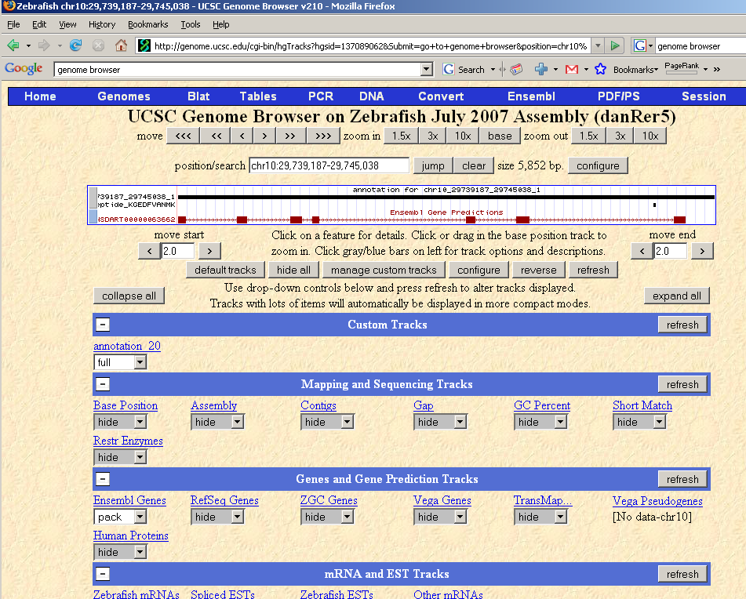
Give a link to Genome Browser to view new peptides.

