Slide 1
Research project data
Dr Kim Bell-Anderson

Slide 2
Data is from:
Australian Health Survey, National Health Survey 2011-2012
National Nutrition and Physical Activity Survey 2011-2012 Basic 3Rd Edition

Slide 3
Australian Health Survey 2011-12
The largest and most comprehensive health survey ever conducted in Australia
It combines:
National Health Survey (NHS)
National Aboriginal and Torres Strait Islander Health Survey
National Nutrition and Physical Activity Survey (NNPAS)
National Health Measures Survey (NHMS)

Slide 4
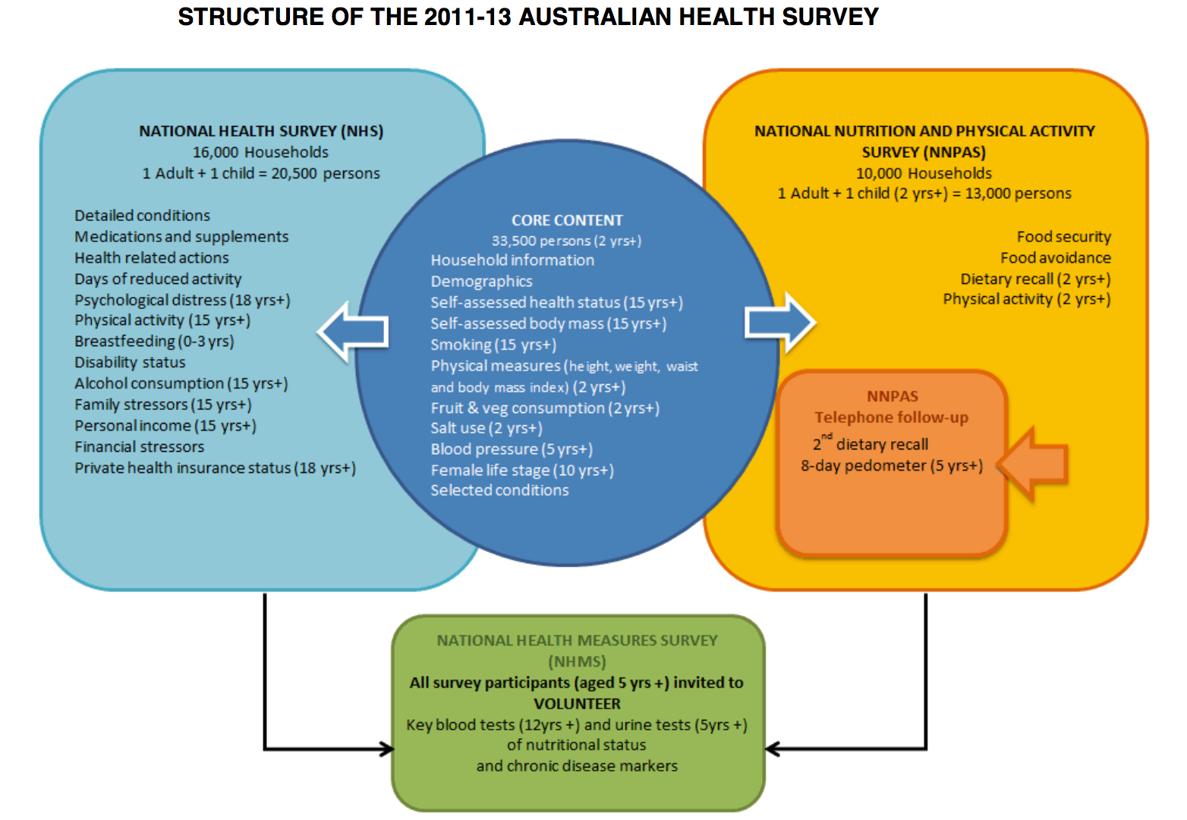
Notes:
Core content is information available for all surveyed persons in AHS

Slide 5
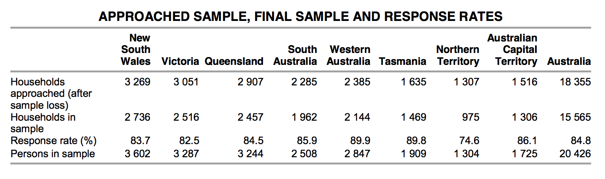

Slide 6
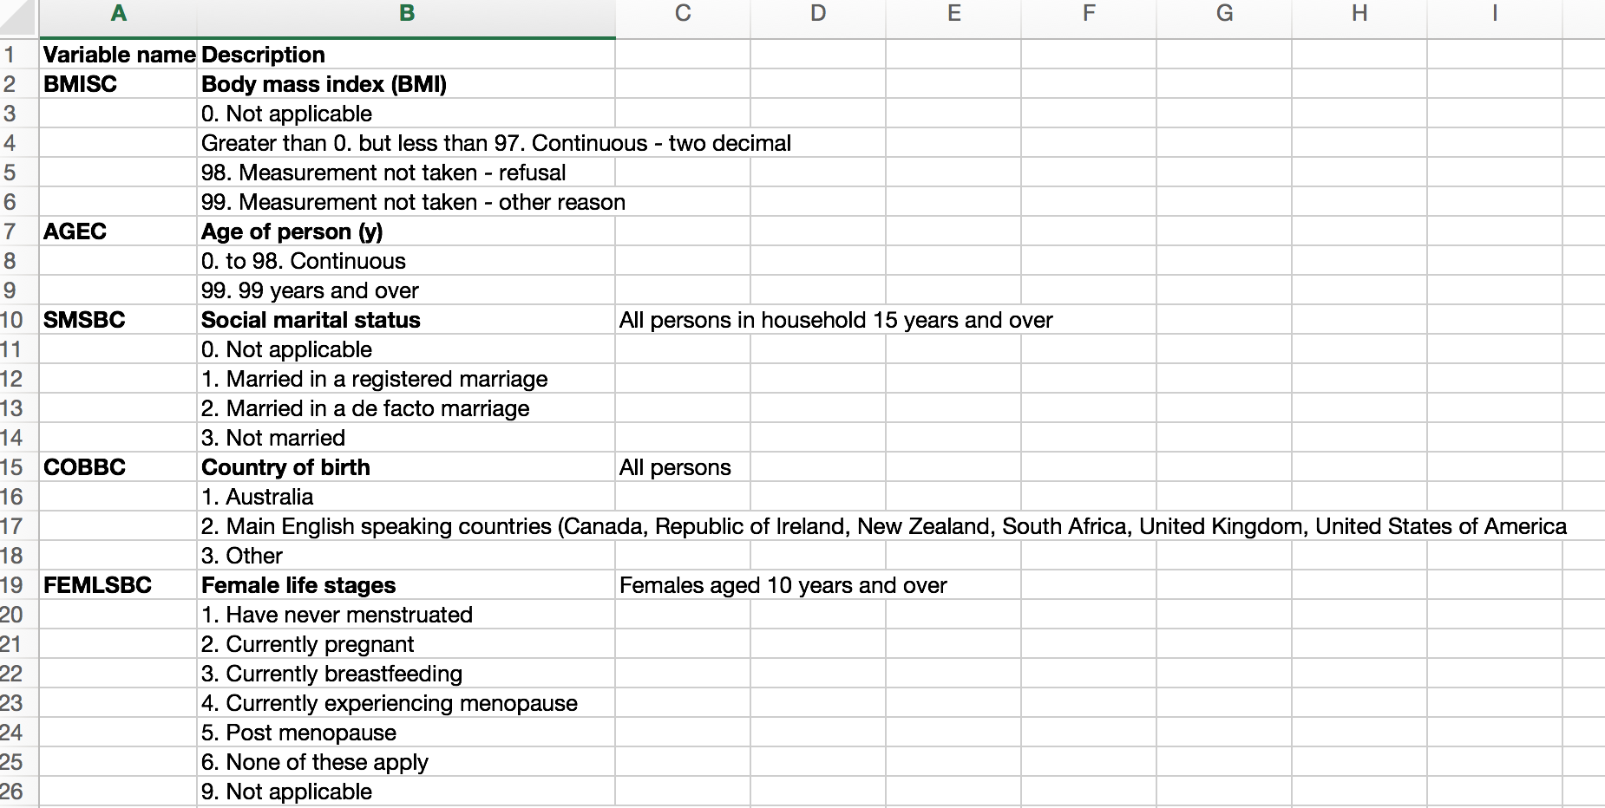
Subset for research project

Slide 7
Data source and definitions
Usual daily intake of fruit and vegetables in the AHS is based on self-reported data for the number of serves of fruit and vegetables that people usually ate each day.
A serve of vegetables was defined as:
half a cup of cooked vegetables
one medium potato or
one cup of salad vegetables
(approximately 75 grams).
A serve of fruit was defined as:
one medium piece or two small pieces of fresh fruit,
one cup of diced fruit,
a quarter of a cup of sultanas, or four dried apricot halves
(approximately 150 grams of fresh fruit or 50 grams of dried fruit).
Tomatoes were included as a vegetable rather than a fruit, and legumes were excluded.
Fruit juices were not considered to be fruit.

Slide 8
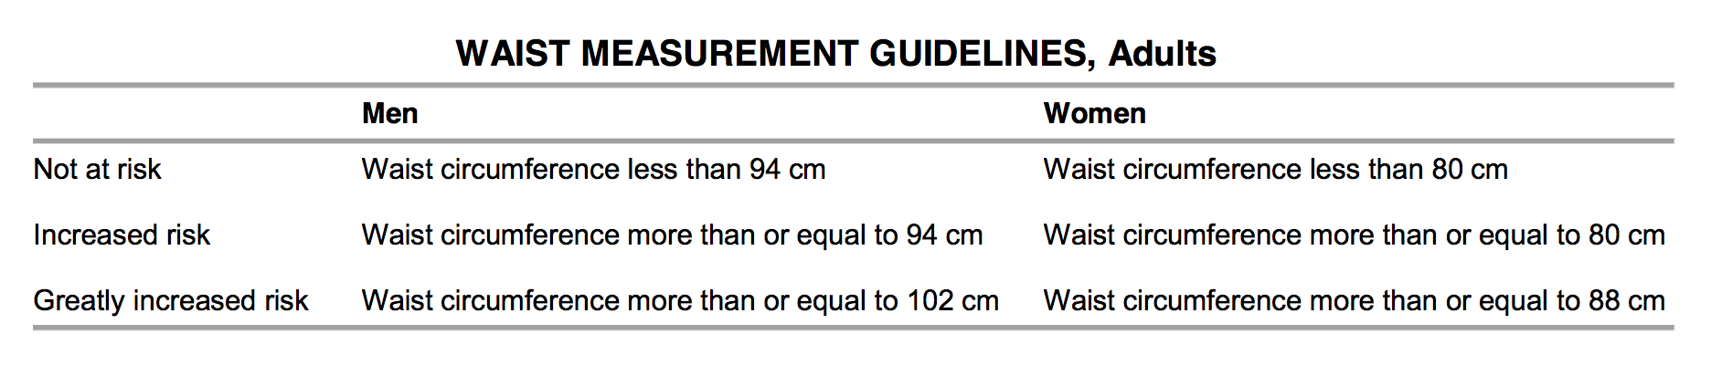

Slide 9
Exercise
Types of exercise covered in the AHS were walking, moderate and vigorous exercise for sport, recreation or fitness.
Moderate exercise consists of activity undertaken for fitness, recreation or sport that causes a moderate increase in heart rate or breathing
Vigorous exercise causes a large increase in a person's heart rate or breathing.
Level of exercise is determined based on the frequency, intensity and duration of exercise.

Slide 10
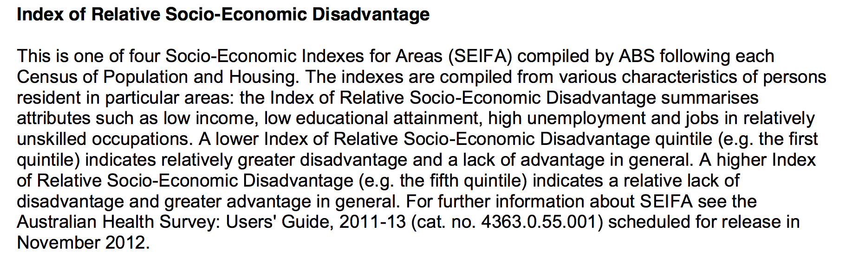

Slide 11
Publications
Sui, Z., Raubenheimer, D., & Rangan, A. (2017). Exploratory analysis of meal composition in Australia: meat and accompanying foods. Public Health Nutrition, 20(12), 2157–2165.
Sui, Z., Raubenheimer, D., & Rangan, A. (2017). Consumption patterns of meat, poultry, and fish after disaggregation of mixed dishes: secondary analysis of the Australian National Nutrition and Physical Activity Survey 2011–12, 1–12.
Brand-Miller, J. C., & Barclay, A. W. (2017). Declining consumption of added sugars and sugar-sweetened beverages in Australia: a challenge for obesity prevention. The American Journal of Clinical Nutrition
Engelen, L., Gale, J., Chau, J. Y., Hardy, L. L., Mackey, M., Johnson, N., et al. (2017). Who is at risk of chronic disease? Associations between risk profiles of physical activity, sitting and cardio‐metabolic disease in Australian adults. Australian and New Zealand Journal of Public Health, 41(2), 178–183.

Slide 12
