Slide 1
Vimic2
CI/CD Orchestration Platform
Ephemeral VM-Based Build Environments

Slide 2
Architecture Overview
4-Layer Architecture:
• User Interface: Fyne Desktop, REST API, WebSocket
• Core Managers: ClusterManager, MonitorManager, AutoScaler
• Infrastructure: Hypervisors (QEMU/KVM), Networks (OVS), VM Pools
• Data Layer: SQLite Database

Slide 3
Dashboard
Real-time System Overview:
• Pipelines: 0 active
• Runners: 5 connected
• VM Pools: 3 configured
• Networks: 3 isolated
• Artifacts: 5 stored

Slide 4
Pipeline Management
Create, Monitor, Manage:
• Multi-platform CI/CD support
• Real-time status tracking
• Stage progress visualization
• Live log streaming
• Artifact collection

Slide 5
Runner Support
Multi-Platform Runners:
✓ GitLab Runner
✓ GitHub Actions
✓ Jenkins Agent
✓ CircleCI Runner
✓ Drone Runner

Slide 6
VM Pools
Pre-Allocated VM Pools:
• ~0.5s VM creation time
• Copy-on-write overlays
• ~100MB per VM disk usage
• Auto-scaling pools
• Template management

Slide 7
Network Isolation
Per-Pipeline Networks:
• Open vSwitch bridges
• VLAN allocation (1000-2000)
• CIDR: 10.100.0.0/16
• Firewall rules
• Complete isolation

Slide 8
Artifact Management
Checksum-Verified Storage:
• SHA256 verification
• TTL expiration
• Download tracking
• Size management
• Retention policies

Slide 9
Performance
Speed Comparison:
Traditional VM: ~120 seconds
Vimic2: ~3 seconds
Improvement: 40x faster
• VM Creation: 0.5s
• Network Setup: 0.3s
• Runner Start: 2.0s

Slide 10
Technology Stack
Core Technologies:
• Language: Go 1.23+ (23MB binary)
• UI: Fyne Desktop (cross-platform)
• Database: SQLite3 (embedded)
• Virtualization: QEMU/KVM + Libvirt
• Networking: Open vSwitch
• CI/CD: Multi-platform runners

Slide 11
API Endpoints
REST API:
POST /api/pipelines - Create pipeline
POST /api/pipelines/{id}/start - Start
GET /api/pipelines/{id} - Status
GET /api/runners - List runners
GET /api/stats - Statistics
WS /ws - WebSocket updates

Slide 12
Platform Support
CI/CD Platforms:
✓ GitLab Runner
✓ GitHub Actions
✓ Jenkins Agent
✓ CircleCI Runner
✓ Drone Runner
Build Platforms:
✓ Linux (amd64/arm64)
✓ macOS (amd64/arm64)
✓ Windows (amd64)

Slide 13
Roadmap
Future Phases:
Phase 8: Docker Container Support
Phase 9: Kubernetes Integration
Phase 10: Auto-Scaling
Phase 11: Webhook Notifications
Phase 12: Metrics & Observability
Phase 13: Distributed Storage

Slide 14
Key Takeaways
Summary:
🚀 40x Faster - VM creation in ~0.5s
🔒 Isolated - Per-pipeline VLAN
🔧 Multi-Platform - GitLab, GitHub, Jenkins+
💾 Efficient - 100MB per VM overlay

Slide 15
Thank You
Questions?
github.com/stsgym/vimic2

Slide 16
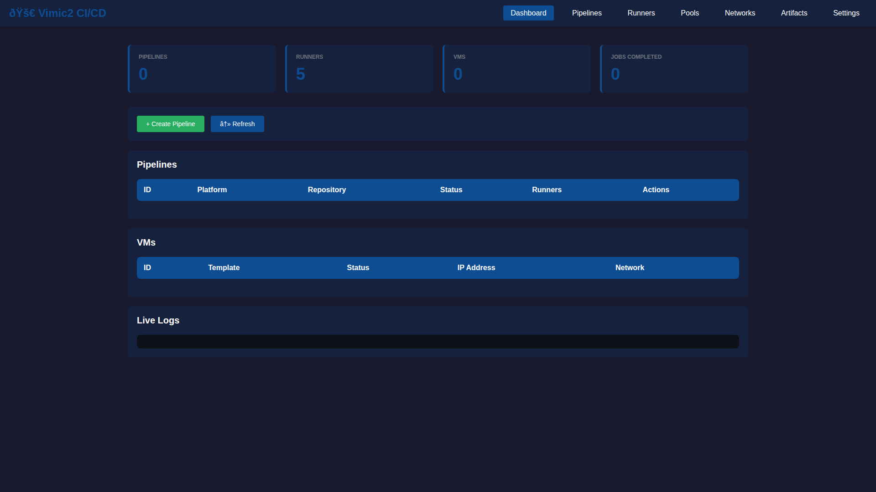

Slide 17
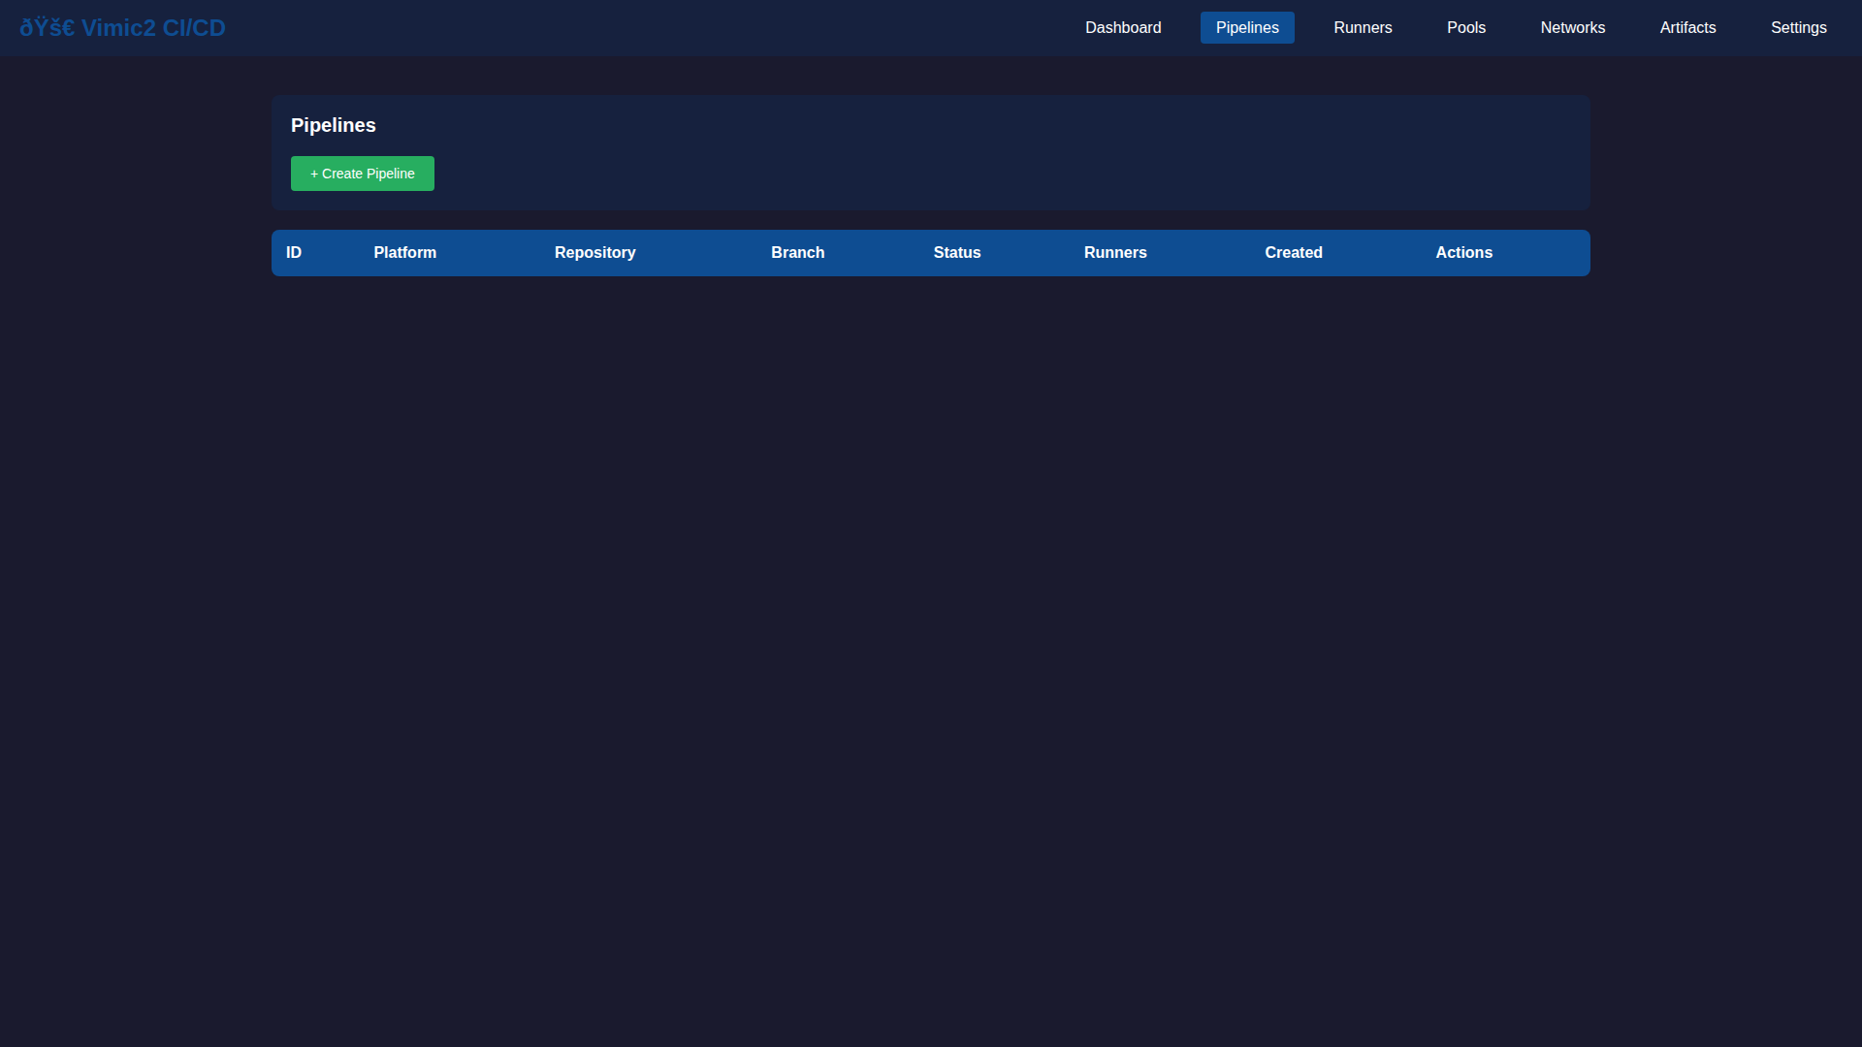

Slide 18
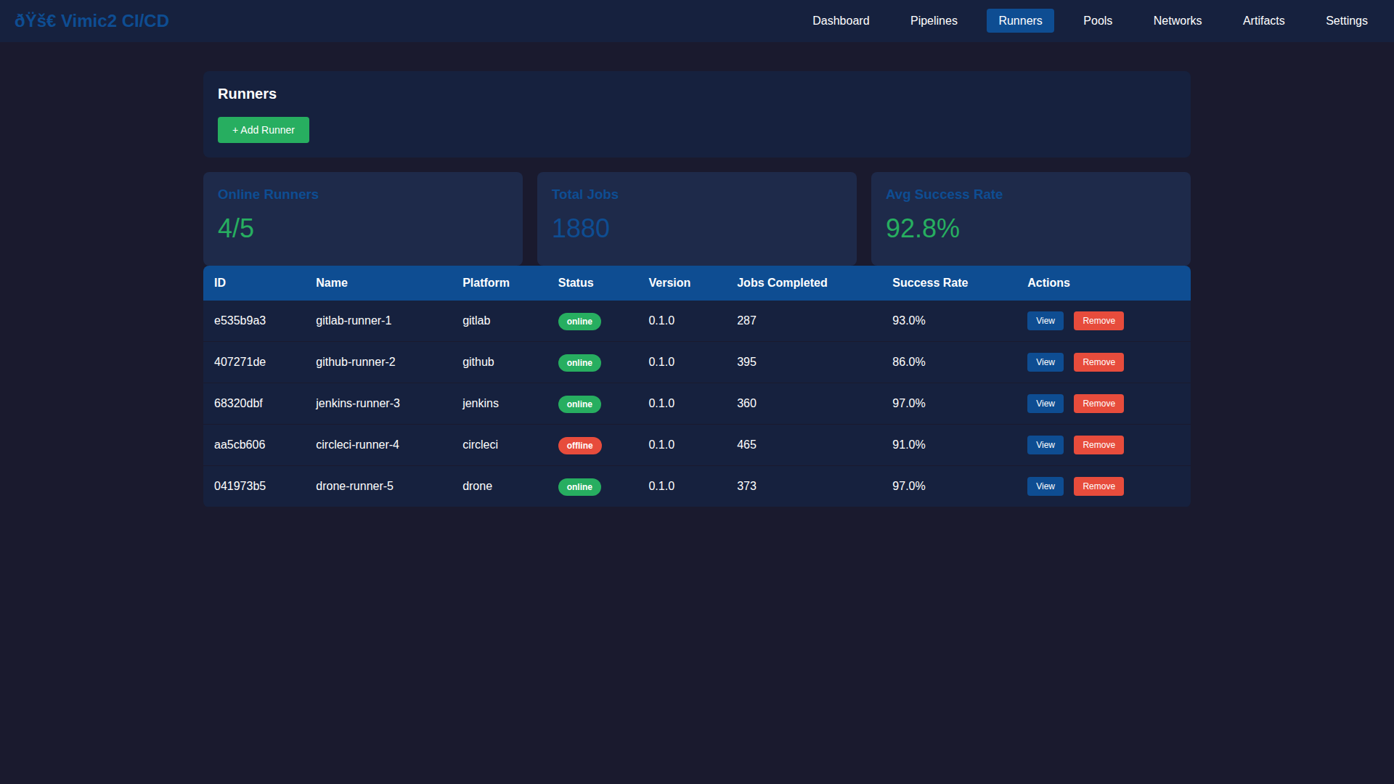

Slide 19
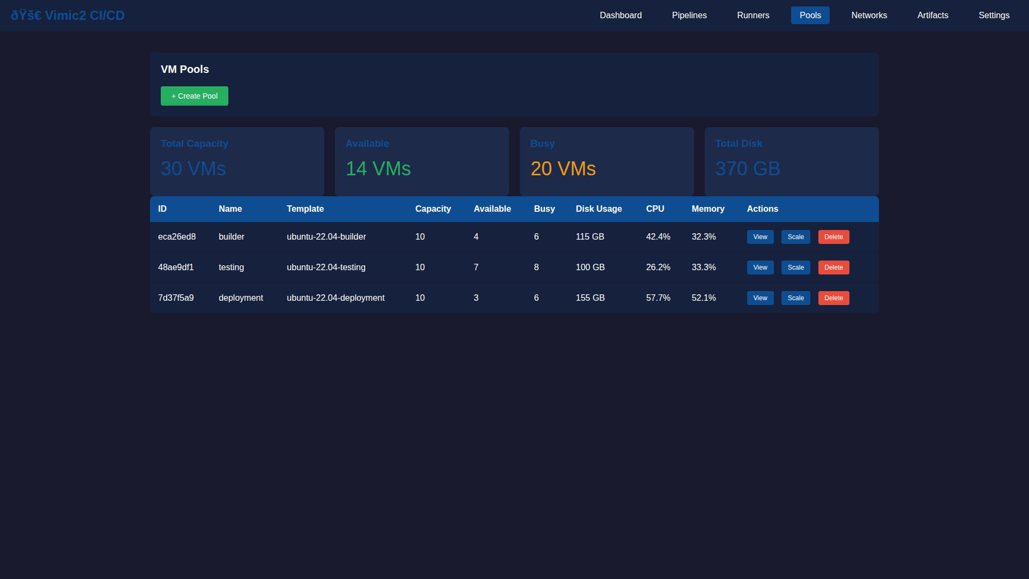

Slide 20
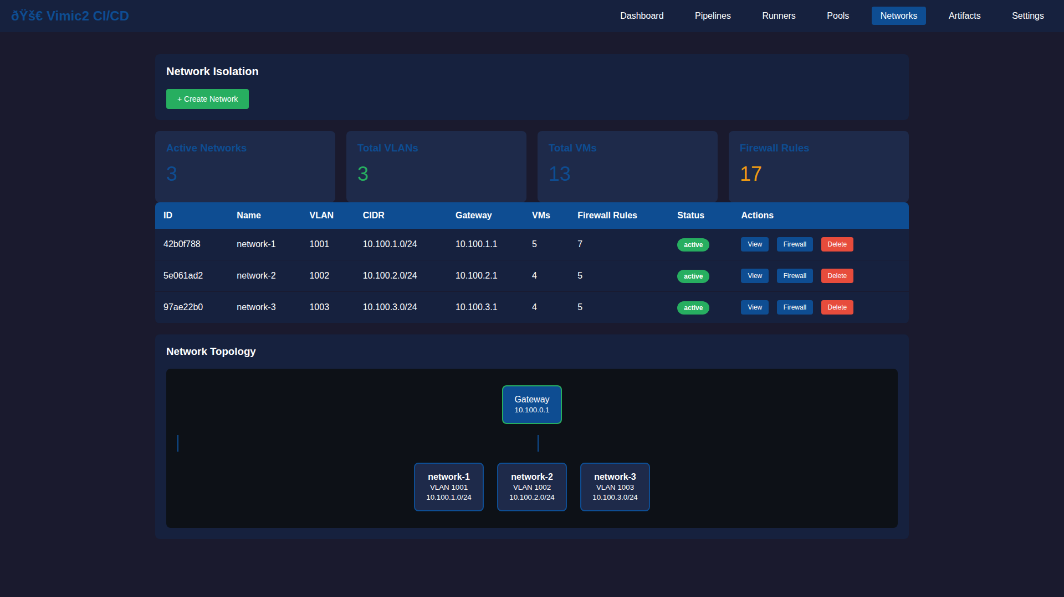

Slide 21
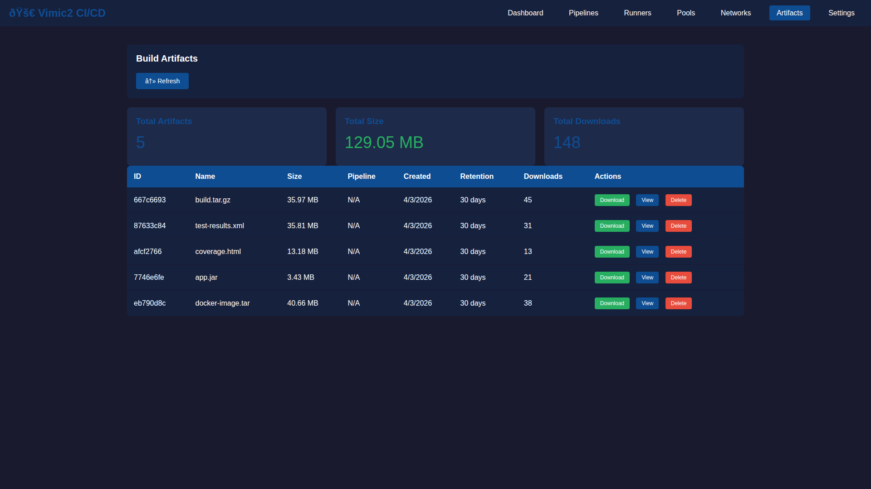

Slide 22
