Slide 1

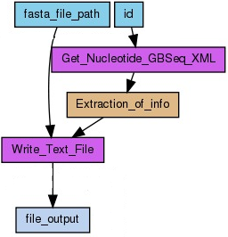





a) Workflow DAG b) Sequentially sorted workflow

