Slide 1
A Checklist-Based Approach for Quality Assessment of Scientific Information
Jun Zhao, Graham Klyne
Department of Zoology, University of Oxford,
^{Oxford, OX1 3PS, UK}
jun.zhao, graham.klyne@zoo.ox.ac.uk
Matthew Gamble, Carole Goble
Computer Science, University of Manchester, Manchester, M13 9PL, UK
m.gamble@cs.man.ac.uk, carole.goble@manchester.ac.uk
Notes:
I shall talk today about our checklist based approach to scientific information quality assessment...

Slide 2

47 of 53 “landmark” publications could not be replicated
“Unquestionably, a significant contributor to failure in oncology trials is the quality of published preclinical data.”
“The scientific process demands the highest standards of quality, ethics and rigour.”
http://www.nature.com/nature/journal/
v483/n7391/full/483531a.html
Adapted from: Carole Goble
Notes:
Science proceeds by building on the research of others, and the quality of published work is key to supporting continued progress.
But this study published in Nature found the results of 47 out of 53 “landmark” studies in preclinical cancer research could not be replicated, casting doubts on their suitability as a basis for further research.
“Landmark” here means results that are regarded as reference points by a research community, and which are widely used to underpin ongoing work.
This reflects a concern among scientists about quality of published research [1], and the high costs of basing further work on poor results.
[1] e.g., see http://retractionwatch.wordpress.com

Slide 3
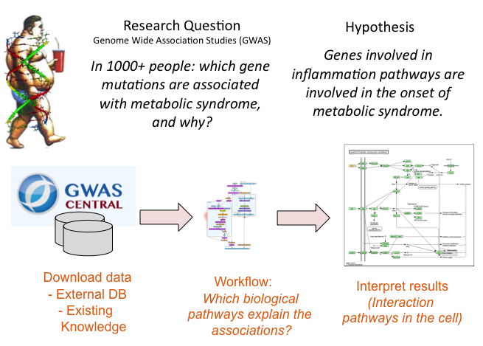
Validating in silico research
Kristina Hettne
Notes:
Science is increasingly dependent on computed results and in silico investigations, such as this genome wide association study into mechanisms involved in metabolic syndrome.
Such research is based on processes that take place in the hidden recesses of computer systems, so how are we to judge the reliability of the results unless we can assess the quality of the input data and of the workflows used?
The concern for quality thus extends to the underpinnings of in silico investigations [1]. Our work aims to support researchers in the creation of high quality in silico research outputs, and in the selection of resources upon which they base their work.
[1] ttp://www.nature.com/news/mozilla-plan-seeks-to-debug-scientific-code-1.13812

Slide 4
The Goal of Our Work
We aim to provide tools that assess
the quality of information
(data and computational artifacts)
used and generated by researchers
Notes:
The Wf4Ever project is concerned with conservation of scientific workflows used, and with mitigation of workflow decay.
As such we are concerned with assessing the quality of information – both data, and computational artifacts – used and generated by informatics-based researchers.

Slide 5
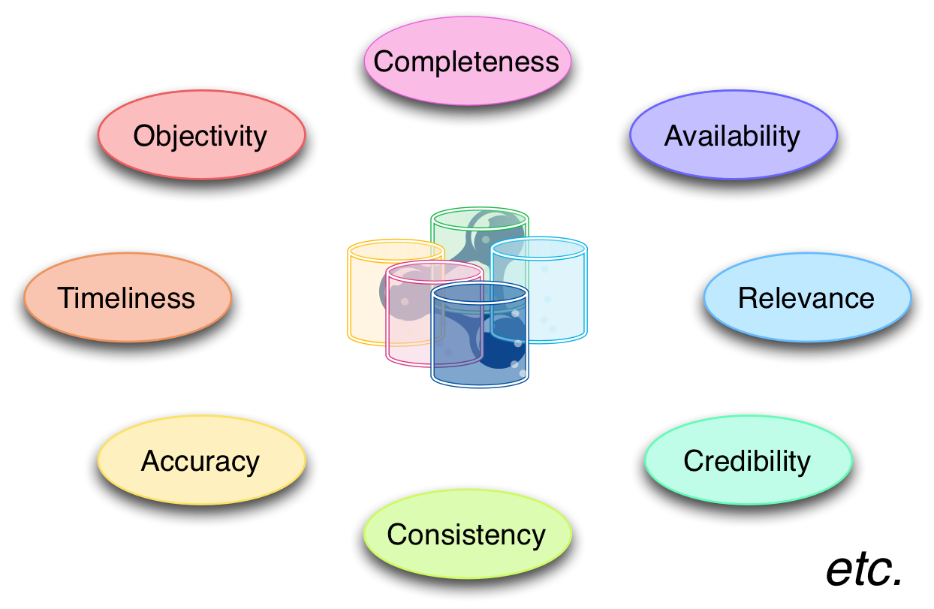
Background:
Linked Data Quality
Notes:
Information quality assessment has been extensively studied in management science, and web-based information systems, to assure the quality of manufactured and information products.
Most existing approaches to quality assessment use quality metrics, and produce an overall quality measure by integrating over a number of quality dimensions, such as accuracy, completeness, or credibility.

Slide 6
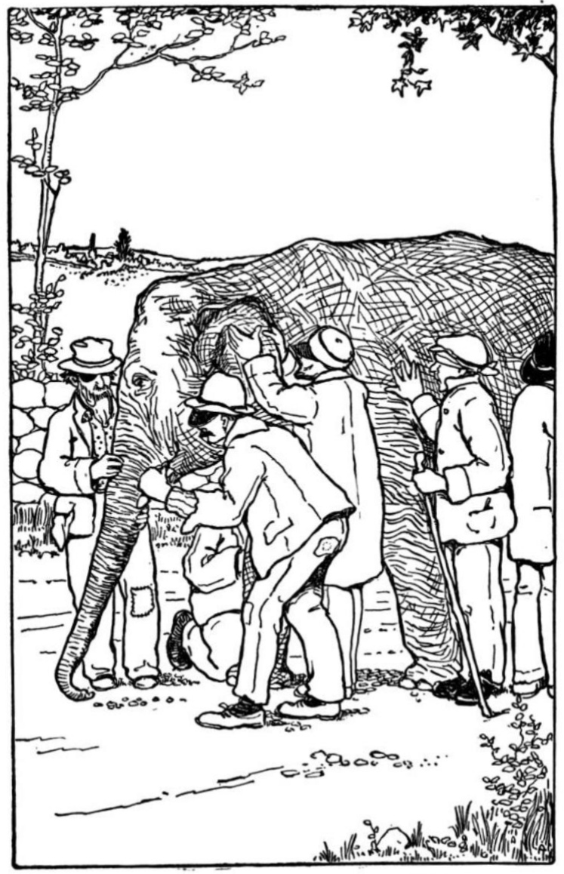
Information quality
http://upload.wikimedia.org/wikipedia/commons/3/32/Blind_men_and_elephant.jpg
Notes:
But this focus on the component dimensions of information quality can leave one feeling like the blind men of legend, trying to evaluate an elephant by touch; its leg like a pillar, its ear like a fan, its tusk like a solid pipe, etc.
These are all features of an elephant that may be assessed and described, but it can be difficult to see how they relate to the elephant as a whole, and in particular to how well it may perform in any given circumstance ...

Slide 7

For these elephant users...
http://www.flickr.com/photos/leosoueu/7121406603/
Notes:
But for these passengers, these users of an elephant, I would expect their main concern here would be...

Slide 8
For these elephant users...
… “can this elephant get me across this river?”
http://www.flickr.com/photos/leosoueu/7121406603/
Notes:
… “can this elephant get us across this river?”

Slide 9

Our approach to information quality assessment
We see complementary approaches to quality:
An analysis of what constitutes quality, and
Users' concern about fitness for use
The work presented here is focused on the latter of these concerns
Notes:
I offer this as an illustration of two complementary approaches to information quality assessment:
- an analysis of what constitutes quality, and
- users' concern about fitness for use
Our work reported here focuses on the fitness-for-use aspect of quality assessment.

Slide 10
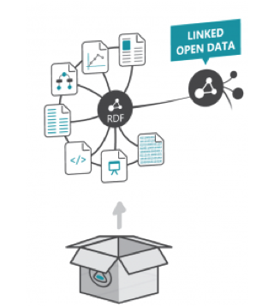
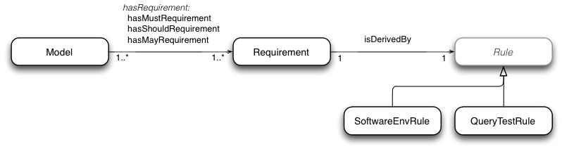
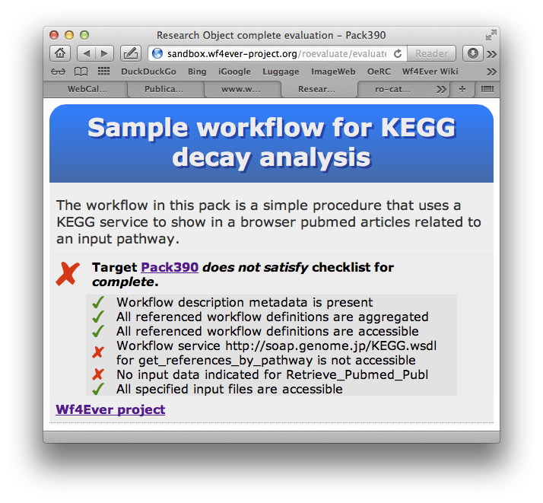
Outline
Research Objects: Context for evaluation
Checklists and the “Minim” model
Evaluation and reflections
Continuing work and concluding remarks
Notes:
The rest of this presentation will address the following topics:
- Our use of Research Objects to define the context, or scope, of a quality evaluation
- Then, I'll introduce checklists, our “Minim” model for describing them as linked data, and associated tools
- Next, I'll describe our evaluation of this approach, and address some comments and questions that have come up in the process
- And finally, I'll wrap up with mention of our continuing work, and some concluding remarks

Slide 11
Research Objects
Context for information quality evaluation

Slide 12
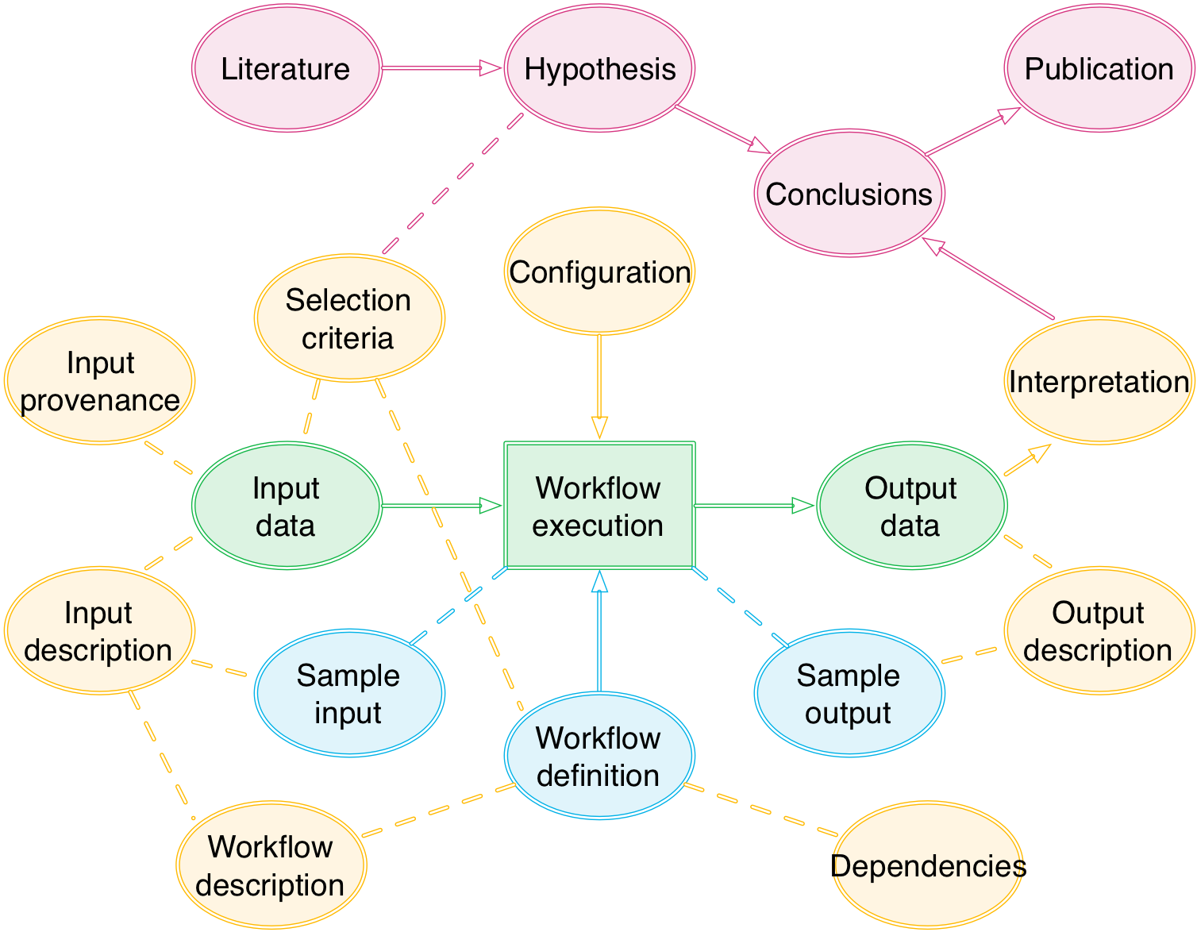
Context for evaluation of scientific information quality
Notes:
Many aspects of quality evaluation are performed with reference to some context or scope of use.
In general, we do not evaluate research artifacts in isolation, but as part of some investigation involving a constellation of related artifacts.
The suitability of any artifact may depend on its role with respect to the other artifacts that are also part of the investigation.
This collection of related artifacts constitutes the context of an investigation, or experiment, and it is within this context that we seek to apply our quality assessments.

Slide 13
Context for evaluation:
Research Objects
Data used or results produced in an experiment study
Methods employed to produce and analyse that data
Provenance and setting information about the experiments
People involved in the investigation
Annotations about these resources, that are essential to the understanding and interpretation of the scientific outcomes captured in a research object.
Jun Zhao
Notes:
We use “Research Objects”, or ROs, to represent this context in the form of an aggregation of related resources, encapsulating essential information needed to understand, reproduce and re-use its elements.
The RO model is based on existing standards, including Object Re-use and Exchange (ORE), Annotation Ontology (AO), W3C Provenance (PROV), etc.
If we look inside an RO, we may find information about:
- data used
- results generated
- descriptions of methods
- provenance and configuration
- people involved
- and...

Slide 14
Context for evaluation:
Research Objects
Data used or results produced in an experiment study
Methods employed to produce and analyse that data
Provenance and setting information about the experiments
People involved in the investigation
Annotations about these resources, that are essential to the understanding and interpretation of the scientific outcomes captured in a research object.
Jun Zhao
Notes:
… annotations about any of these
These annotations provide additional information needed to understand the artifacts and properly interpret their significance.
In our work, we use an RO as a container for information that will be used in assessing the quality of an artifact.

Slide 15
Quality evaluation uses
RO annotations
In our RO implementation, annotations are presented as RDF
E.g., annotations for:
  types of aggregated resources (data, workflow, result, hypothesis, etc.)
  workflow element descriptions
  workflow run provenance traces
  … and more
These annotations are merged into a single RDF graph to provide a starting point for the evaluation process
Notes:
Our implementation of Research Objects uses RDF to represent annotations, covering details such as....
- types of resources encapsulated in the RO
- descriptions of workflow components
- provenance traces of workflow runs
There are no constraints on the kind of information that can be provided, and our evaluation tools are designed to be able to work with whatever information is available.

Slide 16
Fitness-for-use of a Research Object
Our approach is intended to address suitability of RO content, and particularly replicability and reproducibility of results, such as:
Can I trust the conclusion of the experiment described in this RO?
Do the workflows used in this RO still work?
Is the investigation described in this RO ready for publication?
Can I re-purpose the workflow used in this RO for my own experiment?
Notes:
In determining the fitness-for-use of a Research Object, we aim to answer questions like:
- can I trust the conclusions presented?
- do the workflows used still work?
- is the investigation as described ready for publication?
- can I re-use the workflow or other elements in my own work?
- etc.

Slide 17
Some scenarios
Workflow decay detection
  does the workflow used by this RO still work?
  are the external resources used (still) accessible?
DBPedia “ChemBox” data completeness
  does chemical data extracted from Wikipedia info boxes meet community expectations for a full description of a chemical?
Workflow best practices
  has the workflow contained in an RO been supported by good development practices?
Notes:
Here are some particular scenarios we have been working with:
Workflow decay detection, e.g.:
- does a (once-working) workflow still work; can its results be replicated by re-running the workflow
- can it be run on different data to compare results?
- are the external services used and other resources needed still available for use?
Another scenario deals with completeness of information... does chemical data extracted from Wikipedia meet the chemistry research community's expectations for a complete or adequate description of the chemical?
We have also looked at best practices... e.g., has a workflow described in an RO been developed in accord with community best practices?

Slide 18
Checklists and
the “Minim” model
Notes:
In addressing these scenarios, we have defined the “Minim” model...

Slide 19
Our chosen tool: checklists for ROs
Checklists are a widely used, well-understood tool for quality management
A checklist is simply a list of tests; e.g.
  does the RO contain an experimental hypothesis?
  does the RO contain a workflow?
  is the executable workflow description accessible?
  do workflows in the RO have defined inputs?
  are the workflow input files accessible?
  are the workflow web services used accessible?
  etc.
Notes:
Our chosen tool for addressing the quality questions raised is the humble checklist.
I expect everyone here has come across checklists in some form or another – they are widely used as tools for quality management and safety assurance.
In outline, a checklist is simply a list of requirements that we would wish to be satisfied.
Some specific requirements we have considered include:
does an RO contain an experimental hypothesis?
does it contain an abstract workflow description?
is there an accessible, executable definition for all workflows used?
etc.

Slide 20
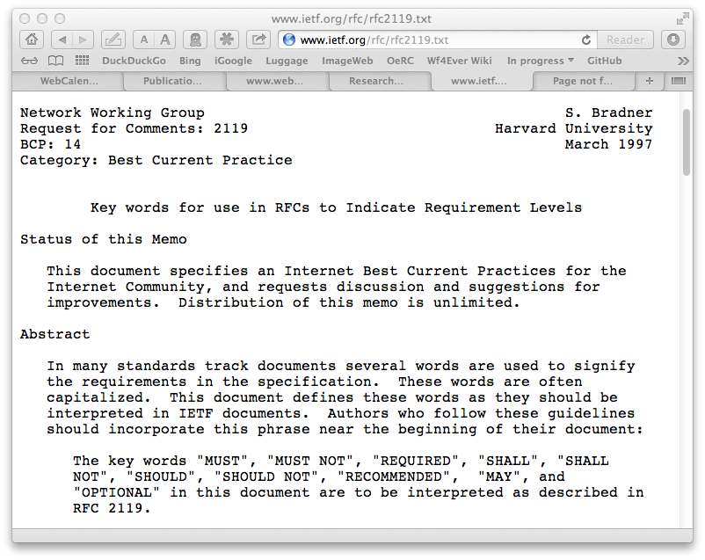
Requirement levels
Each checklist test has a requirement level:
  MUST, SHOULD or MAY
  from RFC 2119
The overall checklist
result reflects the
level of satisfied
and unsatisfied
requirements:
e.g. a failed MUST
is more serious
than a failed SHOULD
Notes:
Associated with each checklist requirement is a requirement level: MUST, SHOULD or MAY. This idea is borrowed from IETF practice for defining Internet technical standards.
The overall result of evaluating a checklist reflects the levels of individual satisfied and unsatisfied requirements. For example, a failing MUST requirement is a more serious problem than a failing SHOULD or MAY requirement.
((@@SKIP: The overall result is reflected as:
- fully satisfied
- nominally satisfied
- minimally satisfied
- not satisfied))

Slide 21
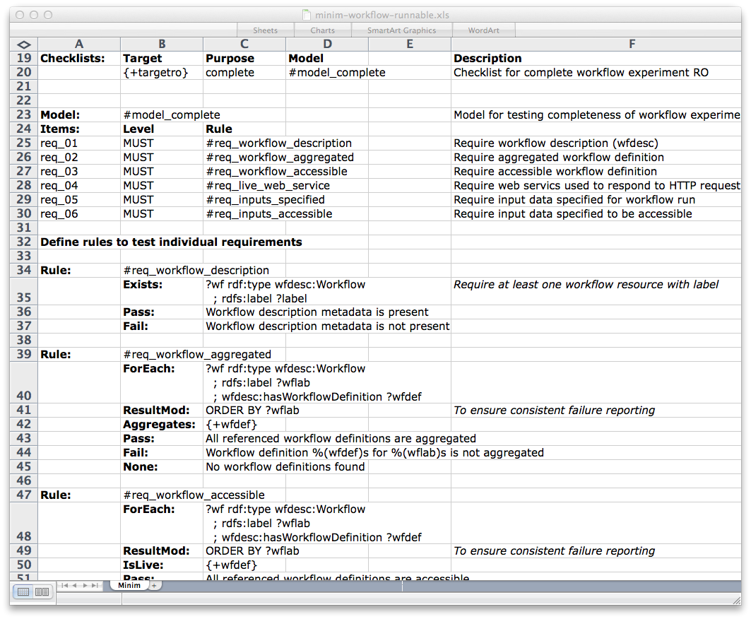
Runnable workflow checklist
Notes:
@@SKIP
To illustrate these ideas in a concrete example...
One checklist we have worked with, which is intended to give an indication of whether a workflow is, prima facie, likely to be runnable, without having to gather the resources needed to actually run it.
To declare a workflow to be runnable, we require that:
a workflow description is present in the RO
the RO includes an executable workflow definition
the workflow definition is accessible
all services references by the workflow are accessible
all inputs required by the workflow are defined
all inputs are accessible

Slide 22
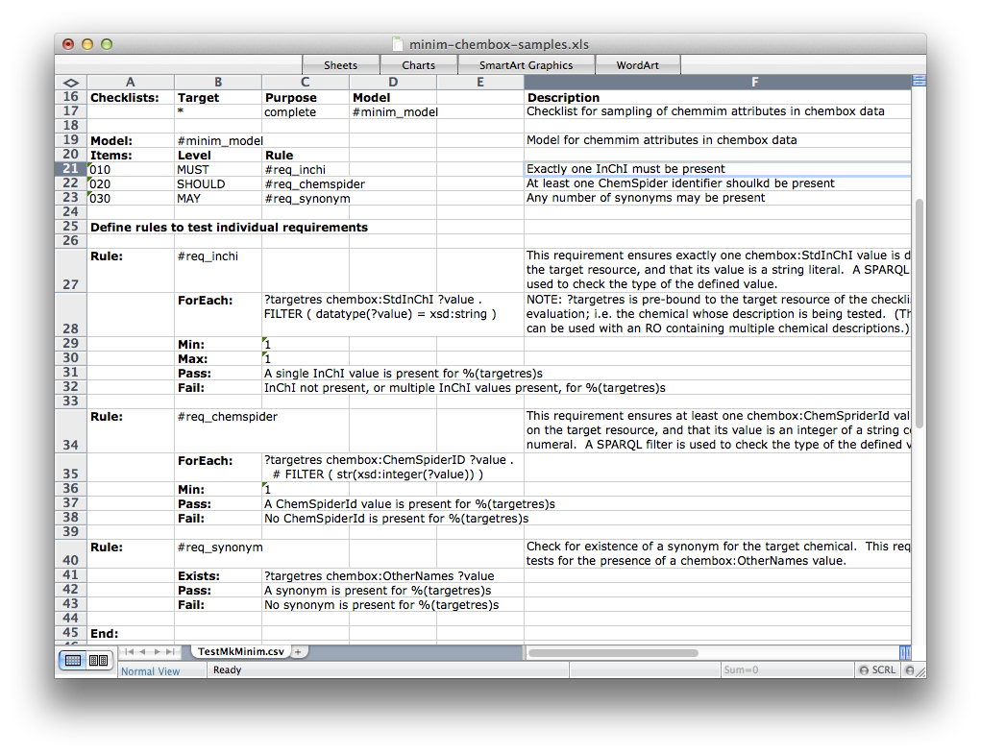
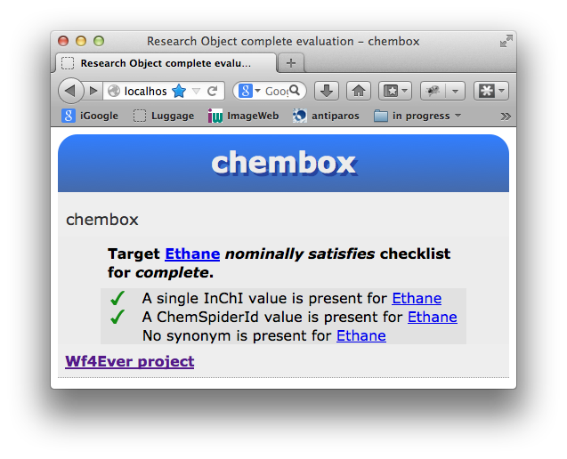
Chemical data checklist
MUST contain
exactly one
InChI requirement
SHOULD contain
one or more numeric
ChemSpider identifiers
MAY include
any number of
chemical synonyms
Notes:
To illustrate this idea of requirement levels in a concrete example, consider this evaluation of completeness of chemical information...
Among other things, community norms expect a that chemical description:
- MUST include exactly one International Chemical Identifier (or InChI),
- SHOULD include at least one integer ChemSpider identifier,
- MAY include any number of synonyms

Slide 23
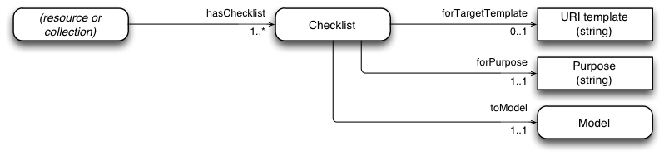
The “Minim” model: checklists as linked data
Checklist selection
Extension point: rule type
Checklist requirements
Notes:
We have defined our “Minim” model to represent these checklists as linked data. I shalln't go through the model in detail, but I shall highlight some key features.
It uses three main sub-components: selectors, checklists and rules:
- checklist selectors are used to select a particular checklist from those available based on a target resource, and the purpose for which it is evaluated (e.g. evaluating a specified chemical description for completeness, or a specified workflow for runnability)
- the next sub-component is the actual checklist, or Model, which is simply a list of requirements with associated requirement levels
- and finally, rules are used to evaluate the requirements (e.g. does a chemical description include an InChI string value?)
The class of evaluation rules represents an extension point in the model, where new rule types may be introduced as required. Here, just two rule types are shown. I shall focus on just one of these...

Slide 24
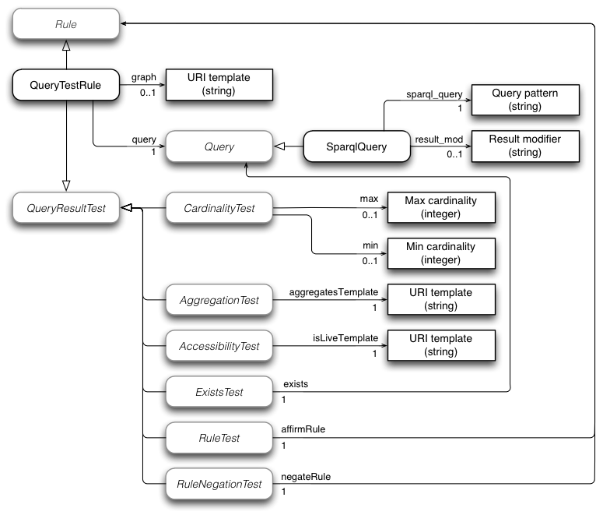
The “Minim” model: query test rule as linked data
Extension point: query type
Query
Test
query
result
Extension point:
query result test type
Notes:
Currently, almost all checklist requirements are evaluated using a “query test rule”, which has two key elements, a query and a query result test:
- the query is evaluated against the combined RO annotations (e.g. to find InChI identifiers), and
- the test that is applied to the result of the query (e.g. is exactly one InChI identifier result returned?). Some tests may request additional information from the RO, or from the wider Web (e.g. to test if a resource is aggregated, or accessible)
The queries used are SPARQL graph patterns, such as appear in a SPARQL WHERE clause. But the query type is another extension point in the model where different query formats may be introduced (e.g. queries based on SPIN, or OWL class expressions could be added here).
Query result tests include existence, cardinality, resource accessibility, etc. But this, too, is an extension point where new features may be introduced if needed.

Slide 25
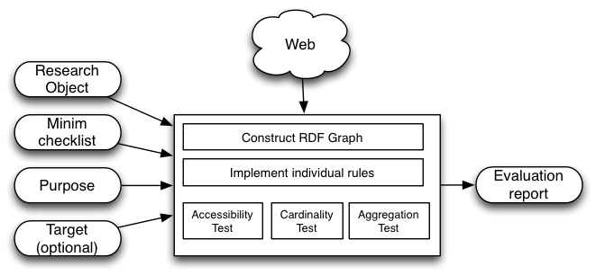
Evaluation overview (1) checklist selection
Minim file may contain
multiple checklists
“Purpose” and “Target” used to
select checklist to evaluate
Notes:
The checklist evaluation proceeds by first selecting a checklist from those available, based upon supplied target resource and purpose values (e.g. is a specified chemical description complete, or is a specified workflow runnable?)

Slide 26
Evaluation overview (2): checklist model evaluation
Construct RDF graph of RO annotations
Evaluate each requirement in the checklist model
Assemble result
Notes:
Having selected a checklist, the main evaluation can proceed:
1. An RDF graph is assembled from the RO annotations
2. Each requirement in the checklist is evaluated in the context of the assembled RDF graph, yielding a True or False result
3. A final result is assembled from the individual results, taking account of the corresponding requirement levels in the Minim model

Slide 27
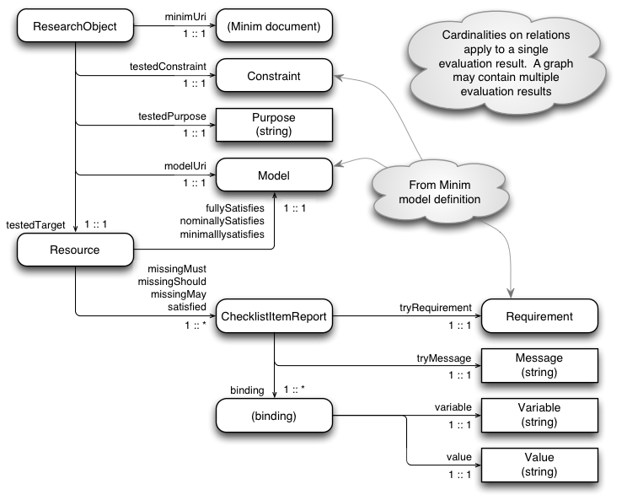
Checklist evaluation: results as linked data
Notes:
The final result of a checklist evaluation is represented as an RDF graph, and could be published and exposed as linked data.
(I'm not going to go into the details now, but it might be worth noting that the result graph links directly back to the evaluated target resource.)
We have also implemented further services that process the RDF graph result to generate a more easily used “traffic light” summary of the evaluation, which is available as either HTML or JSON.

Slide 28
Evaluation and Reflections
Notes:
So how did we do? ...

Slide 29
Evaluation of approach
Our evaluation to date has focused on the capability of our model rather than its performance
  could checklists handle our Wf4Ever project requirements?
  how did our capabilities match those of other tools?
We report on:
  detection of workflow decay
  completeness of linked data chemical descriptions
Notes:
Our evaluation has focused on the capabilities of our tool rather than its performance; i.e. can we perform the evaluations required in the Wf4Ever project, and also how do our capabilities compare with previous work?
We did not set out to evaluate performance, as we did not expect it to be an issue in the envisaged uses of checklists (but I'll return to this later.)
Our main capability evaluation has been performed with respect to two applications:
- one was workflow decay detection – which was a requirement arising from our own Wf4Ever project.
- and the other evaluation was completeness of chemical information - which provides a comparison with some previous quality evaluation work

Slide 30
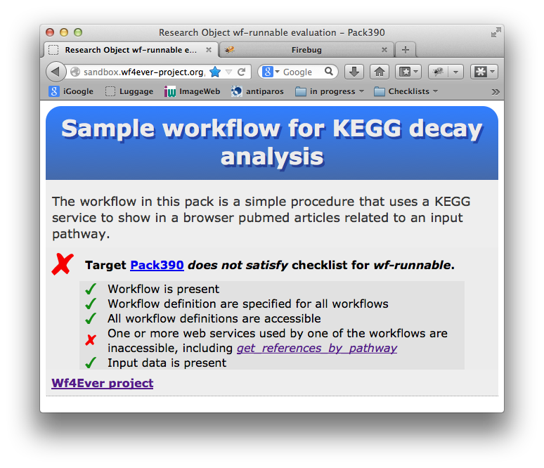
Workflow Decay Detection
2012: replacement of KEGG Web Services with
REST services
Workflows located
in myExperiment
Before shutdown,
workflow runnability
was confirmed
After shutdown,
the checklist reports
workflow decay
http://sandbox.wf4ever-project.org/roevaluate/evaluate/trafficlight_html?minim=http://sandbox.wf4ever-project.org/rodl/ROs/Kegg-workflow-evaluation/Runnable-workflow-checklist.rdf&purpose=wf-runnable&RO=http://sandbox.wf4ever-project.org/rodl/ROs/Pack390/
Notes:
Last year (2012), The Kyoto Encyclopedia of Genes and Genomes transitioned their web services to use a new REST-style interface
Before the old services were shut down, a number of client workflows were located in myExperiment, and run to confirm their viability
After the shutdown, the checklist service was run over these workflows, and for these was able to successfully detect and predict workflow decay caused by withdrawal of the web service

Slide 31
Completeness of
Chemical Descriptions
Requirements testing with SPIN
  Previous work, using SPARQL Inference Notation
“ChemBox” chemical
descriptions extracted
from Wikipedia
Key difference is
query syntax:
  SPARQL vs SPIN
One test was unsuited
to SPARQL query
Notes:
The second application we evaluated targeted the completeness of so-called “ChemBox” chemical descriptions extracted from Wikipedia info boxes.
The evaluation was a comparison with previous work by Matt Gamble that used SPIN as its data probing mechanism. We used our checklist tool to evaluate the same datasets that were used in Matt's work.
The outcome was that we could reproduce the results of the previous work, with the exception of one test involving a complex SPIN expression to match a chemical formula text, which I could not decode with the tools accessible to me.
Given than SPIN is primarily another way to represent SPARQL, it seems probable that this test could have been done using SPARQL. But the complexity of this query means that it may be unsuited for practical use. For this, I would probably choose to use the Minim extension points to apply a different approach, such as regex matching.

Slide 32
Comparison with
OWL-based approach
(OWL – Web Ontology Language)
SPARQL lacks in-built inference capabilities
Some tests don't really work with open world assumption
Some tests look at more than just the data
  e.g. accessibility of web resource
OWL could be used in conjunction with the Minim model
Notes:
We also gave some consideration, but short of a full evaluation, to using OWL in our checklist model...
OWL inference provides an alternative way to generate requirement satisfaction reports, and is in some respects more expressive than SPARQL for this. But, some of our tests, such as cardinality tests, depend on treating an RO as a locally closed world, which is at odds with standard OWL satisfaction semantics.
Further, we use SPARQL queries in conjunction with additional tests that cannot be evaluated from the data alone (e.g. testing if a resource is accessible on the web). Our “Minim” model combines these elements (e.g. when checking for accessibility of workflow inputs). We could, in principle, use OWL instance retrieval as an alternative to SPARQL for probing the RO data.

Slide 33
SKOS Thesaurus quality
Finding Quality Issues in SKOS Vocabularies
  [Mader, et al]
Shows some gaps in our current checklist tool implementation
Gaps addressable using Minim model extensions
Notes:
@@SKIP if < 5 mins
Separately, and not reported in our paper, we have also looked at some work on SKOS thesaurus quality evaluation [1], which has exposed some gaps in our current capabilities.
These gaps appear to be addressable using a small number of extensions to the Minim model
[1] Finding Quality Issues in SKOS Vocabularies
Christian Mader, Bernhard Haslhofer, and Antoine Isaac

Slide 34
What can be checked?
Obviously, not everything can be automated
Starting from user requirements, we:
  determine can be mechanized (possibly with additional annotations or provenance)
  discuss how remaining evaluation can be performed (e.g. special application, manual review, etc.) and create annotations to indicate the outcomes
This process may yield candidates for extending the checklist model
Notes:
Some questions that have arisen in reviews of our paper are:
“what can be checked by our tool” and
“what can be checked automatically?”
Obviously, not every aspect of quality can be checked automatically. Our approach has been to start from user requirements and divide them into those that can easily be handled as automatic tests and others that require more special treatment.
The cases requiring special treatment, such as manual review, are assumed to be handled separately, and then adding annotations to the RO indicating that the required review, or evaluation, has been performed. Tests for these annotations can then be included in a checklist.
These special cases may, in turn, suggest candidates for new automated testing capabilities.

Slide 35
Granularity
What is the granularity of checklist items?
  whatever can be probed with a SPARQL query, down to the level of individual RDF triples.
Some user requirements don't conveniently map down to this level
  future work may consider model extensions for composing tests within a single checklist item
  so far, this has not been a pressing requirement in our work, but the design is easy to imagine (e.g. logical combinations of individual tests).
Notes:
@@Skip slide if <4 mins to go
Another question that has been asked is “what is the granularity of checklist items?”
A short answer is: whatever granularity can be probed by a SPARQL query. This means that granularity can be down to the level of individual RDF triples in the RO annotations.
But we have noticed that some user requirements don't necessarily match the granularity that is conveniently offered by SPARQL, and future work may consider model extensions for composing multiple tests in a single checklist item.
So far, this has not been an issue for us, but it is easy to imagine extension structures that provide for logical combinations of existing tests.

Slide 36
Performance and scalability
Not yet formally evaluated
But some Research Objects have proven slow to evaluate
  Appears to be dominated by RDF load time
  Performance problems have been overcome by using a lightweight RO creation service
Notes:
As noted previously, we did not expect performance to be a concern for the envisaged usage scenarios, and did not undertake a formal evaluation of speed and scalability of our tool.
But we did run into some performance issues, notably in checking completeness of chemical information, where our initial attempts used a single RO with data about some 7500 chemicals.
In this, and in other instances where we have seen performance issues, they were due to RDF loading times rather than the checklist evaluation itself.
For the chemical evaluation, we have since resolved the performance problem by using a lightweight RO creation service (which is mentioned later).

Slide 37
Continuing Work
and
Concluding Remarks
Notes:
To wrap up, I'll mention some ongoing and possible future work, and offer some concluding remarks.

Slide 38
Recent and ongoing work
Minim creation from spreadsheet
Evaluating arbitrary
linked data
  “Overlay RO” service
  lightweight ROs for linked data
Matching/aligning quality metrics with checklist capabilities
Checklist catalogue
Notes:
Until recently, we created Minim checklists by hand editing RDF, but this is clearly not a viable solution for most users. We have since created a tool which uses a spreadsheet as the original checklist source and converts it to a Minim description in RDF. We also have some other ideas for more approachable tools for authoring checklist descriptions.
We have wanted to apply checklists to any linked data (not necessarily supplied in an RO). To this end, we are experimenting with a lightweight “Overlay RO” service that allows linked data to be presented as an RO for evaluation.
Using this Overlay RO service, we were able to overcome the bottleneck in the Chembox evaluation performance that is mentioned in our paper, and alluded to earlier.
Other work under consideration includes aligning work on quality metrics and dimensions with checklist evaluation, and creation of a checklist repository for common evaluation requirements.

Slide 39
Concluding remarks
Our goal: to assess the quality of information (data and computational methods) used and generated by researchers
We adopt checklists, which are a common tool for quality and safety assurance
Checklists are a pragmatic approach to assessing fitness-for-use, complementary to analysis of data
quality dimensions
Our model allows
automated tests to be
combined with
manual review
Notes:
In summary, our goal has been to assess the quality of information, including both data and computational artifacts, that informatics-based researchers build upon in their work. Thus, for example, we hope to contribute to enhancing the reproducibility of in silico research.
Our adoption of checklists is a pragmatic approach to fitness-for-use evaluation of scientific information, which is complementary to existing work on quality dimension analysis, and associated quality metrics
The checklist model is flexible, extensible and in particular allows automated tests to be combined with manual review and other processes to provide a comprehensive coverage of quality evaluation requirements

Slide 40
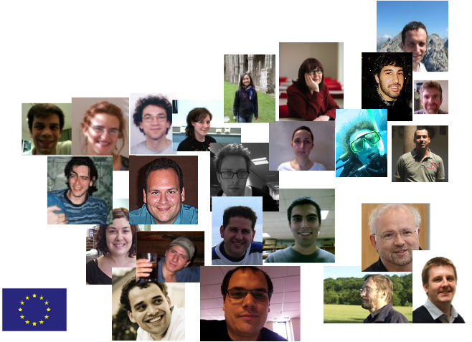
Acknowledgements
EU Wf4Ever project (270129)
funded under EU FP7 (ICT- 2009.4.1).
(http://www.wf4ever-project.org)
Notes:
Finally, we thank the many other researchers in the Wf4Ever project, who have provided valuable motivation and criticisms that have helped to guide the direction of this work.

Slide 41
Links
Paper
  …
This presentation
  https://github.com/wf4ever/ro-manager/ tree/master/doc/Presentations
Software
  https://github.com/wf4ever/ro-manager
Evaluation scripts and data
  https://github.com/wf4ever/ro-catalogue/ tree/master/v0.1/minim-evaluation

