Slide 1
IB290 SEM 465
Topics in Phylogenetics
Meeting 1: Introductions,
Weds Aug 30.

Slide 2
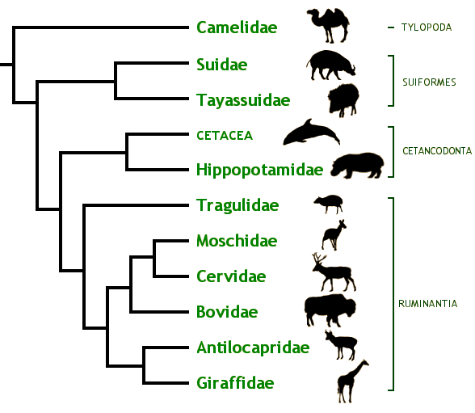
Phylogeny…
Phylogenies are cartoons depicting the evolutionary history of a group of organisms
(they’re trees-of-life)
Concepts:
  Most recent common
  ancestor
  Closest relative
  (“sister group”)
  “Monophyletic”, “Clade”
  Cladograms vs
  phylograms vs chronograms
  Ancestral vs. derived characters
  Sampling, extinction, primitive lineage fallacy, etc
Notes:
Can “swivel” the nodes

Slide 3
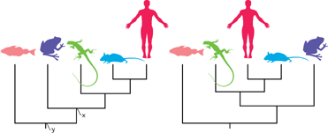
Phylogeny, quiz
From Baum, Smith, & Donovan: The Tree-Thinking Challenge
Notes:
-Which of the species included in this phylogeny is most closely related to the lizard?

Slide 4
Phylogeny, quiz
From Baum, Smith, & Donovan: The Tree-Thinking Challenge
Notes:
-ancestral vs. derived characters – e.g., cold-bloodedness vs. hair

Slide 5
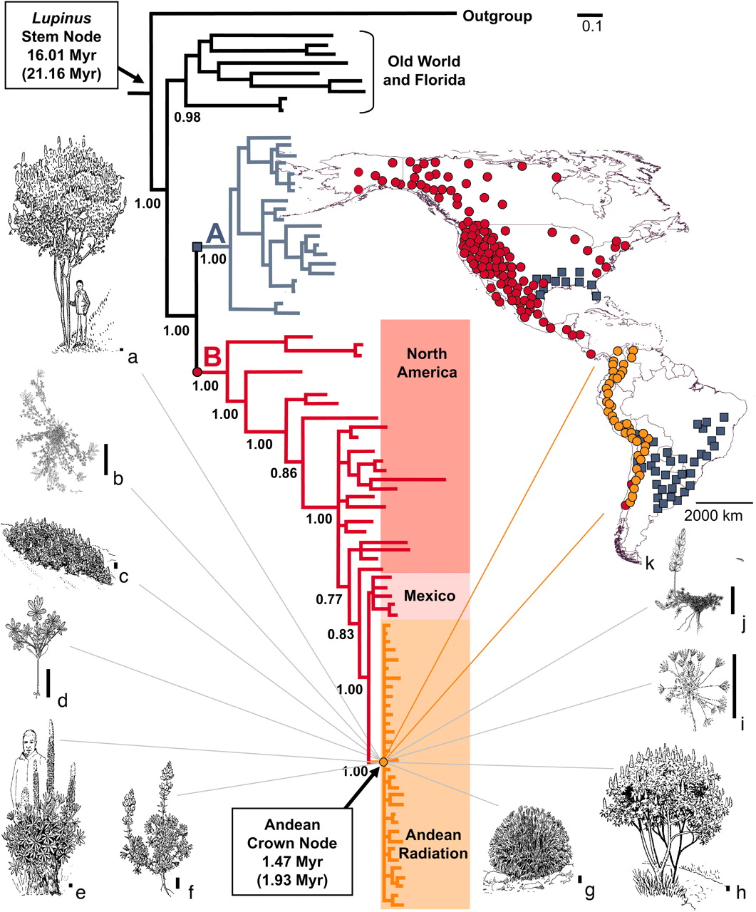
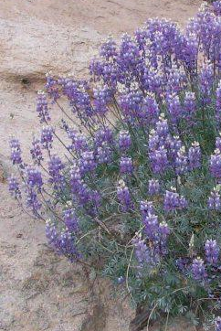
Applications of phylogeny
Hughes & Eastwood 2006. PNAS

Slide 6
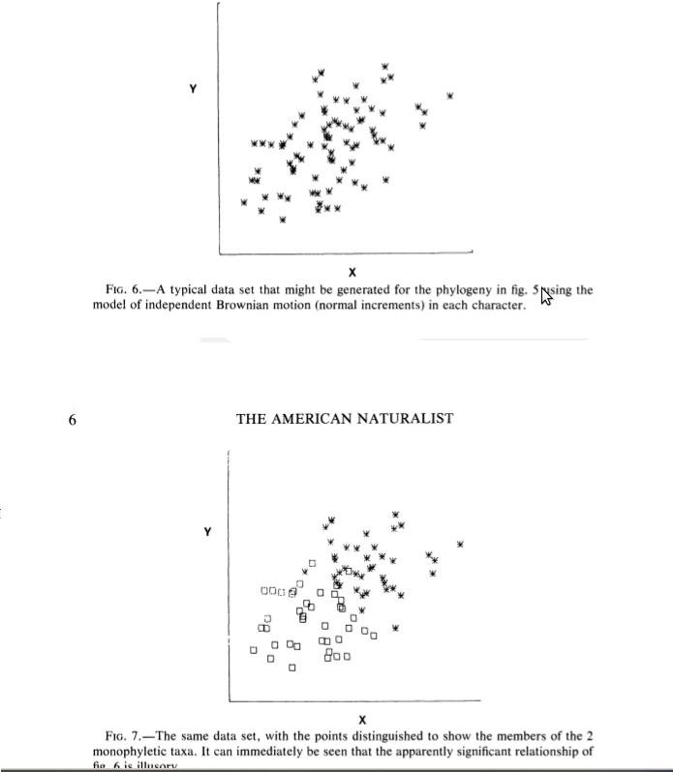

Slide 9
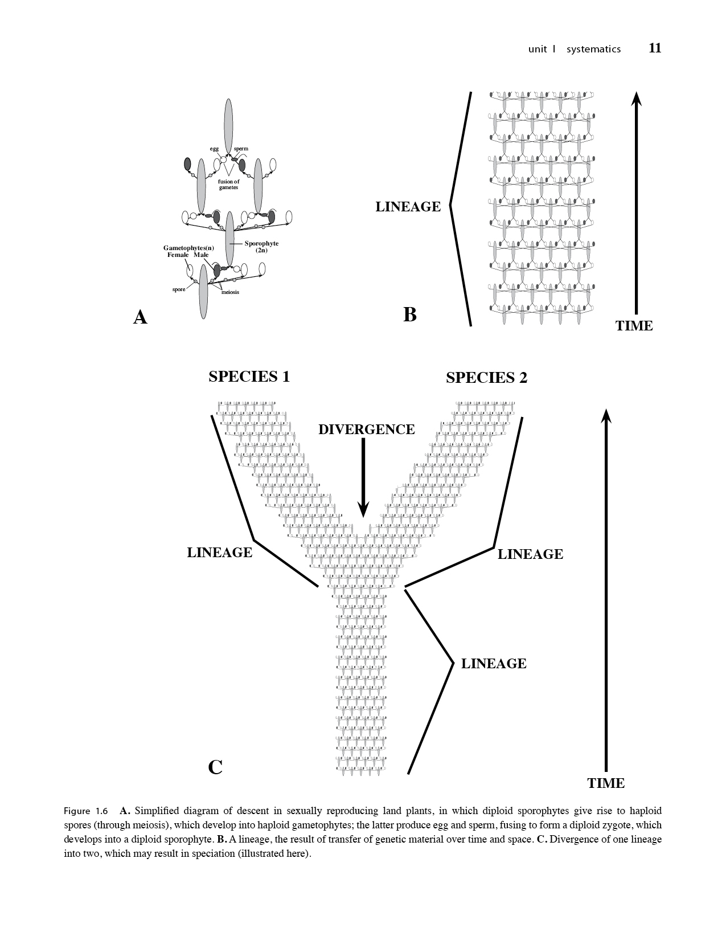
Descent results in a lineage (clade)!
Lineage = a sequence of ancestors (parents) and descendants (offspring)
Involves transfer of DNA through space and time

Slide 10
Split of one lineage into two?
Evolutionary divergence.
Can lead to speciation - origin of new species from pre-existing species

Slide 11
Split, from one lineage into two?
Divergence, which may lead to speciation
Pre-existing feature?
Plesiomorphy (ancestral feature)
New feature?
Apomorphy (derived feature)

Slide 12
Autapomorphy?
Apomorphy for a single lineage
Synapomorphy?
Apomorphy for two or more lineages

Slide 13
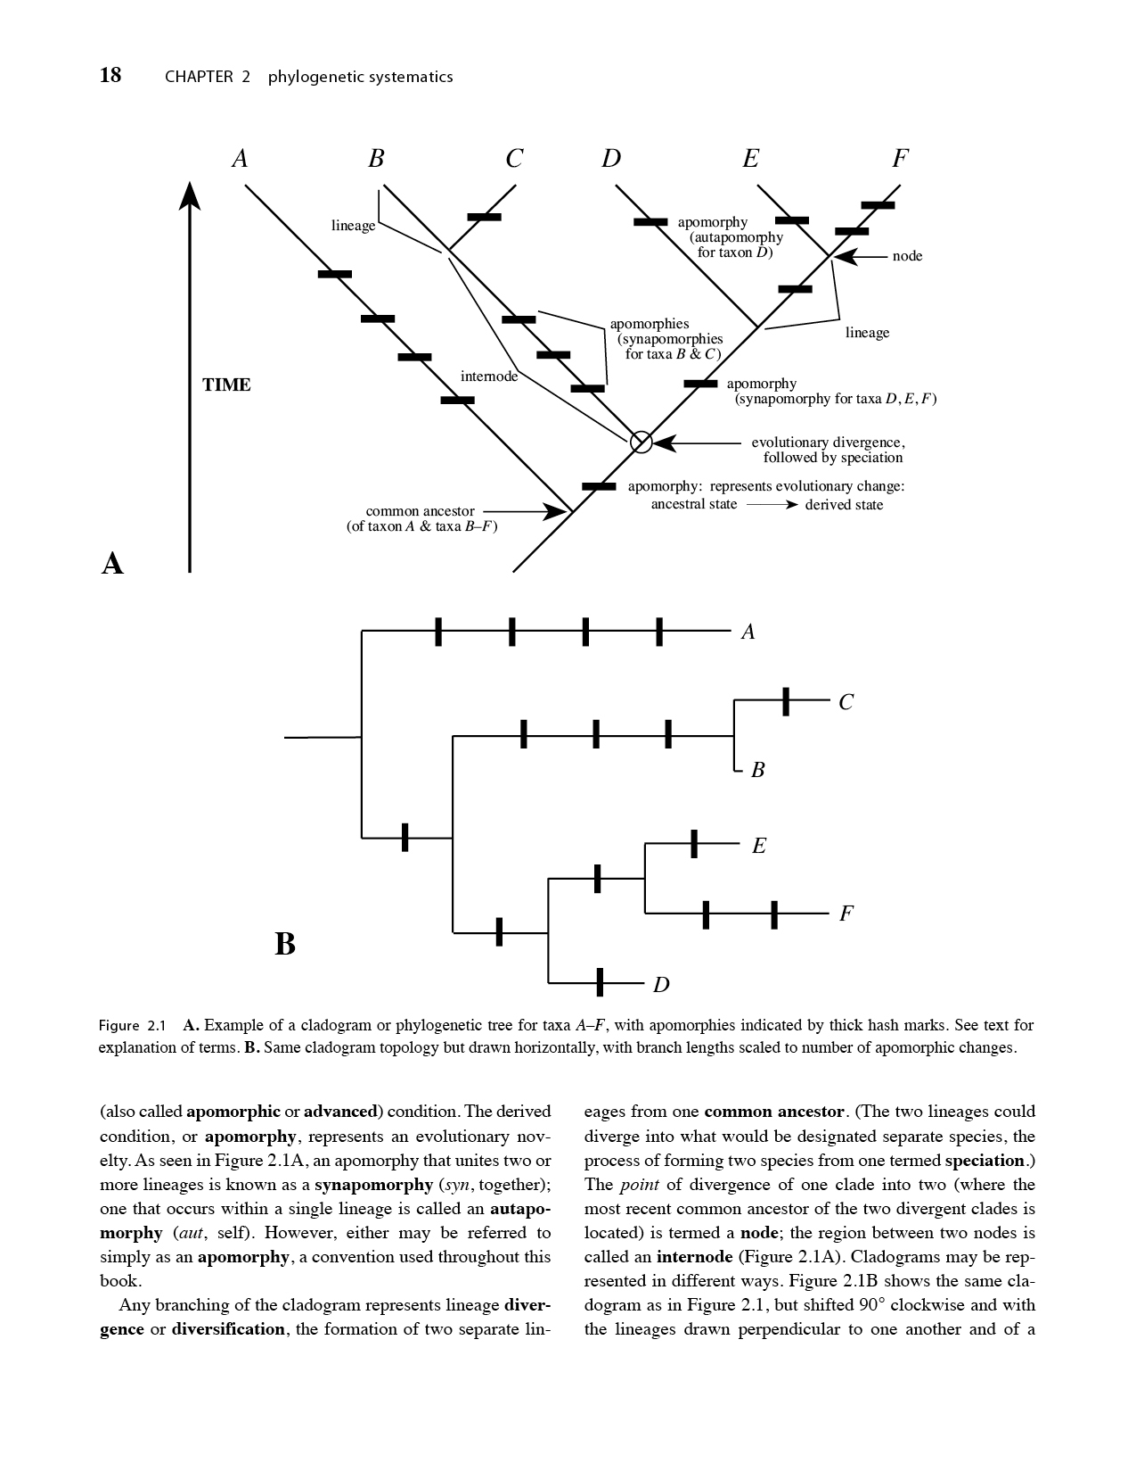
Cladogram vs chronogram vs phylogram

Slide 14
Topology
Structure of branching diagram; how branches are connected together
Ingroup, outgroup, rooting

Slide 15
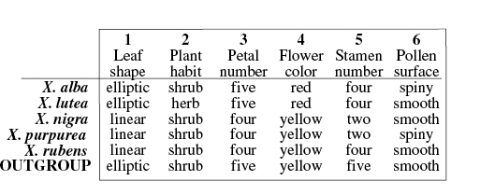
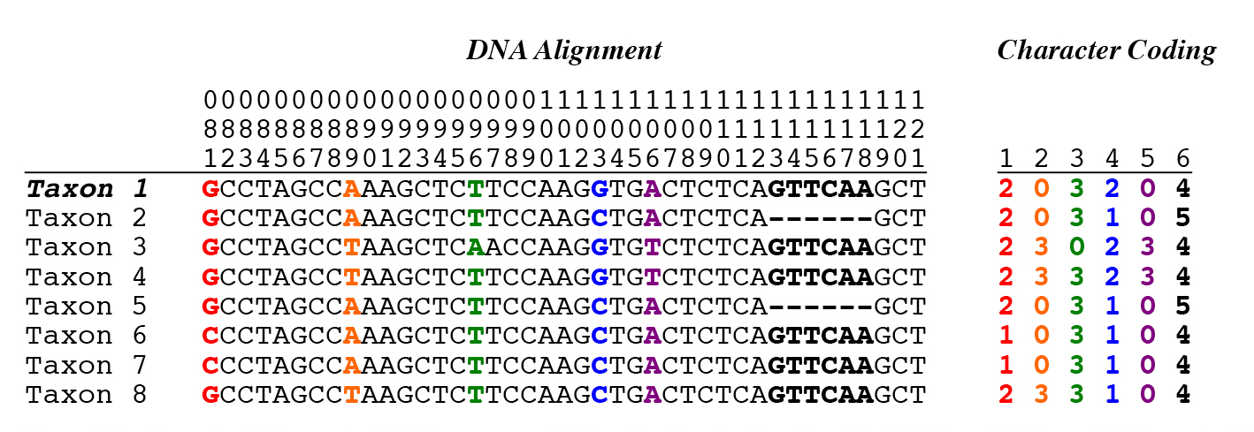
Homology: characters, character states

Slide 16
Primary tenet of phylogenetic systematics?
Taxa (O.T.U.’s) can be grouped by synapomorphies,
because these represent unique evolutionary events. Synpleisiomorphies, on the other hand, don’t provide information for grouping taxa.
Note: This is subtly different from grouping taxa by similarity (similarity can be due to synapomorphies or synpleisiomorphies)
Notes:
-Only made it here in lecture, although I had planned to get further

