Slide 1
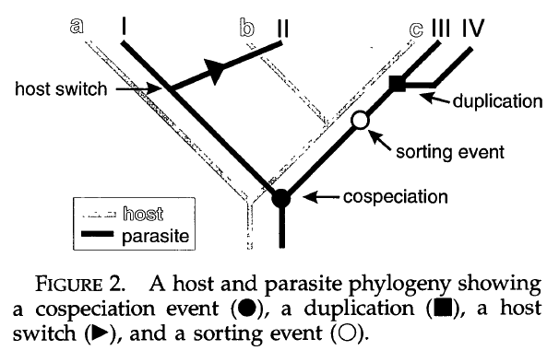
3 kinds of speciation events for parasite: cospeciation, host switch, duplication
sorting: extinction; failure to speciate; ‘miss the boat’; missed collection
Page 1996 Syst. Biol.

Slide 2
Host-parasite evolution vs. Biogeography
Cospeciation = vicariant speciation event
Duplication = speciation within region
Host switch = dispersal to new region + speciation
Host switch without speciation (expansion of niche breadth) = range expansion to new region without speciation
Sorting:
Vicariance with subsequent extinction in one region
Narrowly distributed species that ‘miss’ vicariant event

Slide 3
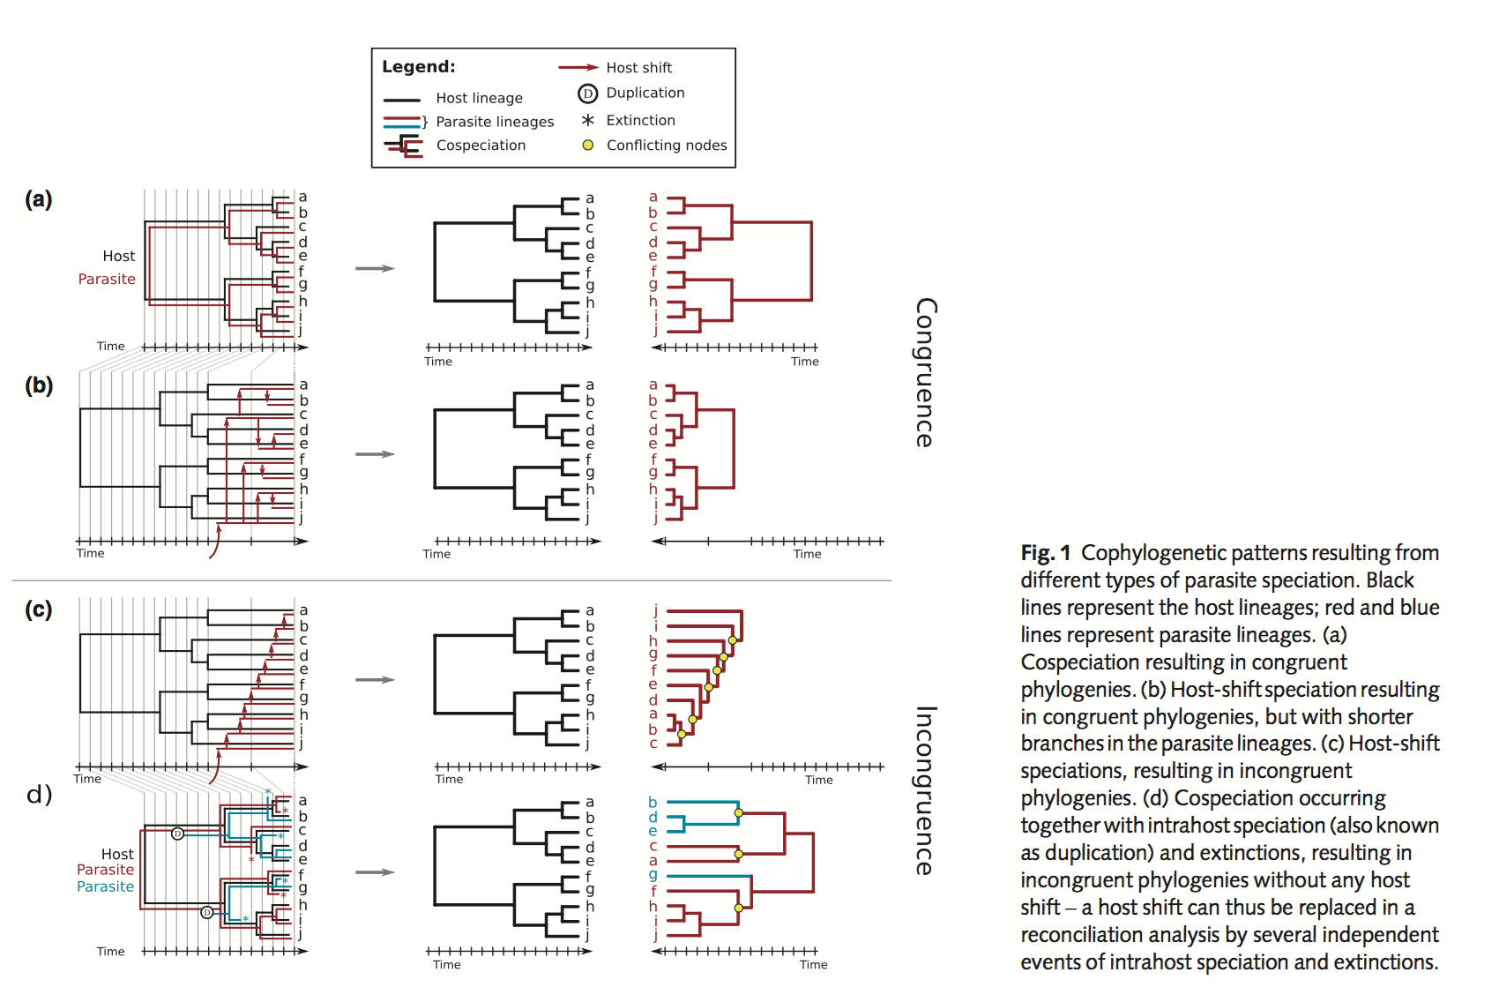
De Vienne et al. 2013 New Phyt

Slide 4
De Vienne et al. 2013 New Phyt

Slide 5
De Vienne et al. 2013 New Phyt

Slide 6
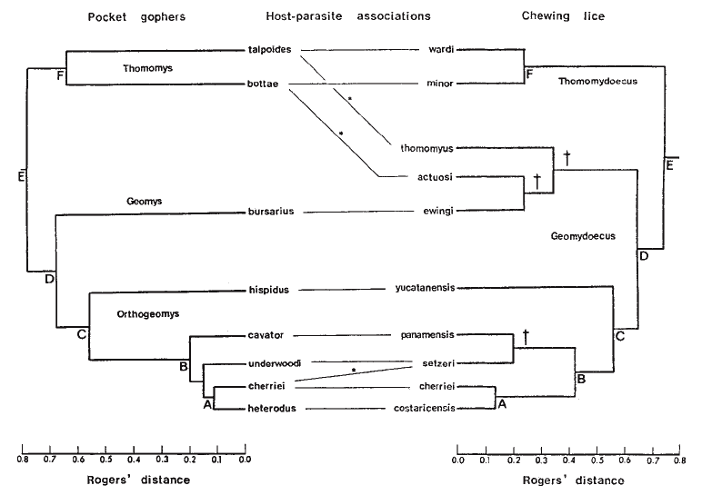
Hafner and Nadler 1998 Nature

Slide 7
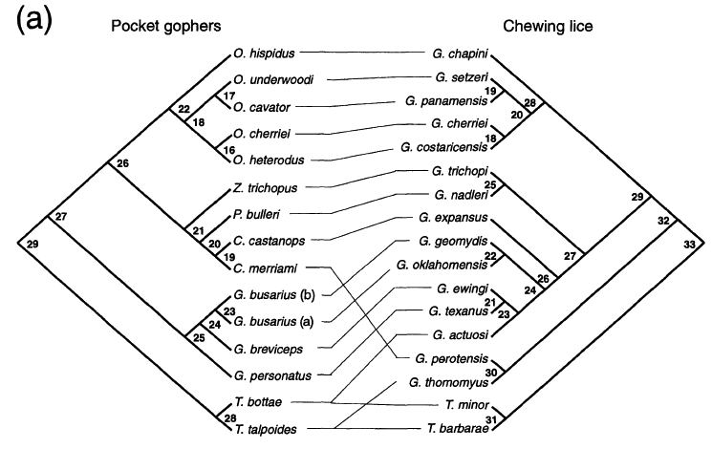
Page 1996 Syst. Biol.

Slide 8
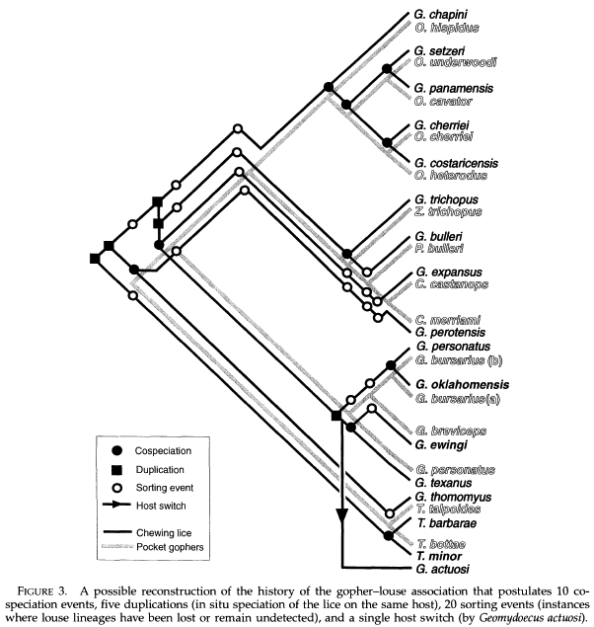
Page 1996 Syst. Biol.

Slide 9
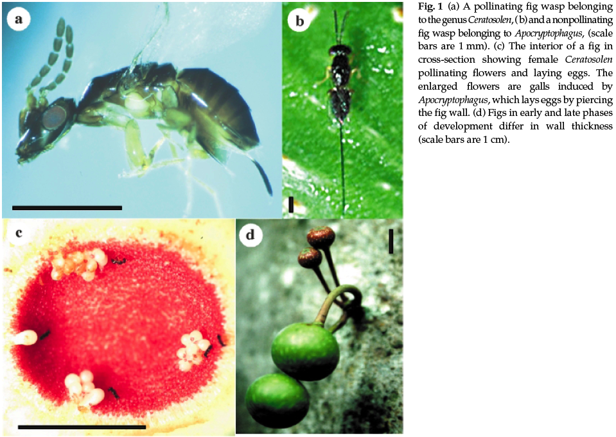
Weiblen and Bush 2002 Mol. Ecol.

Slide 10
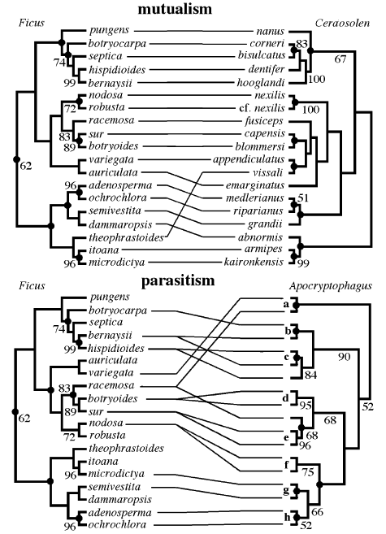
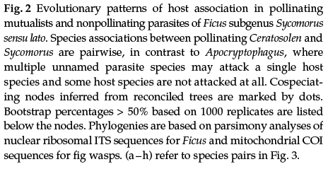
Weiblen and Bush 2002 Mol. Ecol.

Slide 11
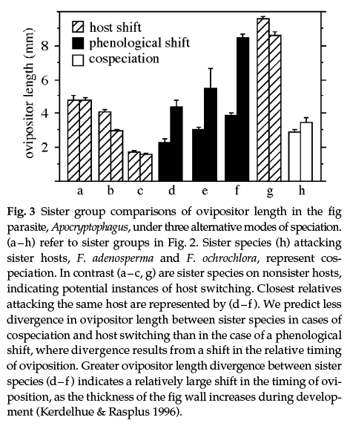
Weiblen and Bush 2002 Mol. Ecol.

Slide 12
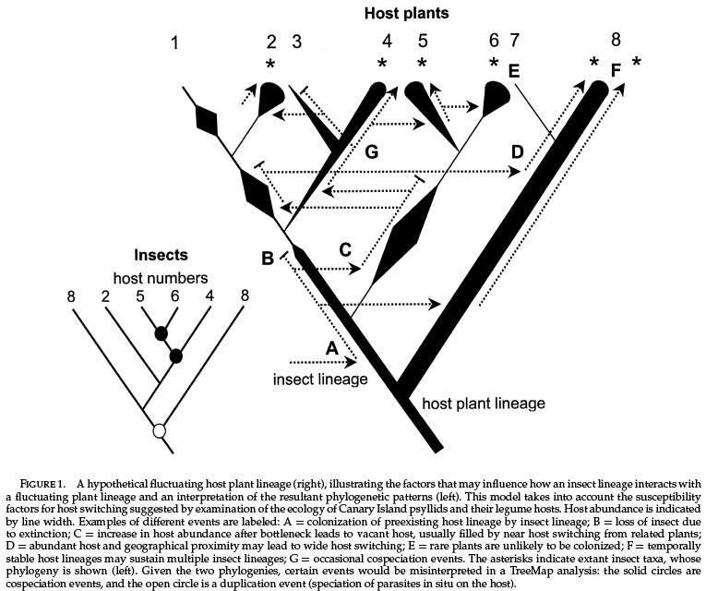
Percy et al. 2004 Syst. Biol.

Slide 13
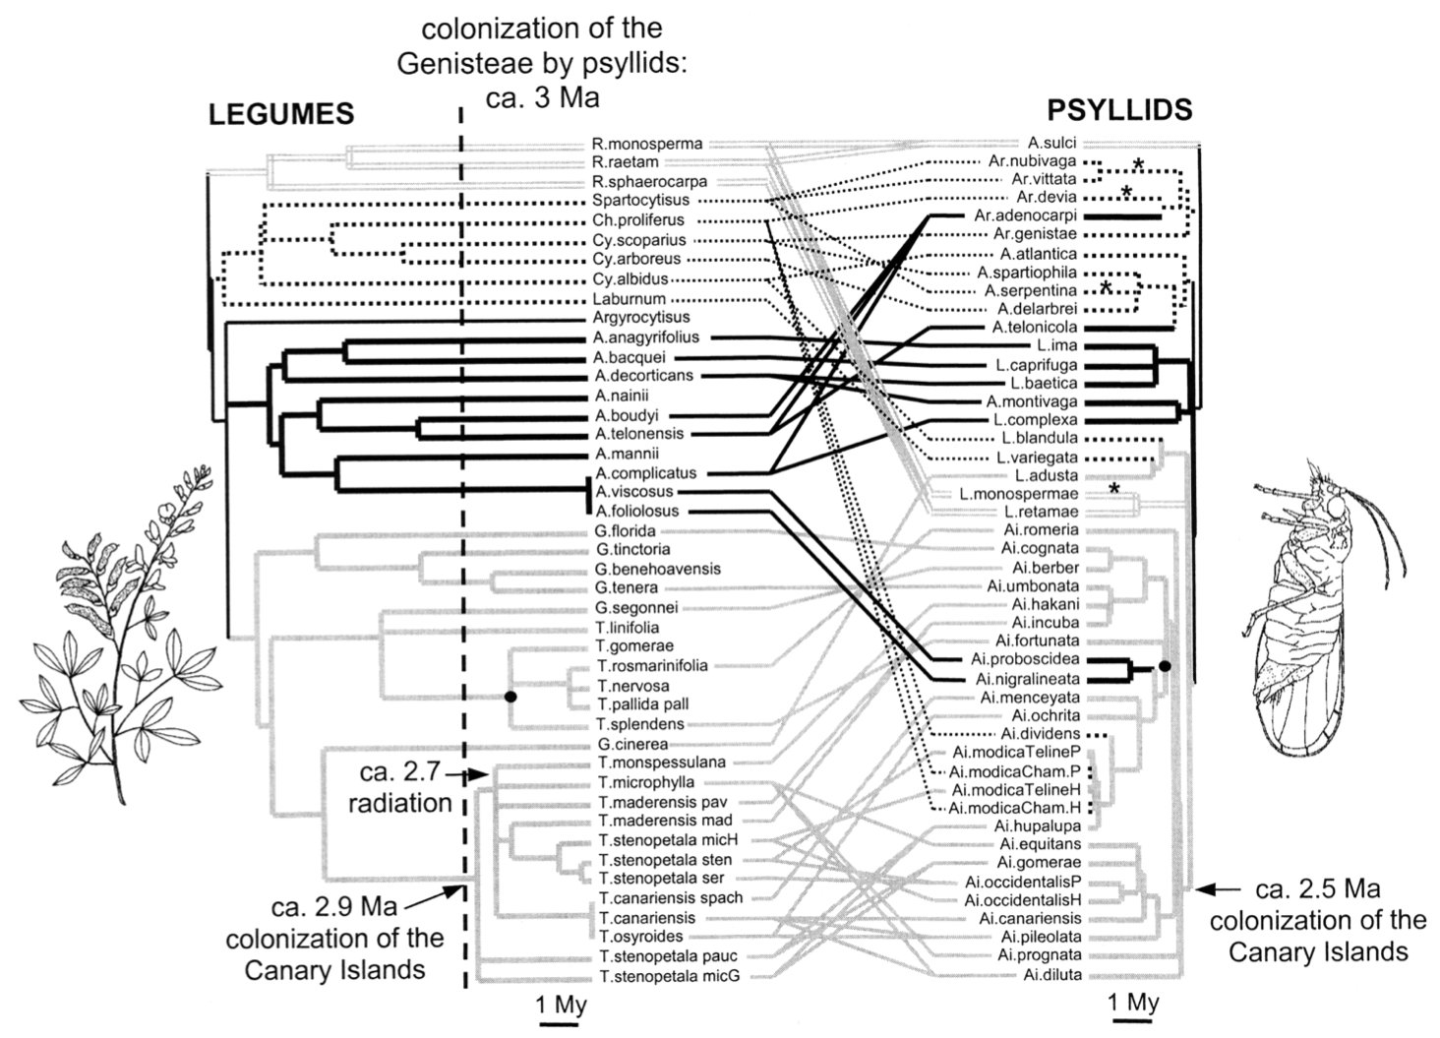
To get 0 host switches:
but assumed 16 cospeciation events (parallel cladogenesis),
29 duplications (parasite speciation without host
speciation), and 220 sorting events (parasite loss from
host lineage), suggesting that the nonrandom pattern
Percy et al. 2004 Syst. Biol.

Slide 14
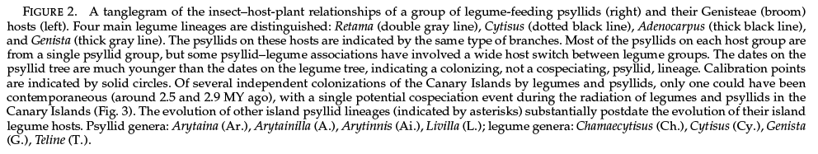
Percy et al. 2004 Syst. Biol.

Slide 15
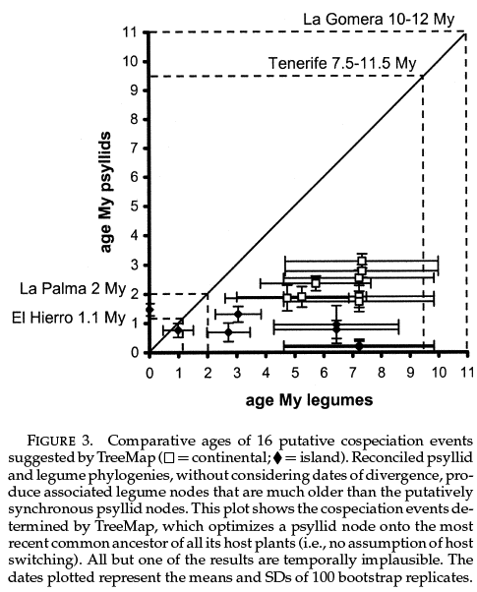
Percy et al. 2004 Syst. Biol.

Slide 16
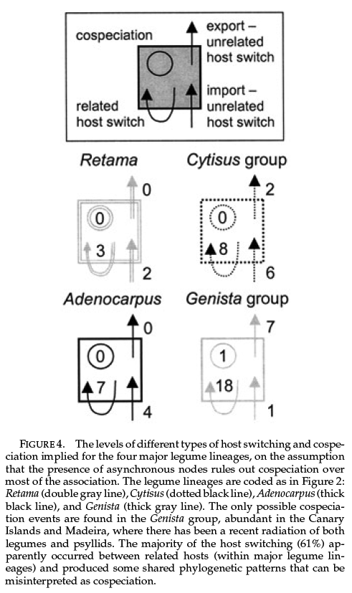
Percy et al. 2004 Syst. Biol.

Slide 17
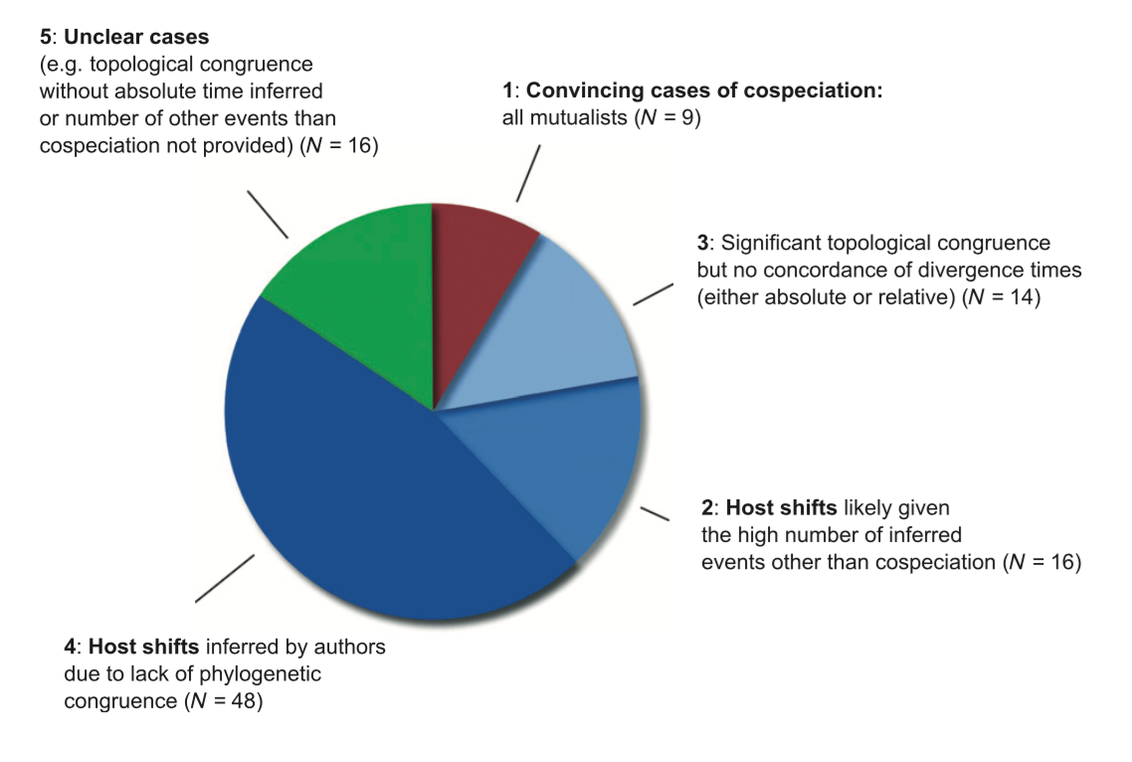
De Vienne et al. 2013 New Phyt

