Slide 1
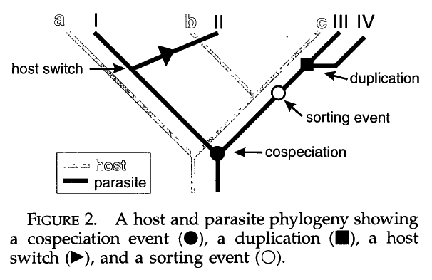
3 kinds of speciation events for parasite
sorting: extinction; failure to speciate; ‘miss the boat’; missed collection
Page 1996 Syst. Biol.

Slide 2
Host-parasite evolution vs. Biogeography
Cospeciation = vicariant speciation event
Duplication = speciation within region
Host switch = dispersal to new region + speciation
Host switch without speciation (expansion of niche breadth) = range expansion to new region without speciation
Sorting:
  Vicariance with subsequent extinction in one region
  Narrowly distributed species that ‘miss’ vicariant event

Slide 3
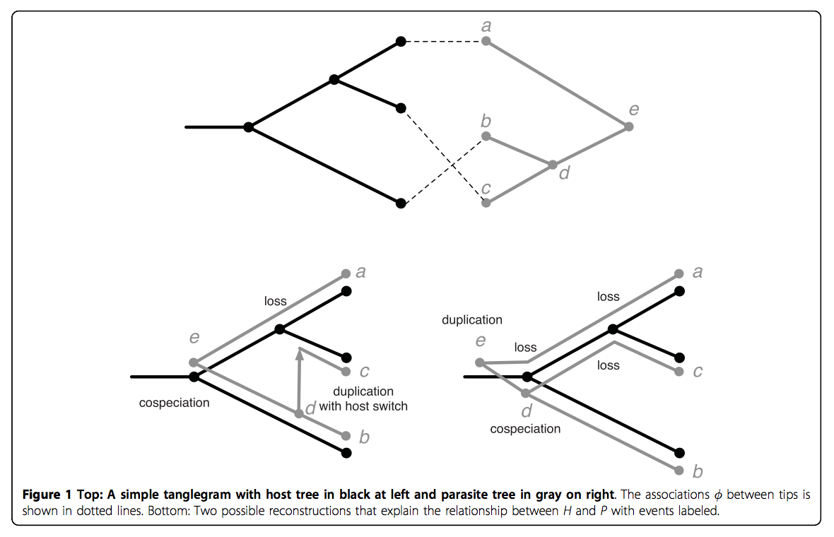

Slide 4
cospeciation: 1
sorting event: 1
host switch: 1
duplication: 1
cospeciation: 1
sorting event: 3
host switch: 0

Slide 5
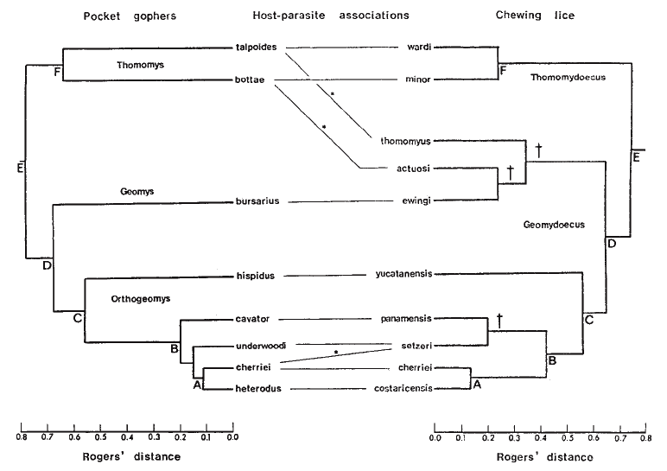
Hafner and Nadler 1998 Nature

Slide 6
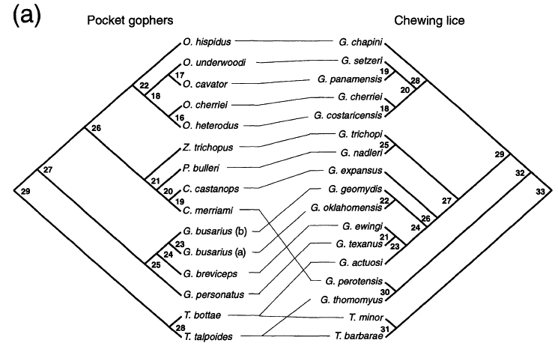
Page 1996 Syst. Biol.

Slide 7
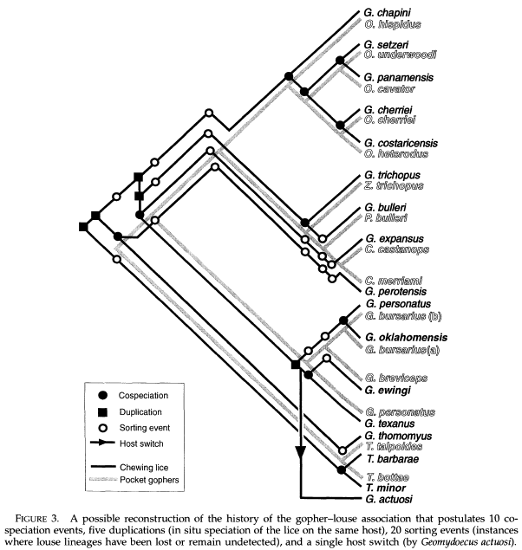
Page 1996 Syst. Biol.

Slide 8
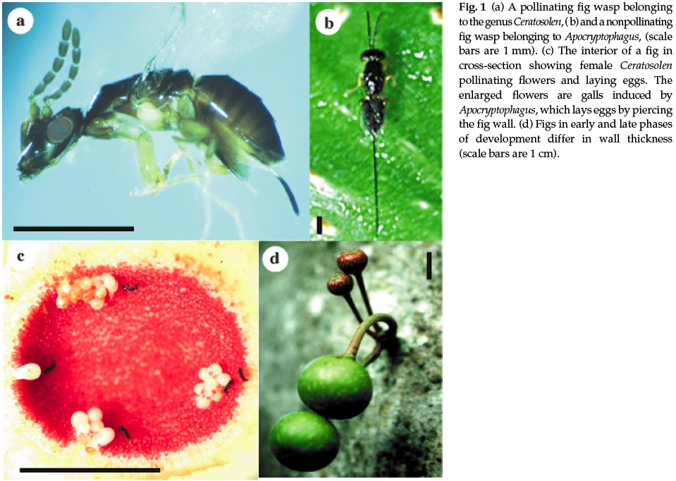
Weiblen and Bush 2002 Mol. Ecol.

Slide 9
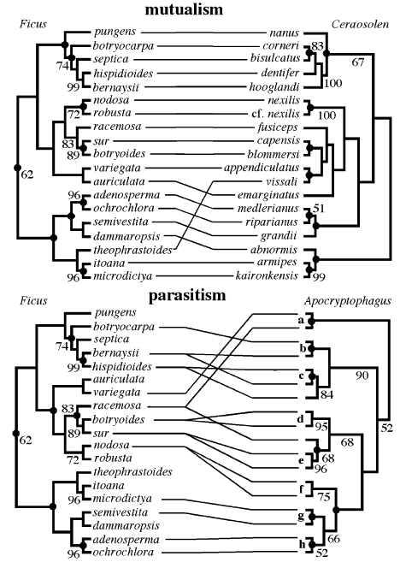
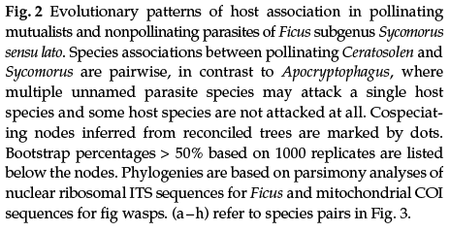
Weiblen and Bush 2002 Mol. Ecol.

Slide 10
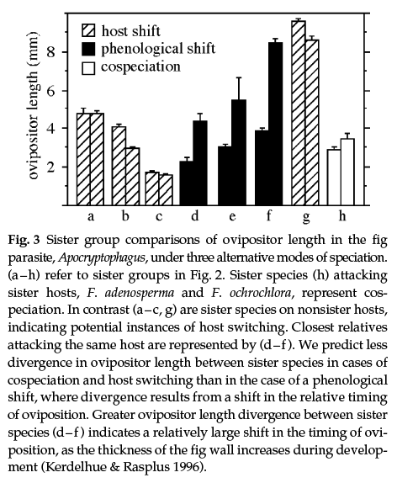
Weiblen and Bush 2002 Mol. Ecol.

Slide 11
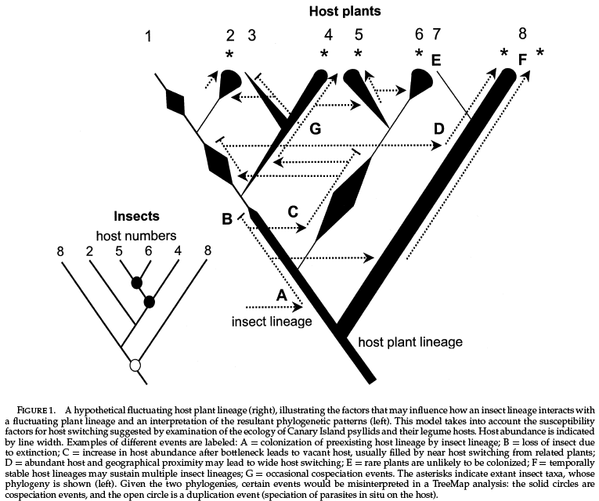
Percy et al. 2004 Syst. Biol.

Slide 12
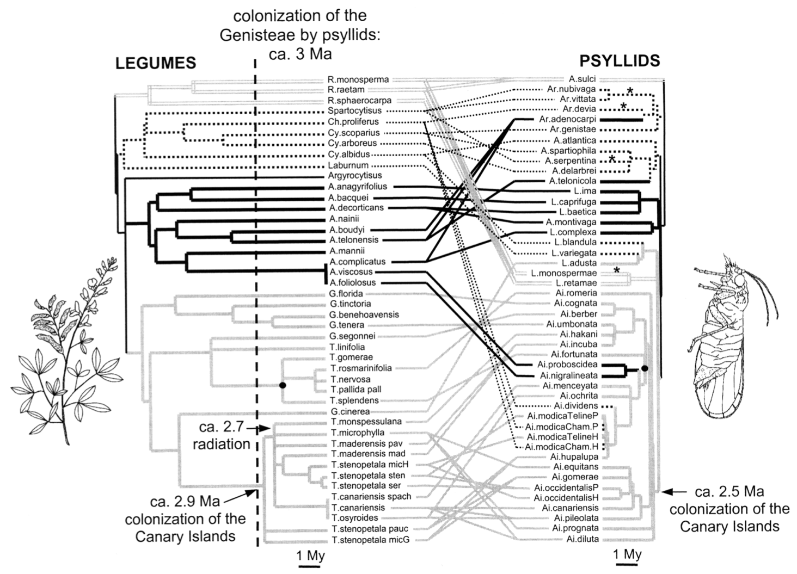
To get 0 host switches:
but assumed 16 cospeciation events (parallel cladogenesis),
29 duplications (parasite speciation without host
speciation), and 220 sorting events (parasite loss from
host lineage), suggesting that the nonrandom pattern
Percy et al. 2004 Syst. Biol.

Slide 13
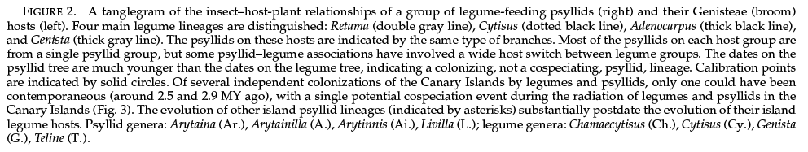
Percy et al. 2004 Syst. Biol.

Slide 14
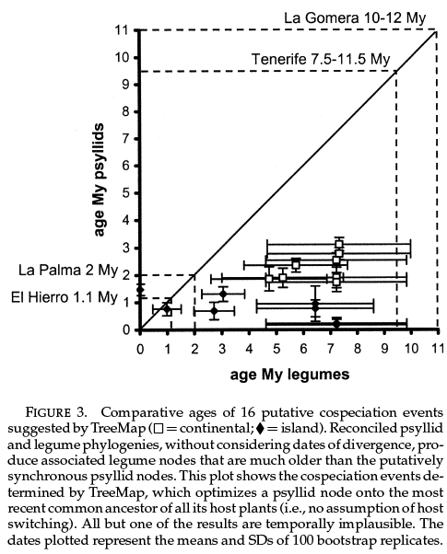
Percy et al. 2004 Syst. Biol.

Slide 15
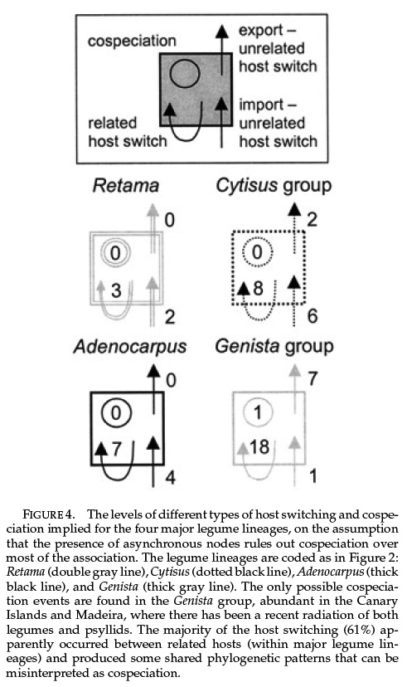
Percy et al. 2004 Syst. Biol.

