Slide 2
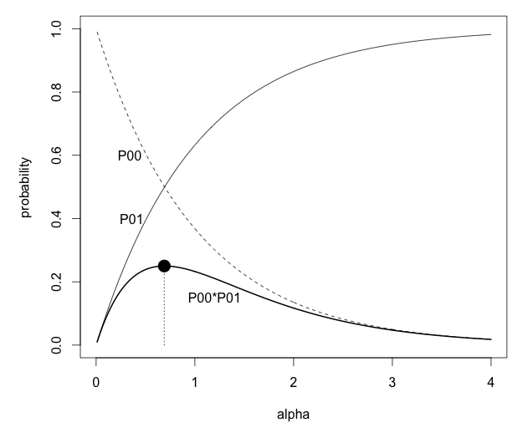
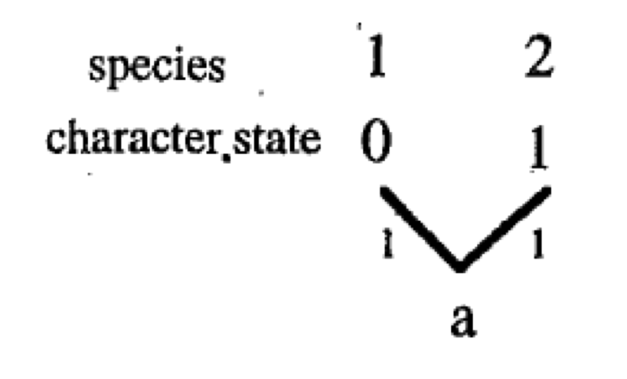
ML solution if a = 0
beta = 0

Slide 3

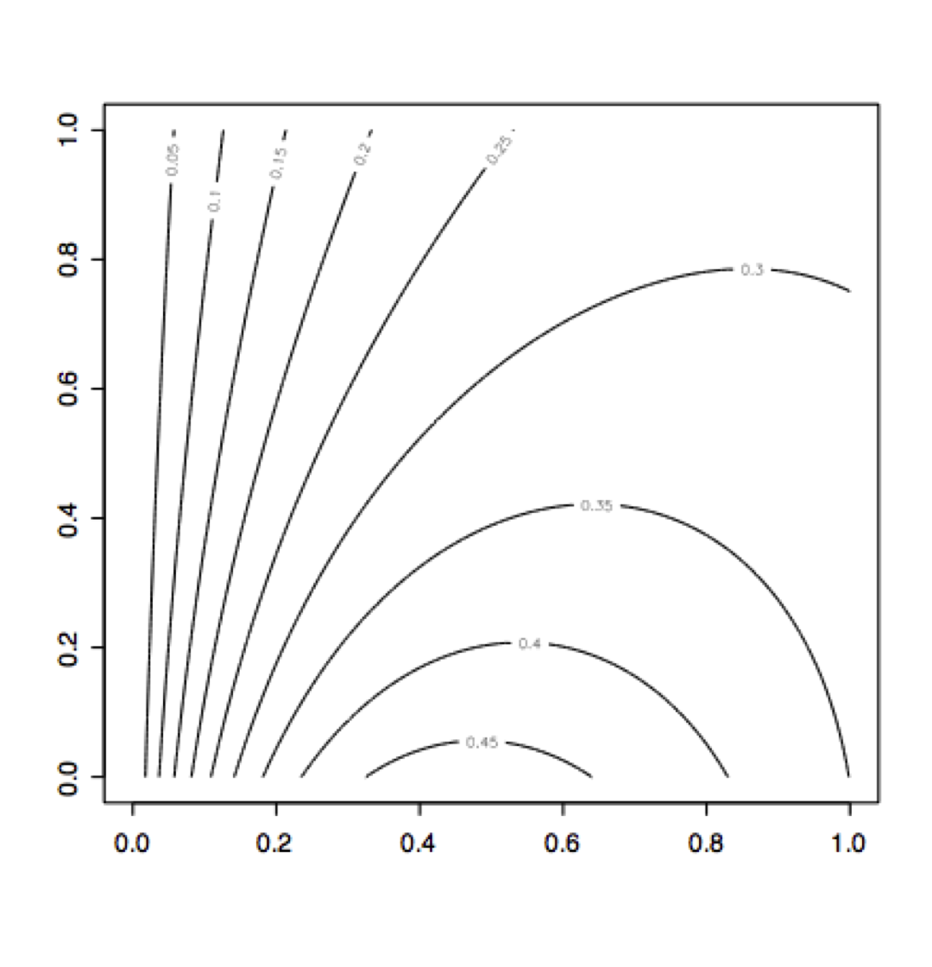
probability contours for a = 0
beta
For a = 1, ML solution is:
alpha = inf
beta = inf
P₁₀ = 0.5
p₁₁ = 0.5
joint probability = 0.25
alpha
alpha = 0.46, beta = 0

Slide 4
Likelihood ratio tests
a measure of support for alternative hypotheses
LR = -2*ln(L₁/L₂)
For two hypotheses with the same number of parameters, there is no exact significance value attached to the LR. Values greater than 2 are considered 'strong support'
For nested hypotheses with different numbers of parameters, LR is distributed as a chi-square with df = the difference in number of parameters. L1 is the likelihood of the model with fewer parameters, and L2 has more parameters. L2 is always greater than L1 (you can’t have a worse model if you add more parameters)
2-rate model (averaged over both possible ancestral states)
α = 0.59
β = 0.31
L(m) ∝ 0.256.
1-rate model
α= β= inf
L ∝ 0.25
LR = -2*ln(.25/.256) = 0.05
chisq(0.05, df=1) = 0.82
NS, so two rate model not supported

Slide 5
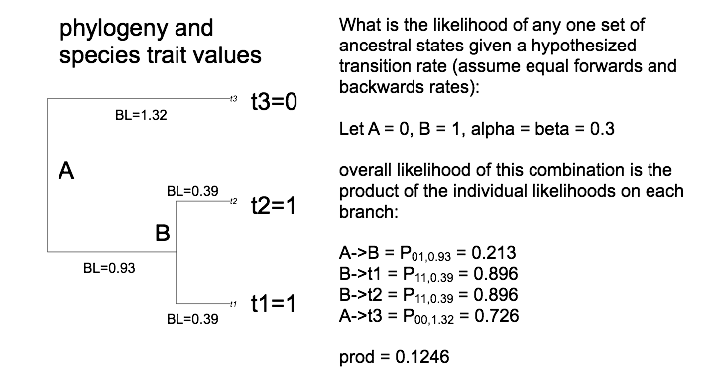

Slide 6
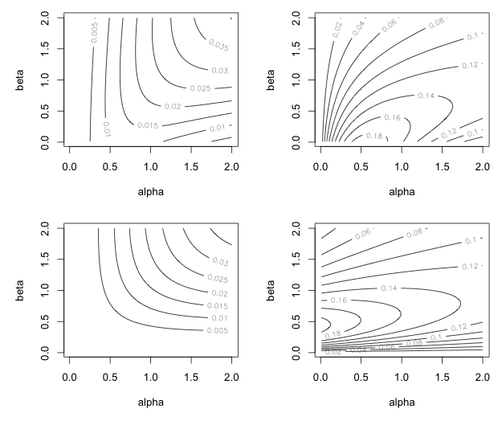
a=(0,0)
a=(0,1)
0
1
a=(1,0)
a=(1,1)
1
1
blue: ML solution for each set of ancestral states
red: overall ML solution showing both ancestral states and transition parameters

Slide 7
P(A=1) = L(A=1)/L(A=0)+L(A=1)
L(A=1) = L(A,B = 1,0) + L(A,B = 1,1)
RL(A=1) = 0.554
RL(B=1) = 0.954
(1,1)
(0,1)
(0,0)
(1,0)

Slide 8
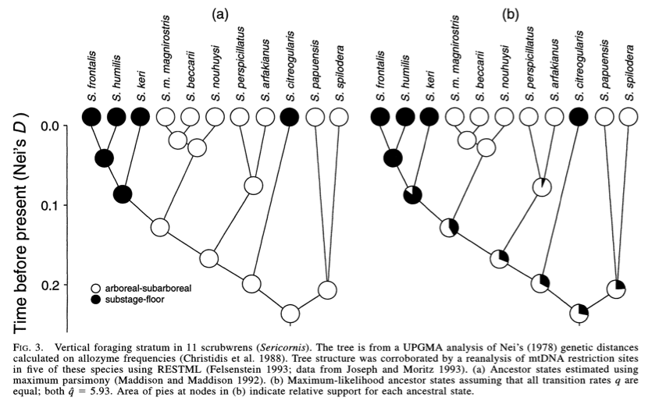
Parsimony
ML with equal rates
Schluter et al. 1997

Slide 9
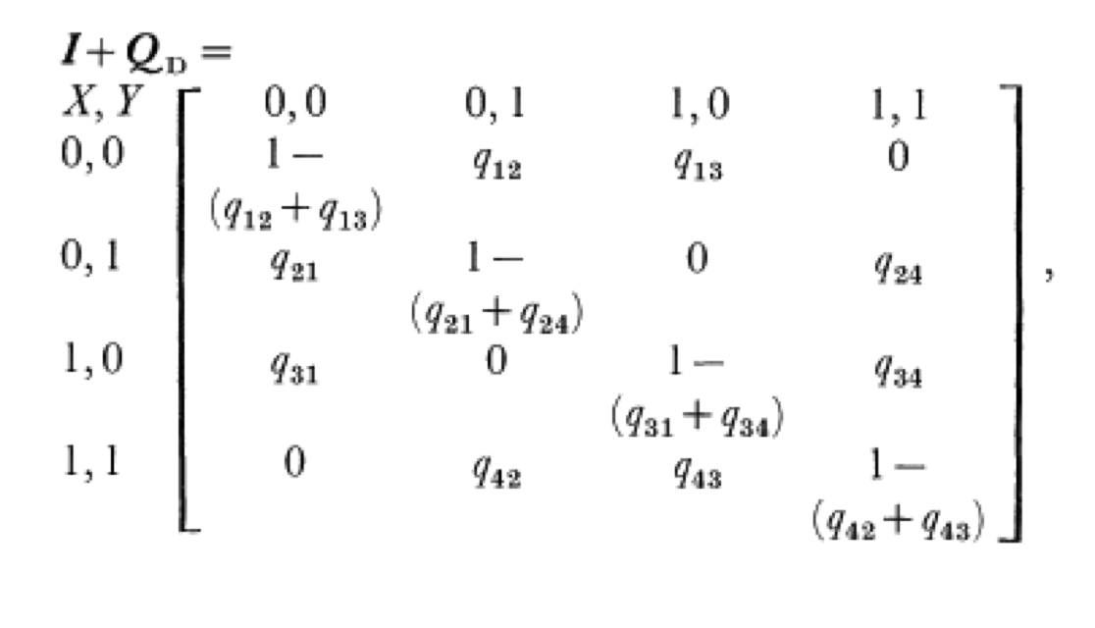
Model with full dependence has 8 parameters
If traits evolve independently, there are only 4 parameters, because:
q12 = q34; q13 = q24; q31 = q42; q21 = q43
Pagel 1994

Slide 10
q₁₂
(0,0)
(0,1)
q₂₁
q₁₃
q₃₁
q₂₄
q₄₂
q₃₄
(1,0)
(1,1)
q₄₃
If traits evolve independently: q12 = q34; q21 = q43; q13=q24; q31=q42 and there are 4 different rates
If evolution of trait 1 is dependent on state of trait 2, but not the other way around:
q12=q34; q21=q43 and there are 6 different rates
If trait evolution is correlated: all 8 rates could be different

Slide 11
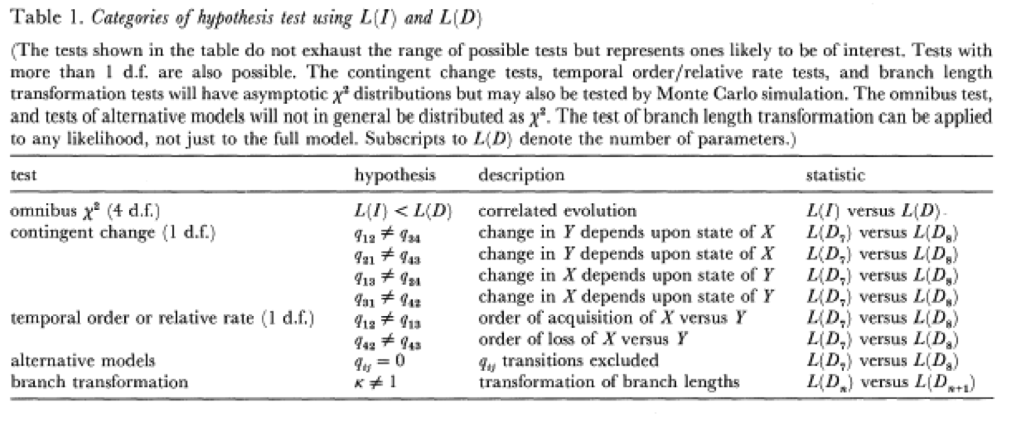

Slide 12
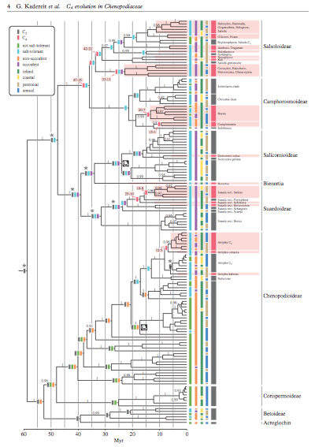
Questions:
Is the rate of C4 evolution higher in salt- or drought-adapted lineages?
Did C4 evolution occur before evolution of salt or drought tolerance (C4 is a predisposing factor)?
Kadereit et al. 2012 Proc Roy Soc Lond B

Slide 13
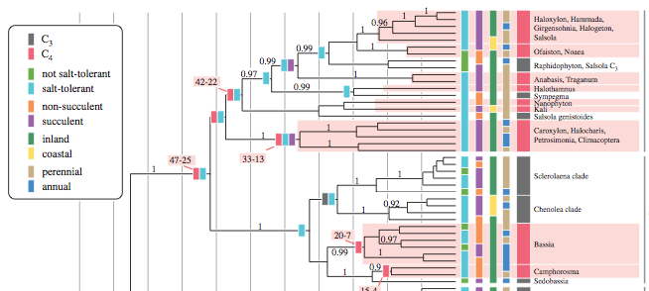

Slide 14
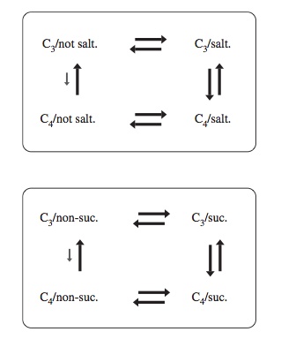
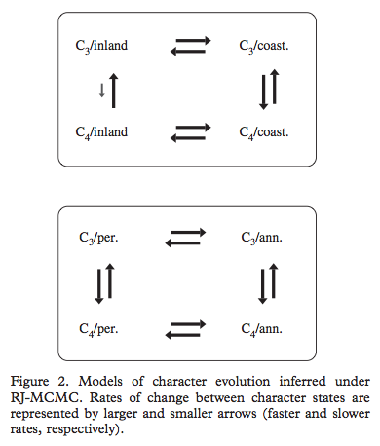

Slide 15
AIC and BIC
AIC: Akaike Information Criterion – used to choose best among alternative models

