Slide 1
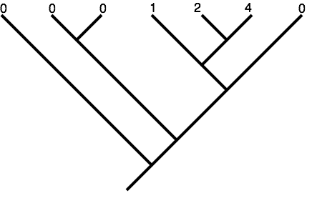

Slide 2
0
2
1
0
0
0

Slide 3
Squared change parsimony = ML with BL = 1
Linear parsimony
0
2
0.08
2.44
1
1.32
0
0.52
0
0.24
0
0.12
ML with BL as shown
0.096
2.54
1.6
0.96
0.67
0.56

Slide 4
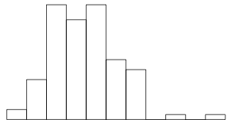
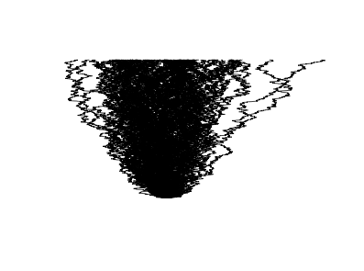
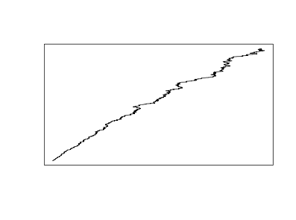
time
var(x)

Slide 5
ML with BL as shown
C
F
Node | ML estimate | Lower 95% CI | Upper 95% CI
A | 0.56 | -0.77 | 1.89
B | 0.67 | -0.43 | 1.78
C | 0.096 | -0.61 | 0.81
D | 0.96 | 0 | 1.95
E | 1.6 | 0.76 | 2.45
F | 2.54 | 1.86 | 3.2
E
D
B
A

Slide 6
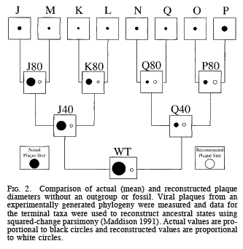
Oakley and Cunningham 2000

Slide 7
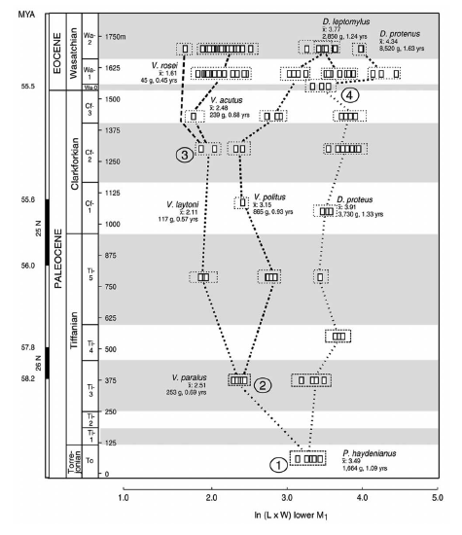
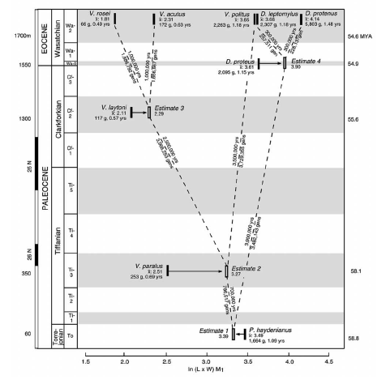
Polly 2001 Am Nat

Slide 8
Independent contrasts

Slide 9
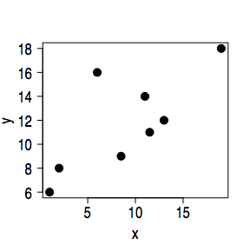
a
2
8
6
16
1
6
11
14
8.5
9
11.5
11
19
18
13
12
b
R = 0.74

Slide 10
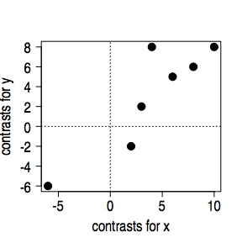
a
2
8
6
16
1
6
11
14
8.5
9
11.5
11
19
18
13
12
4
8
10
8
3
2
-6
-6
4
12
6
10
10
10
16
15
2
-2
6
5
5
11
13
17
8
6
9
14
b
c
R = 0.74
R = 0.92

Slide 11
Oakley and Cunningham 2000

Slide 12
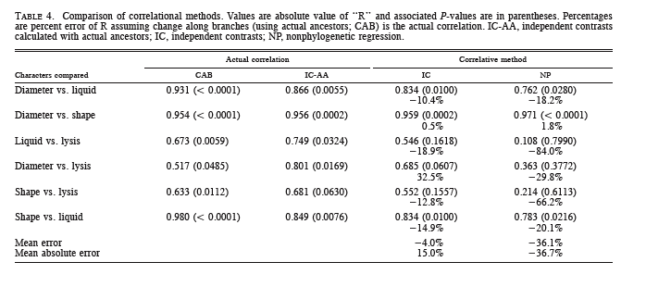
Oakley and Cunningham 2000

Slide 13
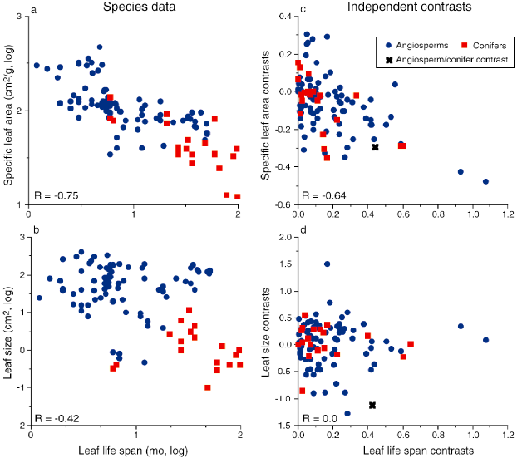
A21223
Fig. 2

