Slide 1
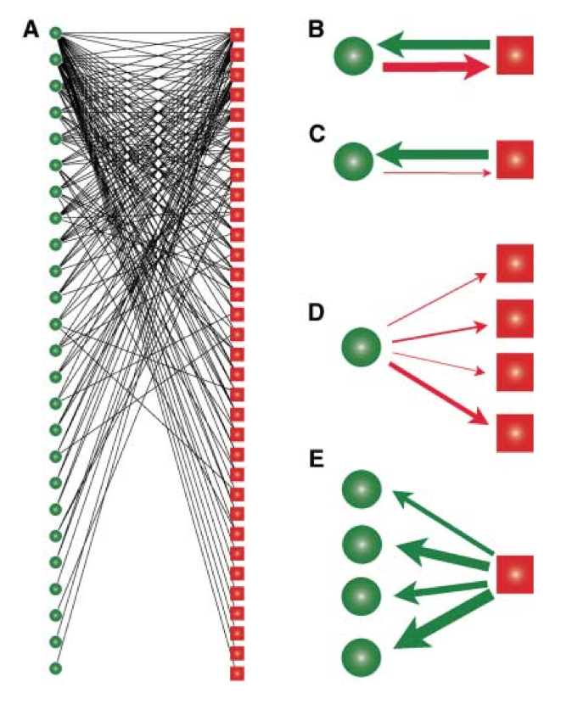
Rezende et al. 2006 Science

Slide 2
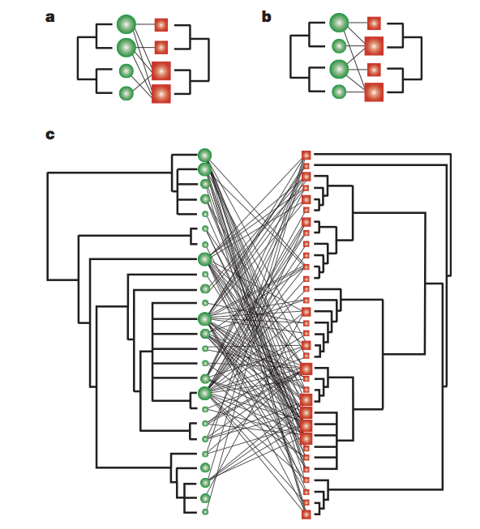
Rezende et al. 2007 Nature

Slide 3
Species degree: Number of links
Species strength: sum of dependencies or interaction weights of animal species on that plant
Ecological similarity (pairwise): The ecological similarity of any two species is defined as the number of species with which they both interact divided by the total number of species with which they interact

Slide 4
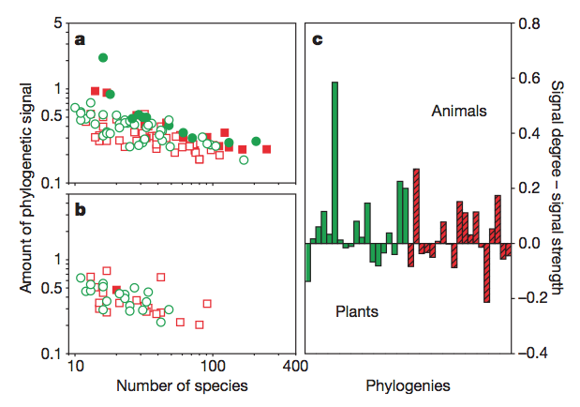

Slide 5
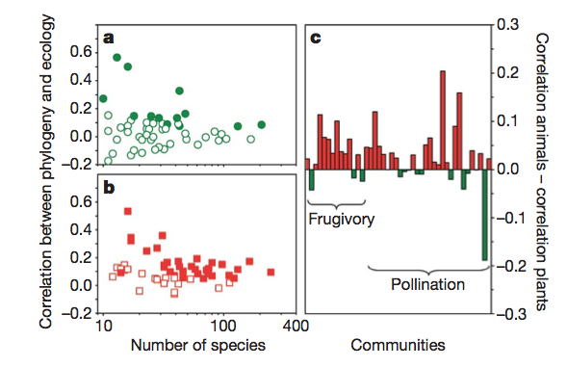

Slide 6
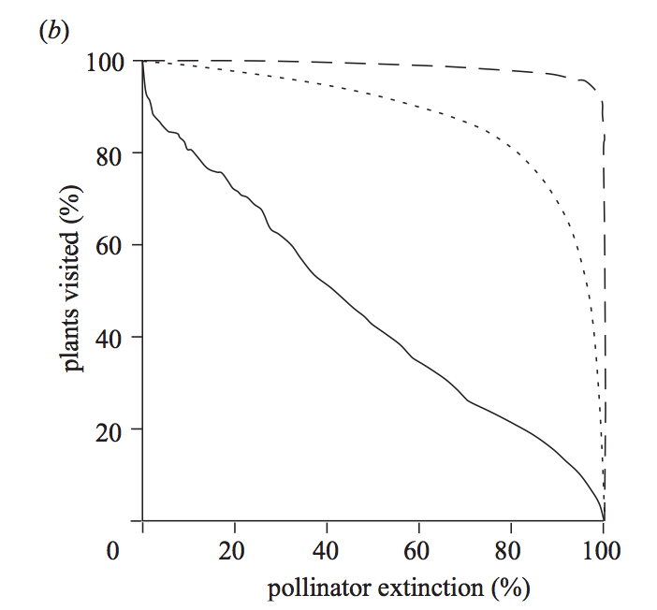

Slide 7
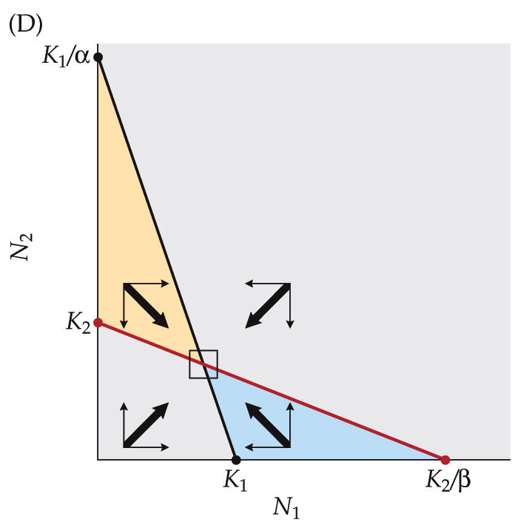

Slide 8
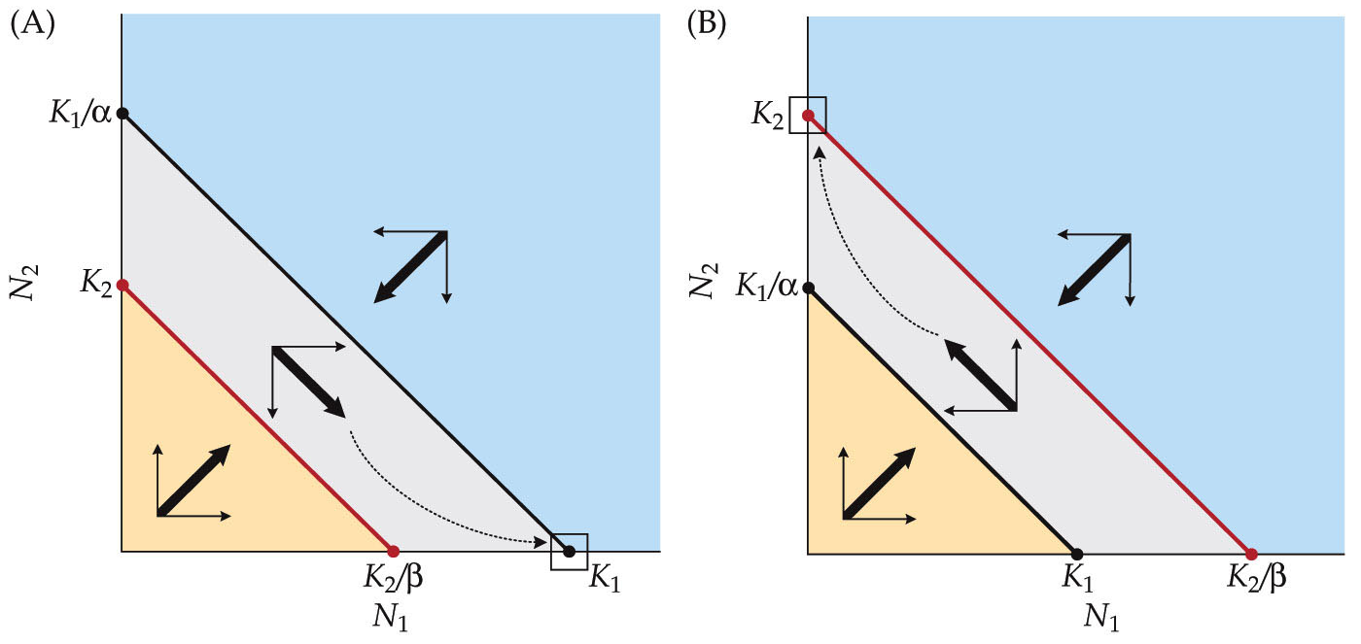
Superior competitors will drive other species extinct, not identical competitors

Slide 9
What happens if species are identical? What is equilibrium outcome?

Slide 10
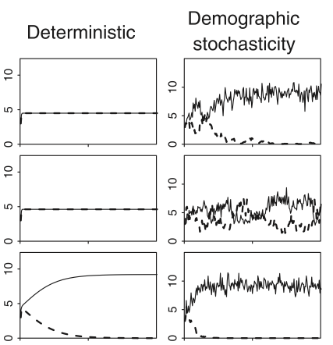

Stochastic dynamics drives one extinct if species are identical (or nearly so)

Slide 12
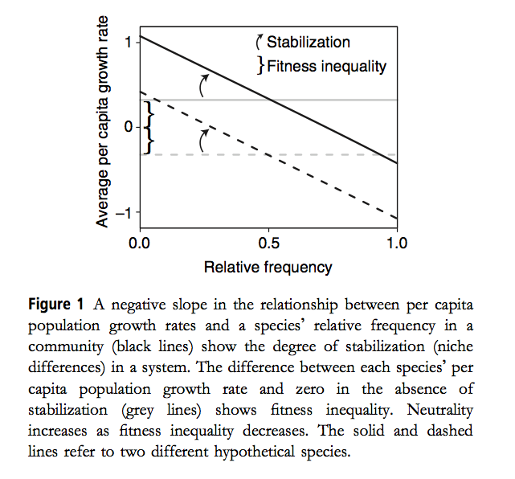
Adler et al. 2007

Slide 13
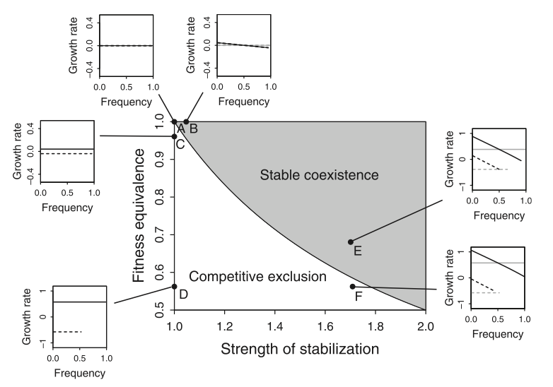
Adler et al. 2007

Slide 14


Adler et al. 2007

Slide 15
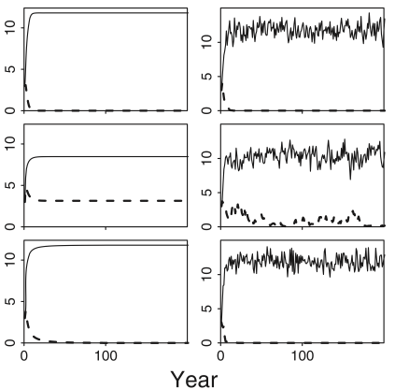

Adler et al. 2007

Slide 16
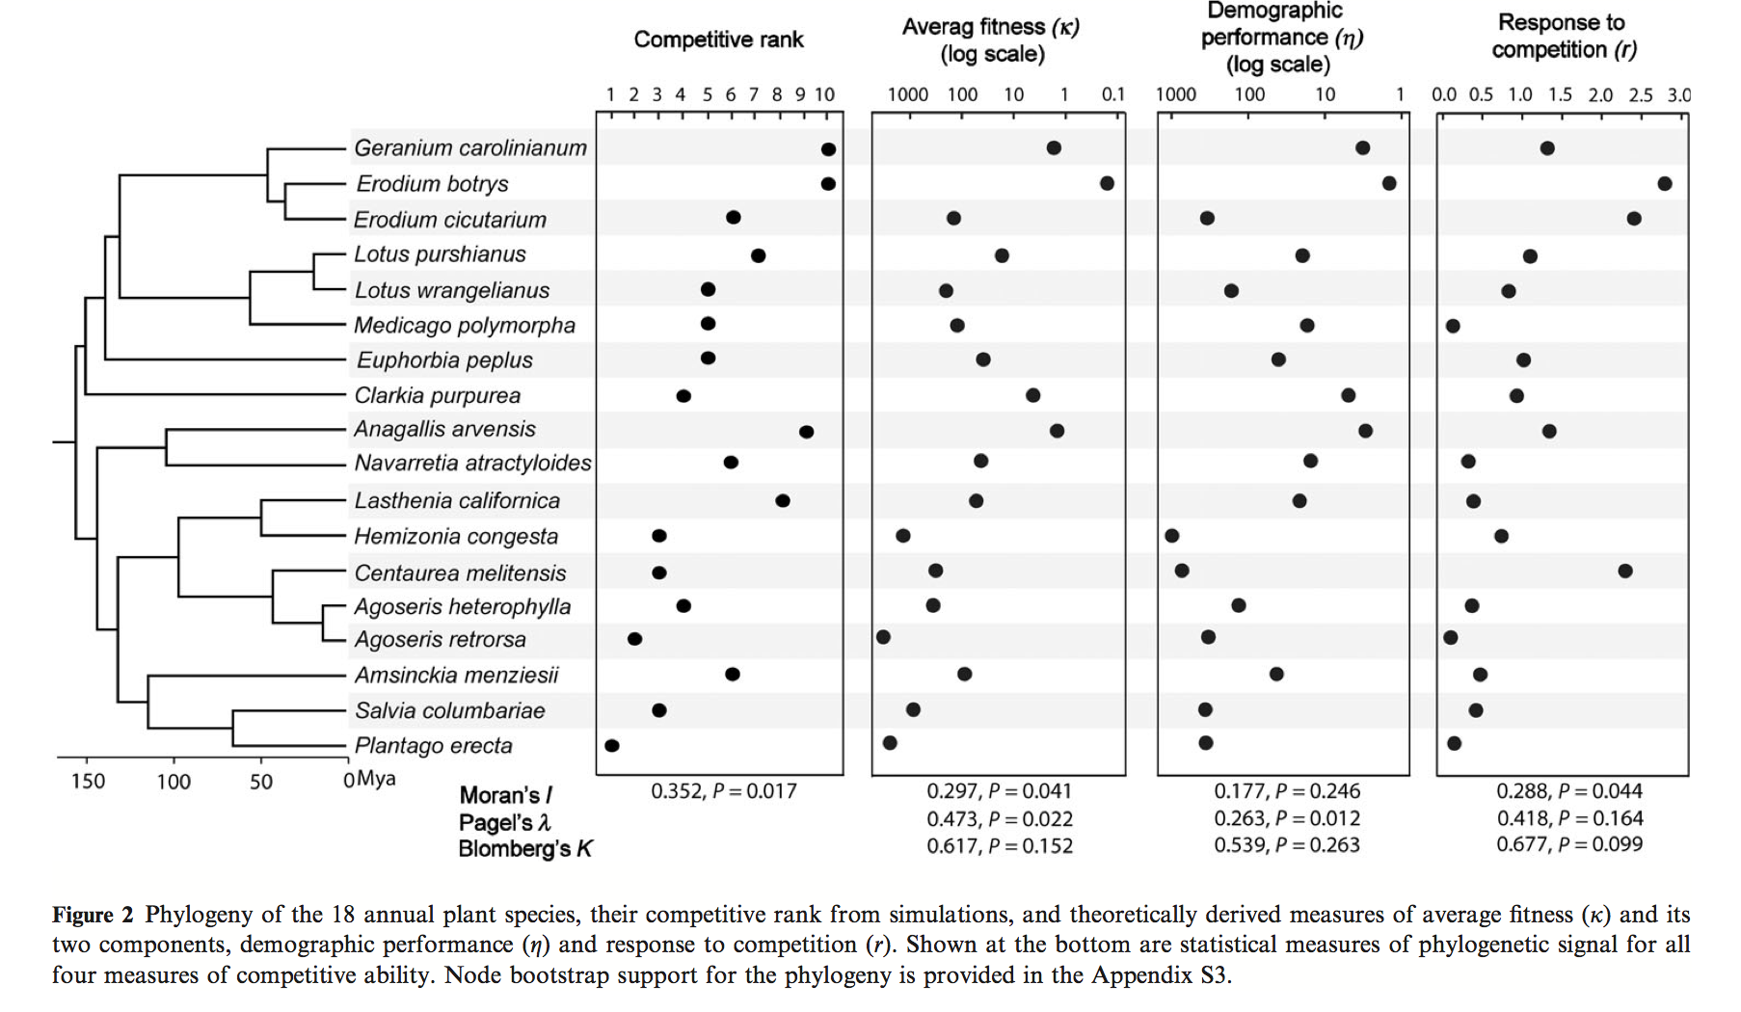
Godoy et al. 2014

Slide 17
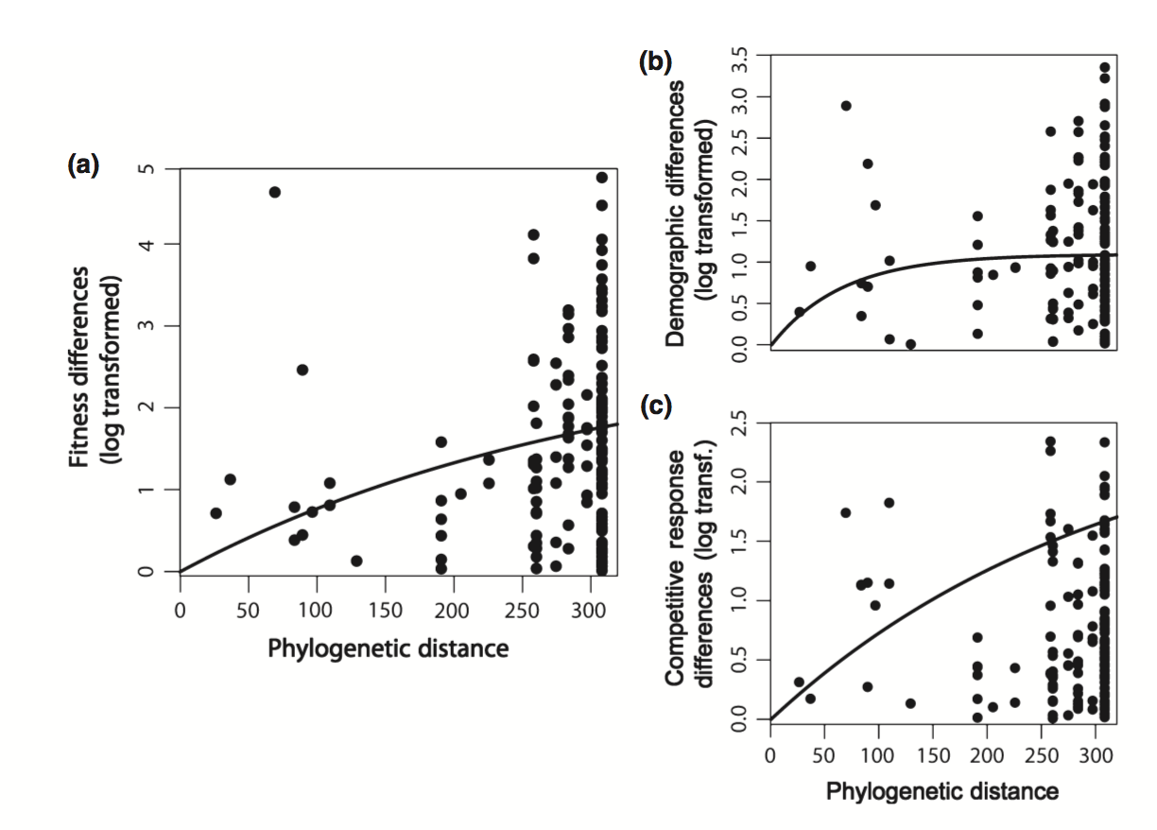
Godoy et al. 2014

Slide 18
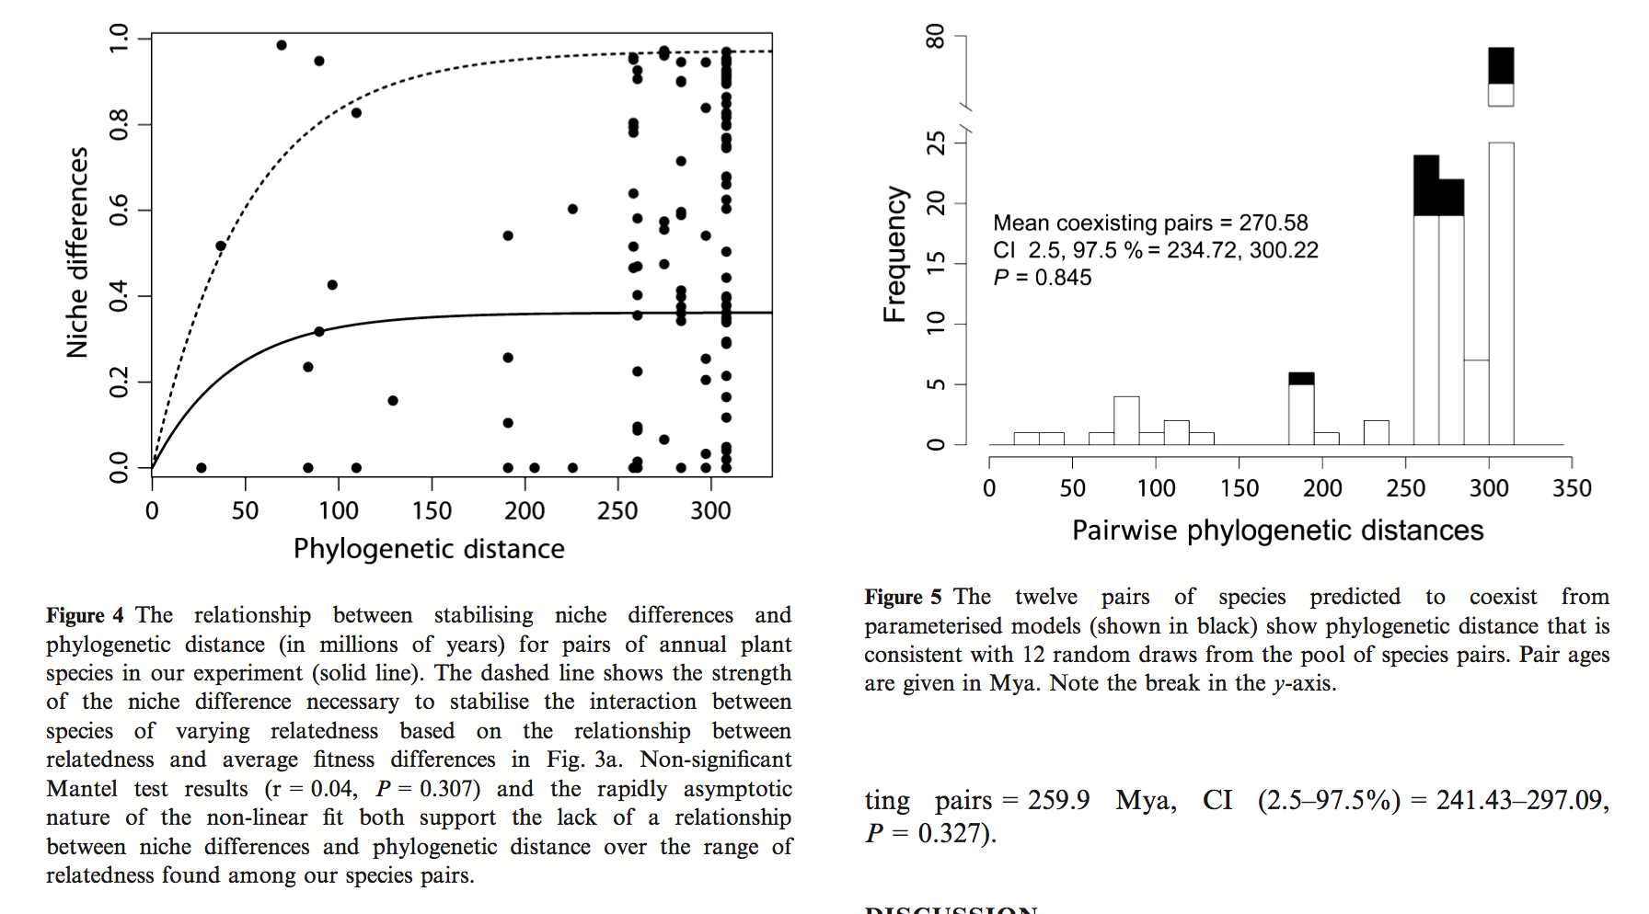
Godoy et al. 2014

Slide 19
Godoy et al. 2014

Slide 20
Debate: in a small group defend or challenge this assertion:
“The presence of a phylogenetic signal, where patterns of interactions between species can be partly explained by phylogenetic relatedness, would suggest that network patterns are partially dependent on past evolutionary history, and so cannot be exclusively explained by current ecological processes” (Rezende et al. 2007)

