Slide 1
Statistics flavors
Descriptive
Inferential
Non-parametric / Monte Carlo
Parametric
Model estimation (sometimes used for inference)
Maximum likelihood
Bayesian

Slide 2
What is an average?
X=(140,150,160,170,180)
mean = sum(X)/N
mean = that value X* such that sum(X-X*) = 0
mean = that value X* such that sum(X-X*)^2 is minimized

Slide 3
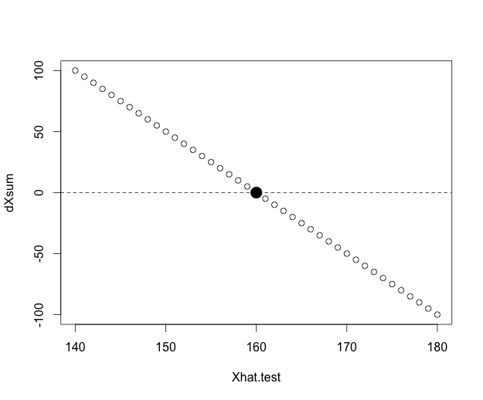

Slide 4
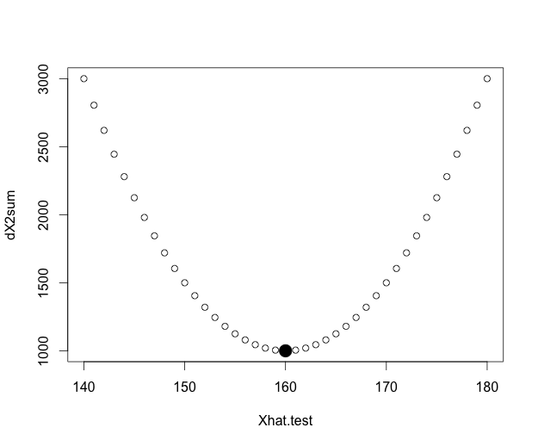

Slide 5
Descriptive vs. inferential statistics
Are the five students shorter (on average) than the average Berkeley student?
Our 5 have a mean height of 160 cm
Let’s say that the average height of Berkeley students is 180 cm
Is this group of people shorter than the average? (Yes, No, Not enough information given)

Slide 6
Inferential statistics
Rephrase our question: are the five students shorter than would be expected for a random sample drawn from the student population?
We can think of the random sample being drawn from 1) all actual students or 2) all theoretically possible students, i.e. the general properties of the population of people who could be students at Berkeley

Slide 7
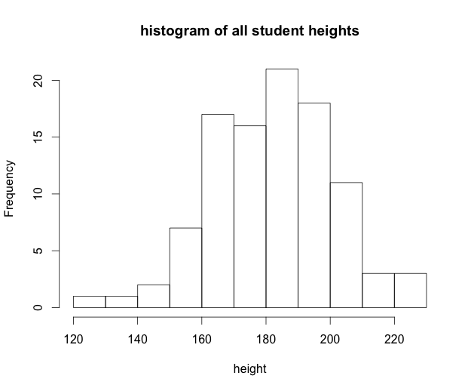
(1000 actual students)

Slide 8
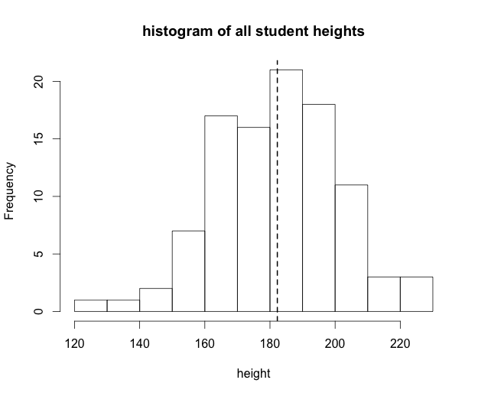
mean = 182.3

Slide 9
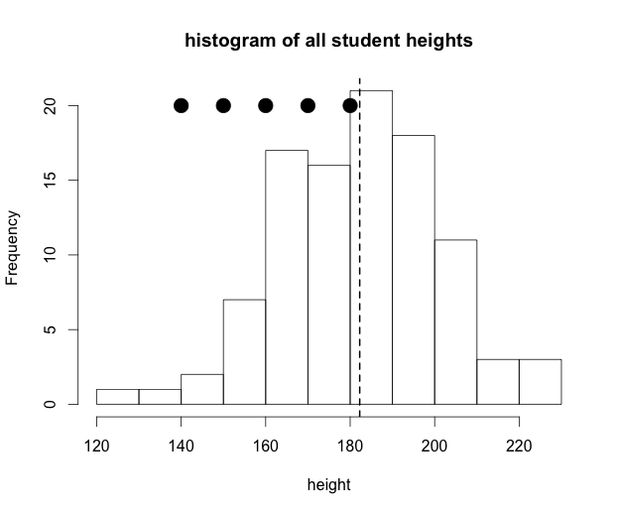

Slide 10
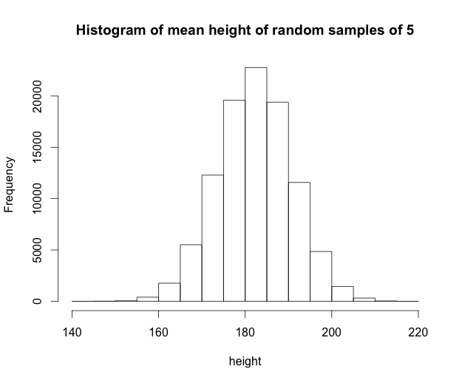
100000 random samples

Slide 11
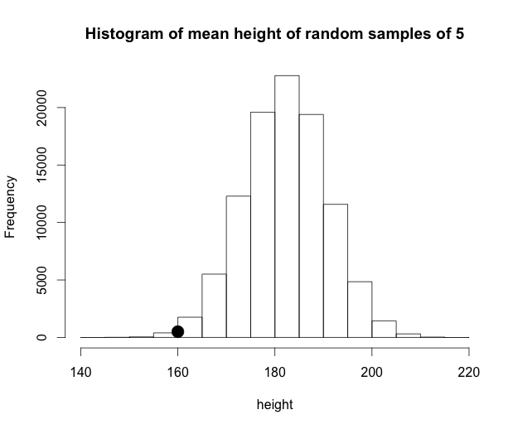
100000 random samples

Slide 12
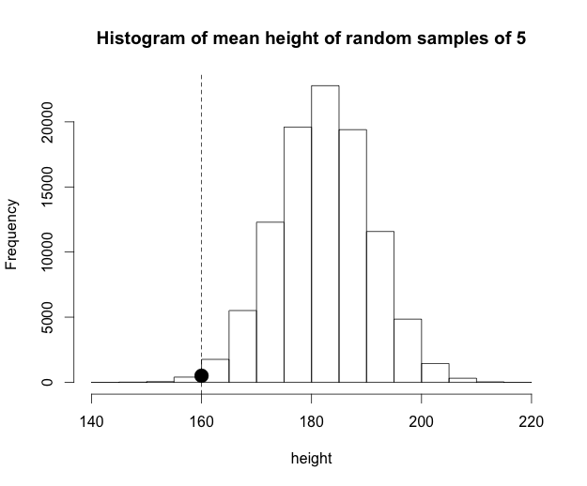
100000 random samples
454 are less than or equal to 160

Slide 13
What is the conclusion? What was the question?
Initial question: are the five students shorter than would be expected for a random sample drawn from the student population?
Revised question: Can we reject the null hypothesis that these 5 students represent a random sample from the general population?
Alternative hypothesis 1: students are non-random sample (2-tailed)
Alternative hypothesis 2: students are non-random and shorter than average (1-tailed)

Slide 14

100000 random samples
454 are less than or equal to 160
408 are greater than or equal to 204.5
NON-PARAMETRIC TEST

Slide 15
Conclusion
2-tailed: The probability of drawing a random sample of 5 with a mean height that is as – or more – different from the general population of 100 students, relative to our actual sample with mean = 160: (454+408)/100000 = 0.00862
1-tailed: The probability of drawing this random sample that is as – or more – different from the general population AND is smaller than the mean is 454/100000 = 0.00454
You can only test a 1-tailed hypothesis is you are willing to ignore the alternative possibility – if you had started with the hypothesis that this group would be larger than expected, you cannot then conclude from this sample that they are actually smaller

Slide 16
(1000 actual students)
mean = 182.3
sd = 19.5

Slide 17
What is the standard deviation
sd = sum(X-X*)^2
sum of squared residuals
it’s the value we minimized to find the mean!

Slide 18
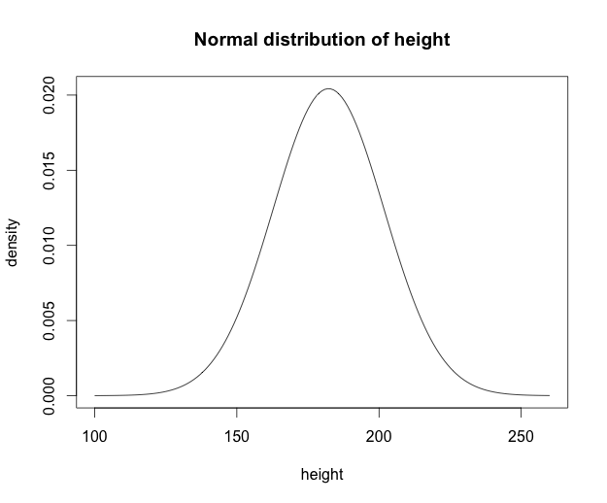
Theoretical distribution (i.e. normal distribution) of height for an infinite population of students with mean = 182.3 and sd =19.5

Slide 19
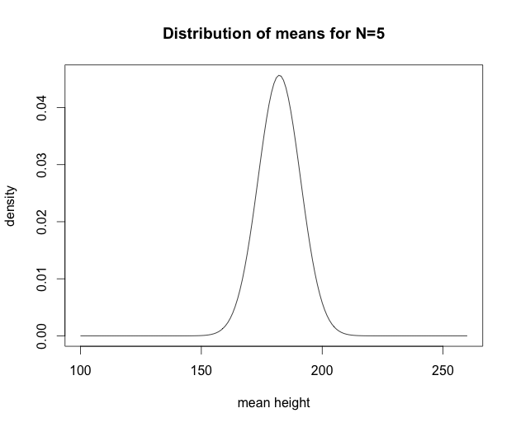
Standard deviation of the distribution of means for samples with N=5 drawn from the overall population: this is called the standard error of the mean
SE = SD/sqrt(N)

Slide 20
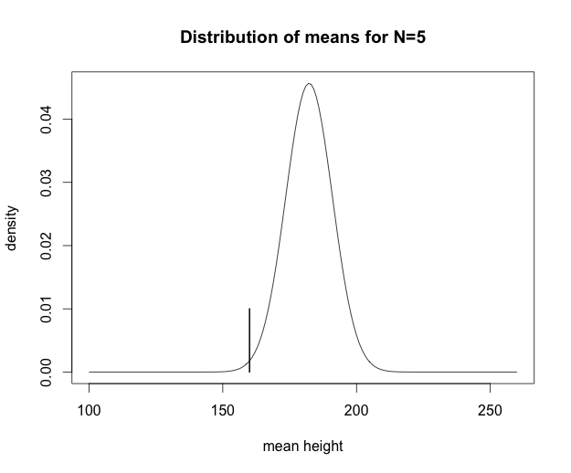
Here is our observed mean of 160 for our sample of 5 students

Slide 21
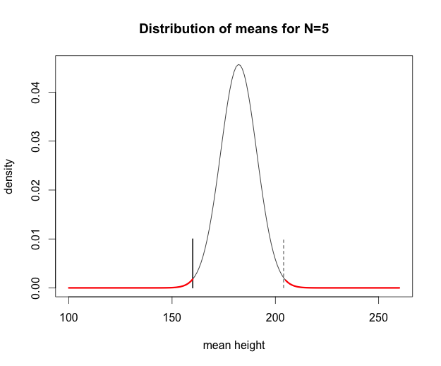
The probability that these 5 students represent a random sample from a population with mean = 182.3 and sd = 19.5 is:
1-tail: p <= 0.00541
2-tail: p <= 0.01082
area under lower tail = 0.005411....
PARAMETRIC TEST

Slide 22
100000 random samples
454 are less than or equal to 160
408 are greater than or equal to 204.5
NON-PARAMETRIC TEST

Slide 23
Is this result significant?
We have decided as a sociological convention that we don’t want to accept random patterns as evidence that something is actually going on more than 5% of the time!

Slide 24
Statistics flavors
Descriptive
Inferential
Non-parametric / Monte Carlo
Parametric
Model estimation (sometimes used for inference)
Maximum likelihood
Bayesian

Slide 25
Parametric vs. likelihood
Parametric: What the data aren’t – rejecting null hypotheses
Likelihood: What the data are – what is the most likely model that these data represent

Slide 26
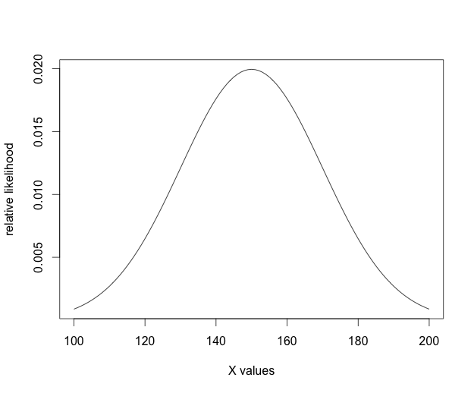
The relative likelihood of values drawn from a normal distribution with mean = 150 and sd = 20
(i.e., the density function of the normal distribution)

Slide 27
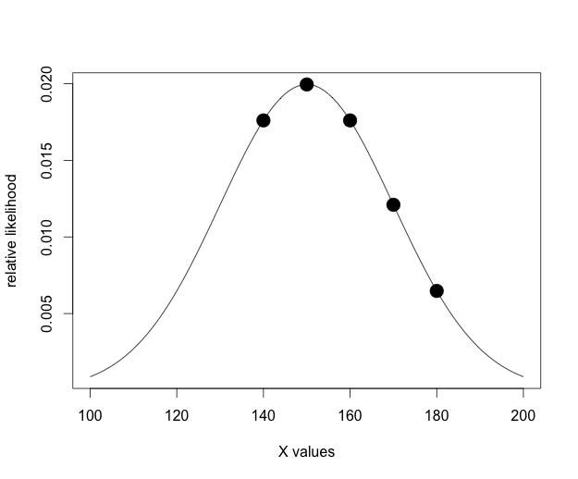
The relative likelihood of values drawn from a normal distribution with mean = 150 and sd = 20
(i.e., the density function of the normal distribution)
Relative likelihoods of our five observations

Slide 28
Calculating likelihoods
What is the overall likelihood of a model with mean = 150 and sd = 20 based on our 5 observations?
The joint probability of independent events is the product of their independent probabilities
P = π(p_{i})
The log of a product = the sum of the log:
log(xy) = log(x) + log(y)
log(P) = π(p_{i}) = sum(log(p_{i}))

Slide 29
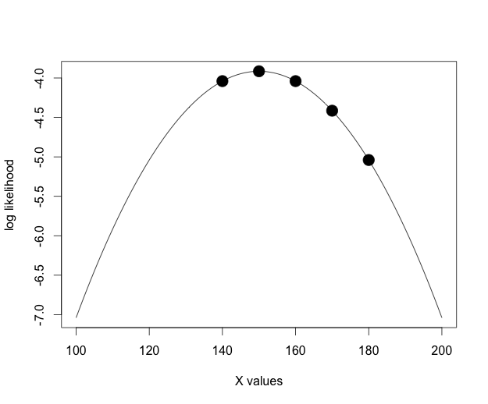
Log likelihood of mean = 150 and sd = 20 based on our 5 observations = -21.44

Slide 30
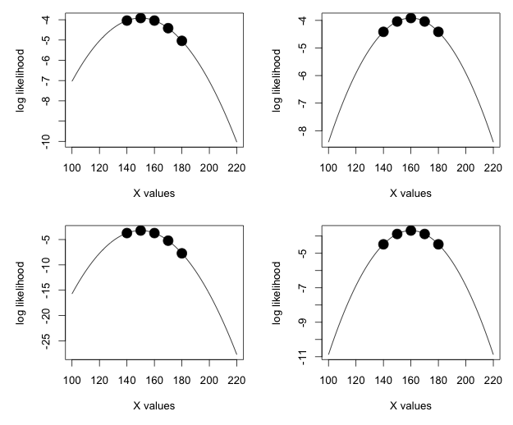
m = 150
sd = 20
L = -21.4
m = 160
sd = 20
L = -20.8
m = 150
sd = 10
L = -23.6
m = 160
sd = 15.8
L = -20.4

Slide 31
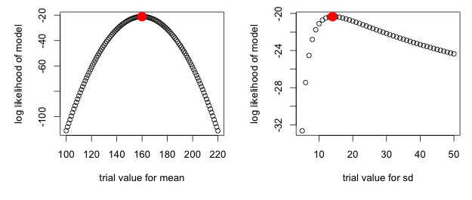
Likelihood surfaces for the mean and sd
Assume sd = 10
Assume mean = 160

Slide 32
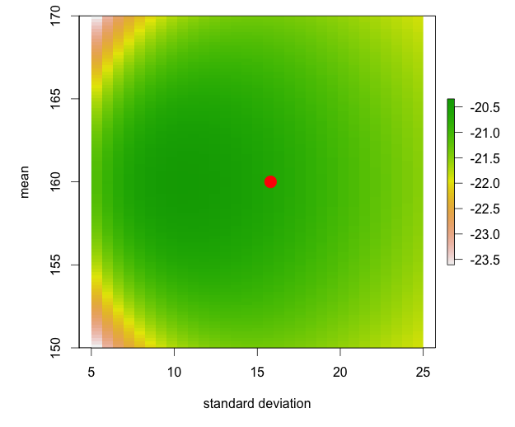
max likelihood for the mean and sd of X

Slide 33
What is Bayesian stats all about?
A philosophy
we have prior knowledge of systems, and our prior beliefs should (and do) inform how we interpret data
An efficient algorithm for complex likelihood problems
Gibbs samplers, MCMC searches

Slide 34
What is R?
R is a system for statistical computation and graphics.
R: initially written by Ross Ihaka and Robert Gentleman at Dep. of Statistics of U of Auckland, New Zealand during 1990s.
Since 1997: international “R-core” team of ca. 15 people with access to common CVS archive.
From Wolfgang Huber – An introduction to R

Slide 35
What is R?
GNU General Public License (GPL)
can be used by anyone for any purpose
contagious
not platform specific!
Open Source
quality control!
efficient bug tracking and fixing system supported by the user community
From Wolfgang Huber – An introduction to R

Slide 36
“Data Entropy” Michener et al. 1997, Ecological Monographs
Time of publication
Specific details
General details
Information content
Retirement or career change
Accident
Death
Time
Notes:
Do everything possible to retain maximum information content, starting with organization prior to data collection. One of the great things about the DGS is that students will learn very quickly how inefficient it is to work with old data that has been treated in the ways that scientists traditionally treat data. And they will learn ways to be more efficient as they move forward in their careers.

Slide 37
Collaboration and data sharing
Personal data management problems are magnified in collaboration
Data organization – standardize
Data documentation – standardize metadata
Data analysis - document
Data & analysis preservation - protect

Slide 38
Why use R?
Analysis automation: code your analyses once and rerun as your data increases
Analysis repeatability: provide R script with data and anyone can run through and repeat the analyses

Slide 39
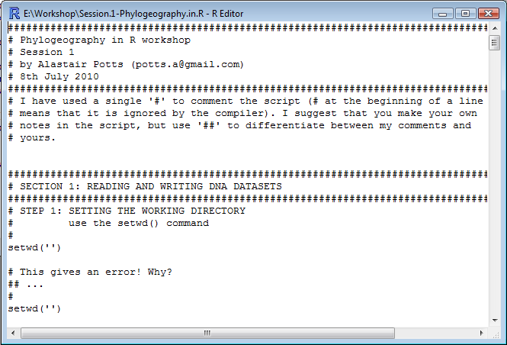
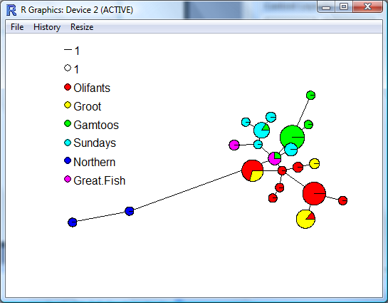
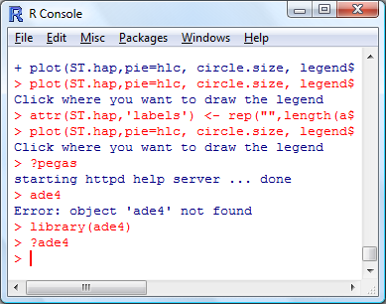

Code in R-Editor (or Tinn-R/notepad or from your head)
Graphics window
R console
Files
Output
R console

Slide 40
Compare this method to:
### Simple Linear Regression - 0+ age Trout in Hoh River, WA against Temp Celsius
### Load data
HohTrout<-read.csv("Hoh_Trout0_Temp.csv")
### See full metadata in Rosenberger, E.E., S.L. Katz, J. McMillan, G. Pess., and
S.E. Hampton. In prep. Hoh River trout habitat associations.
### http://knb.ecoinformatics.org/knb/style/skins/nceas/
### Look at the data
HohTrout
plot(TROUT ~ TEMPC, data=HohTrout)
### Log Transform the independent variable (x+1) - this method for transform
creates a new column in the data frame
HohTrout$LNtrout<-log(HohTrout$TROUT+1)
### Plot the log-transformed y against x
### First I'll ask R to open new windows for subsequent graphs with the windows command
windows()
plot(LNtrout ~ TEMPC, data=HohTrout)
### Regression of log trout abundance on log temperature
mod.r <- lm(LNtrout ~ TEMPC, data=HohTrout)
### add a regression line to the plot.
abline(mod.r)
### Check out the residuals in a new plot
layout(matrix(1:4, nr=2))
windows()
plot(mod.r, which=1)
### Check out statistics for the regression
summary.lm(mod.r)
Copy and paste from Excel
Graph in SigmaPlot
Log-transform in Excel
Copy and paste new file
Graph in SigmaPlot
Analyze in Systat
Graph in SigmaPlot
Notes:
Script your data explorations, analyses and presentations

Slide 41
The benefits of R are:
• R is free. R is open-source and runs on UNIX, Windows and Macintosh.
• R has an excellent built-in help system.
• R has excellent graphing capabilities, and with experience one can produce publication quality figures.
• R’s language has a powerful syntax with many built-in statistical functions.
• The language is easy to extend with user-written functions. Numerous functions and libraries are being written and introduced each year, including many focused on ecology and evolution.
• R is a computer programming language. For programmers it will feel more familiar than others and for new computer users, the next leap to programming will not be so large.
• Analyses in R are written in computer scripts which can be saved and easily rerun. This greatly simplifies: reanalysis of updated data; running the same analyses on new data sets; documenting and sharing workflows

Slide 42
What are disadvantages of R?
• It has a steep initial learning curve.
• It has a limited graphical interface (S-Plus has a good one).
• It has a steep initial learning curve.
• There is no commercial support. (Although one can argue the international mailing list is even better)
• Did I mention that it has a steep initial learning curve?
• The command language is a programming language so students must learn to appreciate syntax issues, and must learn and remember many functions and commands.

Slide 43
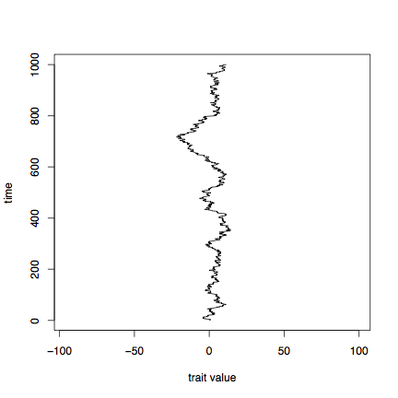
Brownian motion - 1000 steps from N(0,1)
time
trait value

Slide 44
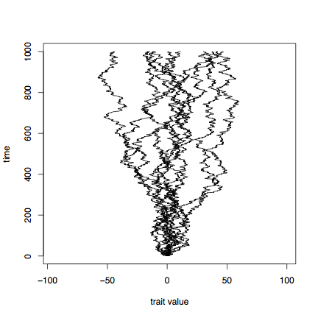
Brownian motion - 1000 steps from N(0,1)
time
trait value

Slide 45
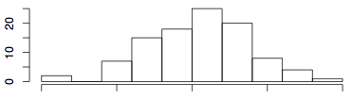
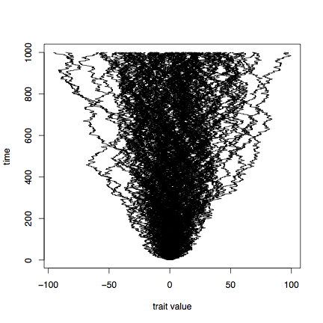
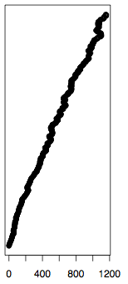
Brownian motion - 1000 steps from N(0,1)
time
trait value
trait variance

Slide 46
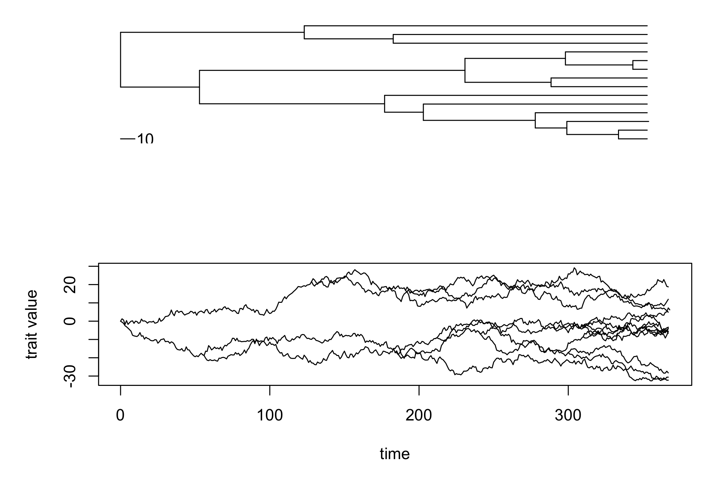
Brownian motion on a phylogeny
Traits of related species will be similar in proportion to the fraction of their history that’s shared

Slide 47
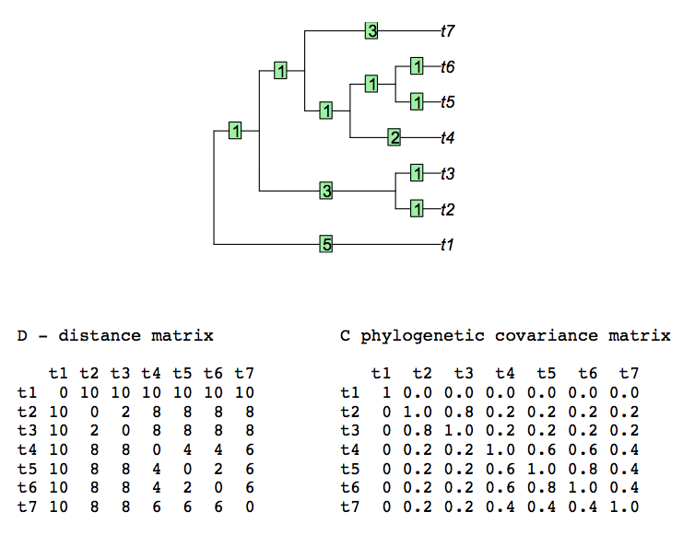
cophenetic.phylo(): D = phyletic distances:
vcv() = variance-covariance matrix =
1 – D/max(D)

Slide 48
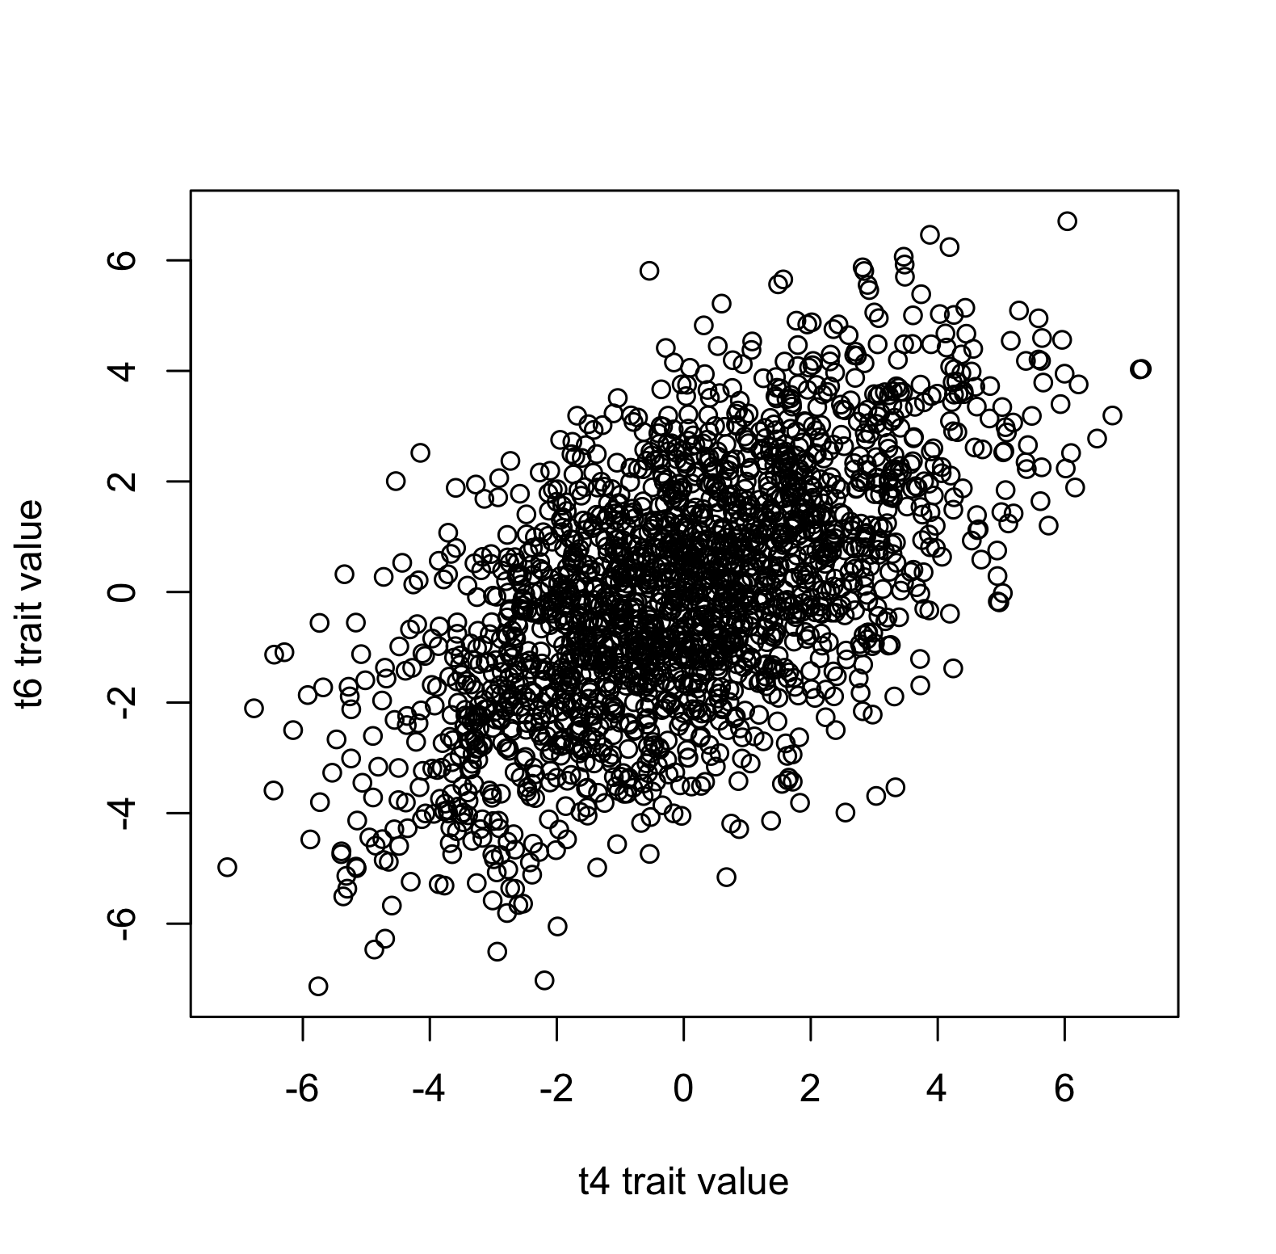
2000 reps, brownian motion t4 vs. t6 values
trait values have an expected covariance, also called ‘non-independence of species’

