Slide 1
Estimating the Number of Data Clusters via the Gap Statistic
Paper by:
Robert Tibshirani, Guenther Walther and Trevor Hastie
J.R. Statist. Soc. B (2001), 63, pp. 411--423
BIOSTAT M278, Winter 2004
Presented by Andy M. Yip
February 19, 2004

Slide 2
Part I:
General Discussion on Number of Clusters

Slide 3
Cluster Analysis
Goal: partition the observations {x_{i}} so that
  C(i)=C(j) if x_{i} and x_{j} are “similar”
  C(i)≠C(j) if x_{i} and x_{j} are “dissimilar”
A natural question: how many clusters?
  Input parameter to some clustering algorithms
  Validate the number of clusters suggested by a clustering algorithm
  Conform with domain knowledge?

Slide 4
What’s a Cluster?
No rigorous definition
Subjective
Scale/Resolution dependent (e.g. hierarchy)
A reasonable answer seems to be:
application dependent
(domain knowledge required)

Slide 5
What do we want?
An index that tells us: Consistency/Uniformity
more likely to be 2 than 3
more likely to be 36 than 11
more likely to be 2 than 36?
(depends, what if each circle represents 1000 objects?)

Slide 6
What do we want?
An index that tells us: Separability
increasing confidence to be 2

Slide 7
What do we want?
An index that tells us: Separability
increasing confidence to be 2

Slide 8
What do we want?
An index that tells us: Separability
increasing confidence to be 2

Slide 9
What do we want?
An index that tells us: Separability
increasing confidence to be 2

Slide 10
What do we want?
An index that tells us: Separability
increasing confidence to be 2

Slide 11
Do we want?
An index that is
  independent of cluster “volume”?
  independent of cluster size?
  independent of cluster shape?
  sensitive to outliers?
  etc…
Domain Knowledge!

Slide 12
Part II:
The Gap Statistic

Slide 13
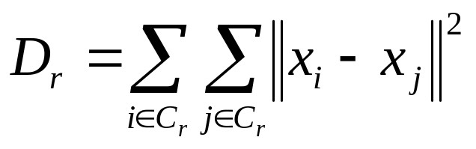
Within-Cluster Sum of Squares
x_{j}
x_{i}

Slide 14
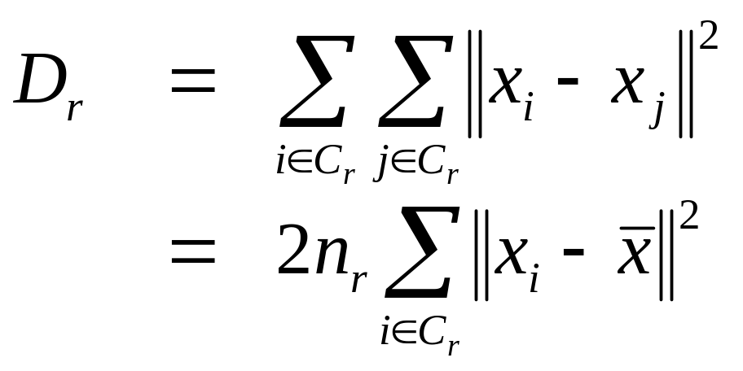
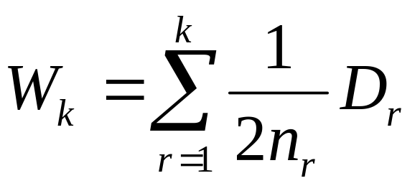
Within-Cluster Sum of Squares
Measure of compactness of clusters

Slide 15
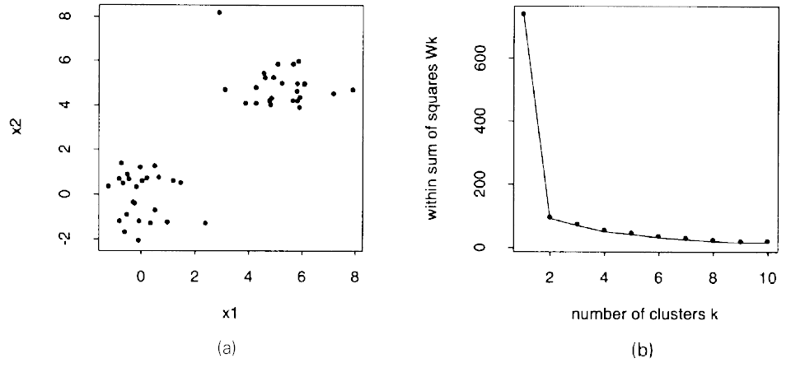
Using W_{k} to determine # clusters
Idea of L-Curve Method: use the k corresponding to the “elbow”
(the most significant increase in goodness-of-fit)

Slide 16
Gap Statistic
Problem w/ using the L-Curve method:
  no reference clustering to compare
  the differences W_{k} − W_{k−1}’s are not normalized for comparison
Gap Statistic:
  normalize the curve log W_{k} v.s. k
  null hypothesis: reference distribution
  Gap(k) := E*(log W_{k}) − log W_{k}
  Find the k that maximizes Gap(k) (within some tolerance)

Slide 17
Choosing the Reference Distribution
A single-component is modelled by a log-concave distribution (strong unimodality (Ibragimov’s theorem))
  f(x) = e^{ψ(x)} where ψ(x) is concave
Counting # modes in a unimodal distribution doesn’t work --- impossible to set C.I. for # modes → need strong unimodality

Slide 18
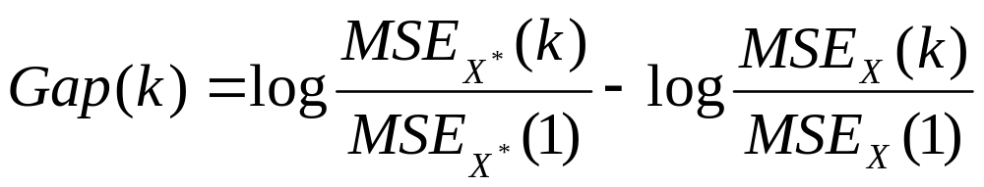
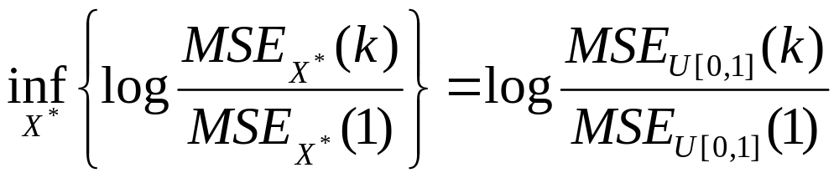
Choosing the Reference Distribution
Insights from the k-means algorithm:
Note that Gap(1) = 0
Find X* (log-concave) that corresponds to no cluster structure (k=1)
Solution in 1-D:

Slide 19
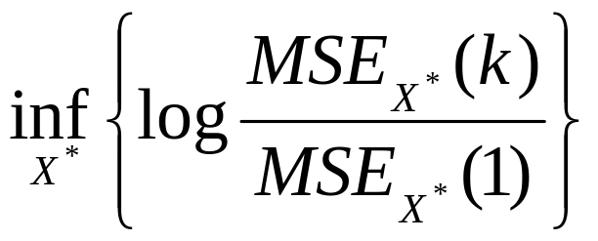
However, in higher dimensional cases, no log-concave distribution solves
The authors suggest to mimic the 1-D case and use a uniform distribution as reference in higher dimensional cases

Slide 20
Two Types of Uniform Distributions
Align with feature axes (data-geometry independent)
Observations
Bounding Box (aligned with feature axes)
Monte Carlo Simulations

Slide 21
Two Types of Uniform Distributions
Align with principle axes (data-geometry dependent)
Observations
Bounding Box (aligned with principle axes)
Monte Carlo Simulations

Slide 22
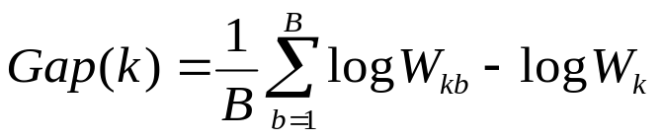
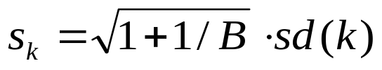

Computation of the Gap Statistic
for l = 1 to B
  Compute Monte Carlo sample X_{1b}, X_{2b}, …, X_{nb} (n is # obs.)
for k = 1 to K
Cluster the observations into k groups and compute log W_{k}
for l = 1 to B
  Cluster the M.C. sample into k groups and compute log W_{kb}
  Compute
  Compute sd(k), the s.d. of {log W_{kb}}_{l=1,…,B}
  Set the total s.e.
Find the smallest k such that
Error-tolerant normalized elbow!

Slide 23
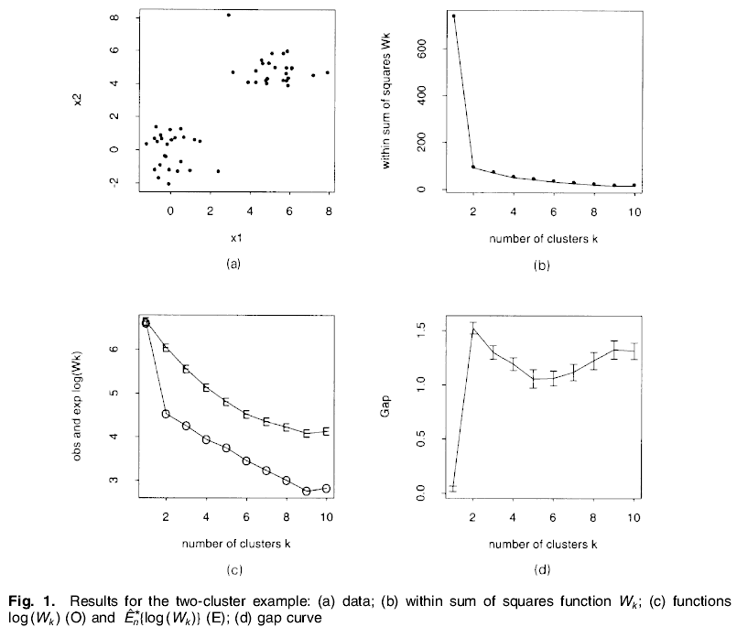
2-Cluster Example

Slide 24
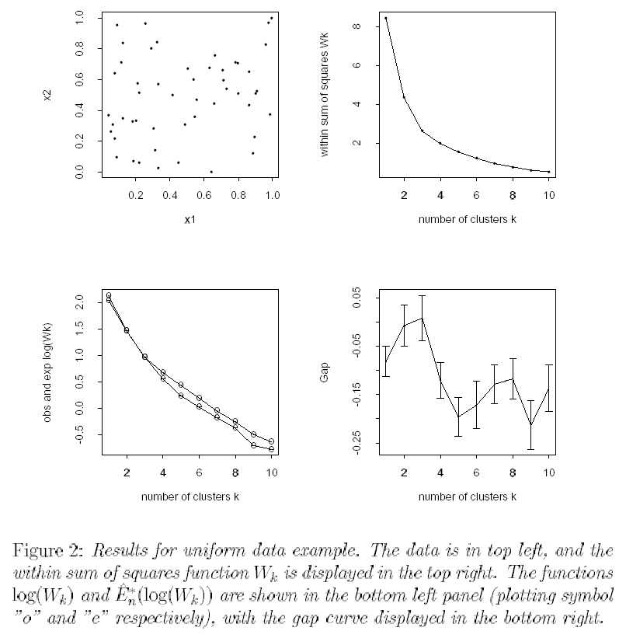
No-Cluster Example (tech. report version)

Slide 25
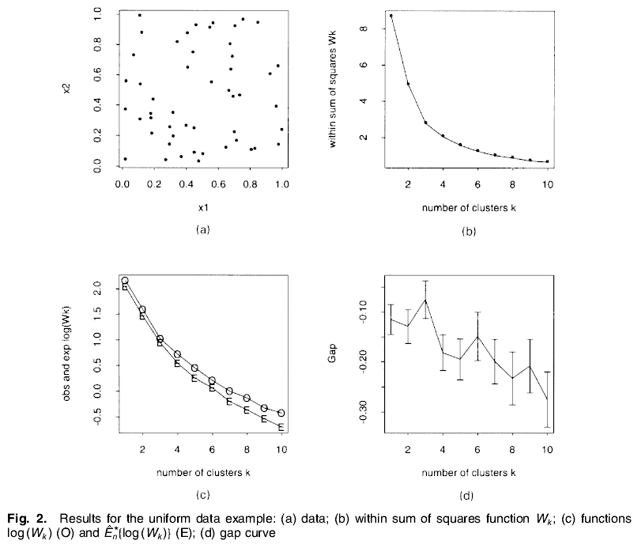
No-Cluster Example (journal version)

Slide 26
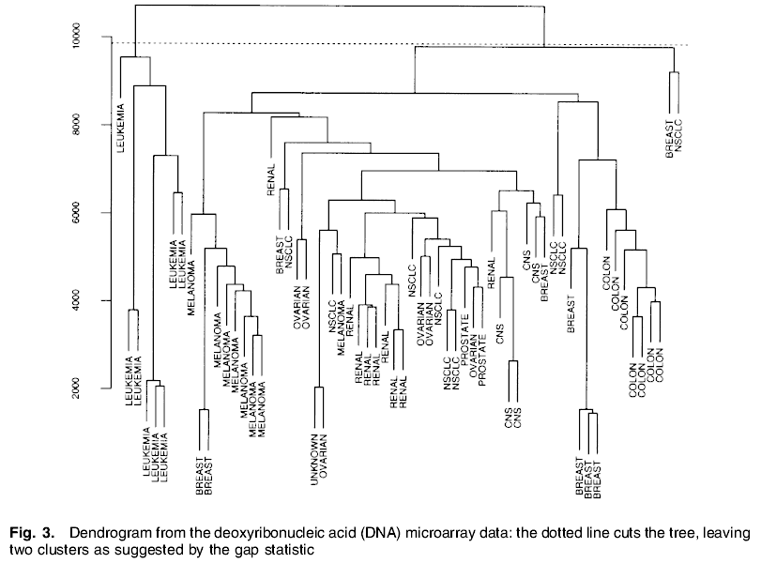
Example on DNA Microarray Data
6834 genes
64 human tumour

Slide 27
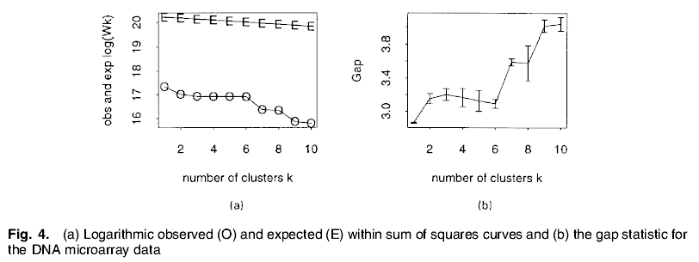
The Gap curve raises at k = 2 and 6

Slide 28
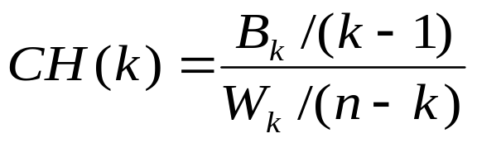
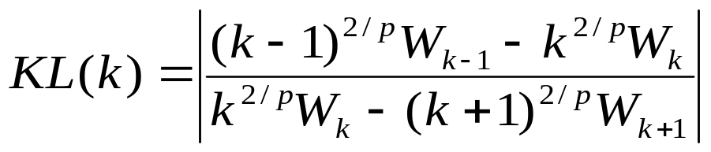
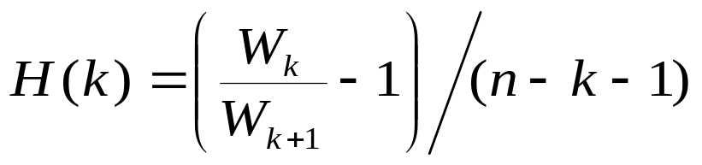
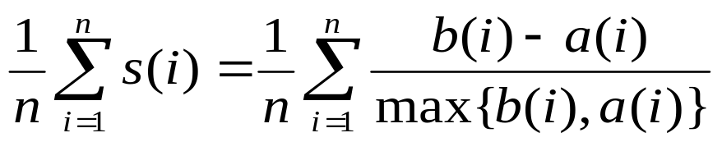
Other Approaches
Calinski and Harabasz ‘74
Krzanowski and Lai ’85
Hartigan ’75
Kaufman and Rousseeuw ’90 (silhouette)

Slide 29
Simulations (50x)
1 cluster: 200 points in 10-D, uniformly distributed
3 clusters: each with 25 or 50 points in 2-D, normally distributed, w/ centers (0,0), (0,5) and (5,-3)
4 clusters: each with 25 or 50 points in 3-D, normally distributed, w/ centers randomly chosen from N(0,5I) (simulation w/ clusters having min distance less than 1.0 was discarded.)
4 clusters: each w/ 25 or 50 points in 10-D, normally distributed, w/ centers randomly chosen from N(0,1.9I) (simulation w/ clusters having min distance less than 1.0 was discarded.)
2 clusters: each cluster contains 100 points in 3-D, elongated shape, well-separated

Slide 30
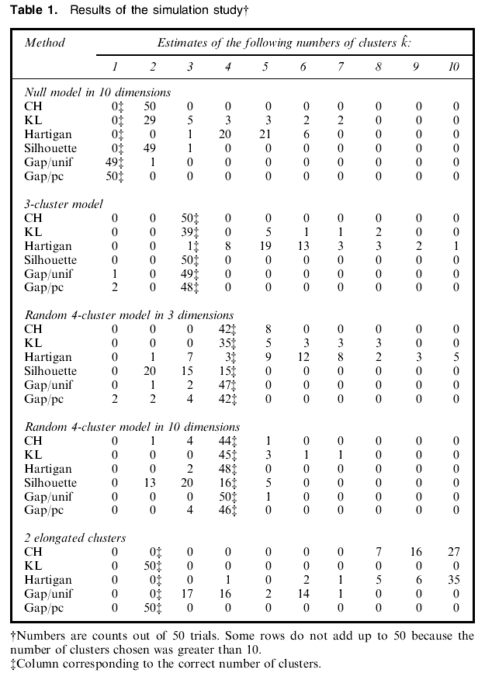

Slide 31
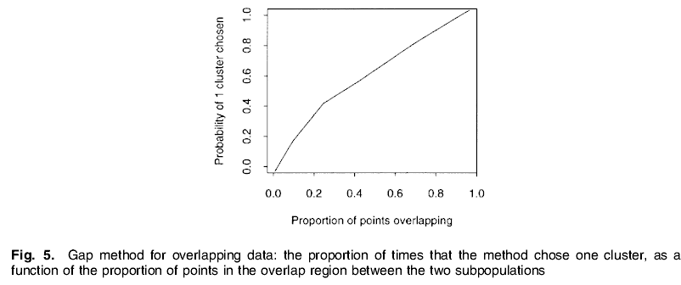
Overlapping Classes
50 observations from each of two bivariate normal populations with means (0,0) and (Δ,0), and covariance I.
= 10 value in [0, 5]
10 simulations for each Δ

Slide 32
Conclusions
Gap outperforms existing indices by normalizing against the 1-cluster null hypothesis
Gap is simple to use
No study on data sets having hierarchical structures is given
Choice of reference distribution in high-D cases?
Clustering algorithm dependent?

