Slide 1
Fourier Neural Operator (FNO) for Parametric Partial Differential Equations for Tumor Growth Prediction
ECE 882: Digital Signal Processing II
Walia Farzana
December 2024
Notes:
FNO solves governing equations or physics -based systems using only data, for example: initial condition of tumor and final state of tumor growth using FNO.

Slide 2
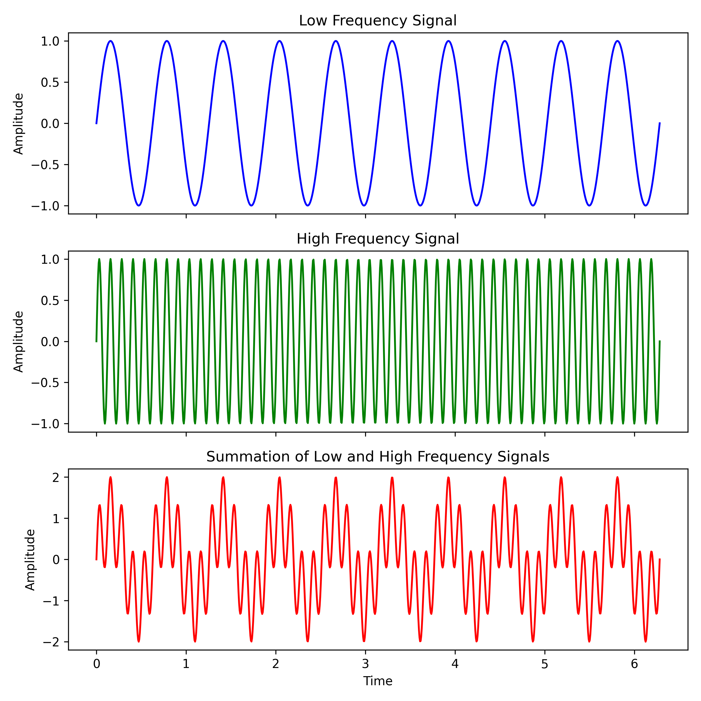
I What is Fourier Transformationave Data. Now what?
Fourier transform is a mathematical technique used to transform a function of time or space to its frequency domain representation.
The Fourier transform decomposes a function into its constituent frequencies, revealing the frequency components that make up the original signal.
The inverse Fourier transform converts the frequency domain to the original spatial domain
Notes:
Complex wave divided into smaller waves (1D example)
Low frequency and high frequency wave (Two spikes in frequency domain)
Signal Processing, denoising
Big wave corresponds to big changes or overall dynamics of changes (tumor grow up to 6 cm which is fatal –general rule)
FNO to understand the general trend in the physical system

Slide 3
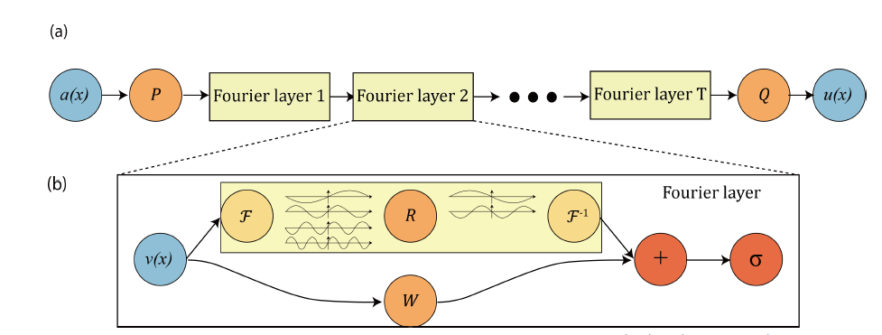
Fourier Neural Operator (FNO)
FNO is a deep learning architecture that combines neural networks with Fourier analysis techniques. It’s designed to solve partial differential equations (PDEs) efficiently, those arising in physics and engineering contexts.
Notes:
Input and a function P that will change the image to some high channels (or dimension)
Then Fourier Layers and then Decoder Q , that will decode from latent space, some kind of representation of input image.
The output is U(x)
Noisy input V(x) and fourier transform to get the signal decomposition
Then pass through the linear transformation (R) and it will cut down the high frequency component up to certain user defined threshold
Then the inverse fourier transform
Another linear transform (W) and concatenation
Then pass through the activation function

Slide 4
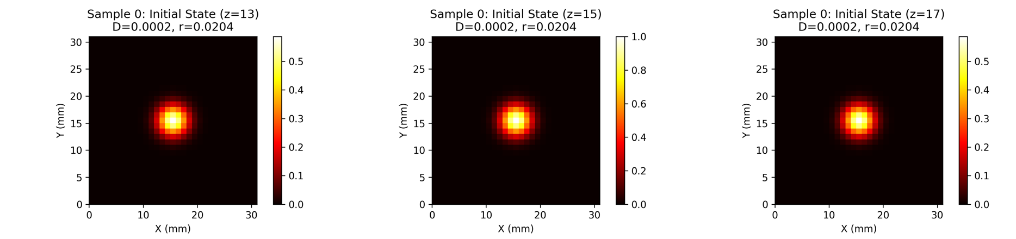
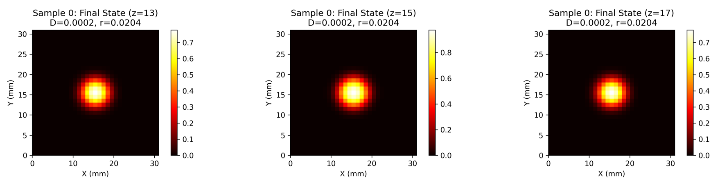
Fourier Neural Operator (FNO)
Training Data
.
.
.
.
.
Notes:
Initial condition and final state is the analytical solution of reaction-Diffusion equation of tumor growth model.

Slide 5
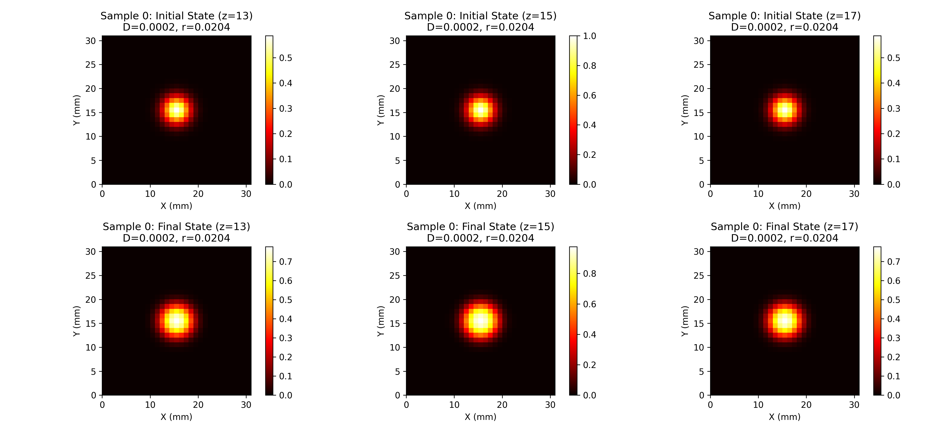
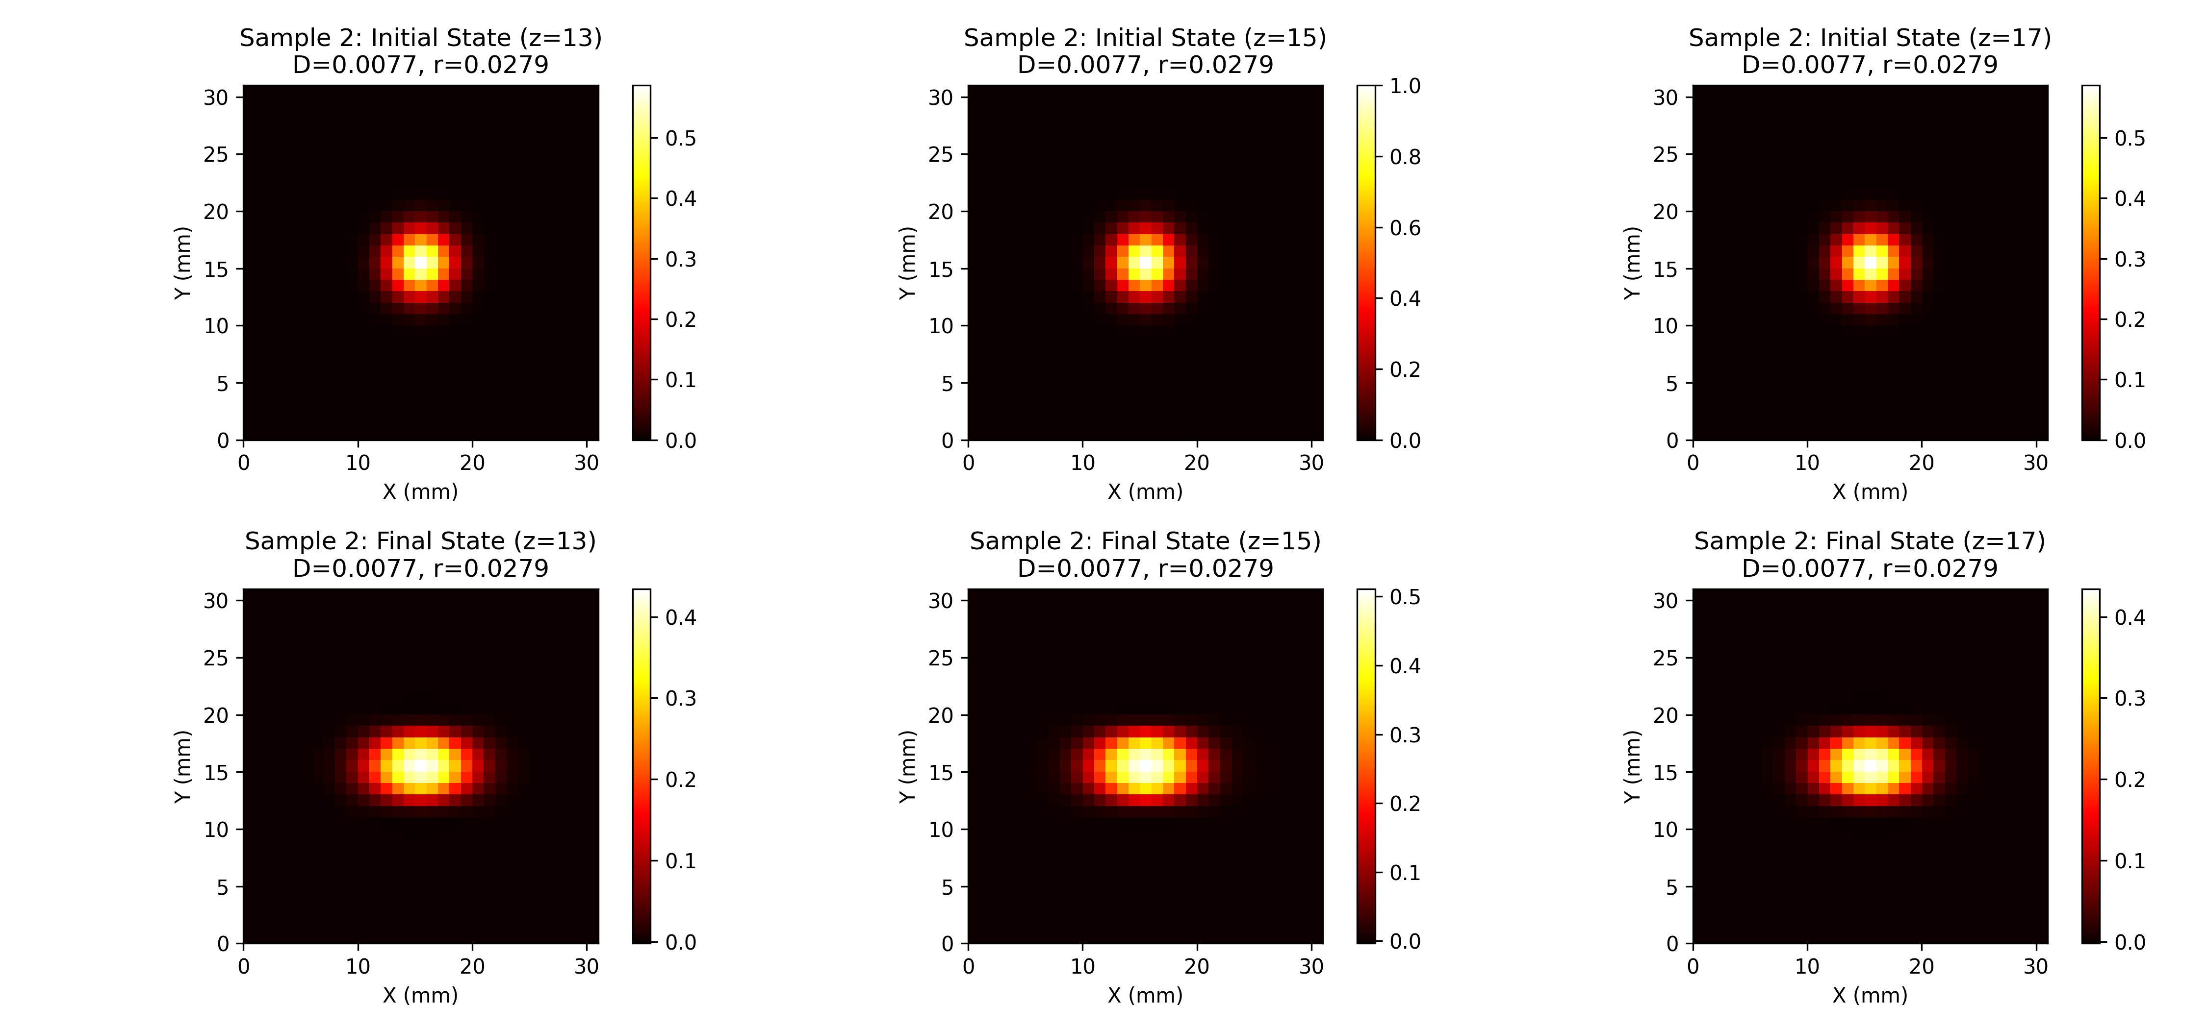
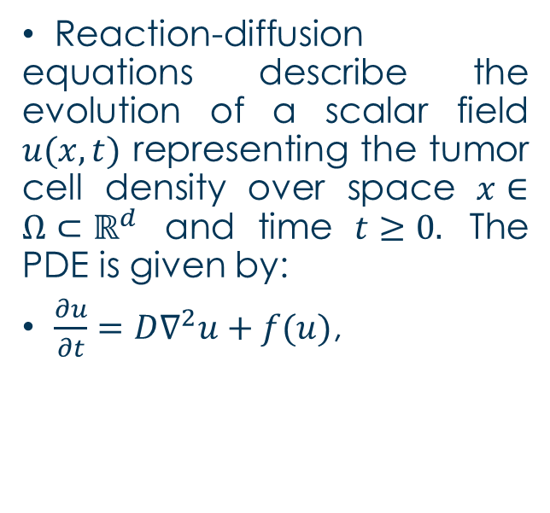
Brain Tumor Growth Simulated Data
Reaction-diffusion equations describe the evolution of a scalar field $u(x,t)$ representing the tumor cell density over space $x∈Ω⊂ℝ^{d}$ and time $t≥0.$ The PDE is given by:
$\frac{∂u}{∂t}=D∇^{2}u+f(u)$,
Notes:
where $D$ is the diffusion coefficient representing the spread of tumor cells, $∇^{2}$ denotes the Laplace operator capturing spatial diffusion, and $f(u)$ represents the reaction term, which models the proliferation of tumor cells.
Traditional methods like FDM or FEM discrete the spatial domain $Ω$ into a fine grid to solve the PDE, but this becomes computationally expensive as the resolution of the mesh increases.

Slide 6
Model Architecture and Training
Convolutional Neural Network (CNN)
Fourier Neural Operator (FNO)
Convolutional Layers: Four 3D convolutional layers with increasing channel depths (16, 32, 64, and 1) extract spatial features.
Batch Normalization: Applied after the first three convolutional layers to stabilize and accelerate training.
ReLU Activation: Introduced after each batch normalization to introduce non-linearity.
Output Layer: A final 3D convolutional layer reduces the output to a single channel, representing the scalar prediction.
Initial Fourier Layer: A 3D convolutional layer with a kernel size of 1 transforms the input into a higher-dimensional representation with a specified width or modes (32 channels).
Intermediate Fourier Layers: Additional convolutional layers are applied to the real and imaginary parts of the Fourier-transformed input to learn representations in the frequency domain.
Final Fourier Layer: A 3D convolution reduces the processed data back to a single output channel
Notes:
The training loop processes 3D data, adding a channel dimension to match the expected input size.
The model minimizes different loss function (mean square error, mean absolute error, huber loss, combined loss) to predict the final tumor state from initial conditions.
The loss is computed over batches, and gradients are backpropagated to update the model's weights
By combining the strengths of FNO3D and CNN architectures, the model effectively captures both local and global spatial dependencies in tumor growth simulations.

Slide 7
Performance Metrics Comparison
Metric | FNO Results | CNN Results
RMSE | 0.0565 | 0.0362
MAE | 0.0195 | 0.0077
R² Score | 0.5178 | 0.7911
PSNR (dB) | 25.17 | 29.04
SSIM | 0.9991 | 0.9995
Dice Similarity Coefficient | 0.3812 | 0.5962
MAPE (%) | 3.504×10^24 | 3.188×10^23
Notes:
The performance metrics used to evaluate the models include RMSE (Root Mean Squared Error), which measures the average magnitude of the errors between predicted and actual values;
MAE (Mean Absolute Error), which quantifies the average absolute difference between predictions and actual values; and
R² (R-squared), which indicates the proportion of variance in the data explained by the model.
PSNR (Peak Signal-to-Noise Ratio) assesses the quality of image reconstruction,
while SSIM (Structural Similarity Index) measures the similarity between two images.
The Dice Similarity Coefficient quantifies the overlap between predicted and actual tumor regions, and
MAPE (Mean Absolute Percentage Error) evaluates the percentage error in predictions.

Slide 8
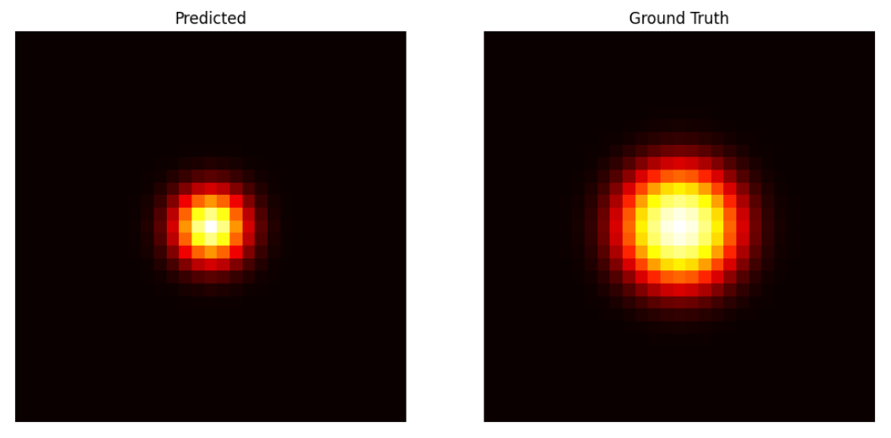
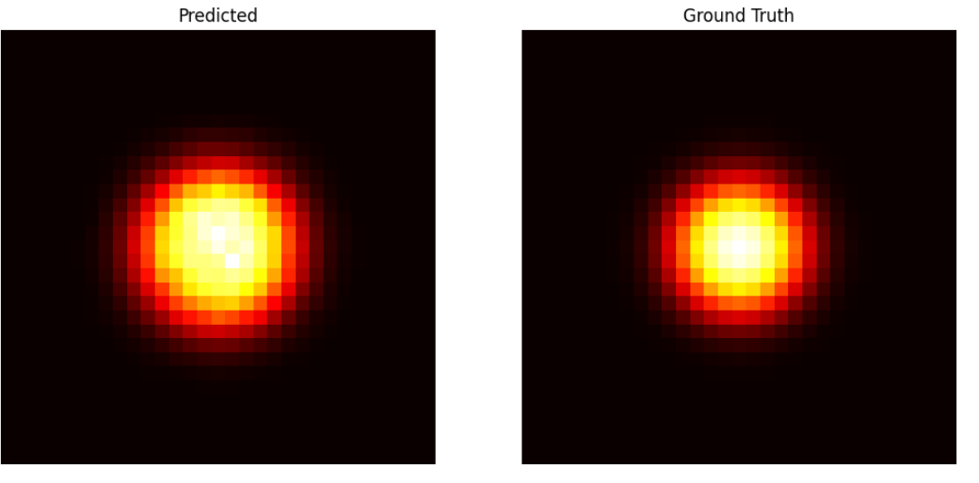
Qualitative Presentation of Prediction
FNO
CNN

Slide 9
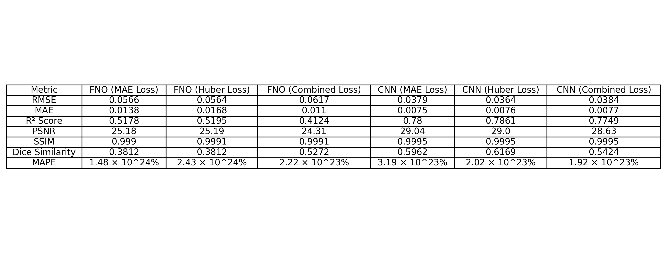
Performance with Different Loss Functions
Notes:
The combined loss function incorporates SSIM to better capture structural similarity between predicted and ground truth images, alongside Huber loss to ensure smooth training.

Slide 10
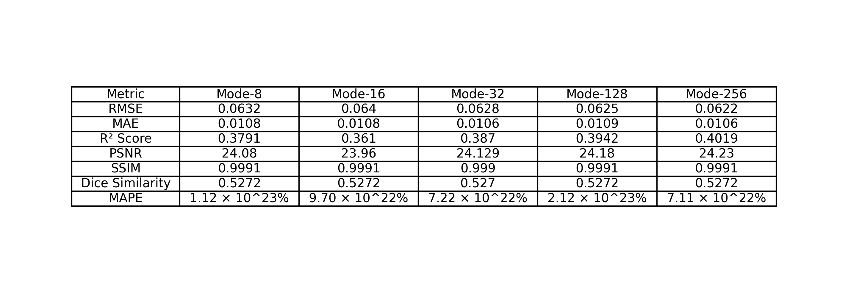
Performance Metrics for FNO with Different Mode
Notes:
In the FNO model, different modes (8, 16, 32, 128, 256) represent different configurations of the model's network, primarily indicating the number of modes (Fourier basis functions) used for the spectral representation of the input data.
The choice of modes can significantly affect the model's performance.
Generally, as the number of modes increases, the model may capture more complex features, potentially leading to better generalization and performance.

Slide 11
Takeaway Key points
The CNN model consistently outperformed the FNO model in terms of RMSE, MAE, R² score, and PSNR, particularly when optimized with various loss functions such as MSE, MAE, Huber loss, and combined loss.
CNNs demonstrated superior ability to capture localized spatial patterns and structures in medical imaging, while FNO's reliance on the Fourier transform made it less effective at handling complex, localized features.
Larger mode sizes in FNO models (e.g., 128, 256) showed slight improvements in R² score and PSNR but did not match the predictive accuracy of CNNs, emphasizing the need for fine-grained spatial feature detection in medical imaging.
The study highlights the potential of CNNs for medical image analysis and plans to explore hybrid architectures, advanced configurations, and larger datasets to enhance model performance and validate findings across diverse imaging modalities.
Notes:
Model Performance Comparison:
FNO vs. CNN Strengths:
Impact of FNO Mode Configurations

Slide 12
Thank you for your Attention!

