Slide 1
TCGAbiolinks: an R/Bioconductor package for intergrative analysis of TCGA data
CS823: Introduction to Bioinformatics
Presented By
Walia Farzana

Slide 2
The Cancer Genome Atlas(TCGA) research networks avails large collection of clinical and molecular phenotypes of 10,000 tumor patients with 33 different tumor type.
TCGA data have some bioinformatics challenges which includes data retrieval, integration of clinical data with molecular data (RNA,DNA methylation).
R/Bioconductor package called TCGAniolinks address these challenges through a guided workflow for users.
The workflow allows query, download and performance analysis.
TCGAbiolinks aids in querying, downloading, analyzing and integrating TCGA data within a single collective Bioconductor package.

Slide 3
The aim of the TCGABiolinks divided into four folds:
Facilitate data retrieval via TCGA’s DCCWS( Data Coordination Center’s Web Service)
Prepare data using appropriate pre-processing strategies
Provide opportunities to conduct standard analysis and advanced integrative analyses
Allow users to download specific version of the data and easily produce research results
TCGABiolinks functions can be grouped into three levels: Data, Analysis and Visualization.
Data handles retrieval and query of TCGA data and consists of three main functions: GDCquery, GDCdownload, GDCprepare.
TCGAanalyze comprises two type of analysis: molecular and clinical analysis. TCGAanalyze_Normalization allows to normalize mRNA transcripts and miRNA using EDASeq package.
TCGAanalyze_DEA allows users to identify differential expression or regions between two populations or conditions.

Slide 4
The visualization section allow to visualize the results generated by analysis section using heatmap, clusters, principal component analysis (PCA).
Two case studies are conducted to perform classical analysis using clinical and genomic data from the Cancer Genome Atlas (TCGA).
The following steps are followed for the two case studies:
1. Downloading the data (clinical and expression) from TCGA
2. Processing the Data (normalization) and saving it locally using table format
3. Unsupervised analysis includes differential analysis, PCA and clustering
4. Building a machine learning model(classifier) to predict cancer.
5. Perform survival analysis of molecular markers detected in previous analysis.

Slide 5
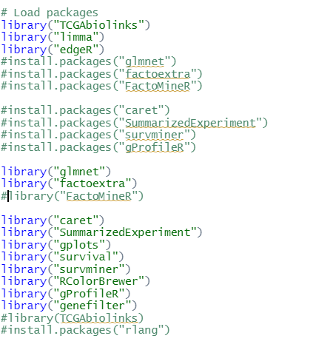
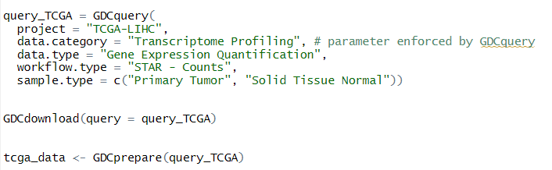
Case Study 1: Liver Hepatocellular Carcinoma (TCGA-LIHC)
2. Query, Download and Prepare Data
1.Importing the required library
TCGA data objects are specified under Bioconductor “SummarizedExperiment” class
To properly install the library and made the functions works, the guideline in the following link will assist:
https://github.com/BioinformaticsFMRP/TCGAbiolinks/issues/493

Slide 6

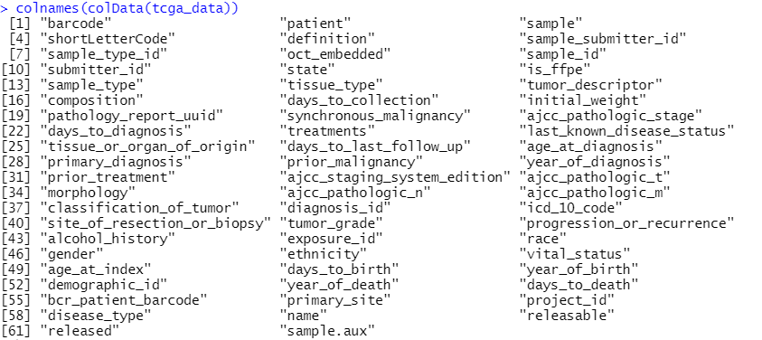
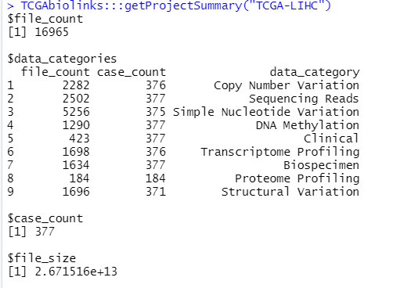
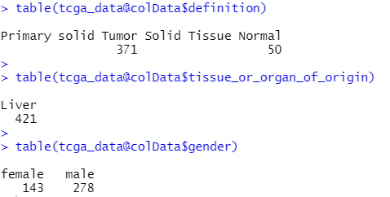
Case Study 1: Liver Hepatocellular Carcinoma (TCGA-LIHC)
3. Project Summary Output
4. Dimension and columns of tcga_data object

Slide 7
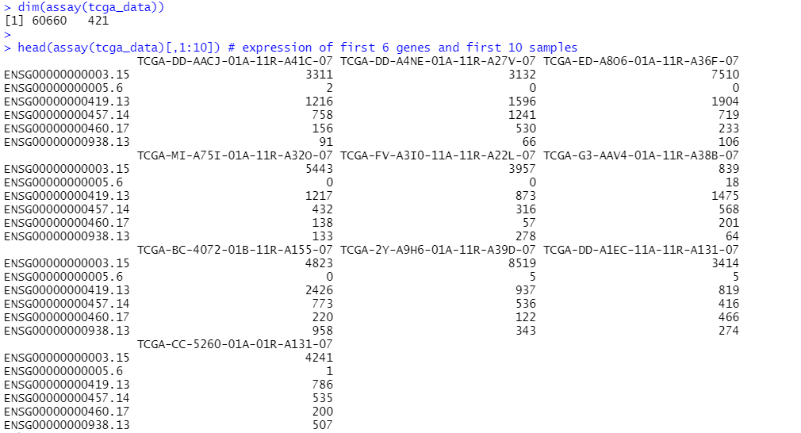
Case Study 1: Liver Hepatocellular Carcinoma (TCGA-LIHC)
‘assay’ function to obtain gene expression quantification matrices and ‘rowData’ to see gene mapping information.

Slide 8

Case Study 1: Liver Hepatocellular Carcinoma (TCGA-LIHC)
Saving and reading the tcga_data object as .RDS file.
5. Gene Expression Data Normalization
The raw data have batch effect and other articafts , that’s why a computational pipeline to perform several steps.
The function is called limma_pipeline(tcga_data,condition_variable,reference_group),where tcga_data is the object, condition is the variable by which patient samples are grouped and the values of condition variables that will be in the reference group within the reference_group parameter.
The function returns three objects: “voom” which contains normalized data, “eBayes” that contains fitted model with statistics related to probes, “topTable” which contain 100 differentially expressed genes sorted by p-value.

Slide 9
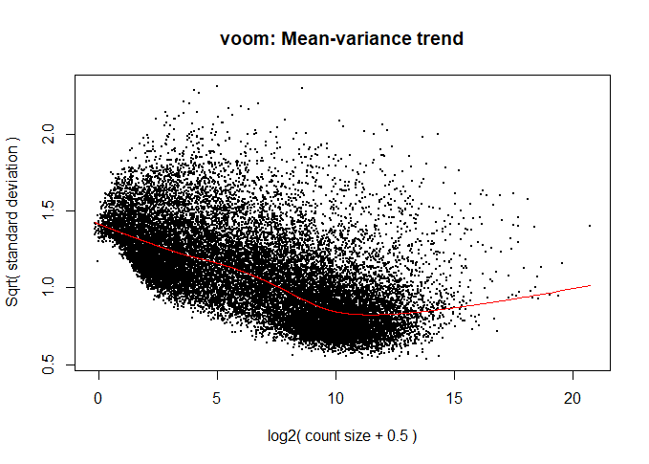
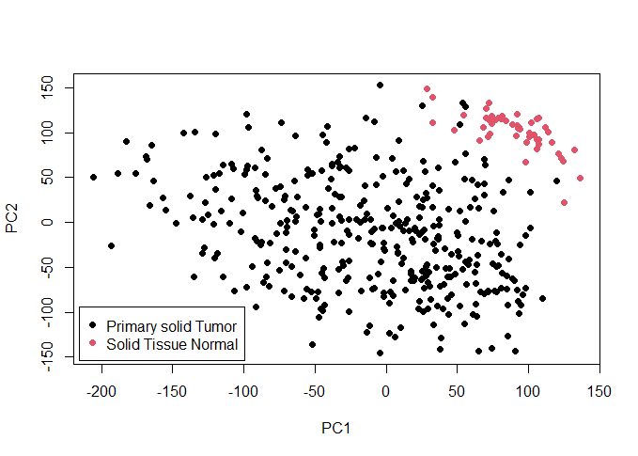
Case Study 1: Liver Hepatocellular Carcinoma (TCGA-LIHC)
6. Visualization
PCA plot for the “voom” object created by the “limma_pipeline” function. The plot exhibits that two sample groups ( tumor tissue, healthy tissue) have a well-separated Gene Expression profile.

Slide 10
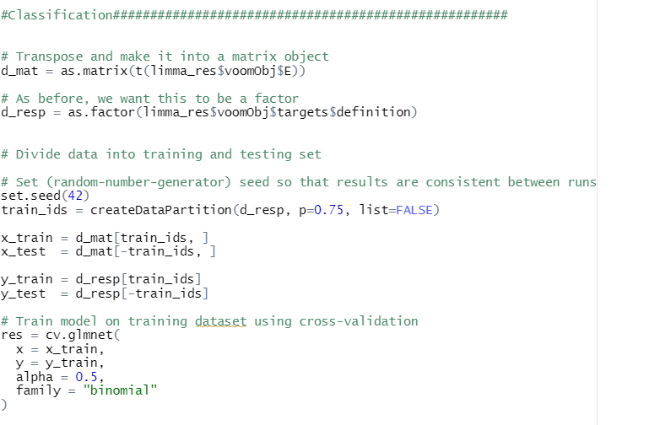
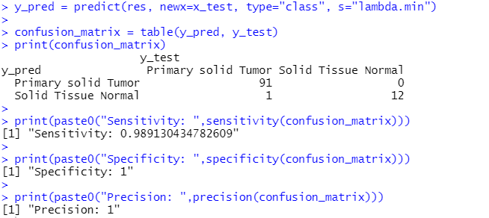
Case Study 1: Liver Hepatocellular Carcinoma (TCGA-LIHC)
Classification (Train with Elastic Net Model)

Slide 11
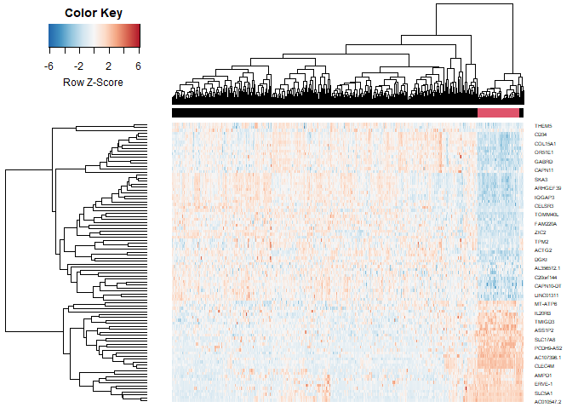
Case Study 1: Liver Hepatocellular Carcinoma (TCGA-LIHC)
Hierarchical Clustering
Clustering of Sample using hierarchical clustering algorithm. The samples highlighted in red are Solid Tissue Normal and the samples in black are Primary Solid Tumor.
Selected genes group into two classes: gene highly expressed in tumor vs genes in control.
Interesting point is gene detected by DE analysis are only associated to high expression in the control group.

Slide 12
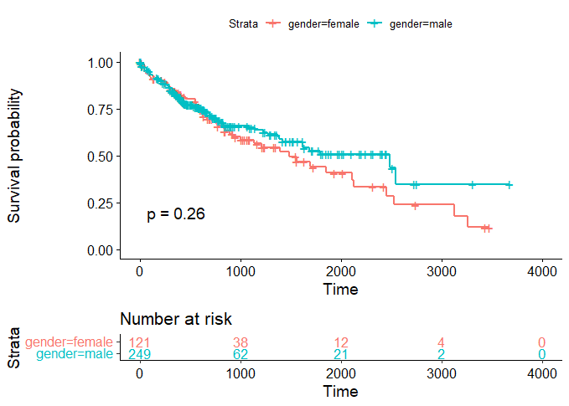
Case Study 1: Liver Hepatocellular Carcinoma (TCGA-LIHC)
Survival Analysis with Kaplan-Meier Plots
Kaplan-Meier plot shows similar trend until 2000 day mark, where female seem to have worse survival probability.
However, the p-value=0.26 is non-significant, therefor gender alone does not significantly sway prognosis in the dataset.
Most of the patients die or are censored before 2000 day mark, therefore p-value is not significant.

Slide 13
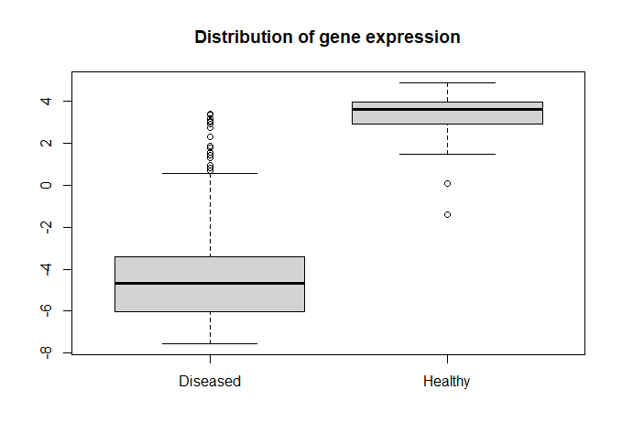
Case Study 1: Liver Hepatocellular Carcinoma (TCGA-LIHC)
Gene Expression and Survival
Some genes are differentially expressed between healthy and disease samples.
Taking one of the selected genes, we know they are either up-regulated in the tumor tissue and not in the normal tissue and vice versa.
Does those genes provide an advantage, disadvantage regarding prognosis?
We take all the expression values in the diseased samples, then take the median.
Patients with expression greater than the median we put in up-regulated groups and others in down-regulated group.

Slide 14
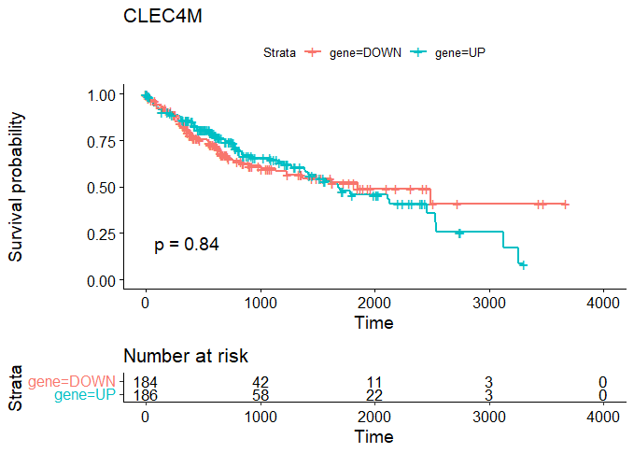
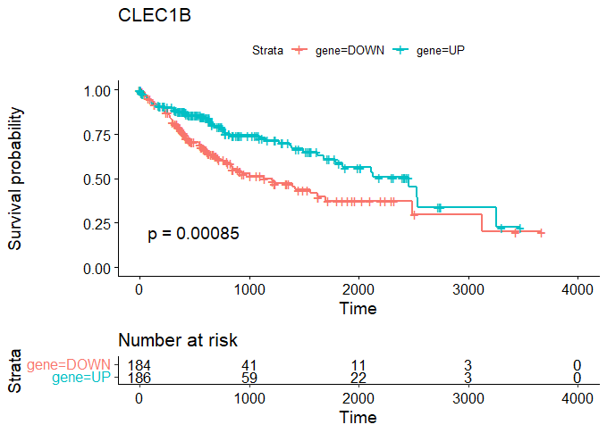
Case Study 1: Liver Hepatocellular Carcinoma (TCGA-LIHC)
Gene Expression and Survival

Slide 15
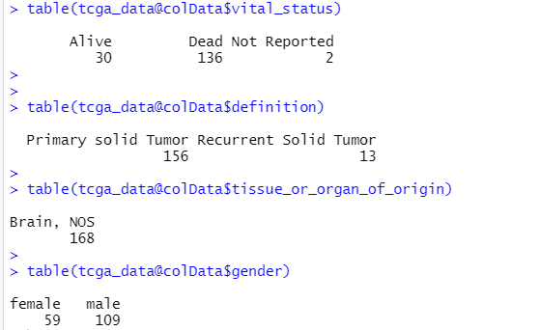
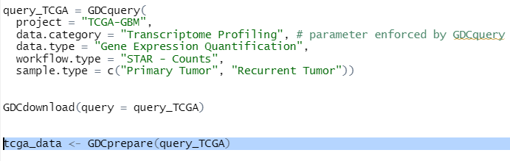
Case Study 2: Glioblastoma (TCGA-GBM)

Slide 16
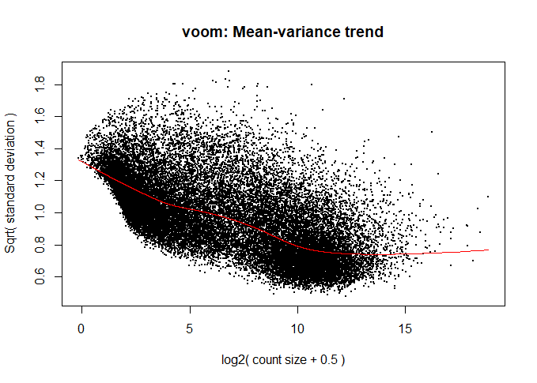
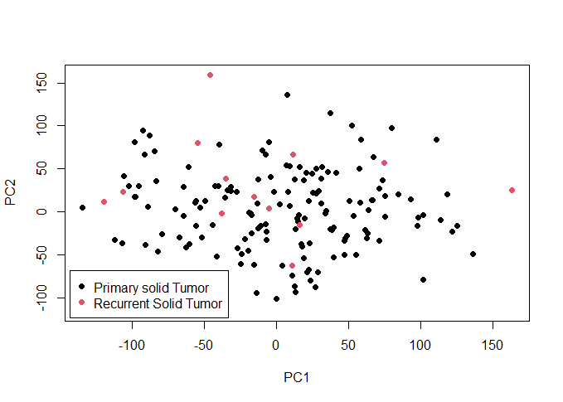
Visualization

Slide 17
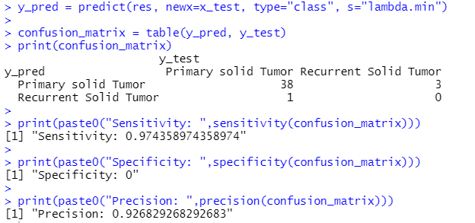
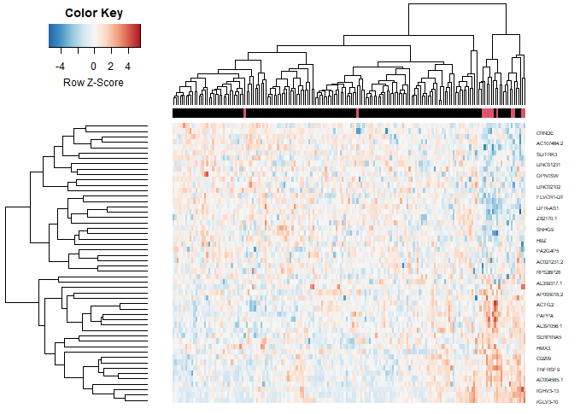
Classification Results & Clustering

Slide 18
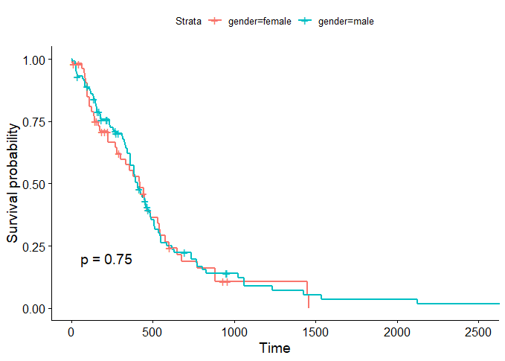
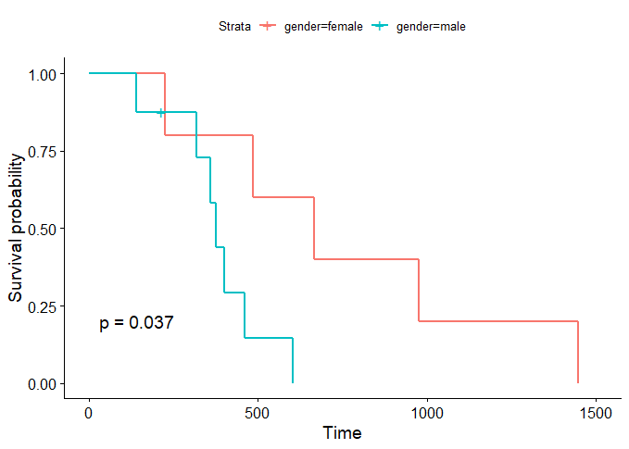
Survival Analysis in Primary & Recurrent Tumor Patients

Slide 19
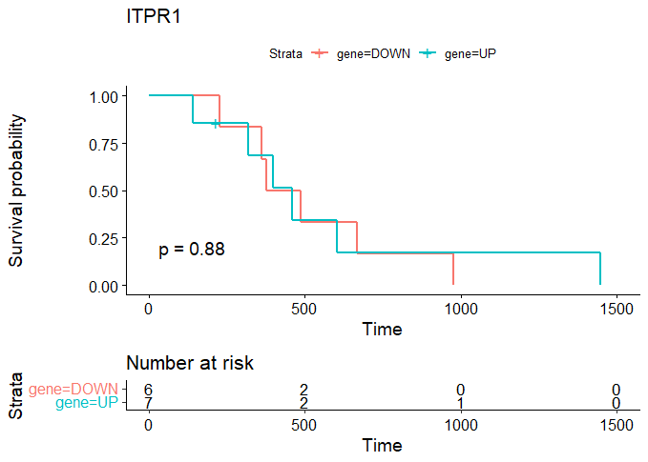
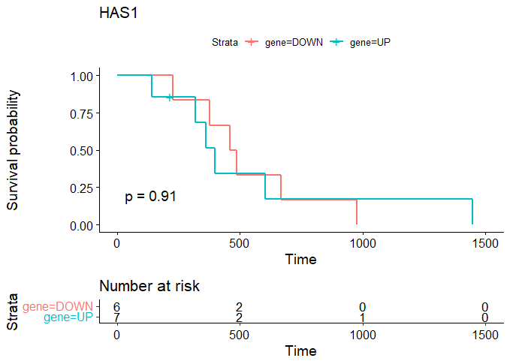
Gene Expression in Recurrent Tumor Patients

Slide 20
Thank you for your attention.

