Slide 1
Assignment 1 Numerical methods in Engineering
ECE 611
Group 2
Joe Zalameda, Walia Farzana, Fatima Raza,
KiranThyloor Shivu, Shafiyee Islam

Slide 2
Assignment Overview
Use of Taylor Series expansion to approximate functions
Compute Pade approximation of function
Utilize MATLAB to compute series expansions to N iterations
MATLAB is used to approximate functions to a finite value
Comparison and results generated presented from the MATLAB terminal output
Notes:
3. summation loops
5. which one produces more accurate results. taylor vs pade

Slide 3
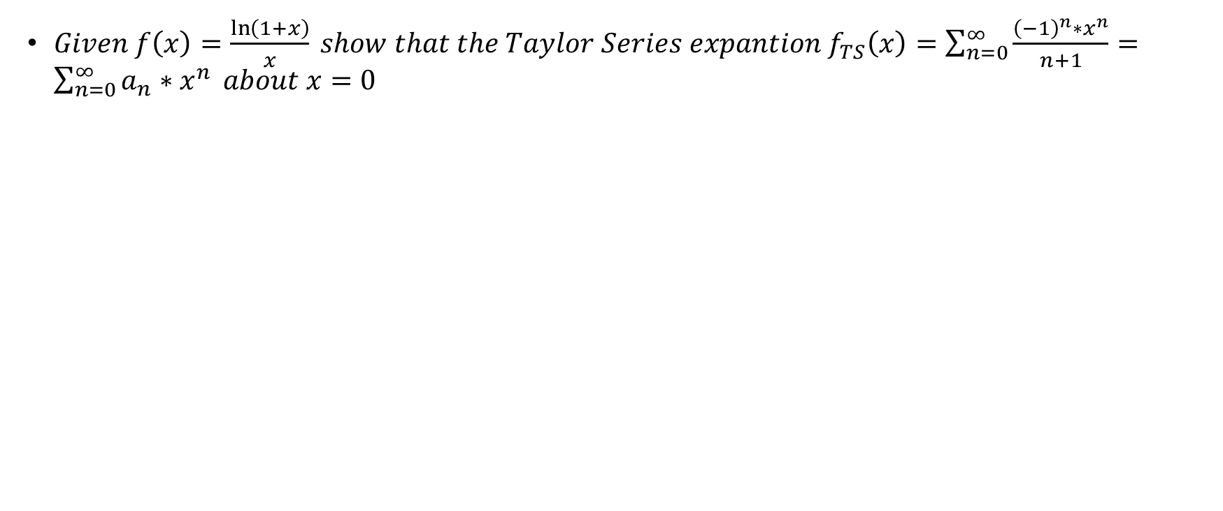
Problem A

Slide 4
Problem A – Solution Part 1/2
Take Maclaurin Series Expansion for p(x)
$f\left(x\right)=\frac{\ln\left(1+x\right)}{x}$
Define p(x)
$p\left(x\right)=ln⁡(1+x)$
$p\left(0\right)=\ln\left(1\right)=0$
Take 1st derivative at x=0
$p^{′}\left(0\right)=1$
Take 2nd derivative at x=0
$p^{′′}\left(0\right)=−1^{−2}=−1$
Take 3rd derivative at x=0
$p^{′′′}\left(0\right)=2∗1^{−3}=2$
Take 4th derivative at x=0
$p^{IV}\left(0\right)=−6∗{\left(1\right)}^{−4}=−6$
Take 5th derivative at x=0
$p^{v}\left(0\right)=24$
Expand Maclaurin Series
$p\left(x\right)=p\left(0\right)+x∗p^{′}\left(0\right)+\frac{x^{2}}{2!}p^{′′}\left(0\right)+\frac{x^{3}}{3!}p^{′′′}\left(0\right)+\frac{x^{4}}{4!}p^{IV}\left(0\right)+\frac{x^{5}}{5!}p^{V}\left(0\right)+…$
$p\left(x\right)=0+x−\frac{x^{2}}{2}+\frac{x^{3}}{3}−\frac{x^{4}}{4}+\frac{x^{5}}{5}+…$
Reintroduce f(x)
$f\left(x\right)=\frac{1}{x}∗p\left(x\right)=1−\frac{x}{2}+\frac{x^{2}}{3}−\frac{x^{3}}{4}+\frac{x^{4}}{5}+…$
[1] | D. A. S. S. Matt Boelkins, "LibreTexts Mathematics," NICE CXone Expert , [Online]. Available: https://math.libretexts.org/Under_Construction/Purgatory/Book%3A_Active_Calculus_(Boelkins_et_al.)/08%3A_Sequences_and_Series/8.05%3A_Taylor_Polynomials_and_Taylor_Series. [Accessed 19 9 2023].
[2] | "emathzone.com," [Online]. Available: https://www.emathzone.com/tutorials/calculus/maclaurin-series-of-ln1x.html. [Accessed 19 9 2023].
[3] | "OpenStax," Rice University, [Online]. Available: https://openstax.org/books/calculus-volume-2/pages/6-3-taylor-and-maclaurin-series. [Accessed 19 9 2023].

Slide 5
Problem A –Solution Part 2/2
Take derivative of f(x)
$f^{′\left(x\right)}=0−\frac{1}{2}+\frac{2}{3}x−\frac{3}{4}x^{2}+\frac{4}{5}x^{3}+…$
$f′′\left(x\right)=\frac{2}{3}−\frac{3}{2}x+\frac{12 }{5}x^{2}+…$
$f^{′′′\left(x\right)}=−\frac{3}{2}+\frac{36}{5}x^{2}+…$
Taking x=0
$f\left(0\right)=1$
$f^{′}(0)=−\frac{1}{2}$
$f′′\left(0\right)=\frac{2}{3}$
$f^{′′′\left(0\right)}=−\frac{3}{2}$
x=0 Taylor Series expansion
$f\left(x\right)=f\left(0\right)+f^{′}\left(0\right)\left(x−0\right)+\frac{f^{′′}\left(0\right)}{2!}{\left(x−0\right)}^{2}+\frac{f^{′′′}\left(0\right)}{3!}{\left(x−0\right)}^{3}+…$
$f\left(x\right)=1−\frac{1}{2}x+\frac{1}{3}x^{2}−\frac{1}{4}x^{3}+…$
General form of Taylor Series
$f\left(x\right)=\frac{{\left(−1\right)}^{0}}{1}x^{0}+\frac{{\left(−1\right)}^{1}}{2}x+\frac{{\left(−1\right)}^{2}}{3}x^{2}+\frac{{\left(−1\right)}^{3}}{4}x^{3}+…$
$f\left(x\right)= \sum_{n=0}^{∞}{(\frac{{\left(−1\right)}^{n}}{n+1}x^{n})}$
given $a_{n}=\frac{{\left(−1\right)}^{n}}{n+1}$
$f\left(x\right)=\sum_{n=0}^{∞}{a_{n}∗x^{n}}$

Slide 6
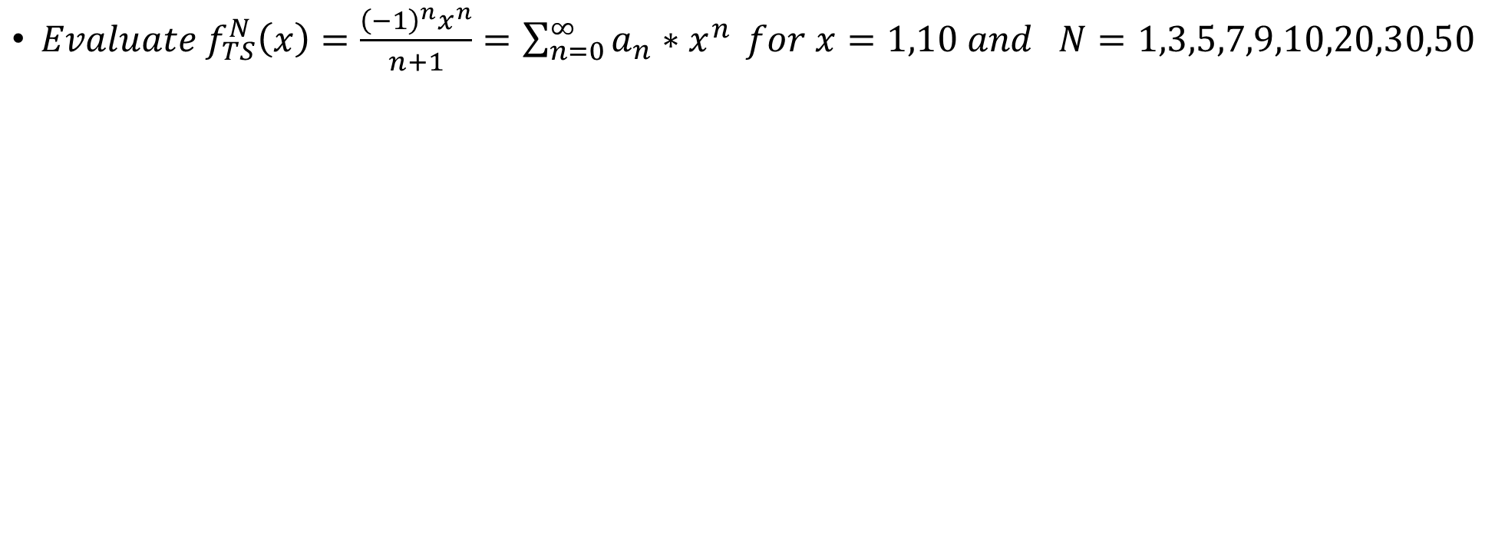
Problem B

Slide 7
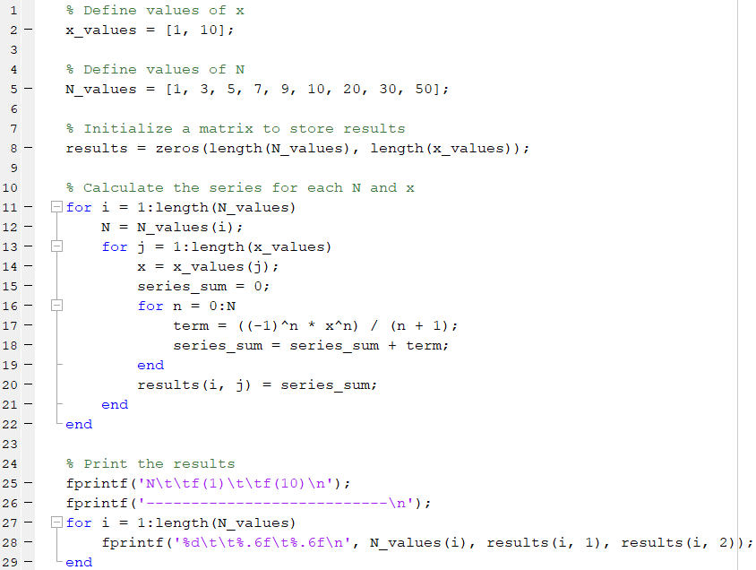
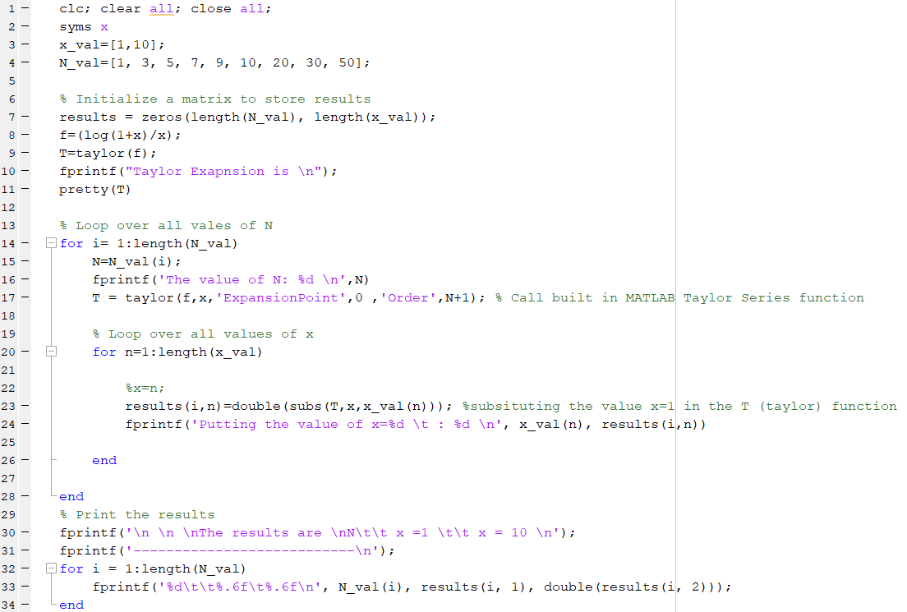
Problem B – Solution Source Code
MATLAB from scratch
MATLAB using built in functions
[5] | MathWorks Inc, [Online]. Available: https://www.mathworks.com/help/symbolic/sym.taylor.html. [Accessed 19 9 2023].

Slide 8
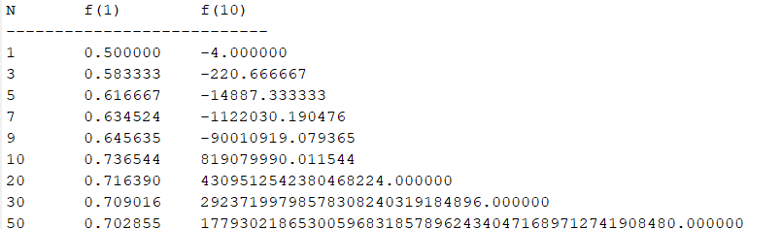
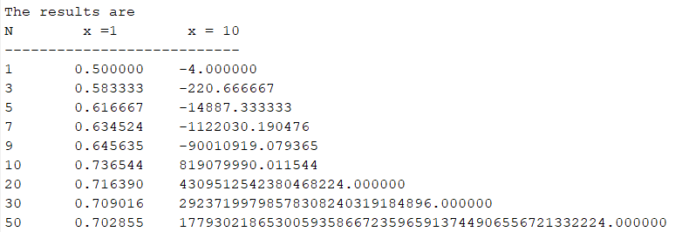
Problem B – Results 1/2
MATLAB from scratch
MATLAB using built in functions

Slide 9
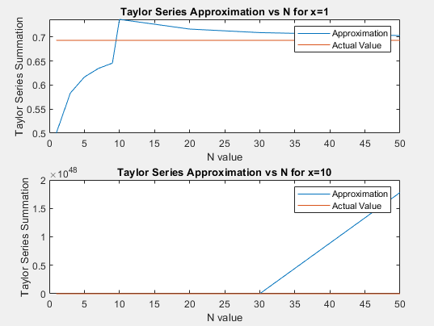
Problem B – Results 2/2

Slide 10
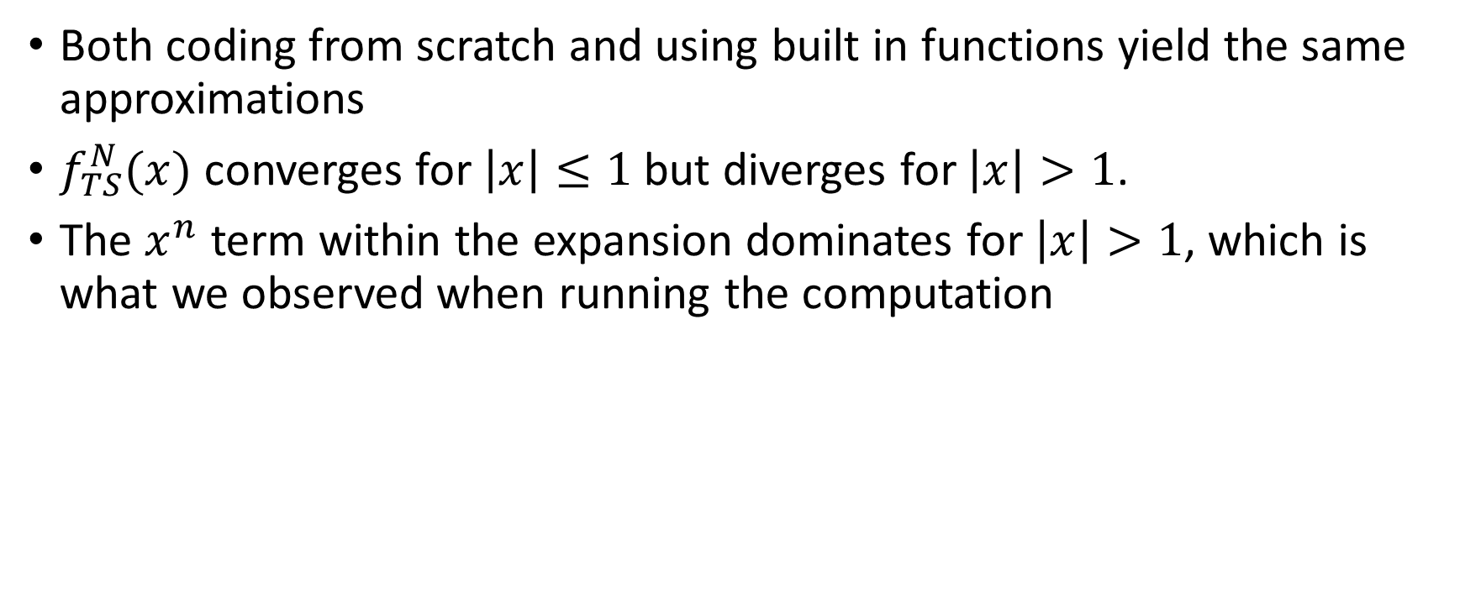
Problem B - Conclusion

Slide 11
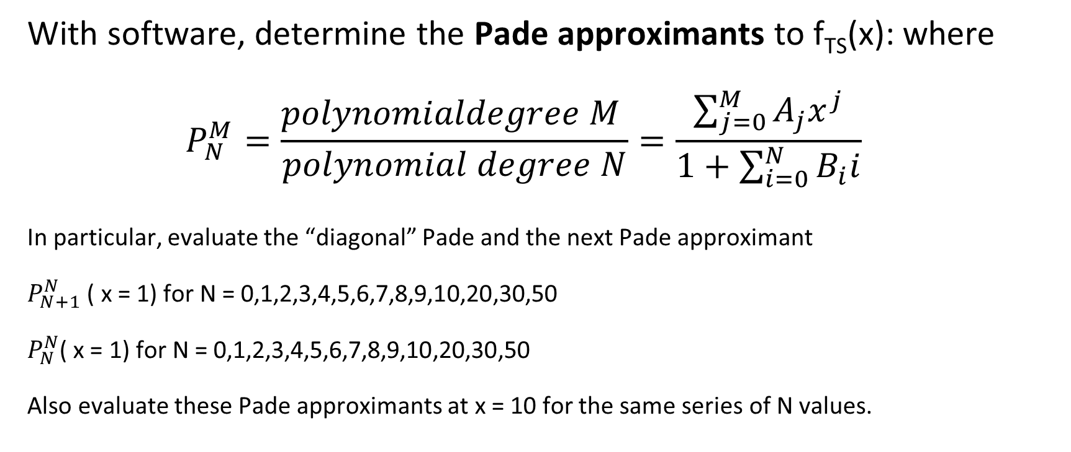
Problem C

Slide 12
Pade Approximant
Padé approximations are rational function approximations, expressed as the ratio of two power series.
Padé approximations well-represent functions with poles, superior to Taylor series in these cases. The rational functions can model poles, unlike Taylor polynomials.
1. mathworld.wolfram.com/PadeApproximant.html [Accessed 09/19/2023]

Slide 13
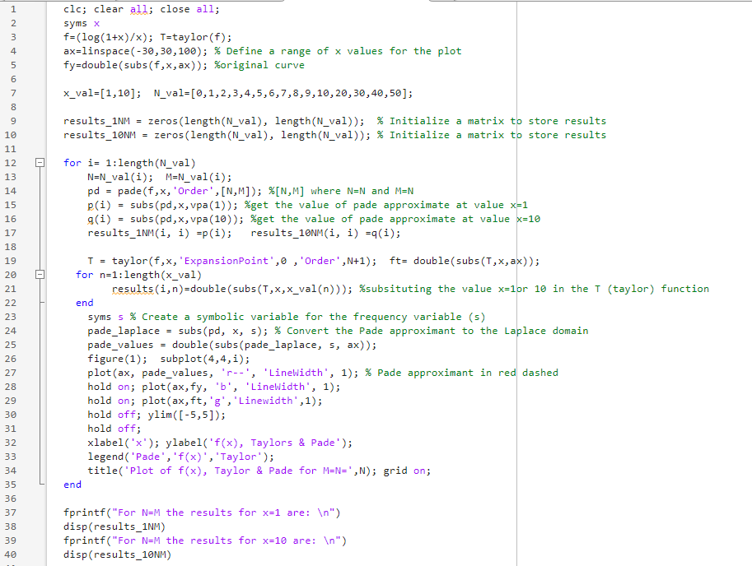
Problem C Source Code

Slide 14
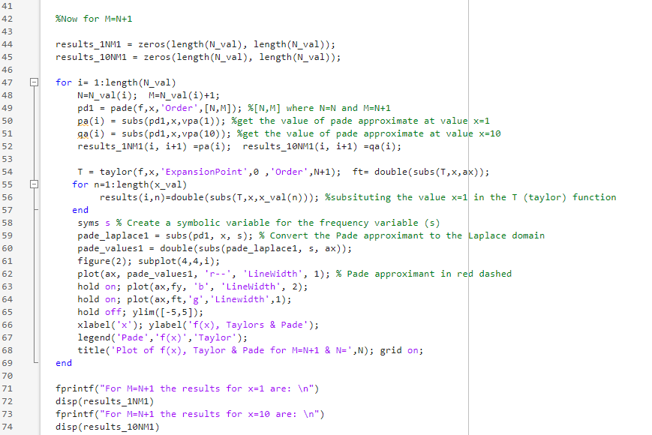
Problem C Source Code [cont…]

Slide 15
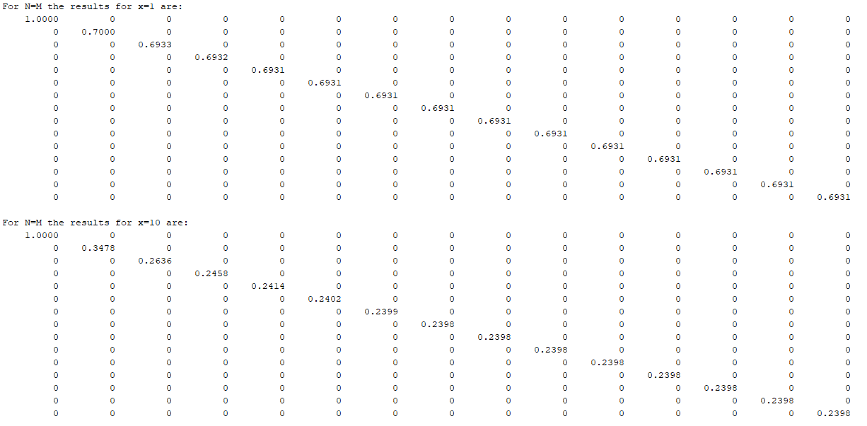
Problem – C Results

Slide 16
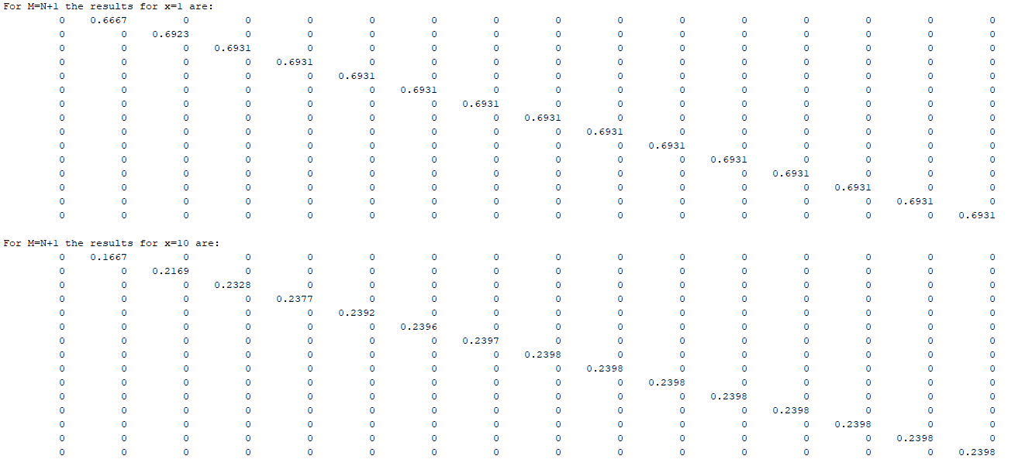
Problem – C Results

Slide 17
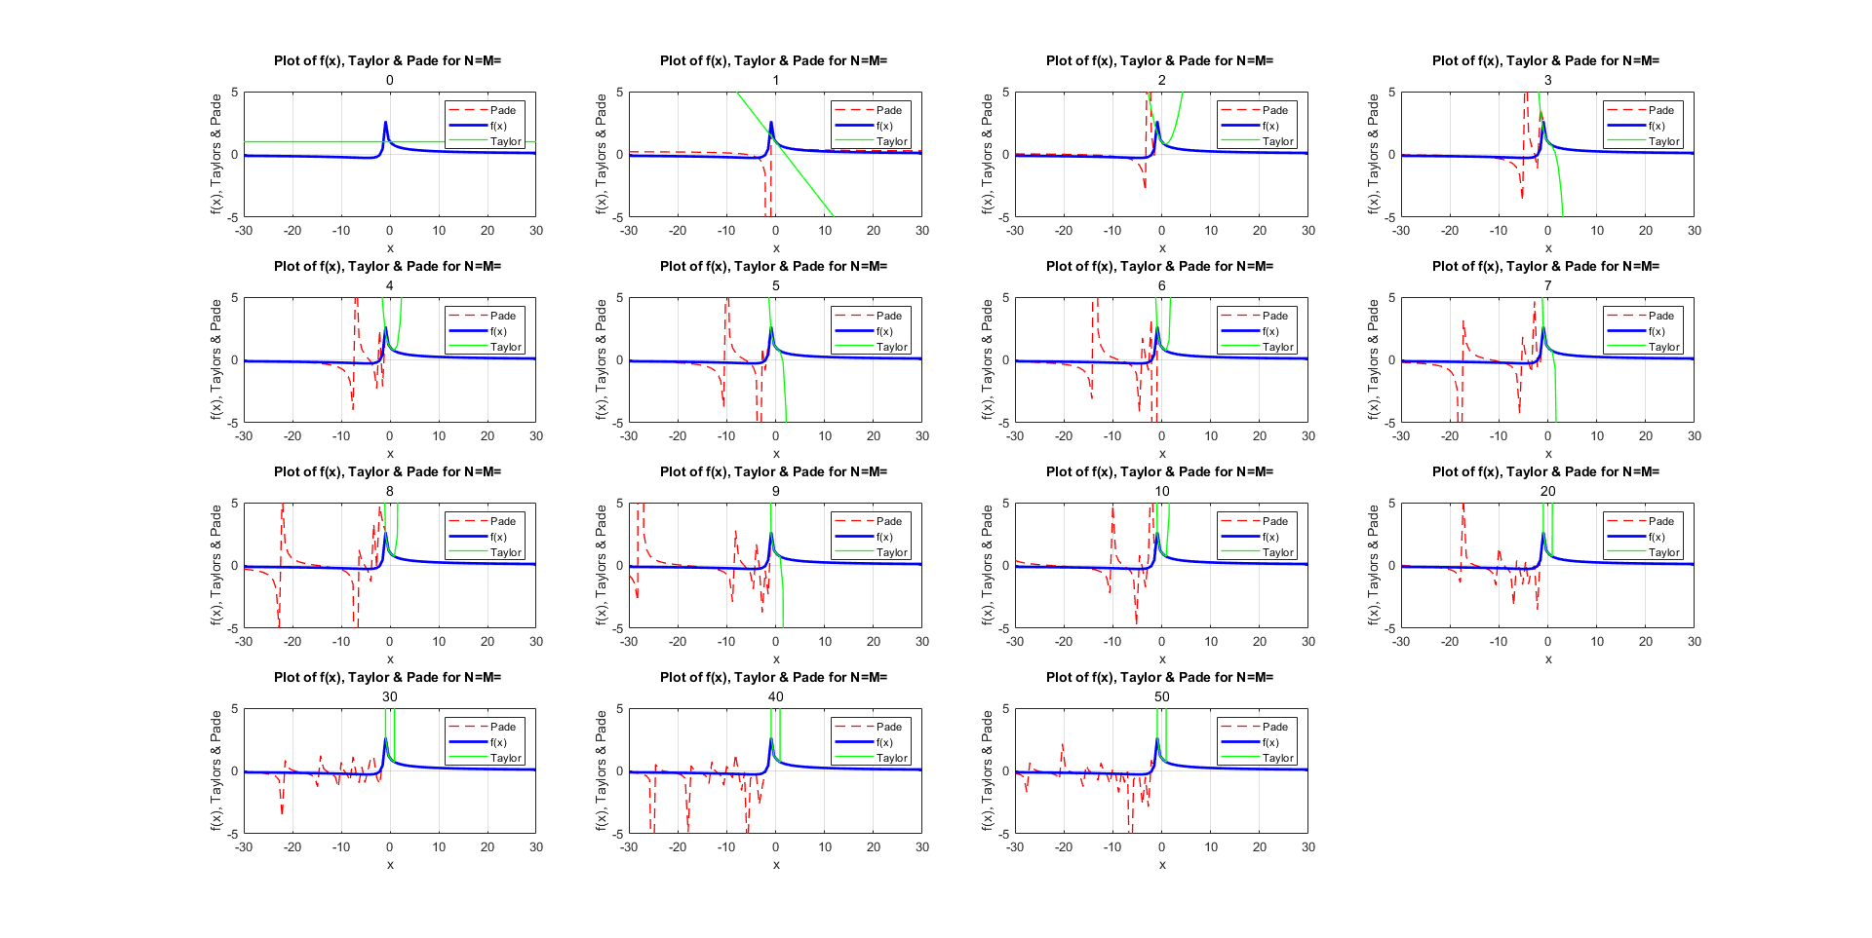
Comparison between f(x), Taylor’s approximation and Pade Approximation for same order
N=M

Slide 18
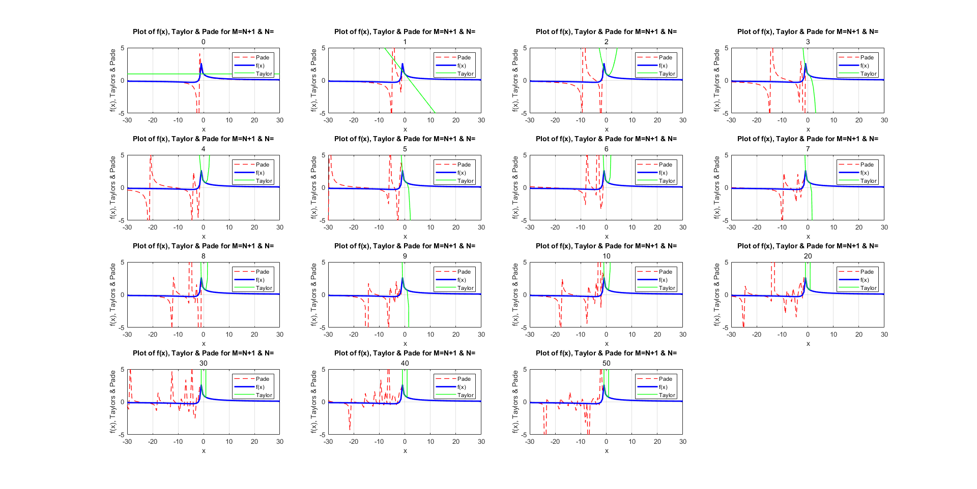
Comparison between f(x), Taylor’s approximation and Pade Approximation for same order
N+1=N

Slide 19
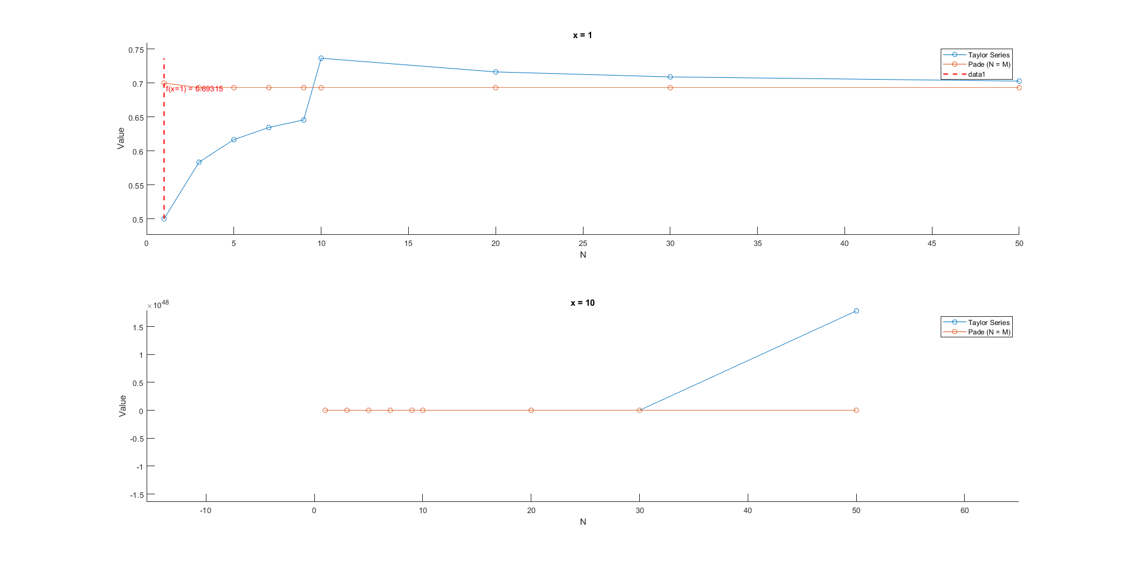
Comparison Between Taylors and Pade Approximation
Value = ln(2)= 0.693147
Value = ln(11)/10= 0.23978

Slide 20
Problem C - Conclusion
Pade approximation gives the best result from get go with lower order
It often provides a better approximation than a simple Taylor series, especially for functions with poles or singularities
As Pade function is of numerator and denominators, working as poles and zeroes, this gives us a more complex view of the function at hand giving out a more balanced result

Slide 21
References
[1] | D. A. S. S. Matt Boelkins, "LibreTexts Mathematics," NICE CXone Expert , [Online]. Available: https://math.libretexts.org/Under_Construction/Purgatory/Book%3A_Active_Calculus_(Boelkins_et_al.)/08%3A_Sequences_and_Series/8.05%3A_Taylor_Polynomials_and_Taylor_Series. [Accessed 19 9 2023].
[2] | "emathzone.com," [Online]. Available: https://www.emathzone.com/tutorials/calculus/maclaurin-series-of-ln1x.html. [Accessed 19 9 2023].
[3] | "OpenStax," Rice University, [Online]. Available: https://openstax.org/books/calculus-volume-2/pages/6-3-taylor-and-maclaurin-series. [Accessed 19 9 2023].
[4] | F. Benistant, "Medium," 4 7 2022. [Online]. Available: https://medium.com/@2020machinelearning/taylor-series-pade-approximants-and-neural-networks-db77d228f8d8. [Accessed 19 9 2023].
[5] | MathWorks Inc, [Online]. Available: https://www.mathworks.com/help/symbolic/sym.taylor.html. [Accessed 19 9 2023].
[6] | N. C. S. o. S. a. Mathematics, "Youtube," [Online]. Available: https://www.youtube.com/watch?v=a2MCBISjujA. [Accessed 19 9 2023].
[7] | Mathworks Inc, "Pade Approximant," [Online]. Available: https://www.mathworks.com/help/symbolic/pade.html. [Accessed 19 9 2023].
[8] | L. Sanguigno, "Pade Approximate," MATLAB Central File Exchange, [Online]. Available: https://www.mathworks.com/matlabcentral/fileexchange/31800-pade-approximant. [Accessed 19 9 2023].
[9] | U. o. C. Boulder, "Pade Approximation," [Online]. Available: https://www.colorado.edu/amath/sites/default/files/attached-files/pade_2.pdf. [Accessed 19 9 2023].

