Slide 1
EECS 738 Machine Learning Project Presentation
Group Member:
Yan, Su
Fei, Wei
Wang, Jiahui

Slide 2
Introduction
Three major steps
Model Selection
Parameter Optimization
Feature Selection with Parameter Optimization
Technique used
Language: Java, shell
Hardware: ITTC Clusters
Library: Weka and its extension jars
Notes:
Today, we are going to demonstrate the principle and strategy of our machine learning project. Like what we did, how we did, and what is the result, etc.
Our project has three major steps, which are model selection, parameter optimization, and feature selection. The feature selection part should run with parameter optimization as an iteration loop.
Here are the technical we used in our project.
Java is for writing the implementation of parameter optimization and feature selection by using weka classifier library. Shell is for writing the scripts to run our codes on ITTC Cluster.

Slide 3
Data Preprocessing
Observe some feature values can be as small as 1.0E-4. Some are as large as 1.0E6
We perform normalization to remap all features to [0, 100]
Avoid extreme large/small feature weights for the purpose of numerical stability of the model.
Ensure quick convergence of optimization algorithms.
Implement with weka.filters.unsupervised.attribute.Normalize

Slide 4
Model Selection
Three Selected Classifiers
Logistic (weka.classifiers.functions.Logisitc)
RandomForest (weka.classifiers.trees.RandomForest)
RBFNetwork (weka.classifiers.functions.RBFNetwork)
Principles of selection
Choose high-accuracy models with default parameters
Has built-in regularization, which help avoid over-fitting
Logistic, RBFNetwork use L2 regularization (Ridge).
RandomForest randomly select a number of features to build each tree.

Slide 5
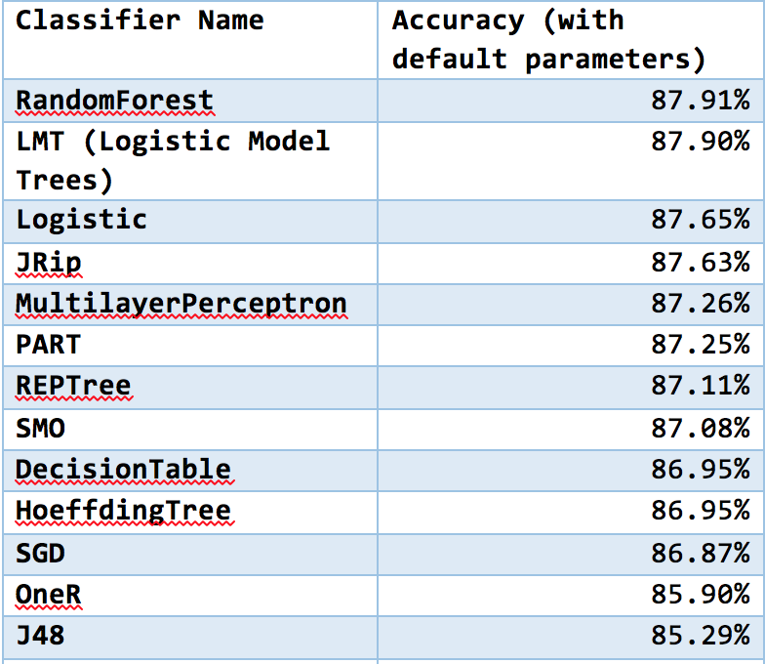
High Accuracy Models In Preliminary Result

Slide 6
Parameter Optimization
weka.classifier.meta.MultiSearch
Allows the optimization of any arbitrary number of parameters
Support both ranged parameter values and array of values
Exhaustive search over all given parameter combinations
Log all result to file. Pick one with best performance
Example
weka.classifiers.meta.MultiSearch
-E ACC
-search "weka.core.setupgenerator.MathParameter -property classifier.ridge -min -10.0 -max 5.0 -step 1.0 -base 10.0 -expression pow(BASE,I)"
-search "weka.core.setupgenerator.MathParameter -property classifier.maxIts -min -1.0 -max 20.0 -step 1.0 -base 10.0 -expression I"
-sample-size 100.0
-log-file "/home/syan/Documents/Logistic.txt"
-initial-folds 10 -subsequent-folds 10
-num-slots 8
-S 1
-W weka.classifiers.functions.Logistic -do-not-check-capabilities -- -R 1.0E-8 -M -1

Slide 7
Optimization Results
Models | Accuracy(%) | ROC Area | MCC
Logistic | 87.6296 | 0.881 | 0.592
RandomForest | 87.9241 | 0.883 | 0.604
RBFNetwork | 86.3382 | 0.858 | 0.545
* All results are obtained with 10-fold CV

Slide 8
Feature Selection
Implementation
Target classifier wrapped by two meta-classifers
MultiSearch + AttributeSelectedClassifier + Target Classifier (e.g. Logistic)
AttributeSelectedClassifier passes selected attributes to Target Classifier
MultiSearch optimizes parameters for Target Classifier using selected attributes
Prevent information leaking!
Testing
16 parallel files
2 classifiers x 8 attribute evaluation algorithm
Attribute selection algorithm used
Correlation-based Subset Selection (weka.attributeSelection.CfsSubsetEval)
Pearson's Correlation Coefficient (weka.attributeSelection.CorrelationAttributeEval)
Gain Ratio (weka.attributeSelection.GainRatioAttributeEval)
Information Gain (weka.attributeSelection.InfoGainAttributeEval)
OneR Classifier (weka.attributeSelection.OneRAttributeEval)
Principal Components Analysis (weka.attributeSelection.PrincipalComponents)
RELIEF (weka.attributeSelection.ReliefFAttributeEval)
Symmetrical Uncertainty Analysis (weka.attributeSelection.SymmetricalUncertAttributeEval)

Slide 9
Example
weka.classifiers.meta.MultiSearch
-E ACC
-search "weka.core.setupgenerator.MathParameter -property classifier.classifier.ridge -min -10.0 -max 5.0 -step 1.0 -base 10.0 -expression pow(BASE,I)"
-search "weka.core.setupgenerator.MathParameter -property classifier.classifier.maxIts -min -1.0 -max 20.0 -step 1.0 -base 10.0 -expression I"
-sample-size 100.0
-log-file "/projects/huanlab/wei/results/Logistic_CfsSubsetEval_BestFirst.txt"
-initial-folds 10
-subsequent-folds 10
-num-slots 8
-S 1
-W weka.classifiers.meta.AttributeSelectedClassifier -do-not-check-capabilities –
-E "weka.attributeSelection.CfsSubsetEval -P 1 -E 1"
-S "weka.attributeSelection.BestFirst -D 1 -N 5"
-W weka.classifiers.functions.Logistic -do-not-check-capabilities -- -R 1.0E-3 -M -1

Slide 10
Current Results
Attribute Evaluator (+ Search method) Accuracy (%) | Logistic | RBFNetwork
CfsSubsetEval+BestFirst | 87.3617 | -------
CfsSubsetEval+GreedyStepwise | 87.2065 | -------
CorrelationAttributeEval | 87.6338 | 86.7544
GainRatioAttributeEval | 87.6337 | 86.7703
InfoGainAttributeEval | 87.4791 | 86.7580
OneRAttributeEval | 87.6338 | -------
PrincipalComponents | ------- | -------
ReliefFAttributeEval | 87.5572 | -------
SymmetricalUncertAttributeEval | 87.6338 | 86.6311
* ------ => computation still in progress

Slide 11
Upcoming
Iterative Feature Selection using Wrapper Method
weka.attributeSelection.WrapperSubsetEval
WrapperSubsetEval returns a set of attributes that maximize the performance of a given classifier and its attributes
Idea
Feed WrapperSubsetEval with a classifier and its current optimal parameters
Get a set of attributes that maximizes prediction performance
Perform parameter optimization on resulting attribute set
Feed WrapperSubsetEval again with same classifier and newly optimized parameters
Do this until convergence…
Difficulty
Computation time too long (~ 7 day 16 hours for one iteration per classifier)

Slide 12
Thank You! Questions?

